Slide 1
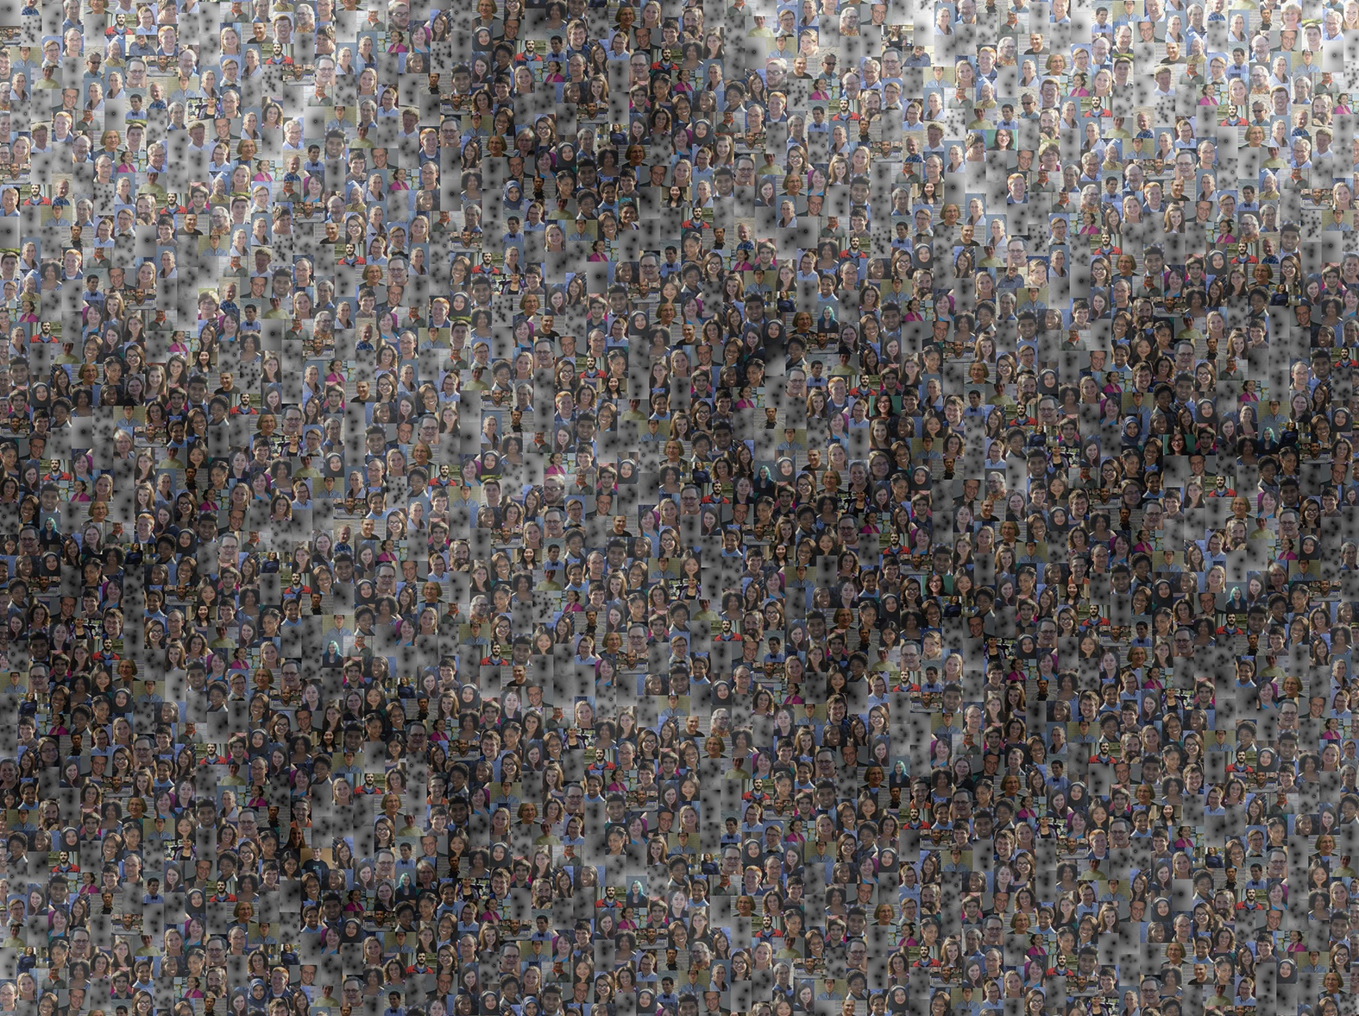
Lost at SEA:
Navigating the Actinophagosphere
Graham F. Hatfull
Department of Biological Sciences
University of Pittsburgh

Slide 2
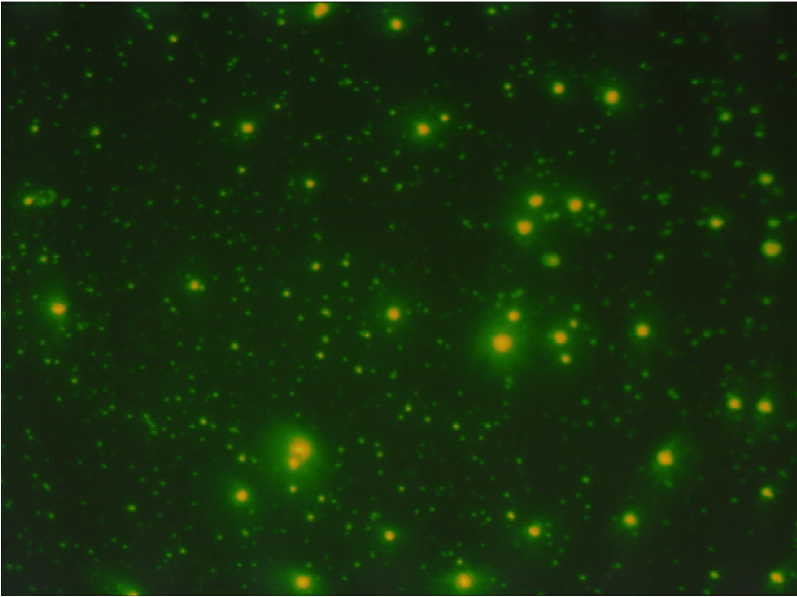

Bacteriophages: The numerical majority
The viral population is vast
10⁶ - 10⁷ phage particles/ml
10³¹ phage particles in biosphere
The viral population is dynamic
5:1 - 10:1 phage:bacteria
10²³ phage infections per second
The viral population is old
Capsid Structural conservation suggests ancient origins
Notes:
The phage population is vast. Epiflourescent visualization reveals that a milliliter of seawater typically contains 10⁶ – 10⁷ viral particles. Small green dot are viruses; large green dots are bacteria. Extrapolation suggests that there are a total of 10³¹ virus particles int eh biosphere (almost exclusively bacteriophages), making them a numerical majority of all biological entities. If we assume an average length of 100 nm, then if all particles were joined end to end, they would make a linear array stretching 200 million light years!

Slide 3
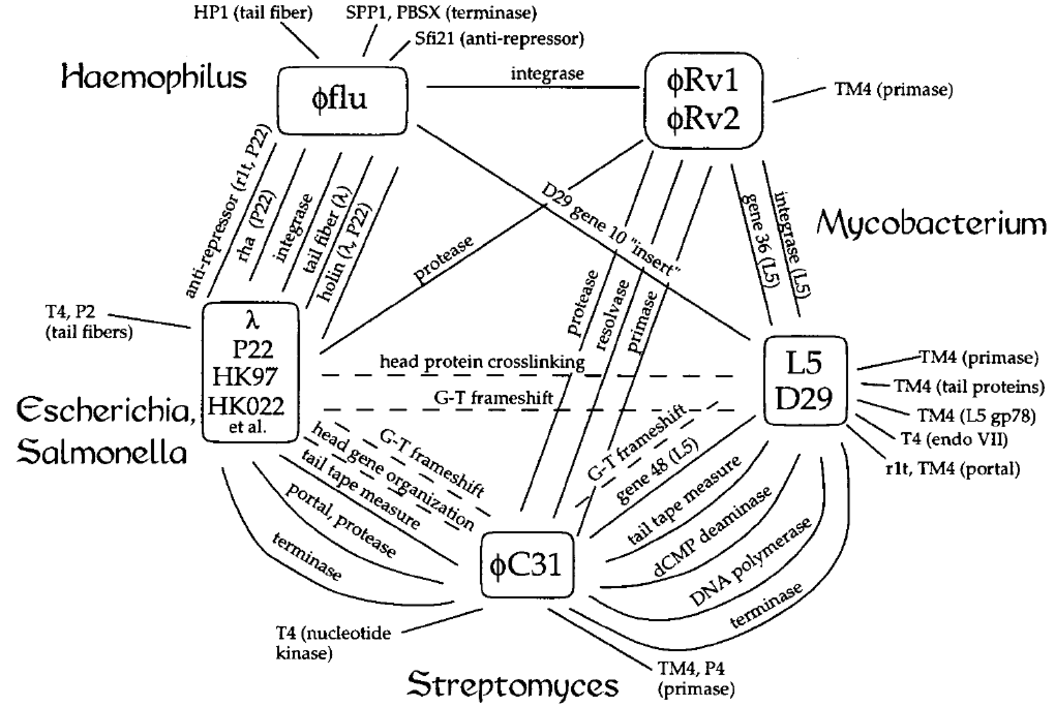
Early glimpses into bacteriophage evolution
We propose a model for the genetic structure and dynamics of the global population in which all dsDNA phage genomes are mosaics with access, by horizontal exchange, to a large common genetic pool but in which access to the gene pool is not uniform for all phage.

Slide 4
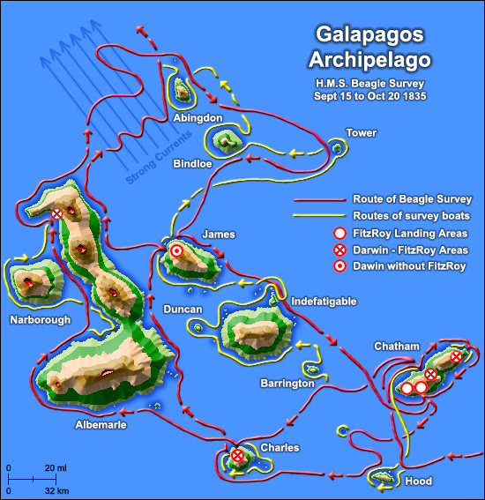
Darwin and the voyage of the Beagle

Slide 5
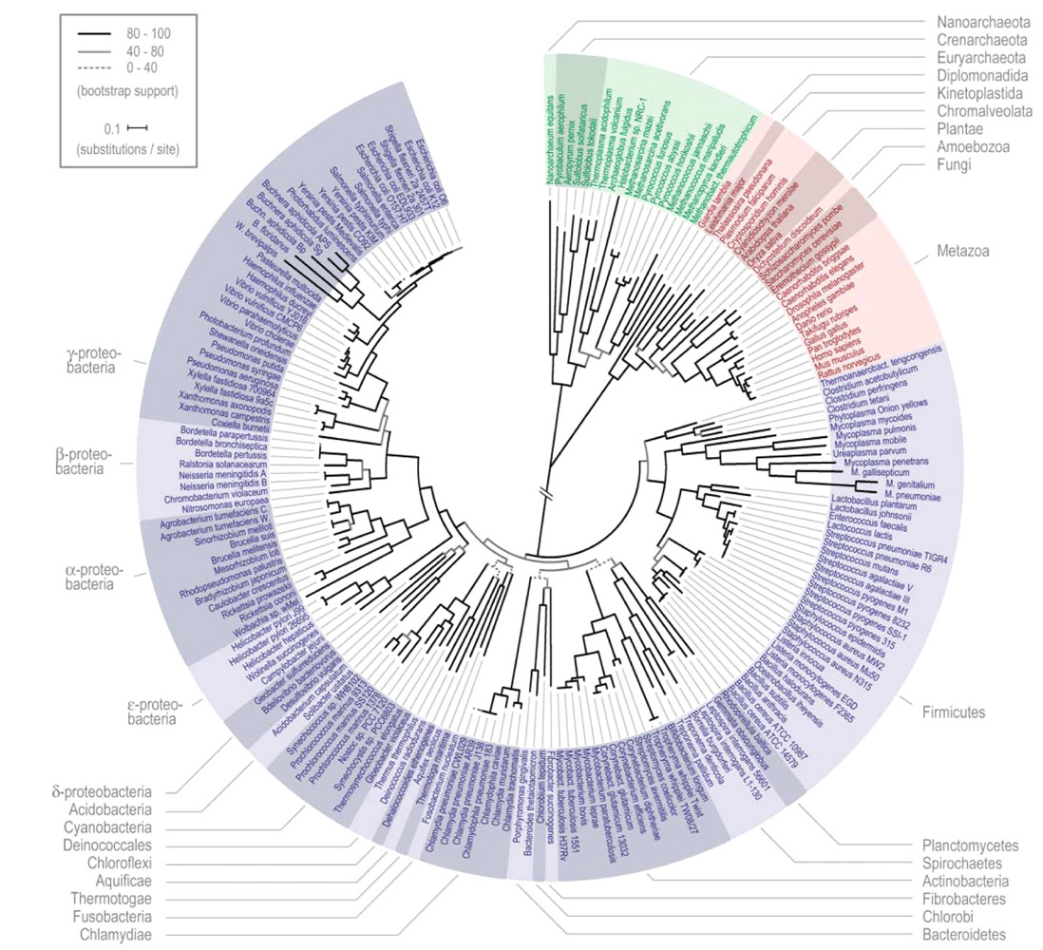

Slide 6
Growth in the number of sequenced Actinobacteriophages
SEA-PHAGES
PHIRE

Slide 7
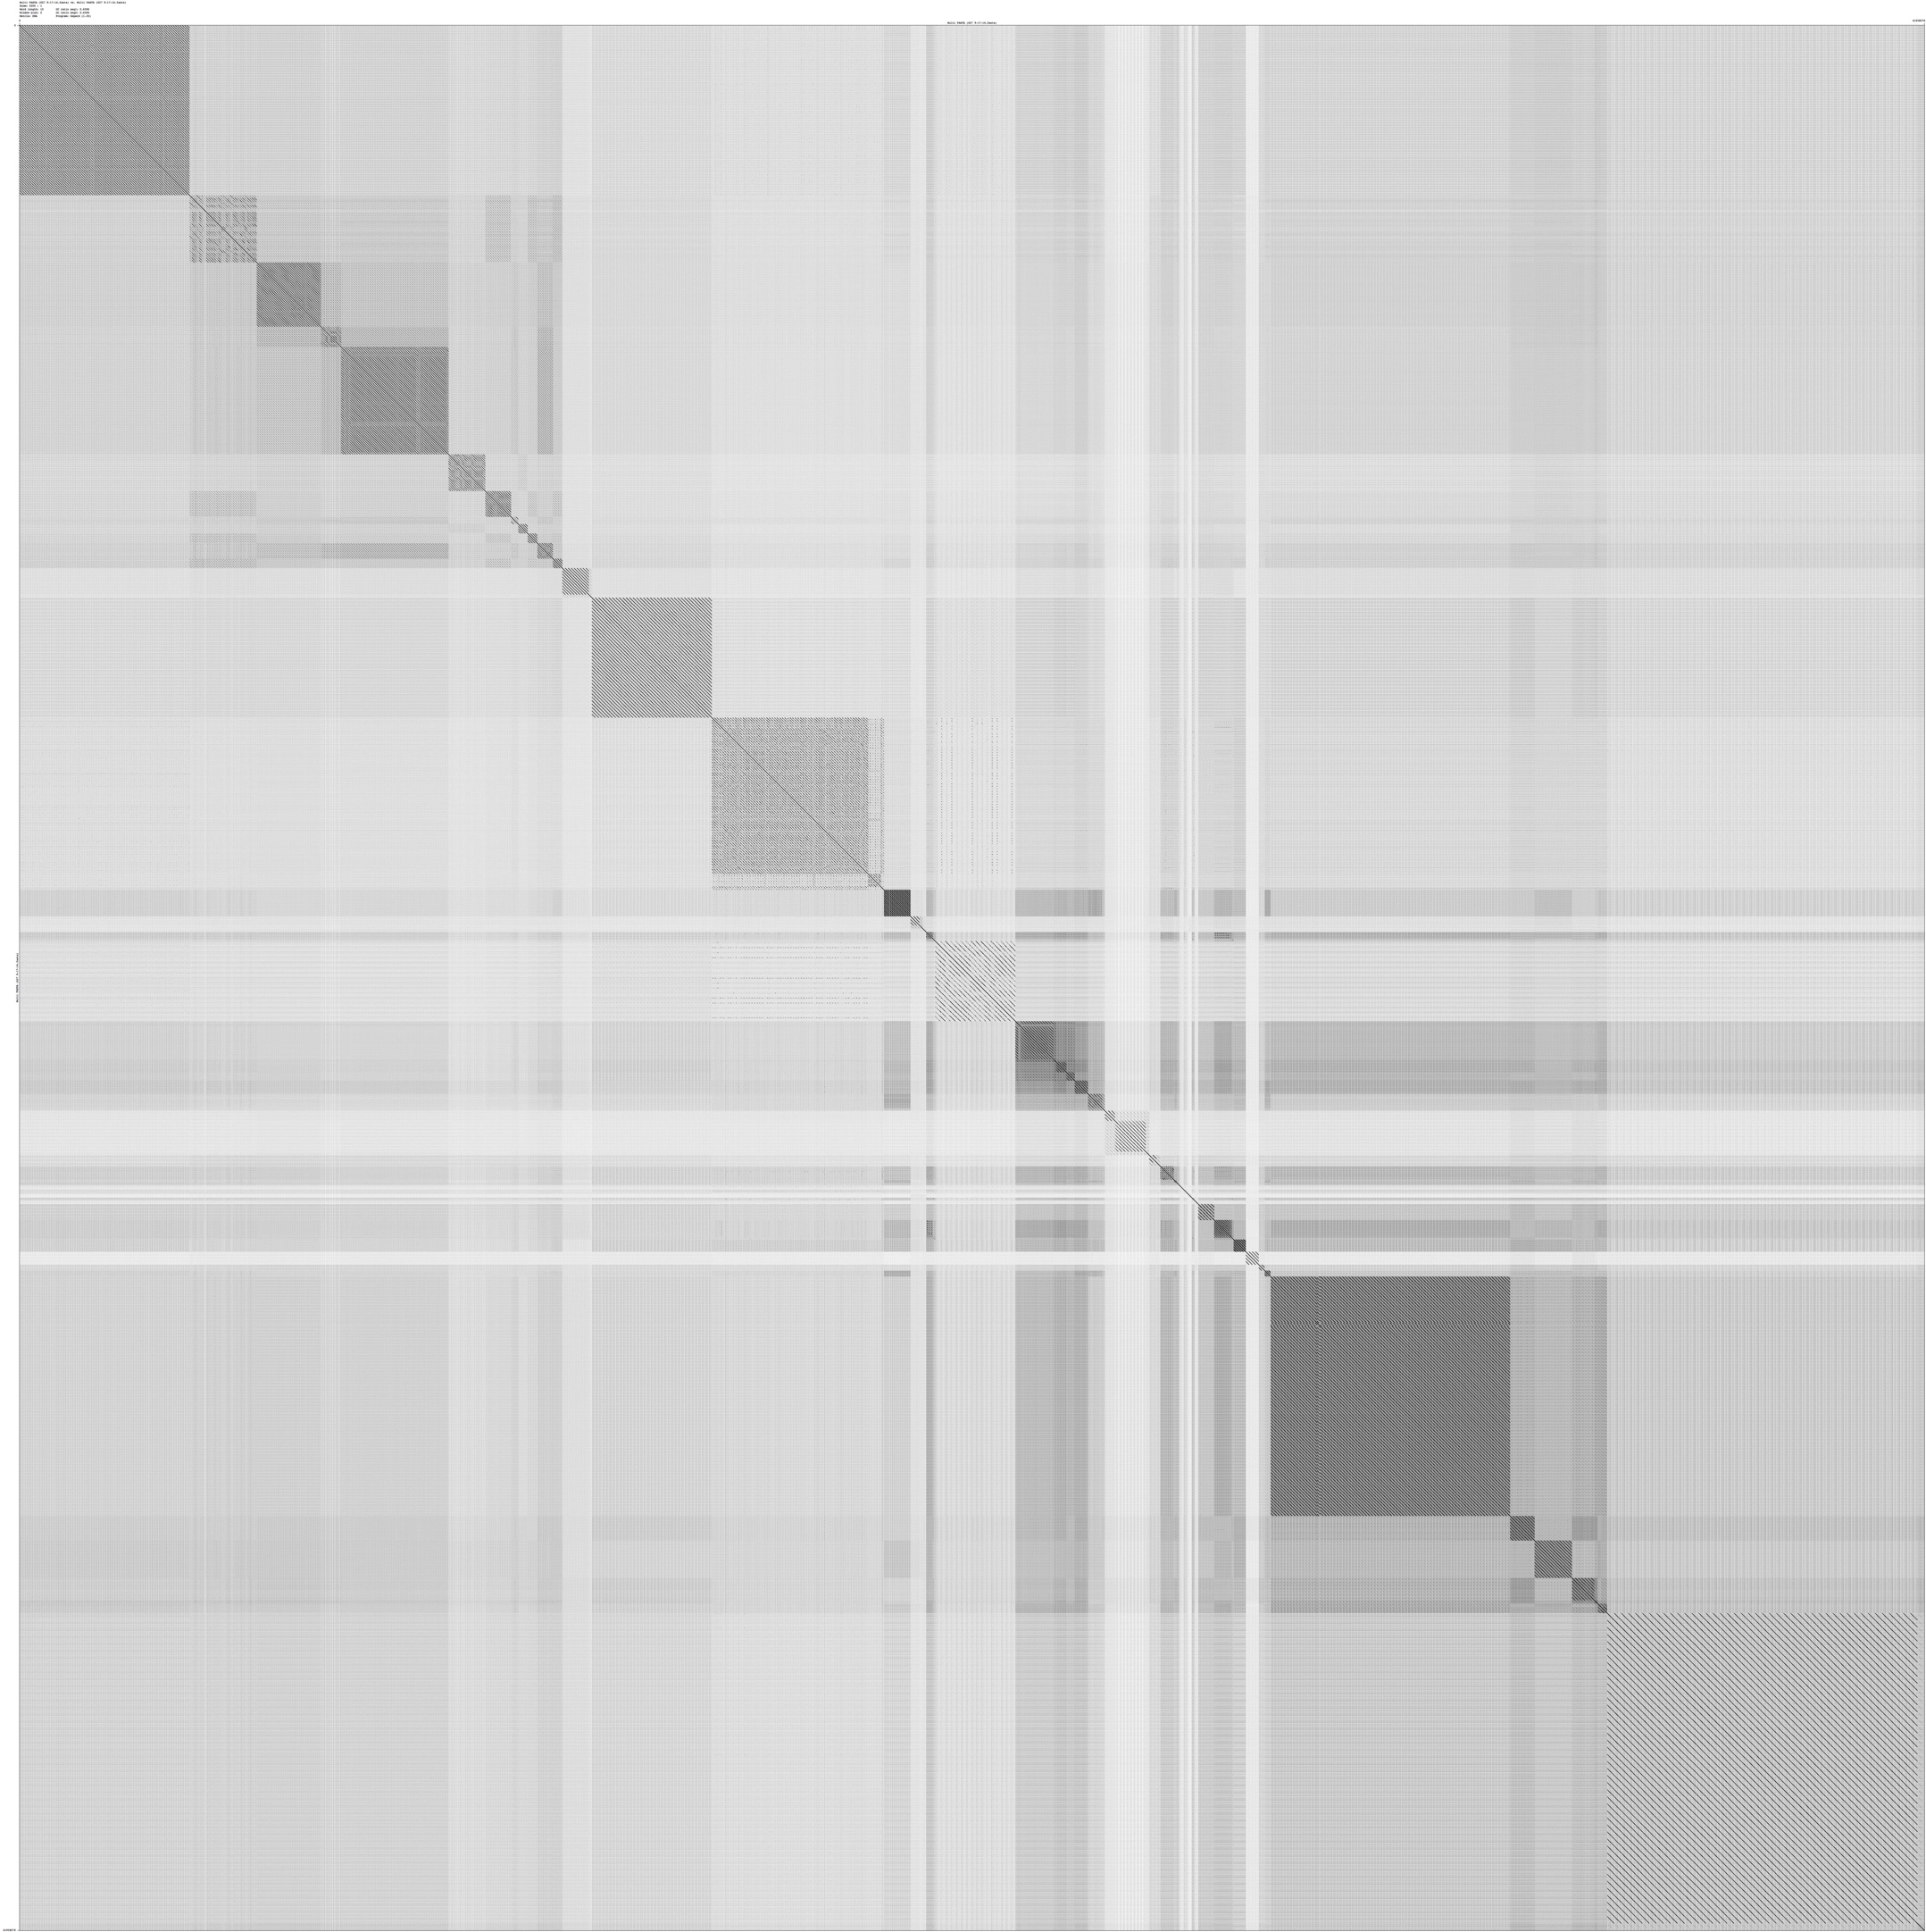
Dotplot comparison of 627 mycobacteriophages

Slide 8
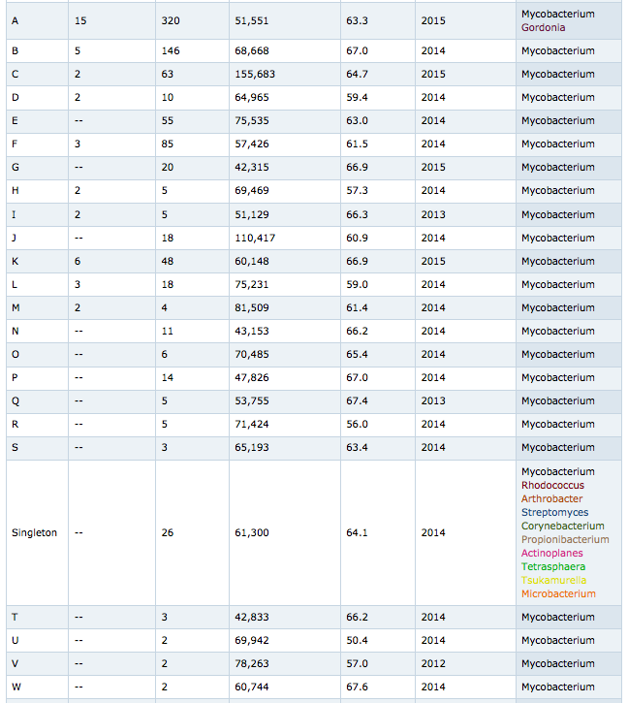
Clusters of Mycobacteriophages

Slide 9
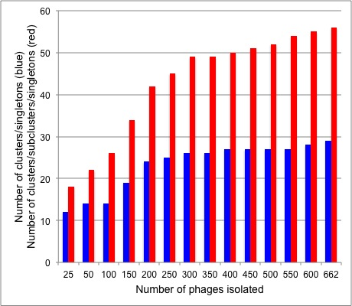
Growth in clusters and subclusters

Slide 10
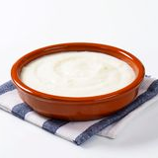

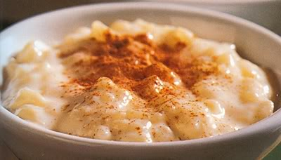
The phage population
Smooth
Lumpy pudding
Discrete

Slide 11
Heat map of mycobacteriophage shared gene content

Slide 12
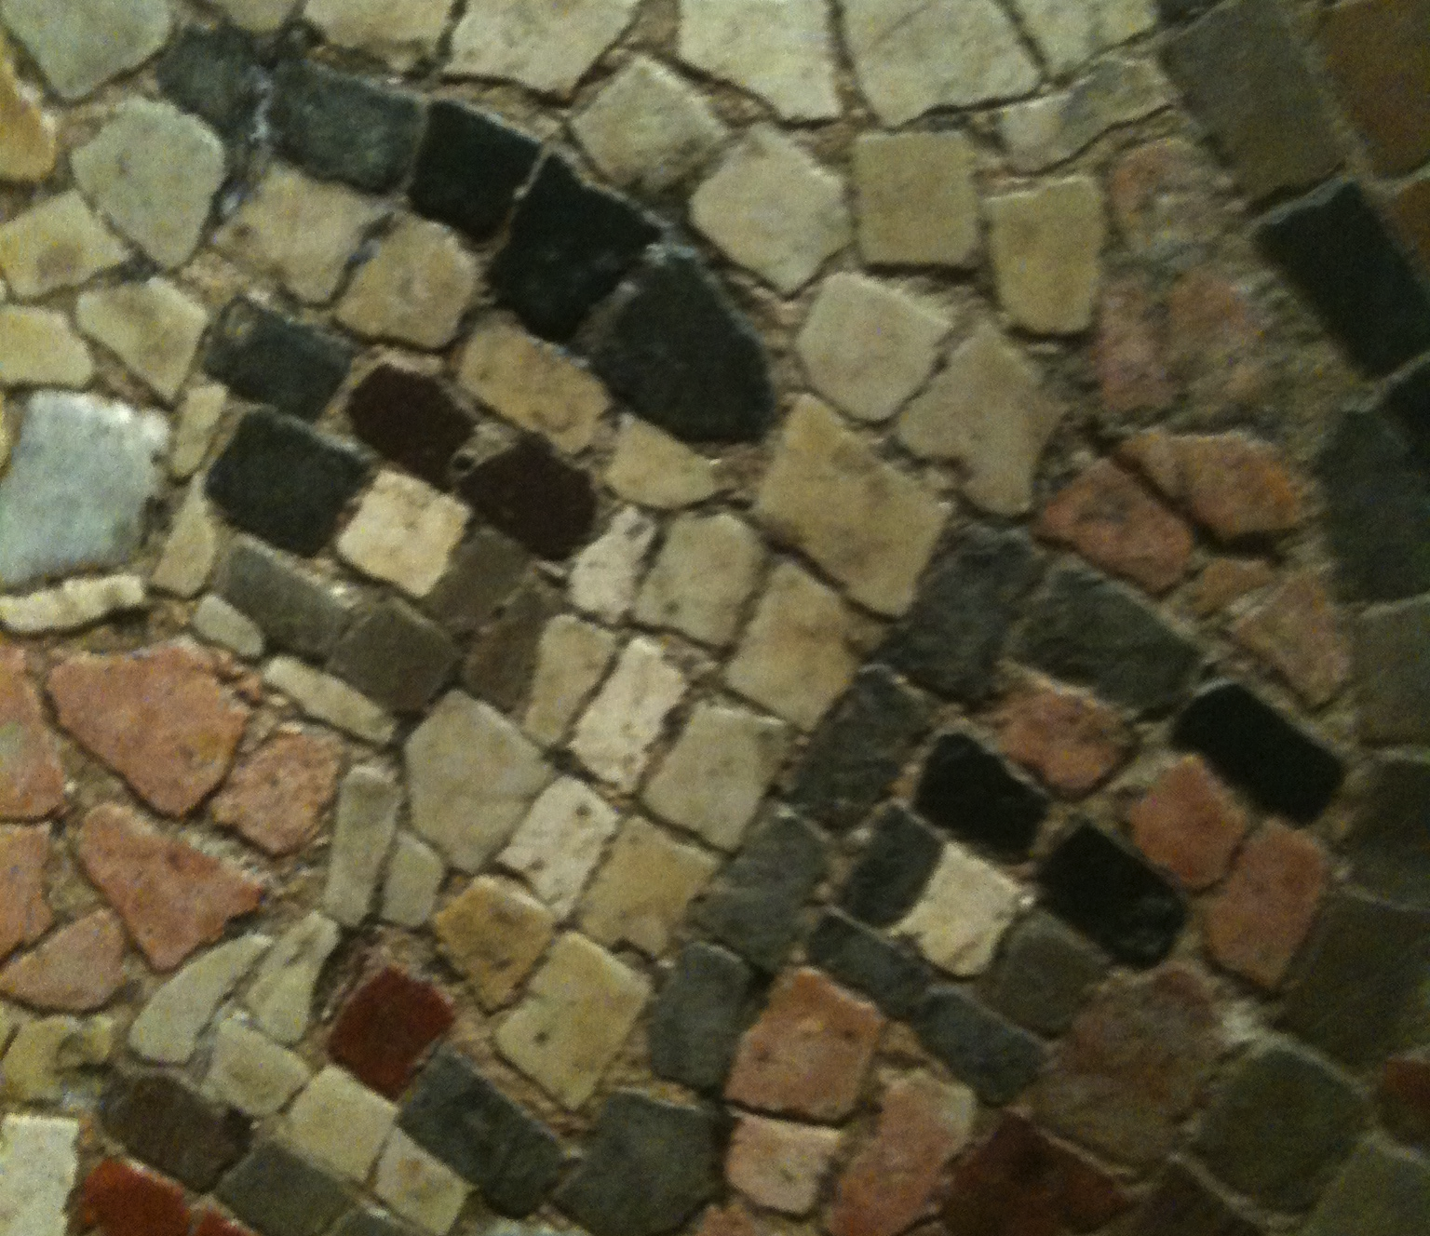
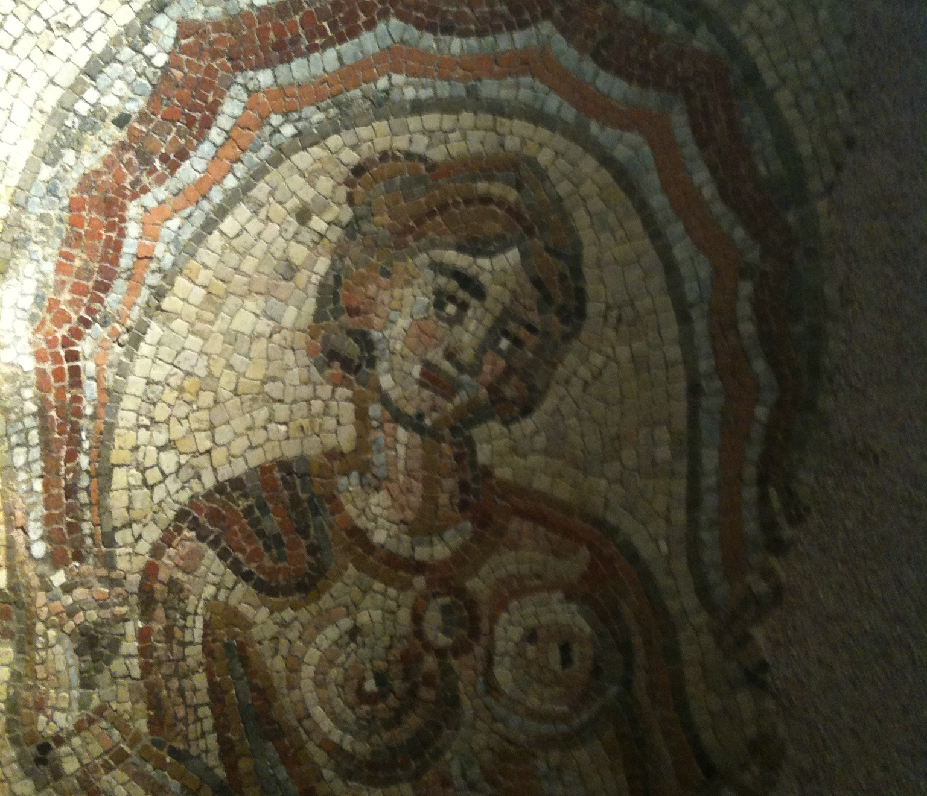
Mosaicism

Slide 13
Single-gene mosaics

Slide 14
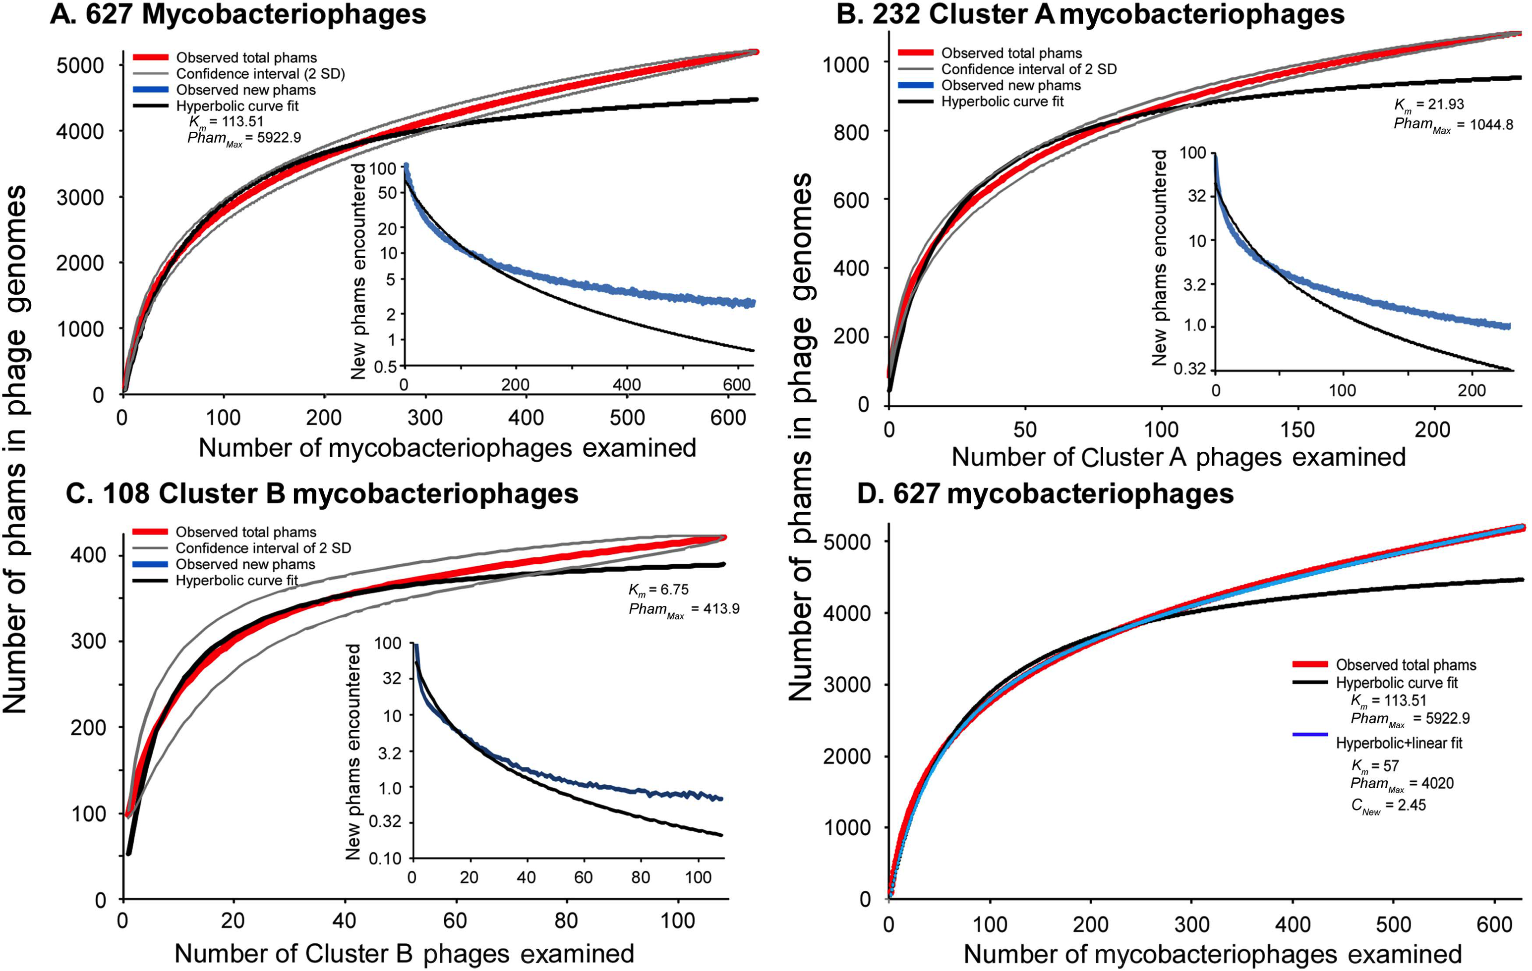
Rarefaction analysis of mycobacteriophages

Slide 15
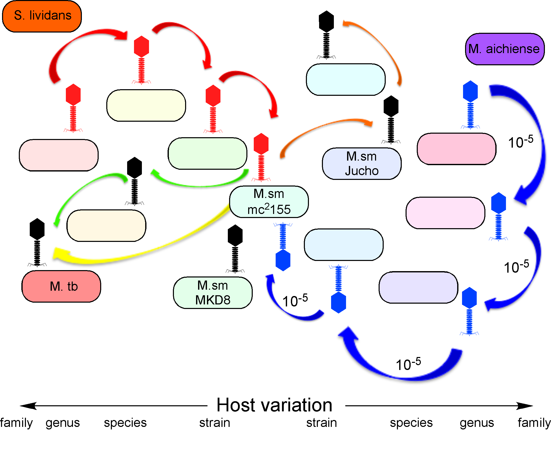
A model for host range evolution
Jacobs-Sera et al., ‘13

Slide 16
Mycobacteriophage Patience

Slide 17
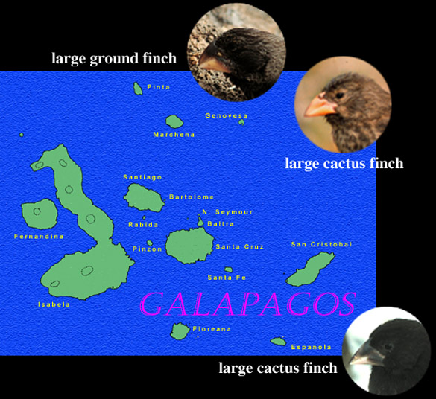

Slide 18
Darwin and the voyage of the Beagle

Slide 19


Slide 20
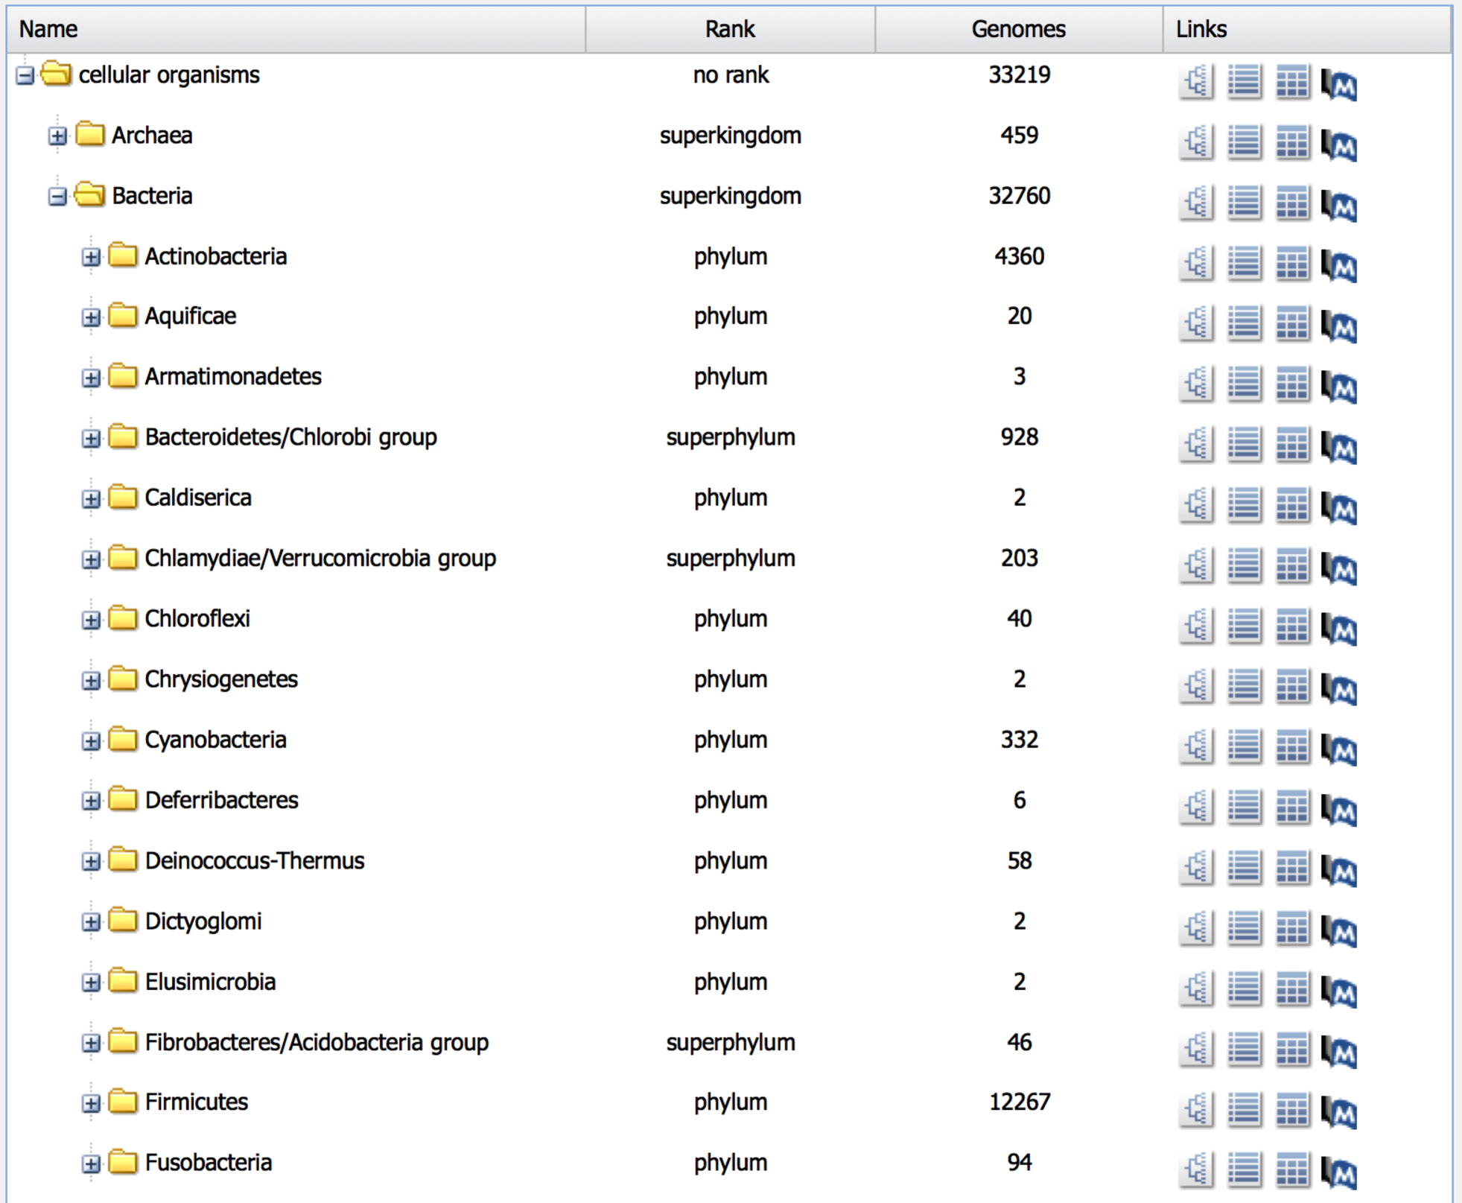
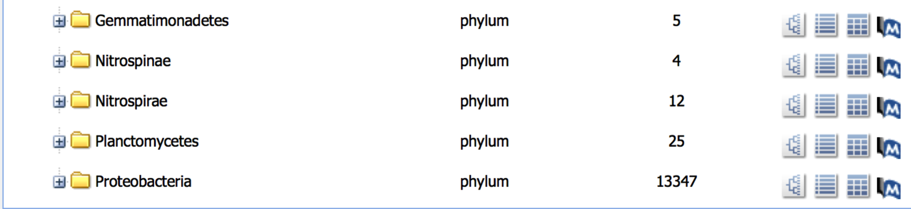
The bacterial landscape

Slide 21
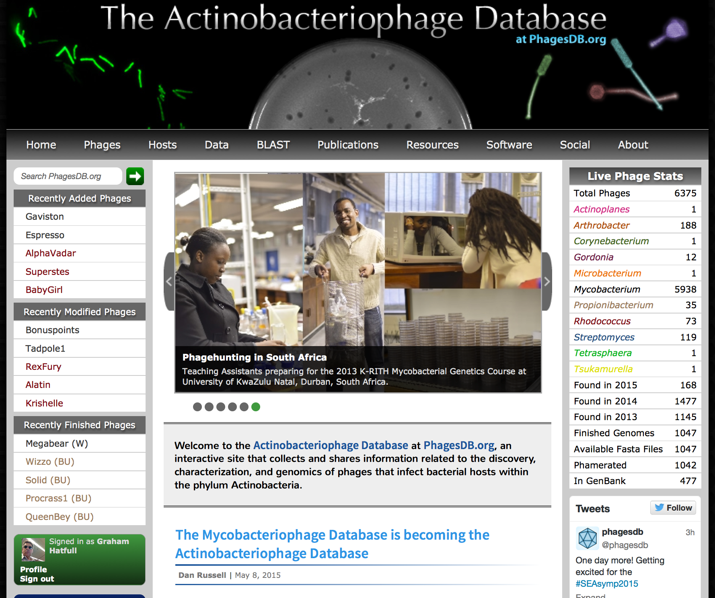
www.phagesdb.org

Slide 22
New genomes, new genes

Slide 23
Splitstree represented phylogeny

Slide 24
The tip of the iceberg

Slide 25
Genomic Mosaicism

Slide 27
Ways in which phages are useful for understanding TB
Transposon delivery
Specialized transduction for gene replacement
Reporter gene delivery for diagnostics
Single-copy integration vectors
Mycobacterial specific recombineering systems
Immunity-based selectable markers
Regulatable expression systems
Phage-based lysis systems
Phage-associated biofilm loss
Host-killer genes for new anti-TB drug targets
Host surfaces used for phage adsorption
Host modulated gene circuits

Slide 28
Thinking about TB phage therapy
What is needed?
A cocktail of 3-6 phages that:
Grow on M. smegmatis for simpler production
Efficiently infect M. tuberculosis
Have different mechanisms of resistance
Do not transduce
Do not encode toxins
Span all clinical isolates

Slide 29
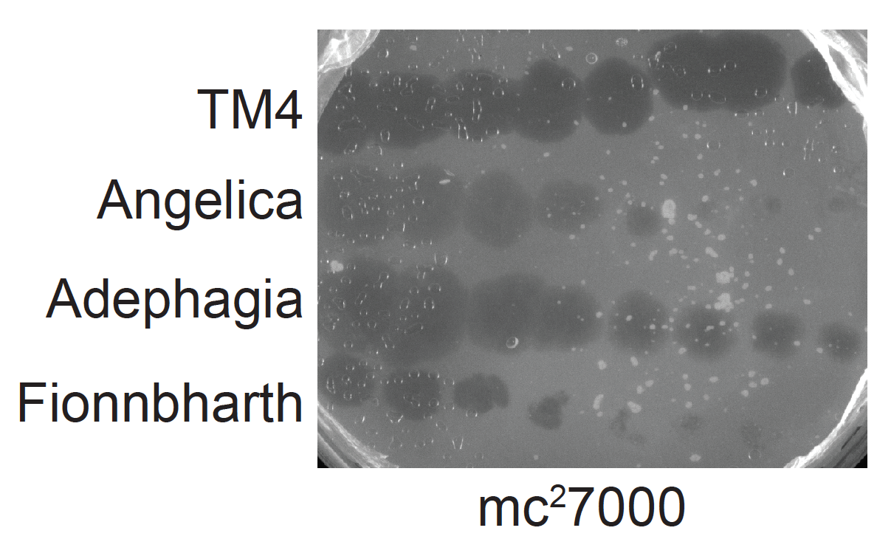
Phage infection of M. tuberculosis

Slide 30
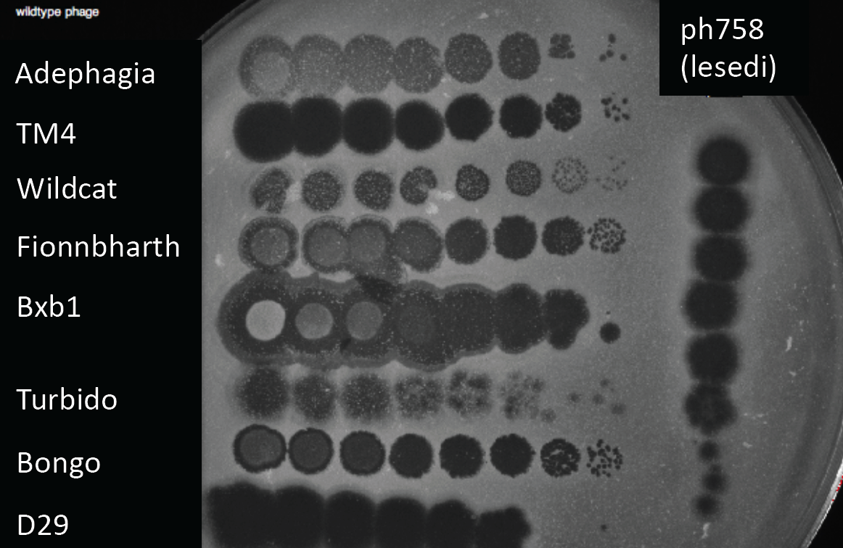
Phage plaques: some are clear, some turbid

Slide 31
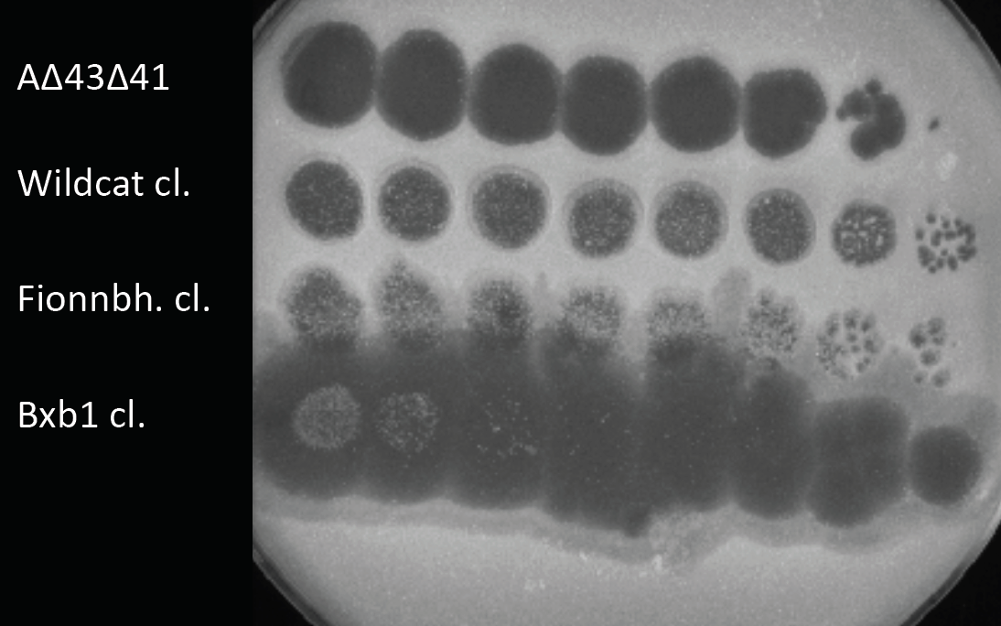
Isolation or construction of clear plaque mutants

Slide 32
Isolation of phage resistant mutants
10⁷ cfu M. smegmatis on TM4

Slide 33
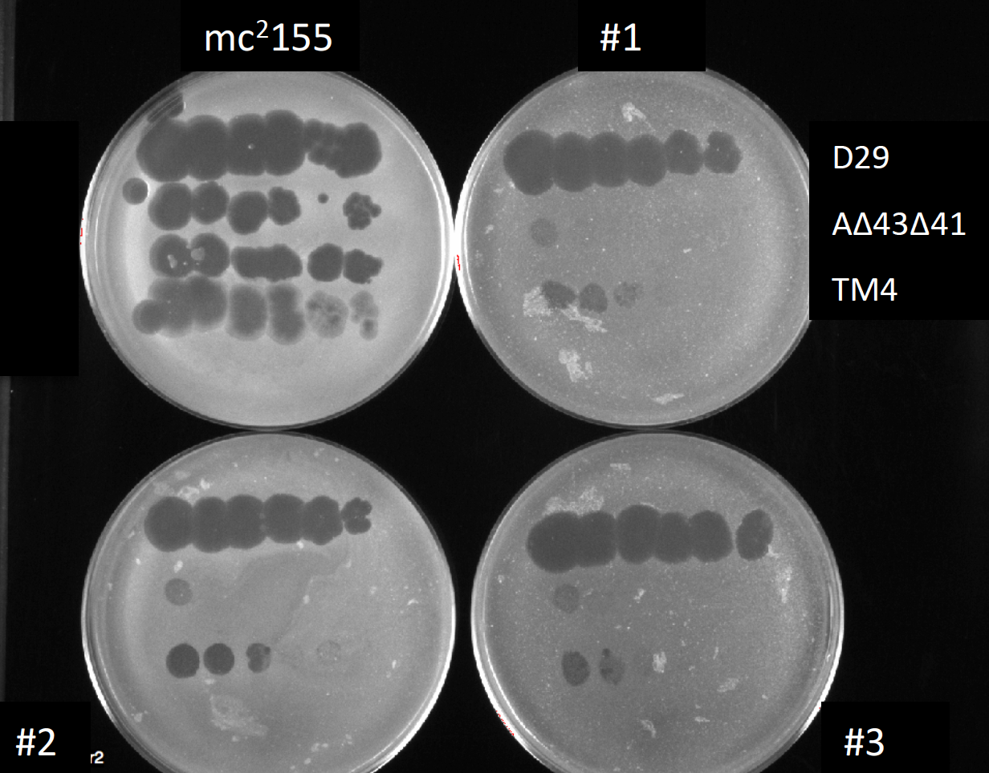
Resistance profiles of Adephagia resistant mutants

Slide 34
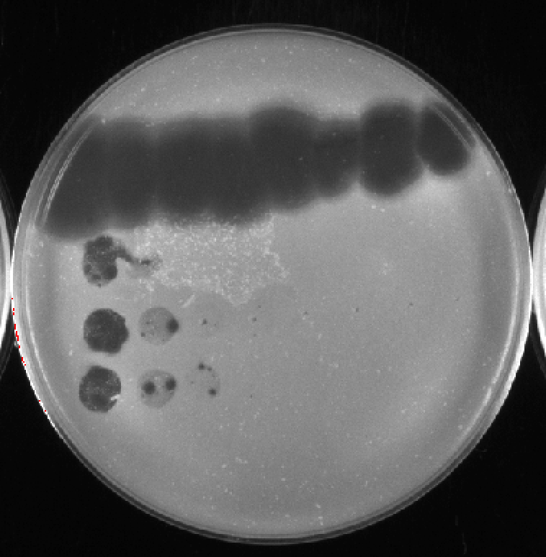
Phage escape mutants infecting resistant mutants

Slide 35
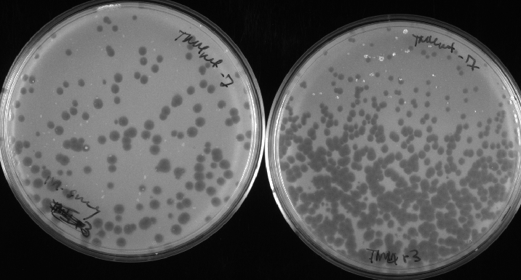
Phage escape mutant still infects M. smegmatis mc²155
mc²155
Resistant mutant

Slide 36
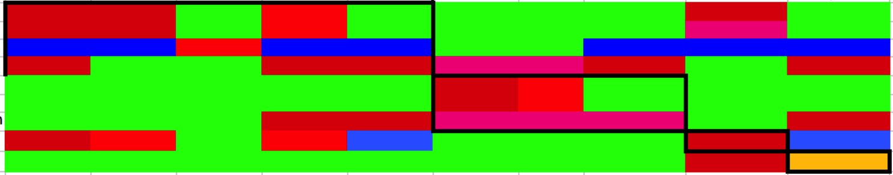
Complex patterns of cross-resistance
1
2
3
4
5
6
7
8
9
10
1
2
3
4
6
7
8
9
10

Slide 37
In summary…
The mycobacteriophage population is highly diverse with genomes of many distinct types
Phage populations are not necessarily discrete, but form a continuum of genetic diversity
The Actinobacteriophage landscape is virgin territory for discovery of genomes and genes
Mycobacteriophages provide a rich toolbox for tuberculosis studies, including therapy.

Slide 38
Acknowledgements
Steve Cresawn
Debbie Jacobs-Sera
Dan Russell
Charlie Bowman
Welkin Pope
Bekah Dedrick
Zaritza Petrova
Crystal Petrone
Roger Hendrix
Jeffrey Lawrence
David Asai
Kevin Bradley
Billy Biederman
Vic Sivanathan
Marianne Poxleitner
Sharon Isern
Scott Michaels
Bill Jacobs
Phage Hunters everywhere!
HHMI, NIH

