Slide 1
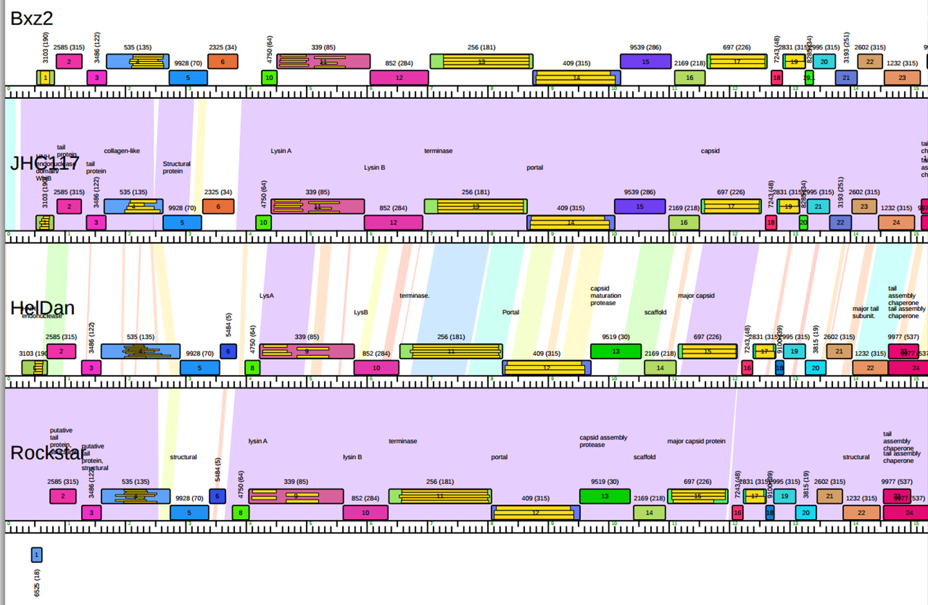
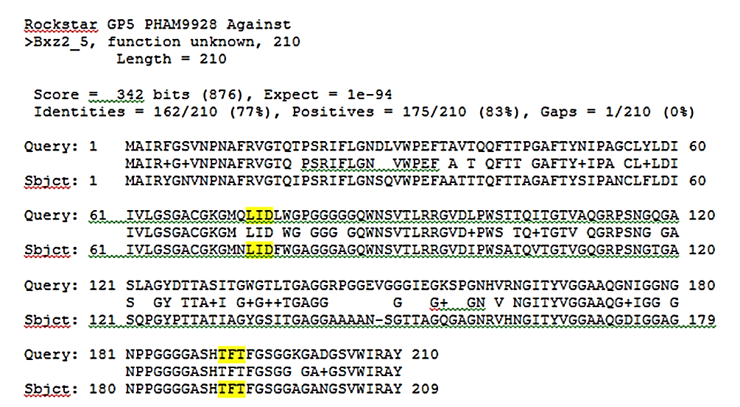
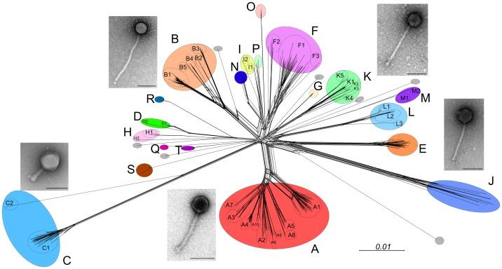
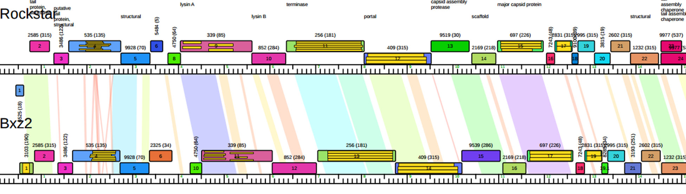
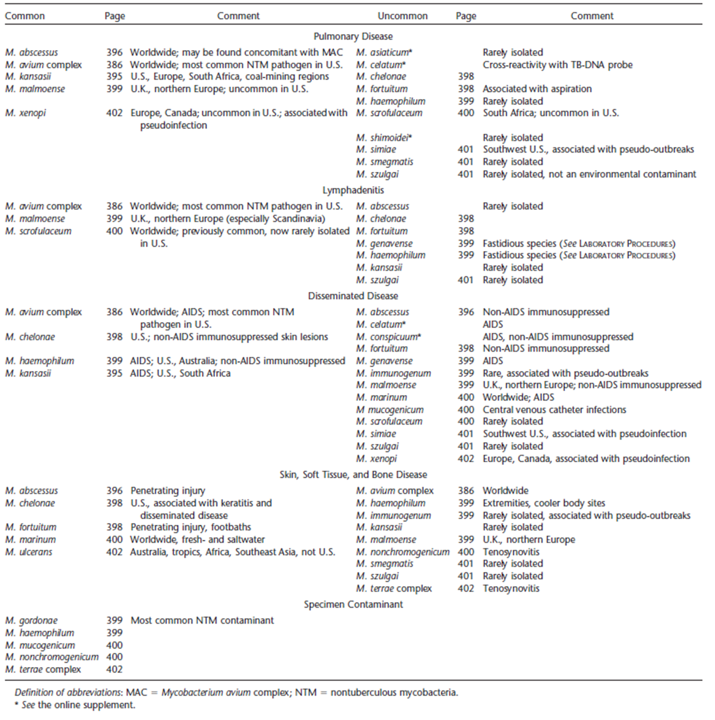
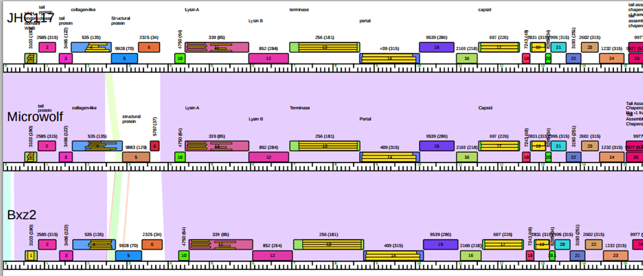
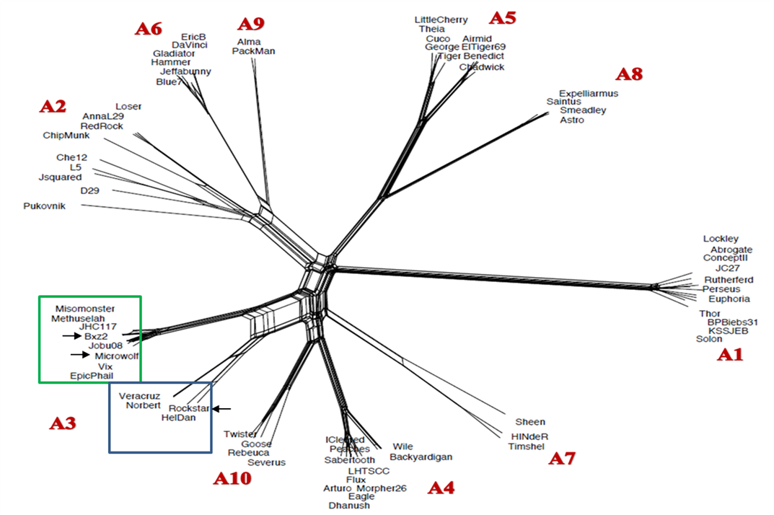
Mycobacteriophage discovery: potential applications for phage therapy of mycobacterial disease
Fernanda Alonzo, Adebanjo Adedoja, Ann M. Findley, School of Sciences, ULM; Chris R. Gissendanner, School of Pharmacy, ULM
Abstract
Nontuberculous mycobacterial (NTM) infections cause a wide range of debilitating diseases and are increasing in prevalence in the U.S and worldwide. Antibiotic therapies for NTM disease are complex and poorly efficacious. One potential option for both prevention and treatment of NTM disease is bacteriophage therapy. In the age of extensive antibiotic resistance for many bacterial pathogens, phage therapy is gaining renewed attention as an alternative for the treatment of infectious bacterial diseases. Despite the potential of phage therapy, many factors complicate phage therapy development and use. One of the more important considerations is the availability of a diverse pool of candidate phages that can be tested for virulence and host-range, two factors that influence suitability and potential effectiveness of phage for therapeutic use. Due to extensive sampling using the non-pathogenic Mycobacterium smegmatis, it is known that a large and genetically diverse pool of bacteriophage exists in the environment that are capable of infecting mycobacterium species. The genomes of greater than 800 of these phage have been sequenced and can be clustered based on genomic sequence similarity. The bacteriophage discovery group at ULM is now exploring the use mycobacteriophage as potential phage therapy for NTM. Specifically, we are investigating the potential of the A3 subcluster of mycobacteriophage. A3 is one of three subclusters, out of 39 distinct clusters/subclusters, that have the ability to infect a broad host-range of pathogenic mycobacterial species. We have identified genetic characteristics of the A3 phage that further advance this group of phage as therapeutic candidates and we are initiating studies to test the 50 known A3 phage against the major NTM pathogens.
Identifying NTM Phage Therapy Candidates
Screen existing sequenced A3 phage against slow- and fast-growing mycobacteria species that cause NTM
Slow-growing species: M. avium subsp. paratuberculosis, M. marinum, M. ulcerans
Fast-growing species: M. abscessus, M. chelonae, M. fortuitum
Comparative genome analysis to identify genetic factors contributing to host-range and virulence
Determine homoimmunity relationships
Isolate highly virulent variants of phage exhibiting broad host-range infectivity
Determine infectivity characteristics (adsorption rate/latency/burst size)
Determine appropriate cocktails for animal testing
Identify additional A3 phage from existing archives of phage isolates or from the environment using molecular screening
Characterize phage from other clusters/subclusters that have tendency for broad host-range as additional possible components of combinatorial cocktails
Is a PHAM 9928 modification a host-range determinant for A3 phage?
In the A3 subcluster, Bxz2 and Rockstar have broader host-range infectivity compared to JHC117 and HelDan. Bxz2 and JHC 117 have high sequence identity and Rockstar and HelDan also have high sequence identity. There are sequence differences in the GP5 region between these nearly identical phage. The protein encoded by GP5 belongs to PHAM 9928 and is a putative structural or minor tail protein. Sequence alignment of the GP5 protein reveals two amino acid differences that correlate with broad host range. JHC117 has amino acids F and T as positions 74 and 192, respectively. Rockstar and Bxz2 have F74L and T192F changes at these positions, respectively. The HelDan PHAM9928 is a more divergent form of PHAM 9928. Twenty-five additional A3 phage have PHAM 9928 and six of these have the F74L and T 192F signature.
A large number of genetically diverse mycobacteriophages that infect the non-pathogenic Mycobacterium smegmatis have been isolated from the environment.
Members from two clusters (A and K) exhibit broad host-range against different mycobacteria species (Jacobs-Sera et al, 2012; Rybniker et al, 2006).
Nontuberculous mycobacteria (NTM) cause a variety of clinical diseases that are difficult to treat with antibiotics.
Is PHAM 9883 also a host-range determinant for A3 phage?
Microwolf also has broader host-range and has high sequence identity to Bxz2. There are also differences in the GP5 region between these two phage but Microwolf encodes a different structural protein (PHAM9883) that has some similarity but clearly diverged from PHAM 9928. Eighteen A3 phage have GP5 (PHAM 9883) and ten are 100% identical to Microwolf GP5. (ex. see alignment to MarQuadt )
Hatfull, 2014
The A3 subcluster of mycobacteriophage exhibit a broad host-range (Jacobs-Sera et al, 2012). Broad host-range A3 phage can be split into two genetically distinct homoimmunity groups (green and blue boxes (arrows indicate specific broad host-range phage). Bxz2 can infect multiple Mycobacteria species (Rybniker et al, 2006 ) and Rockstar and Microwolf can infect M. tuberculosis.
Conclusions
The A3 subcluster contains several broad host-range phage
Comparative analysis suggests that a putative structural/minor tail protein may be a determinant of broader host-range
There are two diverged types of this protein (PHAMS 9928 and 9883)- The F74L/T192F PHAM 9928 variant correlates to broad host-range and PHAM 9883 is found in another broad host-range A3 phage
Other A3 phage with these structural protein variants may also exhibit broad host-range
A3 subcluster phage represent a potential pool of phage that can be developed as phage therapy against mycobacterial pathogens
Griffith et al, 2007
References
D.E. Griffith et al, 2007. An Official ATS/IDSA Statement: Diagnosis, Treatment, and Prevention of Nontuberculosis Mycobacterial Diseases. Am J Respir Crit Care Med, 175, pp 367-416.
G.F. Hatfull, 2014. Mycobacteriophages: Windows into tuberculosis. PloS Pathogens, 10, e1003953.
D. Jacobs-Sera, 2012. On the nature of mycobacteriophage diversity and host preference. Virology, 434, pp187-201.
J. Rybniker et al, 2006. Host range of mycobacteriophages in Mycobacterium ulcerans and seven other mycobacteria including Mycobacterium tuberculosis-application for identification and susceptibility testing. Journal of Medical Microbiology, 55, pp 37-42.
Acknowledgements
Research supported by the National Institute of General Medical Sciences of the National Institutes of Health under Award Number P30GM110703. ULM is a member of the HHMI SEA-PHAGES program and we thank the Graham Hatful lab, University of Pittsburgh, for their support.

