Slide 1



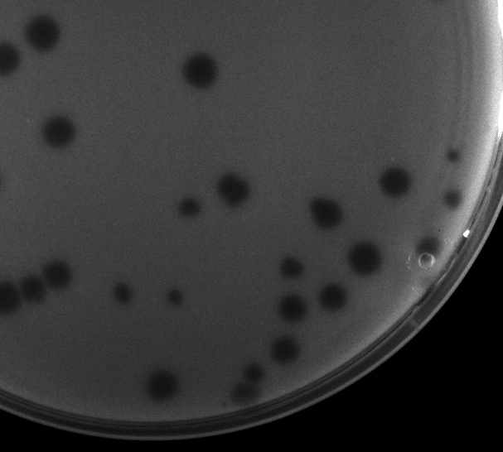
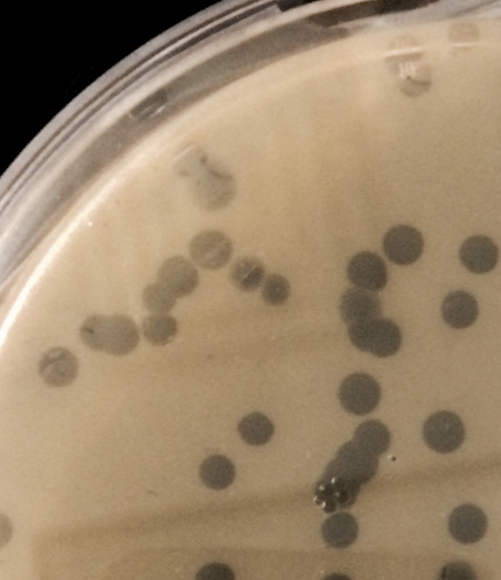
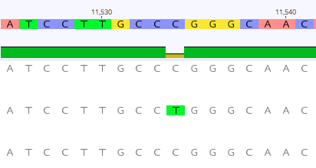
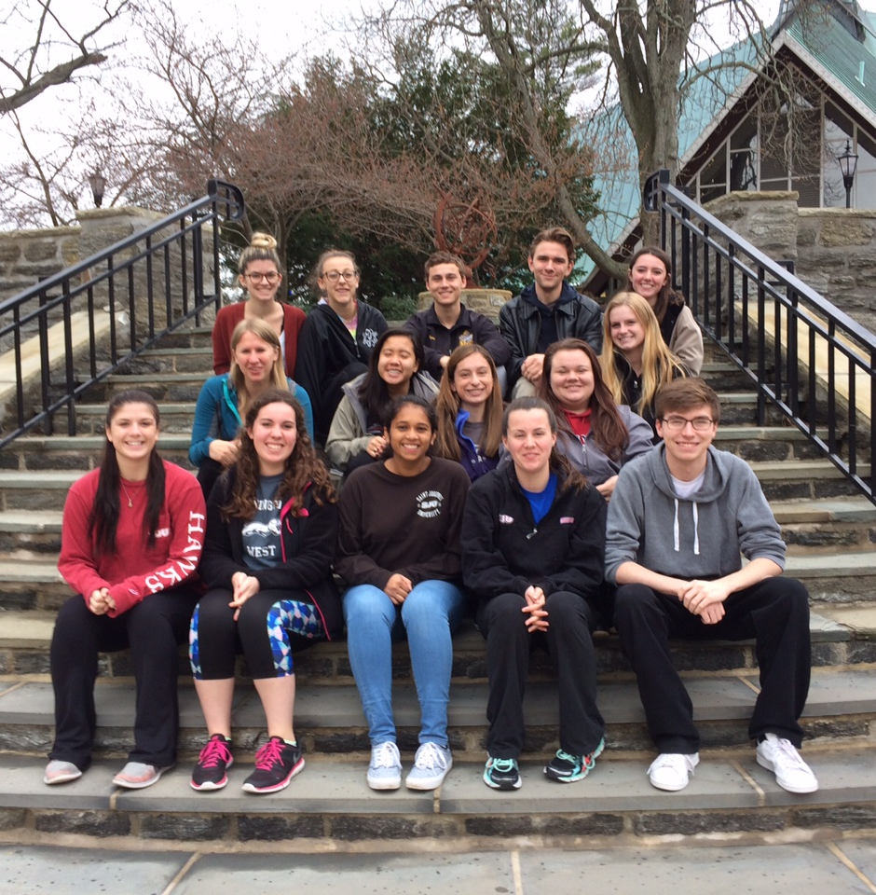
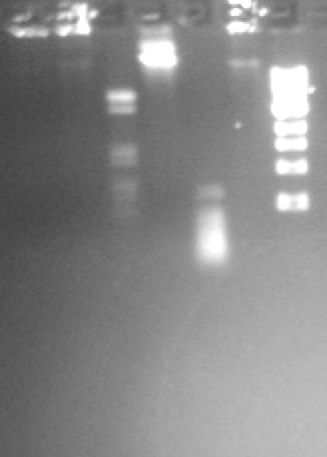
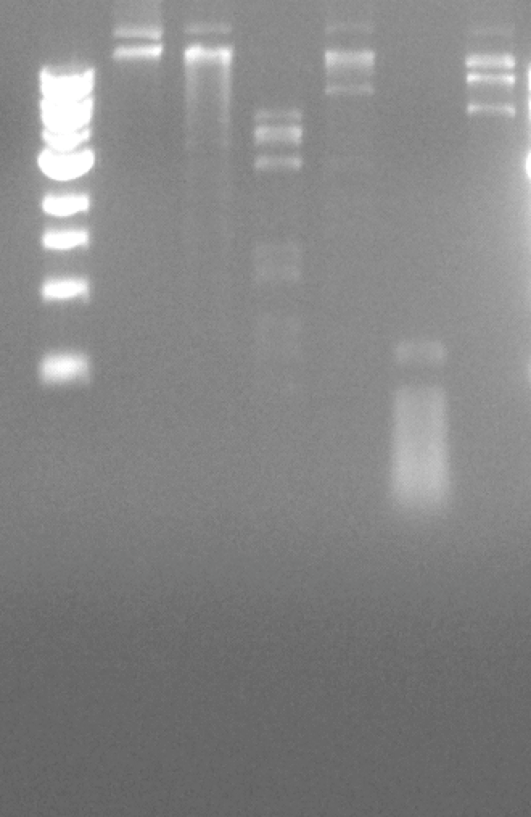
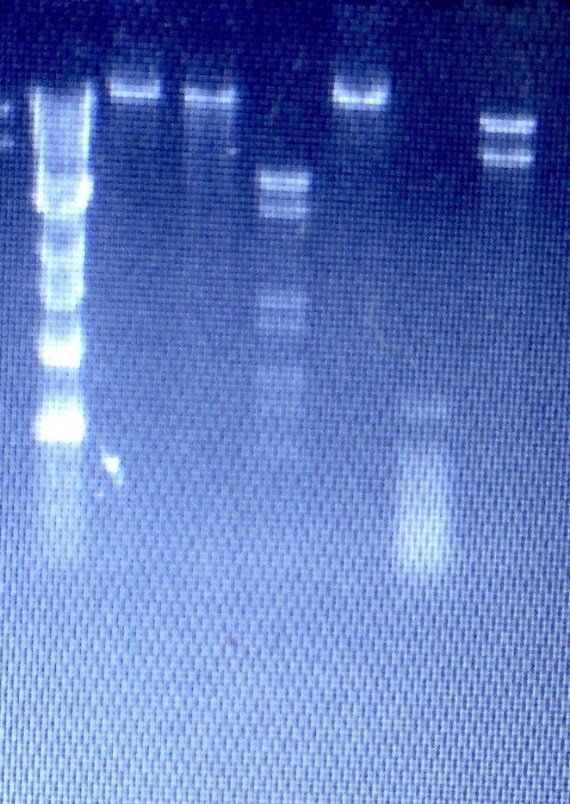
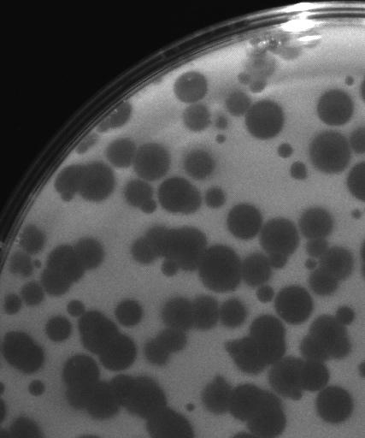
Sarah Muche, Joseph Quinlan, Christina Gareis, Alison Kloiber, Madison Honer,
Taylor Nguyen, Haley Patrick, Martin Ryan, Scott Newman, Lakshmi Narayanam, Ashley Frankenfield, Kaleigh Williams, Megan Siwak, Maddison Jeffries, Megan Hartwell,
Shawn London, Christina King-Smith, John Braverman, Julia Lee-Soety, Shantanu Bhatt
Metagenomic analysis of Arthrobacter-specific bacteriophages in the AN cluster
Department of Biology , Saint Joseph’s University, Philadelphia, PA 19131
Abstract
Phage Safari students at SJU isolated several Arthrobacter phages this year. Most were from soil samples collected in students’ hometowns. Phages were enriched in Arthrobacter sp. cultures and underwent numerous rounds of purification. Three purified phage DNA were sequenced - Mariposa from Downingtown, PA, Massimo from Camp Hill, PA, and Prospero from Vineland, NJ. These phages yielded clear lytic plaques of varying sizes and shared similar restriction digest patterns. The sequences of the three phages were also highly similar and sorted into cluster AN. During the annotation phase, BLAST analyses through DNA Master showed high identity to another set of AN phages, Decurro, Jessica, and Sandman, all isolated by Bucknell University students. We performed a metagenomic sequence analysis on 6 of these phages plus 19 others that are in the AN cluster. So far, phages in the AN cluster have the shortest genomes, averaging 15,544bp. Full genome alignments showed differences ranging from 1 nucleotide (Yank vs Decurro) to 2182 nucleotides (Taj14 vs Seume). For example, Massimo and Mariposa differed in 3 nucleotides, interestingly located within the genes encoding capsid maturation protease, tape measure protein, and a protein with unknown function. In the gene encoding capsid maturation protease, a single nucleotide mismatch was observed resulting in a conservative amino acid (histidine and arginine) difference. In the gene encoding tape measure protein, the difference was synonymous. A phylogenetic tree was estimated and showed two major groupings. The three genomes processed at SJU are found in the same sub-grouping, thus correlating with common geographic origin. However, in the tree, the entire collection of 25 AN cluster phages did not fall into a perfect correlation with geographic origin. The significance of this research is the combination of genomics analysis and evolutionary inferences.
Undigested AfllII
BsaAl
Dralll
Haelll
Nhel
1 kb Ladder
1 kb Ladder
Undigested AfllII
BsaAl
Dralll
Haelll
Nhel
1 kb Ladder
Undigested AfllII
BsaAl
Dralll
Haelll
Nhel
Figure 4. Sequence analyses on all 25 AN cluster Arthrobacter phages show similarities ranging from 1 nucleotide difference (Decurro and Yank) to 2187 nucleotides (Stratus and Taj14). Analyses were performed on the Geneious 9.1.4 software program.
Massimo
Mariposa
Prospero
Figure 5. A C to T mutation may have occurred in Mariposa at NT# 11533. MUSCLE alignment showed T/C difference between Massimo, Mariposa, and Prospero. Moreover, Nucleotide BLAST of alignments with 11 other phages (Jessica, Toulouse, Stratus, Moloch, Maggie, TymAbreu, Sandman, Yank, Muttlie, Decurro) showed consensus of C; only Mariposa contains a T.
Consensus
Identity
Prospero
Mariposa
Massimo
Mariposa
Massimo
Prospero
Figure 2. Arthrobacter phages Massimo, Mariposa, Prospero produced clear plaques on lawns of Arthrobacter sp. Clear plaques indicate lytic phages.
Pittsburgh, PA
Figure 1. Restriction digest patterns for phages Mariposa, Massimo, and Prospero show subtle differences. Isolated phage DNA was treated with five different restriction endonucleases. This initial characterization gave a glimpse of each phage prior to full sequencing.
Waco, TX
Missoula, MT
Waco, TX
Figure 7. Students and TA in the 2015-2016 Phage Genomics lab.
Helix-turn helix DNA binding protein, MerR-like
All from Waco, TX
Terminase
Capsid maturation protease
Amidase
Helix-turn helix DNA binding domain
West Chester, PA
Portal protein
Tape measure protein
Peptidase
Waco, TX
Lewisburg, PA
3804
A/G
HIS/ARG difference
8175
C/G synonymous difference
11533
T/C
TRP/ARG difference
0.02
Somerset, WI
Hudson, WI
Figure 6. Phylogenetic tree generated by Geneious indicates no correlations between geographic location of where soil samples containing phages were isolated and groupings. Phages were isolated and purified at Baylor University (TX, including phage Taj14), University of Pittsburgh, University of Wisconsin, Riverside, Cabrini College (Radnor, PA), Bucknell University (Lewisburg, PA, including phages Sandman and Muttlie), Lehigh University (Bethlehem, PA), and Saint Joseph’s University (phages Mariposa, Massimo, and Prospero).
Pittsburgh, PA
Seaside Park, NJ
Radnor, PA
Vineland, NJ
Hudson, WI
Katy, TX
Figure 3. Phages Mariposa and Massimo differ by 3 nucleotides. Positions of differing nucleotides are highlighted. Two were located in genes expressing capsid maturation protease and tape measure protein (these and other protein functions were identified by Phamerator, BLASTp, and HHPred). The nucleotide difference at position 11533 likely results in significant changes in protein structure.
Radnor, PA
Camp Hill, PA
Bethlehem, PA
Lewisburg, PA
Downingtown, PA

