Slide 1
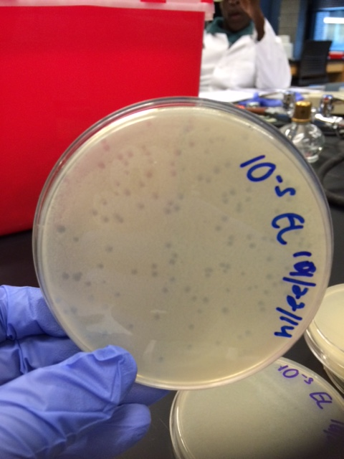
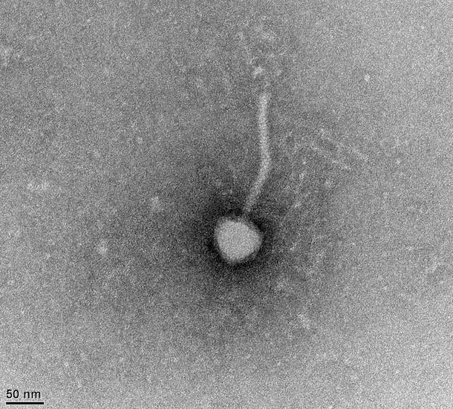
Finding Panchino, a Novel N-Cluster Mycobacterium Phage from The Lincoln University
Erin N. Lockwood, Nijewel X. Holliday, Nnamdi E. Ihejirika, Tamara D. Jones, Lisa R. Mwanza, Prisca C. Obidike, Jacqueline G. Ruban, Nathanial J. Sangster,
Anna K. Hull, and David F. Royer
Background and Hypothesis
The N-cluster
Exploring the Panchino Genome
A phage hunters course was offered at Lincoln University (PA) for the first time during the 2014-15 academic year. The seven students in the course included four freshmen, two sophomores and one senior. Each student successfully isolated a Mycobacterium smegmatis phage from soil samples collected on Lincoln’s campus, and one, named Panchino, was chosen by the class for sequencing based on plaque uniformity and quality of the DNA preparation. Comparison to other phages revealed that Panchino is an N-cluster phage, and electron microscopy indicated that it belonged in the Siphoviridae .
We hypothesize that Panchino is similar to other N-cluster mycobacteriophages in genome size and content.
Table 1: Origin and isolation of N-cluster mycobacterium phages
Table 3: Panchino genome composition
Phage Name | Location Discovered | Year Discovered | Enriched Soil Sample | GPS coordinates
Panchino | Lincoln University, PA | 2014 | Yes | 39.803333 N, 75.925278 W
Butters | Philadelphia, PA | 2011 | Yes | 40.06067 N, 75.046608 W
Carcharodon | Jacksonville, AL | 2013 | Yes | 33.85425 N, 85.67559 W
Charlie | Richmond, VA | 2009 | Yes | 37.544958 N, 77.454041 W
MichelleMyBell | Nyack, NY | 2012 | Yes | 41.088333 N, 73.931944 W
Phrann | New Haven, CT | 2014 | No | 41.333611 N, 72.9525 W
Pipsqueak | Charleston, SC | 2014 | Yes | 34.783667 N, 79.939806 W
Redi | St. Louis, MO | 2009 | Yes | 38.669694 N, 90.383833 W
Skinny Pete | Richmond, VA | 2012 | Yes | 37.325703 N, 77.205717 W
Xeno | New Haven, CT | 2014 | Yes | 41.333611 N, 72.9525 W
Xerxes | Gainesville, FL | 2011 | Yes | 29.643632 N, 82.354930 W
Structural Genes | Functional Genes
gp4: portal protein | gp2: terminase
gp6: major capsid protein | gp5: capsid maturation protease
gp8: head-to-tail connector | gp14: tail assembly protein
gp11: head-to-tail connector | gp15: tail assembly protein
gp13: major tail protein | gp25: lysin A
gp16: tape measure protein | gp26: holin
gp17: minor tail protein | gp29: type 1 restriction enzyme
gp18: minor tail protein | gp32: integrase
gp19: minor tail protein | gp33: immunity repressor
gp20: minor tail protein | gp34: Xis
gp21: minor tail protein | gp44: RecE
gp27: minor tail protein | gp45: RecT
 | gp46: predicted zinc finger
 | gp47: RusA
 | gp48: NrdH-like protein
 | gp55: methylase
 | gp57: HTH DNA binding protein
 | gp66: HNH endonuclease
Methods and Results
The soil sample was collected from a grassy area on the campus of Lincoln University with GPS coordinates 39°48’12” N 75° 55’ 31” W (figure 1). The soil collected was very dry and rocky.
Panchino was isolated from a culture enriched with Mycobacterium smegmatis mc² 155 culture. A single phage species was obtained after five rounds of plaque streaks (figure 2). The isolated phage was very small with 1.5 mm diameter clear plaques.
After obtaining a high titer lysate, DNA was isolated and subjected to restriction enzyme digests (figure 3).
Electron microscopy indicates that Panchino is a Siphoviridae with a head size of 50 nm and a tail that is 200 nm long (figure 4).
Panchino was sequenced by the Hatful lab at the University of Pittsburgh and classified as an N-cluster phage based on comparison to other mycobacteriophages (figure 5)
Panchino gp29 shares several domains with type 1 restriction enzymes (figure 6)
Table 2: Genome Characteristics of N-cluster mycobacterium phages
Phage Name | Genome Size (bp) | GC Content | Number of Genes | Annotation
Panchino | 43516 | 65.9% | 66 | completed
Butters | 41491 | 65.8% | 66 | completed
Carcharodon | 43680 | 66.2% | 71 | completed
Charlie | 43036 | 66.3% | 63 | completed
MichelleMyBell | 42240 | 66.0% | 70 | completed
Phrann | 44872 | 66.3% | N/A | not completed
Pipsqueaks | 43679 | 66.3% | N/A | not completed
Redi | 42594 | 66.1% | 68 | completed
SkinnyPete | 43478 | 66.4% | N/A | not completed
Xeno | 42395 | 66.8% | N/A | not completed
Xerxes | 43698 | 66.3% | N/A | not completed
Table 3 contains the details of the Panchino genome composition: 12 of the 66 genes (18.2%) are structural, 18 genes (27.3%) are functional and 36 genes (54.5%) have no known function.
Conclusion
Panchino is a N-cluster mycobacteriophage isolated from a soil sample at Lincoln University. It is similar to other N-cluster phages in genome length, GC content, and number of genes.
It is most similar to N-cluster phages Butters and Redi with only slightly less similarity to MichelleMyBell and Carcharodon.
Panchino is a member of Siphoviridae with a 200 nm tail and a 50 nm diameter head.
Panchino has 66 genes, 30 were assigned putative functions based on comparisons with other annotated mycobacterial phages and bacterial genomes.
Panchino has a possible type 1 restriction enzyme gene.
Our hypothesis that “Panchino is similar to other N-cluster mycobacteriophages in genome size and content” is supported by the annotation results.
Table 1 and 2 compare Panchino to the other ten N-cluster mycobacterium phages that have been entered on PhagesDB.org to date. The N-cluster is characterized by small genomes that contain 63-71 genes.
Special Features
Figure 6: Blast, putative domain results for Panchino gp 29 – a type 1 restriction enzyme
References
Restriction enzyme
Figure 6 shows the Blast putative domain results for gp29 indicating a type 1 restriction enzyme. Restriction enzymes, found in bacterial cells, destroy foreign DNA, such as phage DNA, by cutting at recognition sequences in the DNA. Type 1 restriction enzymes are complex, multisubunit enzymes that cut DNA at random sites, far from the recognition sequence. (1) They are common in bacterial genomes.
The question is: How and why does Panchino have a gene for a type 1 restriction enzyme?
Programmed Translational Frameshift:
Gene 15 and 16 exhibited a programmed translational frameshift and were merged into a single gene in our annotation. The merged gene codes for a tail assembly chaperone which assists in the assembly of the major tail subunit. The frameshift in the tail assembly chaperone was first observed in lambda phage and is present in many mycobacteriophages. (2)
Figure 1. Soil sample collection site
Figure 2. Panchino plaques
(1) Types of Restriction Endonucleases. New England BioLabs, Inc.
(https://www.neb.com/products/restriction-endonucleases/restriction-
endonucleases/types-of-restriction-endonucleases)
Glossary of Phage Terms. The Actinobacteriophage Database at
PhagesDB.org. (phagesdb.org/glossary/)
Acknowledgements
SEA-PHAGES Program of The Howard Hughes Medical Institute
Graham Hatful Lab at the University of Pittsburgh
Figure 3. Restriction digest,:λ-Hind III, uncut DNA, Panchino cut with BamHI, ClaI, EcoRI, HaeIII, HindIII
Figure 4. Electron Micrograph of Panchino
Figure 5. Phamerator image of three N-cluster mycobacterium phages: Panchino draft, Butters and Redi

