Slide 1
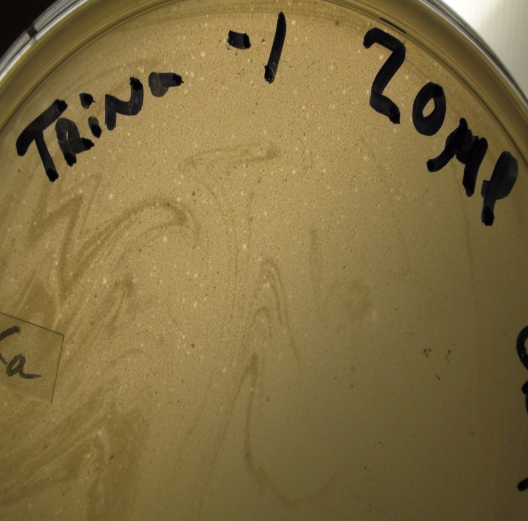
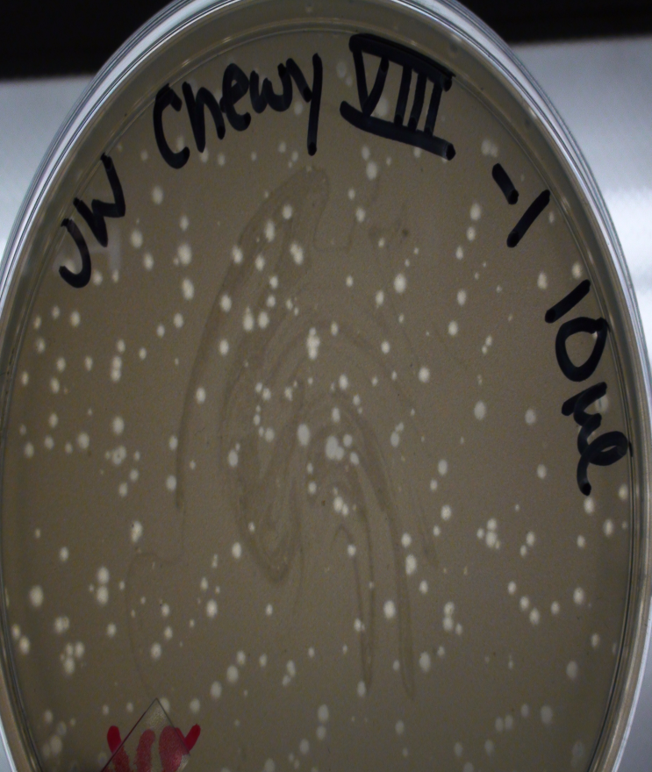
Annotation of Rhodococcus erythropolis Phage Singletons ChewyVIII and Trina
Gillian Holder, Jordan Wagner, Victoria Albritton, Martiana Beach, Christian Bonner, Caleb Green, Makenzie Harrell, Alyssa Juneau, Gabrielle Labat, Shelby Lawrence, Daniel Myers, Anthony Nowell, Zachary Palowsky, Makayla Peoples, London Peterson-Gross, Shelby Rybicki, Colbren Thomas, Naadia West, Dezirea Williams,
G. Brooke Morgan, Fernanda L. Alonzo, Paul D. Wiedemeier, Allison M.D. Wiedemeier, Chris R. Gissendanner, and Ann M. Findley
Biology, School of Sciences and Basic Pharmaceutical Sciences, School of Pharmacy
University of Louisiana at Monroe, Monroe, LA 71209
ABSTRACT
FUNCTIONAL GENE CALLS
PHAMERATOR COMPARISON
Four novel Rhodococcus erythropolis phages were isolated from northeast Louisiana area soil samples. To date, Rhodoccocus phages Chewy VIII and Trina have been sequenced (Illumina Sequencing, University of Pittsburgh) and their genomes annotated with the DNA Master bioinformatics platform. Chewy VIII is a siphoviridae phage with 69,165 bp including a 10 bp 3’ overhang, 100 open reading frames (ORFs) and no tRNA gene coding regions. Trina is 139,262 bp including a 2860 bp terminal repeat and has 249 ORFs and 25 tRNA genes. While functional gene calls can be identified for both genomes, the majority of open reading frames have no sequence homology to any known gene product currently found in GenBank and are consequently labeled as ‘orphams’. Phamerator comparison of a number of recently sequenced Rhodococcus phages indicates that both ULM isolates are significantly different from other existing isolates and are currently designated as ‘Singletons’. Chewy has some BLASTn hits to Gordonia phages but only ~20% query coverage. While Trina is about the same size as Rhodococcus phages Grayson and Peregrin, it is only ~10% similar at the nucleotide level. A BLASTn comparison of Trina and Chewy VIII against the Mycobacteriophage database revealed that Trina displays some limited similarity to L1 cluster mycobacteriophages while Chewy VIII shows a higher degree of similarity to M cluster phages.
CHEWY VIII Putative Functions
ORF | Alignment/E/Query | Putative Function
3 | 50.2%/6.8/24:18 | Sulfur transferase
11 | 74.2%/0.26/37:12 | AT Hook Motif
12 | 14.3%/9.05/ | Carbamoyl dehydratase
14 | 89.6%/7.16/66:13 | Aldehyde activator
22 | 6.2%/1.64/19:651 | Ubiquitin thioesterase
26 | 98.5%/0.00/27:6 | Ribonucleotide diphosphate reductase - beta subunit
27 | 29.1%/0.48/9:105 | Chromodomain-helicase-DNA-binding protein
30 | 15.6%/2.21/6:173 | CHRD domain-containing protein
36 | 95.5%/0.00/1:1 | (FAD dependent) Thymidylate synthase
39 | 30.9%/3e-20/64:76 | Collagen triple helix family protein
43 | 96.3%/0.00/1:21 | Terminase
61 | 97.6%/0.00/7:10 | Tail protein
62 | 98.3%/3.3e-24/8:7 | Tail protein
64 | 68.6%/0.64/13:4 | Sporulation protein
75 | 70.2%/0.00/3:34 | DNA polymerase - alpha subunit
80 | 91.8%/0.00/5:25 | DNA methylase
82 | 50.5%/0.37/60:36 | Translocase
83 | 65.7%/4e-21/5:7 | AAA-ATPase
85 | 93.8%/0.00/12:16 | PAPS reductase
89 | 86.1/0.00/127:101 | Helicase
96 | 81%/8.83/53:663 | ATP-dependent exonuclease
97 | 12.4%/3.30/17:252 | l-asparaginase
99 | 20.1%/9.3/6:142 | Cobalt ABC transporter ATP-binding protein
TRINA Putative Functions
ORF | Alignment/E/Query | Putative Function
2 | 24.2%/0.92/3:64 | Acyltransferase
3 | 22.6%/2.52/35:132 | Transfer protein
6 | 2.9%/4.24/5:1347 | Chemotaxis protein
7 | 12.7%/4.83/9:108 | Secretion protein
9 | 22%/0.32/15:248 | Sulfotransferase
10 | 9.1%/4.63/26:465 | Ribonuclease R, partial
12 | 15.5%/1.25/20:347 | DNA primase
16 | 19.2%/9.99/26:104 | Transcription regulator
19 | 28.2%/7.77/6:142 | 3-oxoacyl-ACP-reductase
20 | 4.6%/4.09/11:608 | Aminopeptidase
21 | 96.5%/0.00/2:3 | DNA methylase
22 | 22.6%/4.64/1:27 | Transcription regulator
24 | 37%/5.93/7:80 | Purine phosphorylase
26 | 99.8%/0.00/3:2 | Nicotinate phosphoribosyl-transferase
29 | 10.6%/0.28/12:404 | Nitrate reductase
30 | 5.6%/8.39/2:404 | Carboxypeptidase
32 | 35%/4.2/43:750 | Polymerase
33 | 87.4/1.4e-26 | RNA methylase transferase
34 | 91%/6.3/13:216 | Adenylate cyclase
37 | 11%/8.21/4:384 | Helicase
41 | 98.5%/1.0e-29/5:6 | ADP-ribosyllation protein
42 | 98.8%/0.00/2:4 | FAD-dependent thymidylate synthase
44 | 49.5%/8.2e-28/33:47 | Resucritation-promoting factor
47 | 76.8%/5.3e-30/28:68 | Methyltransferase
55 | 100%/0.00/1:1 | Glycosyl-transferase
58 | 97.2%/0.00/5:6 | Ribonucleoside-diphosphate reductase, alpha subunit
65 | 45.7%/0.31/43:85 | l-asparaginase
67 | 91.3%/1.2e-41/46:29 | Portal protein
69 | 98.1%/0.00/7:2 | Maturation protease
70 | 99.1%/0.00/3:2 | Major capsid protein
77 | 41.1%/1.15/10:80 | Kinase
78 | 17.7%/0.17/16:58 | Transposase
81 | 49.7%/2.8e-39/246:52 | Minor tail protein
82 | 79.5%/0.08/1:25 | 50s ribosomal protein
84 | 40.1%/0.00/3:2 | Minor tail protein
88 | 99.6%/0.00/3:2 | Metallophosphoesterase
92 | 14%/8.58/29:41 | Intermediate filament tail protein
95 | 97%/0.00/27:4 | DNA helicase
97 | 92.1%/8.3e-40/2:17 | DNA primase
99 | 27%/0.00/5:6 | DNA polymerase III
100 | 42.4%/0.00/10:301 | DNA polymerase III
101 | 22.7%/0.85/11:139 | Hydrogenase nickel incorporation protein
103 | 99.4%/0.00/1:1 | Rec-A-like Recombinase
115 | 91.5%/6.6e-31/6:8 | Terminase association HNH endonuclease
135 | 57%/4e-67/5:7 | Actinase
151 | 31.9%/6.03/3:82 | Uroporphyrin-III methyltransferase
180 | 37.3%/1.77/12:18 | Epimerase
181 | 21.4%/4.50/7:260 | 3-dehydroquinate synthase
188 | 31.5%/0.06/12:110 | Nuclease
194 | 18.2%/2.09/28:269 | DNA polymerase III beta subunit
204 | 5%/1.47/16:307 | Putative alpha-glycan-water dikinase
207 | 16.2%/7.60/38:69 | Iron ABC transporter permease
216 | 89.3%/4e-25/4:8 | Response regulator protein
227 | 18.6%/1.60/3:110 | DNA binding protein
229 | 20.4%/10.0/21:3 | Ribose ABC transporter auxiliary component
233 | 6.9%/5.68/2:158 | Alpha-glucosidase
234 | 9.9%/1.99/22:15 | Adenosylmethionine-8-amino-7-oxonoanoate aminotransferase
236 | 16%/0.085/6:246 | Histinidol-phosphate aminotransferase
237 | 55%/2.67/11:45 | ABC-2-transporter
240 | 34%/0.65/11:19 | RNA/thiamine triphosphate
245 | 27%/8.02/7:167 | ABC transporter sunstrate-binding protein
247 | 24.4%/0.47/3:63 | Phospholipid/glycerolacyltransferase
249 | 25.7%/1.20/110:291 | Translocation TolB protein
Analysis of ChewyVIII genome compared to Rhodococcus phages ReqiPine5 and E3.
STATEMENT OF PROBLEM
Utilizing protocols provided found on phagesdb.org, ULM SEA PHAGES students isolated four Rhodococcus erythropolis phages – Chewy VIII, Trina, Measels, and JohnSpot. Chewy VIII and Trina were sequenced and while both of these Rhodococcus phage singletons display limited sequence homology to known Actinobacteriophages, they do display multiple BLAST hits to phages that infect Rhodococcus, Gordonia, Streptomyces, and Mycobacterium hosts. As such, Chewy VIII and Trina may present good candidates for the study of lateral gene transfer among the Actinobacteriophages.
PLAQUE MORPHOLOGY
Trina tRNA Number | Amino acid charge
1 | Glycine
2 | Glutamate
3 | Asparagine
4 | Lysine
5 | Lysine
6 | Lysine
7 | Arginine
8 | Glutamine
9 | Histidine
10 | Serine
11 | Threonine
12 | Threonine
13 | Glycine
14 | Tryptophan
15 | Cysteine
16 | Isoleucine
17 | Valine
18 | Alanine
19 | Asparagine
20 | Proline
21 | Phenylalanine
22 | Leucine
23 | Leucine
24 | Leucine
25 | Isoleucine
Analysis of Trina genome compared to Rhodococcus phages Peregrin and Grayson.
BLASTn SEQUENCE COMPARISON
Trina produces small lytic plaques after 48 hr incubation. Phage isolate was purified from an enriched soil sample from Benton, LA.
ChewyVIII produces lytic plaques with 24 hr incubation. Phage Isolate was purified from an enriched soil sample from Benton, LA.
PHAGE ENZYME TOOL OUTPUT - http://phageenzymetools.com
EM PROFILES
Trina
Chewy VIII
Explanation
Explanation
Acknowledgments: This work was supported by the HHMI – SEA – Phage Hunters Program and Louisiana INBRE program.
BLASTn results for Chewy VIII show limited sequence homology with Gordonia, Rhodococcus, Streptomyces, and Mycobacterium phages .
BLASTn results for Trina show limited sequence homology with Rhodococcus, Streptomyces, Gordonia, and Mycobacterium phages.

