Slide 1
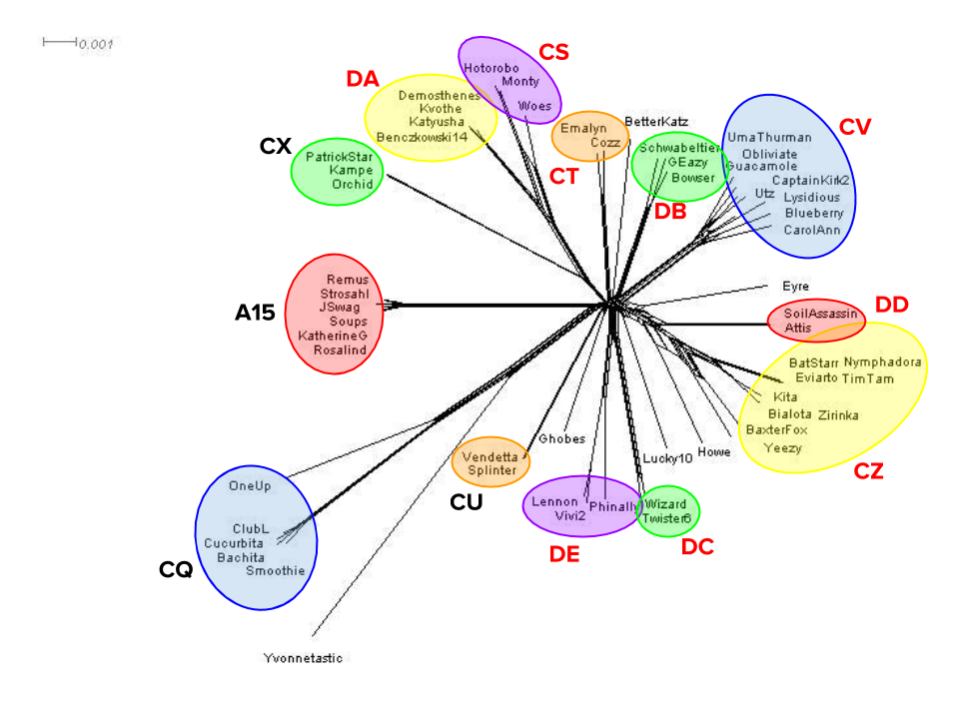
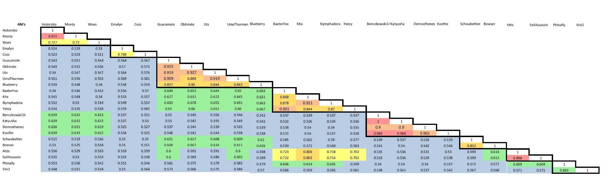
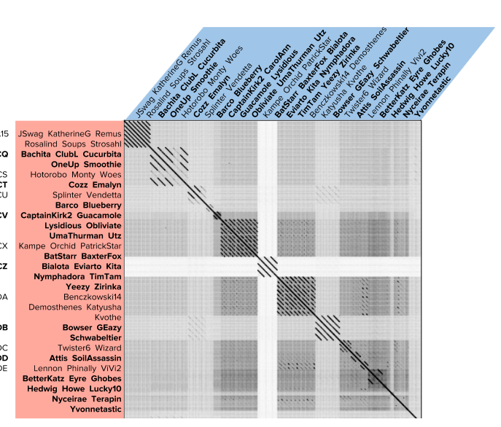
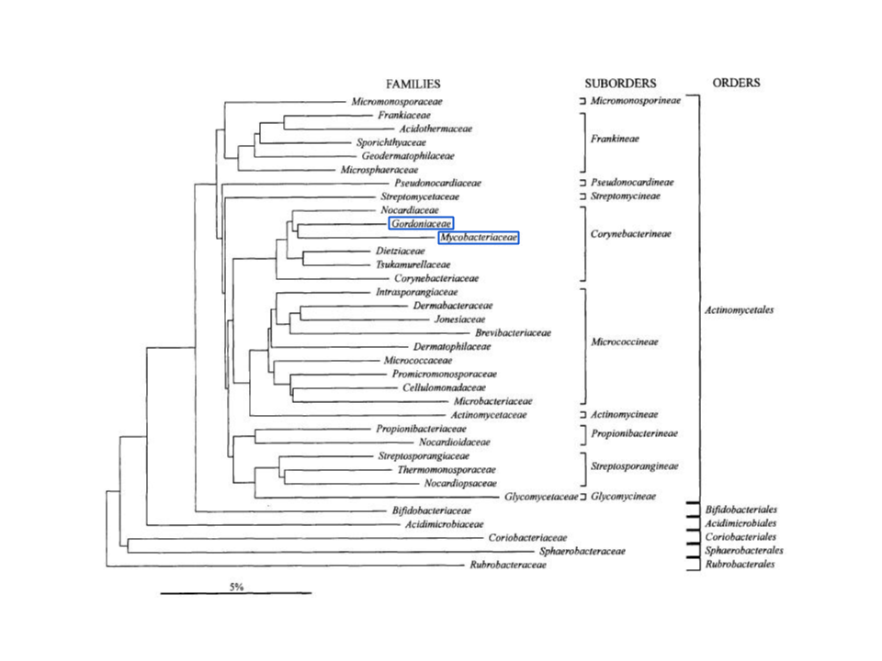
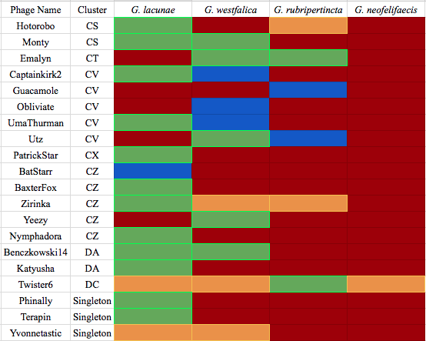
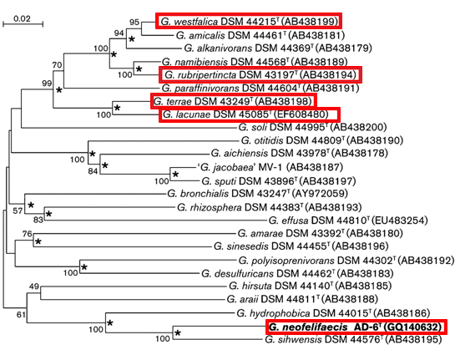
Isolation and analysis of a collection of Gordonia terrae phages reveals novel aspects of lysis, virion morphology, and host range
Matthew Benczkowski, Melanie Umbaugh, Pitt SEA-PHAGES 2015-16 students, Rebecca Bortz, Emily Furbee, Sarah Grubb, Deborah Jacobs-Sera, Matthew Montgomery, Marcie Warner, Welkin Pope, and Graham Hatfull
University of Pittsburgh Department of Biological Sciences
Abstract
Analysis of more than 1,000 Mycobacterium smegmatis bacteriophage (mycobacteriophage) genomes allowed significant insights into phage diversity and evolution. To gain a broader perspective on phage biology, University of Pittsburgh students utilized an alternate host, Gordonia terrae 3612, during the 2015-16 academic year. G. terrae is a member of the same taxonomic order (Cornyebacterium) as M. smegmatis; this relatedness should allow analysis of the distinct evolutionary pressures that affect different classes of phage genes. Isolation of Gordonia phages may also have medical and industrial applications: Gordonia species are implicated in catheter-related infections in humans and as contributors to wastewater sludge. Pitt students isolated 182 Gordonia phages; 30 of which have been sequenced and annotated. These Gordonia phages have been categorized into 8 clusters and 12 singletons, which suggests they may rival the mycobacteriophages in diversity. The genomes of these phages average 54,897 bp in length (ranging from 41,857 bp [Nyceriae] to 98,136 bp [Yvonnetastic]), 65.4% GC content (ranging from 58.9% [Hotoboro] to 68.4% [Phinally]; .G. terrae GC content 67.8%), and 88 genes (ranging from 66 [Emalyn] to 198 [Yvonnetastic]). Gordonia phage genomes share similar architecture with mycobacteriophages: the left arm contains many virion structure and assembly genes, genes involved in lysogeny (if present) are centrally located, and the right arm is frequently rich in DNA metabolism genes, orphams, and genes for which a function cannot be identified. Despite genome architecture similarities to the mycobacteriophages, the Gordonia phages display a number of distinct attributes. The enzymatic functions of typical mycobacteriophage lysin As are commonly separated into two polypeptides in Gordonia phages and lysin B genes are found in unexpected locations. Numerous phages isolated on G. terrae were also able to infect one or more of the following hosts: G. lacunae, G. westfalica, G. rubripertincta, and G. neofelifaecis. This promiscuity in host range is rarely observed in the mycobacteriophages. Gordonia phages also exhibit distinct aspects of virion morphology. Gordonia phages frequently possess exceptionally long, flexible tails; tape measure genes in Hotorobo, Benczkowski14, and Katyusha range in size from 9,084 bp to 9,984 bp are among the longest such genes discovered. To date, Pupper is the sole contractile tailed Gordonia phage that has been identified. Furthermore, cluster CZ (composed entirely of Gordonia phages) is the first cluster to contain phages with both prolate and isometric capsids; this can likely be attributed to the discovery of variability in the major capsid gene present in individual members of this cluster. These distinctive aspects of Gordonia phages, combined with the discovery of a large collection of new orphams in these phages, support the notion that the phage population is vast and continually expanding.
Gordonia Phages are Highly Diverse
Multiple Capsid Morphologies Observed in Cluster CZ
A)
B)
CS
CT
CV
CZ
Key:
DA
DB
A)
BaxterFox
Capsid Type and Corresponding Major Capsid Pham of Cluster CZ Phages
Phage: | Yeezy | BaxterFox | Bialota | Eviarto | Kita | Nymphadora | TimTam | BatStarr | Zirinka
Capsid Type: | Isometric | Isometric | Prolate | Prolate | Prolate | Prolate | Prolate | Prolate | Prolate
Major Capsid Protein Pham: | 9768 | 9768 | 2033 | 2033 | 2033 | 2033 | 2033 | 2033 | 2033
DD
DE
C)
University of Pittsburgh’s Gordonia phages sort into...
9 Clusters | 12 Singletons
B)
Eviarto
Cluster CZ is the first cluster known to contain both isometric- and prolate-capsid phages. A pairwise comparison of BaxterFox (A, Isometric) and Eviarto (B, Prolate) shows that there is no nucleotide similarity in the region containing the major capsid protein, but there is significant similarity throughout the remainder of the genome. Capsid type corresponds to a unique set of phams.
A) A Splitstree diagram of Gordonia phages displays cluster relationships. This tool creates a network based on pham content. B) Average Nucleotide Identities (ANI) of Gordonia phages. The coloring represents the degree of similarity, as shown in the key. ANI values give a representation of overall genome similarity because they are calculated using a sliding window that accounts for mosaicism. The clusters, outlined in black, usually shared high ANI values with the exceptions of the CS and DE clusters. C) Dot Matrix of Gordonia phages. The genomes listed beside the plot are weighted against the genomes along the top in a pairwise comparison using Gepard. If the sequences match, a dot is drawn, creating solid lines for very similar genomes and fragmented lines for less similar genomes.
Introduction to Gordonia terrae
Common soil bacterium
Contributor to the foaming of wastewater sludge⁶
Identified in catheter-related infections in humans²
Member of the same taxonomic order as Mycobacterium smegmatis⁵
Comparative genomic analysis of phages isolated on closely related hosts may reveal interesting insights into phage evolution
Gordonia Phages Readily Infect Other Hosts
Lysis Gene Arrangement in Gordonia Phages Shows Unique Structuring
A)
A)
¹
Mycobacteriophages
Damien
Enzymatic Domains of Separated Lysin As
CaptainTrips
Benczkowski14 | Muramidase, peptidase
Katyusha | Muramidase, peptidase
Hotorobo | Muramidase, peptidase
Emalyn | Peptidase, glycoside hydrolase
Yvonnetastic | L-Ala, D-Glu, glycoside hydrolase
B)
Top row – Terapin
Middle row – BetterKatz
Bottom row – Utz
Phage
Lysate
Concentration
Benczkowski14
G. terrae phages infect other Gordonia species
The indicated phages were serially diluted (10⁰ to 10⁻⁵) and 3ul were spotted on lawns of the indicated Gordonia hosts on PYCa medium and incubated at 30℃ for 3 days.
³
Katyusha
Gordonia terrae is an effective new host organism for SEA-PHAGES
Phages are isolated at the same frequency as mycobacteriophages
Required addition of 10% glycerol to phage buffer for stability
Phage diversity is equal to mycobacteriophages
G. terrae is naturally resistant to low levels of ampicillin
Hotorobo
Phylogenetic Tree Showing Relationship Between Gordonia strains
This tree shows how G. lacunae is closely related to G. terrae, while G. westfalica and G. rubripertincta are further related. This follows the trend of infection.
C)
Emalyn
Phylogenetic Tree Showing Relationship Between Gordonia strains
This tree shows how G. lacunae is closely related to G. terrae, while G. westfalica and G. rubripertincta are more distantly related. G. neofelifaecis is much more distantly related. This follows the trend of infection.
Yvonnetastic
University of Pittsburgh SEA-PHAGES ‘15-’16 Year in Review
Number of Students: | ~ 200 undergraduate students
Number of Phages Isolated: | 182 phages
Number of Phages Sequenced: | 30 genomes
Number of Completed Genomes Uploaded to GenBank | 19 annotated and submitted
Average Genome Length: | 54,897 bp
Average GC Content: | 67.8%
Average Number of Genes: | 88 genes
Host Range and Ability to Infect
There is no clear correlation between clusters, minor tail proteins, or pham and the ability to infect other hosts.
Comparing mycobacteriophages⁴ to Gordonia phages, the arrangement of the lysis genes varies greatly. Lysin As can be split into two polypeptides, the distance between Lysin A and Lysin B can be as great as 50kbp, and the genes immediately follow the tail proteins. The table shows the enzymatic domains of the lysis genes of the Gordonia phages with the unique structuring.
Conclusions
Gordonia phages rival Mycobacteriophages in diversity.
Gordonia phages exhibit unique arrangements of lysis genes.
Cluster CZ is the first to contain isometric and prolate capsid morphologies.
Gordonia terrae phages are able to readily infect other Gordonia species.
Gordonia terrae represents a useful alternative host organism for the SEA-PHAGES program.
Future Directions
Continue to isolate, sequence, and annotate additional Gordonia phages.
Further investigate the mechanism of expanded host range.
Review cluster assignments and establish new subclusters.
References:
Forrest, Wertz, Zhuang. 2016. “Comparative Analysis of Gordonia terrae bacteriophages’ capacity to infect other Gordonia hosts and the genomic differences that may cause this.”
Johnson et al. "Gordonia Bronchialis Bacteremia and Pleural Infection: Case Report and Review of the Literature." Journal of Clinical Microbiology. American Society for Microbiology, 03 Apr. 2011. Web.
Liu et al. 2011 "Gordonia Neofelifaecis Sp. Nov., a Cholesterol Side-chain-cleaving Actinomycete Isolated from the Faeces of Neofelis Nebulosa." Microbiology Society Journals. Microbiology Society, 01 Jan. 2011. Web. 07 June 2016.
Payne, Kimberly M., and Graham F. Hatfull. "Mycobacteriophage Endolysins: Diverse and Modular Enzymes with Multiple Catalytic Activities." PLOS ONE. Journals.org, 28 Mar. 2012. Web.
Stackebrandt et al. 1997. “Proposal for a New Hierarchic Classification System, Actinobacteria classis nov.” International Journal of Systematic Bacteriology. Microbiology Society, April 1997. Web.
Yassin et al. "Gordonia Malaquae Sp. Nov., Isolated from Sludge of a Wastewater Treatment Plant." National Center for Biotechnology Information. U.S. National Library of Medicine, May 2009. Web.

