Slide 1

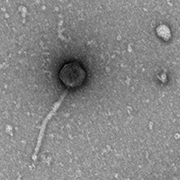
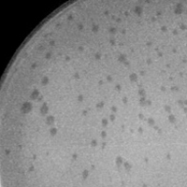
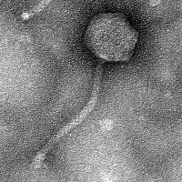
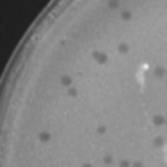
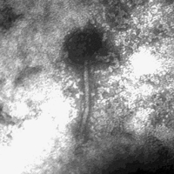
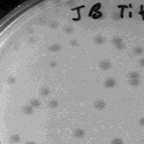
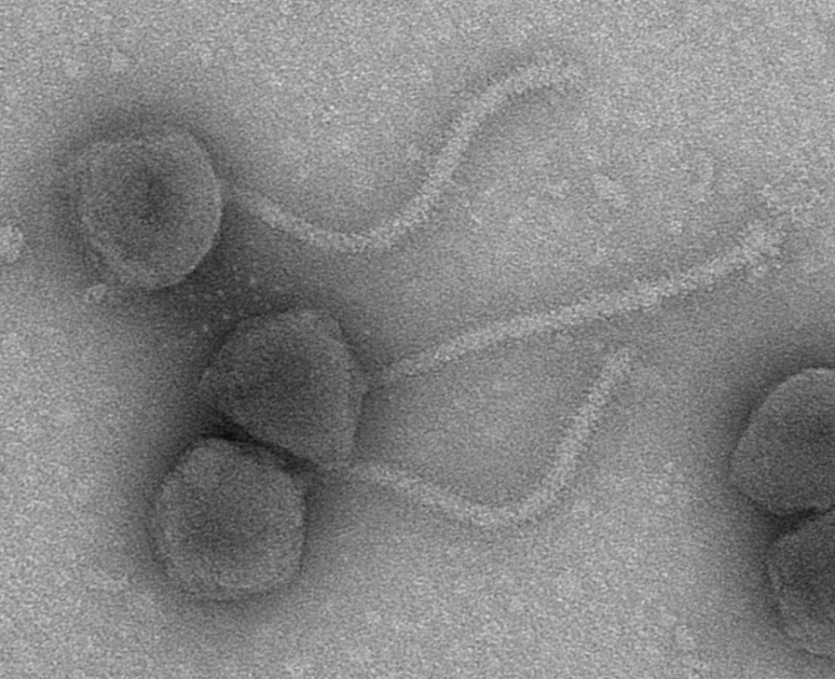
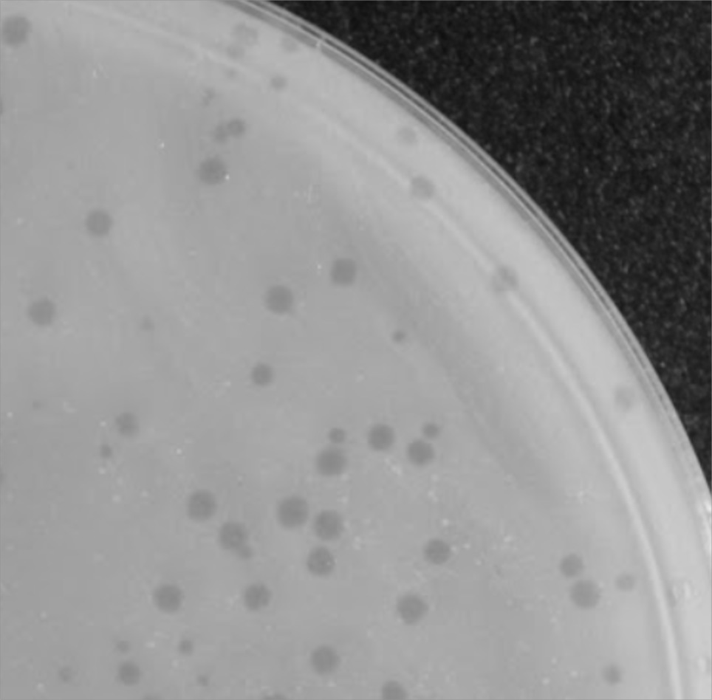
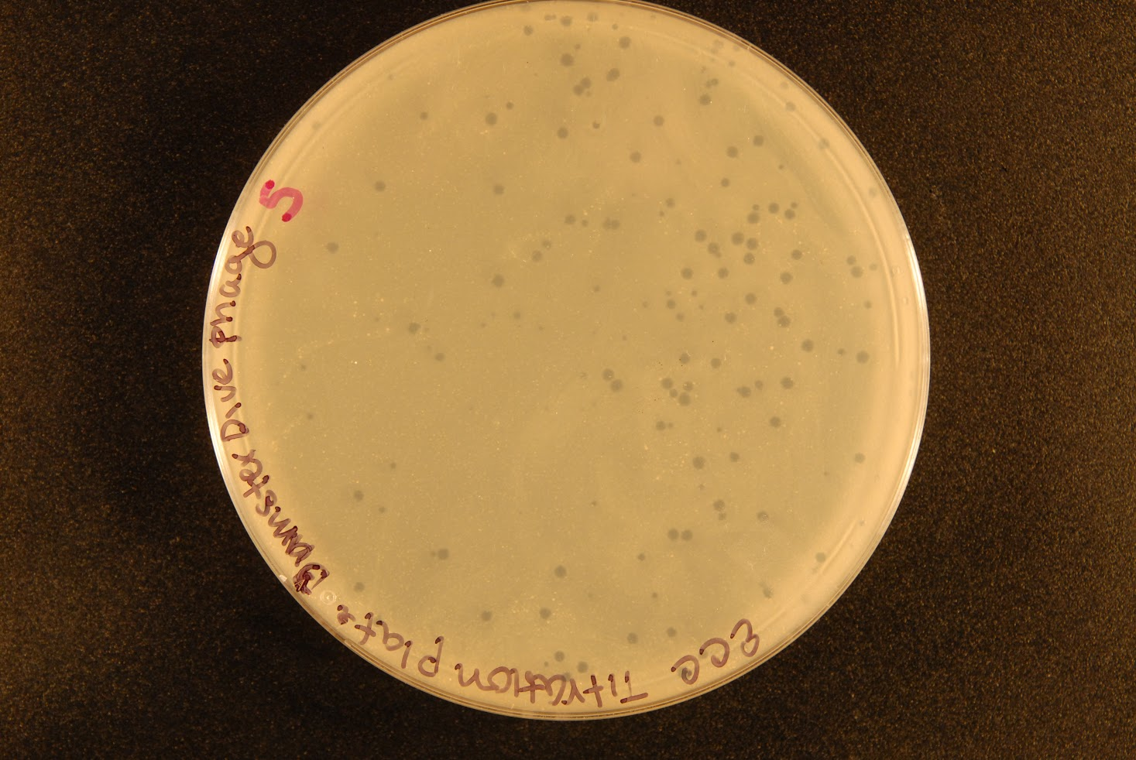
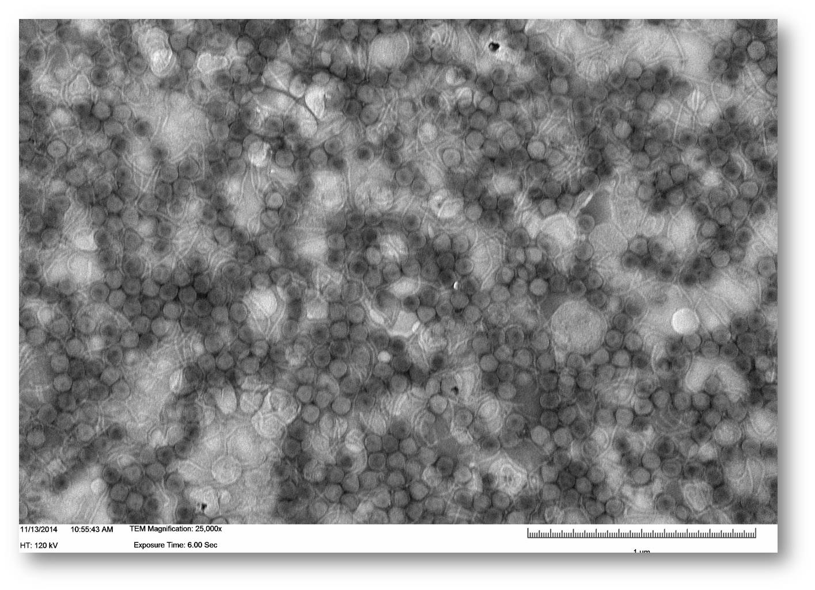
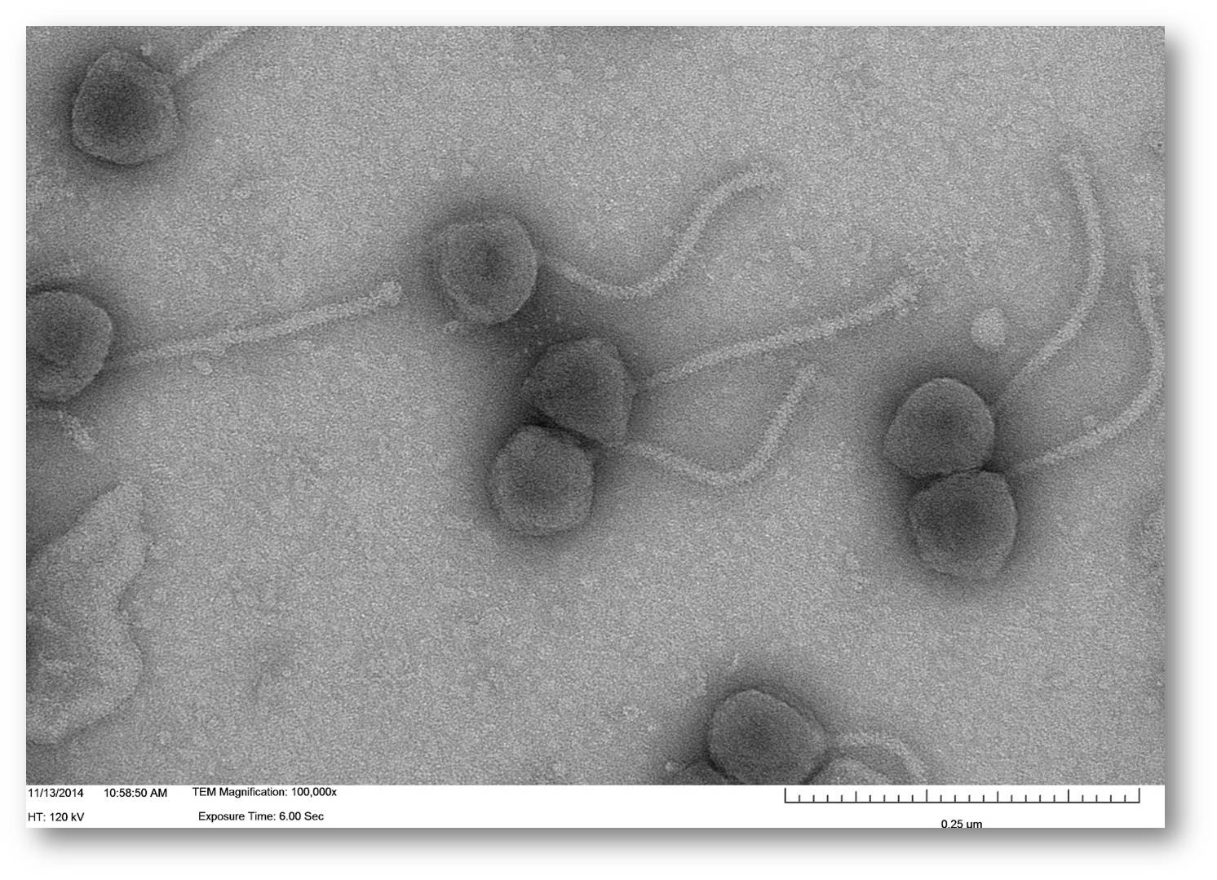
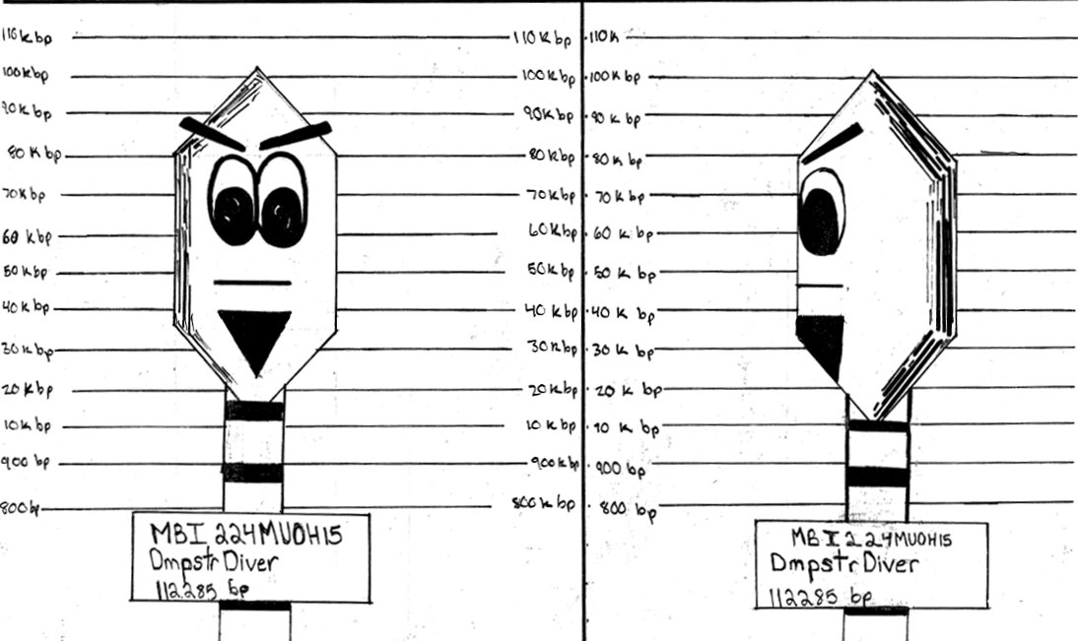
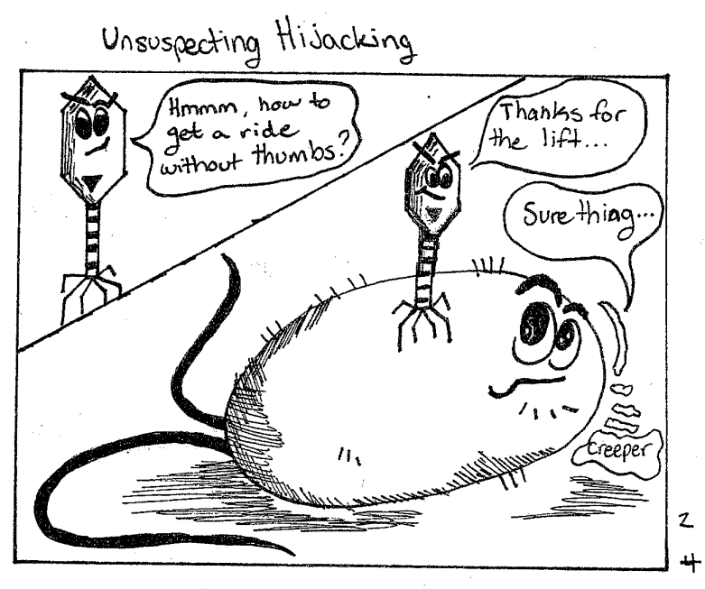
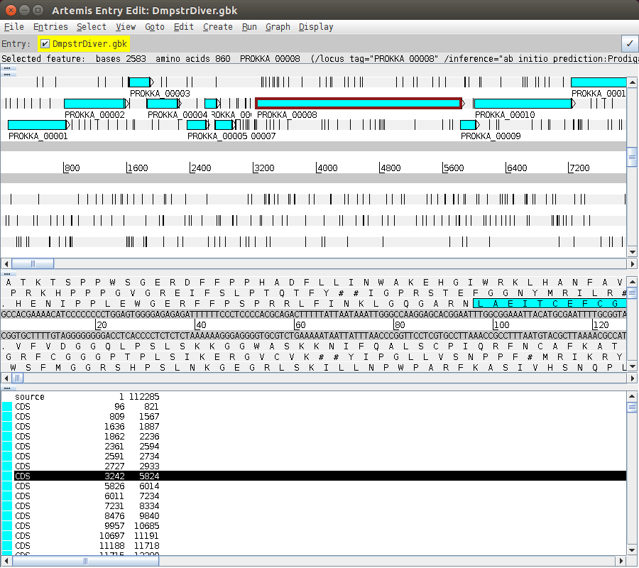
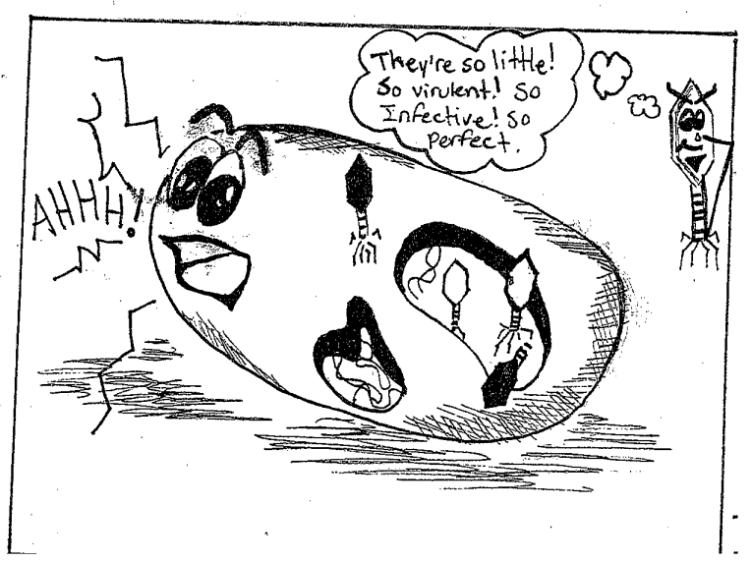
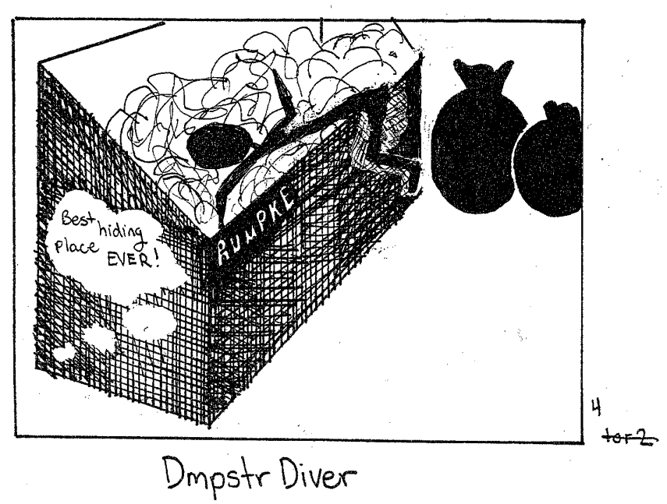
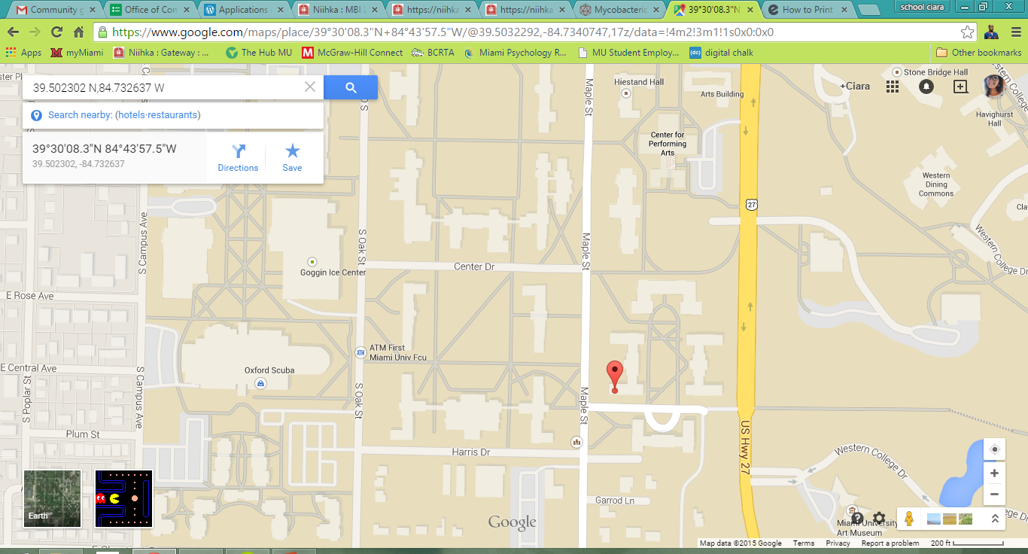
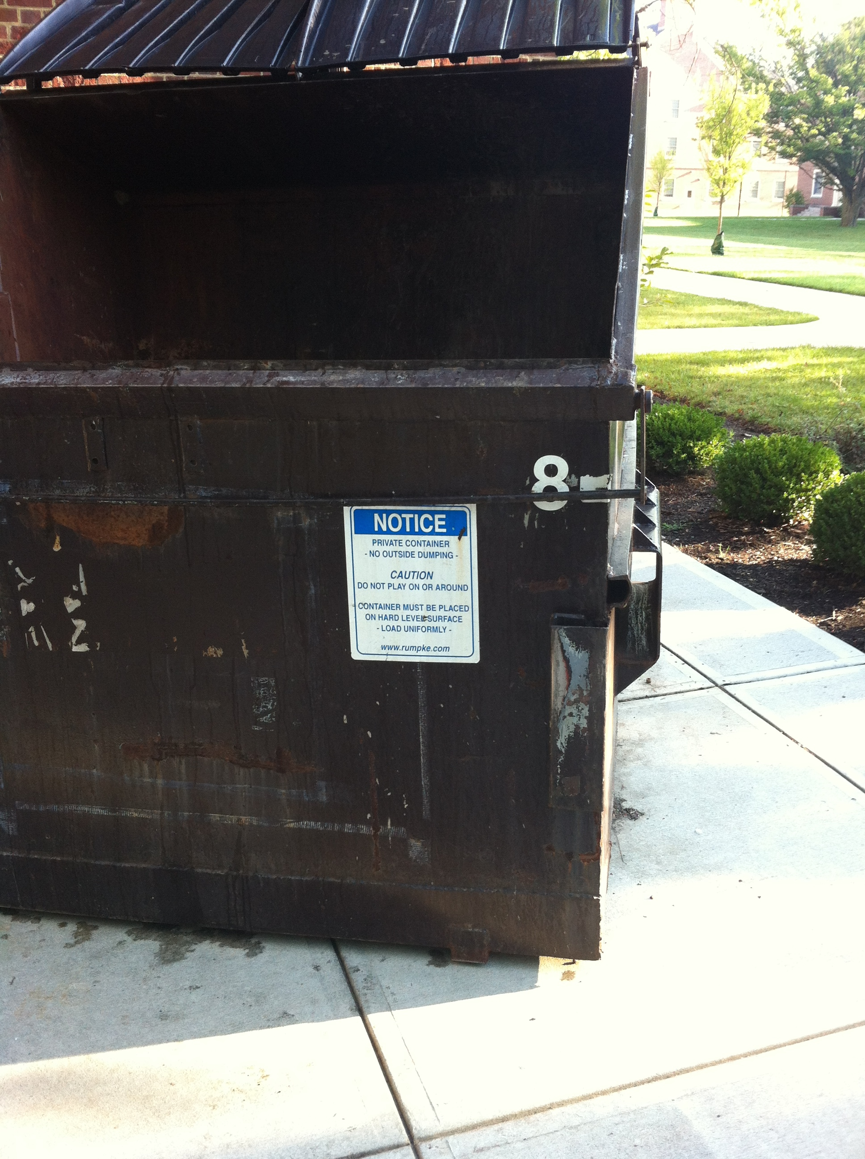
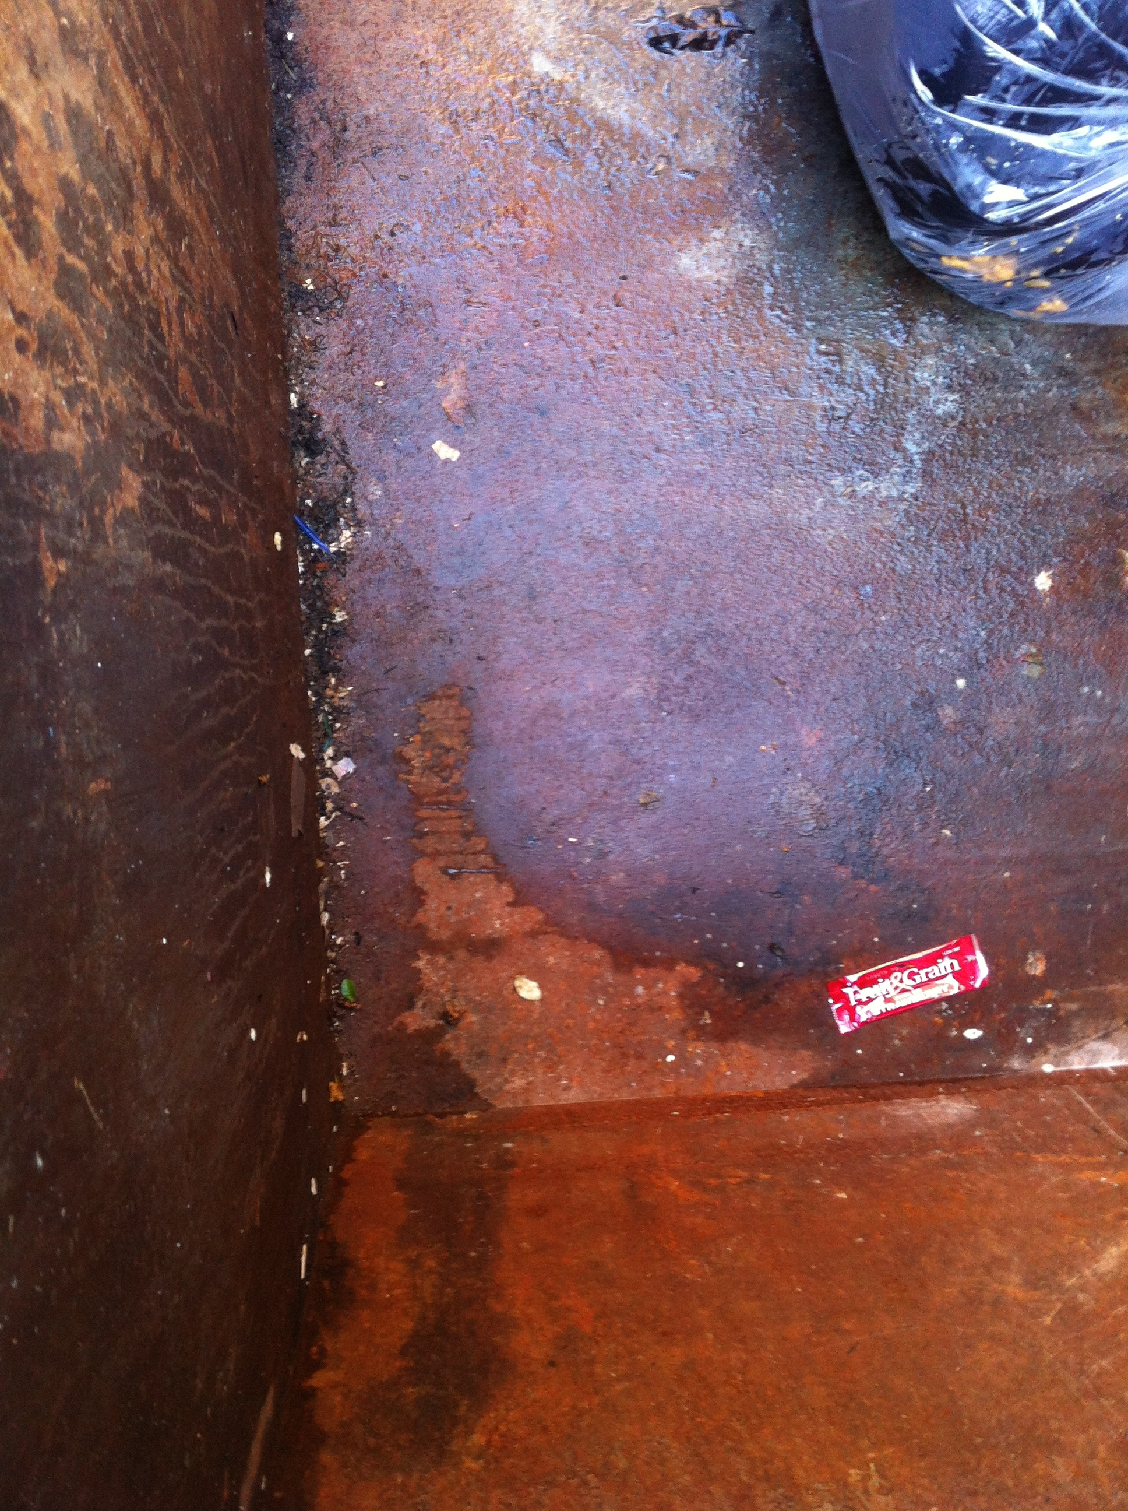
DmpstrDiver: It’s Just a Phage
Elsa Clenny, Jana Cable, Martha Carter, Justin Crookes, Conor Ferrall, Rachana Gollapudi, Sarah Hiner, Pierce Kurek, Ciara Lawson, Geneva Mommsen, Sammi Podolyan, Leah Stetzel, Julie Donna, Ryann Brzoska, Gabrielle Lopez, David Ream, Mitchell Balish, Iddo Friedberg, Gary Janssen.
Abstract
The J Cluster
Discussion
Minerva
Redno2
Wanda
DmpstrDiver
DmpstrDiver, a mycobacteriophage isolated from within a dumpster on a diverse college campus during move-in season presented with a multitude of interesting complexities. The origins of DmpstrDiver are slightly unknown due to the multitude of environments trash is found prior to the dumpster (location of isolation). A pinprick lytic morphology also suggested that DmpstrDiver was uncommon. After genomic analysis, the phage was found to be a member of the J cluster, further supporting the uniqueness of the phage. The other seventeen members of the J cluster showed very similar genome size, GC content, genes, tRNAs, and plaque morphology. Slight variation were observed within the phage morphology in tail length, and hook proteins. After annotation through a new program, Artemis, DmpstrDiver was found to contain genes encoding for a tRNA for glycine, as well as an integrase usually associated with lysogeny. This proved interesting as DmpstrDiver showed a lytic morphology, as did many other J cluster phages suggesting the possible repression of the repressor protein itself. DmpstrDiver’s low GC content of 60.6% suggested the ability to infect other Mycobacterium species which was supported by many genes showing homology with other species.
We have isolated a J cluster mycobacteriophage from a dumpster outside a student residence hall at Miami university (Oxford, OH) by enrichment culture using Mycobacterium smegmatis as a host. The phage, named DmpstrDiver, was isolated through six rounds of purification an consistently yielded lytic plaques of variable size. Electron microscopy revealed phage particles with a distinct head shape and a tail of constant length and morphology The 112,285-base pair genome of DmpstrDiver encodes approximately 230 genes (pending final annotation) and a single tRNA for glycine. There is extensive synteny with other phages from cluster J, including large blocks in which predicted amino acid sequences are 100% identical to any of various other J phages, suggesting strongly that recombination is a major evolutionary mechanism for generation of new phages, which in turn suggests that co-infection is likely. There is also a low GC content of 60.6%, as well as a very small number of unique genes and genes that share homology only with chromosomal genes from other Mycobacterium species.
Genome: 109,871
GC content: 60.7%
Genes: n/a
RNA: n/a
Genome: 108,297
GC content: 60.9%
Genes: n/a
tRNA: n/a
Genome: 109,960
GC content: 60.8%
Genes: n/a
tRNA: n/a
Genome: 112,285
GC Content: 60.8%
Genes: 227-230
tRNA: 3
Results
Methods
Figure 2: Plaque morphology of DmpstrDiver. Small lytic plaques are observed with little plaque density.
Sample was collected from residue within a dumpster.
Phage was isolated through enrichment, providing an ideal growth environment.
Phage was purified and plated with Mycobacterium Smegmatis.
  Multiple streaks were done to further purify the phage.
  Due to contamination, 25µL Chloroform was added to dilutions of purification 5.
A stock solution was created with a titer of 5.36 x 10⁷ PFUs/mL.
Phage morphology was observed through transition electron microscopy.
DNA was extracted and analyzed by the Pittsburgh Bacteriophage Institute.
The genome was then annotated using Genemark, Artemis, and BLAST.
Protein functions were then predicted using interProScan.
Future Application
A
B
We plan to further address the question: Does DmpstrDiver infect other Mycobacterium species beyond Mycobacterium smegmatis. We hope to test DmpstrDiver on Mycobacterium tuberculosis with a goal of improving the lives of patients with TB.
Figure 3: Electron micrographs displaying phage morphology of DmpstrDiver. Figure A shows a high density of phage at 25,000x magnification. Figure B shows phage morphology at 100,000x magnification. Relatively strong capsid structures are observed with medium length tails and small hook proteins.
Isolation
Figure 4: DmpstrDiver contains a genome length of 112,285bp translating to 227-230 genes. Within this genome there is a low GC content of 60.6%. DmpstrDiver was found to be a member of the J cluster of phages making it relatively unique. This genome was found to encode for capsid proteins as well as proteins associated with hydrolysis, including nucleases, transcription factors, a possible RNA ligase and an integrase.
A
B
C
Figure 1: Location of isolation of DmpstrDiver. Figure A presents the exact coordinates of isolation, while figures B and C show the dumpster and soil collected from within.
References:
1 Hatfull, G. Bacteriophages: Nature’s Most Successful Experiment (2008) Microbiology Today Nov: 189.
2 Hamilton, G. Virology: The Gene Weavers (2006) Nature 441: 683-85.
Acknowledgments: Miami University Center for Advanced Microscopy and Imaging, Howard Hughes Medical Institute, Pittsburgh Bacteriophage Institute, SEA Phages Program.

