Slide 1
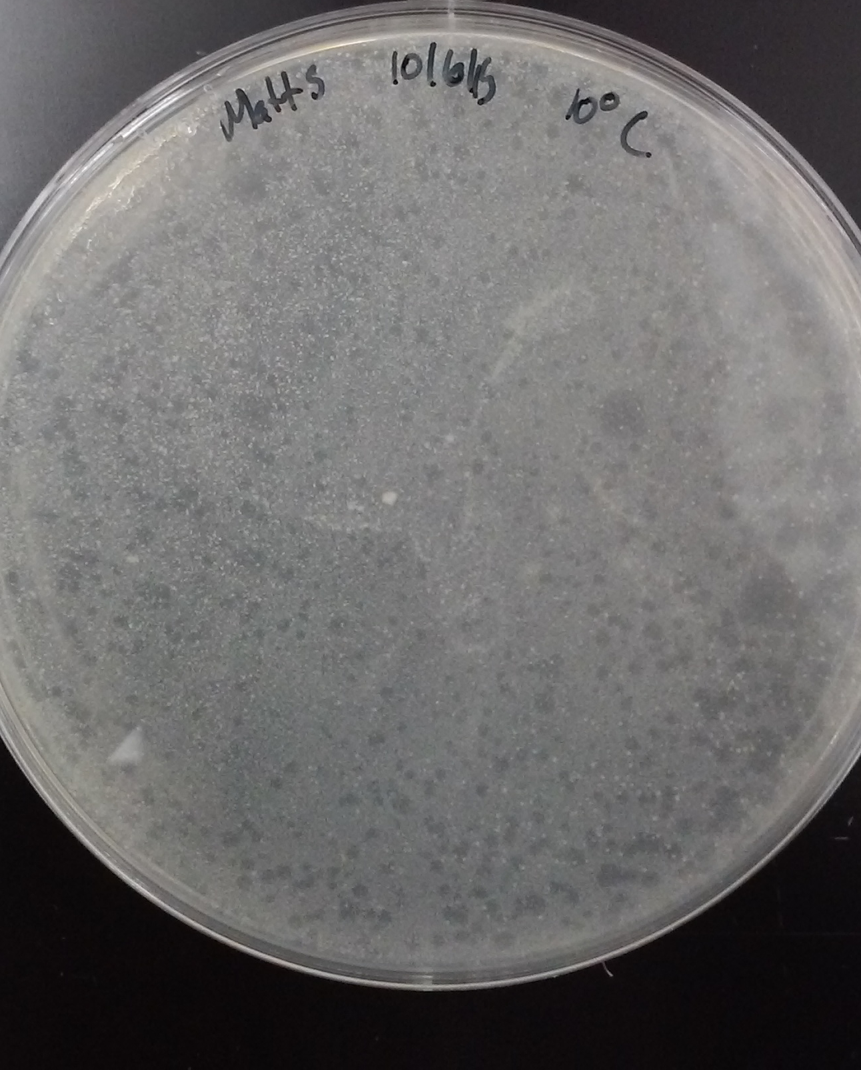
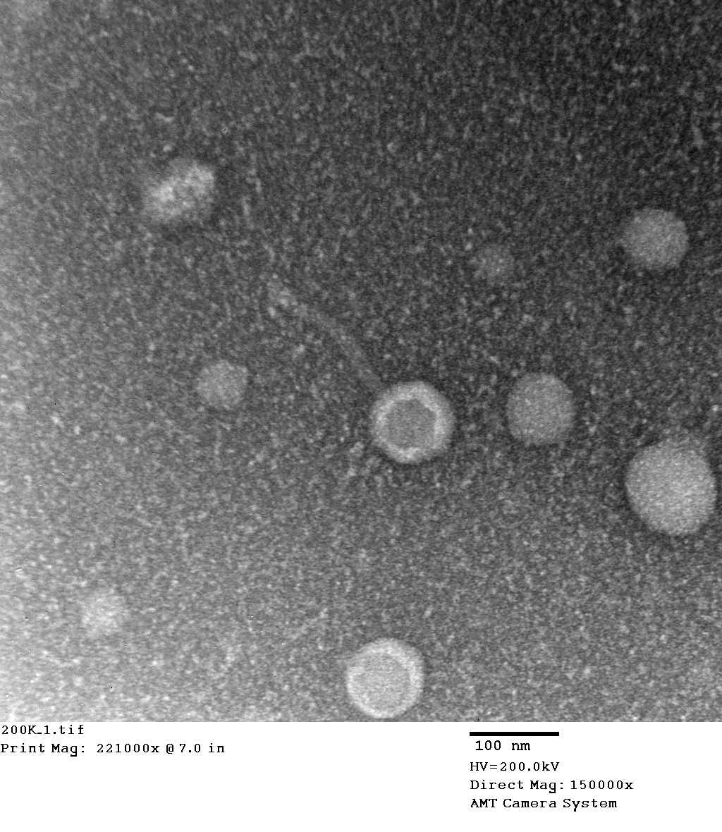
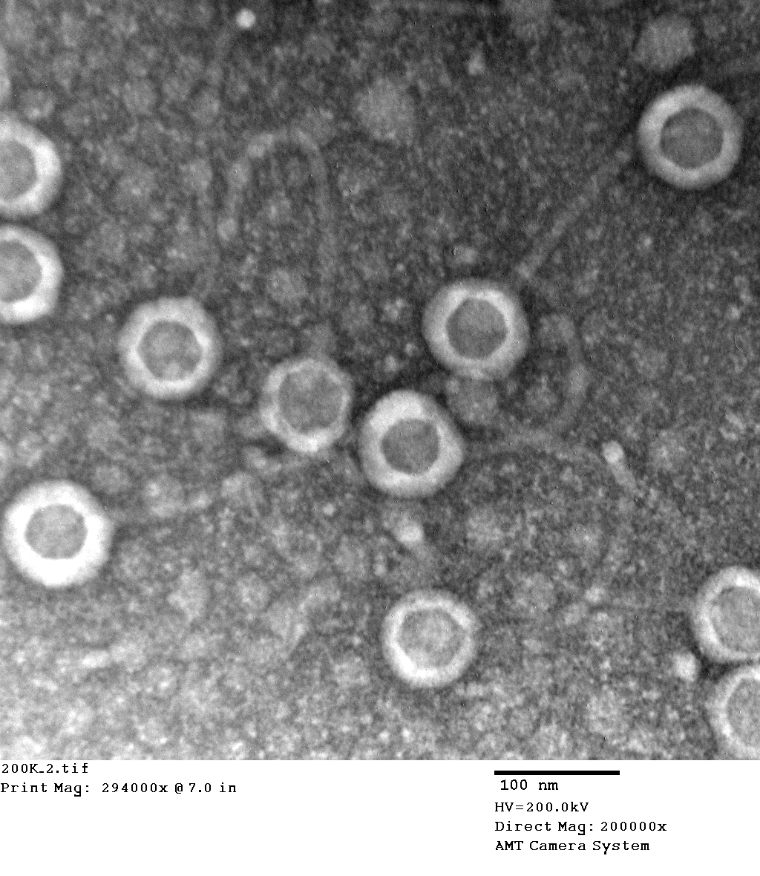
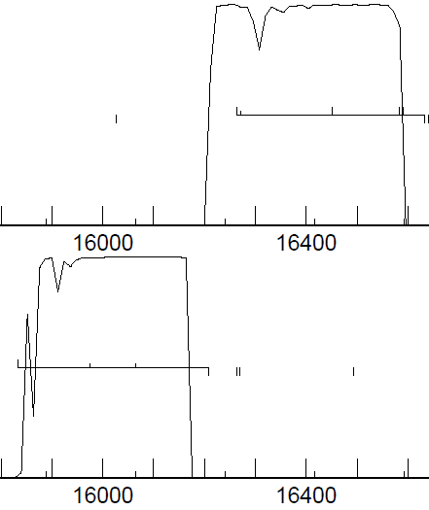
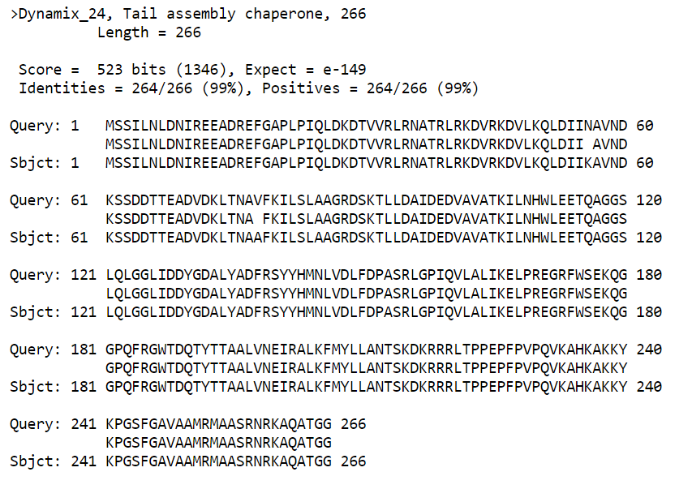
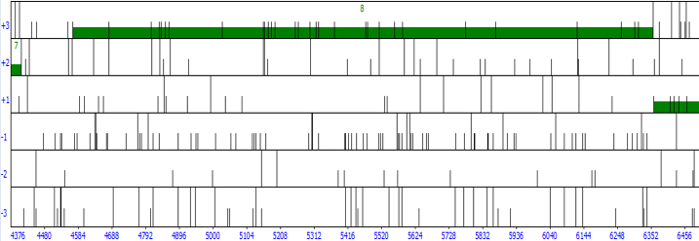
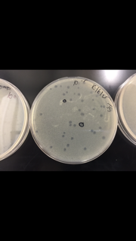
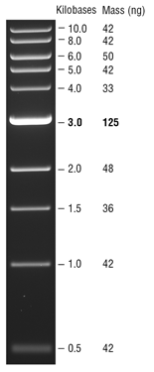
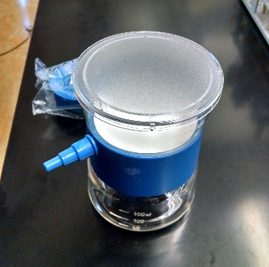
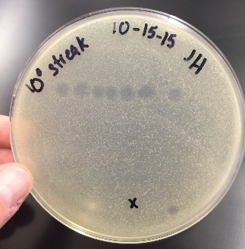
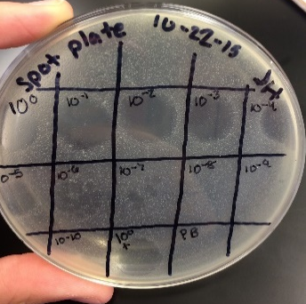
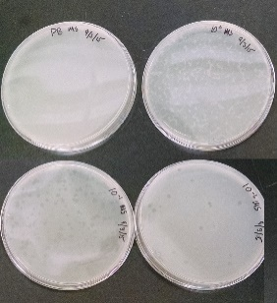
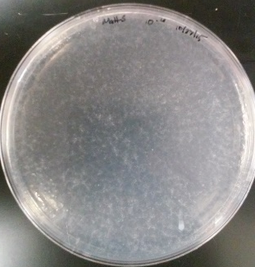
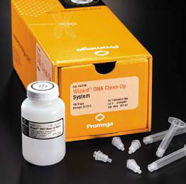
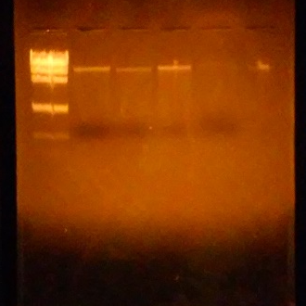
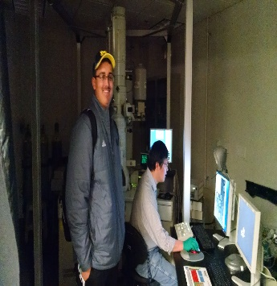
Here to be Phamous:
Discovery and Analysis of Briton15 and Timmi
Matthew Stander, Joshua Sannes, Dr. Ken Saville, Dr. Ola Olapade
Albion College, Albion, MI
Abstract
Bacteriophage, or phage for short, are a type of virus that use bacterial cells as their host. Because phage infect bacteria and there are an increasing number of antibiotic-resistant bacteria strains, research is currently being conducted to utilize phage as an alternative treatment for bacterial infection and disease. The purpose of our project was to isolate and purify a novel bacteriophage and then annotate its genome. We isolated phage using Mycobacterium smegmatis as the host. This bacterium comes from the same genus of bacteria that causes tuberculosis. In this project, we each isolated, purified, and annotated our own phage. To isolate bacteriophage, we collected and filtered dirt. Various phage strains were in the filtered dirt solution so we then purified a single phage strain through several processes consisting of serial dilutions, spot platings, and streak platings. Once we purified a single phage, we isolated and extracted its DNA. The DNA of both of our phages were sent to the SEA-PHAGES project to be sequenced. Once we received our sequenced phage DNA, we annotated it using several programs including DNA Master, Phamerator, Starterator, NCBI BLAST, and HHPred. Each of us further looked into a gene that we annotated that was unusual or challenging. Overall, we successfully isolated and purified a novel bacteriophage and annotated its genome. Our findings will advance the understanding of bacteriophages and bacteriophage gene function, which will hopefully lead to the development of phage therapy treatments.
Introduction
A bacteriophage, or phage for short, is a type of virus that infects and replicates inside a bacteria cell. A phage consists of protein capsid that encapsulate a DNA or RNA genome and a protein tail. Though they are not considered to be alive, phages largely affect the world today. Currently, research is being conducted for the use of bacteriophage as an alternative treatment to antibiotics. This works by introducing a strain of phage into a patient that attack a bacterial infection, all without harming the patient. With an increasing amount of antibiotic-resistant strains of bacteria, phage therapy may be the next new treatment. Also, with the arrival of a new genomic field, bacteriophage give a better understanding of annotation.
The goal of our project was to isolate and purify a novel bacteriophage and then annotate its genome.
Timmi
Briton 15
Conclusions
Function of the 8th Gene
The 8th gene is a phage portal protein. The purpose of this gene is to form a location for the DNA to pass through during packaging and ejection. This gene specifically forms the junction between the head of the phage and the proteins of the tail
After successfully isolating and purifying Briton15, we were able to take electron micrographs to view the phage’s morphology. The next task at hand was to annotate Briton15’s genome.
Timmi
After completing the identification and annotation of the phage Timmi, we have determined that Timmi is a B1 cluster phage and it has a length of 68,246 bp. Overall, Timmi’s genome was not all that complex. There were a few subtractions of genes due to their length and that was the only complication that occurred throughout the entire annotation process.
Figure 4. A view of the coding potential for the phage Timmi. This view is specifically the portion of coding potential that is covered by the 8th gene. The 8th gene completely covers this coding potential because of an extension in the start codon to lengthen the gene and lessen the gap that was between the 7th and 8th gene. Shortens the gap between 7 and 8 by 14 bp and this also moves it closer to being the Longest Reasonable Open Reading Frame. With this extension, the gene is completely covering this potential by extending to 4552 and covering the very beginning of the coding potential.
Phage Coordinates | 39.255 N, 76.713611 W
# Genes | 92
Genome Length | 53032 bp
GC Content | 63.7%
Figure 7. Briton15 has small lytic plaques with a high density on the plate.
Figure 8. Electron micrograph of Briton15 taken at Wayne State University. Magnification of 150,000x shows phage morphology. There is a capsid of about 100 nm and a tail of about 160 nm.
Briton 15
After annotating Briton15, we have found that it is a cluster A1 phage with 92 genes and a length of 53,032 bp.
Based on a variety of different evidence and criteria, I chose to combine gene 22 and gene 23 into one frameshift gene.
The function of the frameshift gene is a tail assembly chaperone. A tail assembly chaperone is actually 2 proteins that assist in the assembly of the major tail subunit around the tail’s core.
Based upon the results of our PCR experiment, the section of Briton15’s genome appears to be specific to Briton15. However, examination of a greater amount of phage genomes would provide greater accuracy in determining if the section is specific to Briton15.
9a.
9b.
Figure 9a. Coding potential of genes 22 and 23.
Figure 9b. Original Open Reading Frames for genes 22 and 23.
In both maps, genes 22 and 23 are extremely close to each other but on separate reading frames.
23
22
Methods
Briton15 and Timmi were discovered and isolated using similar methods described in Figure 1.
To annotate the DNA sequence, we used various programs consisting of:
DNA Master auto-annotates the genome using Glimmer and GeneMark and allows user analysis to edit the annotation if necessary.
Phamerator provides a visual comparison of similar phage genomes
Starterator provides a map of starts that were called by similar genes.
NCBI pBLAST compares the amino acid sequence of a gene to a database of other gene sequences.
We also used the lab protocol “Annotation and Bioinformatics Analysis of Bacteriophage Genomes” to guide us through this process.
Figure 10. pBLAST result from the frameshift gene (genes 22 and 23). The 1:1 alignment and 99% amino acid match are evidence that this was a frameshift gene. Gene 23 makes up the first part of the frameshift gene and gene 24 makes up the second part, starting at the yellow line (118 bp).
Figure 3. Electron micrograph of Timmi taken at Wayne State University with a magnification of 200,000x.
Figure 11. The sequence of nucleotides and the resulting amino acids from different reading frames. The end of gene 22 is shown in red and the beginning of gene 23 is shown in light blue. The yellow line shows where the frameshift occurs. The green box shows the codon for the ‘G’ in the sequence ‘QAG’ and the purple box shows codon for the ‘G’ in the -1 frameshift. The light blue box shows the new sequence of amino acids in the frameshift gene.
Possible future areas of study for this project are to investigate the efficacy of the viruses on Mycobacterium tuberculosis and
determine the function of the genes with no known function.
Figure 5. This is a view of the 8th gene of Timmi found through DNA Master. This is the frames image of Timmi before the extension of the start. Timmi was able to be extended without having it’s 7th and 8th gene being too close together. Also, with the placement of these two genes on separate reading frames, it gives the 8th gene a better option by not closing the bp gap by too large of an amount.
The final annotated gene started at 15837 bp and ended at 16636 bp, giving it a length of 799 bp.
Though there was an upstream start that would have extended the ORF, it had a TTG start codon which is not very common. There was also a start with better Z, Final, and SD values, but it greatly reduced the ORF.
I chose this start position because it did not reduce the ORF and ribosome binding site had a good values (z=1.659, Final=-5.697, 2nd best SD).
All coding potential is now covered in the frameshift gene. The steep drop and rise in coding potential (Figure 9a) was another indicator that genes 22 and 23 were part of a frameshift.
BLAST data aligns 1:1 at a high percentage of amino acid matches with several genes such as Perseus gene 22 and Dynamix gene 24 which have the same function.
Acknowledgements
Special thanks to:
Dr. Ken Saville and Dr. Ola Olapade
for advising us through the project
Our Virus Hunters and Virus Tamers Classes: Ashley Audisho, Warren Smith, Jephte Jean Claude, Will Colborn, Rebecca Enerson, Bailee Huhta, Sydney Hogg, Felicia Soto, Brigette Kobs, Aimee Gama, Jacquelyn Harbin, Jordan Gembarski, Molly Collins, Travis Mersino, Megan Bertels, John Calhoun, Briana Flanagan, Keena Gilbert, Robert Hays, Robert Joerg, Jonathan Lewis, Laurel McGerty, Matthias Osterndorf, Noah Pappas, Alexandra Radzville, Cezara Siotean, Henry Swett, Kiana Thomas, Leah Zawerucha, Dana Anderson, Angela Walczyk, Taylor Sokoloskis, Evan Andreski, Khaila Royster, Matt Myers, Megan Munger, Hannah Whitaker, Brendan McClorey, Connor Healy
The Howard Hughes Medical Institute SEA-PHAGES Program
The Biology Department at Albion College
Finding a region of DNA specific to Briton15 through PCR
To determine the DNA sequence to use for the PCR primer, we compared Briton15’s genome to other phage genomes (Dynamix, Wheeler, and Timmi) using a Phamerator map.
We then input the proposed Briton15 specific DNA sequence into primer BLAST to identify primer sets that would bind to our sequence.
We used the custom primers to amplify the amount of specific DNA sequence using PCR. As a negative control, we ran a PCR with no DNA. To test if the DNA sequence was only in Briton15, we ran a PCR using Briton15’s custom primers with Timmi’s DNA. We then ran a gel electrophoresis on the PCR products.
1 kb ladder
MM - No DNA
MM - Briton15
MM - Timmi
MS - NO DNA
MS - Briton15
MS - Timmi
Collected dirt from the Whitehouse Nature Center at Albion College
Incubated dirt samples with enrichment media and SMEG
Centrifuged then filtered supernatant to rid solution of debris
Figure 6. Timmi with large plaques at a lower total amount of plaques.
Figure 2. (Below) Below shows the similarities between Timmi, Vista, and Vivaldi. Overall, throughout their sequences, they are very similar. The only major discrepancy is near the end starting at the 68th to the 70th gene. Other than that difference, the the start codons and stop codons for most of the genes throughout all three of the genomes line up almost exactly.
Figure 13. A photo of the gel electrophoresis results. The bright bands in wells 3 and 6 are the specific sequences of Briton15’s genome. Shown to the left is the translation for the 1kb ladder.
Further isolated phage colonies using Streak plating
Further isolated phage colonies using Spot plating and Serial Dilutions
Isolated phage colonies using Serial Dilutions of the filtered phage solution
Figure 12. Results from Primer BLAST showing forward and reverse sequence, product length, start and stop position, and melting point.
Made a serial dilution using a picked plaque and created web plates for a Medium Titer Lysate
Made five web plates for a High Titer Lysate
Isolated Phage DNA using Wizard DNA Clean-Up System
References
Jacobs-Sera, D., et al. (2014) A User Guide to DNA Master: Annotation and Bioinformatics Analysis
of Bacteriophage Genome. Pittsburgh, PA: University of Pittsburgh. The Actinobacteriophage Database: Glossary of Phage Terms. The Actinobacteriophage Database.
Glossary of Phage Terms. N.p., n.d. Web. 07 Apr. 2016. http://www.phagesdb.org/glossary/
Alcaide, F, and P Coll. "Advances in rapid diagnosis of tuberculosis disease and anti-tuberculous
drug resistance." Enfermedades Infecciosas y Microbiología Clinica 29.1 (2011): 34-40.
PubMed.gov. Web. 11 Apr. 2016.<http://www.ncbi.nlm.nih.gov/pubmed/21420565>.
Phage portal protein, HK97. (n.d.). Retrieved May 27, 2016, from
https://www.ebi.ac.uk/interpro/entry/IPR006427
Phage DNA sequenced in Pittsburg, Pennsylvania by the SEA-PHAGES project
Electron Microscopic images were taken of our phages at Wayne State University
Performed a gel electrophoresis with phage DNA to ensure that we isolated DNA
Figure 1. A map of the methods that were used in isolating and purifying novel phage from dirt.
Figure 2. A Phamerator map of Briton15 and Timmi with additional phages from the the same clusters. Briton15, Dynamix, and Wheeler are from cluster A1. Timmi, Vista, and Vivaldi are from cluster B1. Light areas between phages represent sections of DNA that are different from the previous phage.

