Slide 1
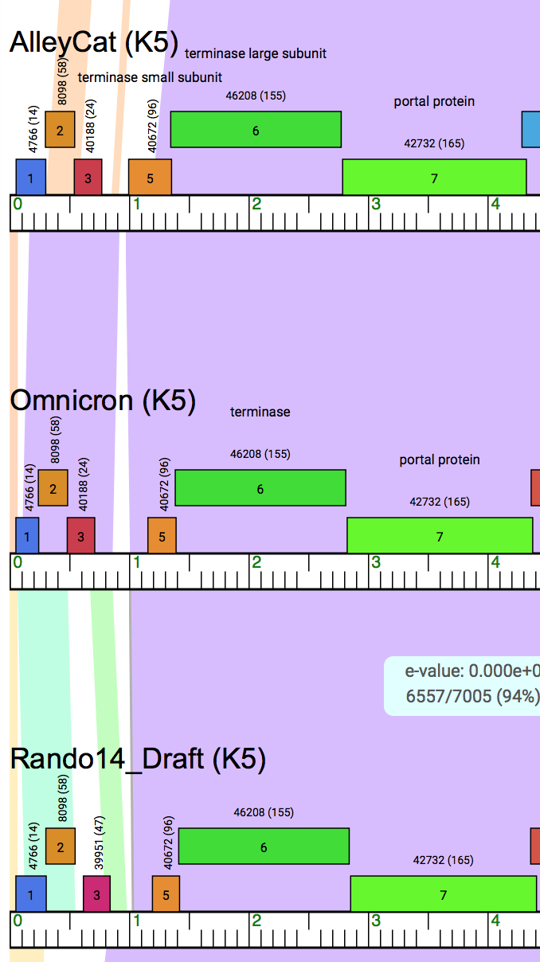
>Rando14_Draft gp5MAEKTSDRLAELRKLHGRISTAVFDEDTPPRDLAALSRRLMEISKEIETIELQRLQNGETSADVPADEAFDGEDV
Terminase small subunit?

Slide 2
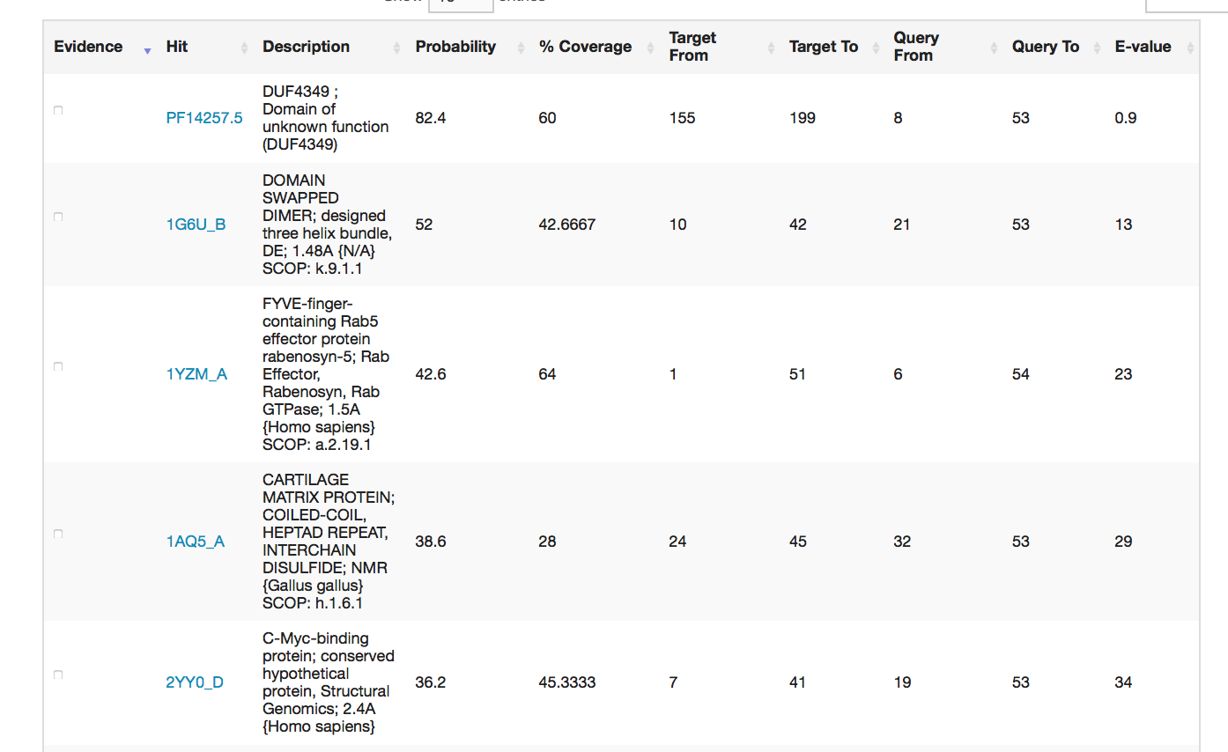

Slide 3
