Slide 1
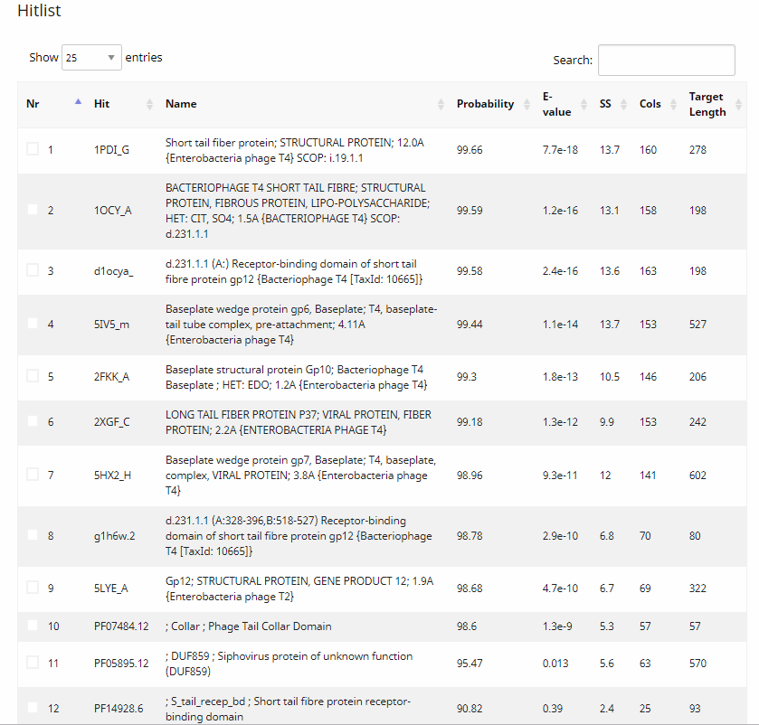
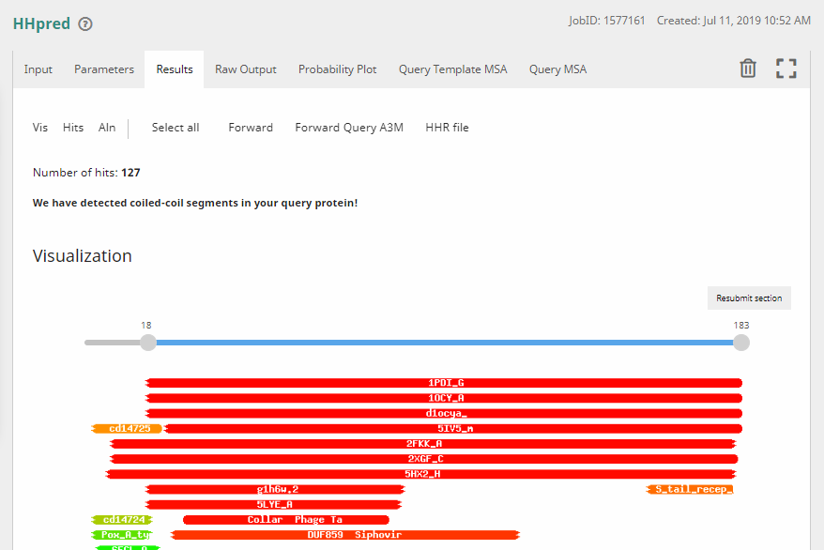
Vanisius_15 HHPred results – possible tail fiber?

Slide 2
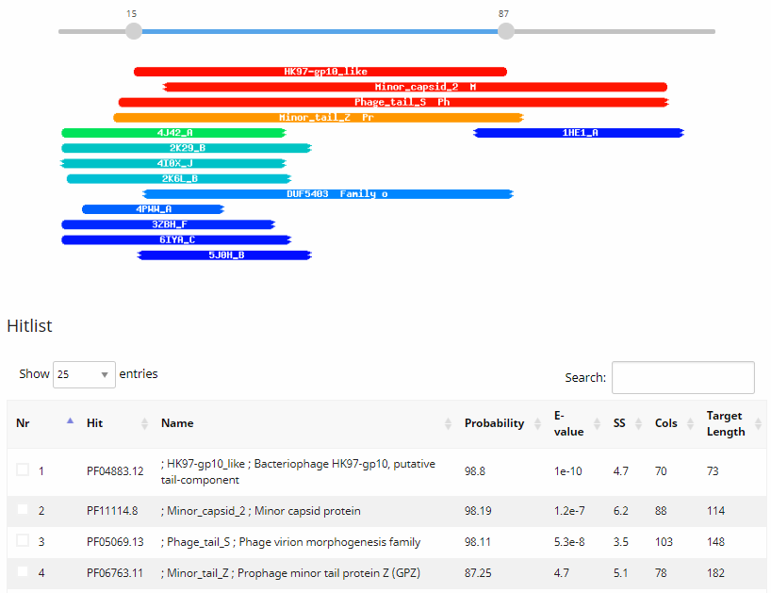
Vanisius_9 HHPred results – minor tail protein or NKF?

