Slide 1
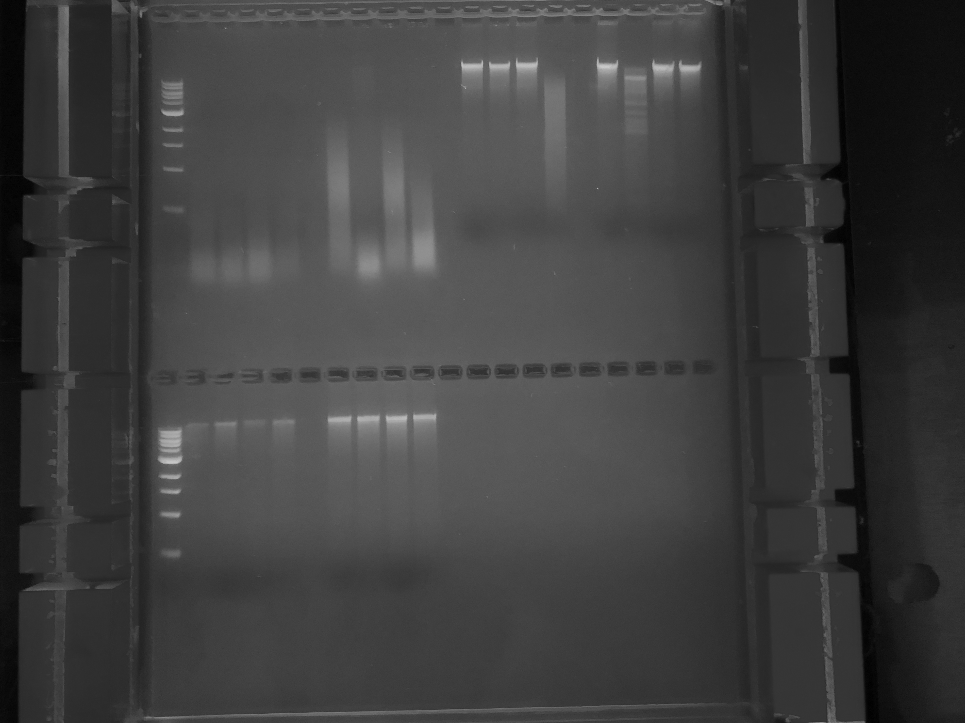
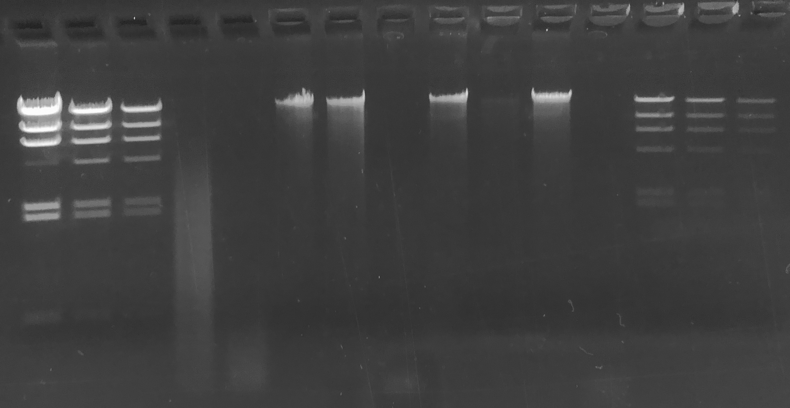
Rosemary
Rosemary
Lamba HindIII
Square
Lamba HindIII
Square
500
250
125
62
31
16
QC gel on 11/9/18
DNA digests on 10/26/18
Order of bands
Uncut BamHI EcoRI XhoI

