Slide 1
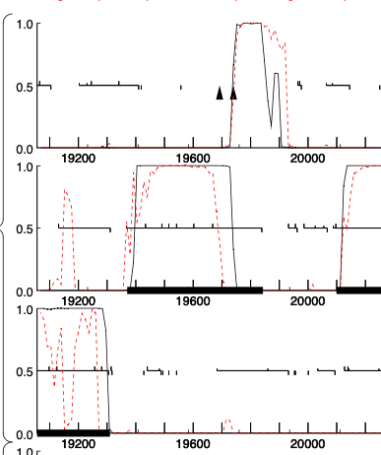
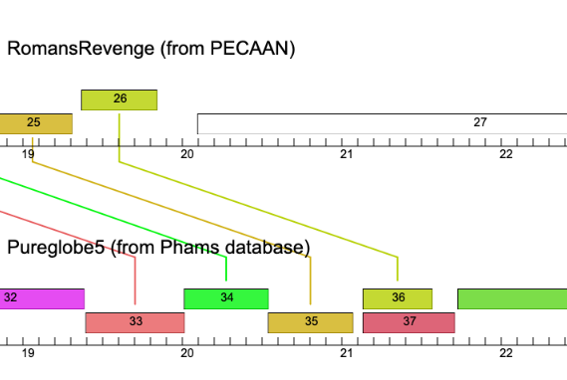
TAC in RomansRevenge?

Slide 2
Pureglobe5_36
MKEFIKAAGSQSKEVAEEDVLITTHWGTEIAFIKPSEGQFLMMLAMGGRNMDLKAIGNFIALFIELGDEETQRYFQGLLGDRDSGFSVFGEGGIFDIWDEIIKEWSGKVRPQAPASPGSSSETTPVSTARSRRSISYRSQPAES
Pureglobe5_37
MKEFIKAAGSQSKEVAEEDVLITTHWGTEIAFIKPSEGQFLMMLAMGGRNMDLKAIGNFIALFIELGDEETQRYFQGLLGDRDSGFSVFGEGGIFDIWDEIIKEWSGKSPAAGTRLARILIGNYARLDGSFPQVDLLSLPARRILNIVYVWMLDHLHGEDREKWLNELESPLPGEKADASSFDDSFDQIRQ
RomansRevenge_26 (stop: 19843)
MQEFITAARDNFQVEESETHVIMLDGREVTLYEPNTTQGALMLTFVRGEMTPEKVAQFMTLFFSFIHKDDRTYIEDRLMDVEDPFKLDSEGGLLDIFFWLMEQIEGGRPPVEPTDYQPSRRATGQRSTATTRAKASTSSPSRSRASSRSSKSGTSNA
RomansRevenge_26
Not seeing a slippery sequence…at least not one from the list provided

Slide 3
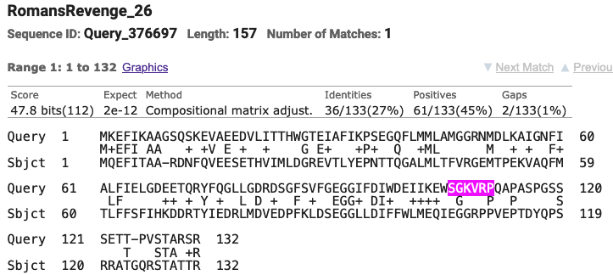
Alignment with PureGlobe5_36

