Slide 1
Rosebush gp15 and gp16 Remote Homologs
Identification of Remote Homologs to the characterized capsid proteins of Rosebush

Slide 2
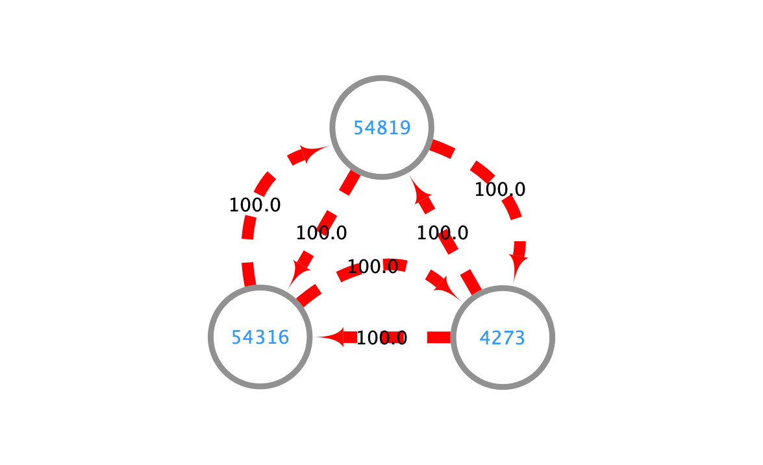
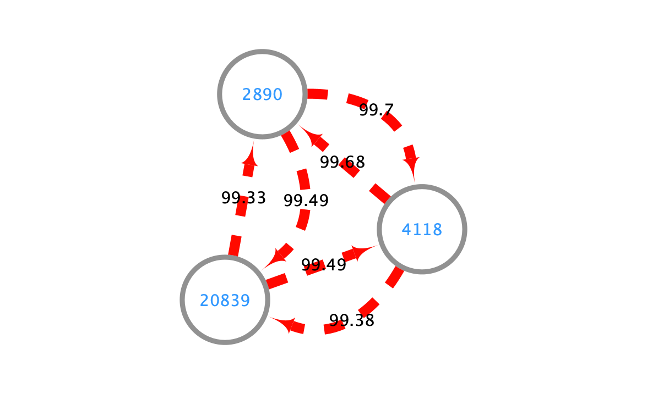
Rosebush gp15/gp16 Share Homology with Neighboring Phams
Alignments of HMM-HMM Profiles built from Phams reveal that members of other phams share strong remote homology to the Phams containing Rosebush gp15 and gp16
Rosebush gp15
Pham ID
Alignment
Probability
Rosebush gp16

Slide 3
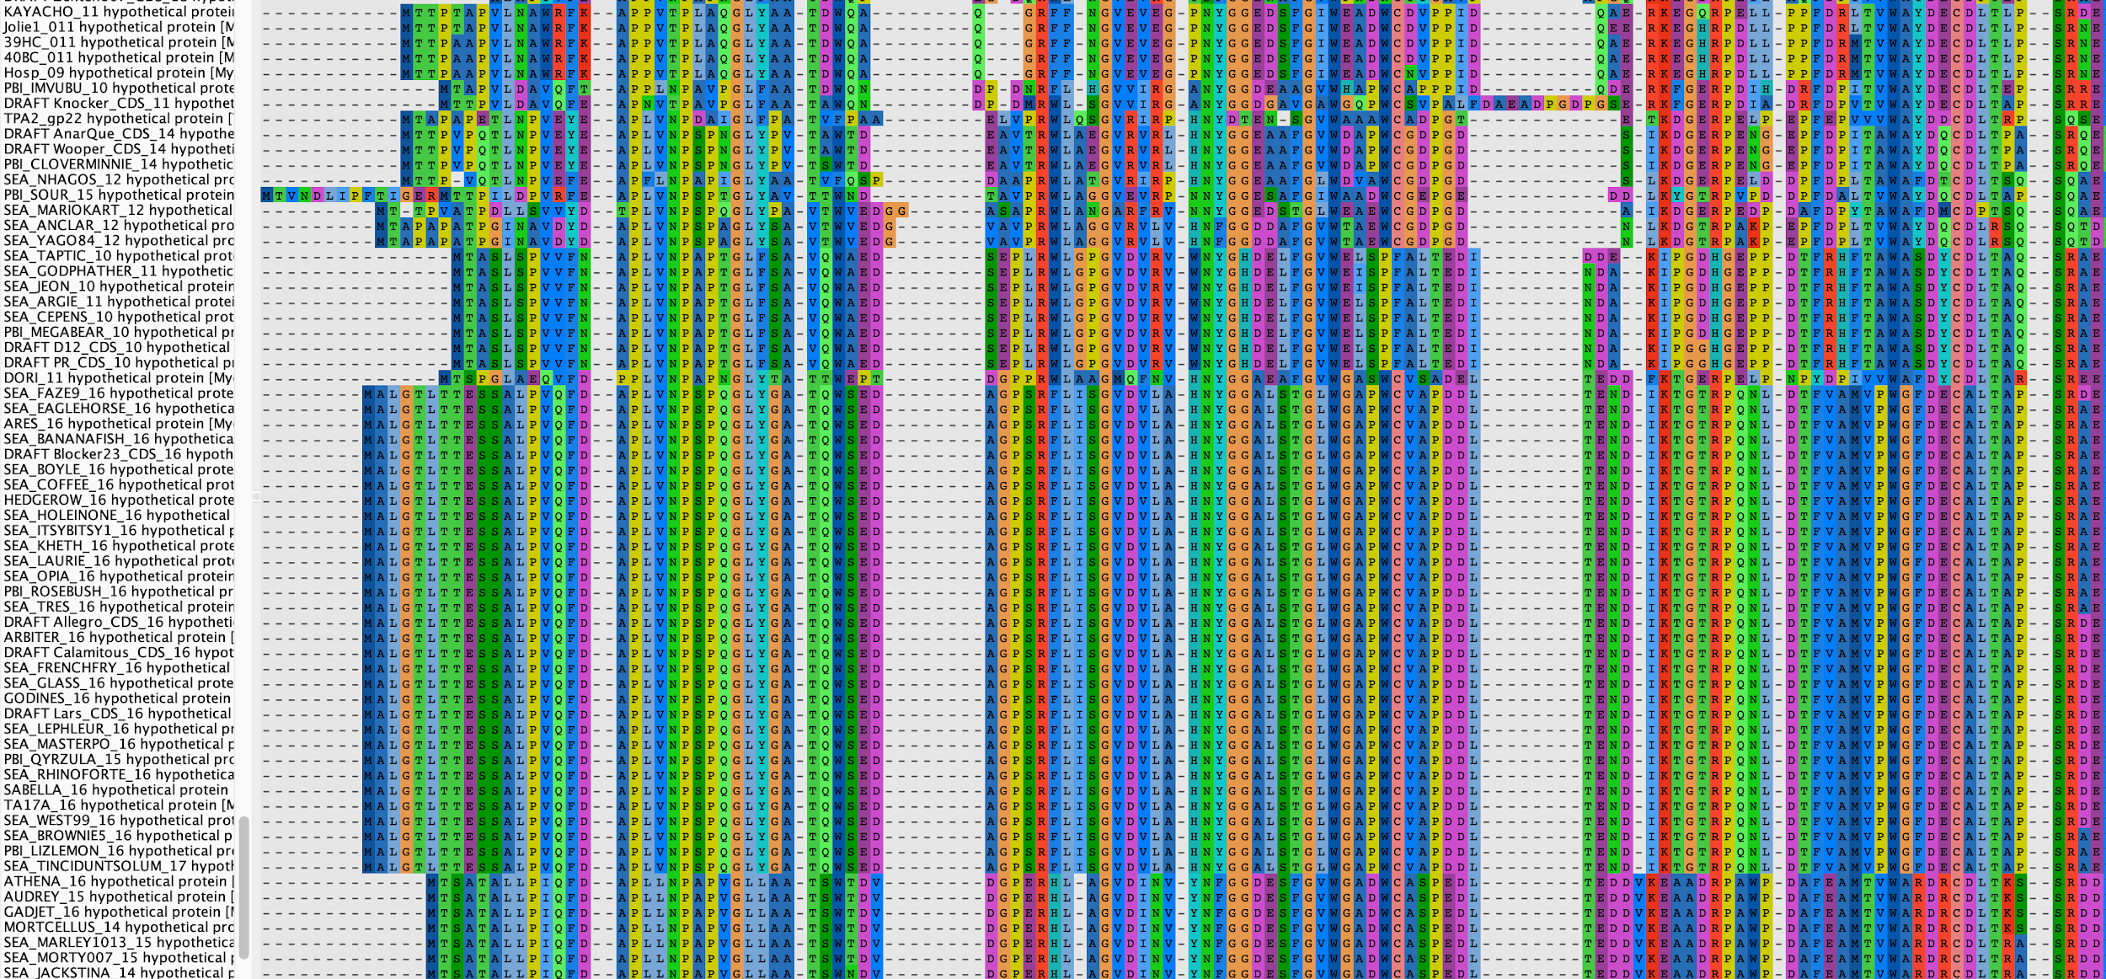
Rosebush gp16 Remote Homologs Share Conserved Residues

Slide 4
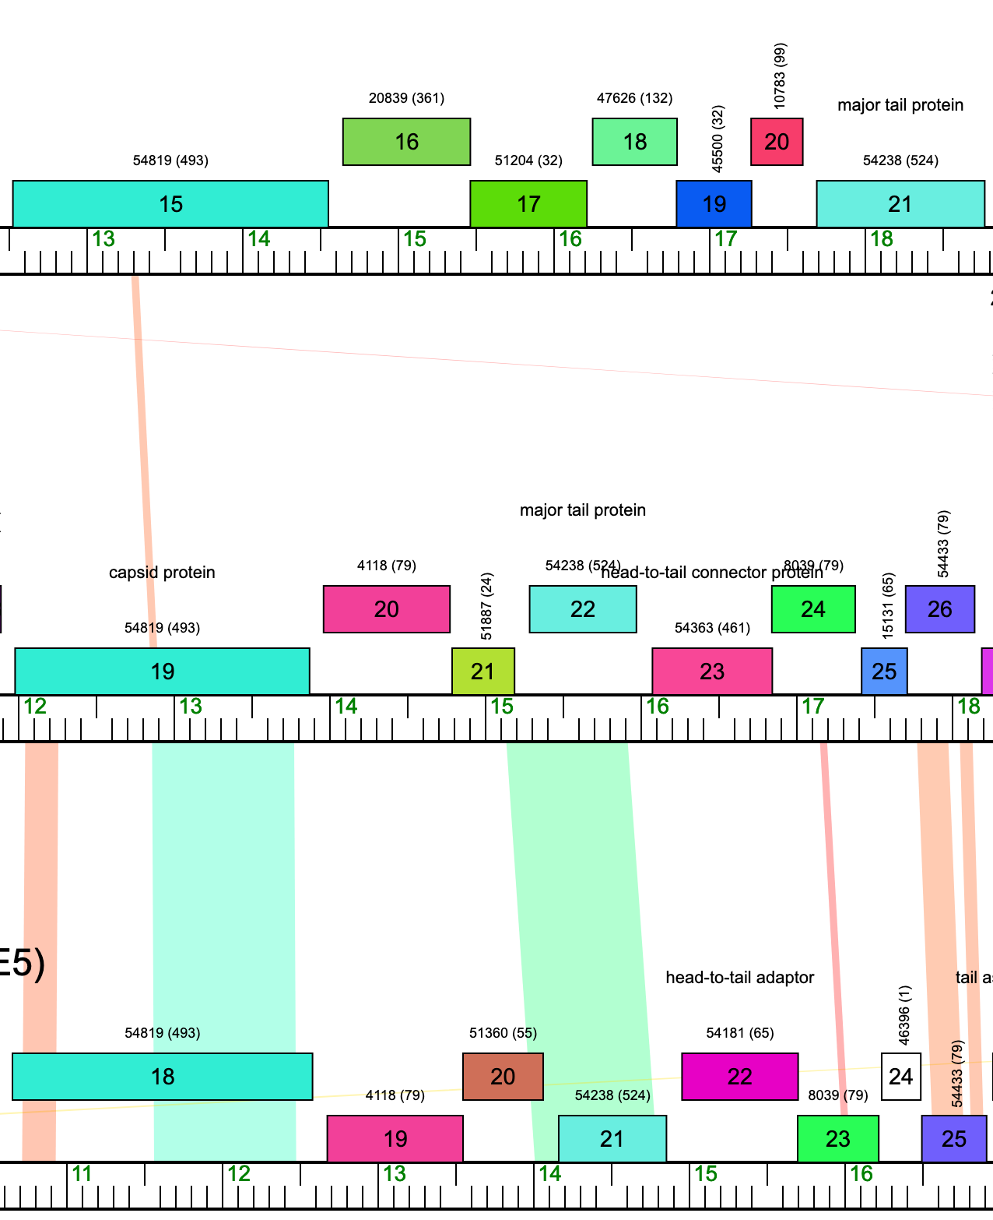
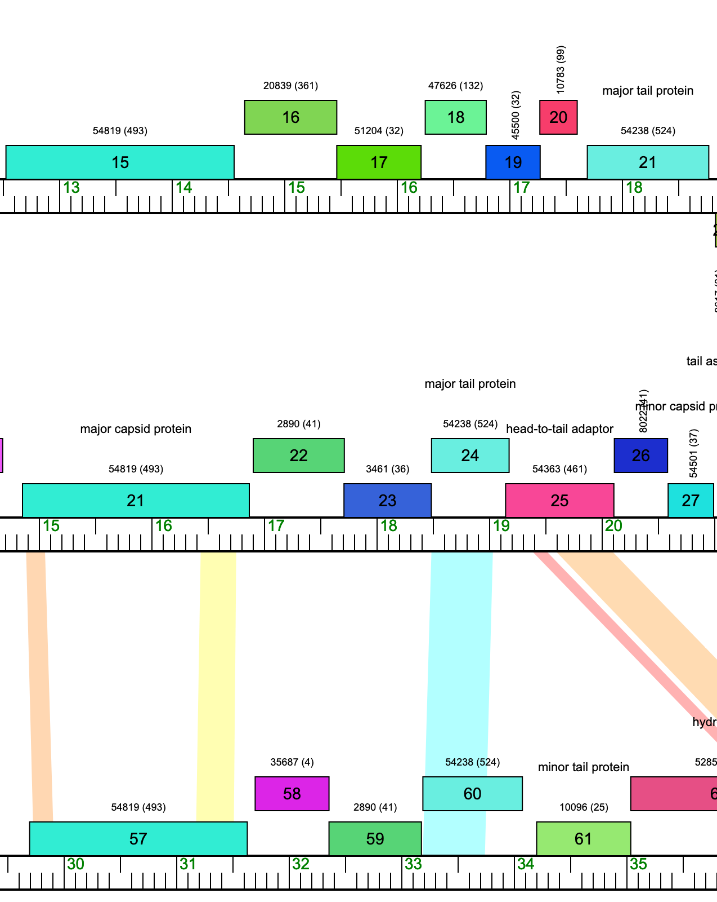
Evidence of Microsynteny Exists in Rosebush gp16 Remote Homologs
Rosebush (B2)
Rosebush (B2)
Wizard (DC)
Megan (EC)
LilBeanie (DE5)
Hendrix (GC)

