Slide 1
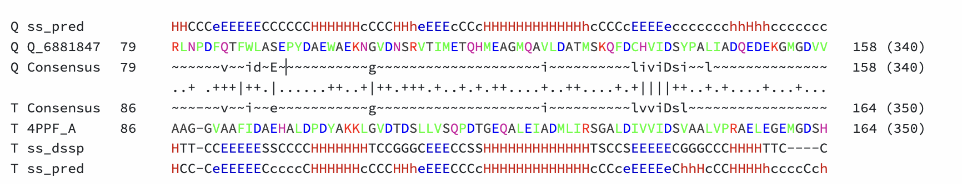
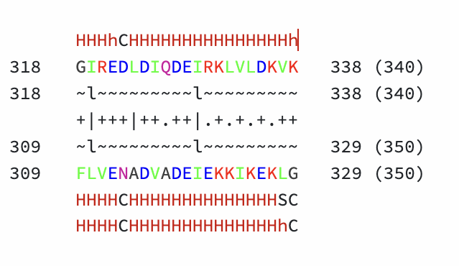
Based on the “How to call a RecA this protein had two issues which suggested it might not be a valid recA
Note above how in this particular phage protein the Hydrolytic residue (i.e. the E in the 4PPF crystal) is aligning to a S in this phage protein. Biochemically a Serine cannot substitute for a Glutamic Acid they are very different. However, there is a Glu just to the right.
Second the protein was shorter and while alignment to the C-terminal domain was present this phage protein was only 338 amino acids long so it was missing the final Mg binding domain.
End of protein!
Mg++ binding tail not present

Slide 2
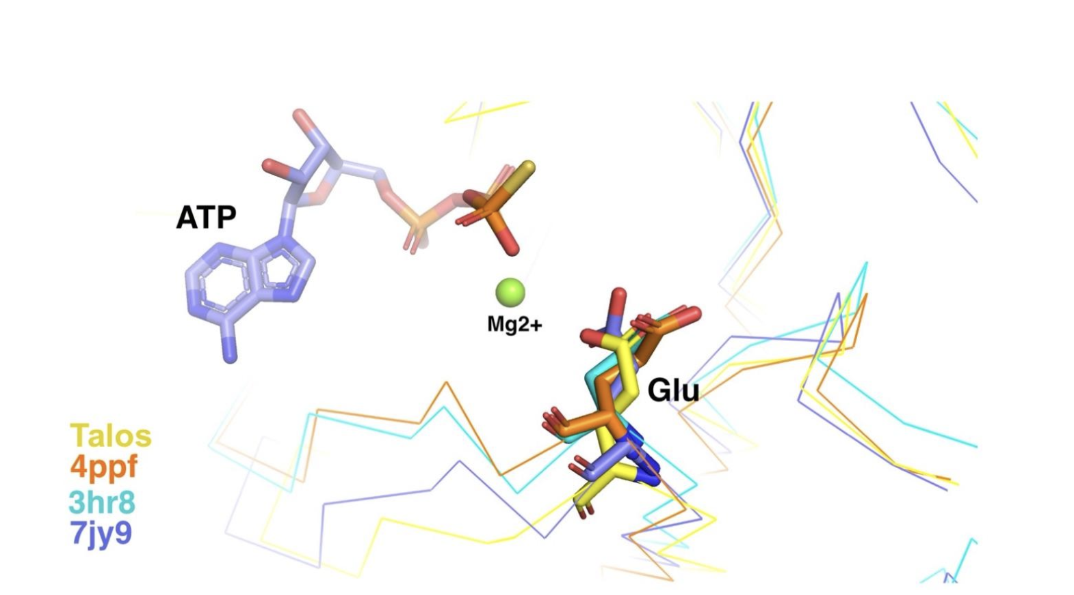
Could the E to the right of the S provide the hydrolytic activity needed?
We used alphafold to predict the 3d structure of this protein and then compared that structure to three other published structures of RecA. By using special software we could focus in on the region with this hydrolytic residue.
Note that while the backbone moves around the placement of the Glu is predicted to be in the same place for all 4 so this shift in the HHPRED alignment is NOT good evidence for lack of hydrolytic activity and shows a limitation in the HHPRED analysis

Slide 3
What about the missing Mg binding domain at the end?
End of protein!
Mg++ binding tail not present
We found this paper:
.” Journal of Biological Chemistry, vol. 278, no. 18, 2003, pp. 16381–88, ‌Lusetti, Shelley L., et al. “Magnesium Ion-Dependent Activation of the RecA Protein Involves the C Terminus
It turns out, the last 17 amino acid residues of the RecA C-terminus (RecAΔC17) are important for regulating the RecA activity, and removing these amino acids makes the RecA MORE ACTIVE. Thus this phage protein is also very likely active and the fact that the end is missing is not good evidence of lack of activity.

