Slide 1
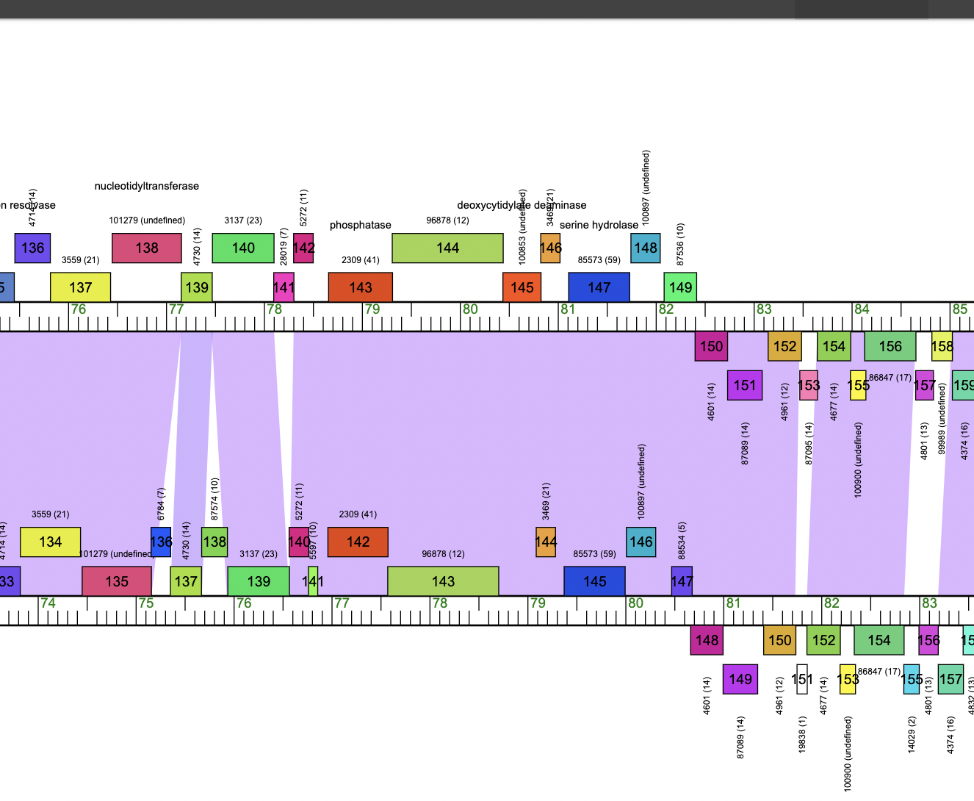
Lysin B
Cucurbita
Culver

Slide 2
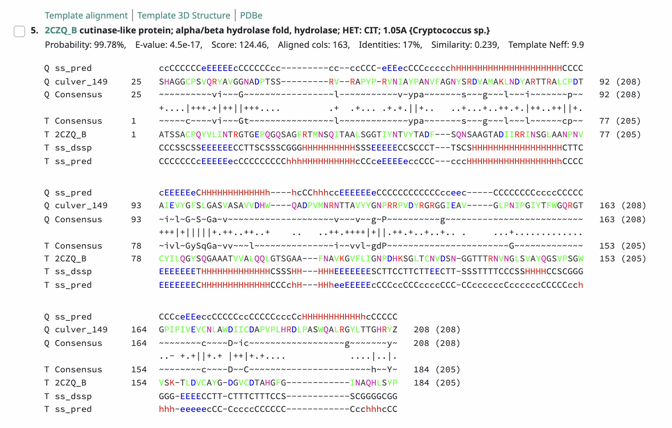
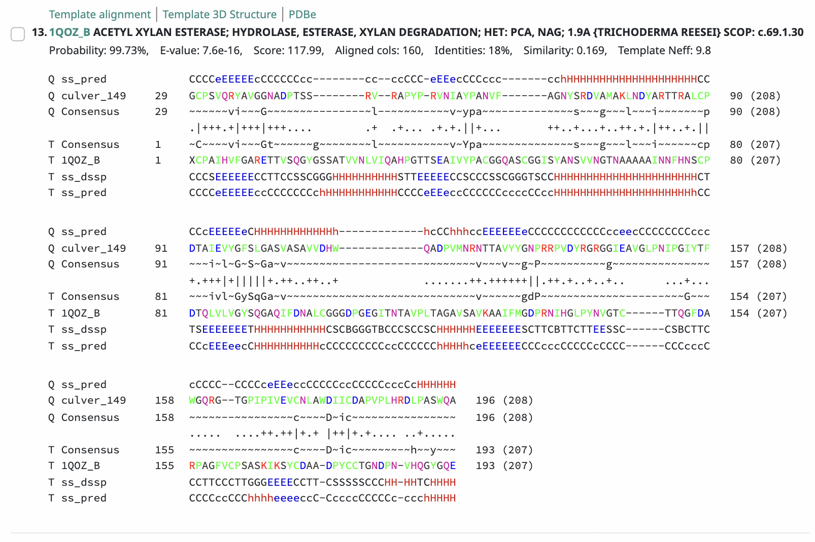
Like D29 lysin B, Culver_145 aligns to 2czq cutinase and 1qoz acetyl xylan esterase (Payne et al. 2009)
Payne, K., Sun, Q., Sacchettini, J. and Hatfull, G.F., 2009. Mycobacteriophage Lysin B is a novel mycolylarabinogalactan esterase. Molecular microbiology, 73(3), pp.367-381.

