Slide 1
Bacteriophage Gene Functions
Welkin Pope
SEA-PHAGES Bioinformatics Workshop, 2016

Slide 2
Anaya
Virion structural and assembly genes, i.e. those encoding proteins that are either components of virion particles or assist in their formation. These include genes encoding the terminase, portal, capsid maturation protease, scaffolding protein, major capsid protein, head to tail connectors, major tail subunit, tail assembly chaperones, tape measure protein, and minor tail proteins.
Genes involved in phage DNA replication. These include DNA polymerase, DNA primase, DNA helicase, nucleotide metabolism genes, and ssDNA binding proteins.
Genes involved in life cycle regulation. These include various regulators such as repressors and activators, integrases, recombination directionality factors, etc.
Genes involved in lysis, including endolysins (referred to as Lysin A in the mycobacteriophages), Lysin B, and Holins.
Other genes, including transcription factors, toxin/anti-toxin systems, peptidases, phosphatases, host gene homologues, methylases, nucleases, and DNA binding proteins, among others.

Slide 3
Structural genes

Slide 5
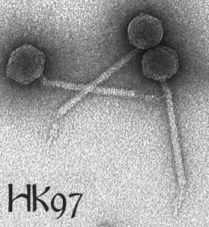
Bob Duda

Slide 6
Functional Assignments with Alignment Tools
Databases:
Phagesdb
nr at GenBank
PDB
Conserved domain
pFam
Alignment Tools
BLASTp
HHpred
Browsers
Website-phagesdb
Website-NCBI
Website-HHpred
Phamerator
DNA Master
PECAAN

Slide 7
Databases
Phagesdb.org:
Contains Actinobacteriophage genes and genomes
Maintained and curated by University of Pittsburgh
Phamerator
Contains phage genomes and gene sequences, gene phamilies
Maintained and curated by JMU and Pitt (linked to phagesdb)
nr at GenBank
Contains all nucleotide and protein sequences
Additional db are RefSeq and Conserved Domain Database
Curated by overworked GenBank staff (not phage experts)
Anyone can submit anything to nr

Slide 8
Databases, cont.
Conserved domain database (CDD)
Actually five databases of multiple sequence alignments (housed at NCBI): pFam, SMART, COGS, PRK, TIGRFAM
pFam (protein families)
Multiple sequence alignments of conserved protein sequences (housed at EBI)
Protein data bank
Consists of crystal structure coordinates. Data is very high quality, however it is limited by what can be crystallized.

Slide 9
Alignment tools
BLASTp – pairwise local word-based alignments of protein sequences.
You can control your scoring matrix and word size (defaults are usually fine)
Sacrifices optimal alignment for speed
Scores are influenced by length of the alignment (longer alignments score more highly) and database size
E value and % alignment
You may need to manually check to see if critical residues are present for enzymatic activity

Slide 10
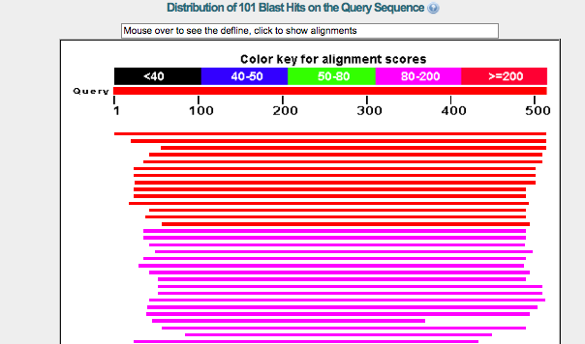

Slide 11
Conserved Domain Database

Slide 12
HHpred
HHPred
uses a combination of multiple sequence alignments and Profile Hidden Markov Models to find remote homologs: proteins that may be distantly related to your query sequence and share the same function.
Uses iterative alignments, somewhat like PSI-BLAST
Control number of iterations and databases you want to search
Probability and % alignment
You may still need to manually check and see if critical conserved residues are present

Slide 13
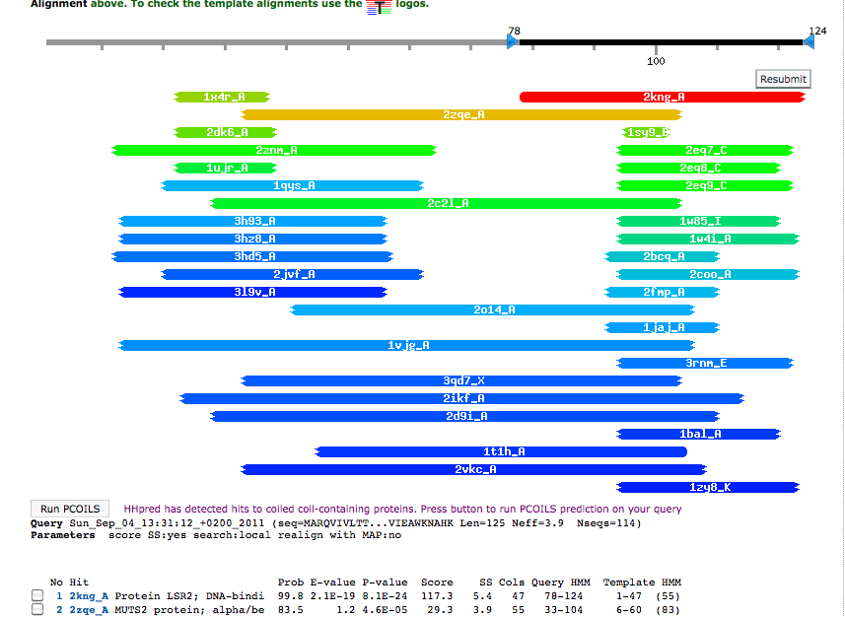
HHPred

Slide 14
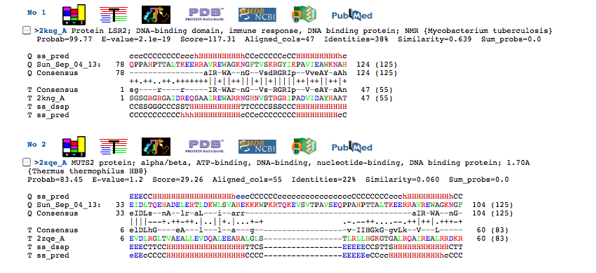

Slide 15
Synteny
Phage gene order is *somewhat* conserved
Use Phamerator or DNA Master Genome Comparison Tool
Terminase → Portal → Capsid Maturation Protease → Scaffolding → Major Capsid Subunit → Major Tail Subunit → Tail Assembly Chaperones → Tape measure → Minor Tail Proteins
Lysis (lysins, holins)
Integration cassette
DNA metabolism/Replication

Slide 16
Additional secondary structure prediction tools
Phagesdb.org/links

Slide 17
An advanced exploration
RosiePosie gene 5

Slide 18
Assigning Functions and function sources in your Annotation File
First: Phamerator/Phagesdb. Include phagename and gene number, e value, and % alignment
Most of these will be supported by HHpred and BLAST on NCBI.
Second: If you find a new function NOT in Phamerator/Phagesdb or in conflict with the Phamerator/Phagesdb assignment, include in your notes:
HHpred, Include probability score and approximate % of match length.
Or --
BLASTp on NCBI. Include e value, species/phagename, and approximate % of match length.
Finally: Include any other support you would like to. (Run TMHMM on a putative holin, and find two transmembrane domains? Write it down! Find one unlabeled gene between the portal and the major capsid protein? Sounds like a good candidate for the capsid maturation protease, assigned via synteny!)

Slide 19
a standardized SEA-PHAGES function list
SEA-PHAGES functional assignments
USE | Do NOT use | Example
terminase, small subunit | TerS | Sisi_1
terminase, large subunit | TerL | Sisi_2
terminase | If there are not two obvious large and small terminase genes in the same genome, just assign the function "terminase". | TM4_4
portal protein | head to tail connector | TM4_5
scaffolding protein | Scaffold | Sisi_5
capsid maturation protease | Protease, prohead protease | Sisi_4
major capsid protein | capsid | Sisi_6
head-to-tail connector protein |  | Sisi_7,8,9,10
major tail protein | major tail subunit | Sisi_11
tail assembly chaperone | Tail scaffolding protein | TM4_15; 16
Note: case matters. GenBank wants functions written all lower-case (except when
using conventional protein labels derived from genes eg “LacZ”)

Slide 21
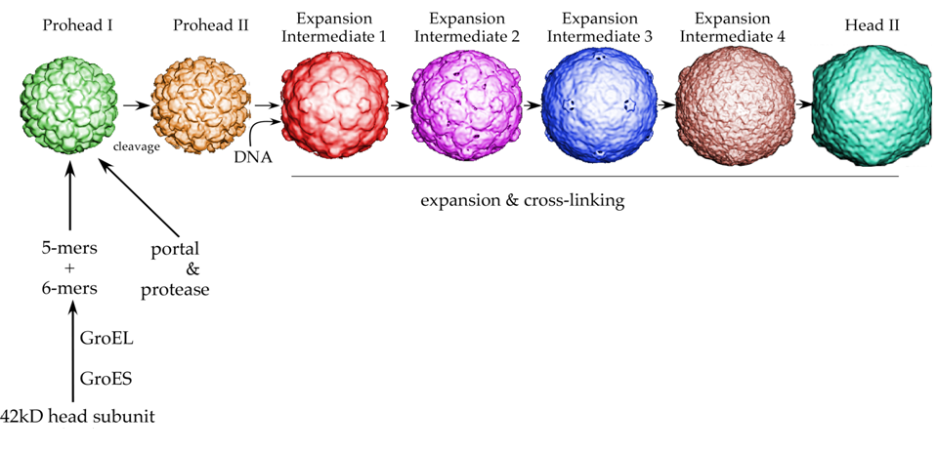
Bacteriophage HK97
(gp3)
(gp4)
(gp5, mcp)
Conway, Duda, and Hendrix

