Slide 1
Phage Clustering: Methods and Considerations for Herding Genomes
Dan Russell

Slide 2
Why a talk about clustering phages?
Fundamental topic, but rarely covered in detail
Has changed over time, new updates
Basis for much science, this weekend and in general
Good for students to know
Prerequisites:
Notes:
I'm not really going to talk about details of particular clusters that's for you this weekend

Slide 3
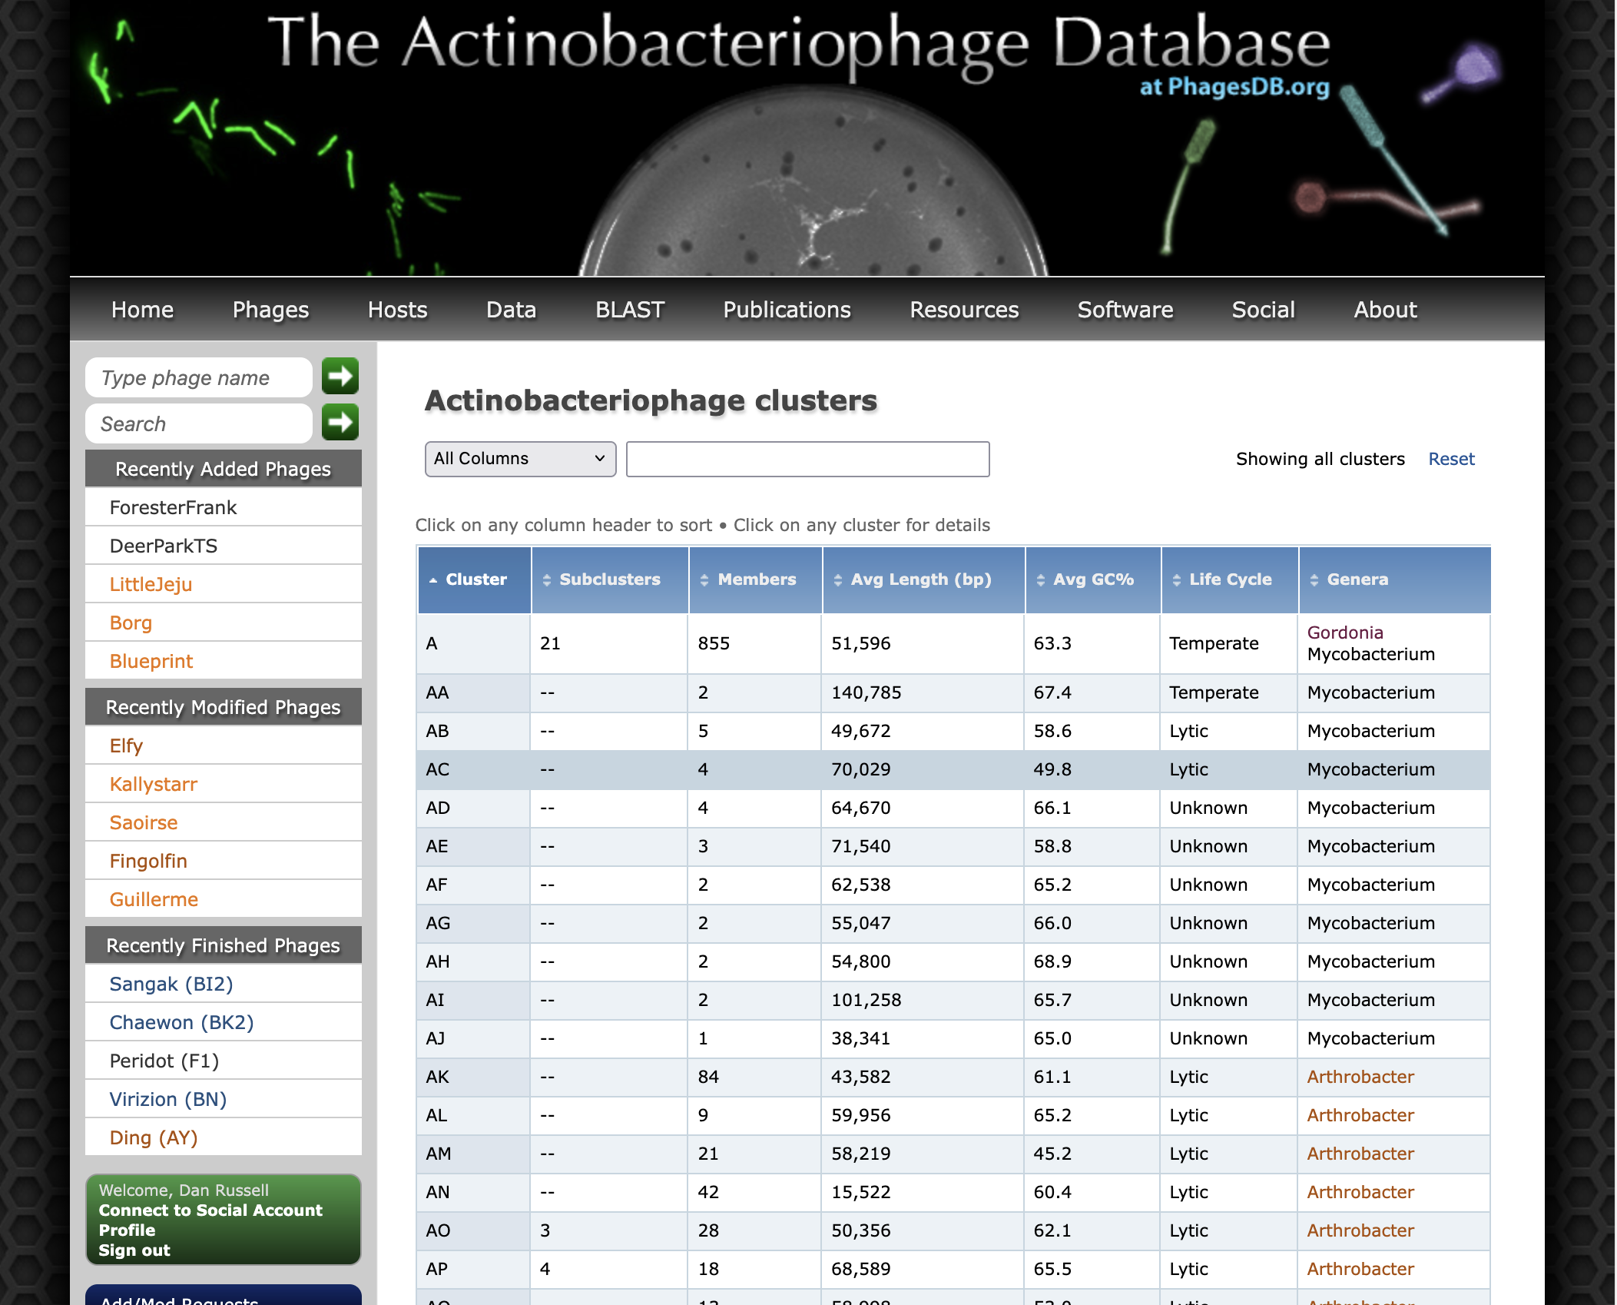
Over 5000 Actinobacteriophages Sequenced
173 Clusters, 72 Singletons

Slide 5
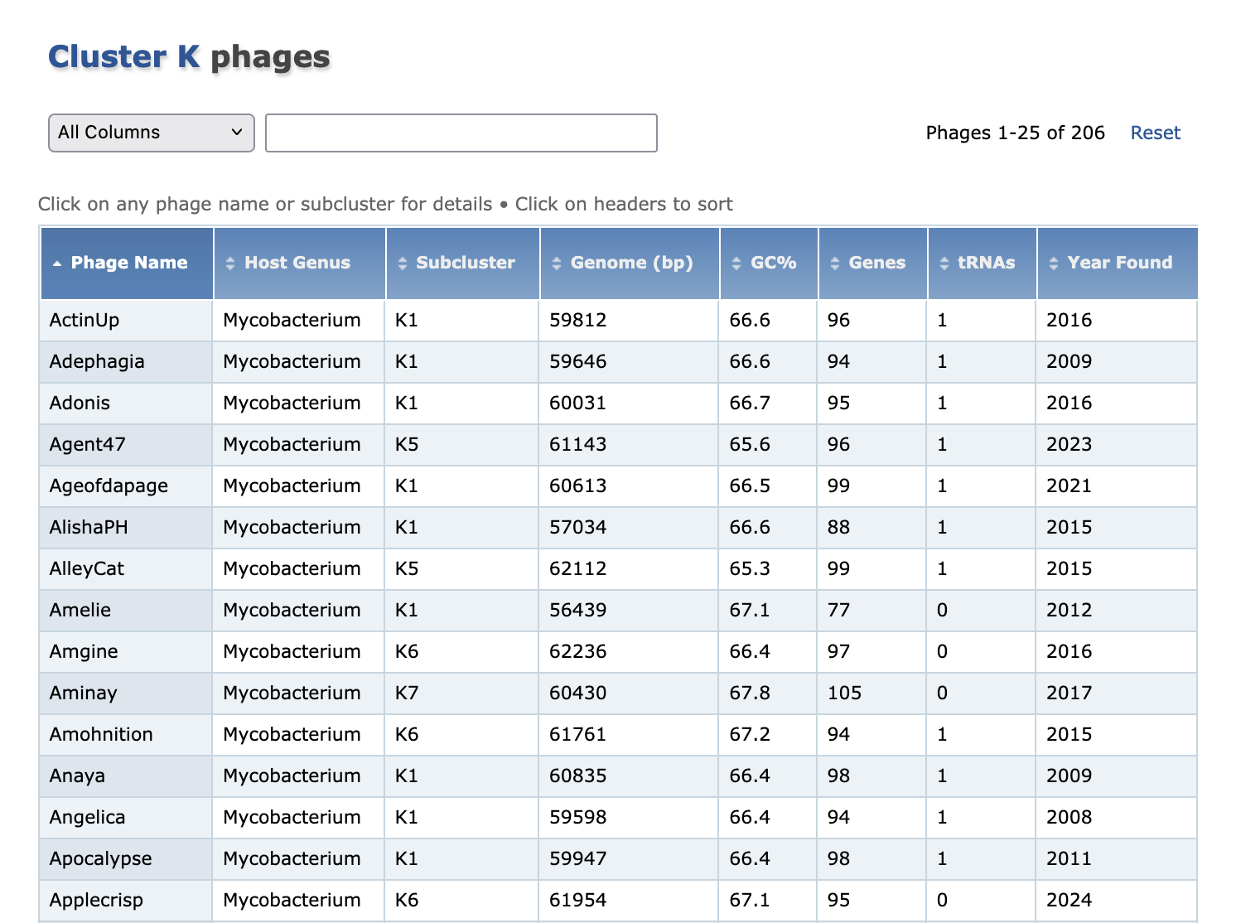

Slide 6
Outline
Spoiler
Part One: Imbroglios of Viral Taxonomy
Part Two: Clusters Begin
Part Three: Defining, Refining, Redefining, Automating
What’s coming next?

Slide 7
Outline
Spoiler
Part One: Imbroglios of Viral Taxonomy
Part Two: Clusters Begin
Part Three: Defining, Refining, Redefining, Automating
What’s coming next?

Slide 8
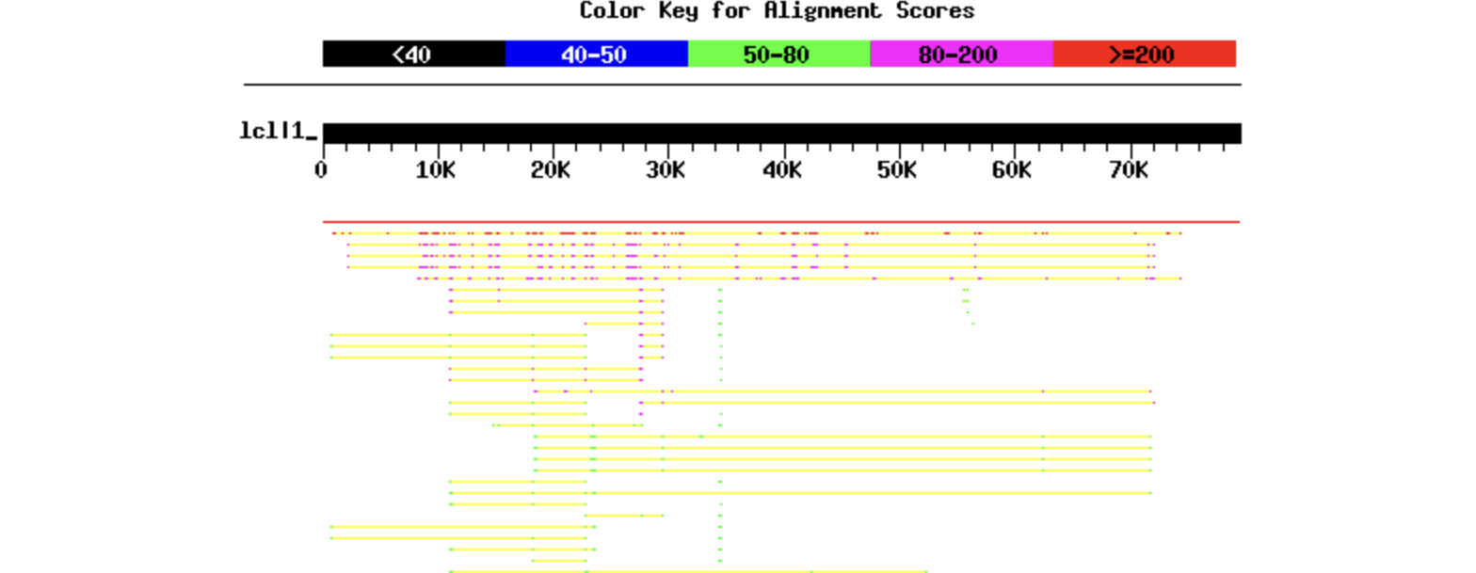
(How we truly put a phage into a cluster)
Becky Garlena
Notes:
Important here to note historical context. We’re scientists, like you, working with the best info we have at the time, making decisions. New data may change things!

Slide 9
Outline
Spoiler
Part One: Imbroglios of Viral Taxonomy
Part Two: Clusters Begin
Part Three: Defining, Refining, Redefining, Automating
A few practical considerations
What’s coming next?

Slide 10
1992: First Mycobacteriophage is Sequenced (L5)

Slide 11
1997: D29 is Sequenced
1997: D29 is Sequenced, Kinda Looks Like L5
“The overall organization of the D29 genome is similar to that of L5 [but] they are punctuated by a large number of insertions, deletions, and substitutions of genes, consistent with the genetic mosaicism of lambdoid phages.”

Slide 12
2003: 14 Sequenced
Notes:
Key point: with the numbers we have, eventually we're going to need some kind of categories

Slide 13
Let’s Group Our Phages. How?
Must be doable
Must be useful
Should not be misleading

Slide 14
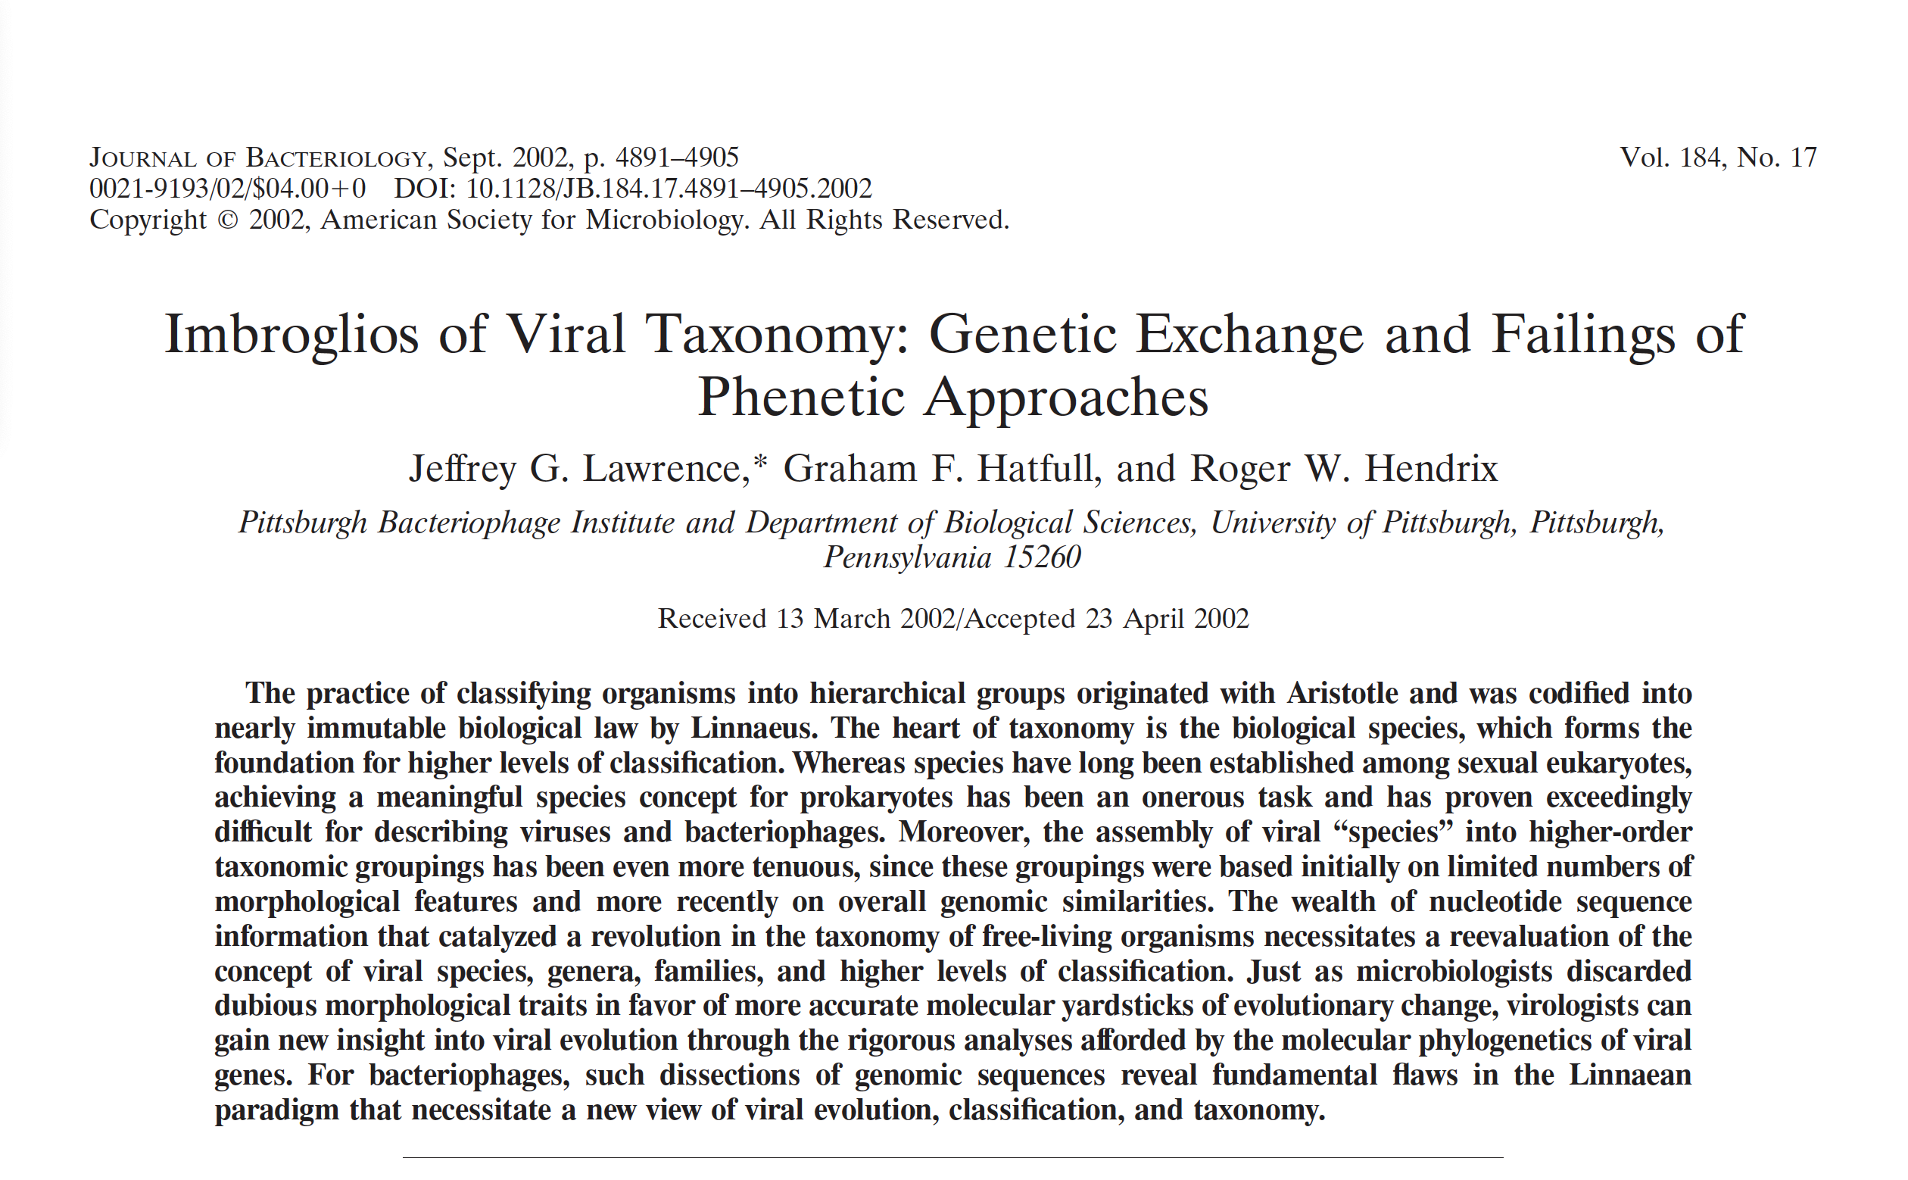
It’s Not Easy

Slide 15
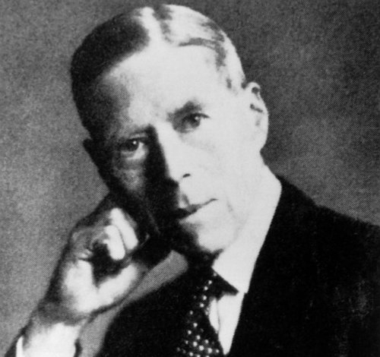
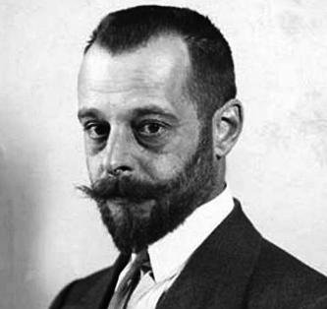
Phages Discovered 1915-17
Notes:
Almost all phage work done in the last 100 years, biology a lot older

Slide 16
Species Concepts Preceded
Phage Discovery
How do we define species?
Notes:
There were already ideas about how to categorize! How can we define species?

Slide 17
Species Concepts Preceded
Phage Discovery
Taxonomic species concept (overall similarity)
Biological species concept (reproduction/gene pool)
Ecological species concept (one niche, one species)
Phylogenetic species concept (ancestry)
Notes:
There were already ideas about how to categorize! How can we define species?

Slide 18
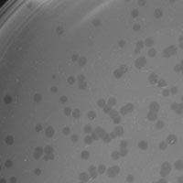
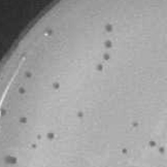
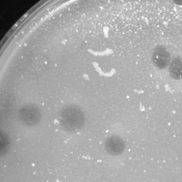
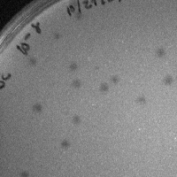
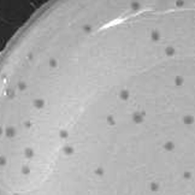
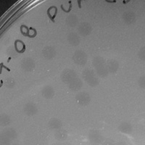
Comparing Plaque Morphologies
1
Anglerfish (A1)
4
Catera (C1)
2
Arcanine (A1)
5
Charlie (N)
3
BPs (G1)
6
Angelica (K1)

Slide 19
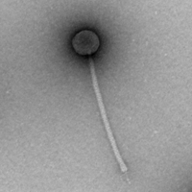
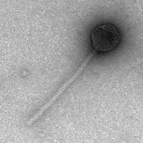
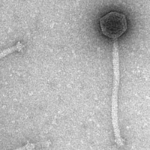
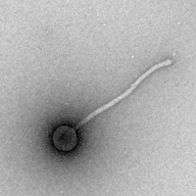
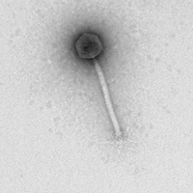
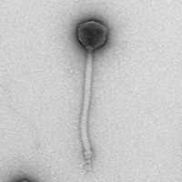
Comparing Virion Morphologies
1
Kikipoo (B1)
4
Wilde (AP)
2
BPs (G1)
5
Giles (Q)
3
Mozy (F1)
6
Tweety (F1)

Slide 20
Many Species Concepts
Aren’t Useful for Phages
Taxonomic species concept (overall similarity)
Biological species concept (reproduction/gene pool)
Ecological species concept (one niche, one species)
Phylogenetic species concept (ancestry)

Slide 21
Many Species Concepts
Aren’t Useful for Phages

Slide 22
Many Species Concepts
Aren’t Useful for Phages
Taxonomic species concept (overall similarity)
Biological species concept (reproduction/gene pool)
Ecological species concept (one niche, one species)
Phylogenetic species concept (ancestry)

Slide 23
Many Species Concepts
Aren’t Useful for Phages
Taxonomic species concept (overall similarity)
Biological species concept (reproduction/gene pool)
Ecological species concept (one niche, one species)
Phylogenetic species concept (ancestry)
We’re probably going to need to look at the genome to see what it’s related to and do it that way, right? BUT…
Notes:
Okay so we have looked at some ways you could make species, but really we know now that the main way is via their DNA.

Slide 24
BUT

Slide 25
Vertical Gene Transfer
Horizontal Gene Transfer

Slide 26
Horizontal Gene Transfer

Slide 27
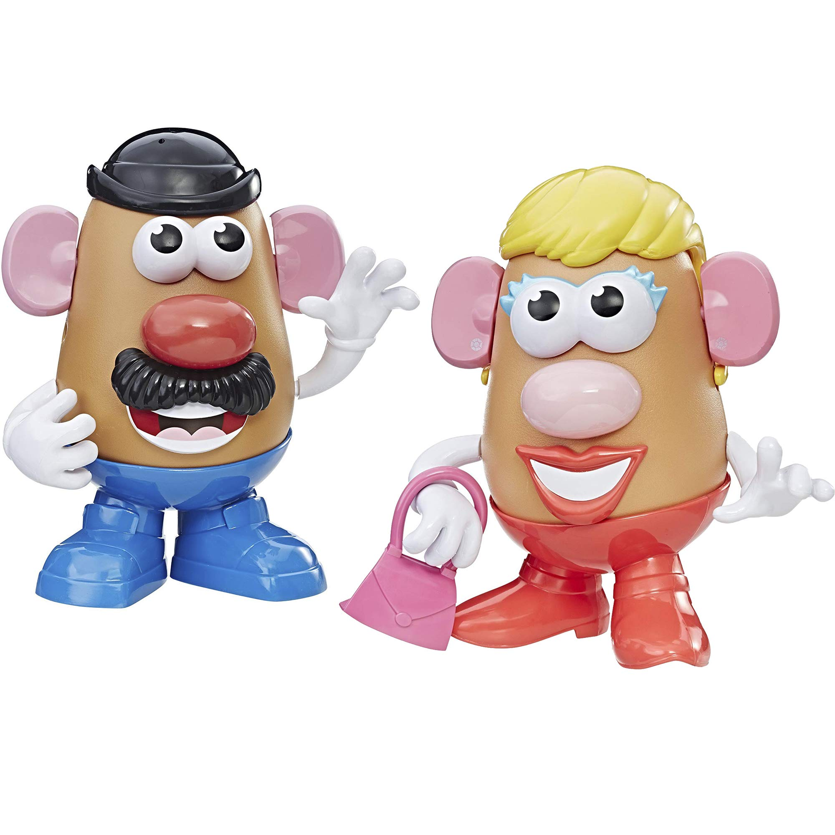
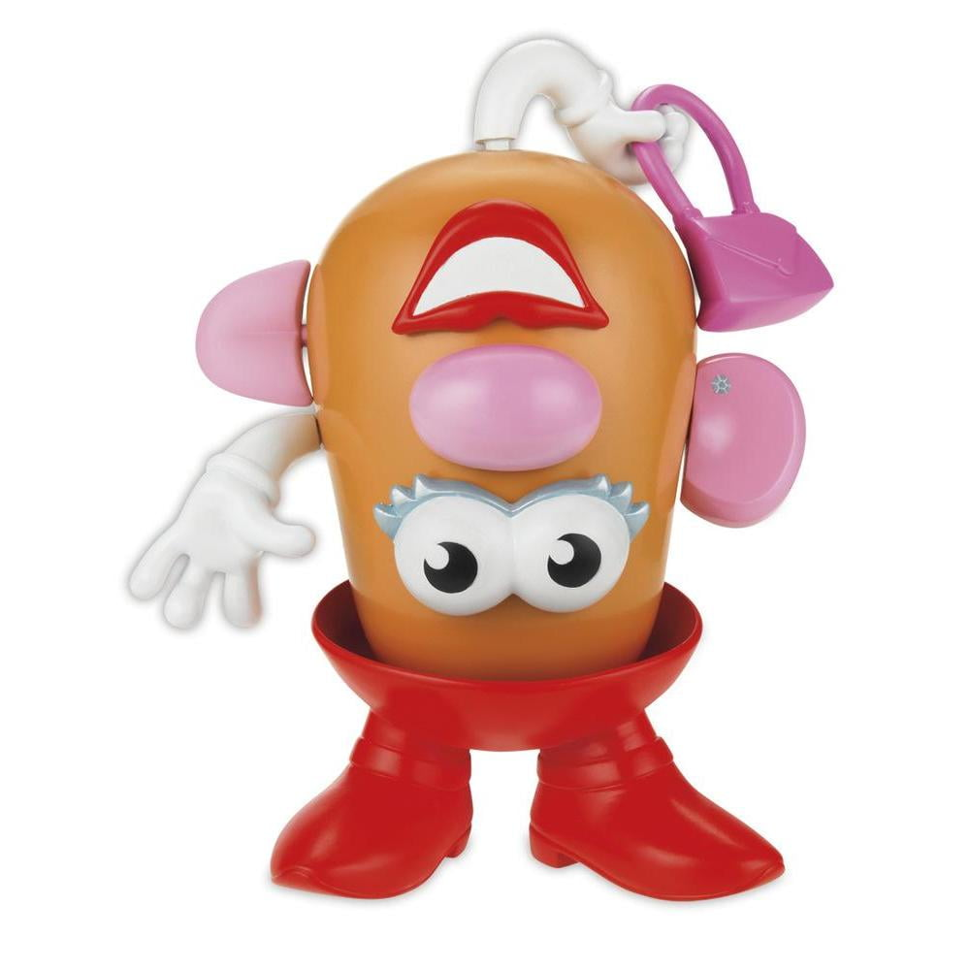
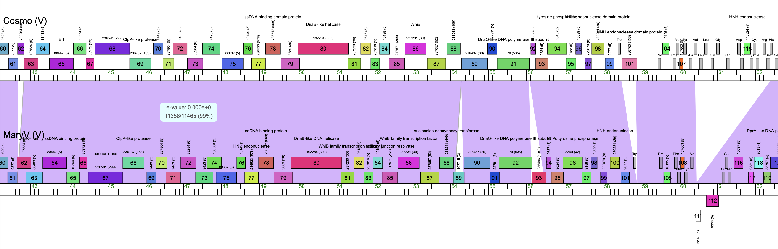
Notes:
Horizontal Gene Transfer: Not a thing for Simba, very much a thing for phages

Slide 28
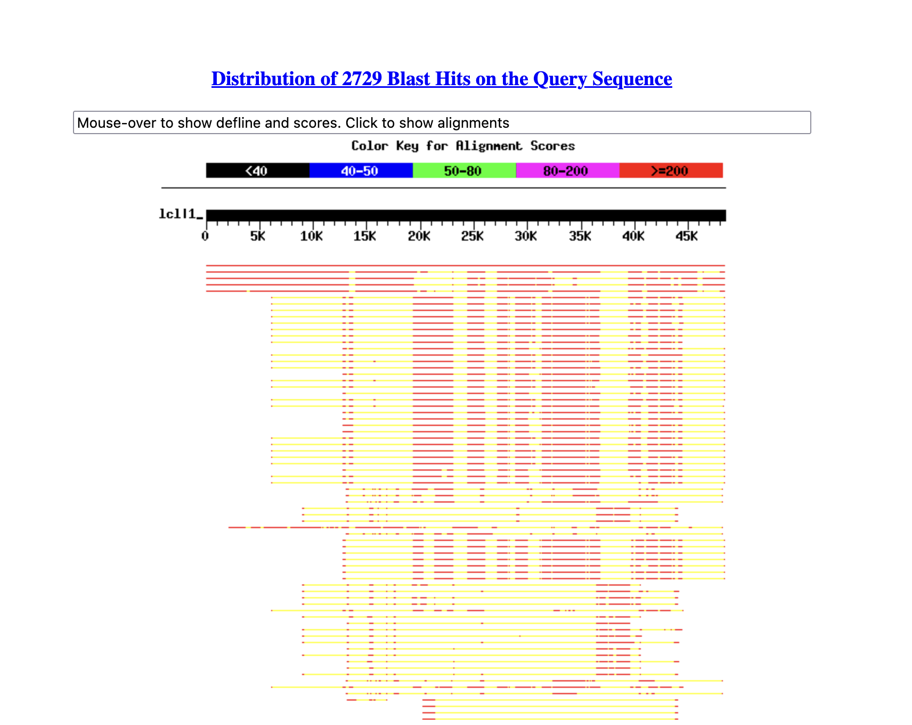
Horizontal Gene Transfer Leads to Mosaic Genomes
Babsiella (I1)
Cluster I1s
Cluster Ps
Cluster Ns
Cluster I2
Cluster F

Slide 29
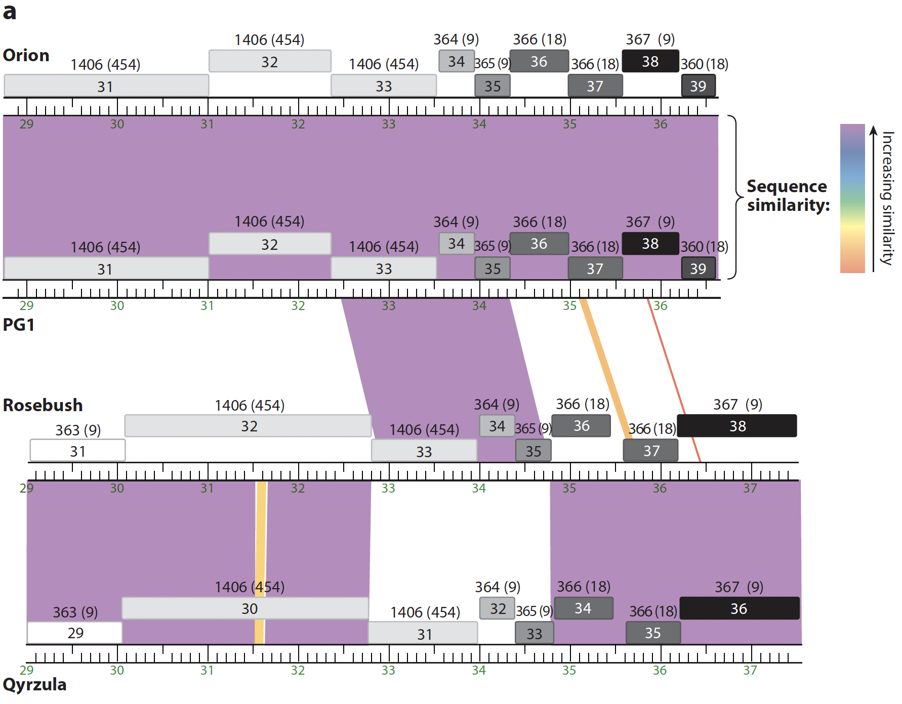
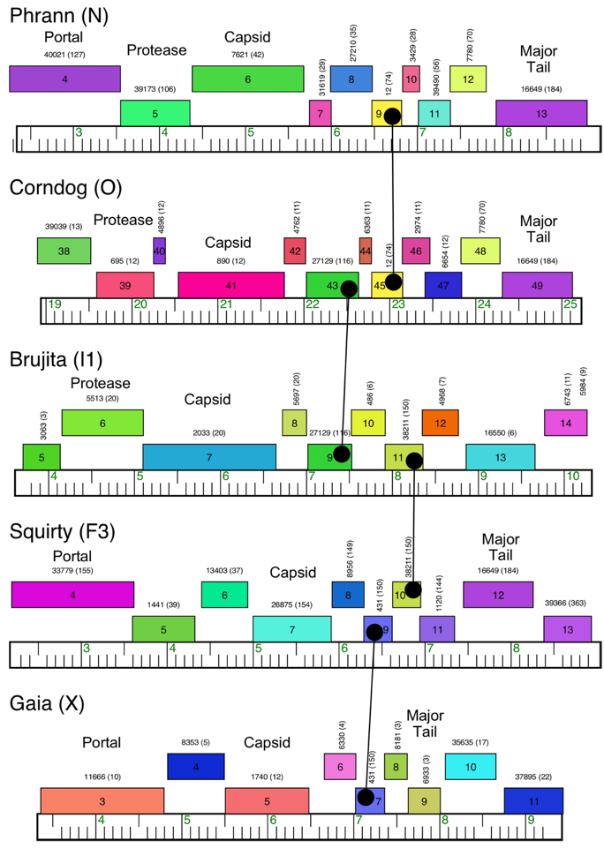
Horizontal Gene Transfer Leads to Mosaic Genomes
Slide from Graham Hatfull

Slide 30
Horizontal Gene Transfer
Taxonomic species concept (overall similarity)
Biological species concept (reproduction/gene pool)
Ecological species concept (one niche, one species)
Phylogenetic species concept (ancestry)
Can happen via homologous or illegitimate recombination, between two phages infecting the same host at the same time, or between a phage and a prophage in the host it’s infecting.

Slide 31
Existing Species Concepts Aren’t Ideal for Phages
“...achieving a meaningful species concept for prokaryotes has been an onerous task and has proven exceedingly difficult for describing viruses and bacteriophages.”
“Although it has been argued that virologists want and need a finely divided hierarchical taxonomy for the purpose of understanding their study organisms, it is clear that placing an organism into a taxonomic ‘box’ has utility only if the box is biologically meaningful.”

Slide 32
Outline
Spoiler
Part One: Imbroglios of Viral Taxonomy
Part Two: Clusters Begin
Part Three: Defining, Refining, Redefining, Automating
What’s coming next?

Slide 33
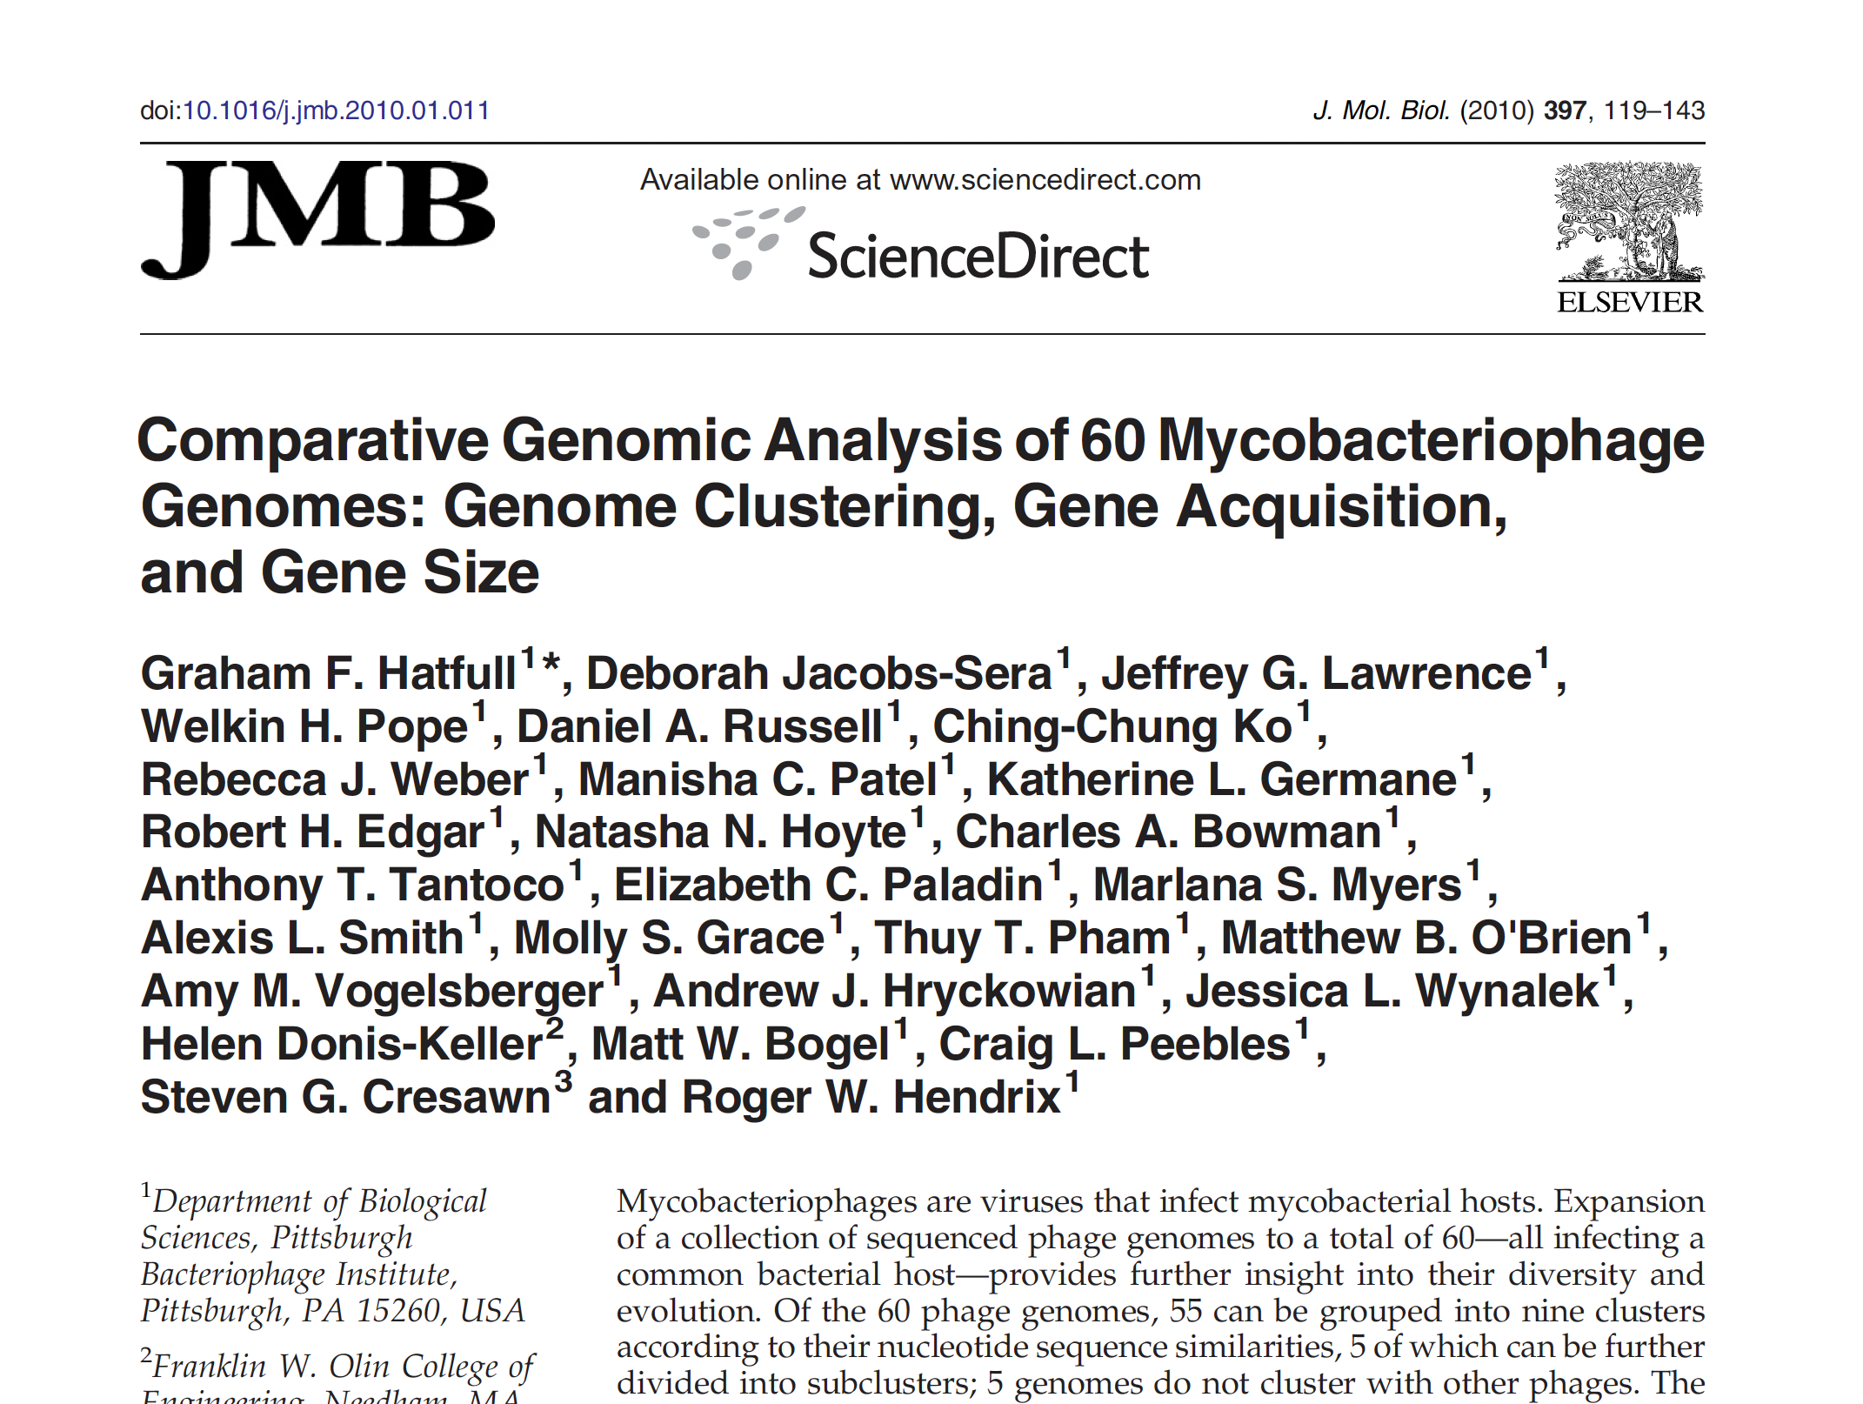

Slide 34
Clustering Begins: Four Approaches

Slide 35
Clustering Begins: Four Approaches
Dot plot analysis
≥50% of genome
“dotted” = same cluster

Slide 36
Clustering Begins: Four Approaches
Average Nucleotide
Identity (ANI)

Slide 37
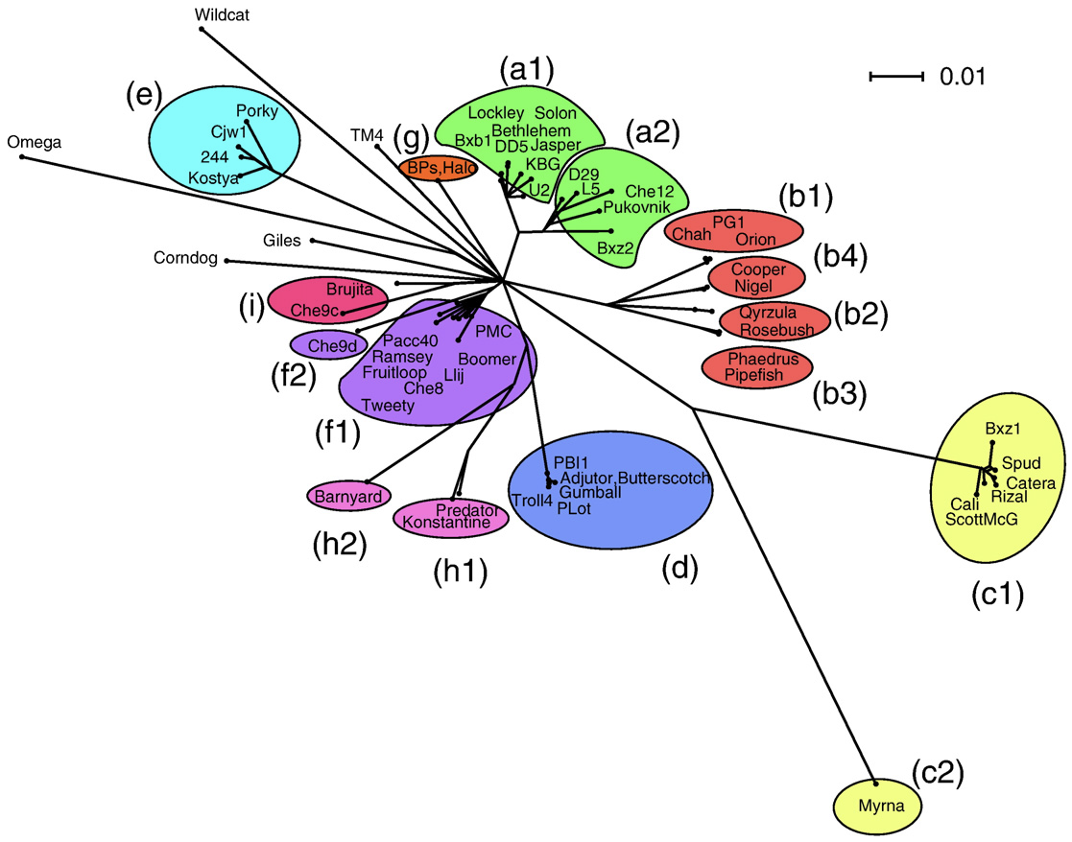
Clustering Begins: Four Approaches
Gene content
analysis (Splitstree)

Slide 38
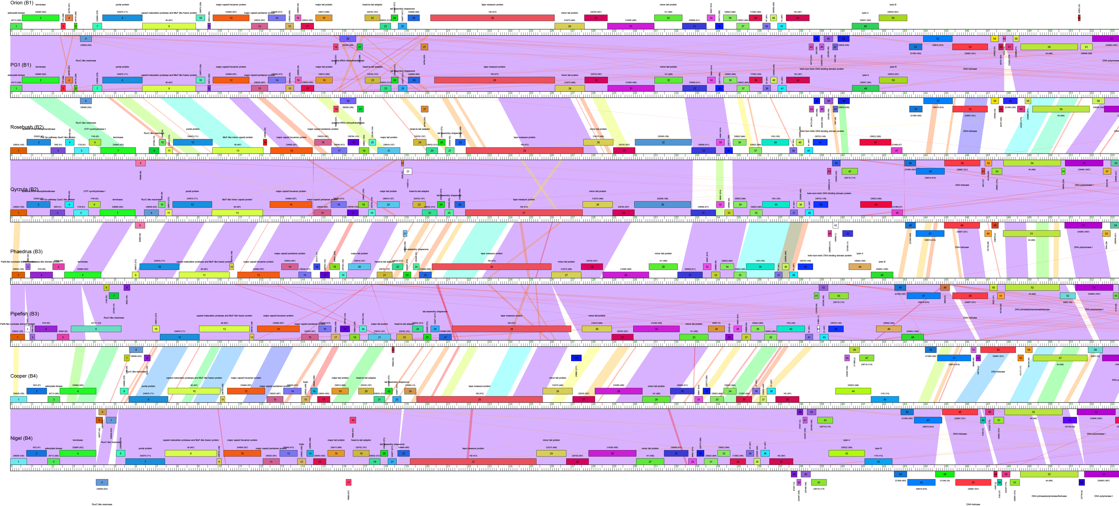
Clustering Begins: Four Approaches
Pairwise comparison
(synteny)

Slide 39
Clustering Begins: Four Approaches

Slide 40
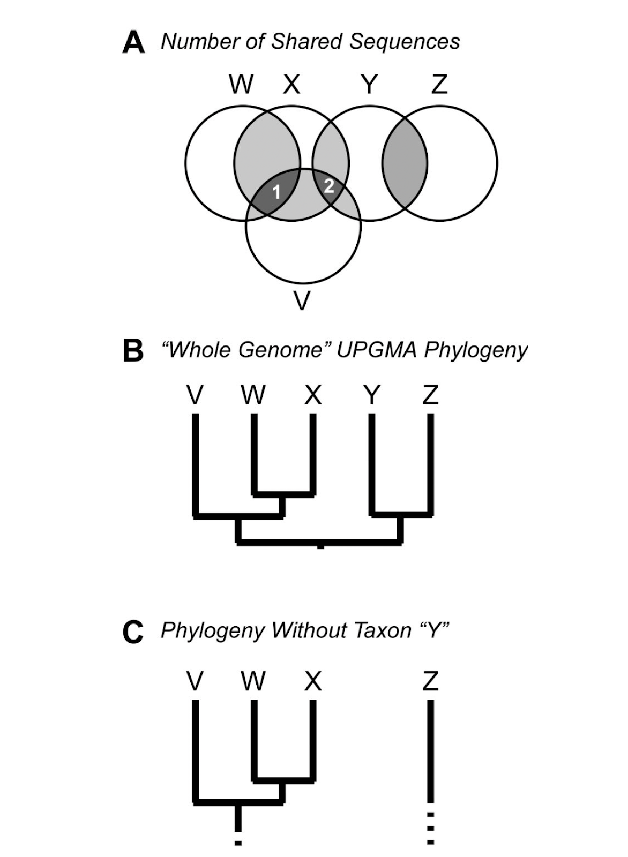
60 Phages Clustered!
9 Clusters, 5 Singletons
“Currently, it is not yet clear whether the tailed phages can be divided into multiple, genetically coherent groups, or whether they will be seen to be an indivisible continuum of types when sufficient data are available.”
Sampling plays a major role…
SEA-PHAGES to the rescue!

Slide 41
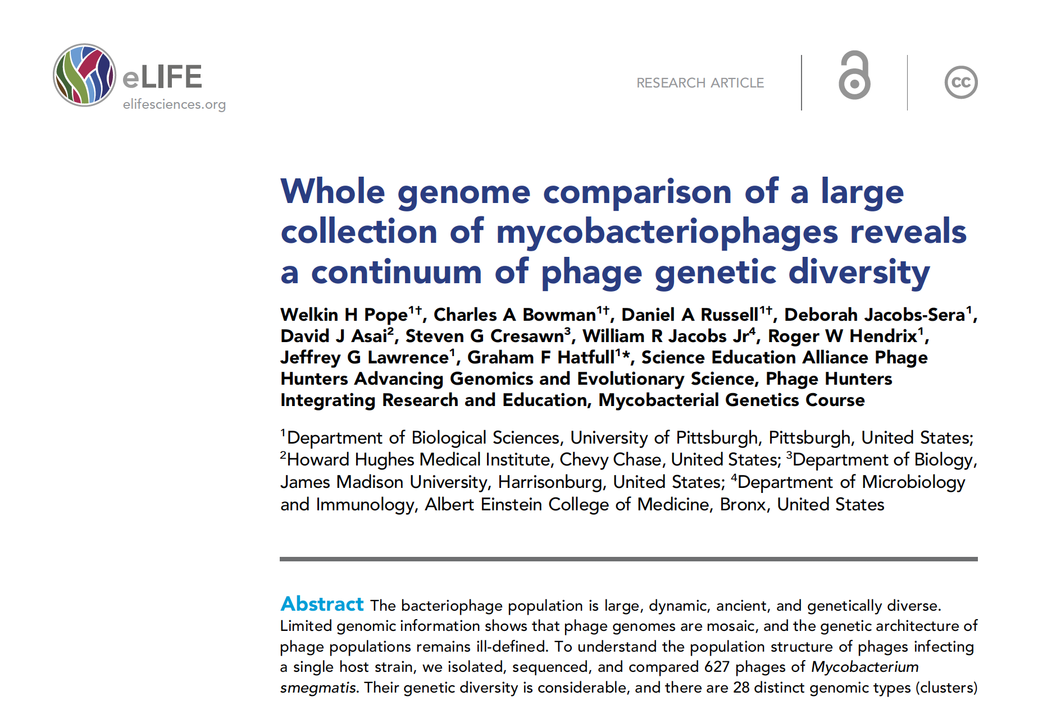
627 sequenced mycophages
2015
Notes:
More than 10x as many than 5 years before, go SEA-PHAGES!

Slide 42
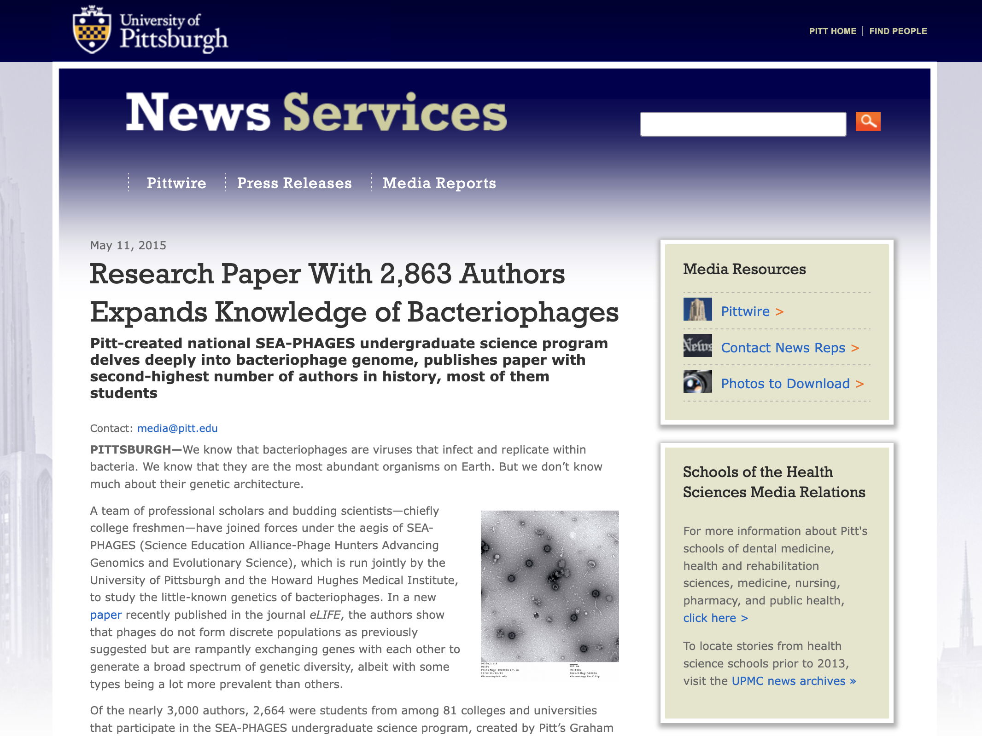

Slide 43
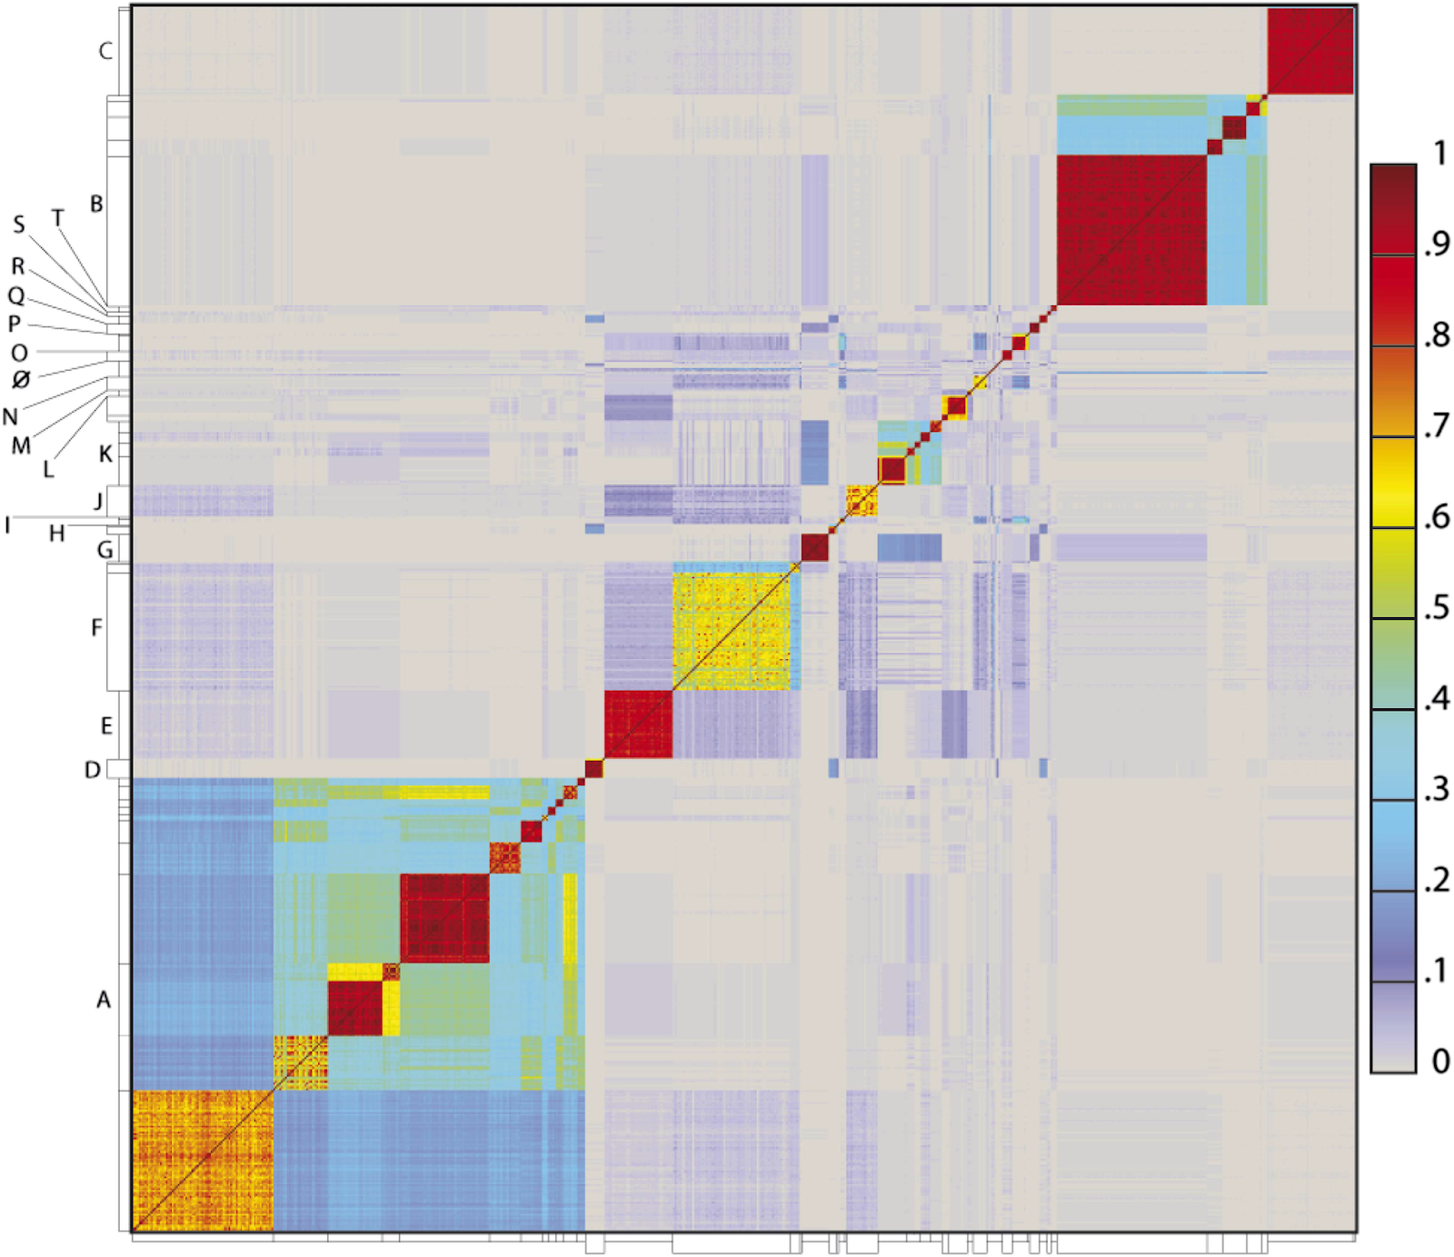
Different Clusters are Differently Different

Slide 44
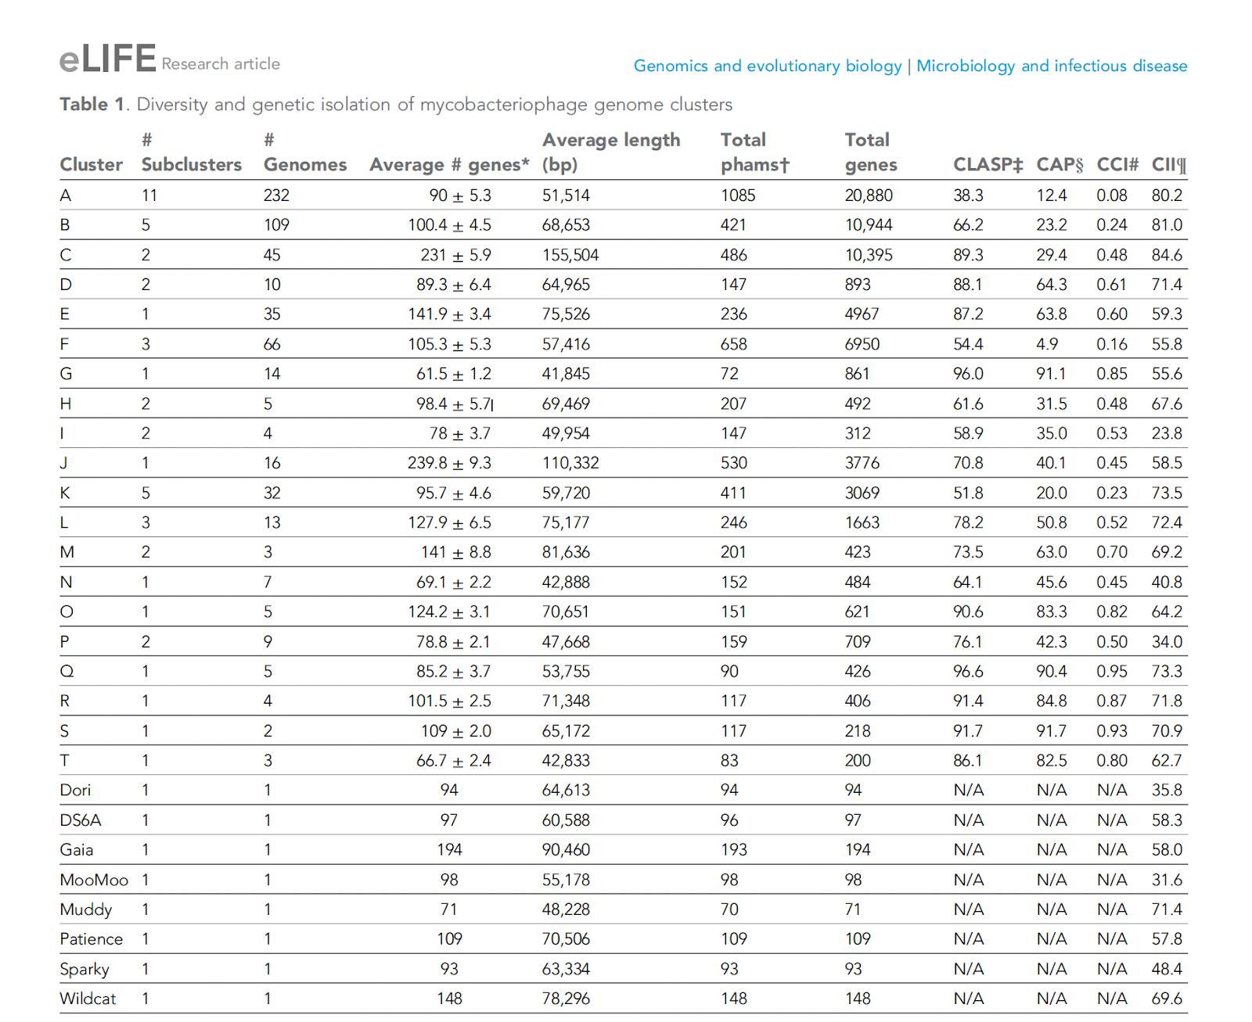
Different Clusters are Differently Different
Because clusters differ in internal cohesiveness, it’s impossible to set a single stable subclustering cutoff value.
Notes:
Note that, e.g., Cluster G had 14 members but 96% CLASP, whereas Cluster H/I had only 4/5 but < 70% CLASP.

Slide 45
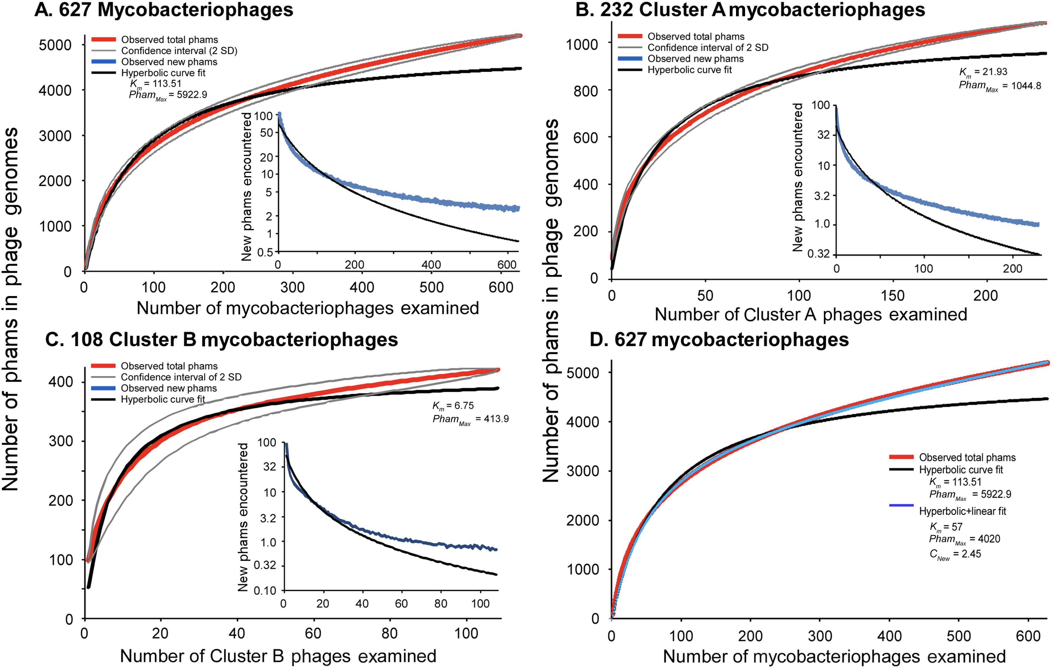
Mycobacteriophages are not a Closed System

Slide 46
Outline
Spoiler
Part One: Imbroglios of Viral Taxonomy
Part Two: Clusters Begin
Part Three: Defining, Refining, Redefining, Automating
What’s coming next?

Slide 47
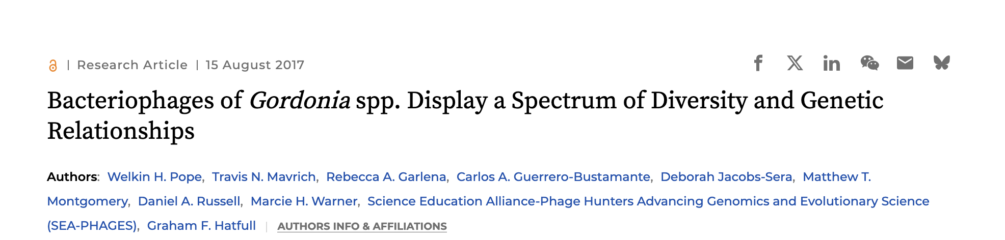
Switch to Gene Content Similarity (GCS)
“[There are] examples where phages share a substantial portion of their gene content, without necessarily having nucleotide span-length matches exceeding 50% of the genomes.”
“We therefore chose to further refine the clustering parameters such that phages would be grouped into the same cluster if they share at least 35% of their genes.”
Notes:
Only made this determination by looking manually, trying stuff. But in 2017 there were far fewer. How do we move forward?

Slide 48
Can We Automate Clustering?
Takes time to investigate individually
Sequencing is now much faster
Consistency with existing set?
But…
What approach? Nucleotide level? Amino acid level? Both?
What does similar mean? Percent identity? Coverage? Number?
Notes:
Existing Clusters are good, GFH made them! ;)

Slide 49
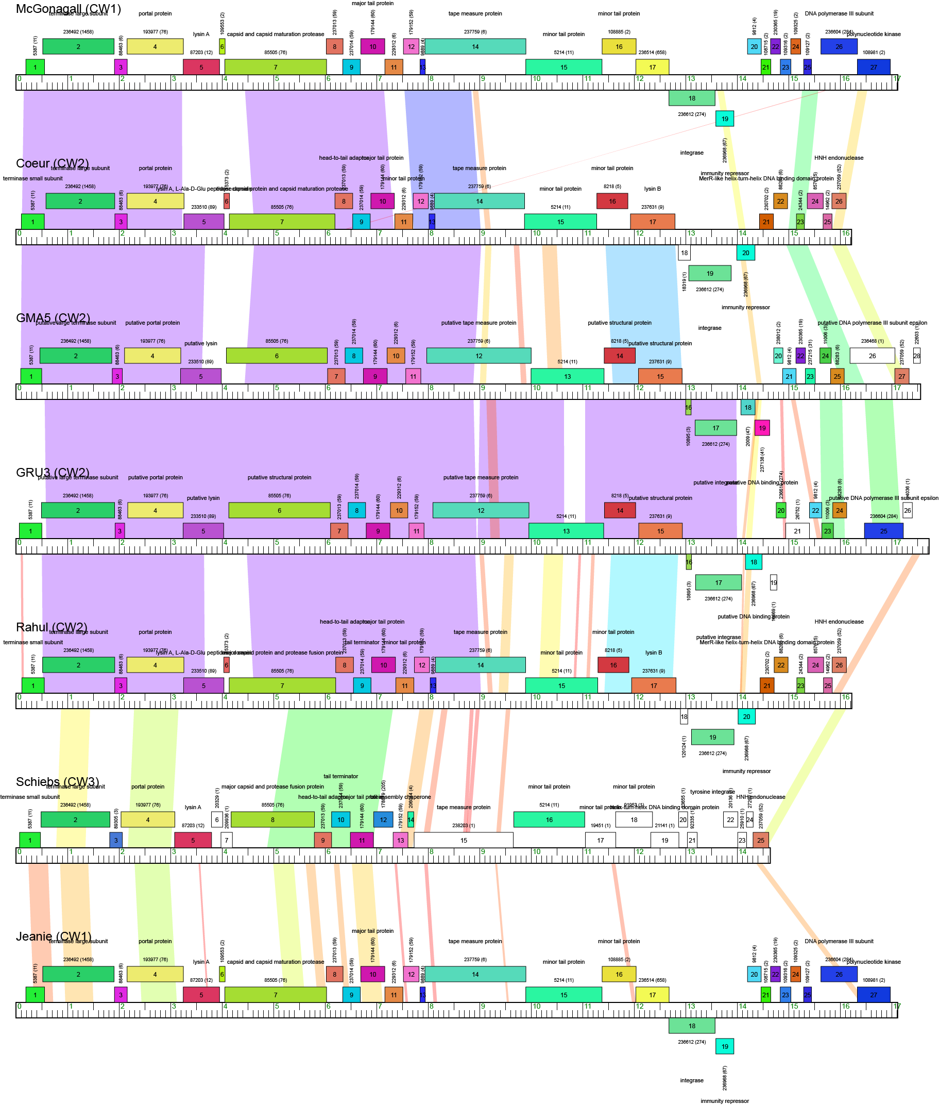
Cluster CW
Similarity of smaller genomes can be particularly swayed by choice of metric

Slide 50
Can We Automate Clustering?
Takes time to investigate individually
Sequencing is now much faster
Consistency with existing set?
But…
What approach? Nucleotide level? Amino acid level? Both?
What does similar mean? Percent identity? Coverage?
Which linkage?
Notes:
Existing Clusters are good, GFH made them! ;)

Slide 51
Types of Linkage
GCS % | Cluster Member 1 | Cluster Member 2 | Cluster Member 3 | Cluster Member 4 | Cluster Member 5
Candidate 1 | 39% | 31% | 40% | 32% | 34%
Candidate 2 | 28% | 36% | 31% | 32% | 28%
Candidate 3 | 46% | 43% | 36% | 52% | 48%

Slide 52
Types of Linkage
Complete: Must exceed threshold (35%) with every current member
GCS % | Cluster Member 1 | Cluster Member 2 | Cluster Member 3 | Cluster Member 4 | Cluster Member 5
Candidate 1 | 39% | 31% | 40% | 32% | 34%
Candidate 2 | 28% | 36% | 31% | 32% | 28%
Candidate 3 | 46% | 43% | 36% | 52% | 48%

Slide 53
Types of Linkage
Average: Must exceed threshold (35%) on average
GCS % | Cluster Member 1 | Cluster Member 2 | Cluster Member 3 | Cluster Member 4 | Cluster Member 5
Candidate 1 | 39% | 31% | 40% | 32% | 34%
Candidate 2 | 28% | 36% | 31% | 32% | 28%
Candidate 3 | 46% | 43% | 36% | 52% | 48%

Slide 54
Types of Linkage
Single: Must exceed threshold (35%) with any current member
GCS % | Cluster Member 1 | Cluster Member 2 | Cluster Member 3 | Cluster Member 4 | Cluster Member 5
Candidate 1 | 39% | 31% | 40% | 32% | 34%
Candidate 2 | 28% | 36% | 31% | 32% | 28%
Candidate 3 | 46% | 43% | 36% | 52% | 48%

Slide 55
Can We Automate Clustering?
Takes time to investigate individually
Sequencing is now much faster
Consistency with existing set?
But…
What approach? Nucleotide level? Amino acid level? Both?
What does similar mean? Percent identity? Coverage?
Which linkage?
Can we replicate existing historical clusters?
Notes:
Existing Clusters are good, GFH made them! ;)

Slide 56
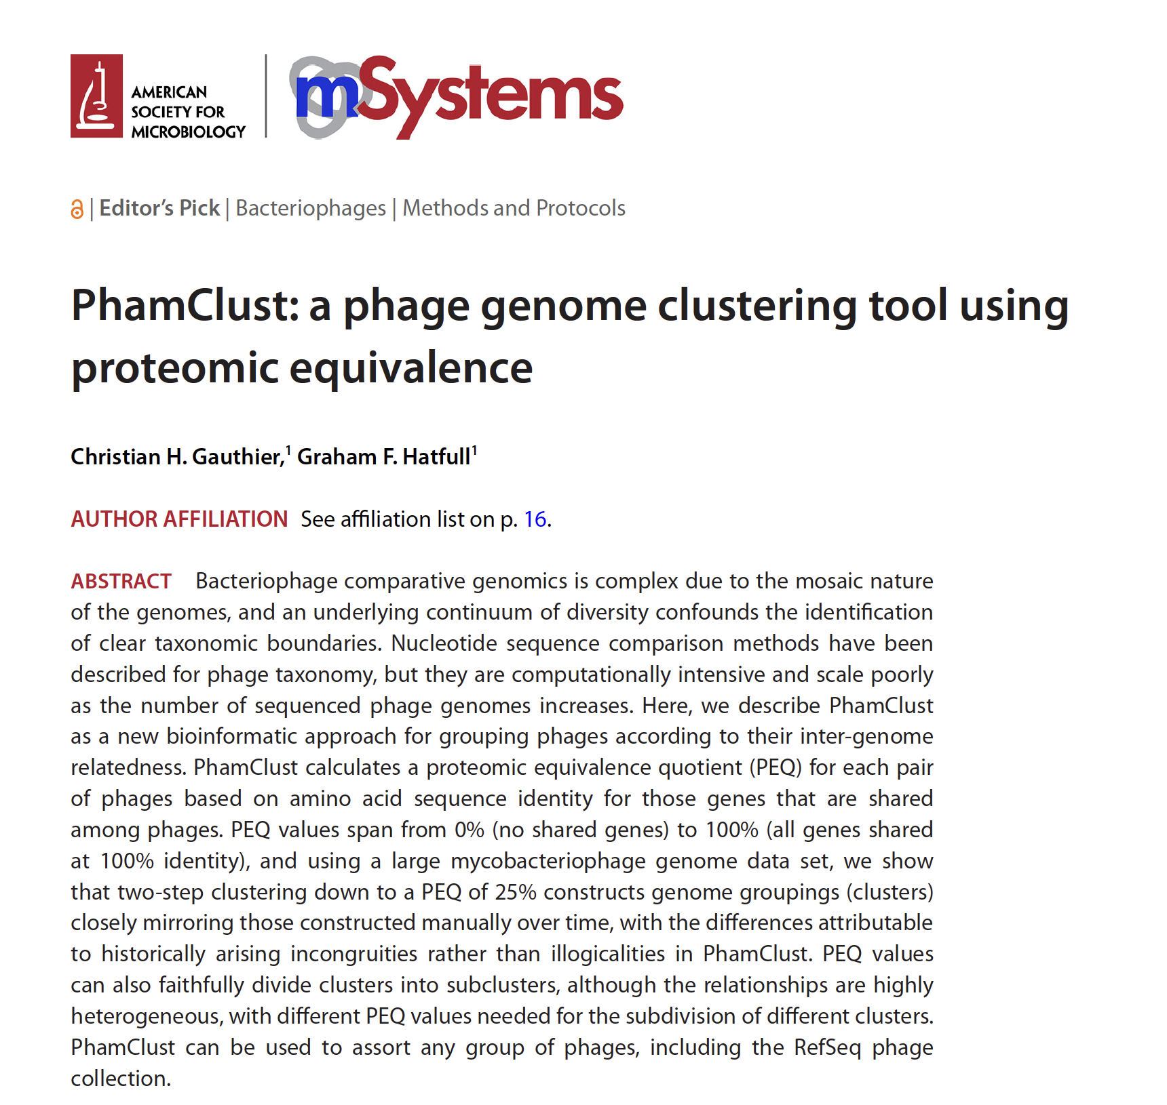

Slide 57
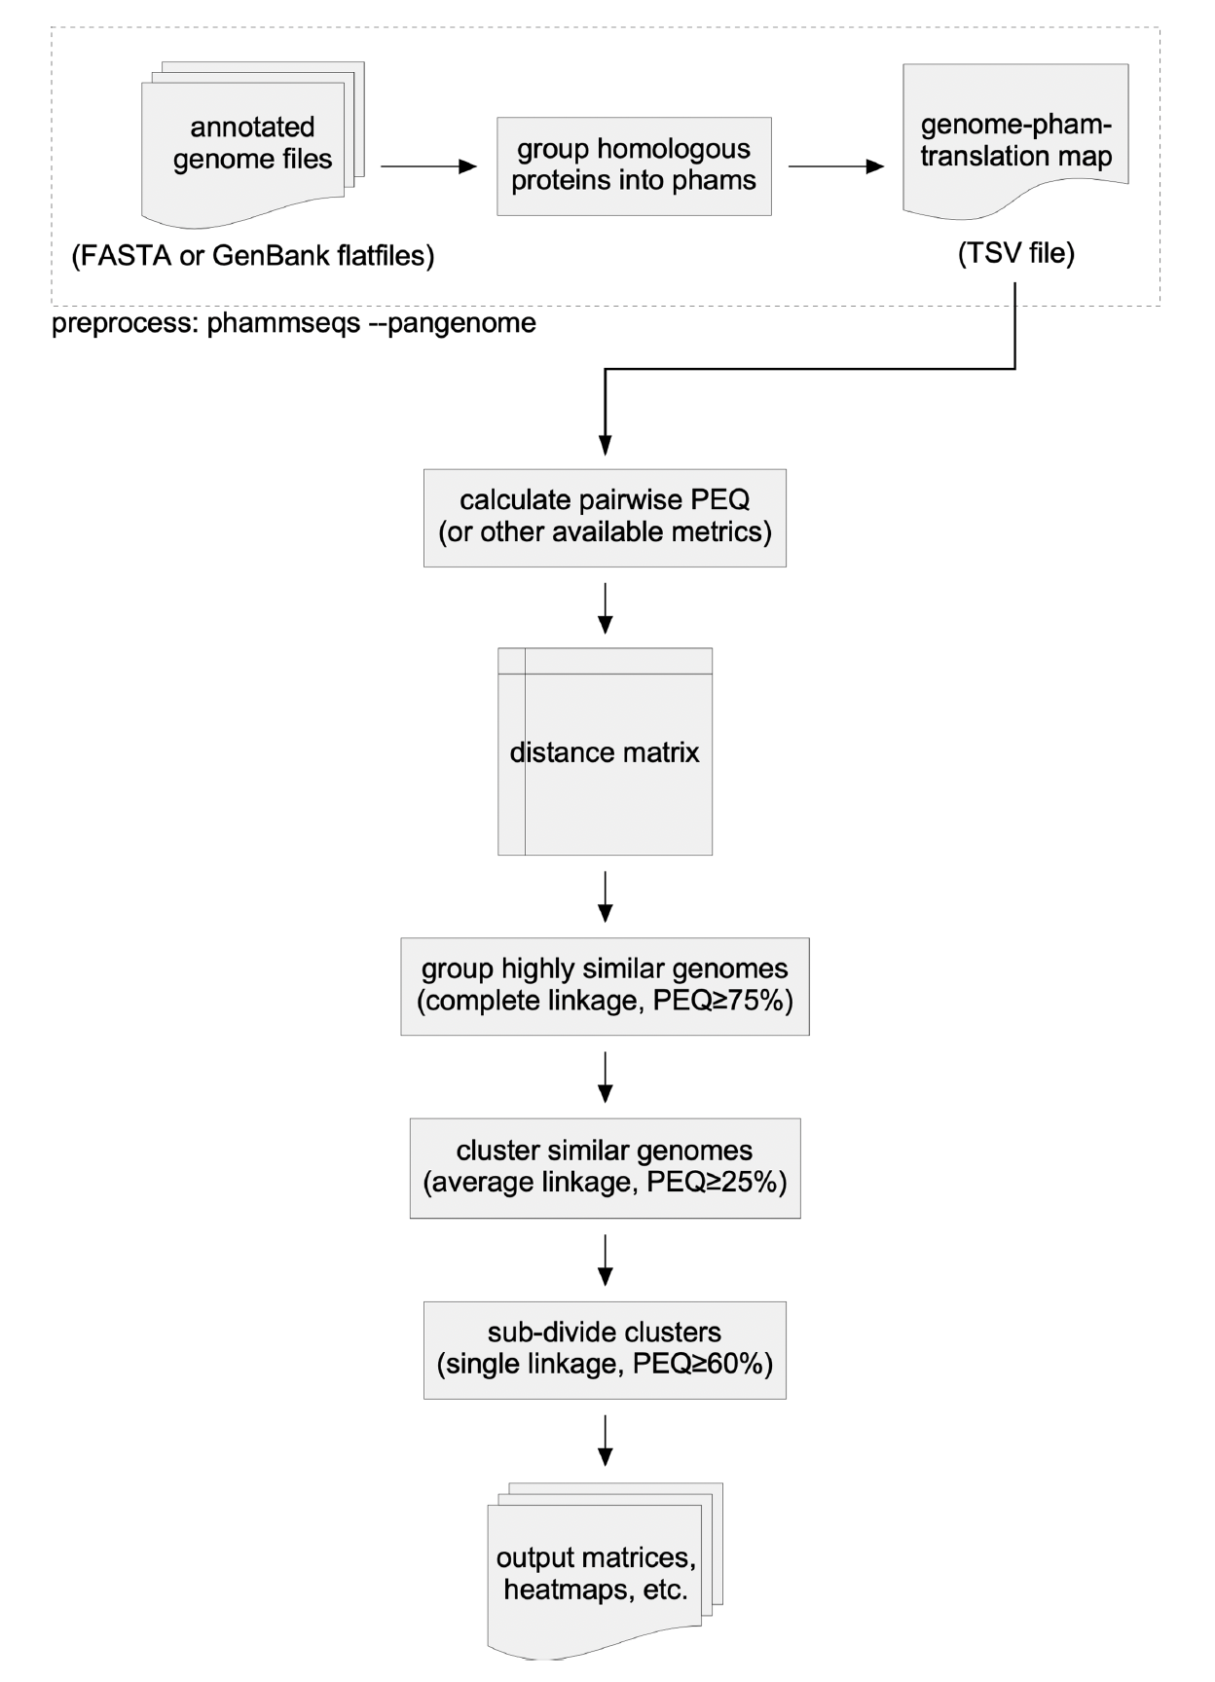
PhamClust
Protein Equivalence Quotient (PEQ)
Takes into account proportion of the genes that are shared and how similar homologous genes are
Two-Step Clustering
First, complete linkage @ 75% PEQ
Then, average linkage @ 25% PEQ
Subclustering
Single linkage, different values

Slide 58
PhamClust
Can we replicate existing historical clusters?
“This two-step clustering workflow produced 33 clusters and 7 singletons, in close alignment to the extant groupings of 31 clusters and 7 singletons.”
One Free Phage
Genome Sequence
if you can tell me which are the two previously existing subclusters PhamClust spun off into their own new Clusters?
Notes:
Graham found A1 with Clusterator!

Slide 59
(Published) Thoughts on Clustering Phages
“A primary utility of clustering the genomes is to facilitate identification of genes and modules that have been exchanged between genomes by lateral gene transfer in recent evolutionary time and that contribute to the mosaic architectures of phage genomes.” –eLife 627-Phage Paper
“…the organization of related mycobacteriophages into clusters provides a framework for identifying and interpreting gene trafficking within and among potentially distinct groups of genomes.” –60 Phage Paper
“Thus, the clusters, although biologically meaningful, are separated by boundaries that are not very sharply defined and, we suspect, are intrinsically incapable of being sharply defined.” –60 Phage Paper
“Furthermore, because no new singleton was discovered, this would suggest that most of the major clusters have been identified.” –60 Phage Paper
Notes:
Graham found A1 with Clusterator!

Slide 60
(Published) Thoughts on Clustering Phages
“A primary utility of clustering the genomes is to facilitate identification of genes and modules that have been exchanged between genomes by lateral gene transfer in recent evolutionary time and that contribute to the mosaic architectures of phage genomes.” –eLife 627-Phage Paper
“…the organization of related mycobacteriophages into clusters provides a framework for identifying and interpreting gene trafficking within and among potentially distinct groups of genomes.” –60 Phage Paper
“Thus, the clusters, although biologically meaningful, are separated by boundaries that are not very sharply defined and, we suspect, are intrinsically incapable of being sharply defined.” –60 Phage Paper
“Furthermore, because no new singleton was discovered, this would suggest that most of the major clusters have been identified.” –60 Phage Paper
Notes:
Graham found A1 with Clusterator!

Slide 61
Outline
Spoiler
Part One: Imbroglios of Viral Taxonomy
Part Two: Clusters Begin
Part Three: Defining, Refining, Redefining, Automating
What’s coming next?
If I know you guys, it’ll be more phage genomes!
Notes:
More phages!

Slide 62
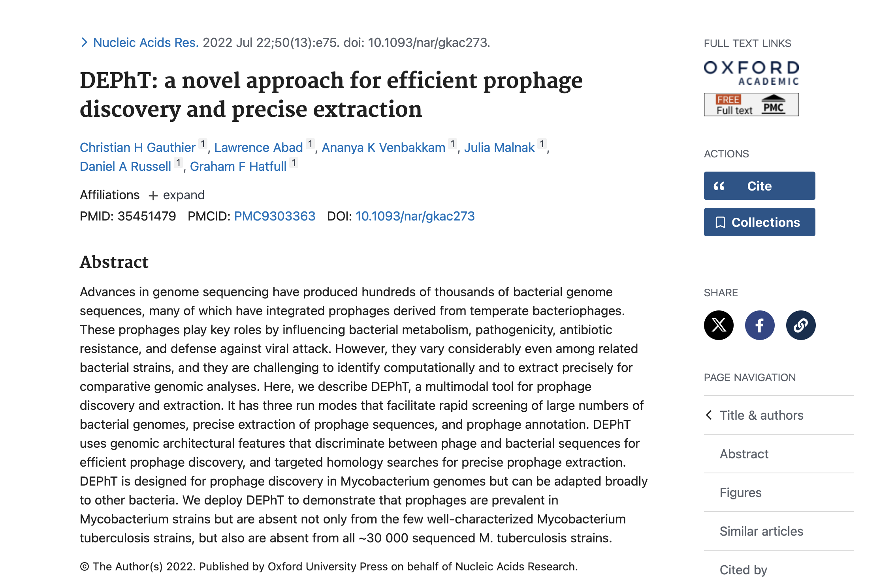

Slide 63
Detection and Extraction of Phages Tool (DEPhT)
“Searching the 2498 genomes with fewer than 100 contigs (1799 of which are M. abscessus) identified 2630 prophages present in 1479 genomes.”
Hopefully, by the end of 2025, these prophages (and LPSIPs) will be in PhagesDB, and will be clustered with everything else using DEPhT.

Slide 64
Key Points
Categorizing phage genomes is tricky, partly due to their mosaic nature
Horizontal gene transfer confounds hierarchical taxonomy
Clusters can be useful, even if not biologically “True”
Underlying population is likely a continuum of diversity
Sampling: New data will challenge existing delineations/methods
We have clustered in a few ways over the years, perhaps PhamClust will be the future?

Slide 65
Thanks! Questions?

Slide 67
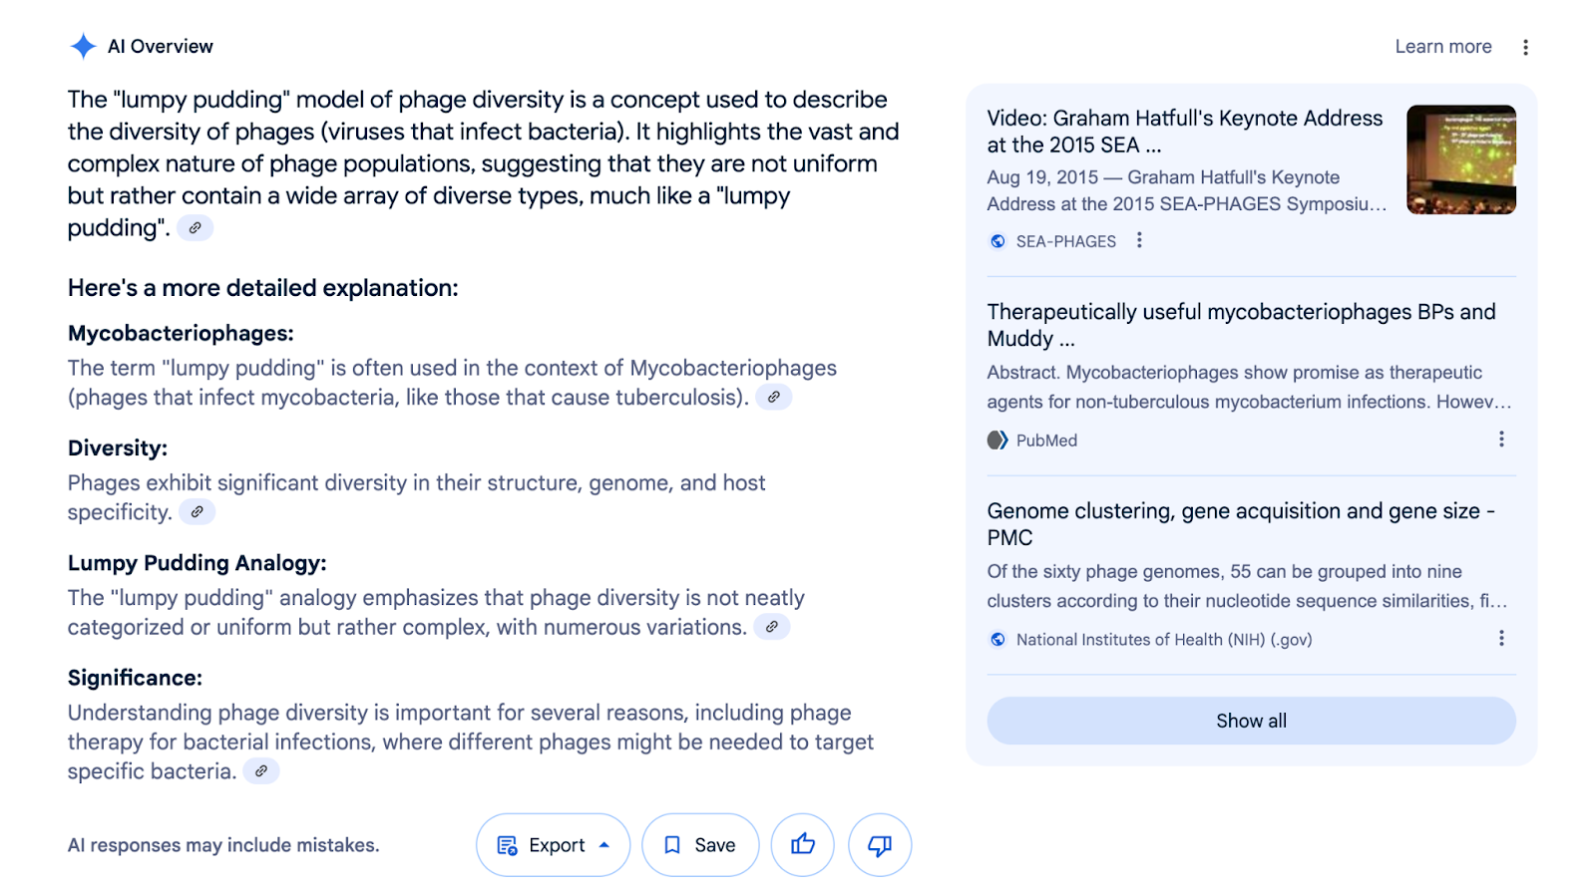

Slide 68
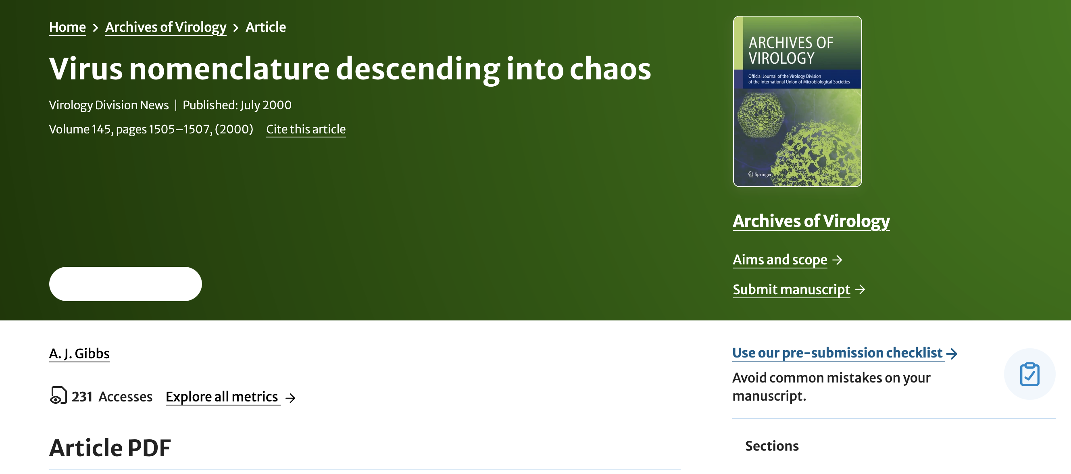

Slide 69
YES

Slide 70
NO

