Slide 1
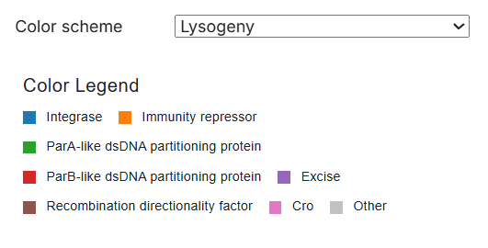
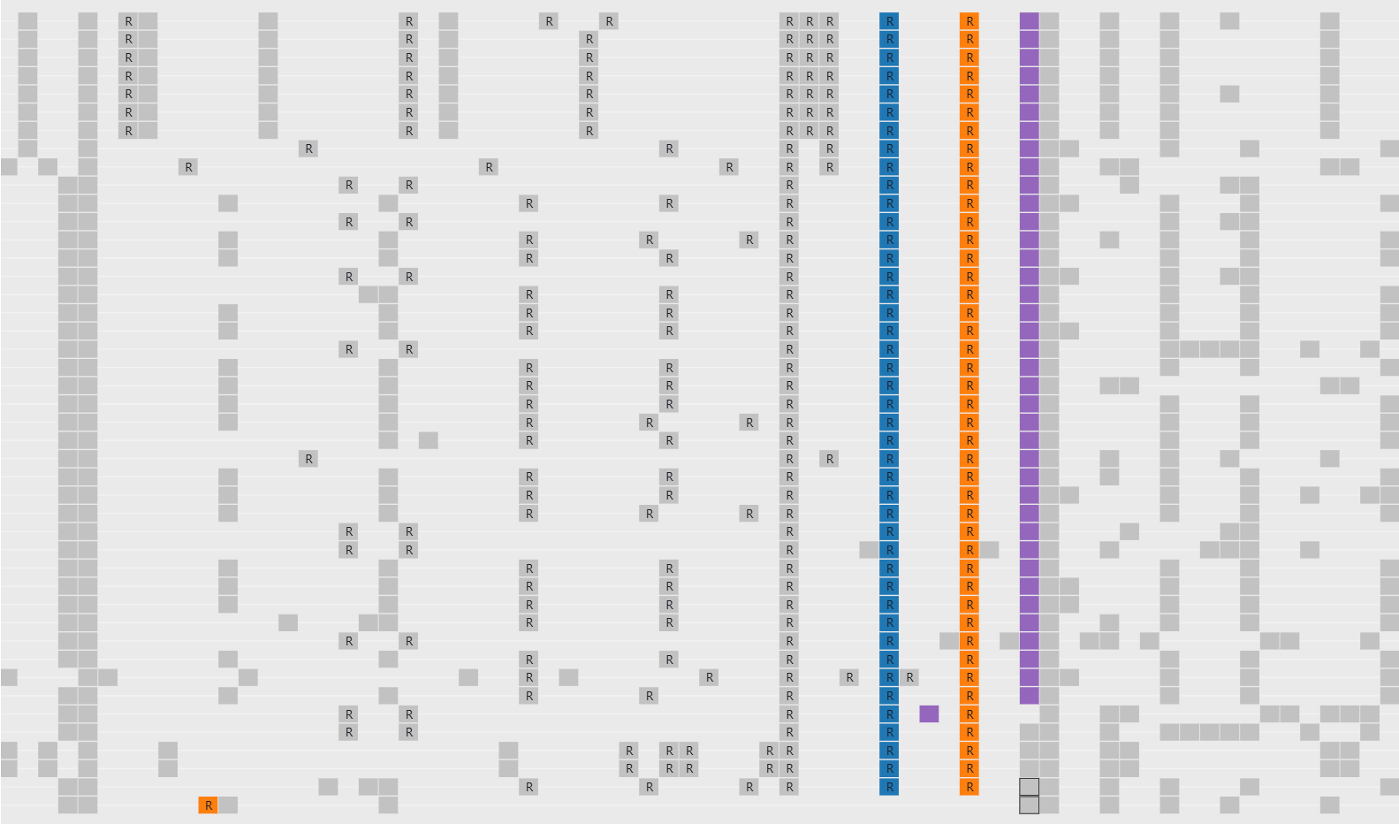
Cluster Exploration
Genes Involved in Lysogeny
Appendix B
Cobb et al., Pham Matrices. Accessed June 2, 2025. Observable. https://observablehq.com/@cresawn-labs/pham-matrix.

Slide 2
Cluster Exploration
Genes Involved in Lysogeny
Figure 2
(38)
int
rep
1
excise
1
(1)
int
rep
1
excise
2
(3)
int
rep
1
NKF
(1)
int
rep
1
DNA binding
(1)
rep
2
DNA binding
Figure 2. Architecture of genes associated with lysogeny in Cluster N phages. Analysis of 44 Cluster N phages reveals 5 different gene arrangements. Boxes represent genes in the forward orientation. A box with an arrow indicates a gene in the reverse orientation. (#) indicates the number of phages with the indicated gene arrangement. int = integrase; rep = immunity repressor; DNA binding = DNA binding domain protein. Excise 1 and excise 2 indicate excise genes in two different phams. Rep1 and rep2 indicate repressor genes in two different phams.

