Slide 1
AUTHOR CARD
TO USE THIS DATACARD TEMPLATE,
REPLACE ALL HGHLIGHTED TEXT WITH THE APPROPRIATE INFORMATION FOR YOUR DATASET
Successful/Unsuccessul Lysogen Preparation for Jerole, a subcluster AS2 phage isolated using Arthrobacter globiformis B-2979
Bethany Wise, Viknesh Sivanathan
Center for the Advancement of Science, Leadership and Culture, Howard Hughes Medical Institute
sivanathanv@hhmi.org

Slide 2
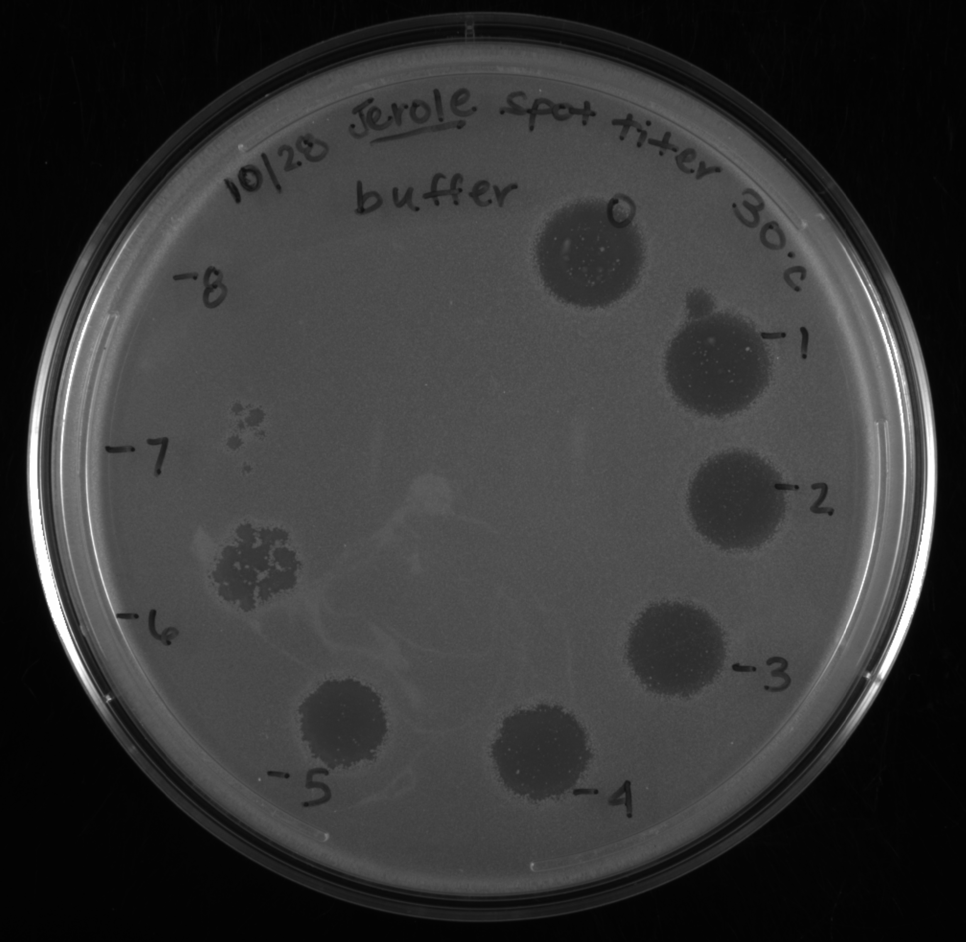
DATA CARD: Spot Plate for Mesa Formation (Protocol 11.1)
Phage | Jerole
Lawn | Arthrobacter globiformis B-2979
Incubation temperature | 30 ˚C
Incubation durations (days) | 2 days
Description: Candidate lysogens for phage Jerole were generated by spotting a dilution series of a lysate for phage Jerole onto top agar supplemented with Arthrobacter globiformis B-2797. At the lower dilutions, clearings with a light mesa and some individual colonies were observed after incubation for 2 days at 30 ˚C

Slide 3
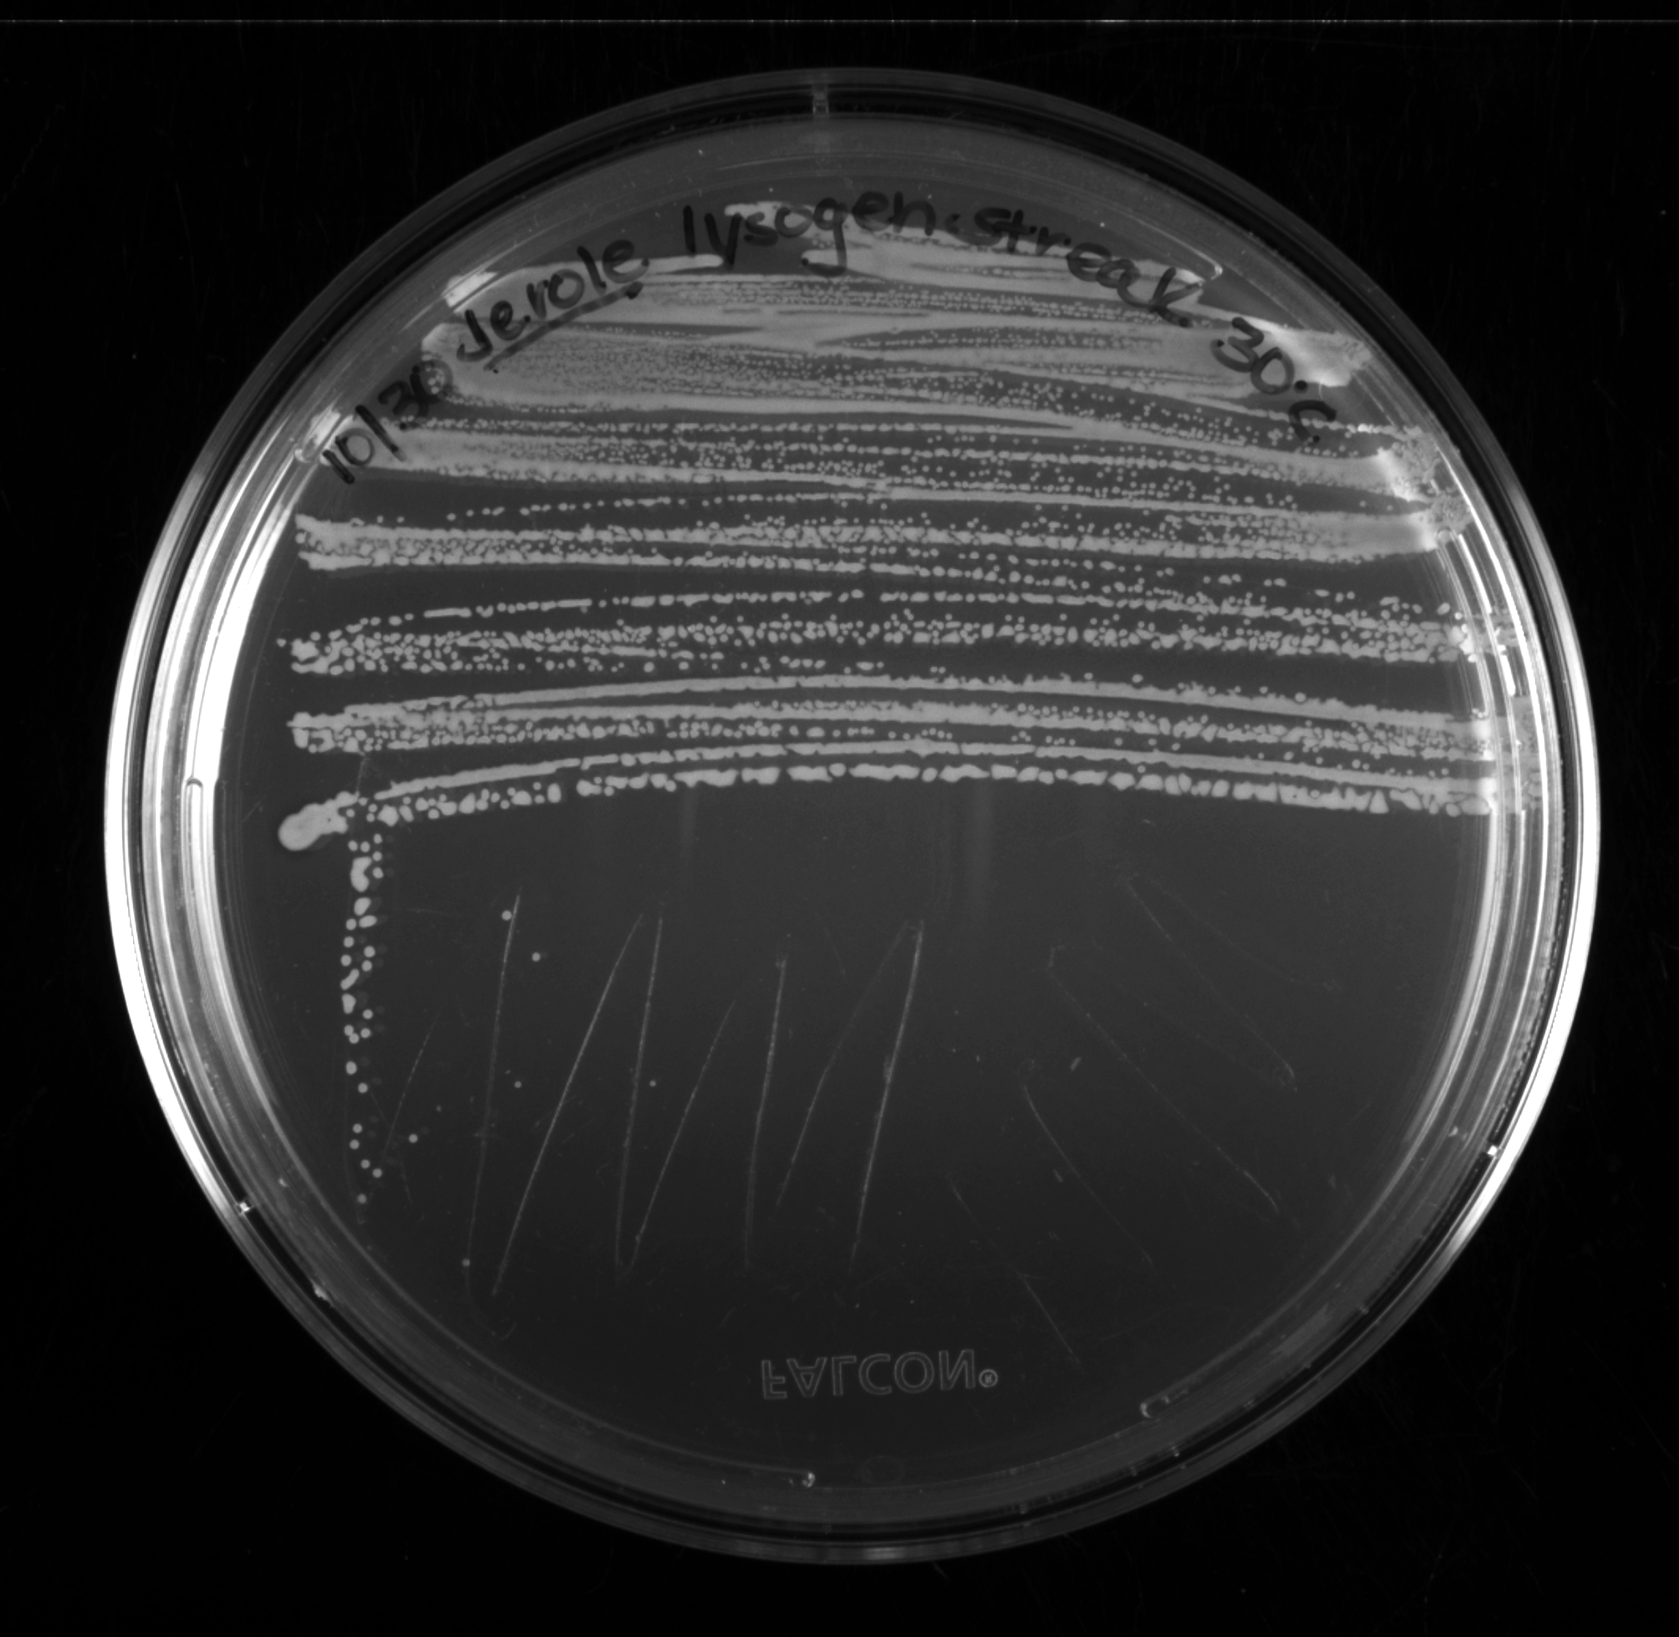
DATA CARD: Colony Isolation from Spot Plate Clearing via Streak Plate (Protocol 11.1)
Incubation temperature | 30 ˚C
Incubation durations (days) | 2 days
Description: From the mesa for the undiluted spot, bacterial cells (candidate lysogens) were gathered and streaked onto a plate, which was incubated at 30 ˚C for 2 days for colony formation.

Slide 4
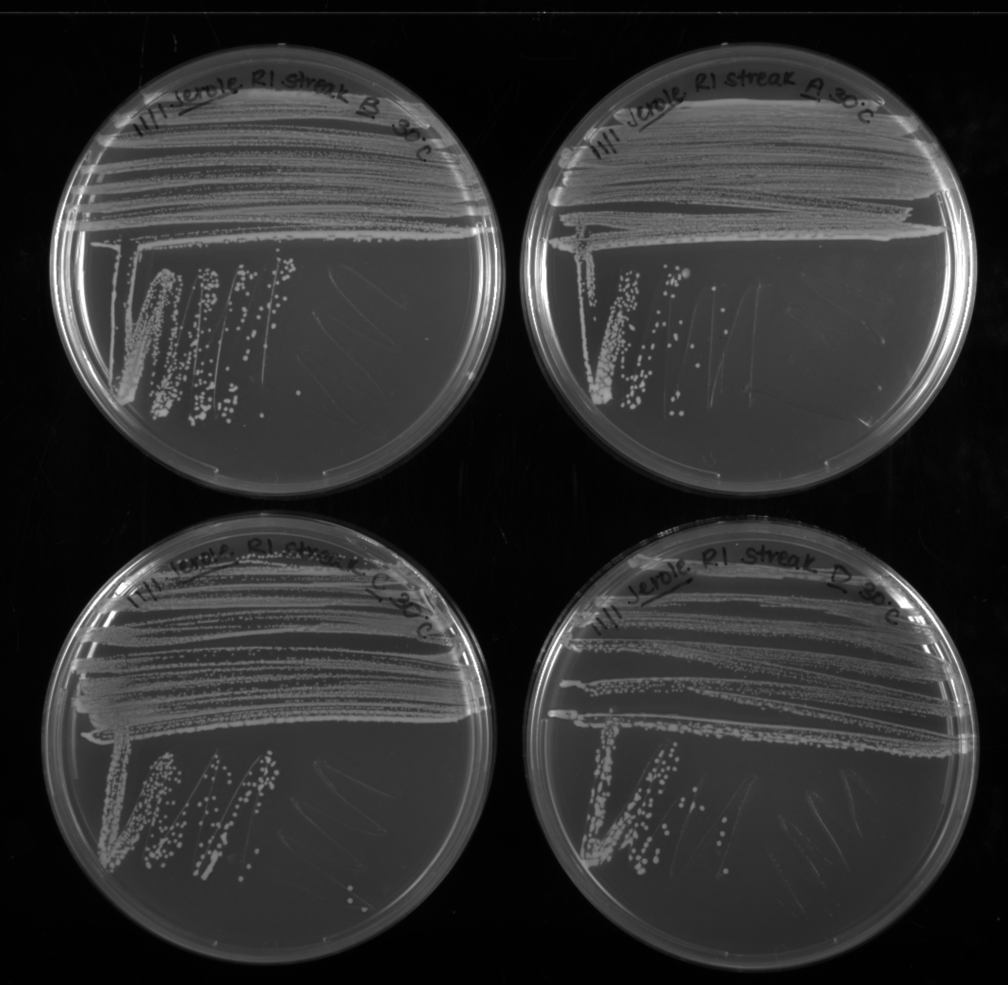
DATA CARD: Colony Purification of Four Candidate Lysogens via Streak Plate (Protocol 11.1)
Incubation temperature | 30 ˚C
Incubation durations (days) | 2 days
Description: Of the colonies that formed for bacteria collected from the mesa, four were selected and purified by another round of streaking. Plates were incubated at 30 ˚C for 2 days.

Slide 5
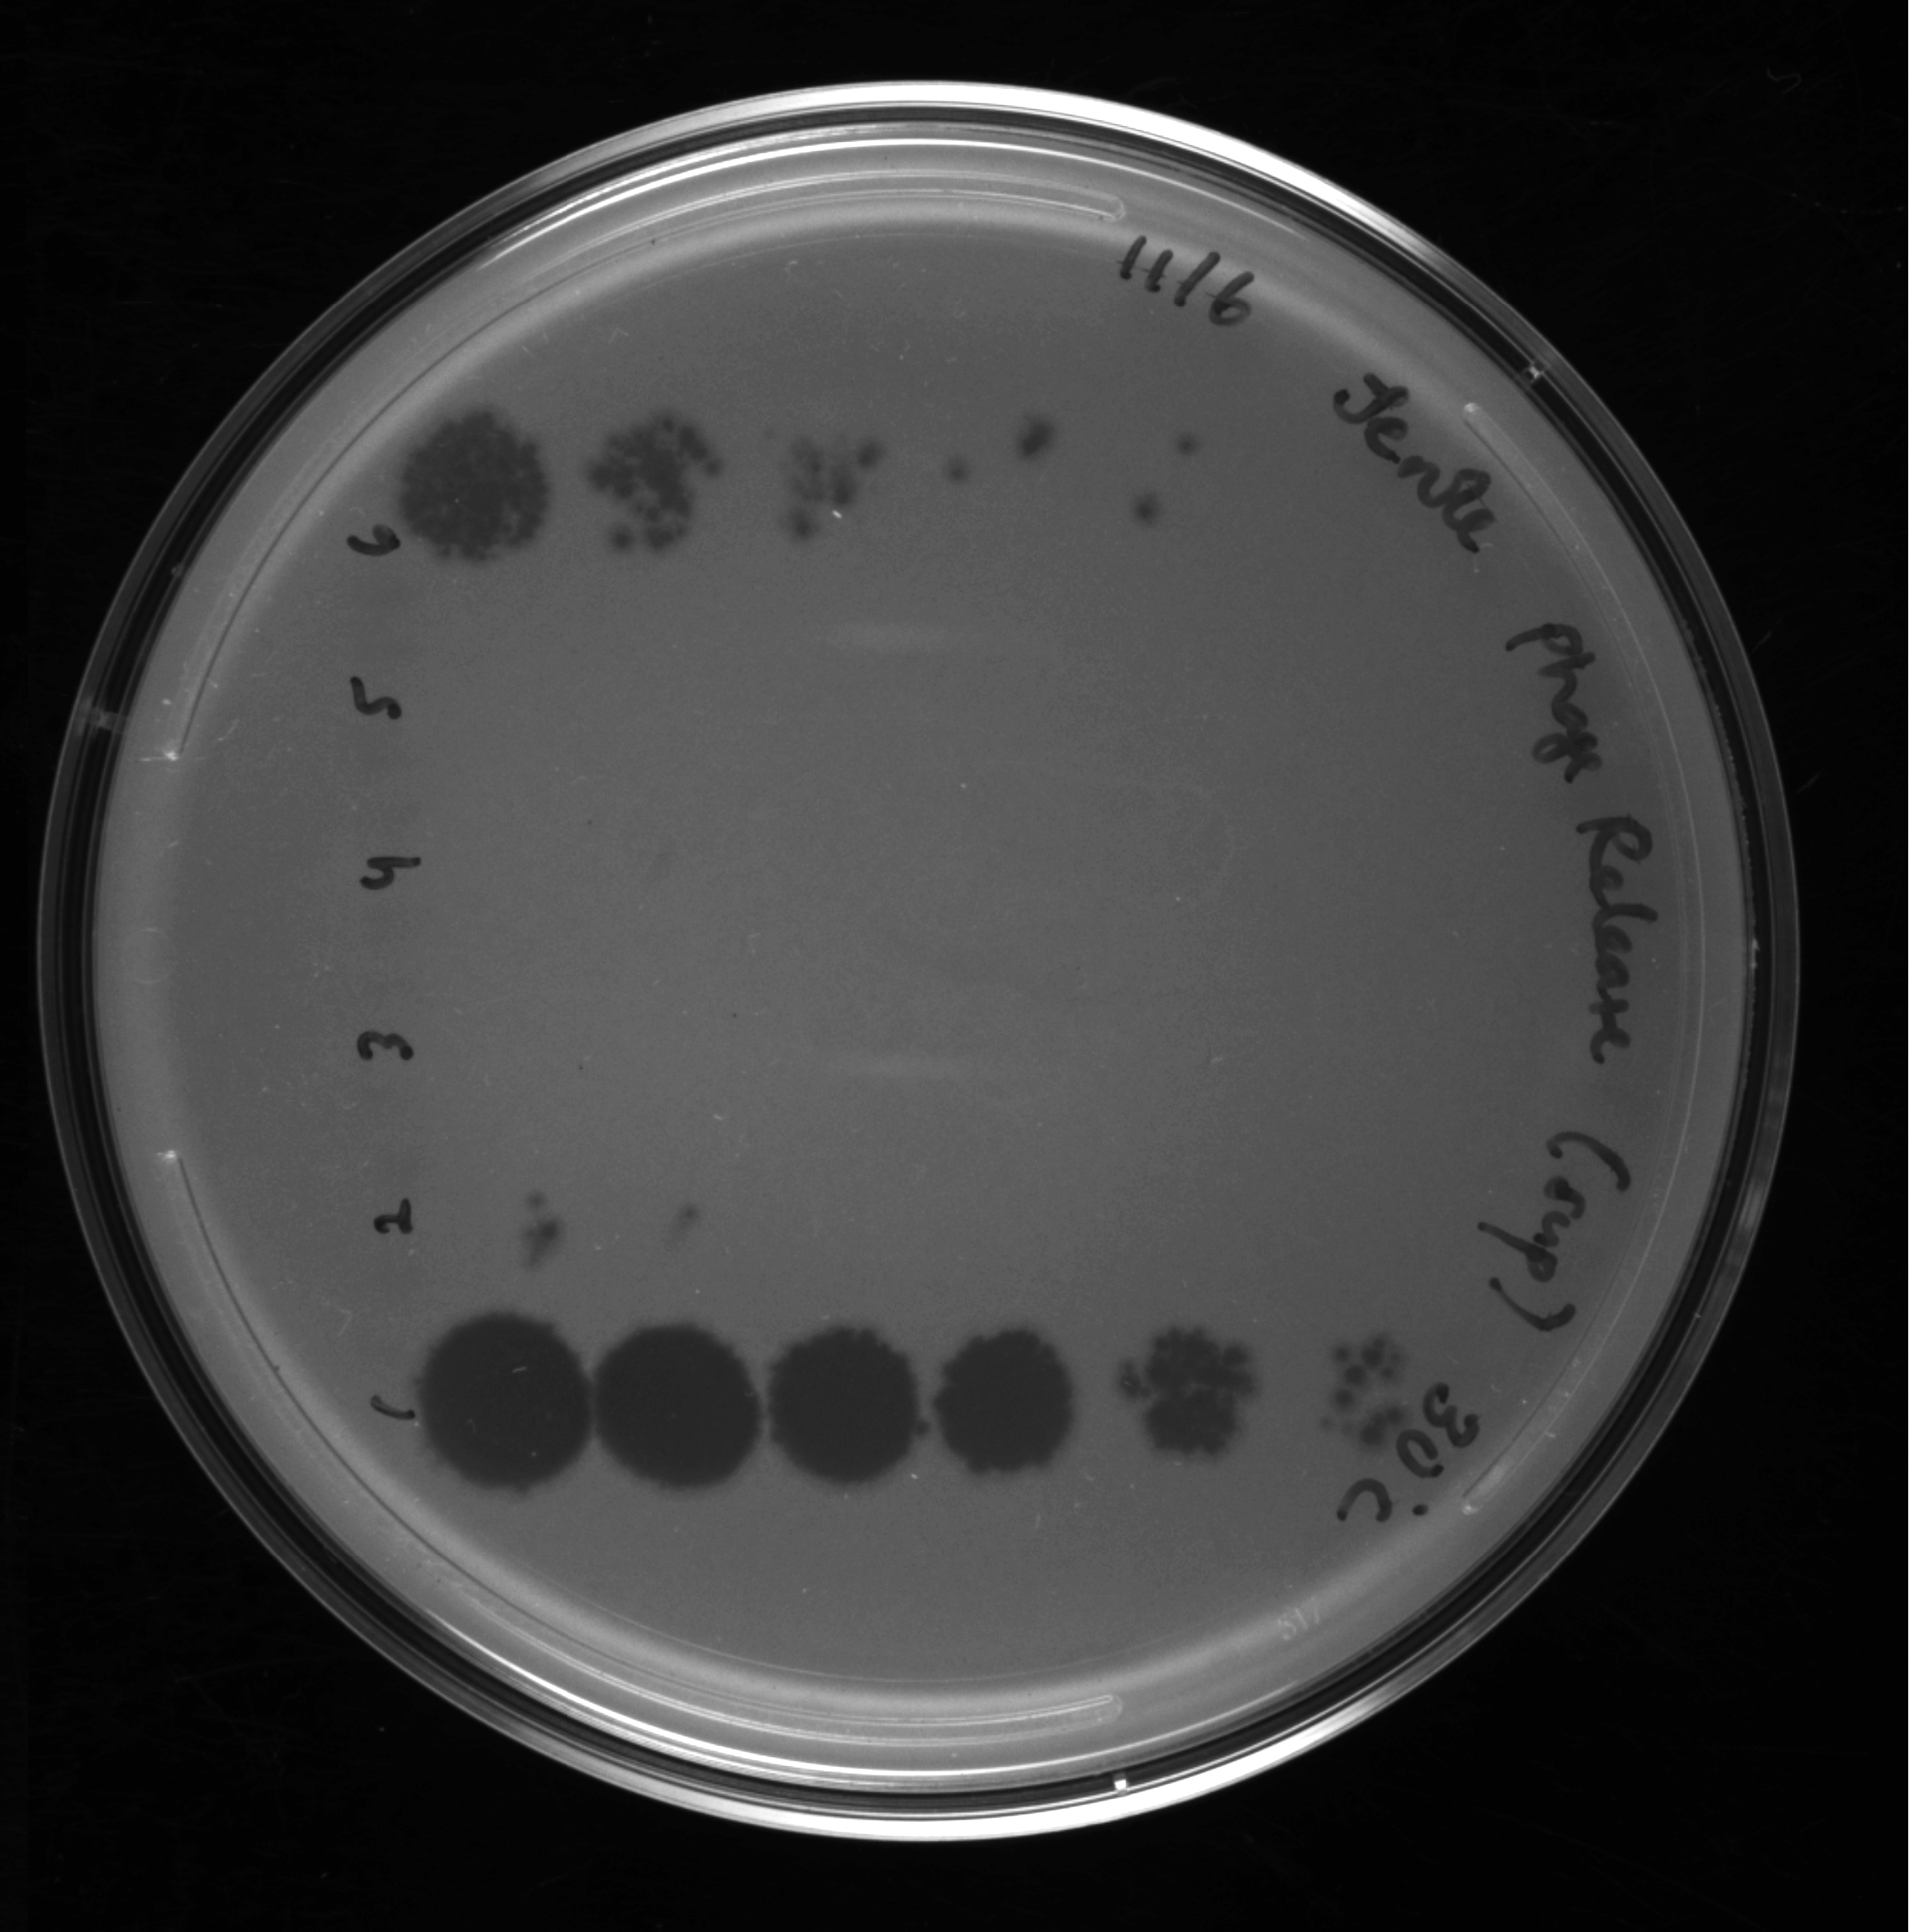
DATA CARD: Lysogen Determination via Phage Release (Protocol 11.3)
Lawn | Arthrobacter globiformis B-2979
Negative Control | Arthrobacter globiformis B-2979 culture supernatant
Candidate Lysogens A - D | Lysogen culture supernatant
Incubation temperature | 30 ˚C
Incubation durations (days) | 1 day
Description: A colony for each candidate lysogen was used to inoculate a liquid culture. After 2 days of incubation at 30 ˚C with shaking, the resulting cultures was spun and filtered, and the filtrate for one candidate (candidate D) tested positive for the presence of phage in a spot titer assay.
Candidate Lysogen D
Candidate Lysogen C
Candidate Lysogen B
Candidate Lysogen A
Negative Control
Jerole

Slide 6
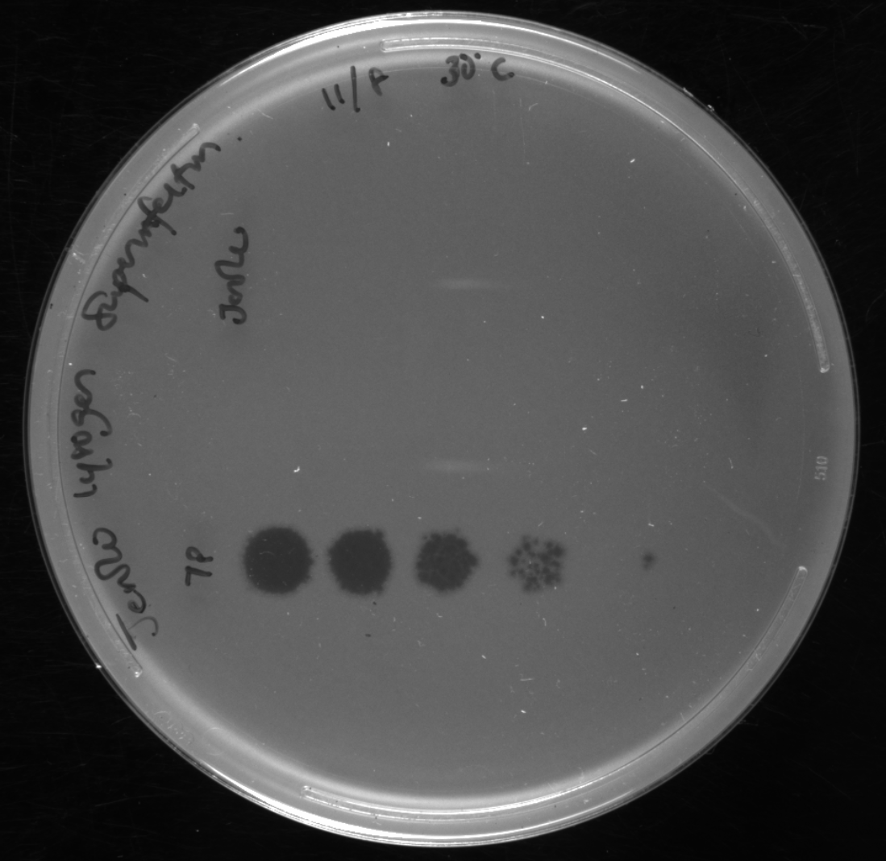
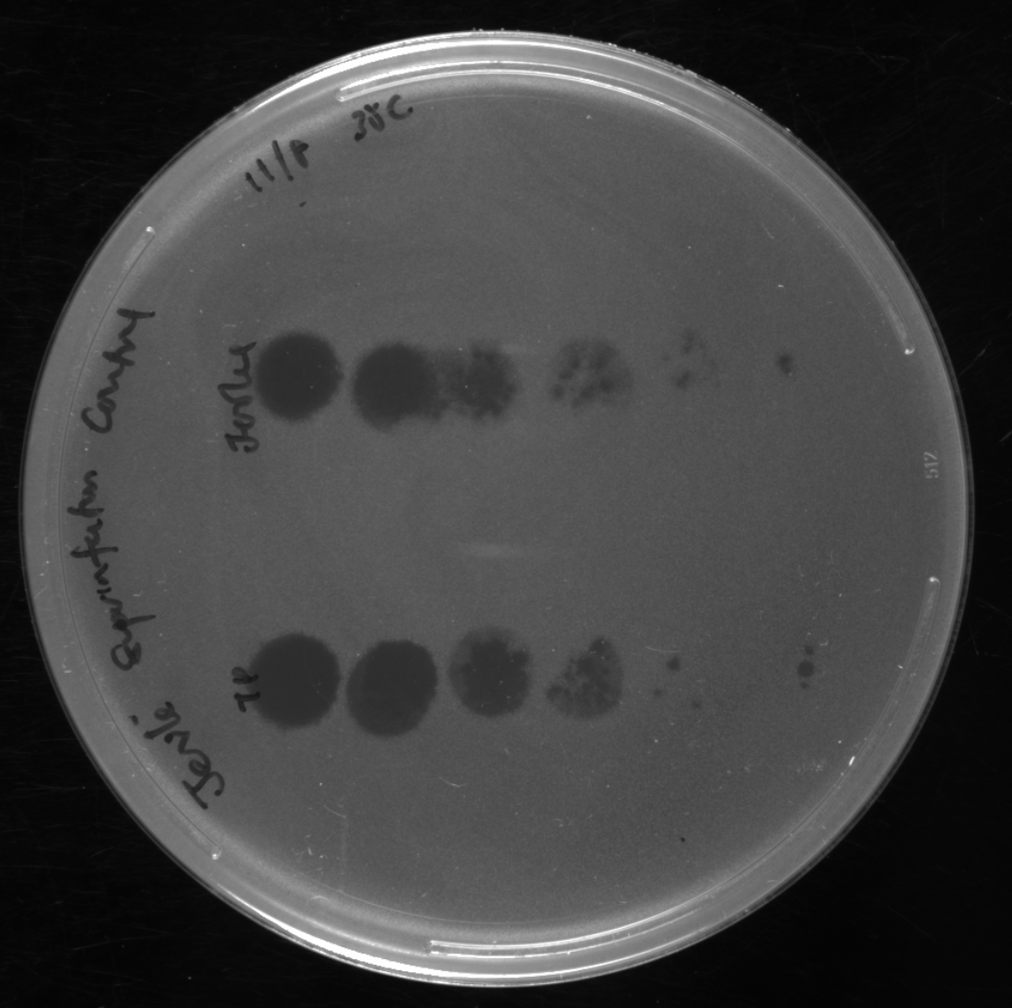
DATA CARD: Lysogen Confirmation via Superinfection Immunity (Protocol 11.4)
Lawn | Candidate Lysogen D
Incubation temperature | 30 ˚C
Incubation durations (days) | 1 day
Description: The culture of candidate lysogen D was then prepared as a top agar lawn and observed to be immune to superinfection by Jerole but not by a TrixiePhattel, a phage from a different cluster and presumed to be lytic.
Jerole
TrixiePhattel
Lawn | Arthrobacter globiformis B-2979
Incubation temperature | 30 ˚C
Incubation durations (days) | 1 day
Description: Both Jerole and TrixiePhattel were able to infect a lawn of A. globiformis B-2979
Jerole
TrixiePhattel

