Slide 1
Lysogen Formation Data Card
LYSOGEN FORMATION DATA CARD
Data Cards serve as the essential primary research records for SEA research. They document the raw data generated by SEA researchers with enough information and analysis to be clear, interpretable, and useful to the broader scientific community. The following checklist indicates what is required for a data card on lysogen formation to be accurate and interpretable. Please consult this guide throughout your research— while planning experiments, as you collect data, and as you prepare and evaluate Data Cards
Objective: Submitted data should allow for confirmation of lysogen formation.
DATACARD CHECKLIST | ✓
The experiment reports on the release of a given phage in a culture of a lysogen prepared using that phage, following protocol 11.3 in the Phage Discovery Guide, and includes additional controls listed below.
Positive control: Appropriate dilutions of the phage lysate are spotted along a straight line on a top agar lawn of the original isolation host for that phage. A reduction in plaque formation should be observed consistent with the dilutions.
Negative control: Dilutions of the supernatant from a culture of the isoaltion host, from 10⁰ to 10⁻⁵, should spotted on the same plate, in parallel to spots for the positive control.
Lysogen Sample: Dilutions of the supernatant from of a lysogen, from 10⁰ to 10⁻⁵, should be spotted on the same plate, in parallel to spots for the positive and negative control.
Plaques should be visible for the lysogen supernatant, and a reduction in plaque formation should be observed consistent with the dilutions.
Clear images are provided with entire plate visible and plaque formation observable.
The data card is completed with accurate information, including name of the phage (i.e. positive control), the host, incubation time and temperature.
The author card has the author information.
The data description card describes the data, includes a brief description of the methodology, and any relevant references.
Sample data included were prepared by Dr. Heller of HHMI

Slide 2
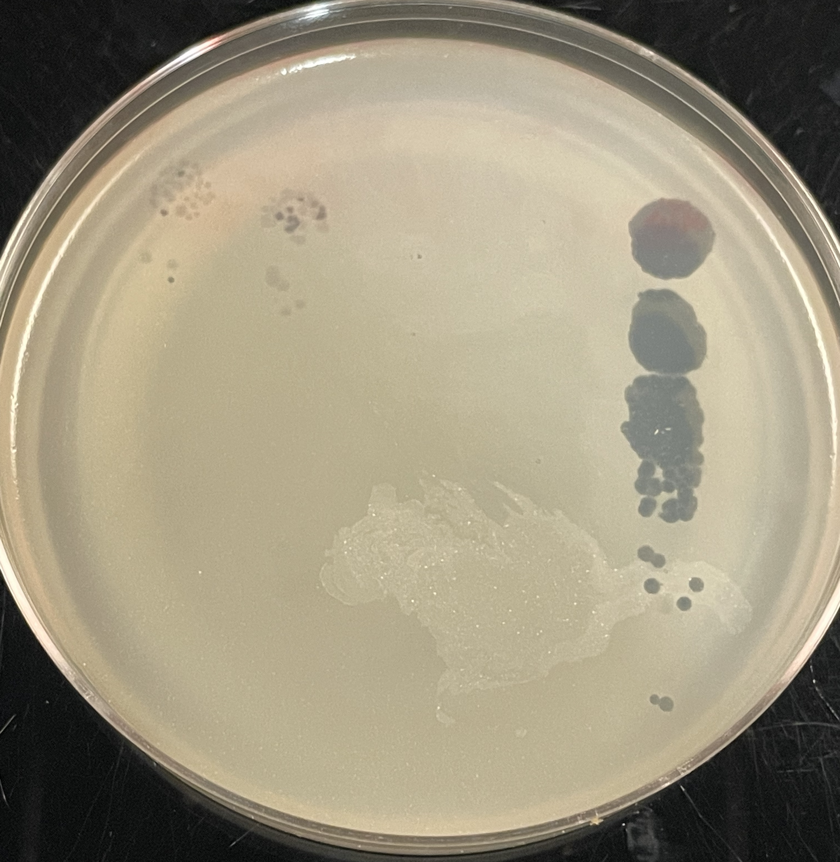
SAMPLE DATA CARD
negative control
lysogen #1
lysogen #2
positive control
positive control | Waterfoul
negative control | Supernatant from culture of M. smegmatis mc² 255
Lawn | M. smegmatis mc² 255
Incubation temperature | 37 ˚C
Incubation durations (days) | 2 days

Slide 3
AUTHOR CARD
Title:
Authors:
Author Affiliations:
Corresponding Author Email:

Slide 4
TEMPLATE DATA CARD
negative control
positive control
lysogen
positive control
negative control
Lawn
Incubation temperature
Incubation durations (days)

Slide 5
DATA DESCRIPTIONS CARD
Description of Data and Observations: Replace this text with a brief description of your data and your interpretation.
Methods: Replace this text with any deviations from the protocol for generating and testing lysogens (protocol 11.1, 11.2, and 11.3). Otherwise, state no “no deviations for standard protocols”
References: Replace this text with any relevant references

