Slide 1
HOST RANGE DATA CARD
Data Cards serve as the essential primary research records for the phage host range project. They document the raw data generated by SEA researchers with enough information and analysis to be clear, interpretable, and useful to the broader scientific community. The following checklist indicates what is required for a Host Range Data Card to be accurate and interpretable. Please consult this guide throughout your research— while planning experiments, as you collect data, and as you prepare and evaluate Data Cards
Objective: Submitted data must include proper controls to allow for interpretation of host range experiment results.
DATA CARD CHECKLIST | ✓
The experiment compares plaque formation and lysate titer on at least 2 different hosts—the original host of isolation and closely-related hosts in the same genus .
Appropriate dilutions of lysates, from 10⁰ to 10⁻⁸, should be spotted in the same manner (placing, orientation) on plates/lawns of all hosts being assessed.
10-fold reduction is plaque formation for the dilution series should be evident on the plate with the original host. The calculated titer on the original host should be at least 10⁸ pfu/ml
Negative control (phage buffer) is spotted on each plate.
The data card is complete with clear plate images that are labeled properly with dilutions, date, name of strains, experimenter identifier code, incubation time and temperature, and control labels.
The interpretation of results (efficiency of plating) is consistent with the provided data.
The author card has the author information.
The data description card describes the data, includes a brief description of the methodology, and any relevant references.
This data card and sample data included were prepared by Dr. Butela of the University of Pittsburgh

Slide 2
HOST RANGE DATA CARD INSTRUCTIONS
Complete the host range experiment using Protocol 11.5 in the Phage Discovery Guide.
Using the template data card provided in this slide deck, insert a high-resolution photograph of the entire spot-titer plates -- one perform using the original isolation host and one for the alternative host. Prepare a similar data card for each additional alternative host tested in your experiment.
Place the plate containing the original isolation host on the left and the plate containing the alternative experimental host on the right. Label each with the appropriate host and phage name in a text box below the image.
In the text box at the very top of the slide, indicate how long the plates were incubated at 30 ºC.
Rotate each image so that the spotting pattern is the same, making interpretation easier.
If your labeling on the plate is not visible in the photograph are not visible, label each dilution spot with the appropriate dilution factor (10⁰, 10⁻¹, 10⁻², etc.) in text boxes centered at the bottom of each dilution spot. If your negative control spot’s label isn’t visible on the plate, label the negative control spot on each plate with ‘-’ in a text box centered at the bottom of that spot.
Calculate the titer of your phage on each host (see protocol 11.5 for guidance)/ Note: If you did not observe a ~10-fold decrease of plaques as you move down the dilution series, record “dilution error” in the titer column.
Calculate the “Efficiency of Plating” and record your interpretations (see protocol 11.5 for guidance).
Complete the template data card, author cover card, and data description cards. Submit these cards to sea@hhmi.org for considerations for publication on QUBES as part of SEA Research.

Slide 3
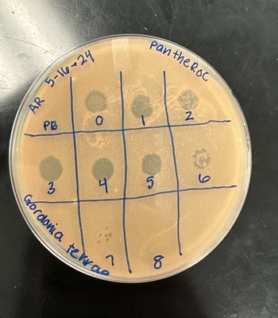
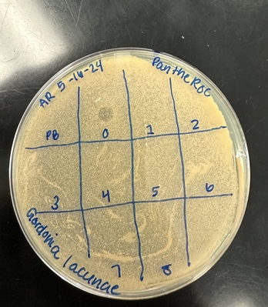
SAMPLE DATA CARD
Efficiency of plating: titer on alternative host/ titer on isolation host | 1.6 x 10⁻⁸
Interpretation: Phage may infect the alternate host, Gordonia lacunae, but more experiments would be needed to confirm this result since single plaques weren’t found on this plate. The clearing observed at the 10^0 square is either a result of "killing from without" in which some bacterial cells die not because of infection from the phage, but because they endure stress as a result of the presence of a large concentration of phages. The fact that no plaques or clearings were observed in any of the other squares/ lanes suggests "killing from without" as well. Alternatively, we cannot observe plaques due to the grainy appearance of the G. lacunae lawn. Performing a Full Plate Titer on this host is recommended as a next step. If plaques are observed, then PantheRoc can infect G. lacunae. If no plaques are observed, then we can conclude the clearing on this plate is killing from without.
Isolation Host | Gordonia terrae
Incubation temperature | 30 ˚C
Incubation durations (days) | 5 days
Phage | PantheRoc
Titer, pfu/ml (from plate above) | 2 x 10¹⁰ pfu/ml
Alternative Host | Gordonia lacunae
Incubation temperature | 30 ˚C
Incubation durations (days) | 5 days
Phage | PantheRoc
Titer, pfu/ml (from plate above) | 3 x 10² pfu/ml

Slide 4
AUTHOR CARD
Title:
Authors:
Author Affiliations:
Corresponding Author Email:

Slide 5
TEMPLATE DATA CARD
Isolation Host
Incubation temperature
Incubation durations (days)
Phage
Titer, pfu/ml (from plate above)
Alternative Host
Incubation temperature
Incubation durations (days)
Phage
Titer, pfu/ml (from plate above)
Efficiency of plating: titer on alternative host/ titer on isolation host
Interpretation:

Slide 6
DATA DESCRIPTIONS CARD
Description of Data and Observations: Replace this text with a brief description of your data and your interpretation.
Methods: Replace this text with any deviations from the protocol for host range experiments (protocol 11.5). Otherwise, state no “no deviations for standard protocol”
References: Replace this text with any relevant references

