Slide 1
Draft Annotation
An annotation in need of refinement

Slide 2
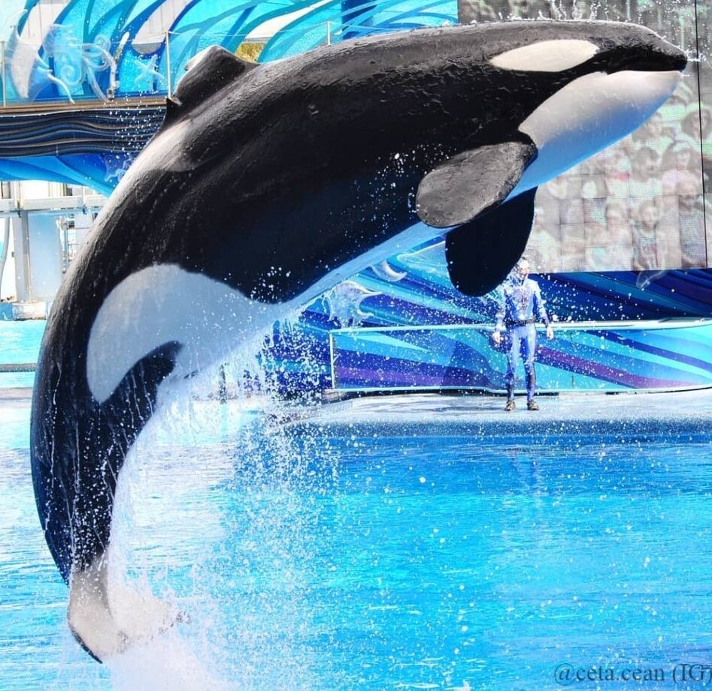
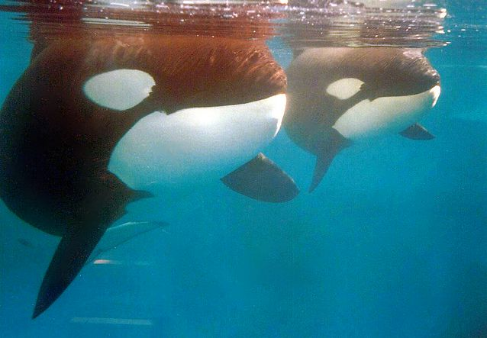

Slide 3
Guiding Principles

Slide 4
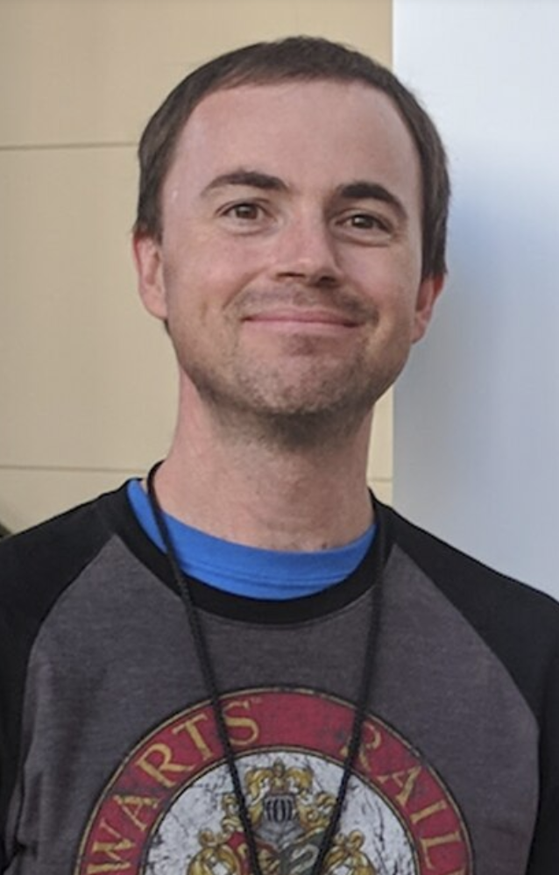
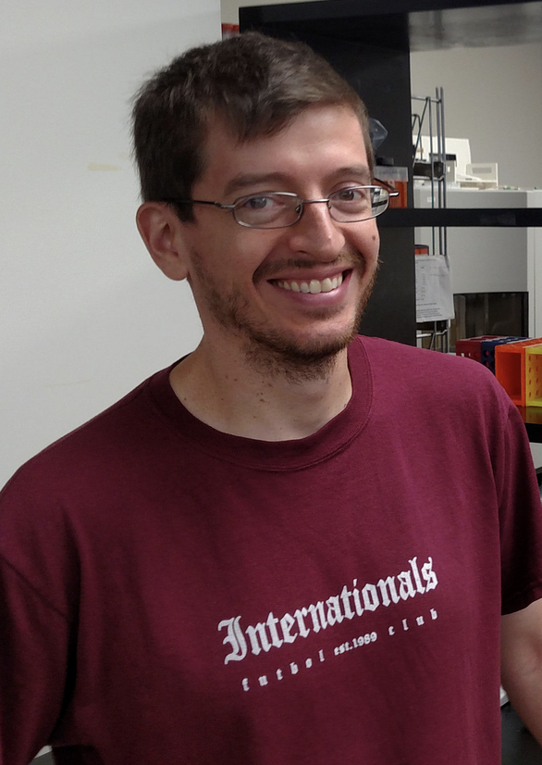
How did we get here?
Once a sequence is “finalized”, an automated draft annotation is sent to PDM_utils.
Database creation – PDM_Utils
Database display – Phamerator.org
PhagesDB display- lists/links
Steve Cresawn
Dan Russell

Slide 5
What do we know?
Go to phageDB (home page and phage page) and answer these questions:
  What is the host of this phage?
  What do we know about the host?
  What do we know about the phage?
    There are 517 sequenced Arthrobacter phages on phagesDB (2486 found)
    There are 40clusters of Arthrobacter phages (AK -> AZ, FA – FR, 6 singletons)
  What cluster is Quinn Avery in?
  How many members are in that cluster?
  What papers are written about Arthrobacter phages?

Slide 6
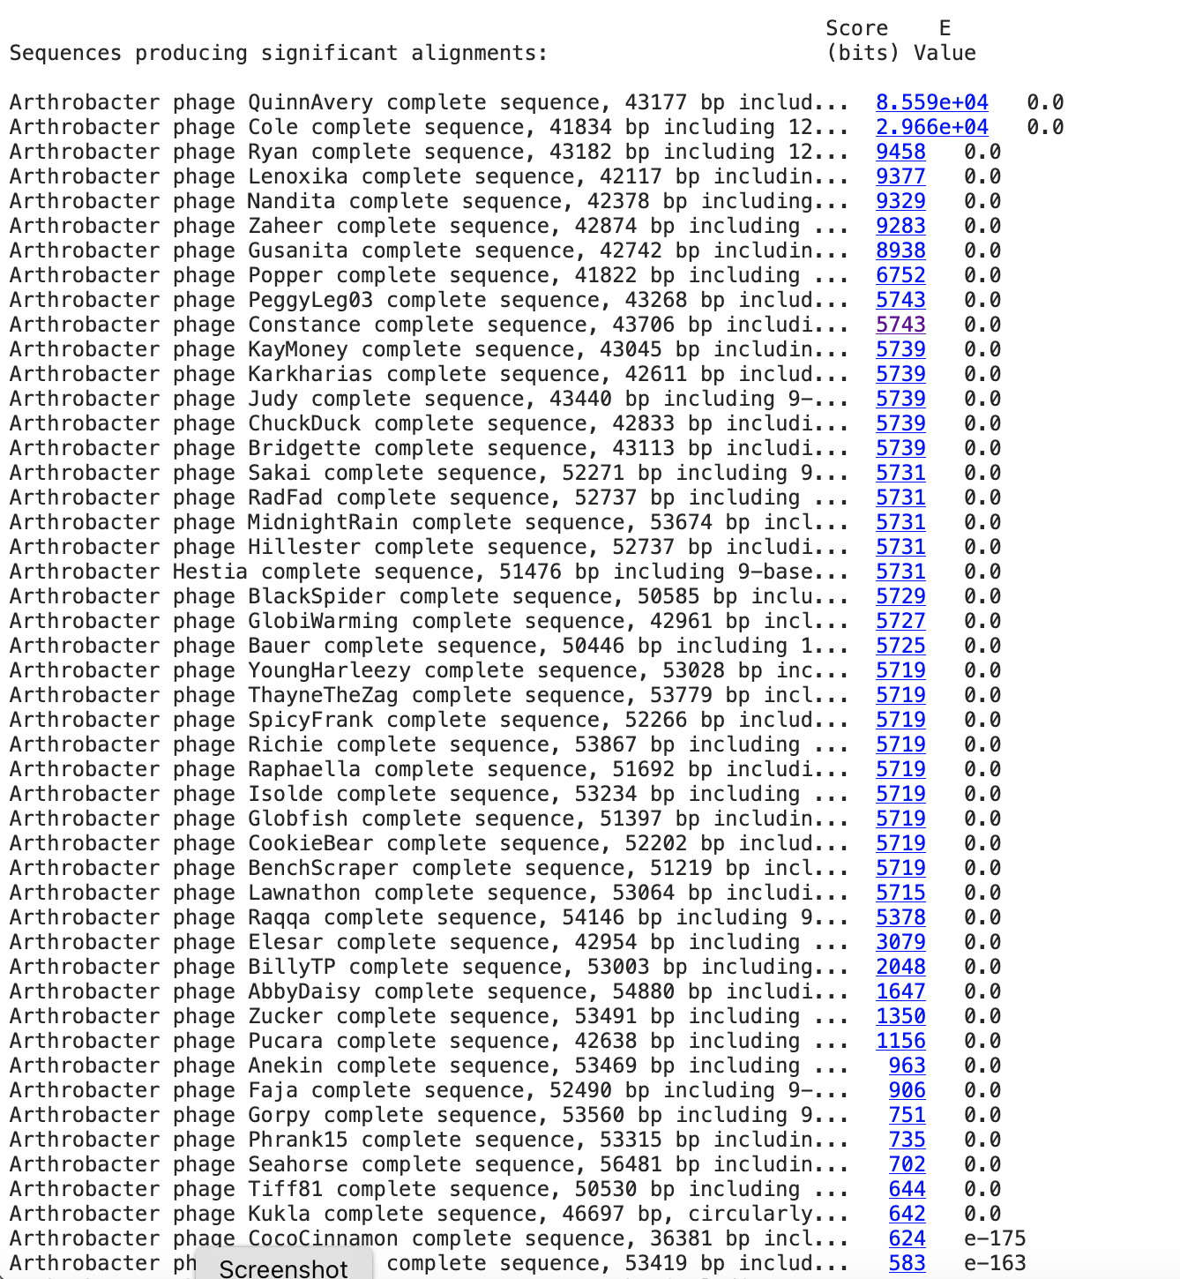
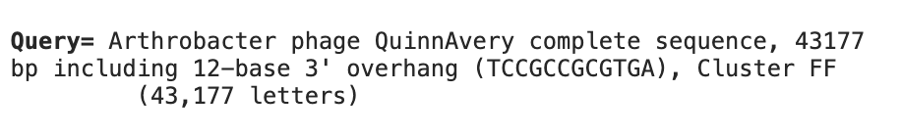
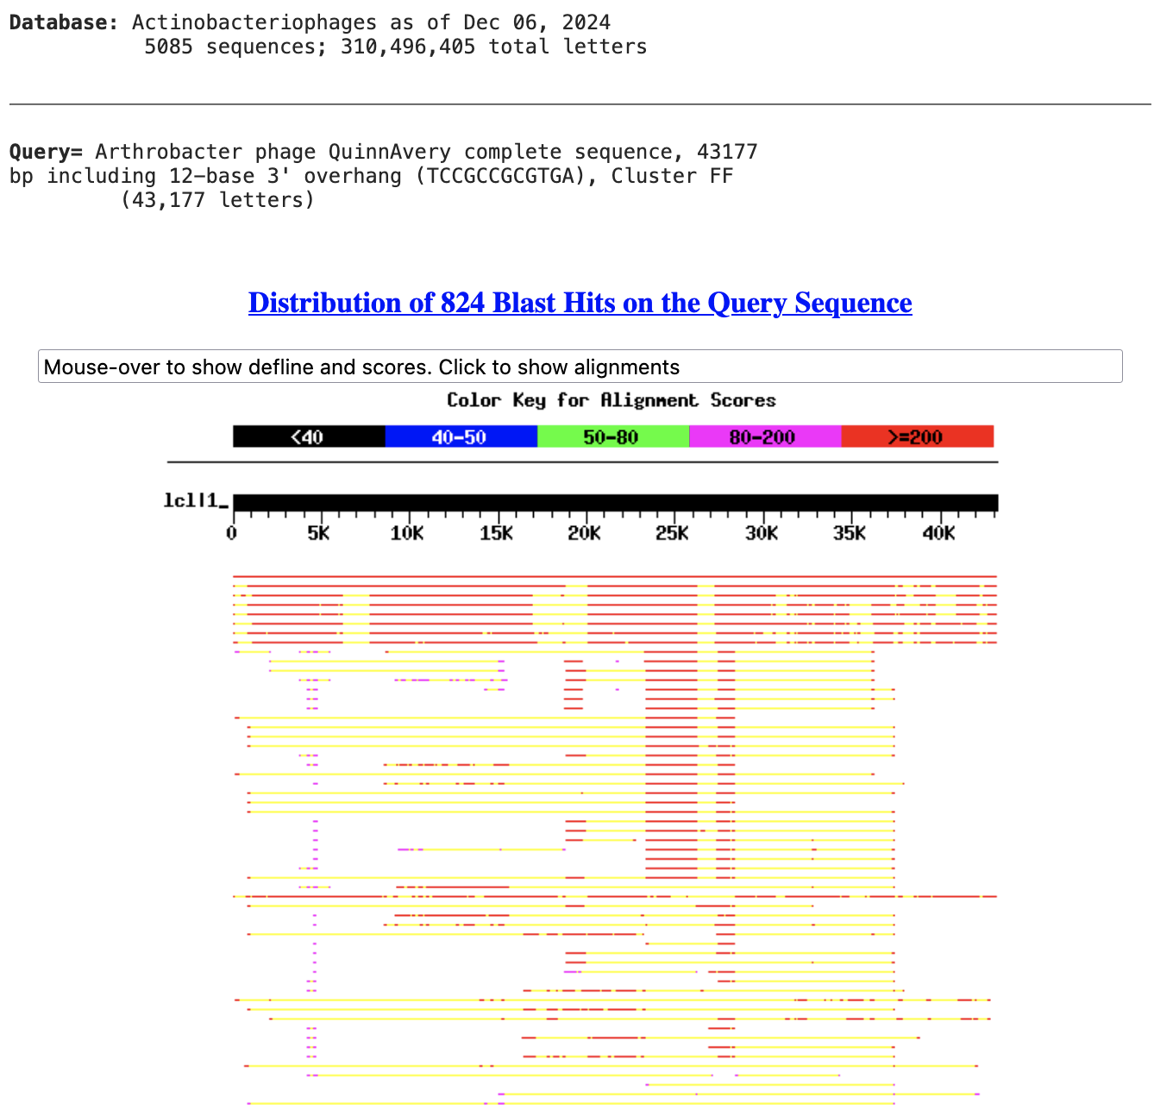
BlastN QuinnAvery.fasta

Slide 7
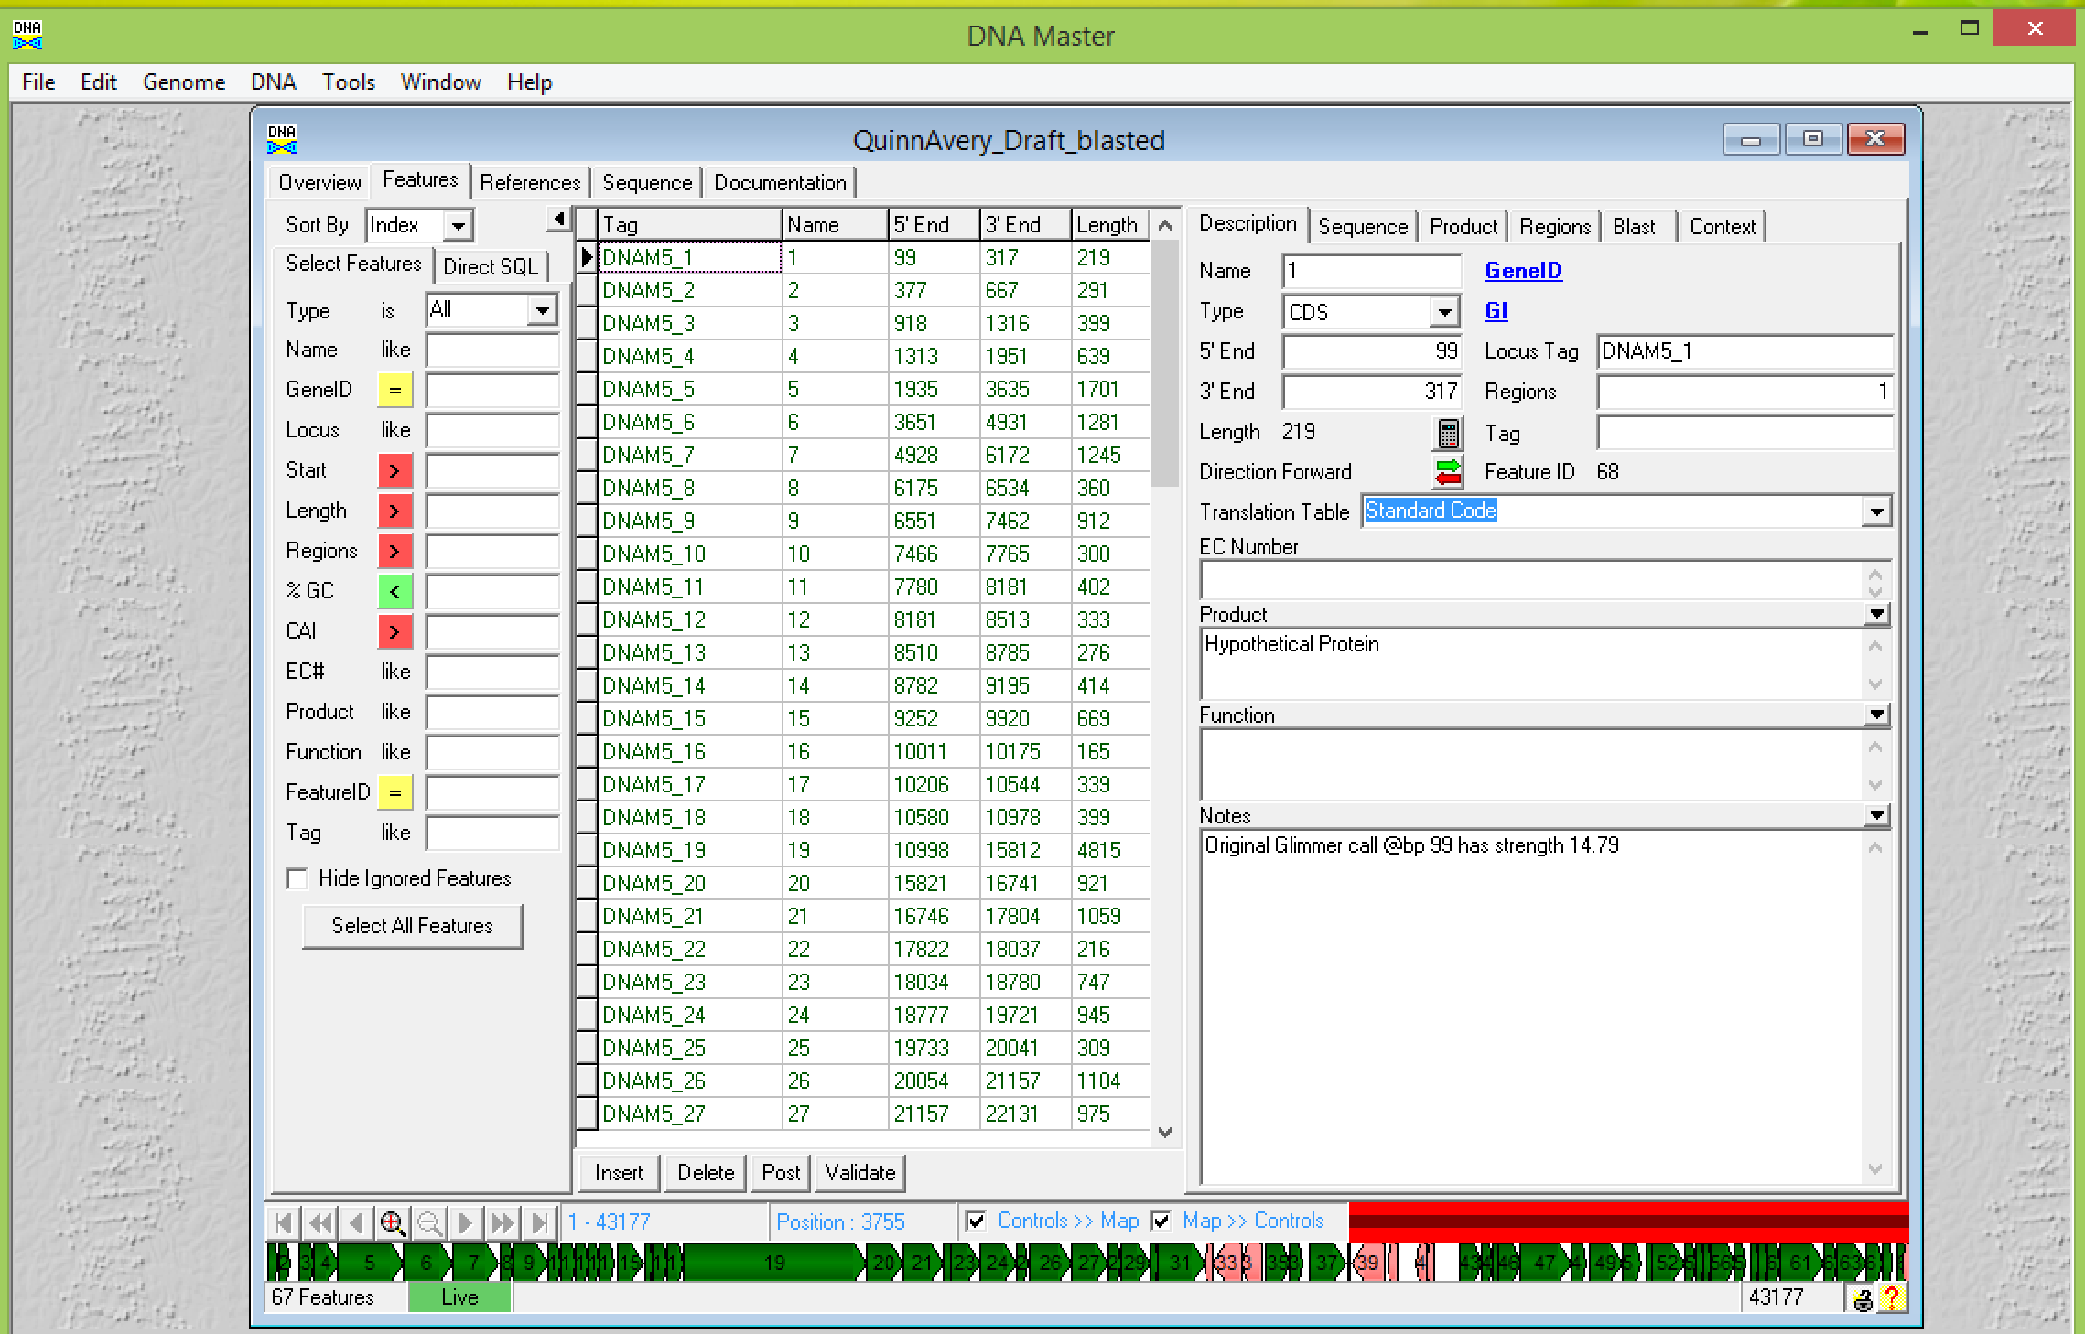

Slide 9
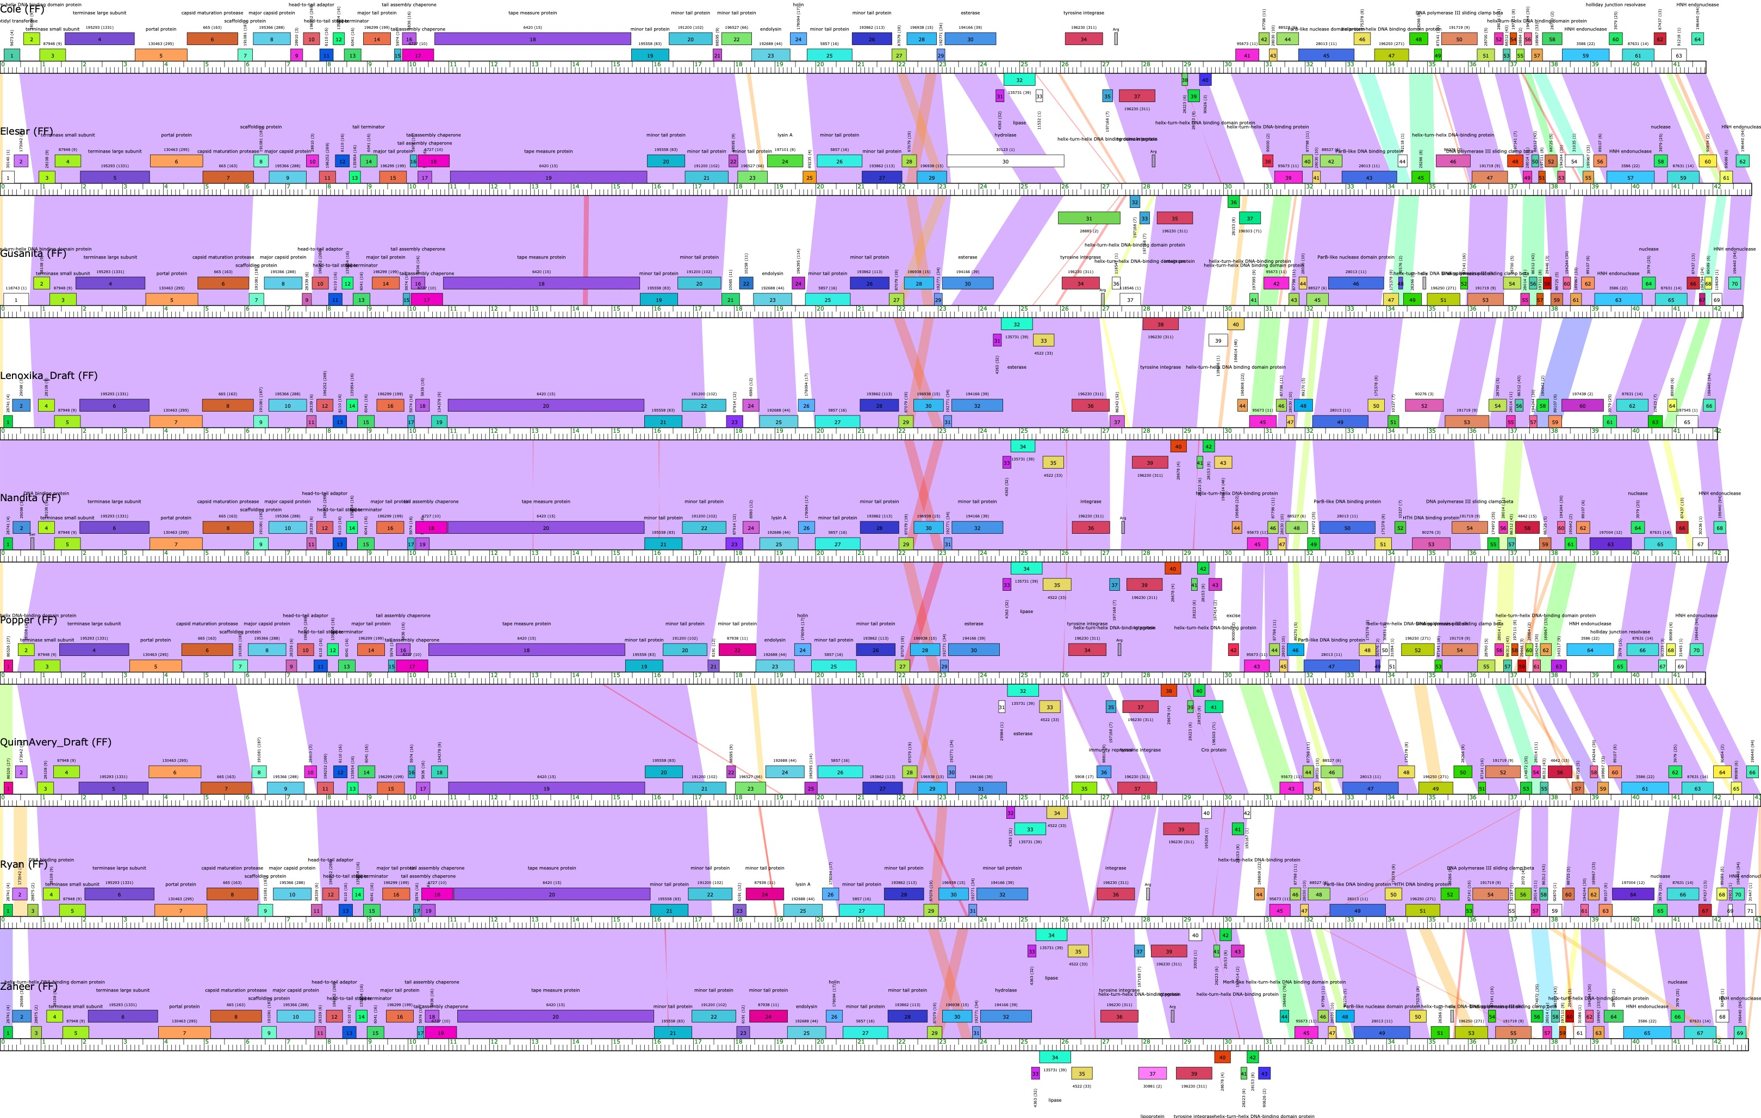
QuinnAvery_Draft

Slide 10
Big picture (zoom out) evaluation
How do I know? QuinnAvery and how many members of Cluster FF
What to do next:
  Find the differences
    Why are there differences?
  Assign Draft FUNCTIONS
    Why? To help with context
    What is the source of these functional calls?

Slide 11
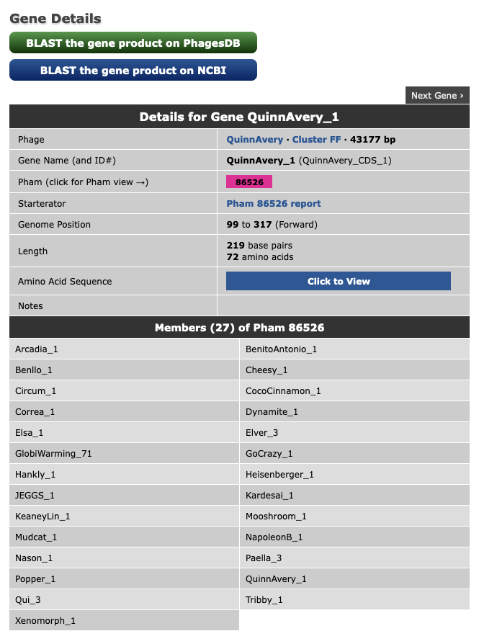
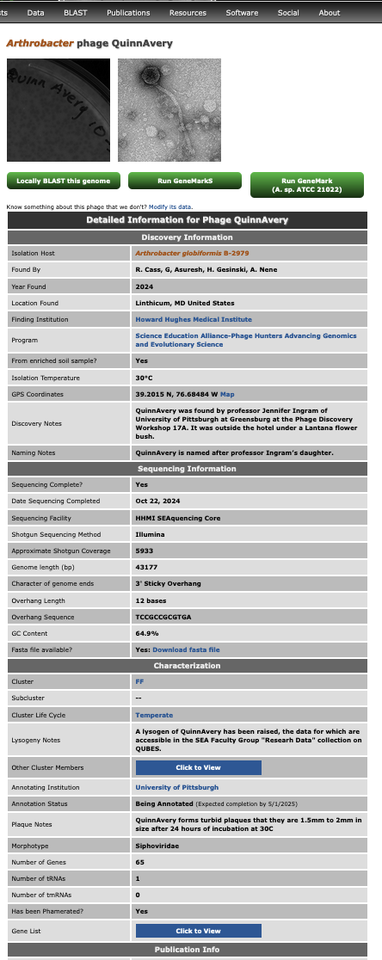

Slide 13
To Do:
Assign functions according to Phamerator/phagesDB
  Record on your phage map
Add any insights or questions as you go?
Why? To get a whole genome, comparative perspective of QuinnAvery.
All will be reviewed and revised as you perform your gene by gene evaluations!

Slide 15
What functions did we find that we expected?
What functions did we find that we did not expect?
Any curiosities?

Slide 16
What was the point of this exercise?
Provides context for the work that we will do
What is the work that we will do?
Call the genes of the genome as precisely as possible by answering 3 questions:
  Is it a gene?
  What is its start?
  What is its function?

Slide 17
Next step: Manual curation
Why? Models are written for bacterial genomes
Phages are smaller genomes
Phages have smaller genes
The math breaks down for those smaller genes
Do we care about those smaller genes? Yes!
What about Horizontal Gene Transfer? (Those genes can break the rules!)

Slide 18
Gene Evaluations
We are always looking for the supporting data.
DNA Master is our genome editor
We (it) use 2 programs, Glimmer and GeneMark, to identify coding potential.
We use Phamerator output for a visual representation of gene and nucleotide similarity.
We use PECAAN to store the data efficiently.
We use the Guiding Principles to remind us of all of the parameters.
As we evaluate, we can:
  Add a gene
  Delete a gene
  Change a gene start

Slide 19
Guiding Principles

Slide 20
QuinnAvery_Draft

Slide 21
Gene Evaluations
For each feature we have 3 questions.
Is it a gene?
What is its start?
What is its function?
For each question, what is the supporting data?

Slide 22
Supporting Data #1: Coding Potential
Glimmer and GeneMark
Is it a gene?
Use Hidden Markov Models to identify coding potential
Use a sample of the genome
Identify longest ORFS in that sample
Calculate patterns in the nucleotides:
    2 at a time, 4 at a time
Notes:
A hidden Markov model (HMM) is one in which you observe a sequence of emissions, but do not know the sequence of states the model went through to generate the emissions. Analyses of hidden Markov models seek to recover the sequence of states from the observed data. http://www.mathworks.com/help/stats/hidden-markov-models-hmm.html

Slide 23
Supporting Data #2: Refinement/Review
DNA Master – our genome editor
Draft Annotation
  Glimmer
  GeneMark
Refinement of Draft Annotation
  Blast
    NCBI
    PhagesDB
  HHPred Suite – what database hits?
  Comparative Data
    Phamerator
    Starterator

Slide 24
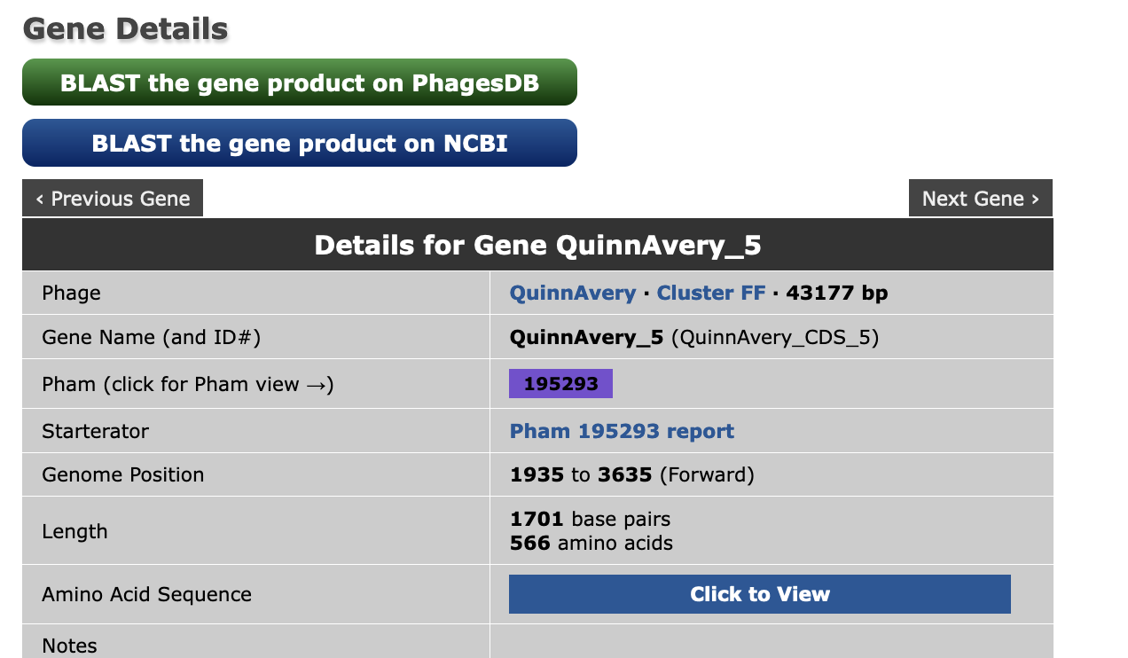

Slide 25
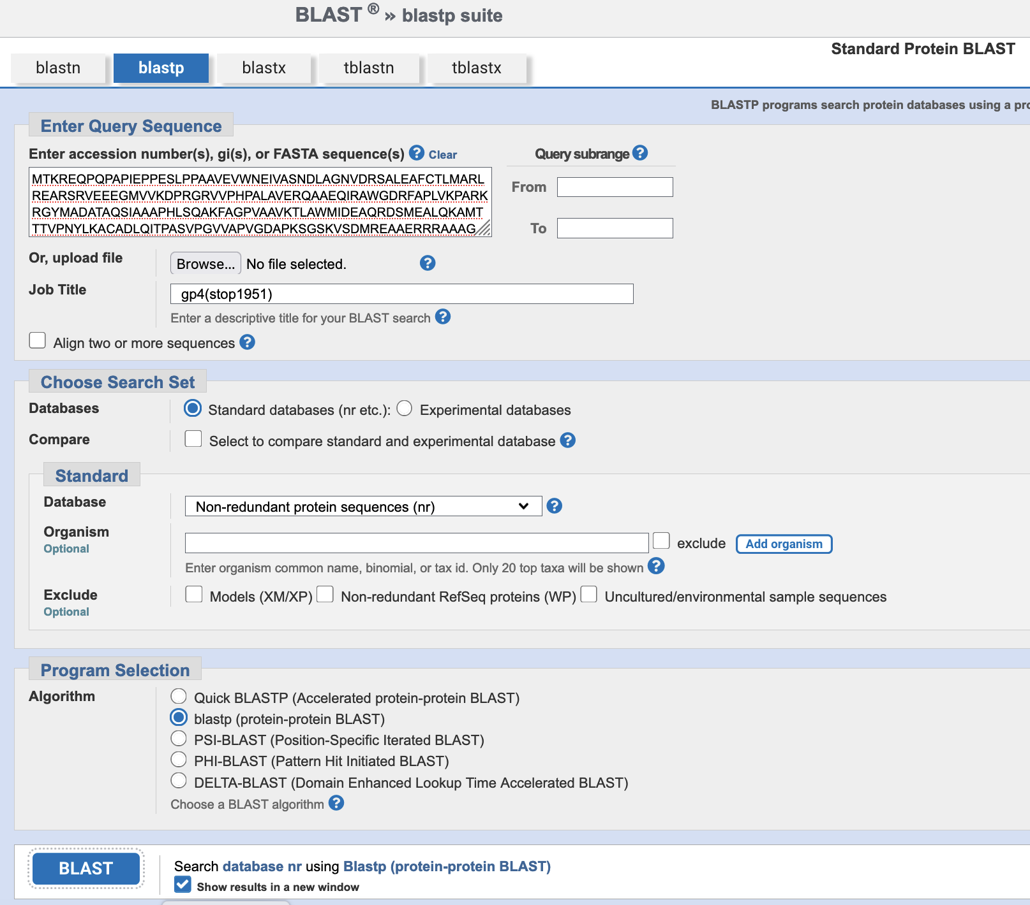
Blast Comparisons

Slide 26
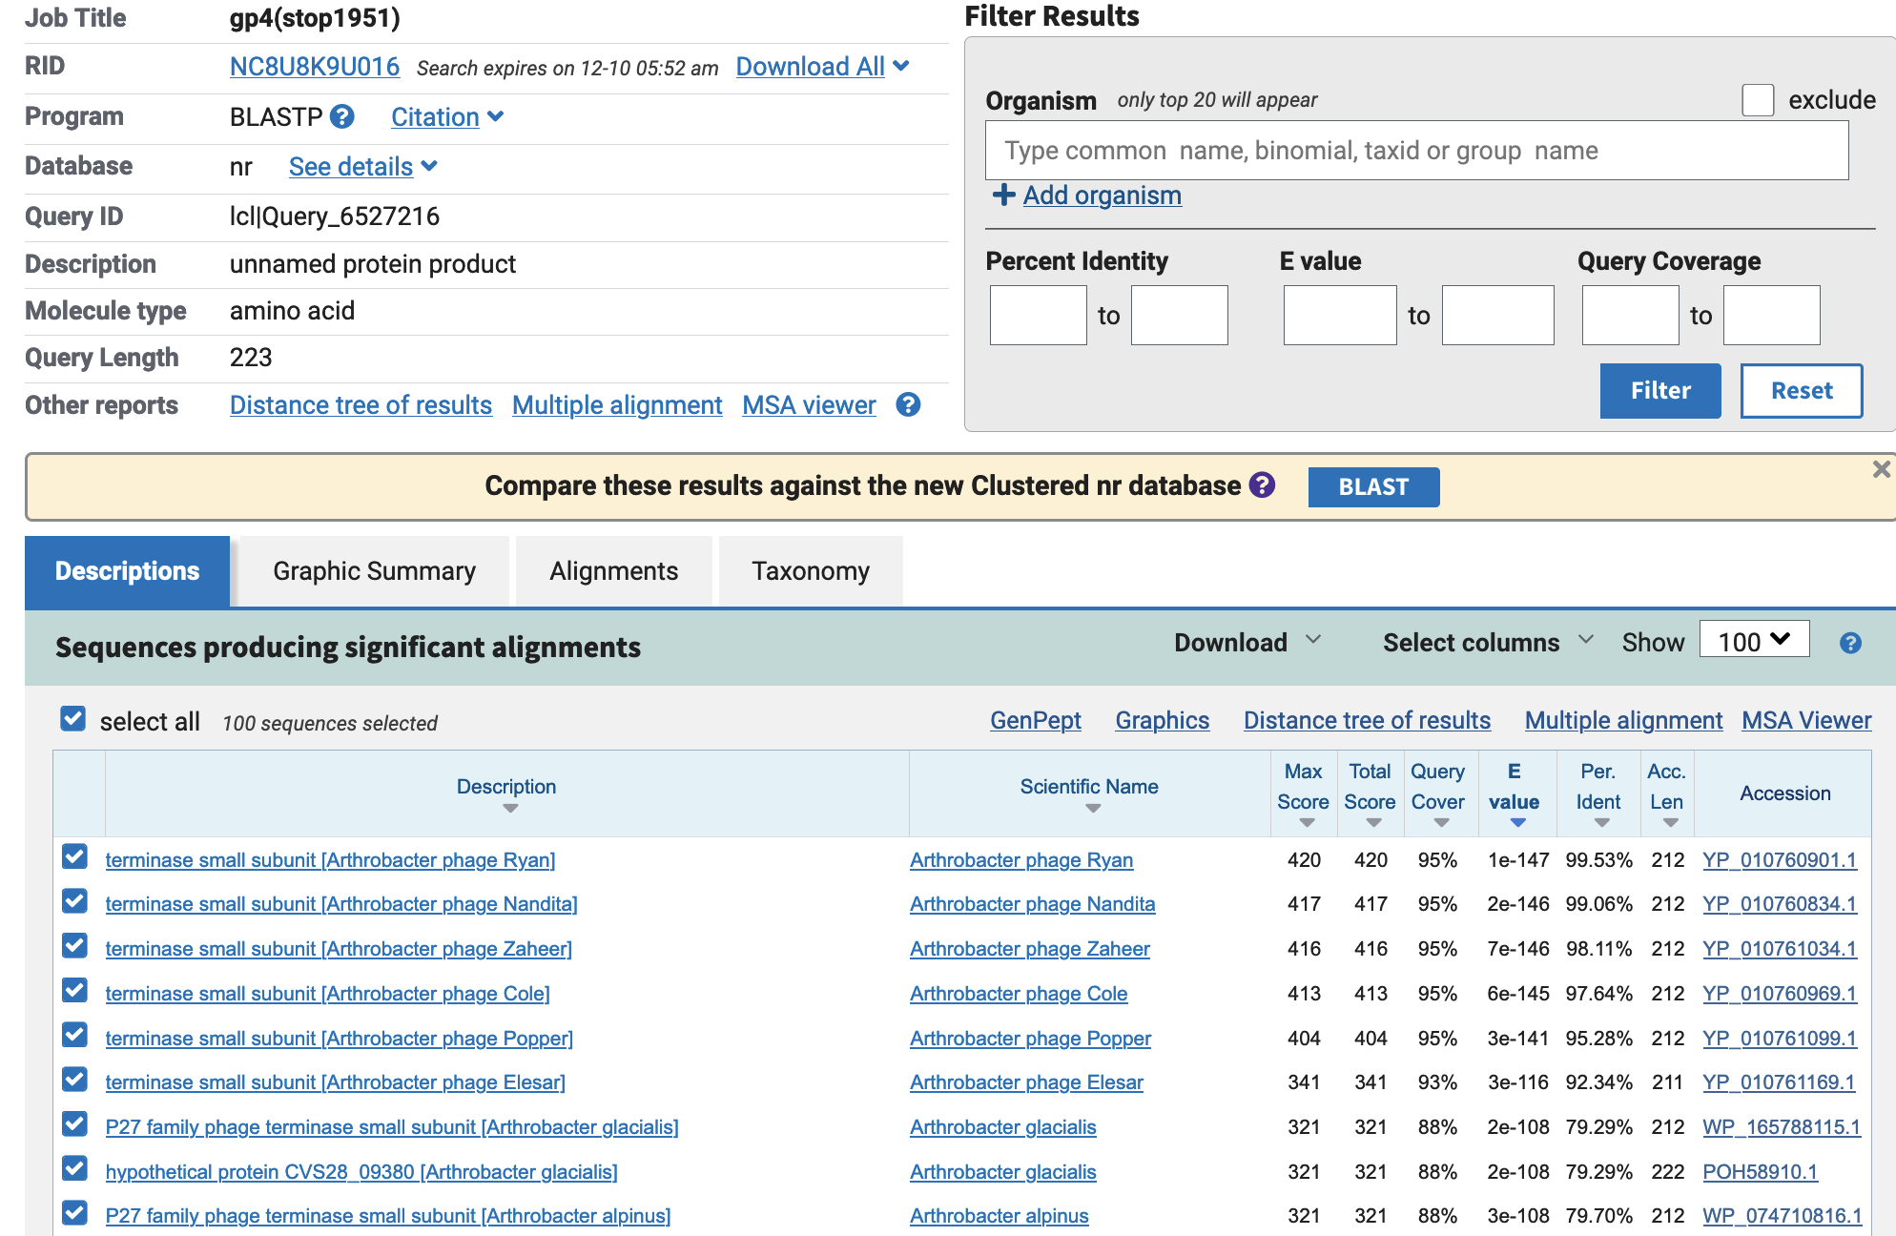

Slide 27
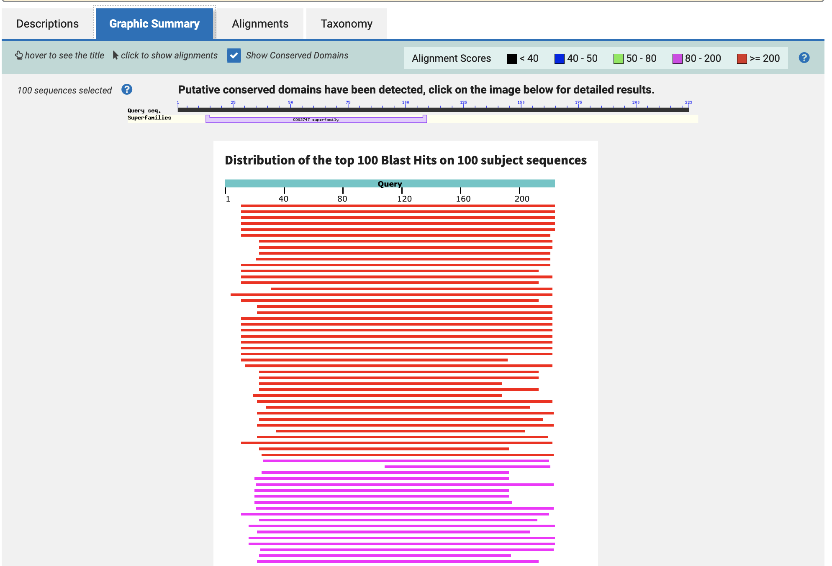

Slide 28
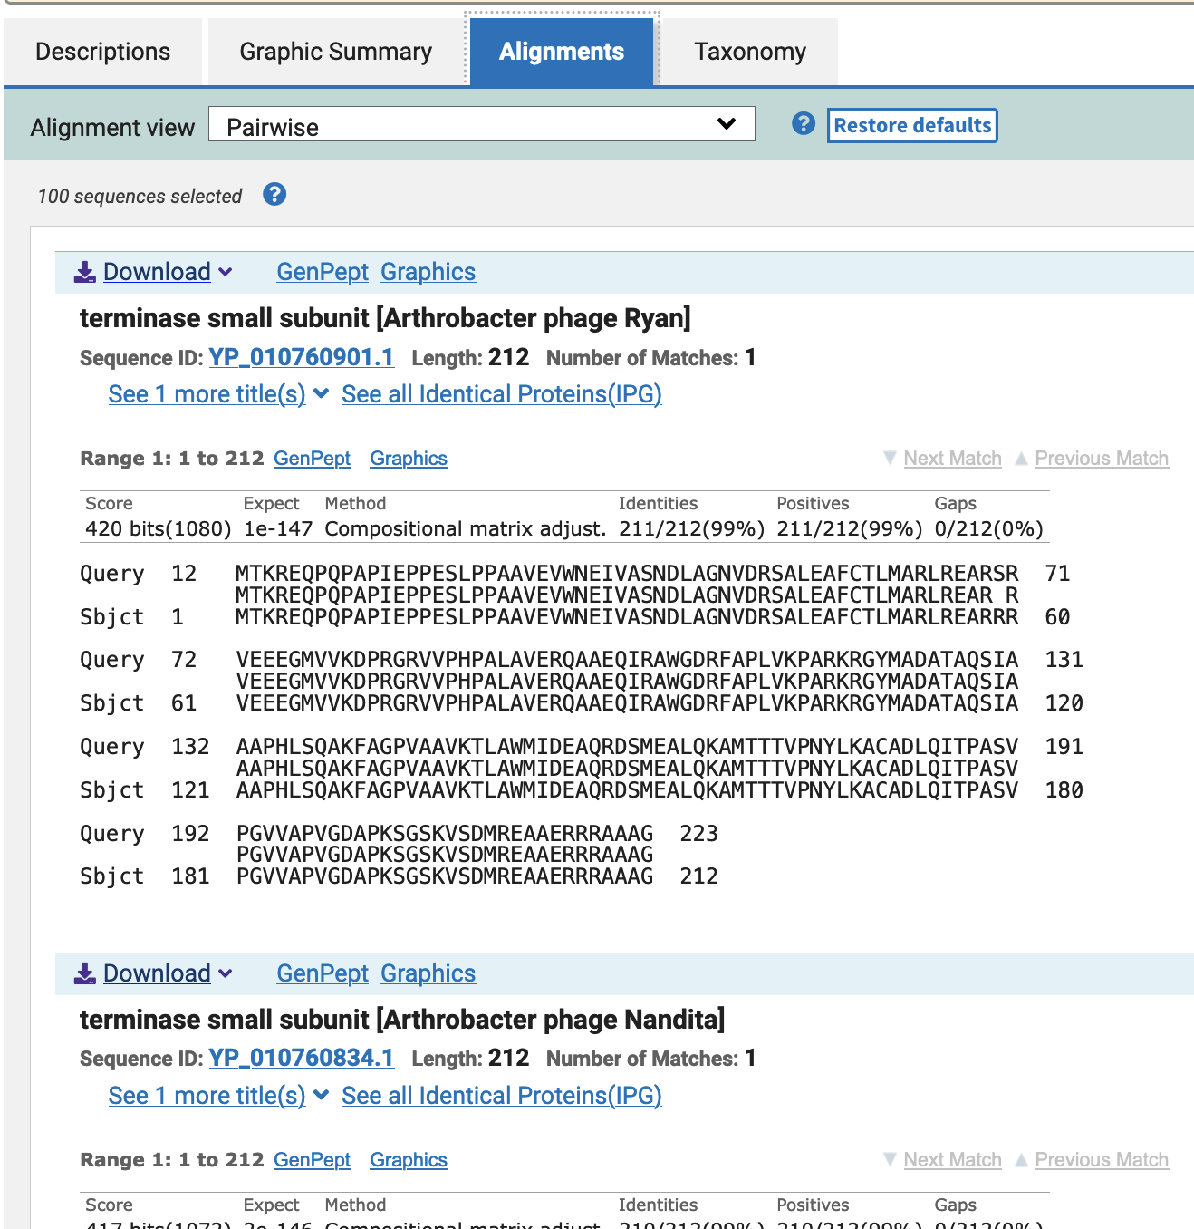

Slide 30
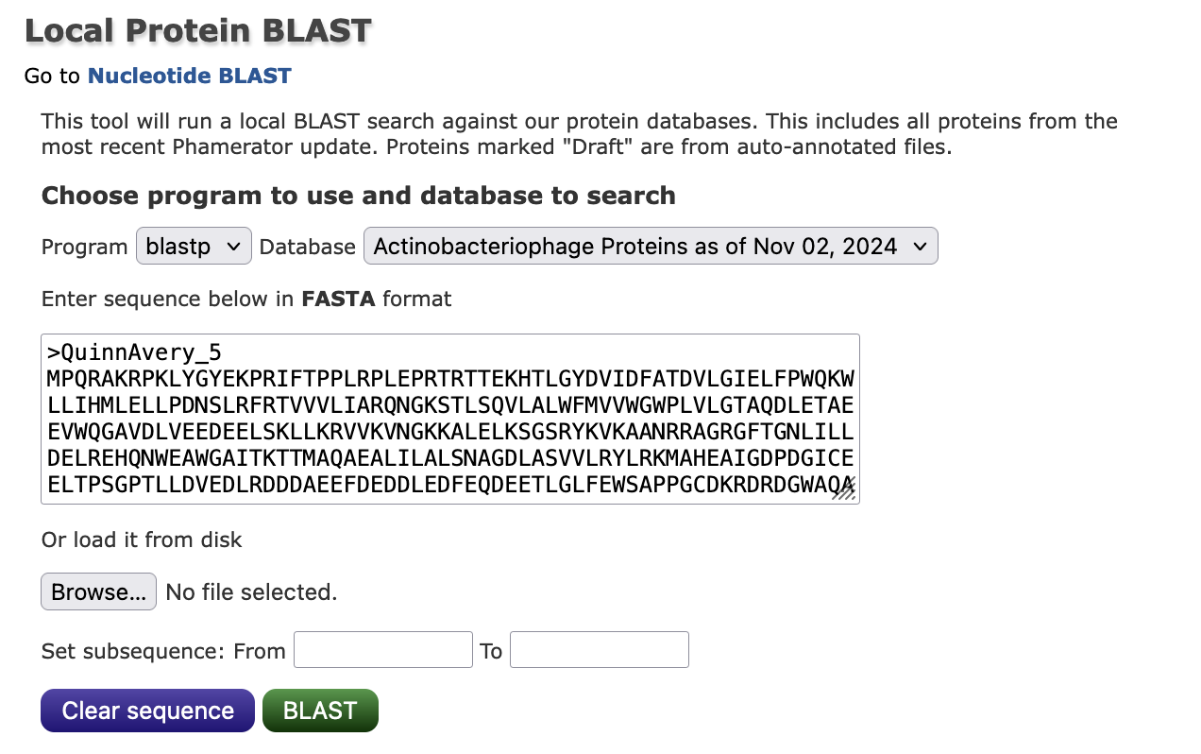

Slide 31
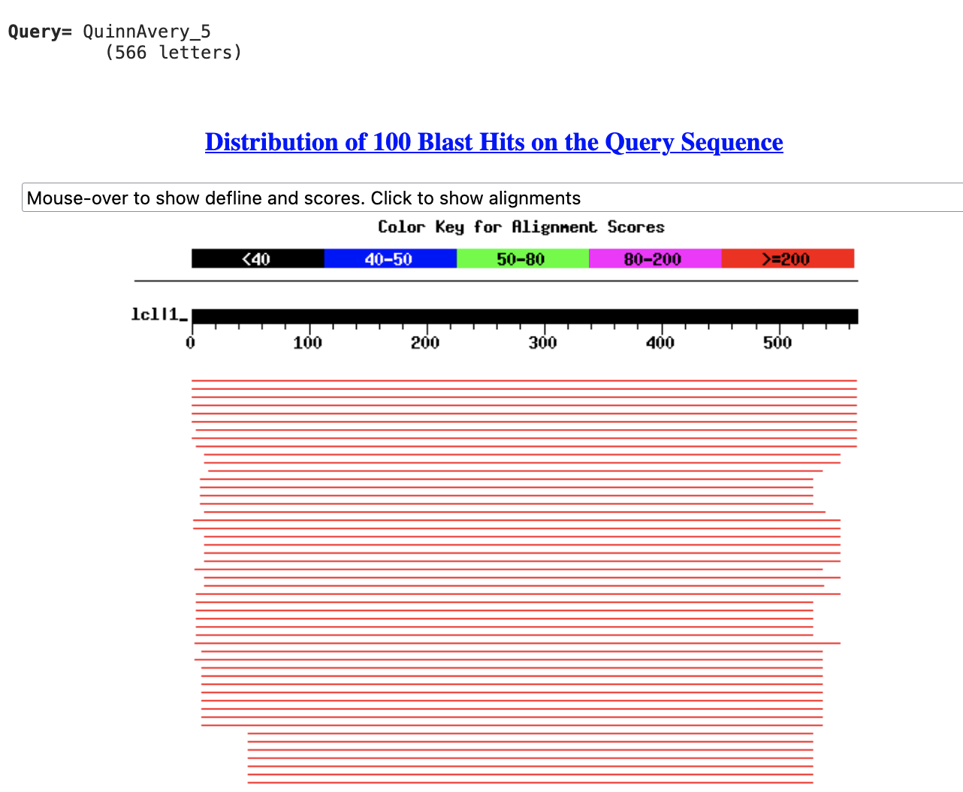

Slide 32
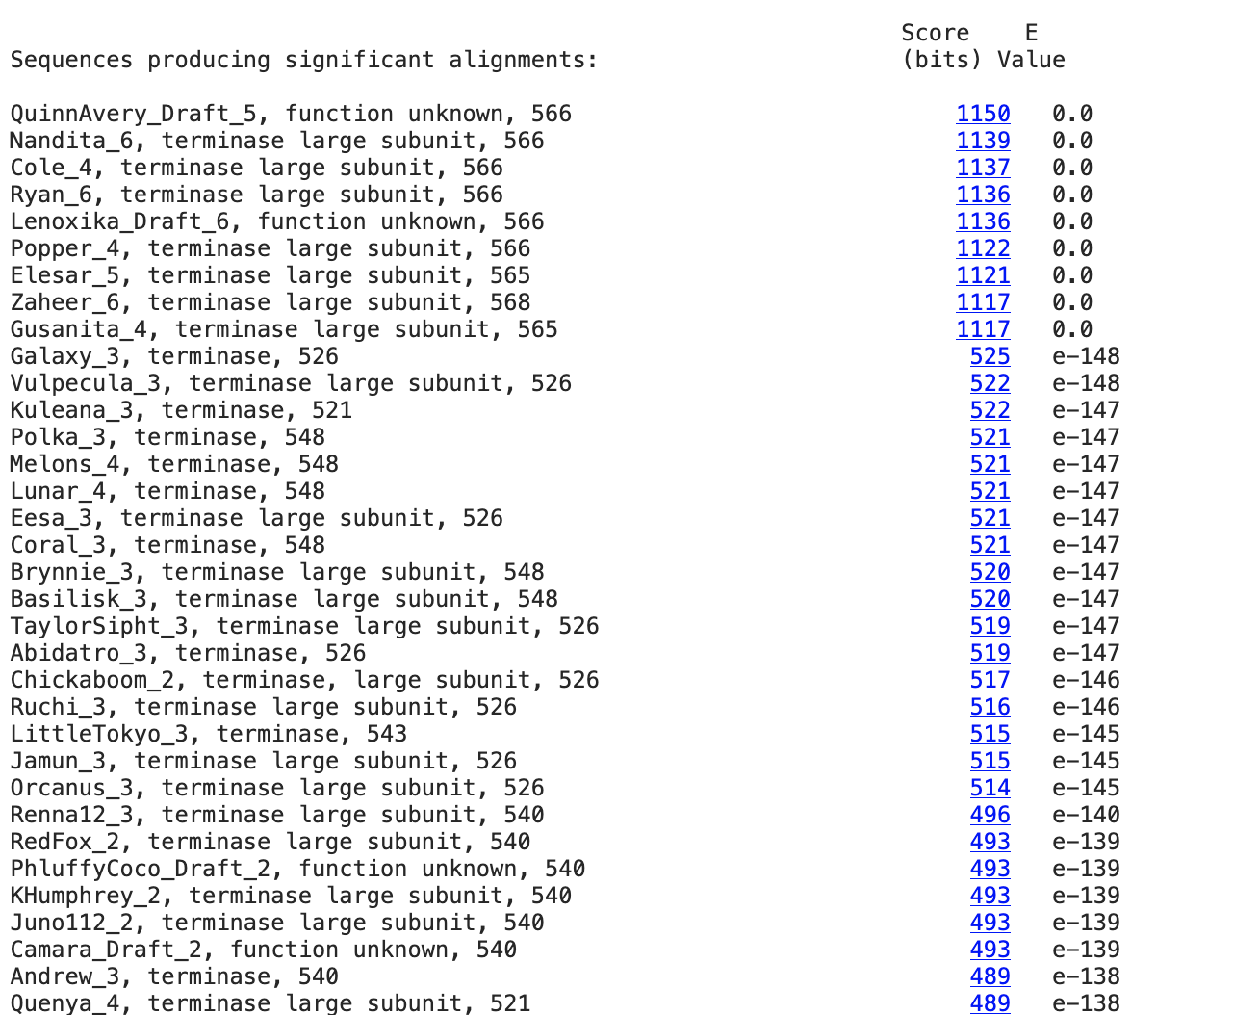

Slide 33
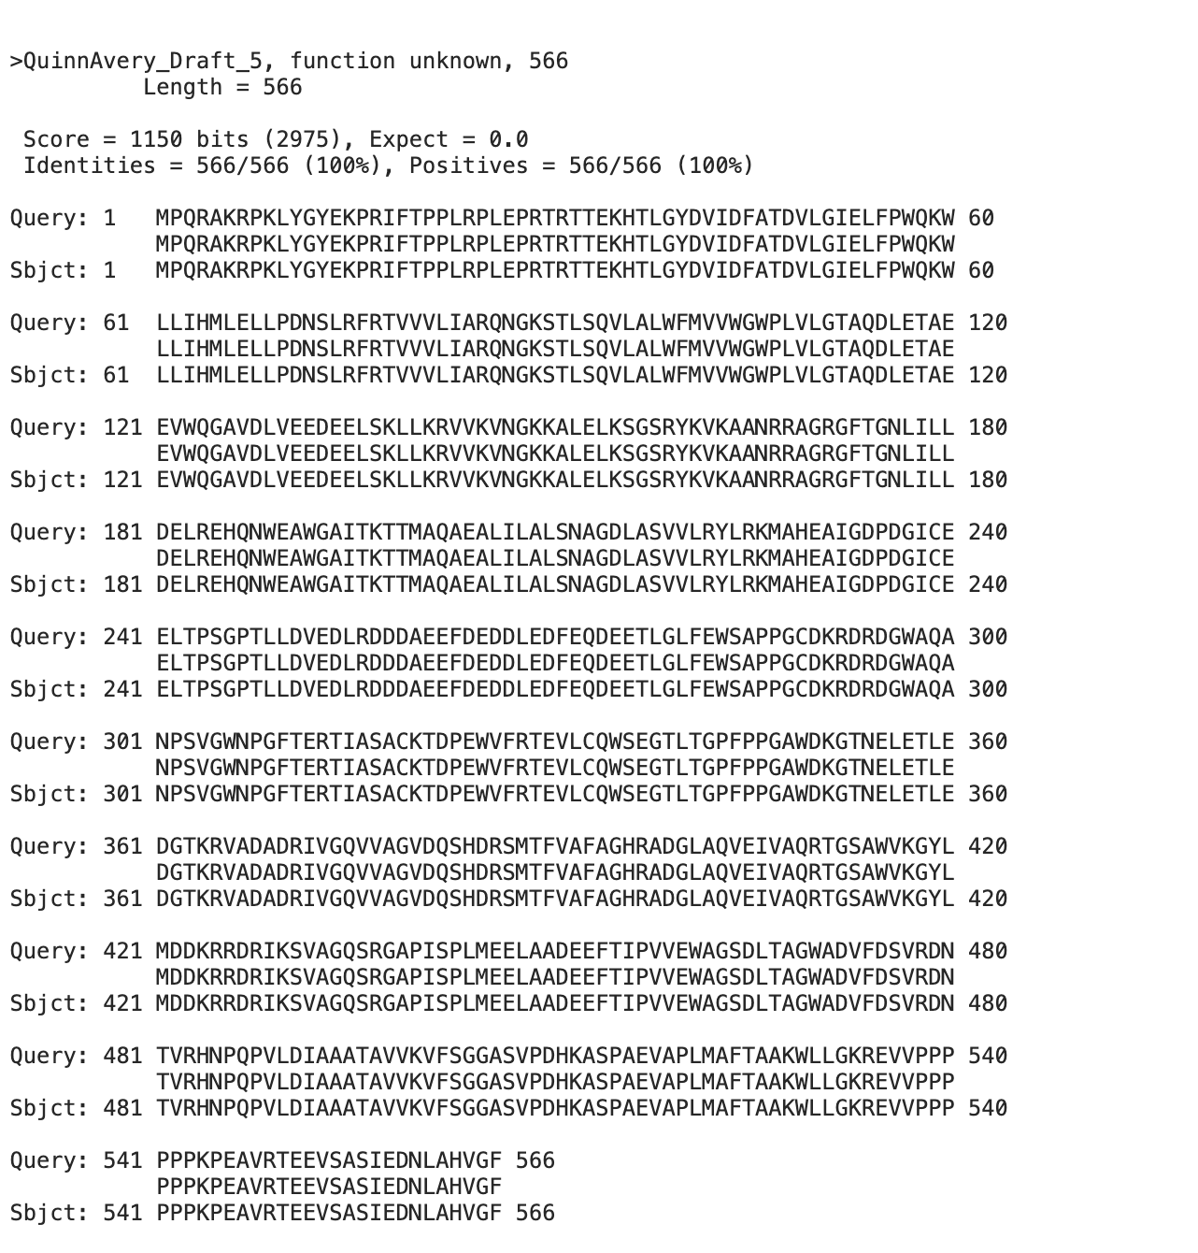

Slide 34
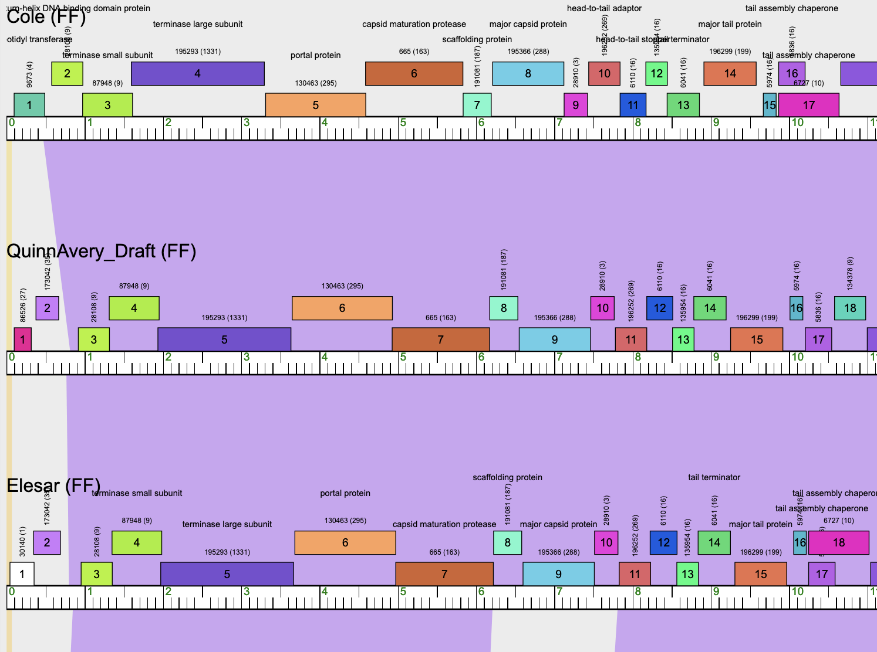
Phamerator map

Slide 36
What is its start?
Guiding Principles
Pham alignments (blastP)
Starterator

Slide 37
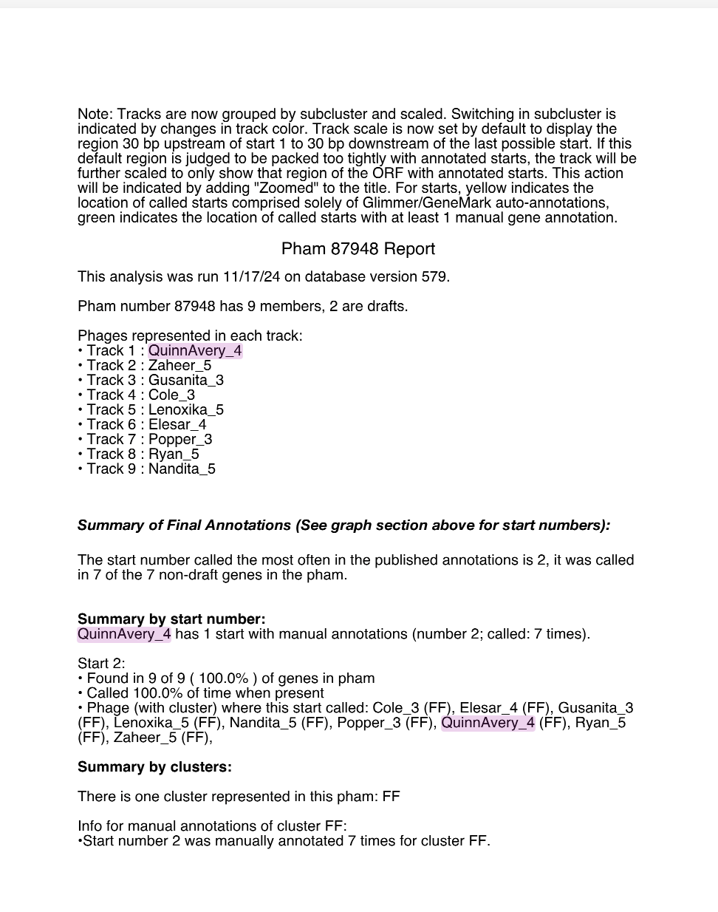
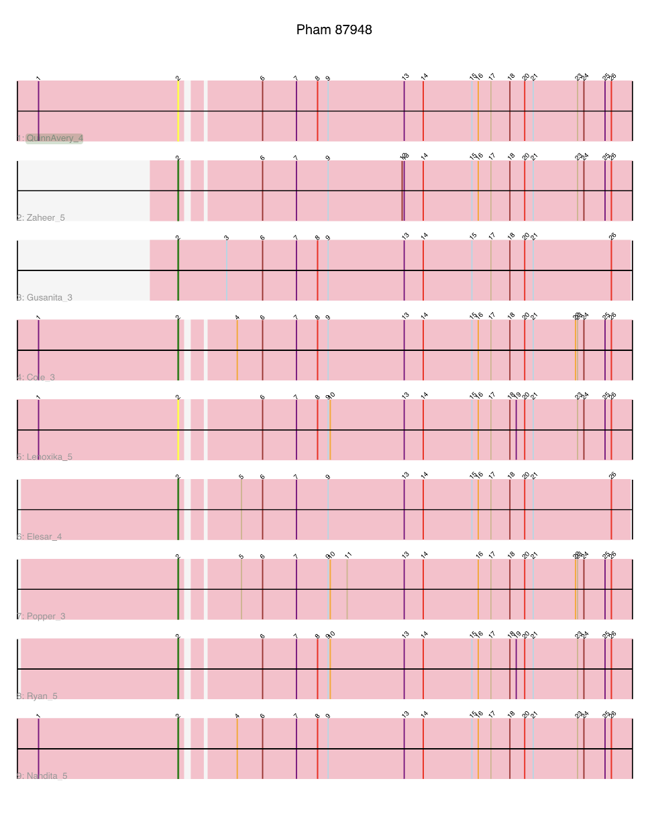
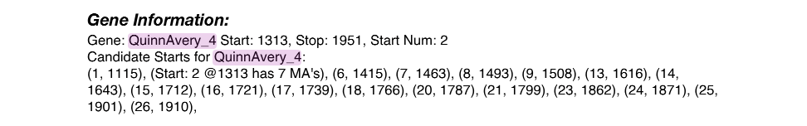
Starterator data
For gene 4 (stop 1951)

Slide 38
Tips for DNA Master Files
Save .dnam5 file often
Save .dnam5 file as a new name. (Then don’t save the old named one.)
If working in a virtual machine, be mindful about closing/shutting down
Did I mention to save your files often using a new name?

