Slide 1
Predicting Genes in Actinobacteriophages
2023 Phage Genomics Workshop Training
SEA-PHAGES Cohort 16
Deborah Jacobs-Sera

Slide 2

Context
What are they?
How did they get to be that way?

Slide 3
It is all about finding the patterns…
Since the beginning of time, woman (being human) has tried to make order and sense out of her surroundings. Gene annotation and analysis is just a primal instinct to make order.
Young children, as they prepare to enter school, are tested to see if they are ready by recognizing patterns, a form of making order.
1. Where will the dot appear in the 4th box?
Remember, everything you need to know, you learned in kindergarten….

Slide 4
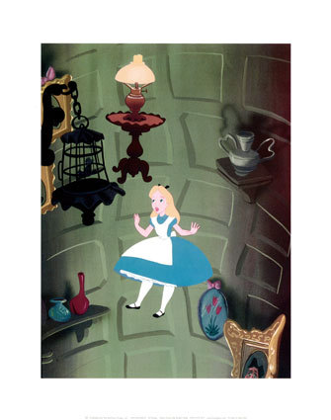
Make-Believe or Putative
Remember, you are working in the putative gene world. All gene predictions are made with the best evidence to date. Most of that evidence is computational (bioinformatic), not experimental. Tomorrow’s data may give us better evidence, but your prediction today is the best it can be … today! Make good predictions following a consistent approach. Let these predictions lead to experimentation that can provide the evidence to improve future predictions.

Slide 5
How many phage genome sequences are in GenBank?
13390
No longer countable
How many actinobacteriophage genomes are sequenced?
4562
Notes:
684 last yeat

Slide 6
What is the universal format for a sequence?
How many As, Cs, Ts, and Gs are in a mycobacteriophage genome?
On average: ~70,000 base-pairs
Range: ~40,000 to ~165,000 bp
FASTA

Slide 7
How do you make sense of the nucleotide sequence?
Convert to genes
How do you convert ATCGs to genes?
Codons
Code for Amino Acids, Starts, Stops

Slide 8
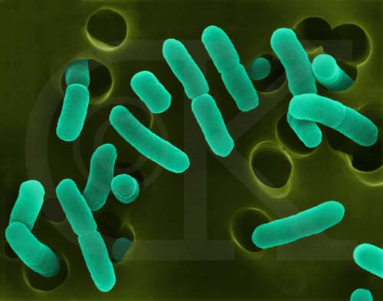
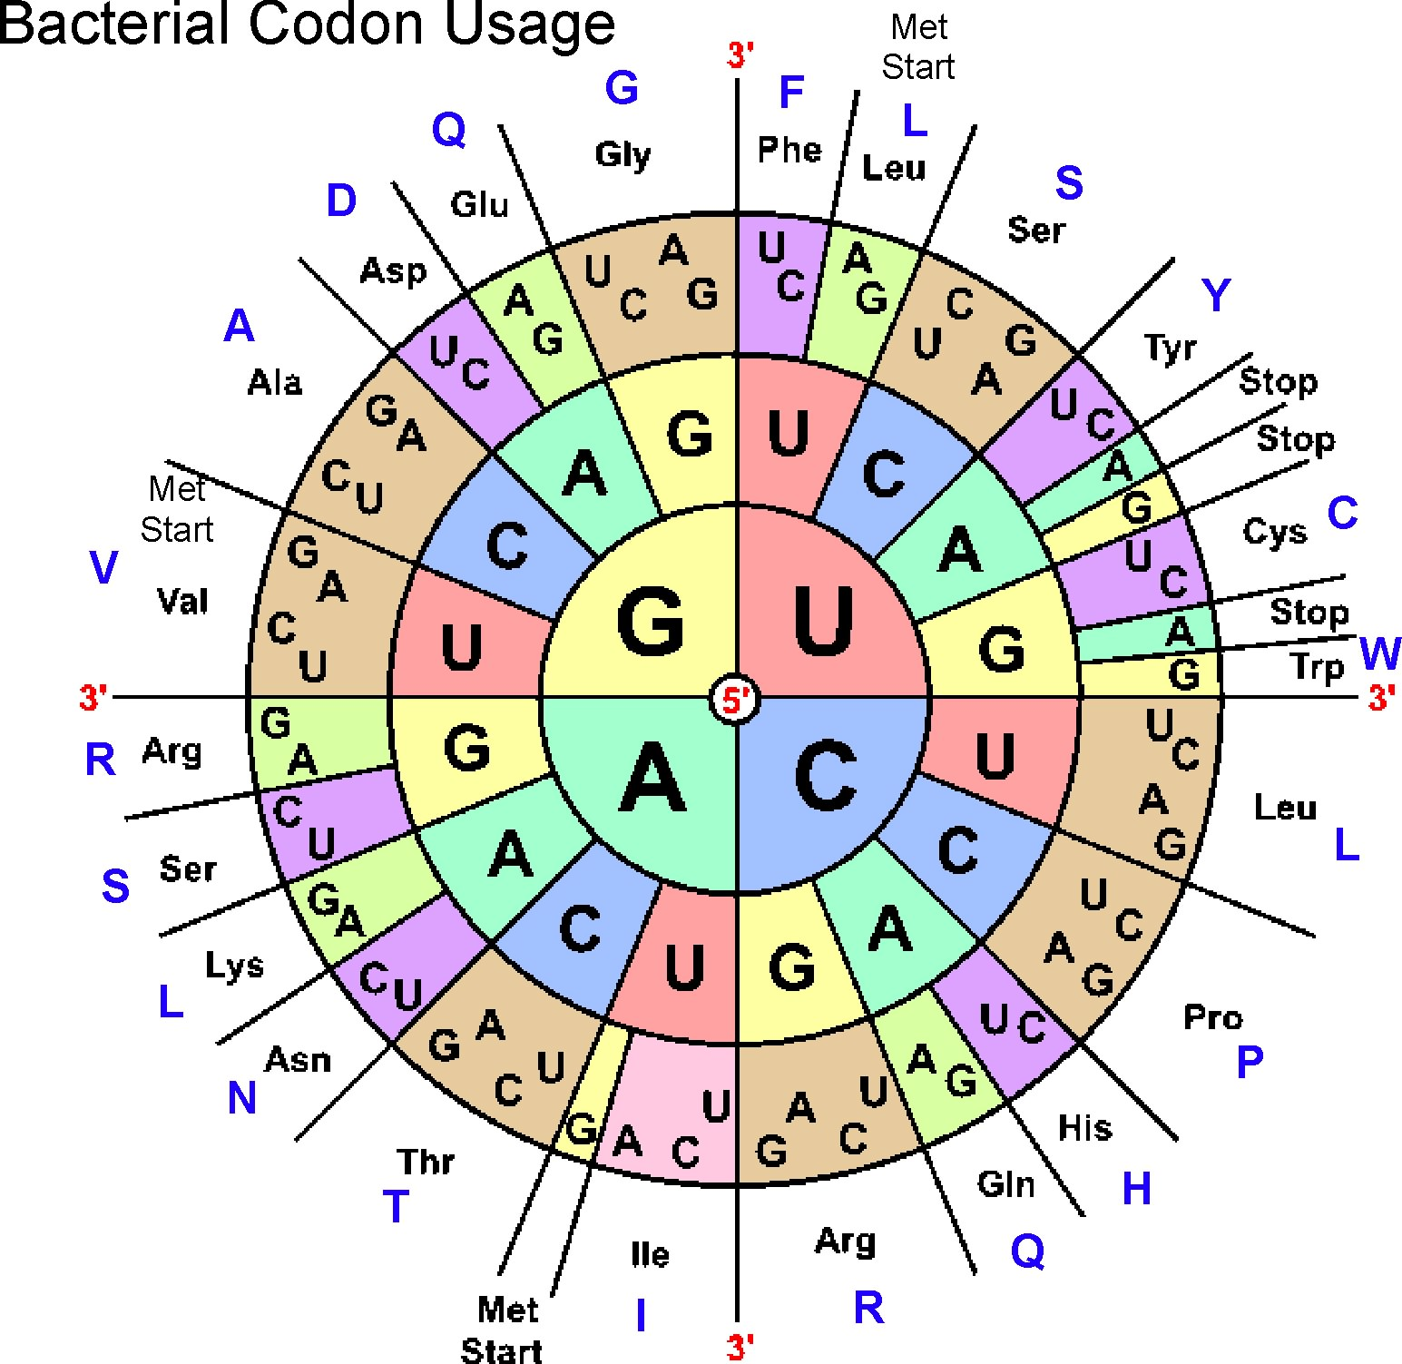
Phages use the Bacterial and Plant Plastid code (NCBI: Table 11)
3 starts
    ATG (methionine)
    GTG (valine)
    TTG (leucine)
      3 stops (TAA, TAG, TGA)
      Space in-between: Open Reading Frame -- ORF
www.cen.ulaval.ca

Slide 9
ATGGACCTCTCGCCC
ATG GAC CTC TCG CCC
TGG ACC TCT CGC ….
GGA CCT CTC GCC ….
If there are 3 choices (frames) in the forward direction,
how many are in the reverse direction?

Slide 10
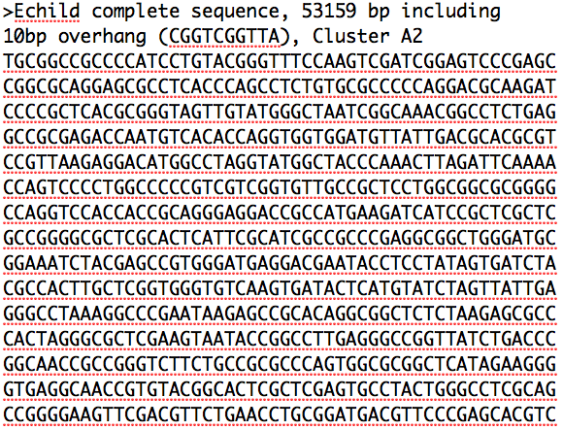

Slide 11
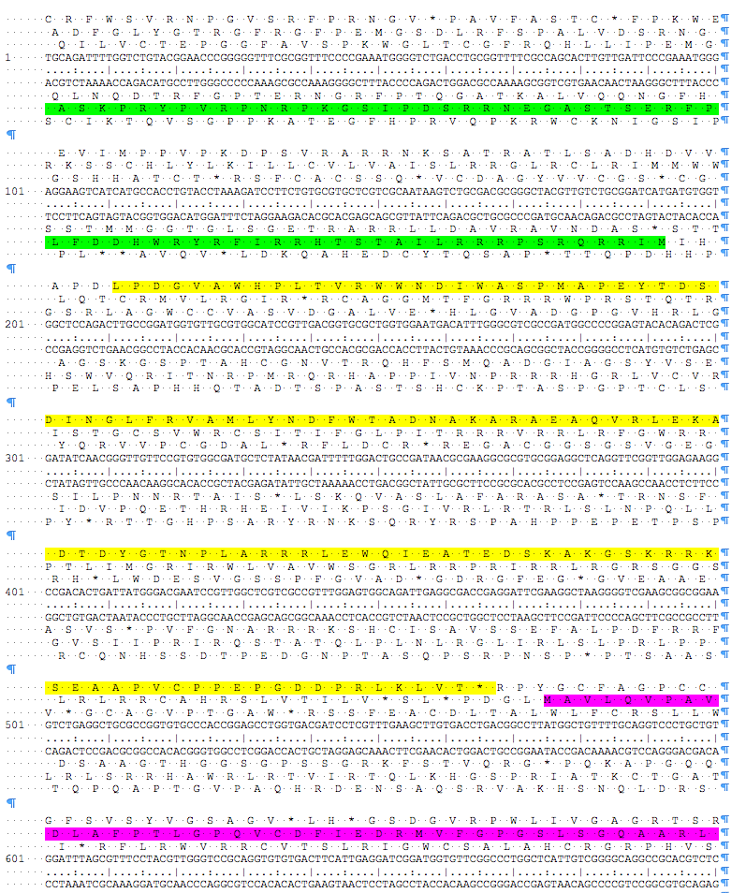
Six-Frame
Translations

Slide 13
How to find predictable genes?
Use programs that predict coding potential.
Programs use math to detect coding potential
  2 programs widely used: Glimmer & GeneMark
  These are algorithms that use interpolated Markov models for patterns in the order of DNA’s nucleotides
  Use a sample of the provided genome, find largest ORF, look for patterns and apply it to the target (your provided genome)

Slide 14
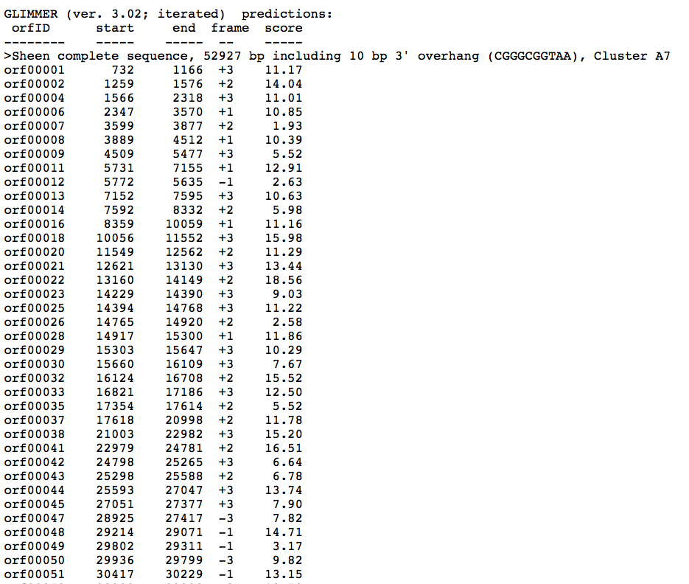
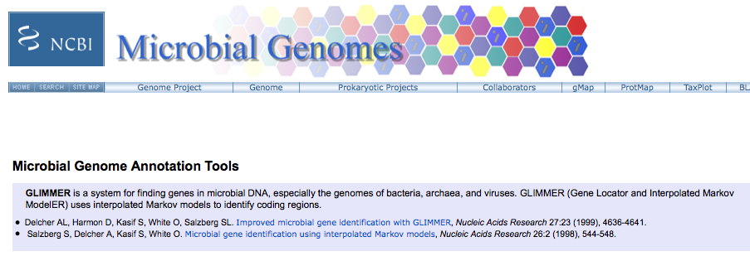
GLIMMER
http://www.ncbi.nlm.nih.gov/genomes/MICROBES/glimmer_3.cgi

Slide 15
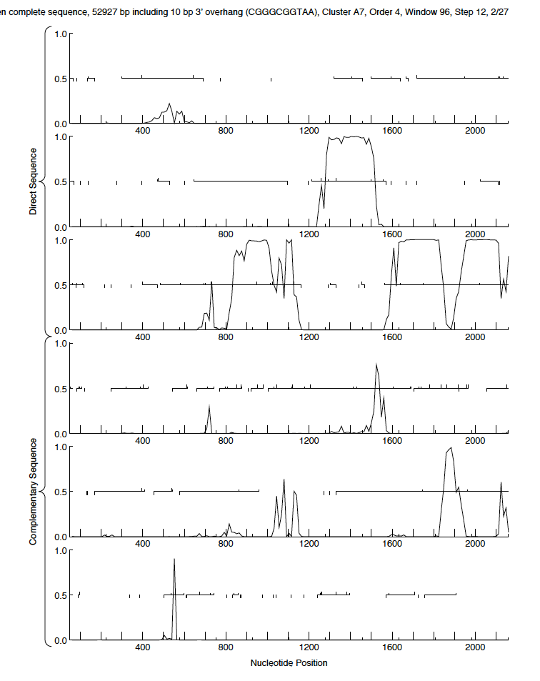
GeneMark Output
(trained on
M. tuberculosis)

Slide 16
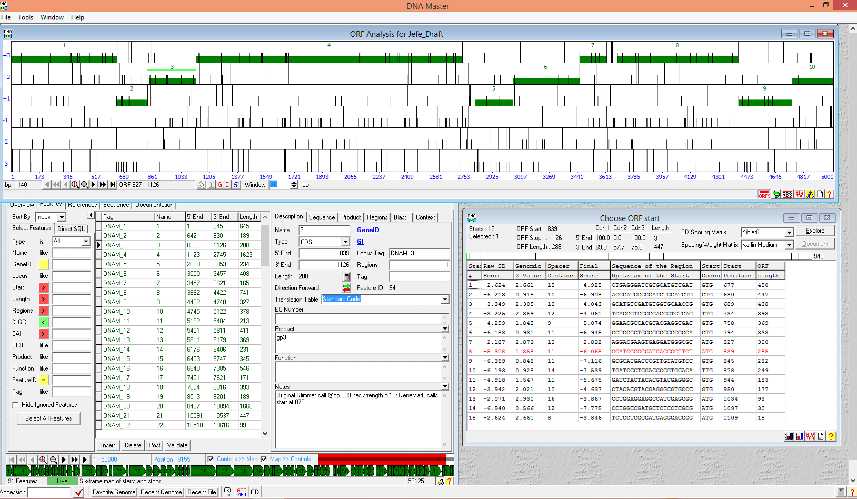

Slide 17
GUIDING PRINCIPLES
OF BACTERIOPHAGE GENOME ANNOTATION
Found in “Phage Annotation, Genomics and Data Interpretation” Section of the Bioinformatics Guide
15 Key Directives
Read for tomorrow
  https://seaphagesbioinformatics.helpdocsonline.com/guiding-principles

Slide 18
Let’s get started!
Gather Data
Auto-annotate in DNA Master
Gene Calling
Functional Assignments

Slide 19
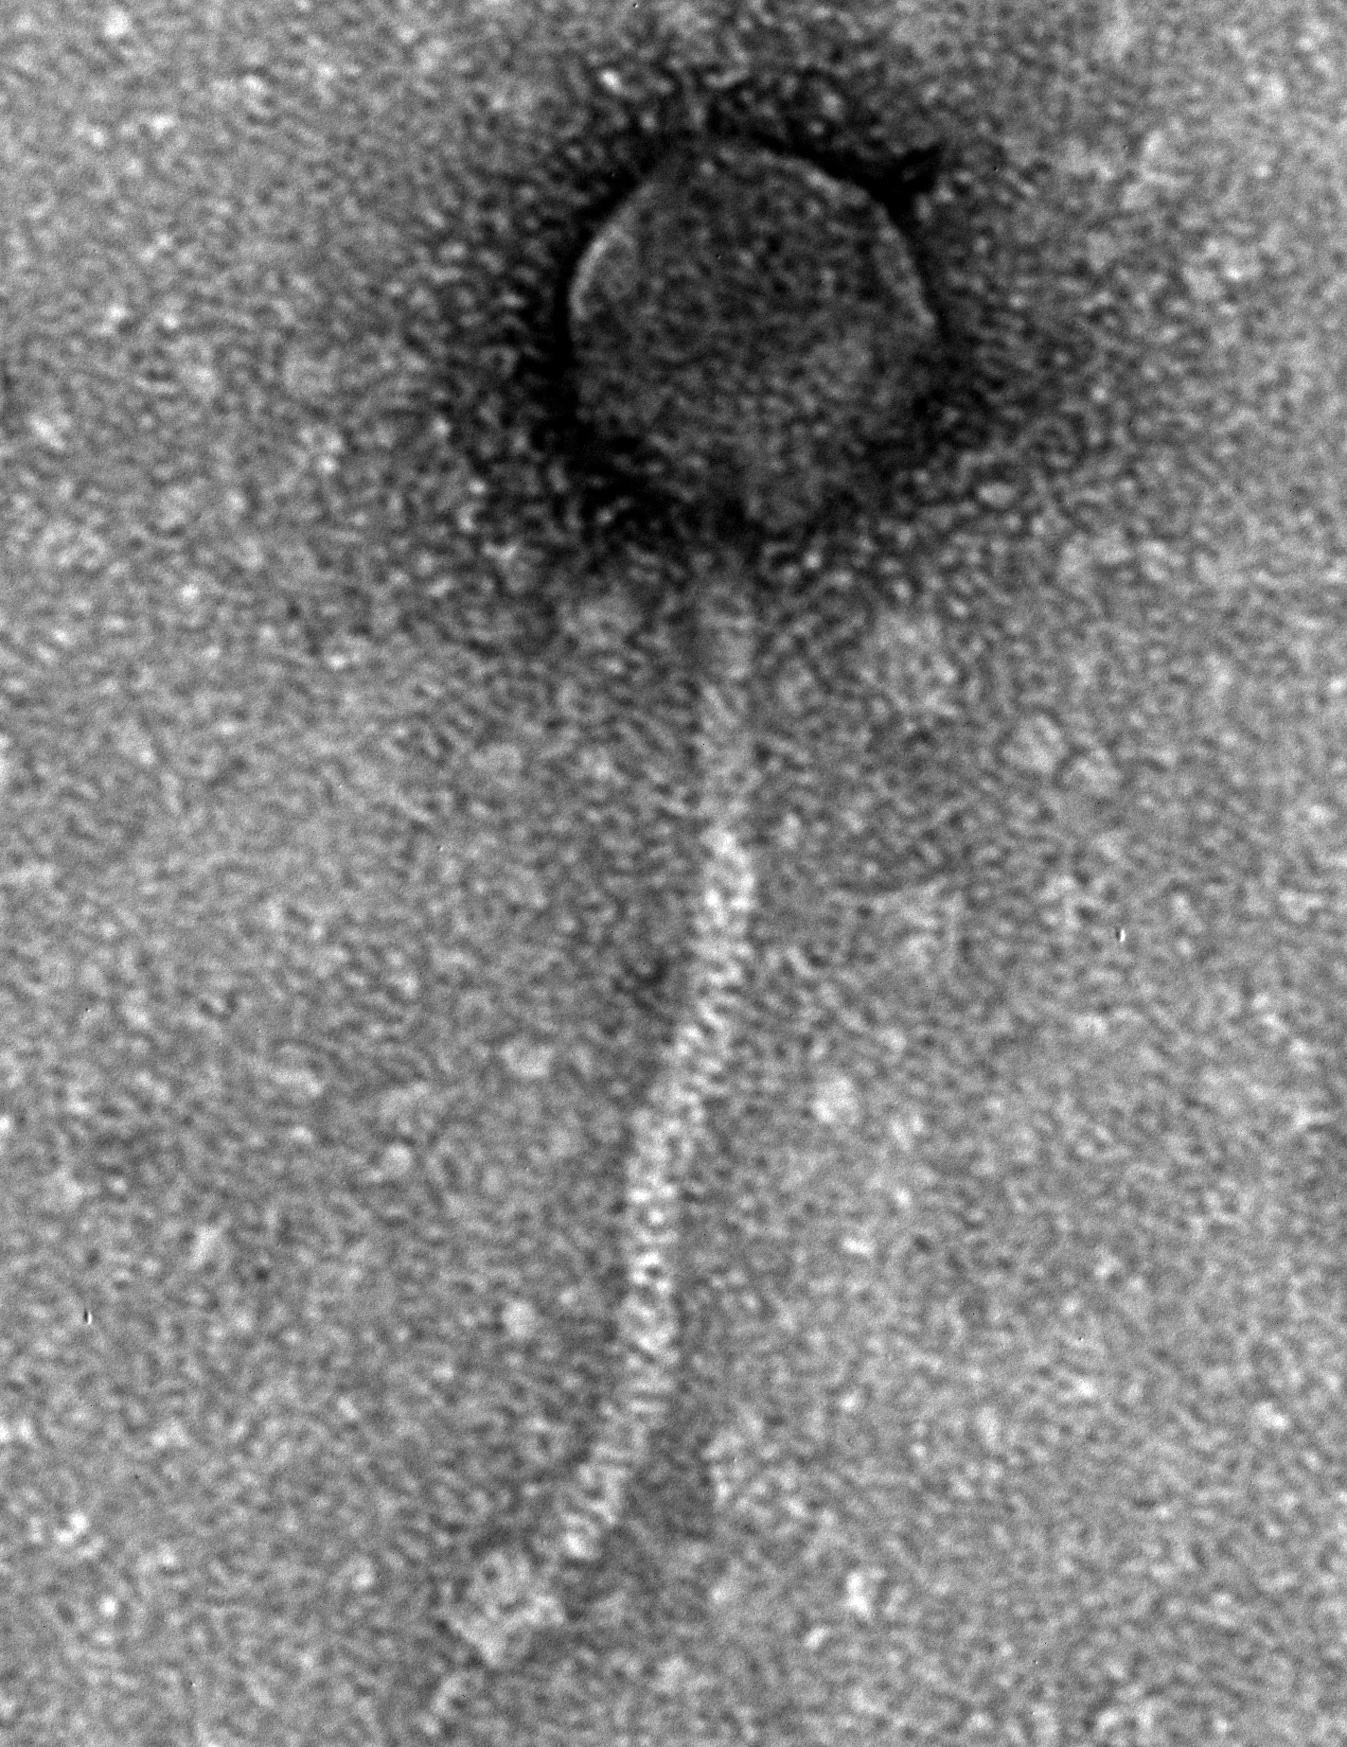
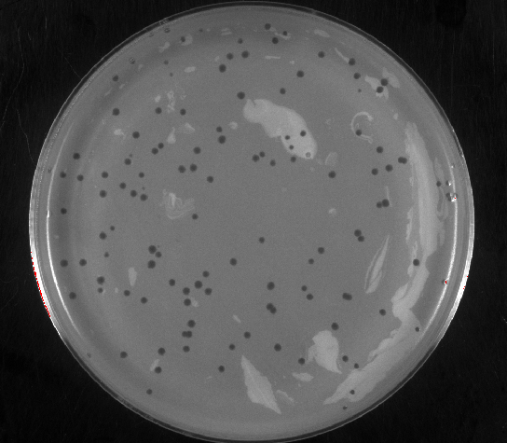
Mycobacterium phage Feyre
Found by students at Ouachita Baptist University, from a compost pile in Arkadelphia, AR

Slide 20
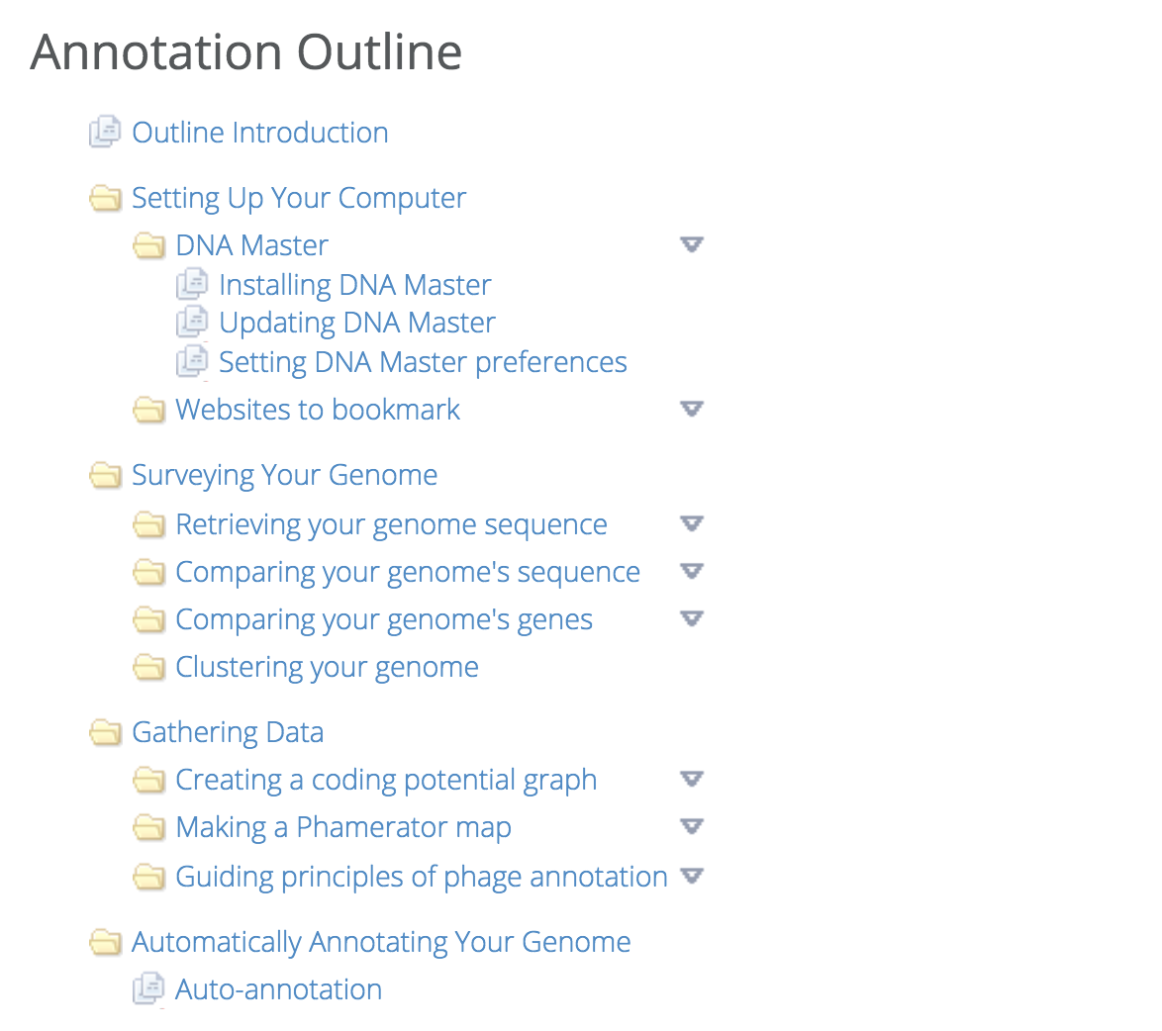
Tonight’s Tasks:
✓
DNA Master
Current Build
2705
✓
Once you have Build 2705, turn off updates. Go to Preferences -> Timed Events -> unclick the first entry “Automatic checks for DNA Master updates ….”
✓
✓
Tonight’s reading
Complete Genome Blastp in DNA Master

Slide 21

