Slide 1
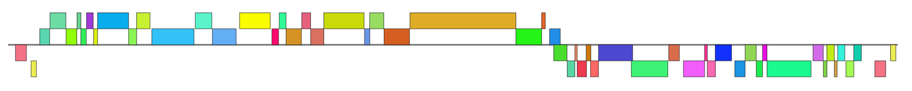
Phamerator.org
comparative genomics for bacteriophages
Steven G. Cresawn
Department of Biology
James Madison University

Slide 2
Common things you'll see on a phamerator map
Synteny: the conservation of gene order in different genomes.
Homology: the presence of highly similar sequences in different genomes. Homology can be inferred from similarity.
Mosaicism: regions of very high similarity are interspersed with regions of little or no detectable similarity. Mosaicism implies prior recombination events.
Insertions and deletions
Sequence similarity level is often not uniform across entire genomes.

Slide 3
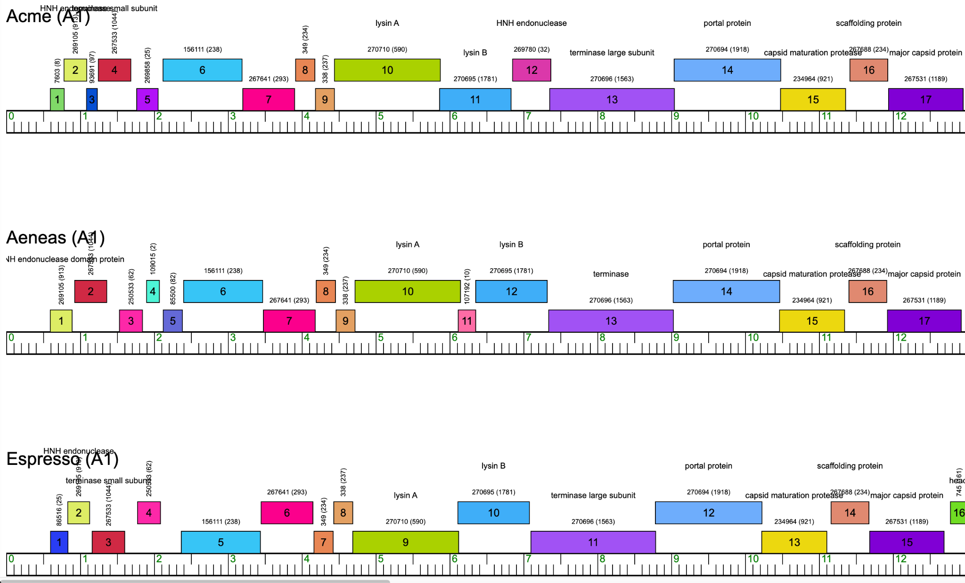
Synteny: the conservation of gene order

Slide 4
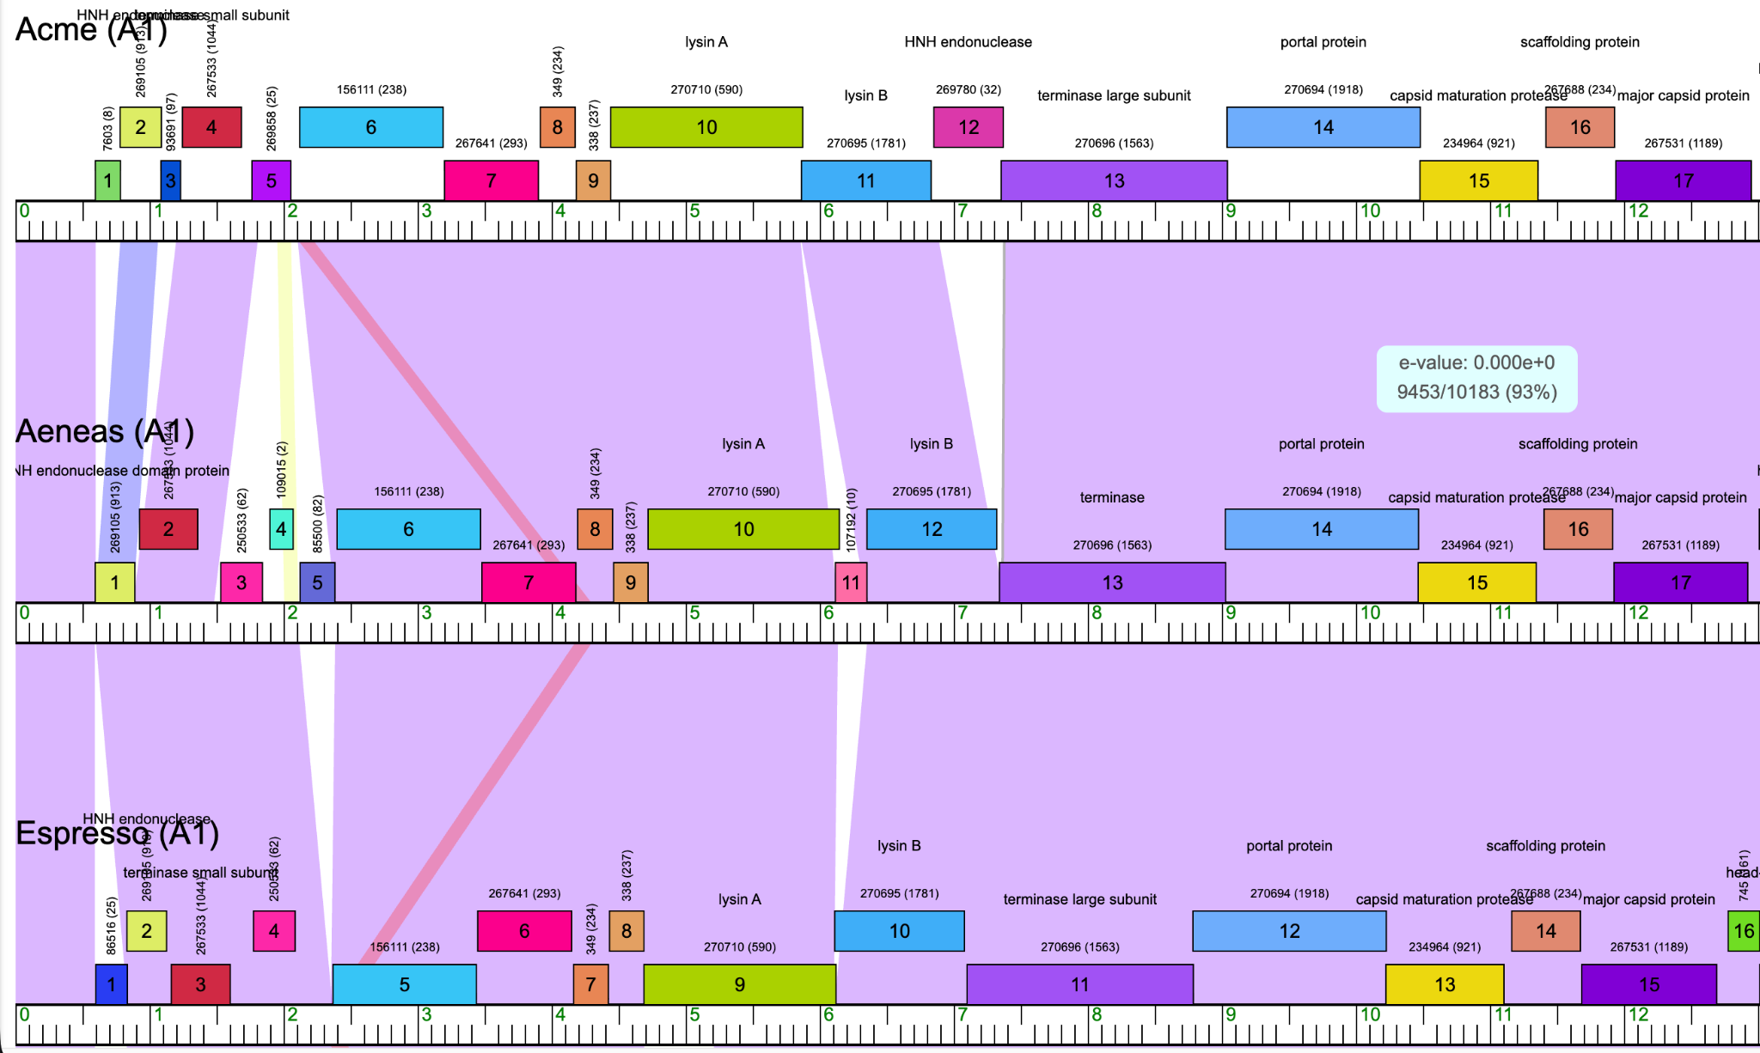
Homology: the presence of highly similar sequences in different genomes

Slide 5
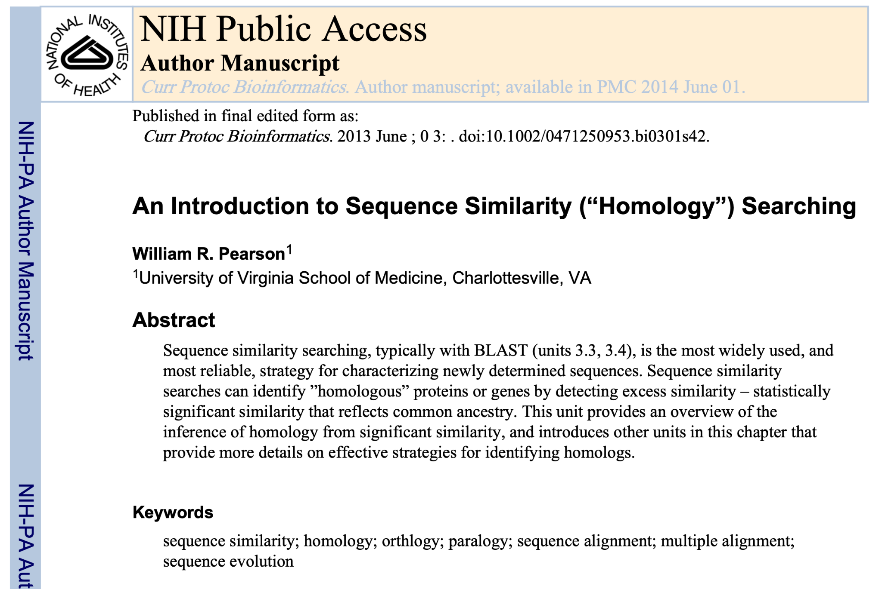
https://pmc.ncbi.nlm.nih.gov/articles/PMC3820096/

Slide 6
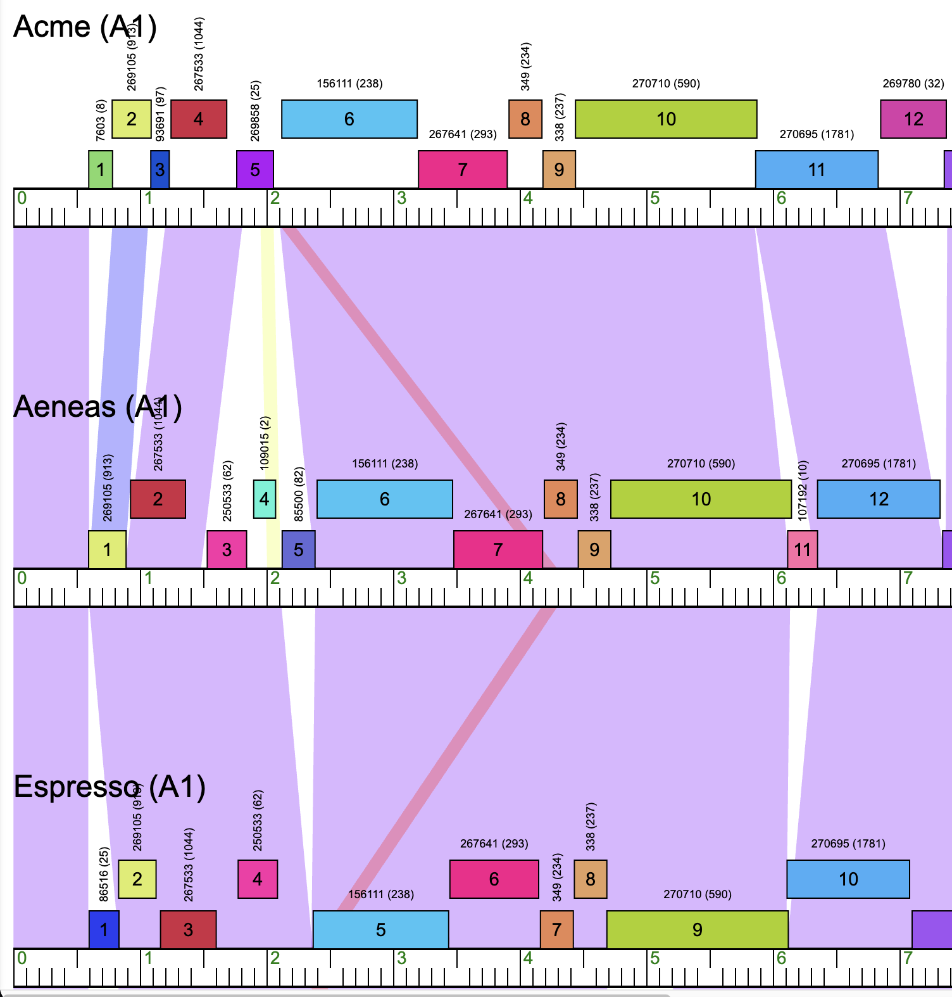
Mosaicism: regions of very high similarity interspersed with regions of little or no detectable similarity
Mosaic boundaries can be caused by insertions, deletions, or substitutions

Slide 7
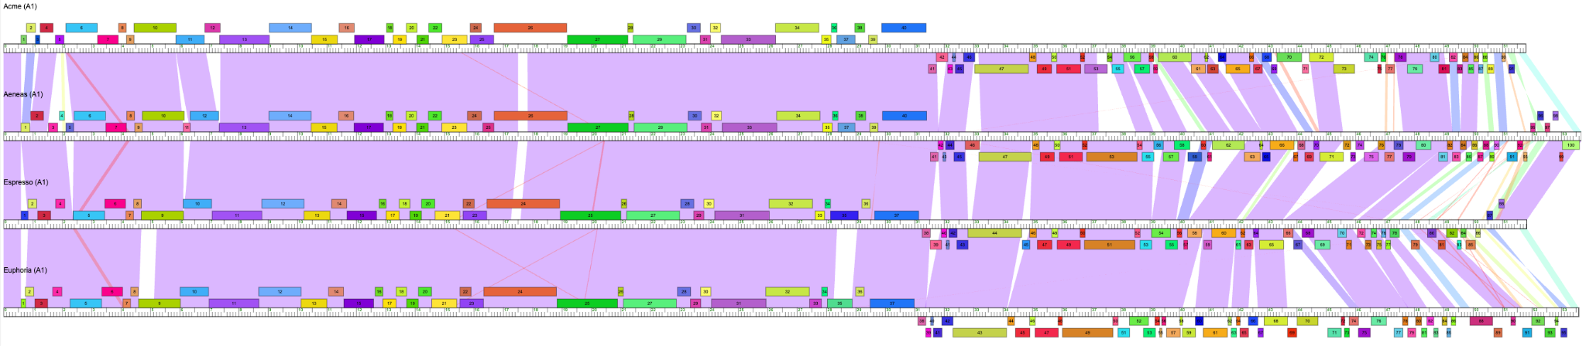
Sequence similarity is often not uniform across entire genomes

Slide 8
Less common things to see on a phamerator map
Mobile elements
DNA sequence inversions or palindromes
DNA sequence repeats
Terminal repeats

Slide 9
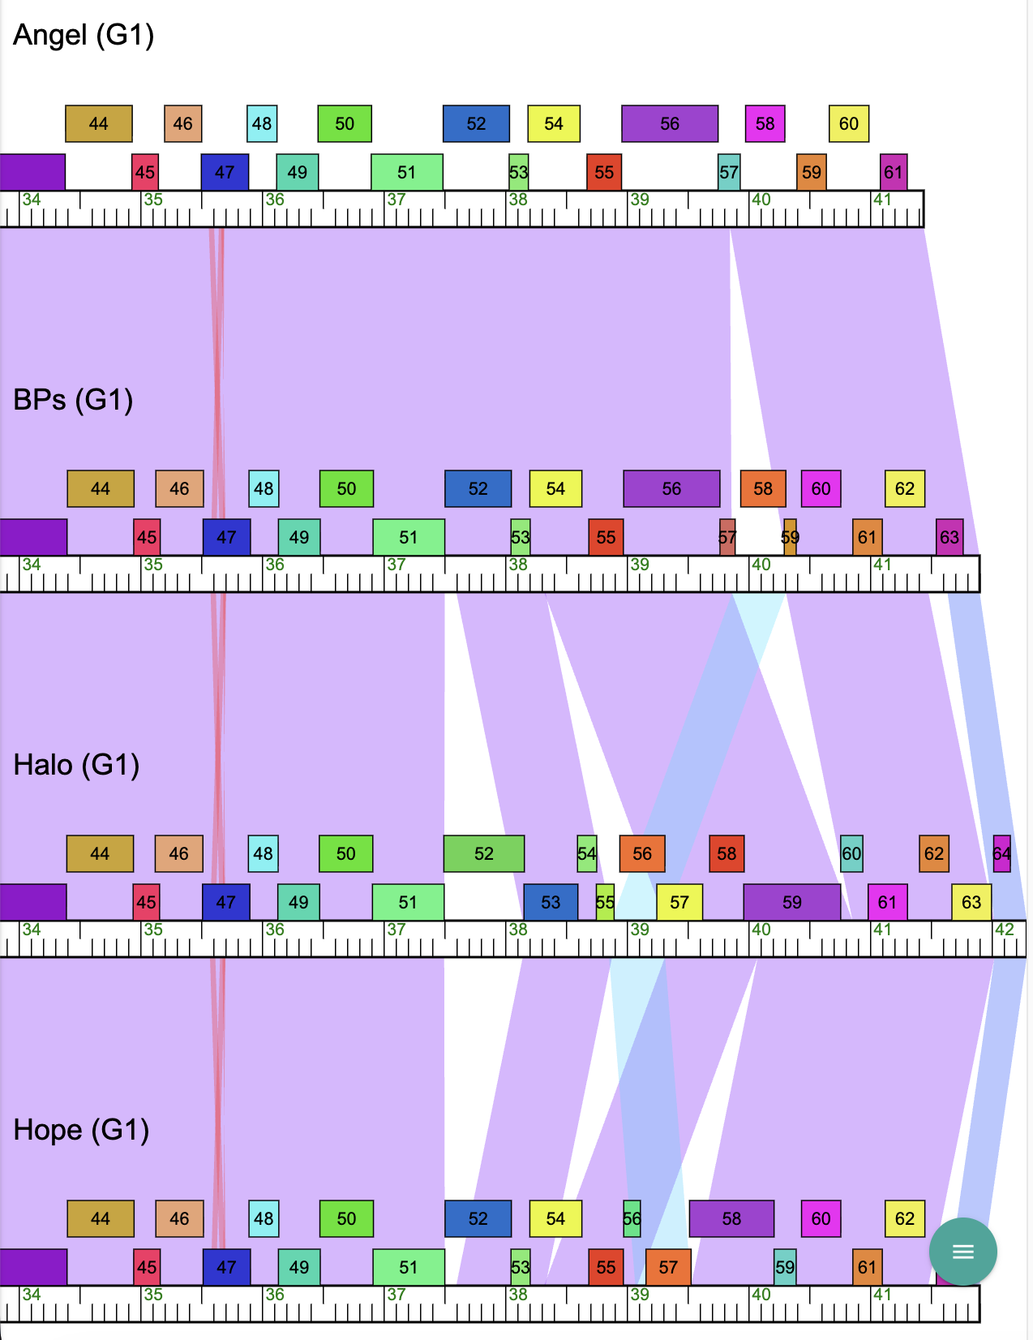
Mobile elements

Slide 10
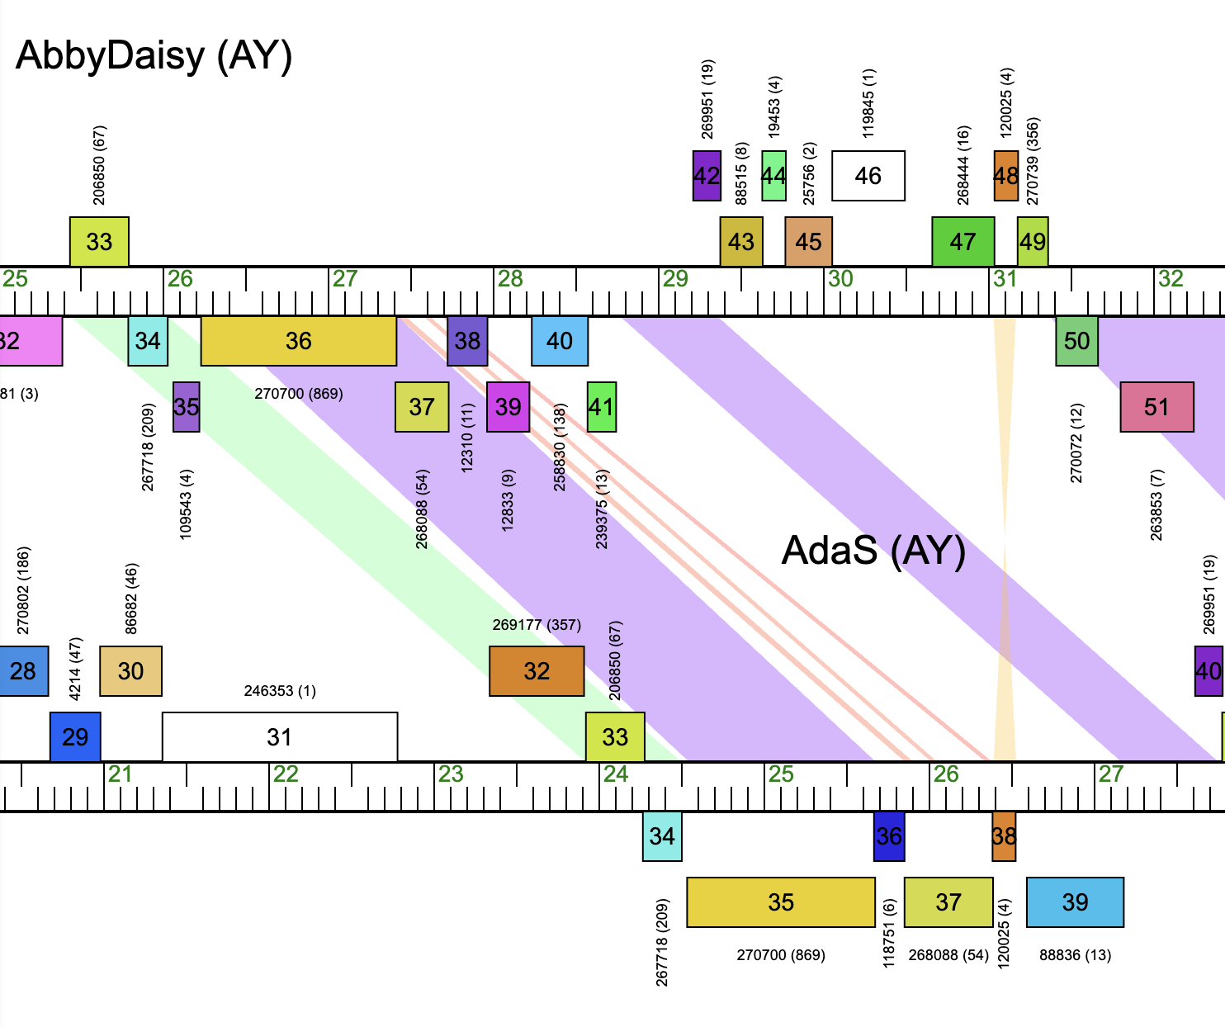
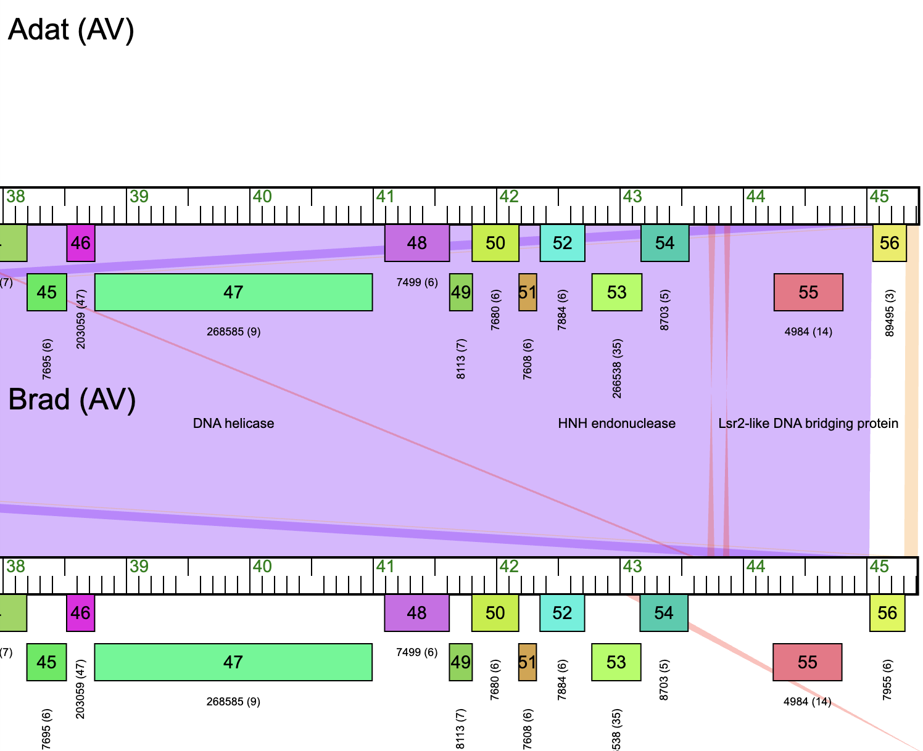
Inversions / palindromes
look for the hourglass…

Slide 11
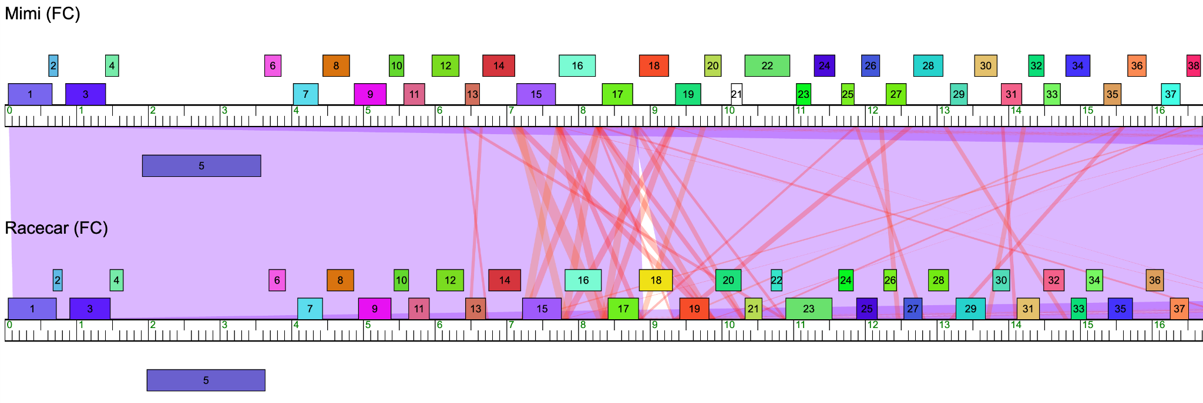
DNA sequence repeats

Slide 12
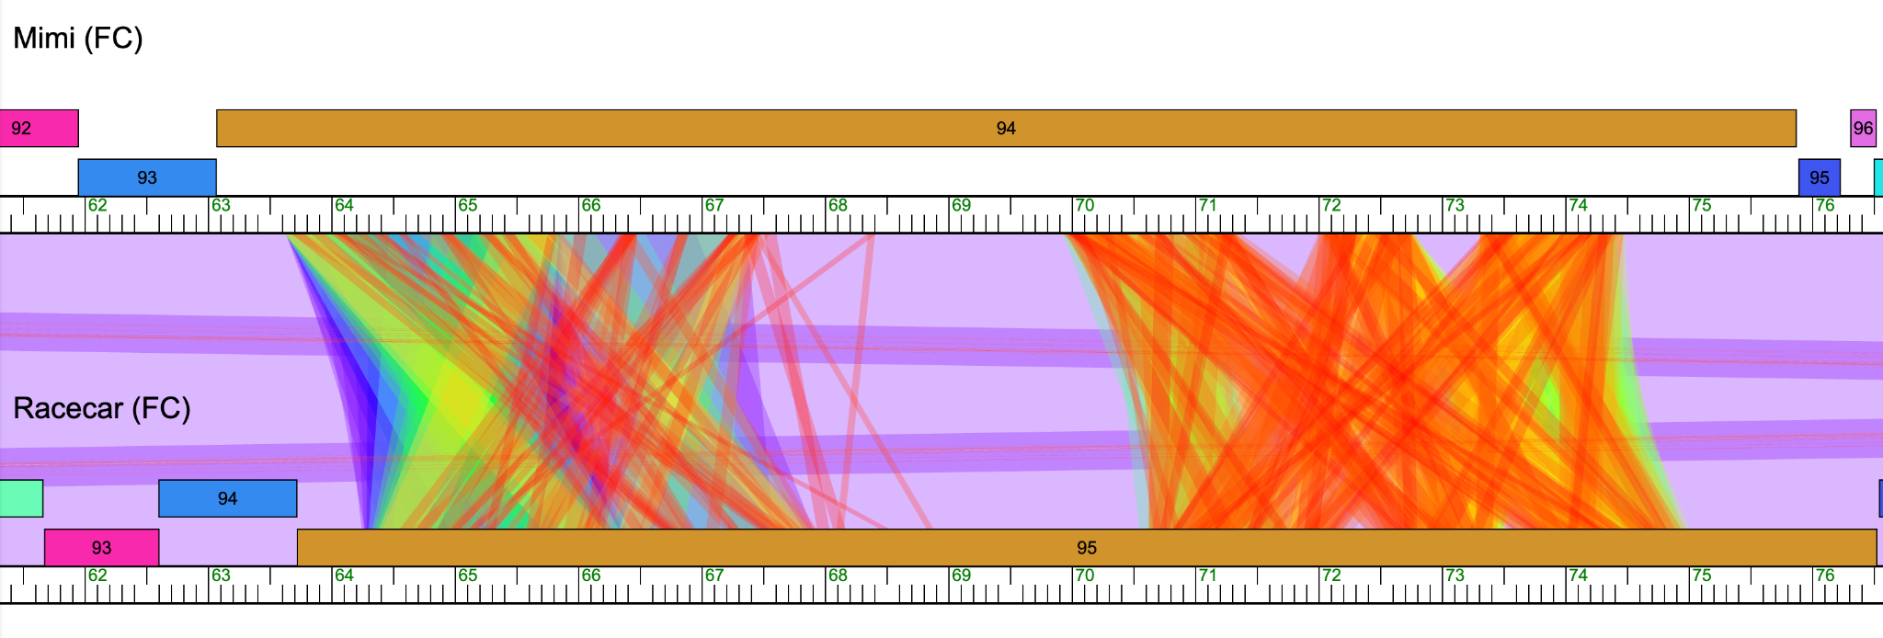
Even crazier DNA sequence repeats

Slide 13
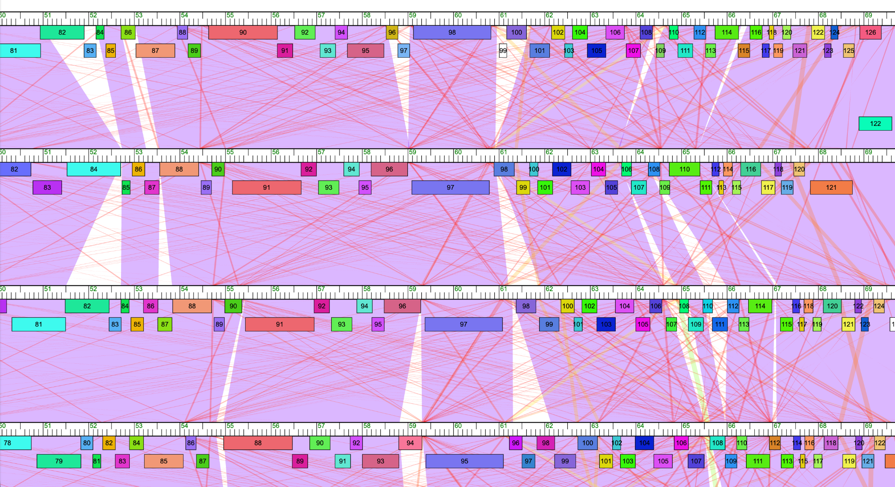
Repeats in cluster O

Slide 14
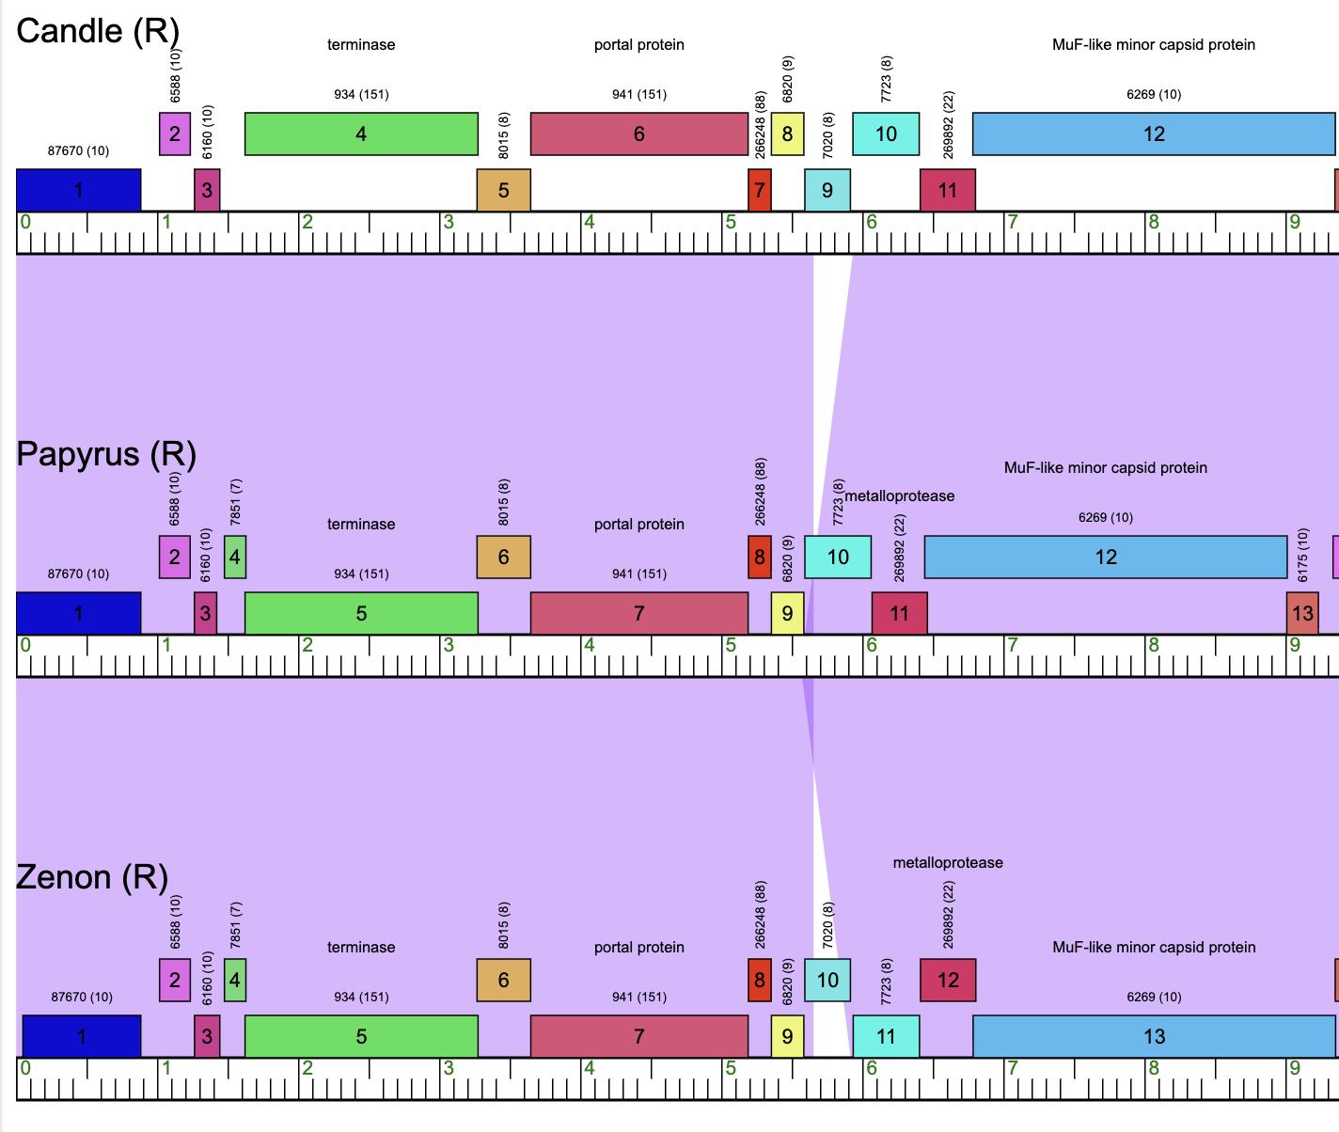
One more repeat

Slide 15
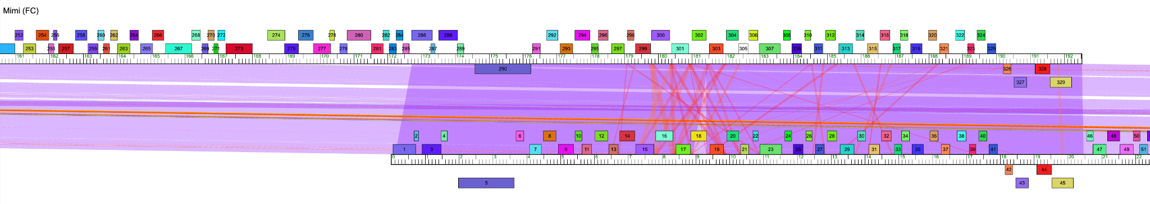
Direct terminal repeats

Slide 16
Phamerator 1.0
Phamerator.org 2.0
Phamerator.org 3.0
2006
2016
2026

