Slide 1
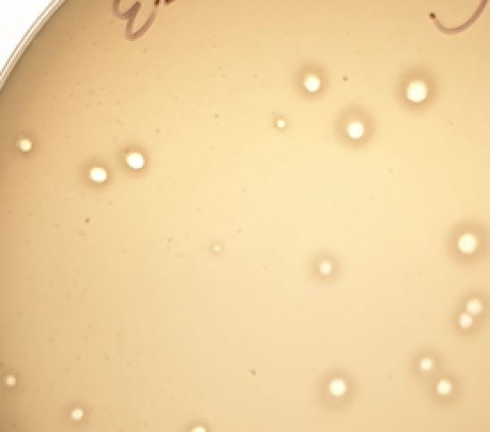
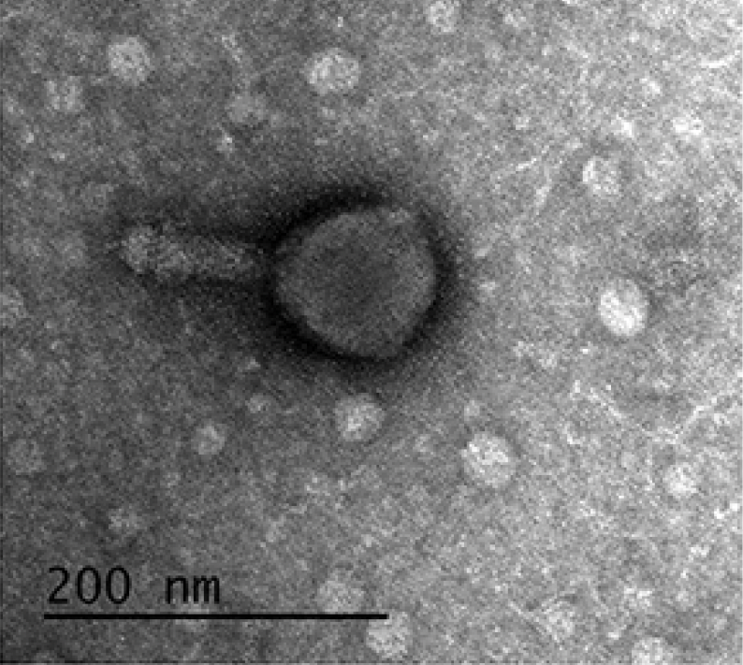
The “Take Home” message of your poster goes here! Emphasize the important words.
Title
RESULTS
PRESENTER
YOUR NAME
This panel is for extra graphs, figures, or observations. This section is for you to help explain your research to your audience.
It’s great if your study is a ’work in progress’! If you are far along enough in your study to draw some conclusions, you can state them briefly here.
BACKGROUND
Explain why your study matters as concisely as possible. Feel free to add graphics!
What is the main result, observation, or idea that you want to convey to your audience?
METHODS
Describe what you did with
brief bullet points or
some type of flowchart or figure.
FUTURE DIRECTIONS
Please use font that can be easily read, no smaller than Arial 54 or equivalent!
Try to minimize text so people can spend less time reading and more time listening to your presentation!
What do you want to explore next in this study? What open questions do you have? This is a great opportunity to get input from your peers in the SEA community!
Add an illustration that is a visual representation of the “take home” message. Get creative!
AUTHORS
Full Author List here: Leeroy Jenkins, author2, author3, author4, author5, author6, author7,
If using color to illustrate ideas, please use an inclusive color palette
Notes:
Disclaimer: This template slide has been adapted from the BetterPoster by Mike Morrisson.

Slide 2
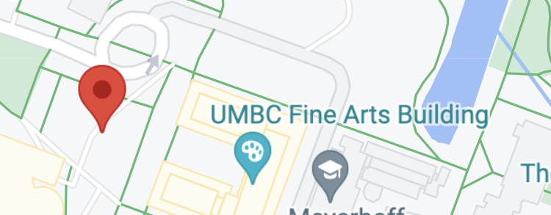
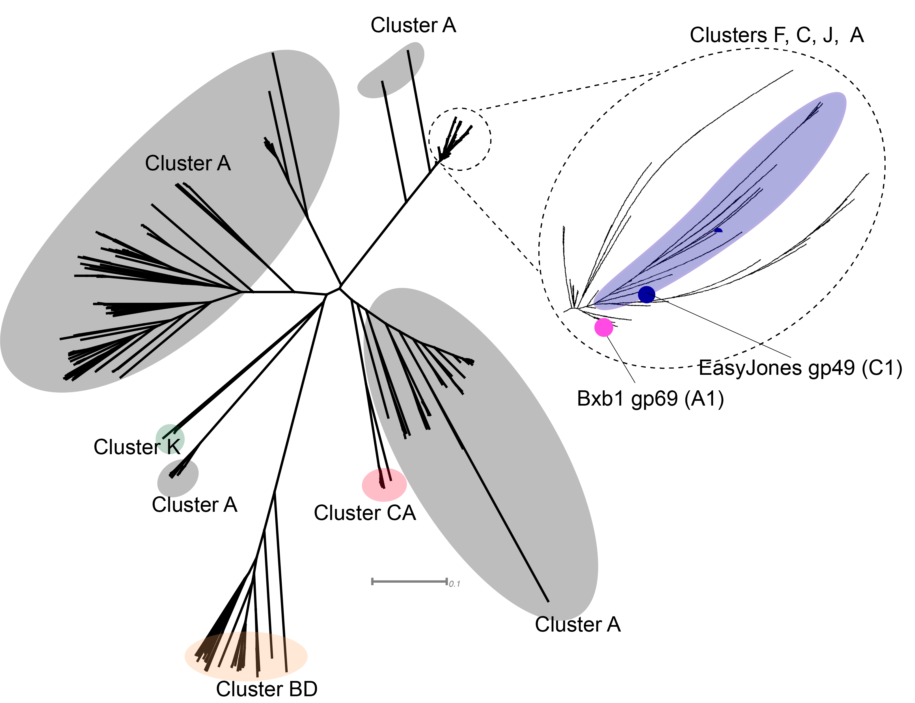
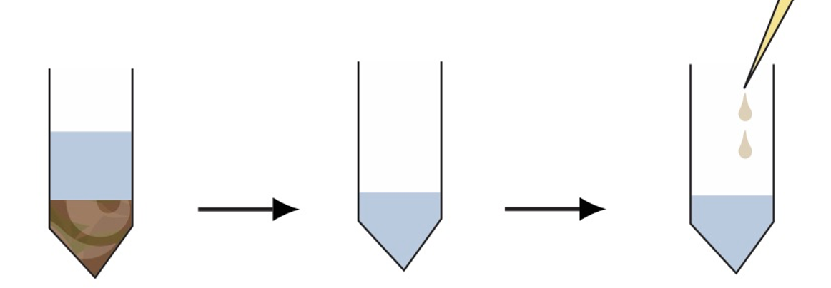
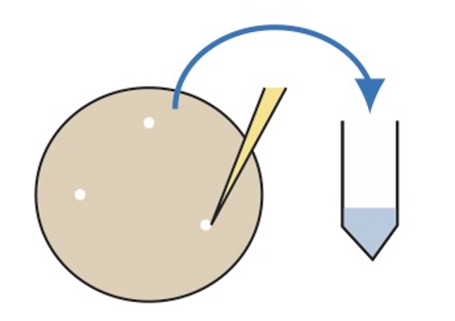
Characterization of mycobacteriophage EasyJones
RESULTS
EasyJones is a
cluster C1 lytic phage that has stolen a
cluster A immunity repressor
PRESENTER
Isabel Amaya
clear plaques, similar to other C1 phages
myovirus;
~88 nm capsid ⌀
~88 nm tail length
BACKGROUND
With bacteriophages increasingly being considered as a therapeutic for multidrug-resistant bacterial infections, the isolation and characterization of new bacteriophages is important.
GENOME
Length: 154,315 bp
G+C content: 64.7%
>83% gene content similarity to other members of cluster C1
Encodes:
276 proteins including a putative immunity repressor
34 tRNAs
1 tmRNA
SAMPLE POSTER
METHODS
Soil from UMBC, MD
Pham 98211
815 homologs
FUTURE DIRECTIONS
Enriched isolation w/ M. smegmatis
wash,
filter
add
host
Can gp49 confer superinfection immunity against cluster A phages?
What are the functions of gene 49 neighboring genes 48-51? These genes are conserved in other C1 phages with gp49 pham members.
3 rounds of plaque purification
28% of C1 phages encode a gp49 homolog
AUTHORS
Isabel Amaya, Duyen Bui, Ariel Egbunine,
Ember Mushrush, Maggie Viland,
Deborah Jacobs-Sera, Danielle Heller,
and Vic Sivanathan
Genome annotation using SEA-PHAGES Guide
Notes:
Disclaimer: The sample poster was created by HHMI staff for illustration purposes only, to be used as an example for developing a poster.

