Slide 1
Phage Genomics Workshop WELCOME

Slide 2
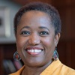
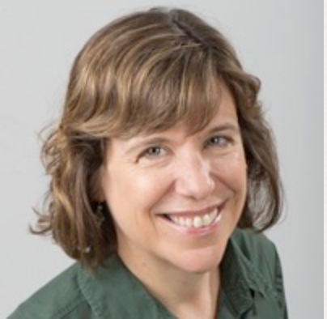
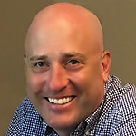
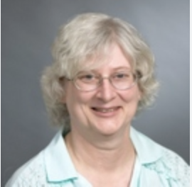
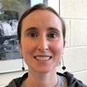
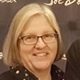
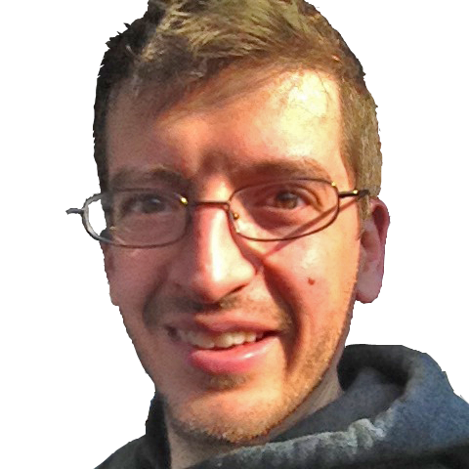
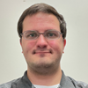
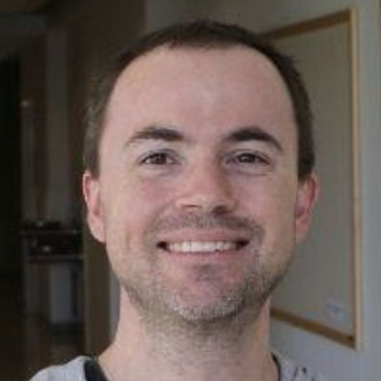
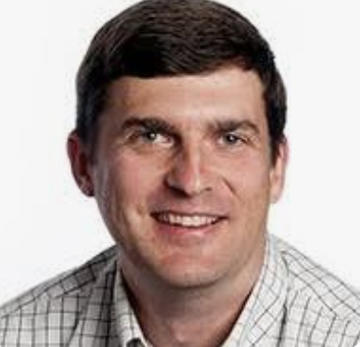
Jackie
Washington
Karen
Klyczek
Dan
Williams
JoAnn
Whitefleet-Smith
Maria
Gainey
Debbie
Jacobs-Sera
Dan
Russell
Christian
Gauthier
Steve
Cresawn
Graham
Hatfull
Billy
Biederman

Slide 3
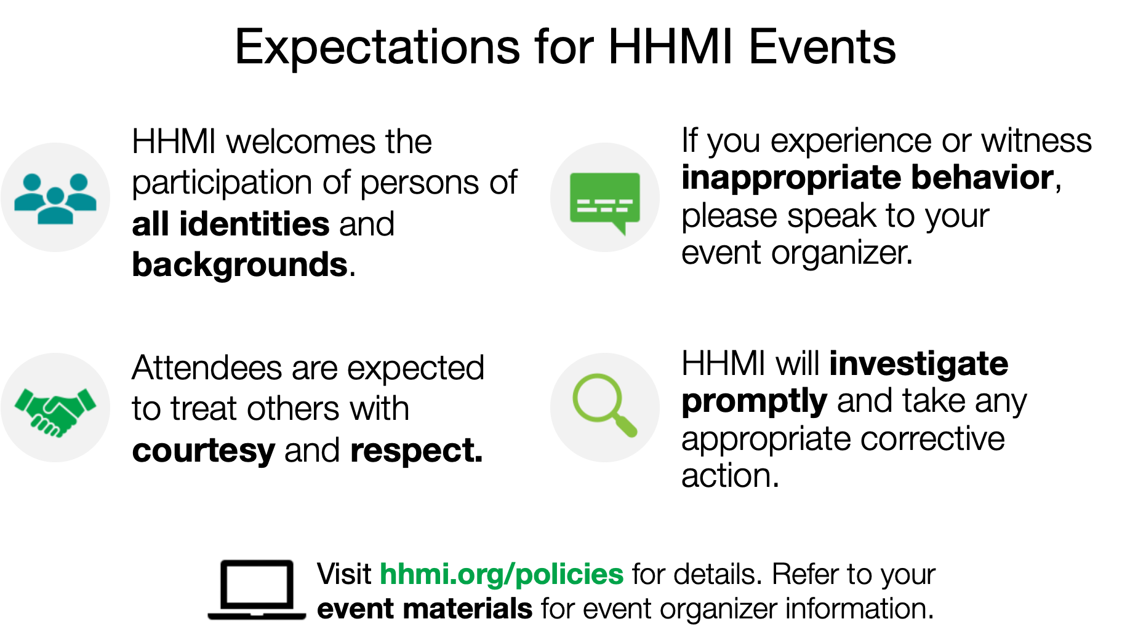

Slide 5
Workshop Logistics
Enjoy our campus
Keep to workshop schedule (especially for meals)
Please wear your name badges

Slide 6
SEA-PHAGES Bioinformatics Workshop Overview

Slide 7
Objectives
Characterize and investigate phage genomes including the details of gene calling, functional assignments, and preparing final submission files that meet QC requirements.
This year’s genome is Mycobacterium phage Feyre. We will add a few genes from Mycobacterium phage Chartreuse.
Install and use the software for annotation and analysis of phages. The software includes DNA Master, Phamerator, and other web-based tools.
Identify basic phage biology concepts that underlie bioinformatic investigations.
Explore classroom implementation strategies.

Slide 8
Primary Learning Method
Learn by doing
Gather data
Do the work: annotate & analyze the genome
Do science like scientists do it. [Translation: new technology changes at a moment’s notice]

Slide 9
Workshop Logistics
Workshop page at seaphages.org
We will be working in groups (assignments are on Workshop page)
SEA-PHAGES Bioinformatics Guide
Lab notebook. Take notes while annotating!
seaphages.org forums: Check often.

Slide 10
We Will…
Use Mycobacterium phages Feyre genome to
Learn to manipulate the tools we use
DNA Master
GeneMark, Glimmer
BLAST
Phamerator
HHpred
Starterator
Practice calling genes and functions
Increase our phage biology knowledge
Produce a quality genome annotation
Sequence quality control: ✓
Annotation quality control: Checklist and files

Slide 11
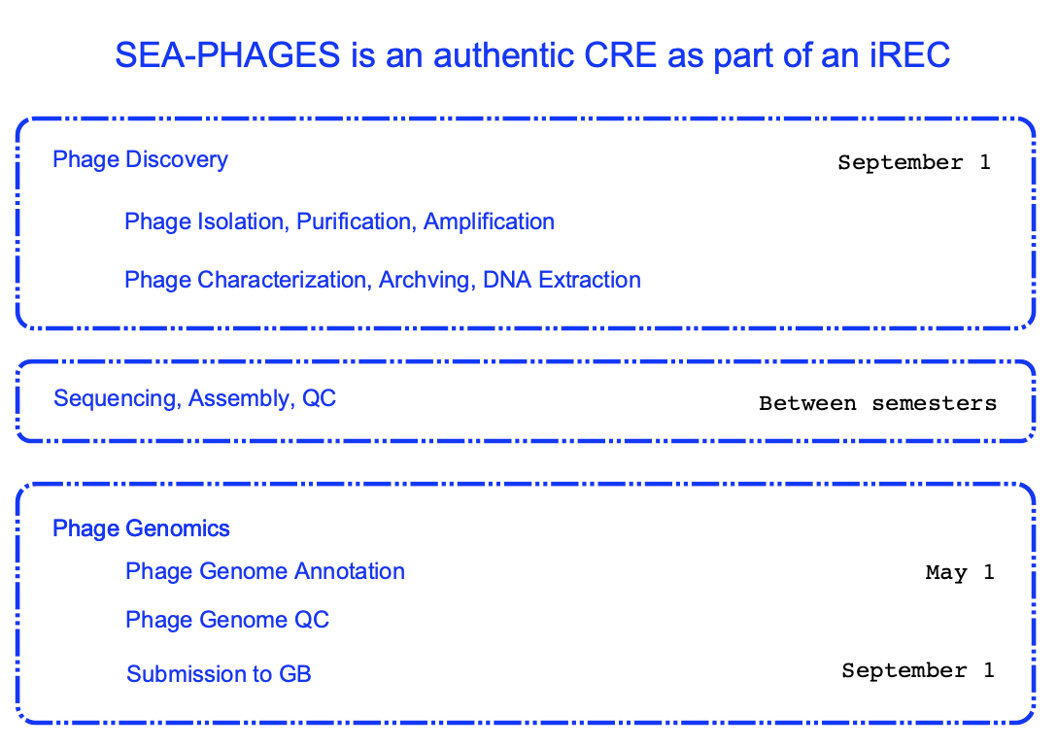

Slide 14
Two aspects that go hand in hand: Biology of phages & Mechanics of phage annotation
To get started on the Biology of phages, review Central Dogma principles, according to phages. (before dinner)
Read Bioinformatics Section in the Phage Discovery Guide
Review Central Dogma check-list
Questions
To get started on the Mechanics. (after dinner)
Auto-annotate
Blast
Gather GeneMark graphic outputs
Bookmark websites

