Slide 1
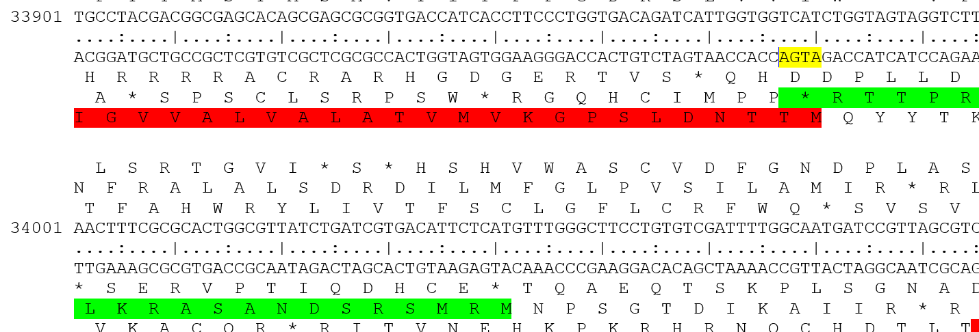
Can we call gene 47a, having an ATGA overlap (yellow highlight) with gene 45, but not with 47b in the F1 subcluster?

