Slide 1
Genome Announcements: An Overview
Dan Russell

Slide 2
How’d we get here?

Slide 3
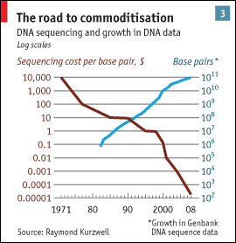
from The Economist

Slide 4
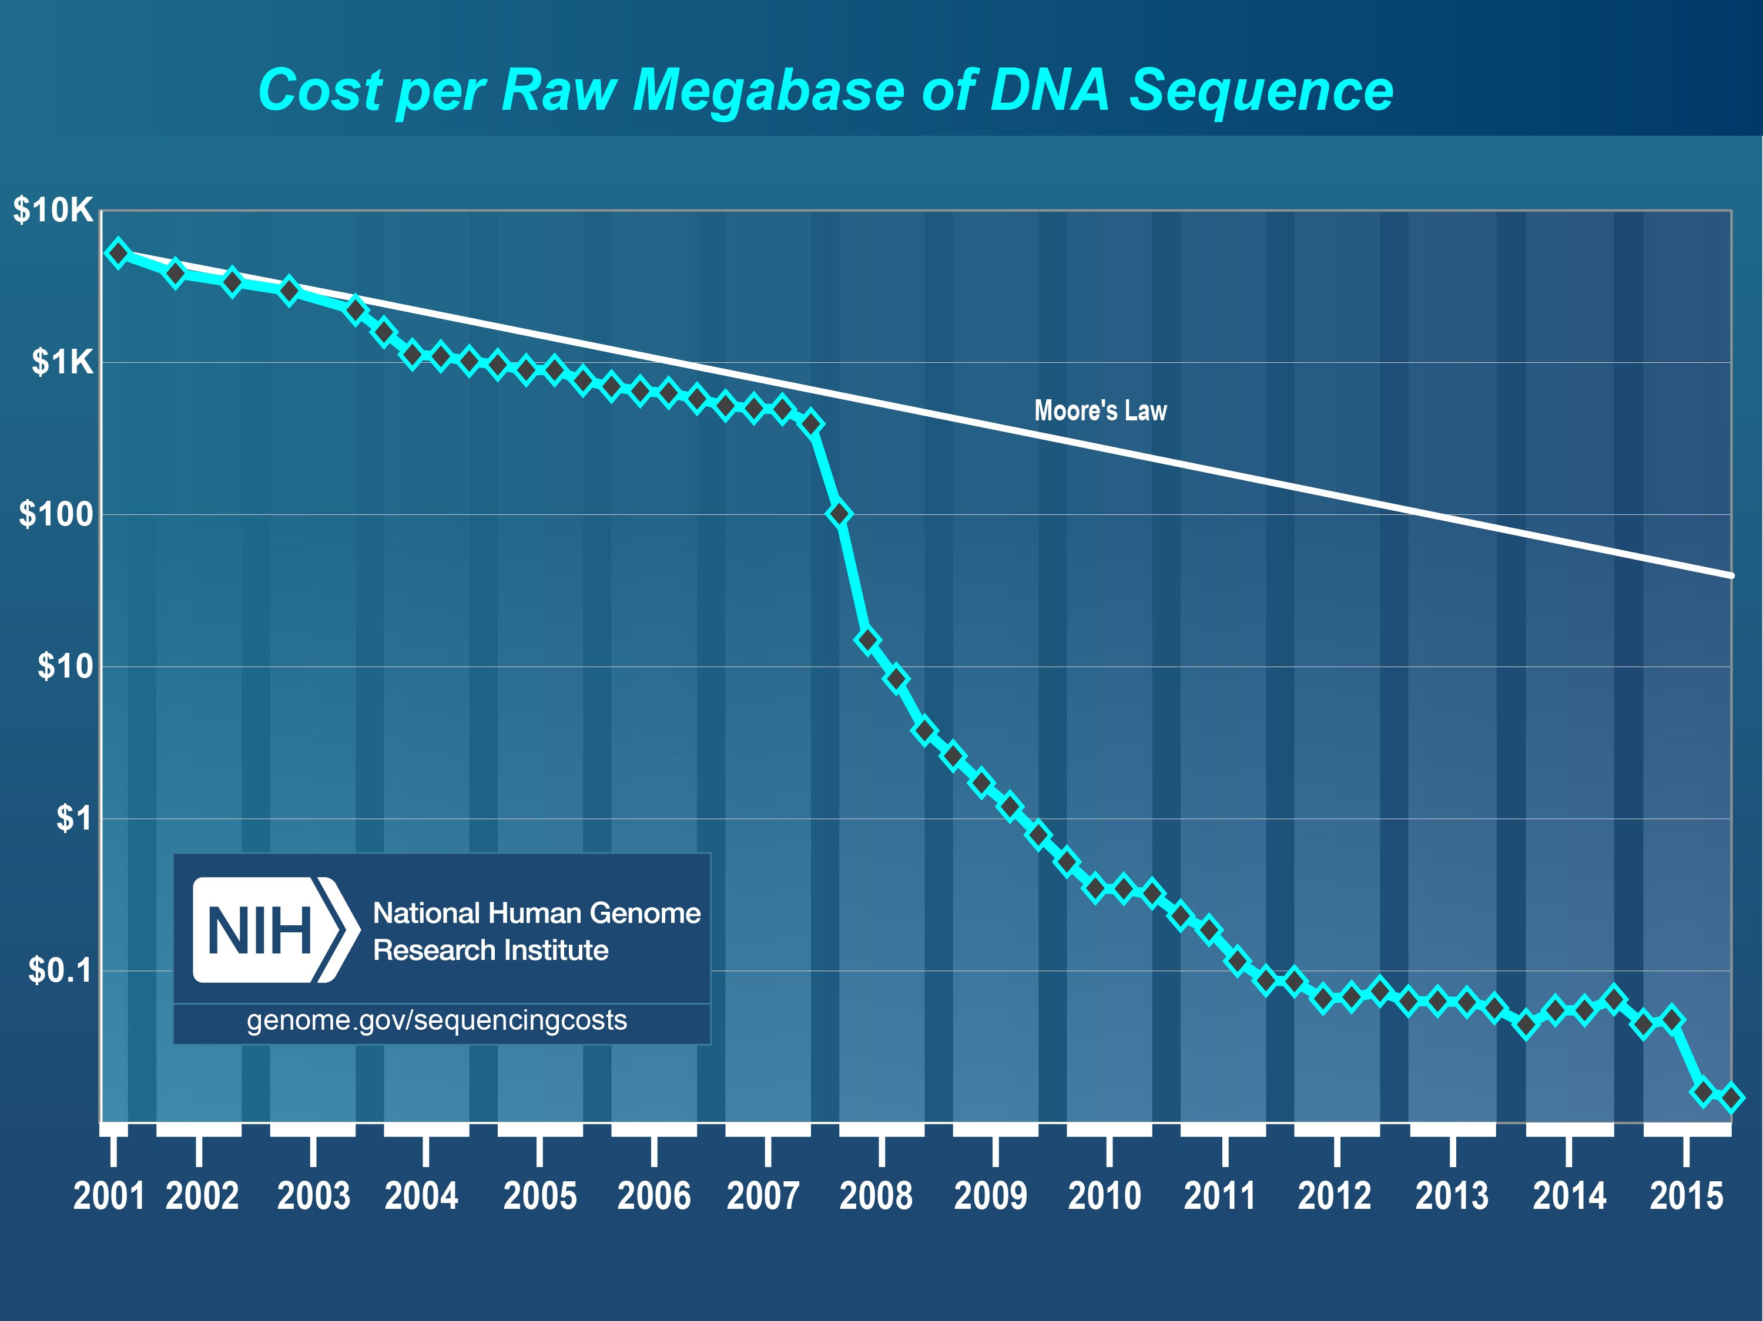
Wetterstrand KA. DNA Sequencing Costs: Data from the NHGRI Genome Sequencing Program (GSP) Available at: www.genome.gov/sequencingcostsdata. Accessed June 11, 2017.

Slide 5
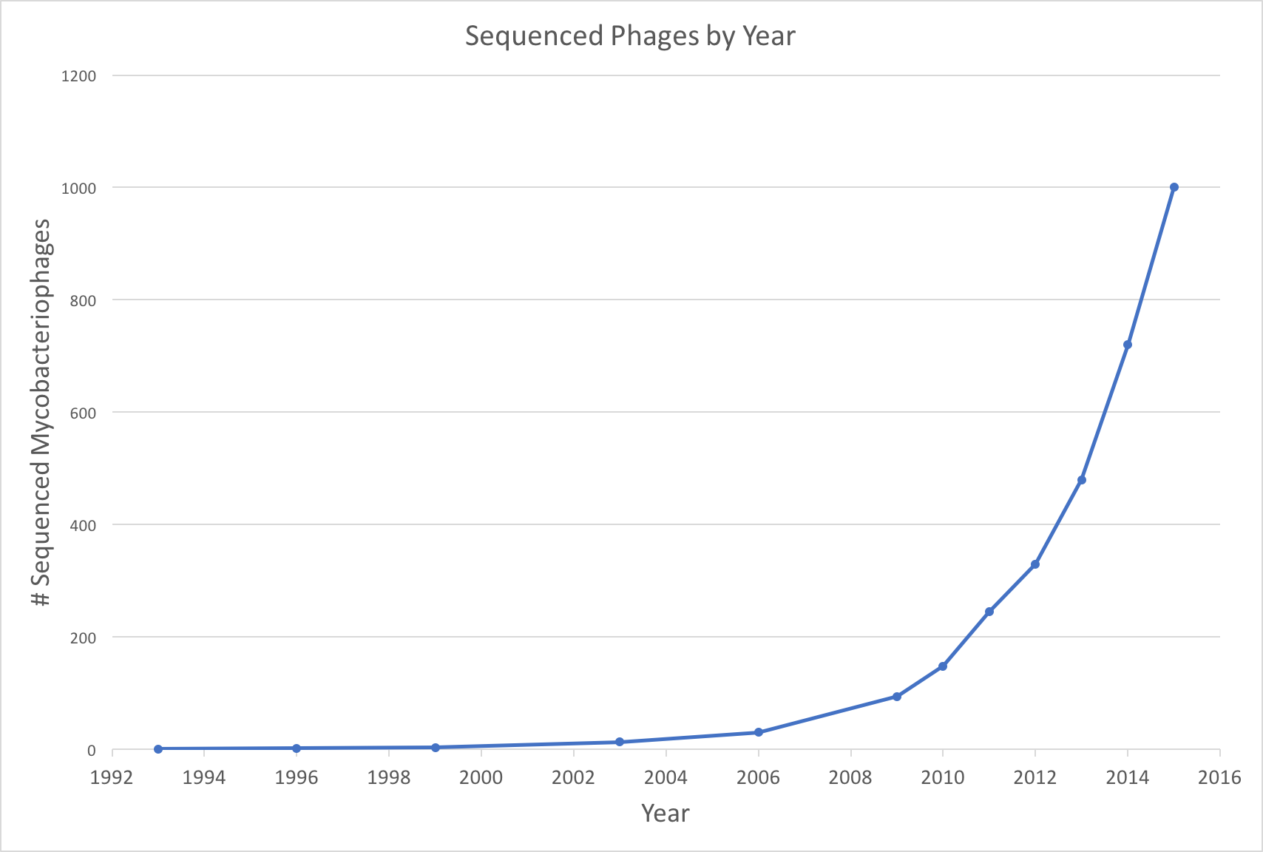

Slide 6
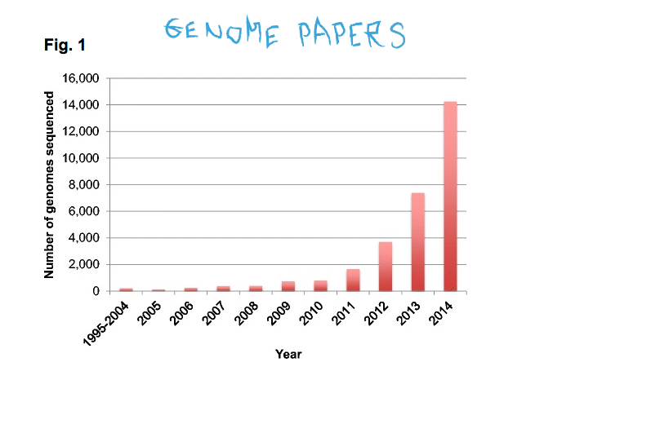
Land M, Hauser L, Jun S-R, et al. Insights from 20 years of bacterial genome sequencing. Functional & Integrative Genomics. 2015.
Land M, Hauser L, Jun S-R, et al. Insights from 20 years of bacterial genome sequencing. Functional & Integrative Genomics. 2015.

Slide 7
Genome papers through recent history

Slide 8
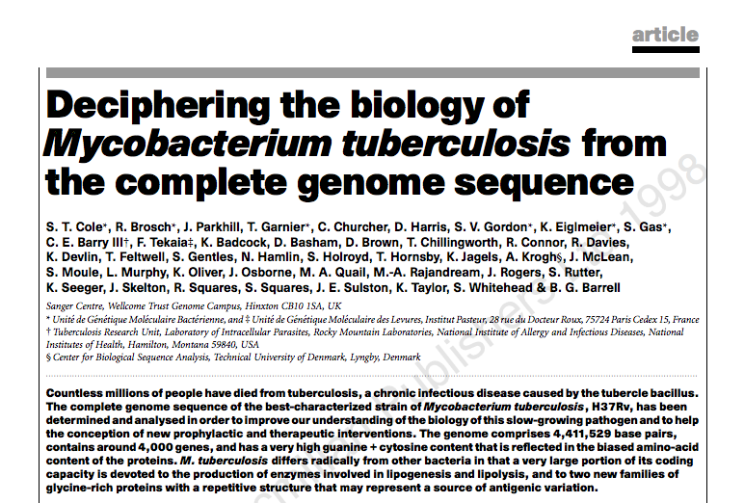
Stats
Nature
Cited by: 7402
1998

Slide 9
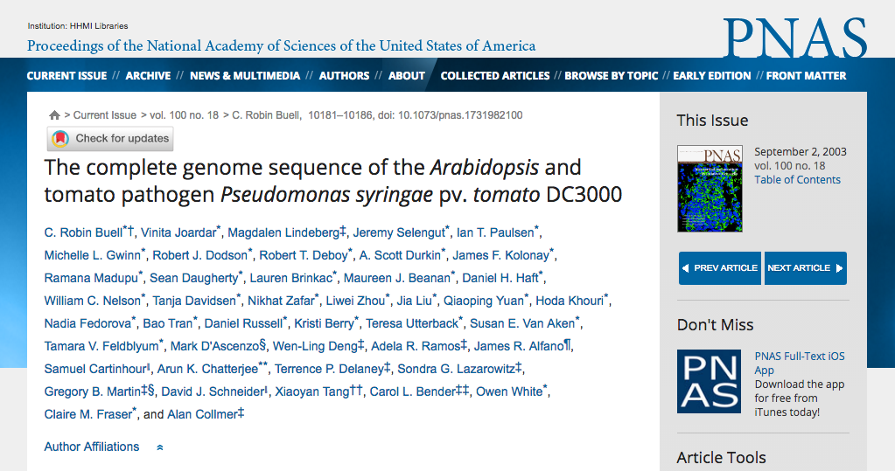
Stats
PNAS
Cited by: 765
2003

Slide 10
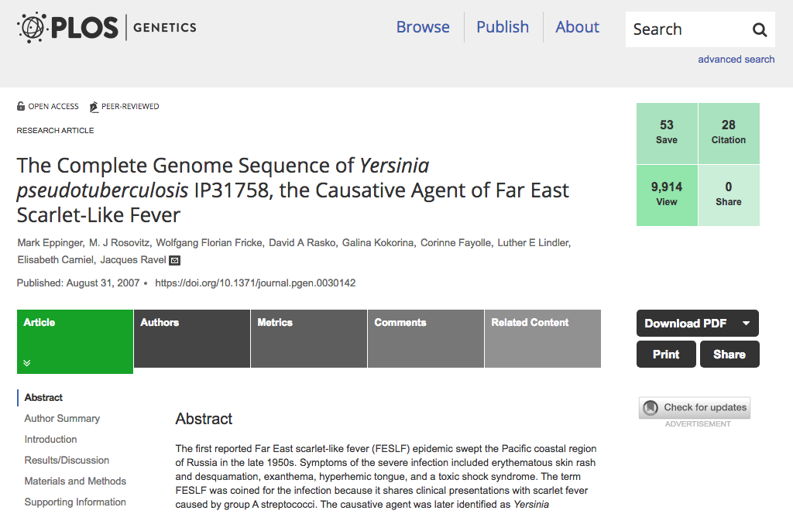
Stats
PLoS Genetics
Cited by: 104
2007

Slide 11
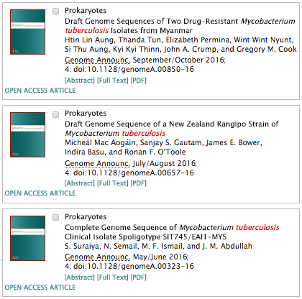
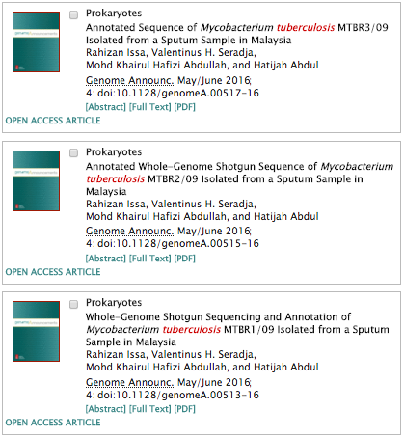
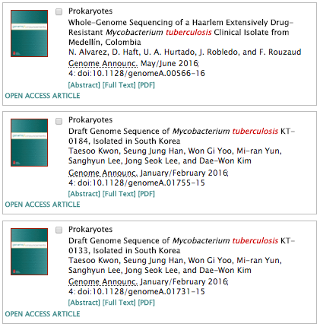
2016

Slide 12
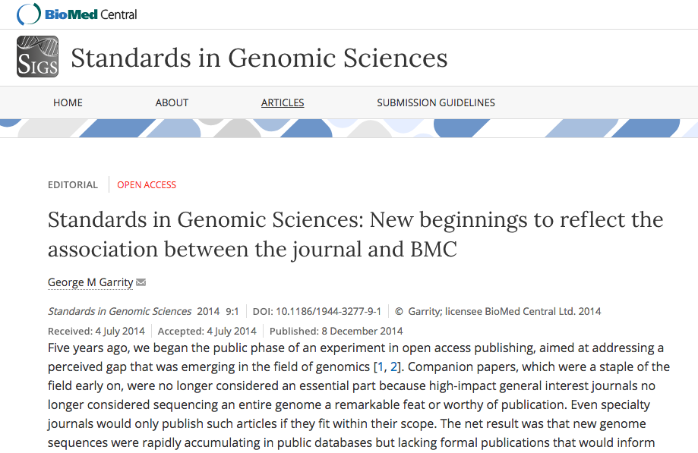

Slide 13
“…[As of 2009,] high-impact general interest journals no longer considered sequencing an entire genome a remarkable feat or worthy of publication.”

Slide 14
Land M, Hauser L, Jun S-R, et al. Insights from 20 years of bacterial genome sequencing. Functional & Integrative Genomics. 2015.
Land M, Hauser L, Jun S-R, et al. Insights from 20 years of bacterial genome sequencing. Functional & Integrative Genomics. 2015.

Slide 15
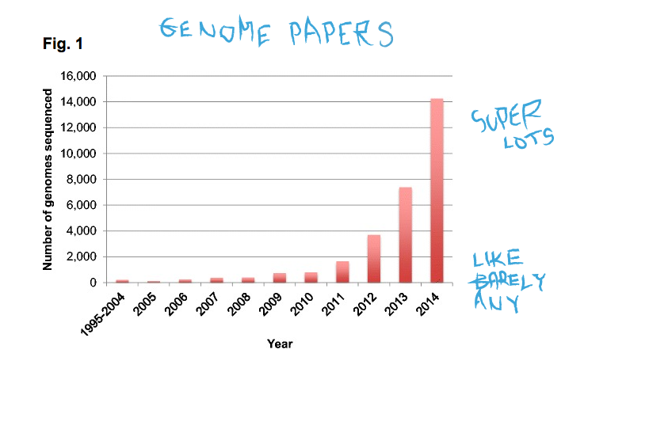
Land M, Hauser L, Jun S-R, et al. Insights from 20 years of bacterial genome sequencing. Functional & Integrative Genomics. 2015.
Land M, Hauser L, Jun S-R, et al. Insights from 20 years of bacterial genome sequencing. Functional & Integrative Genomics. 2015.

Slide 16
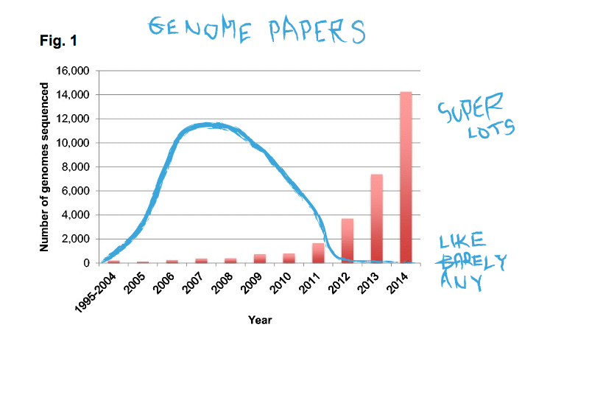
Land M, Hauser L, Jun S-R, et al. Insights from 20 years of bacterial genome sequencing. Functional & Integrative Genomics. 2015.
Land M, Hauser L, Jun S-R, et al. Insights from 20 years of bacterial genome sequencing. Functional & Integrative Genomics. 2015.

Slide 17
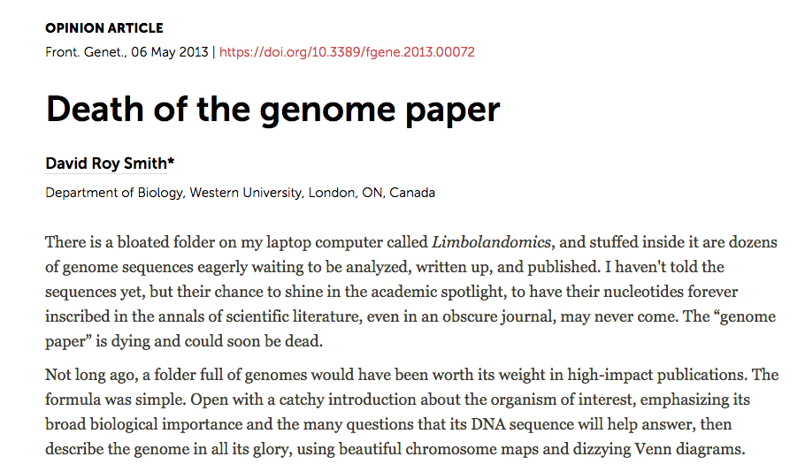

Slide 18
“…[As of 2009,] high-impact general interest journals no longer considered sequencing an entire genome a remarkable feat or worthy of publication.”
“…new genome sequences were rapidly accumulating in public databases but lacking formal publications that would inform readers of the rationale for why the sequence was generated, or a description of the methods used to produce and annotate the sequence and contextual information about the source organism.”

Slide 19
Where do we go now?

Slide 20
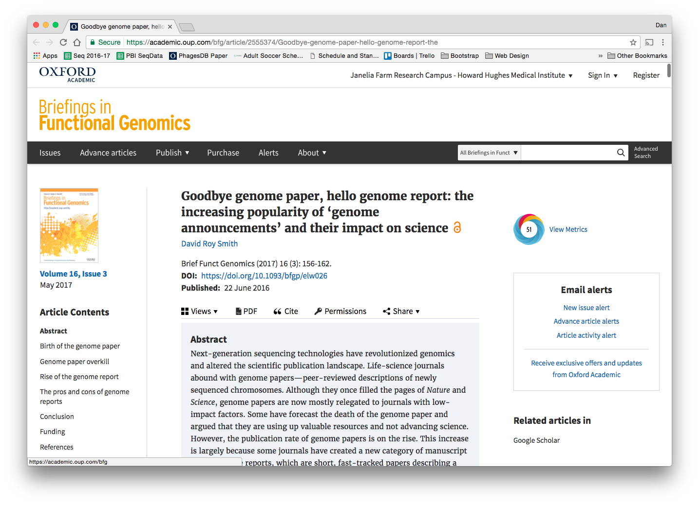

Slide 21
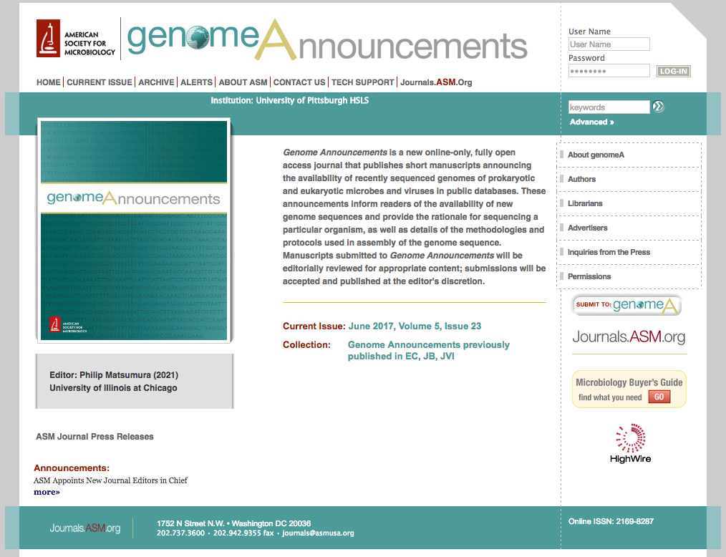
“[Genome] announcements inform readers of the availability of new genome sequences and provide the rationale for sequencing a particular organism, as well as the details of the methodologies and protocols used in assembly of the genome sequence.”

Slide 22
Genome Announcements: Journal Info
Online only
Open access
Editorial review rather than peer review
$500 publication fee ($750 for non-ASM members)

Slide 23
Genome Announcements: Parameters
50 word abstract; 500 word limit
Limitations on subheadings
No figures
Does not preclude subsequent publications

Slide 24
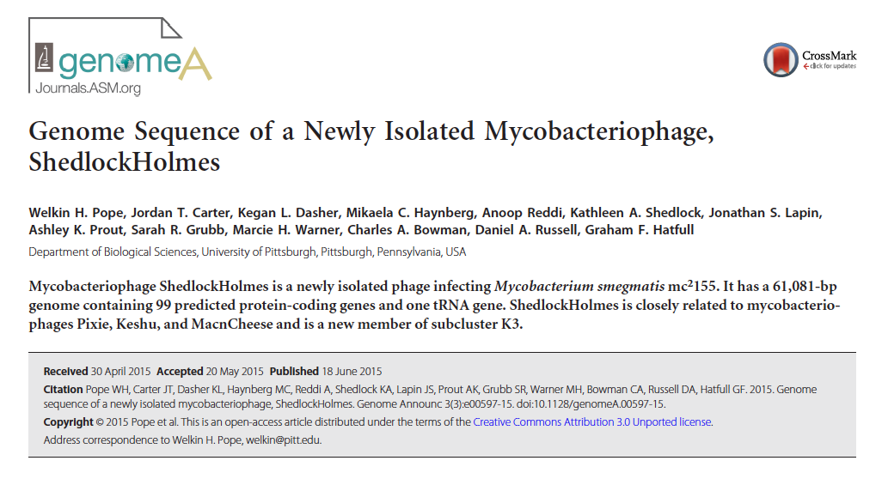
Parameters
Can be for a single phage genome…

Slide 25
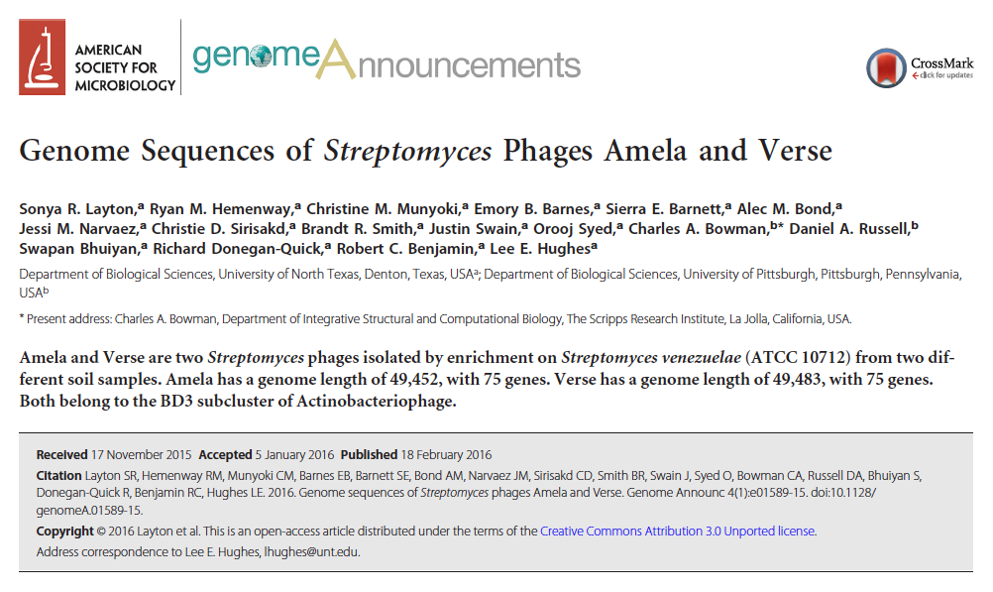
Parameters
Or for a couple phage genomes…

Slide 26
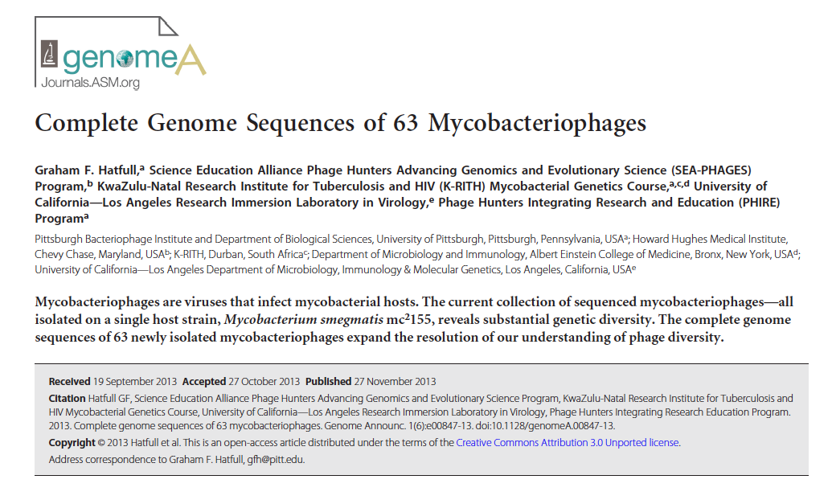
Parameters
Or for many phage genomes…

Slide 27
Parameters
Or for a single bacterial genome…

Slide 28
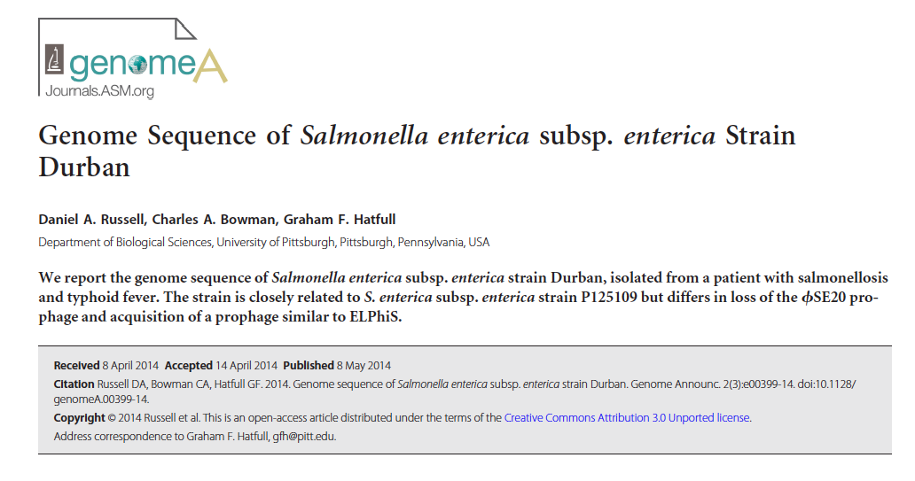
Parameters
Or primarily revenge-based
“While returning home from Durban, South Africa, three microbiologists and a 10-year-old child became sick…”
“For one adult, a phage biologist, the identification of bacteremia with Gram-negative rods prompted hospital admission, after which abnormal liver function was observed and typhoid fever was diagnosed…the patient was released after 5 days and returned to normal health.”
“[There is] an additional prophage inserted between coordinates 2,755,509 and 2,789,459 of the Durban genome.”
“There is no evidence that the professional work of the phage biologist contributed to the acquisition of the ELPhiS prophage by strain Durban.”

Slide 29
Writing a Genome Announcement
Settle on phage(s) and ensure they’re in GenBank
Collect lots of information about genome(s)
Decide what’s worthy of inclusion

Slide 30
Genome Announcement Contents
Rationale for sequencing
Details of sequencing and annotation protocols
(A bit of) results of sequencing/annotation

Slide 31
This Workshop
Work in small groups
Goals
Write actual genome announcements
Learn to investigate genomes

Slide 32
