Slide 1
What’s in a (phage) name?
Dan Russell

Slide 2
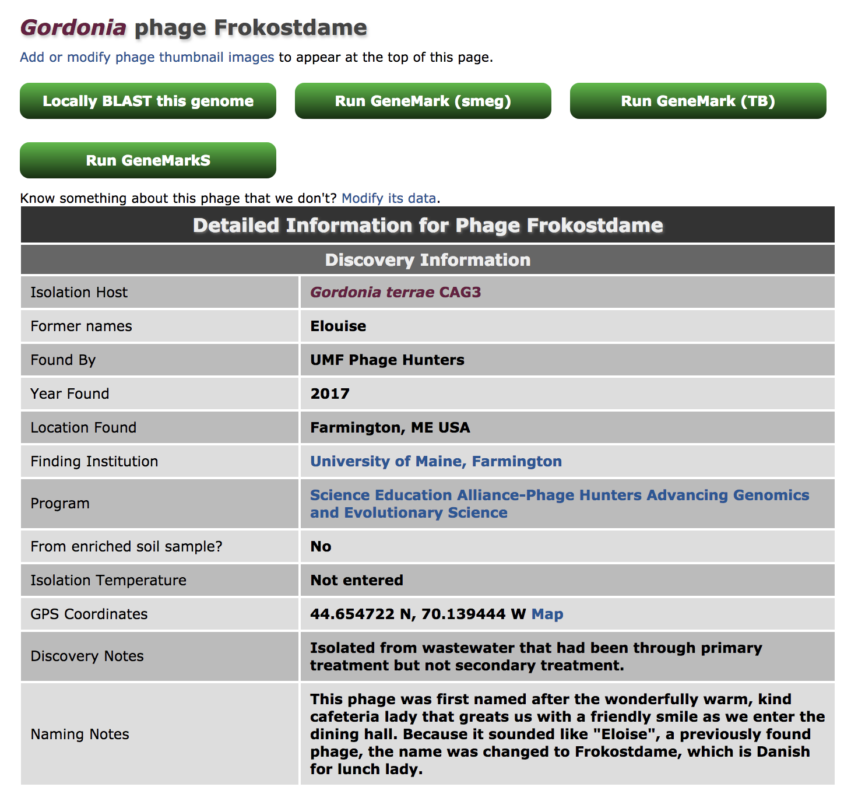

Slide 3
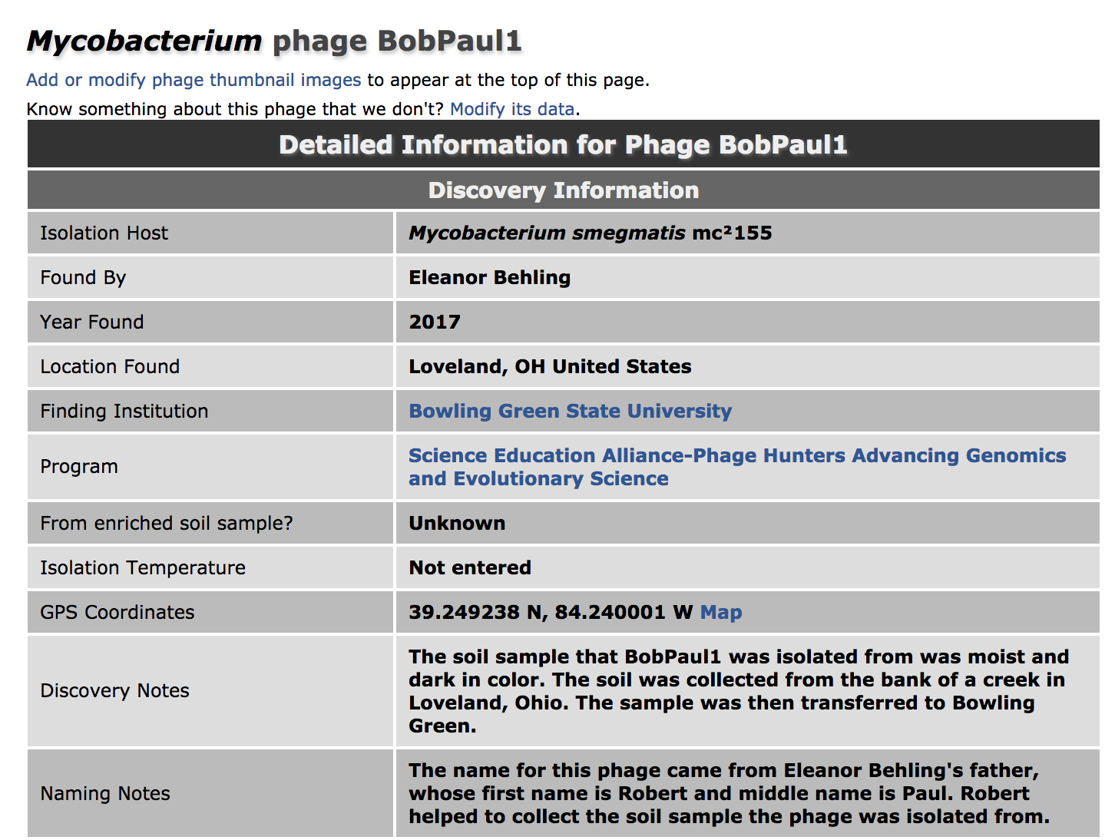

Slide 4
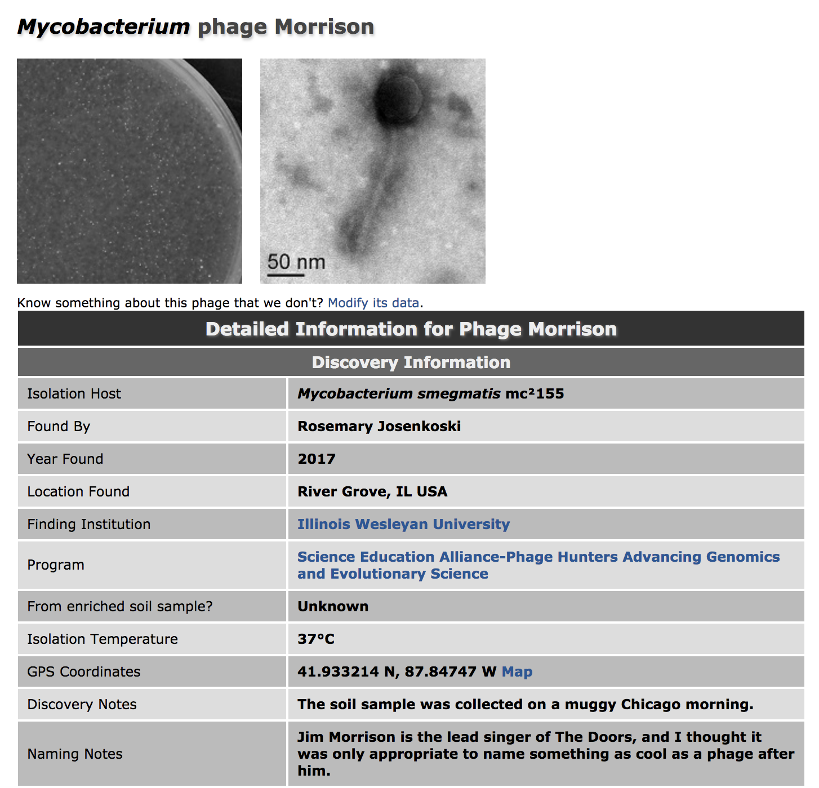

Slide 5
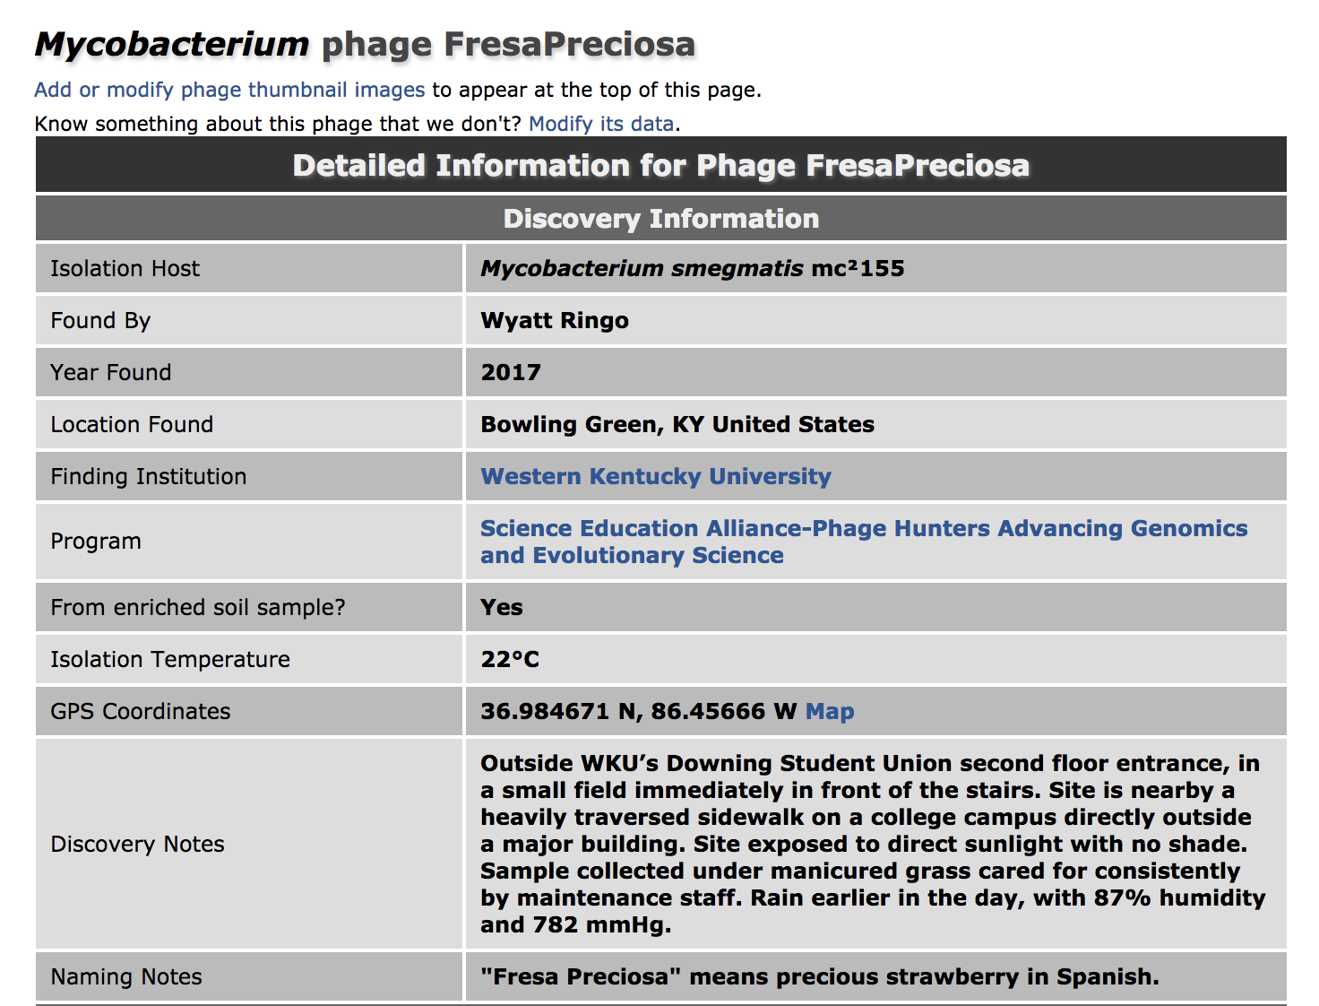

Slide 6
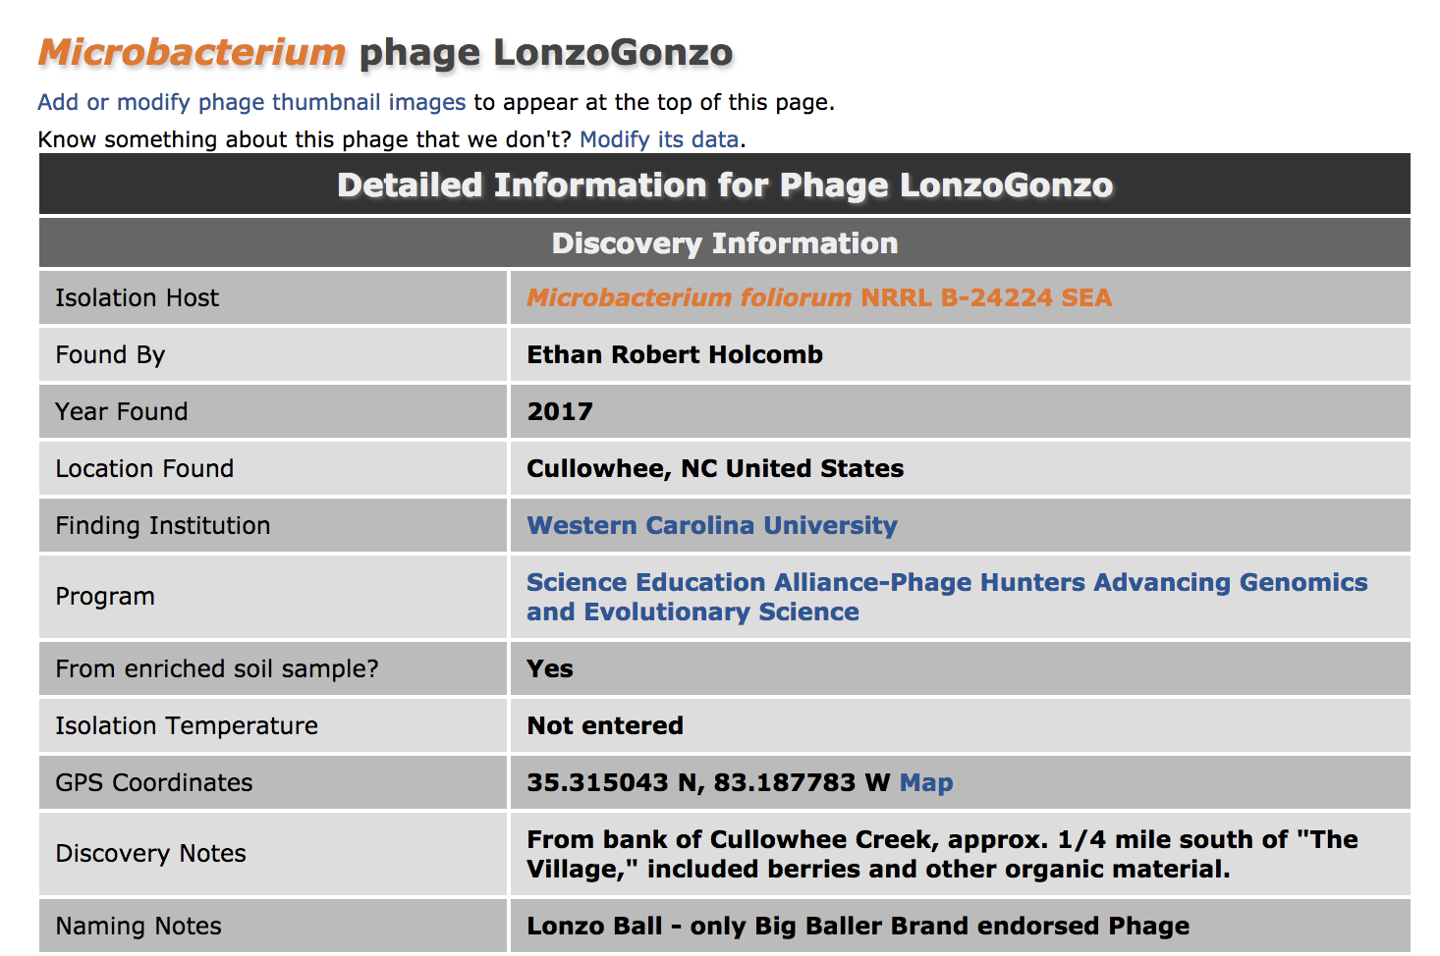

Slide 7
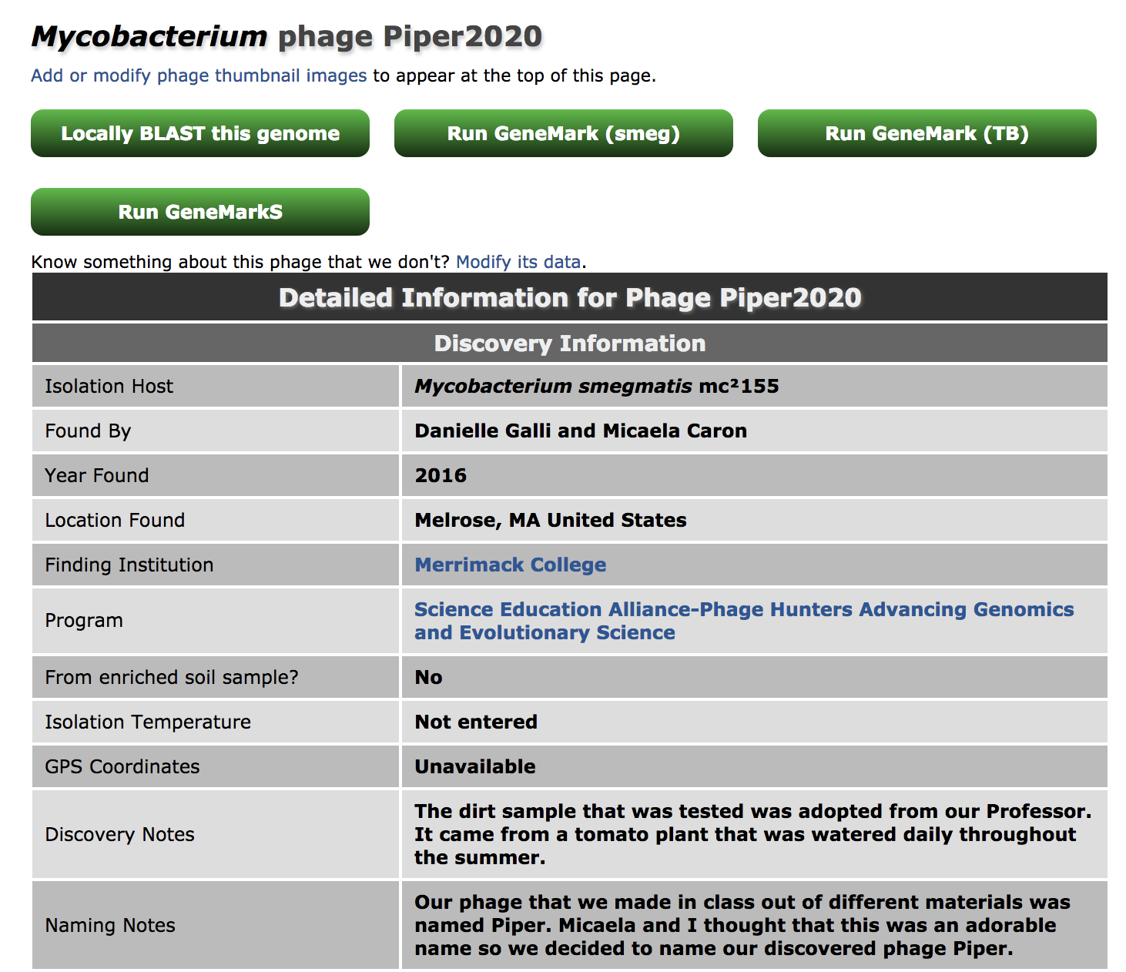

Slide 8
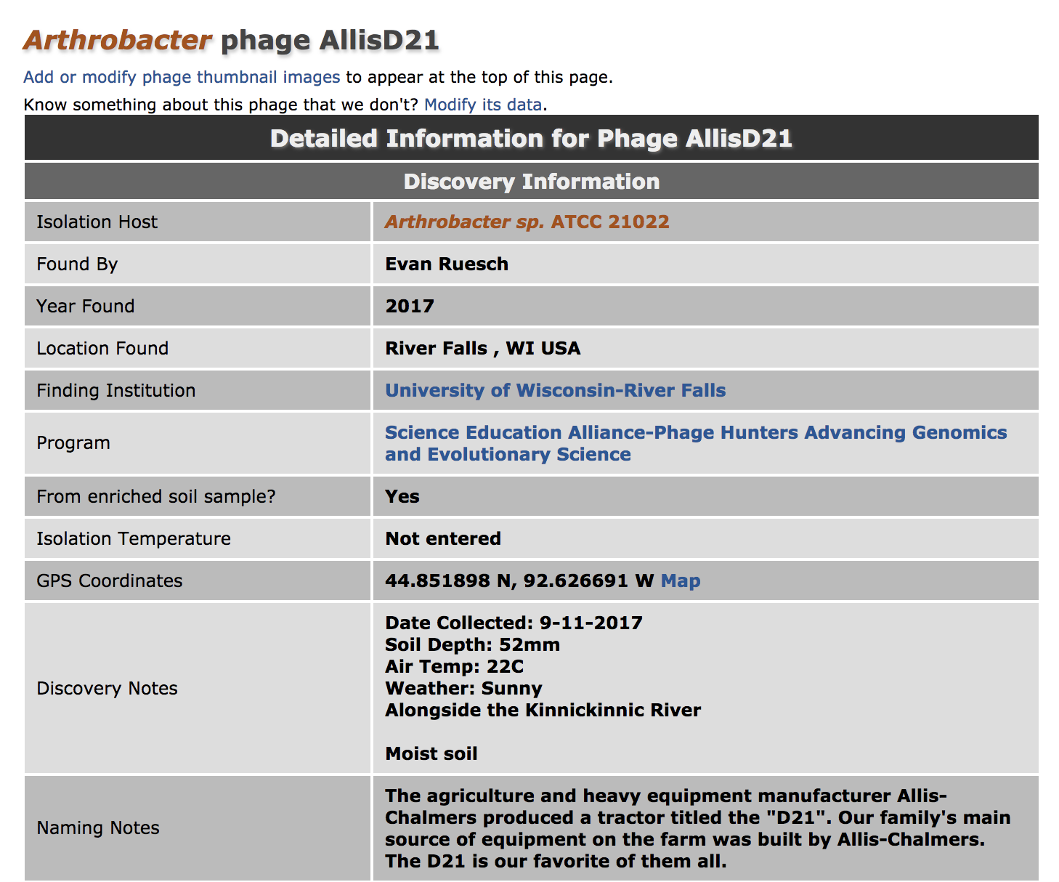

Slide 9
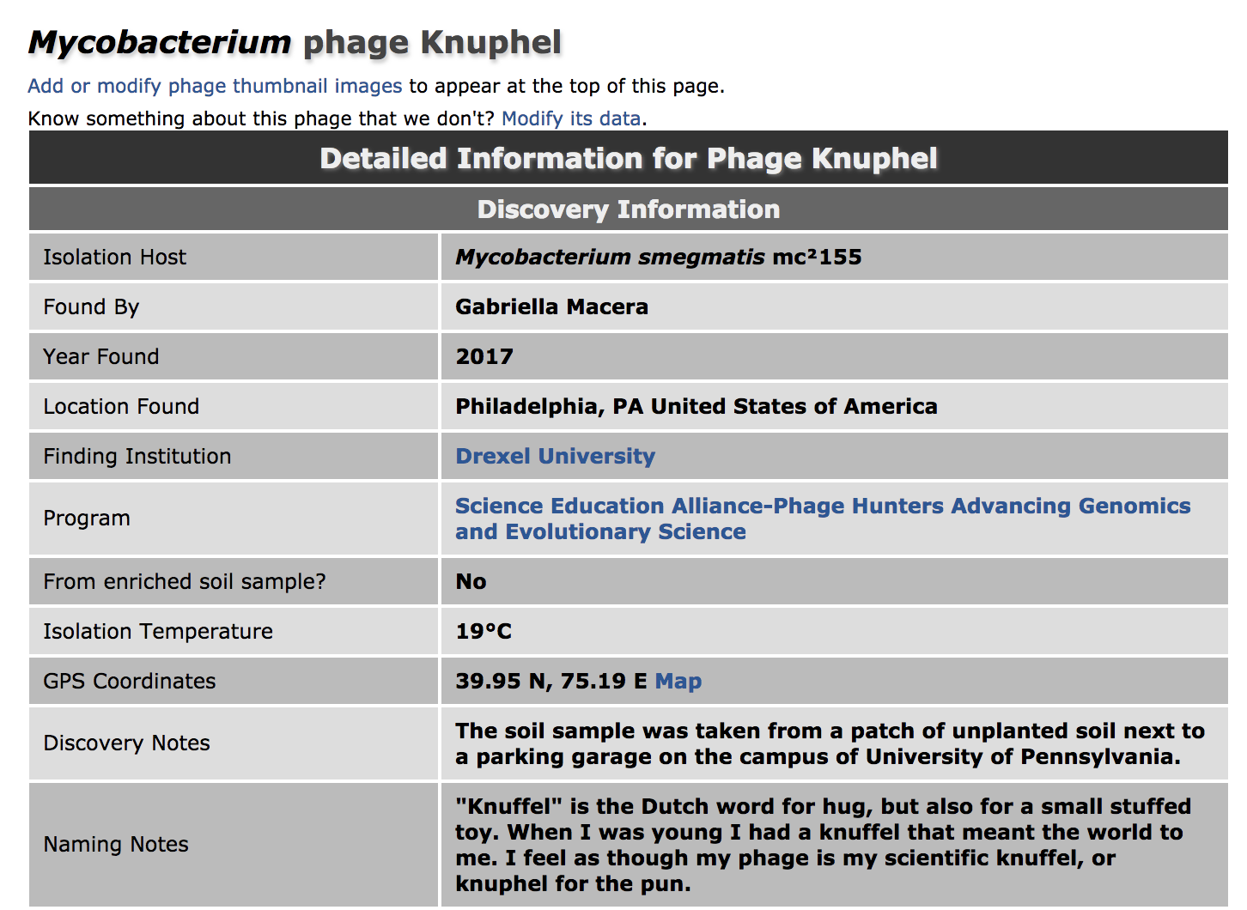

Slide 10
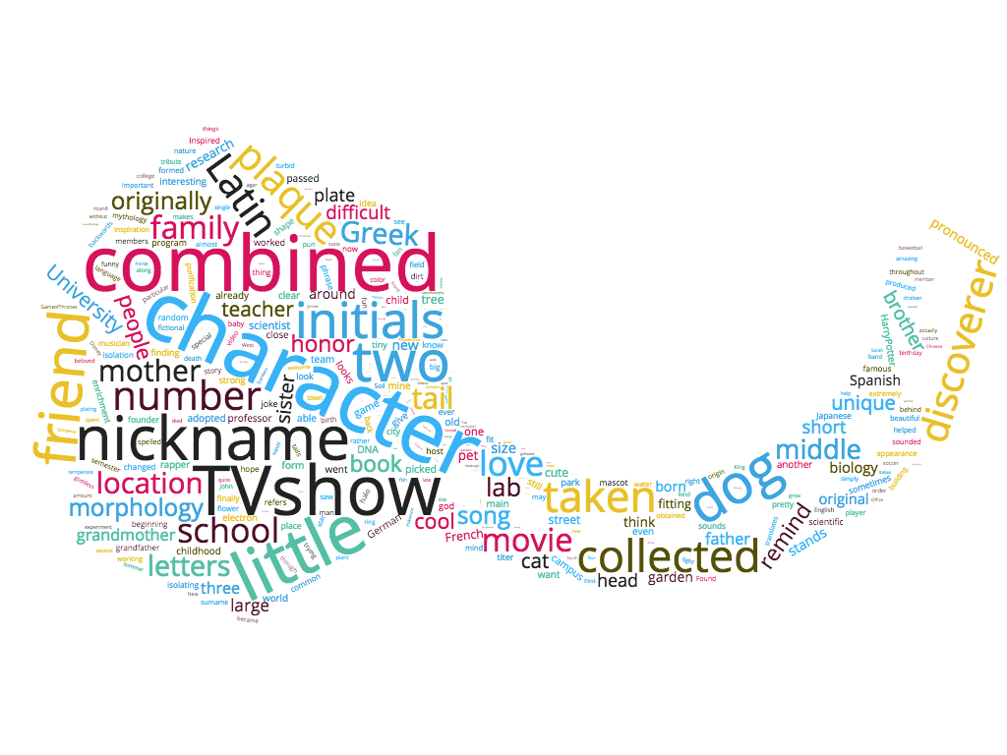

Slide 11
Pauline: 7?!

Slide 12
Happy
Sad
19
2

Slide 13
Failure
Success
19
41

Slide 14
Star Trek
Star Wars
9
17

Slide 15
Batman
Superman
8
4

Slide 16
Mulan
Belle
4
4

Slide 17
Rapper
Scientist
37
43

Slide 18
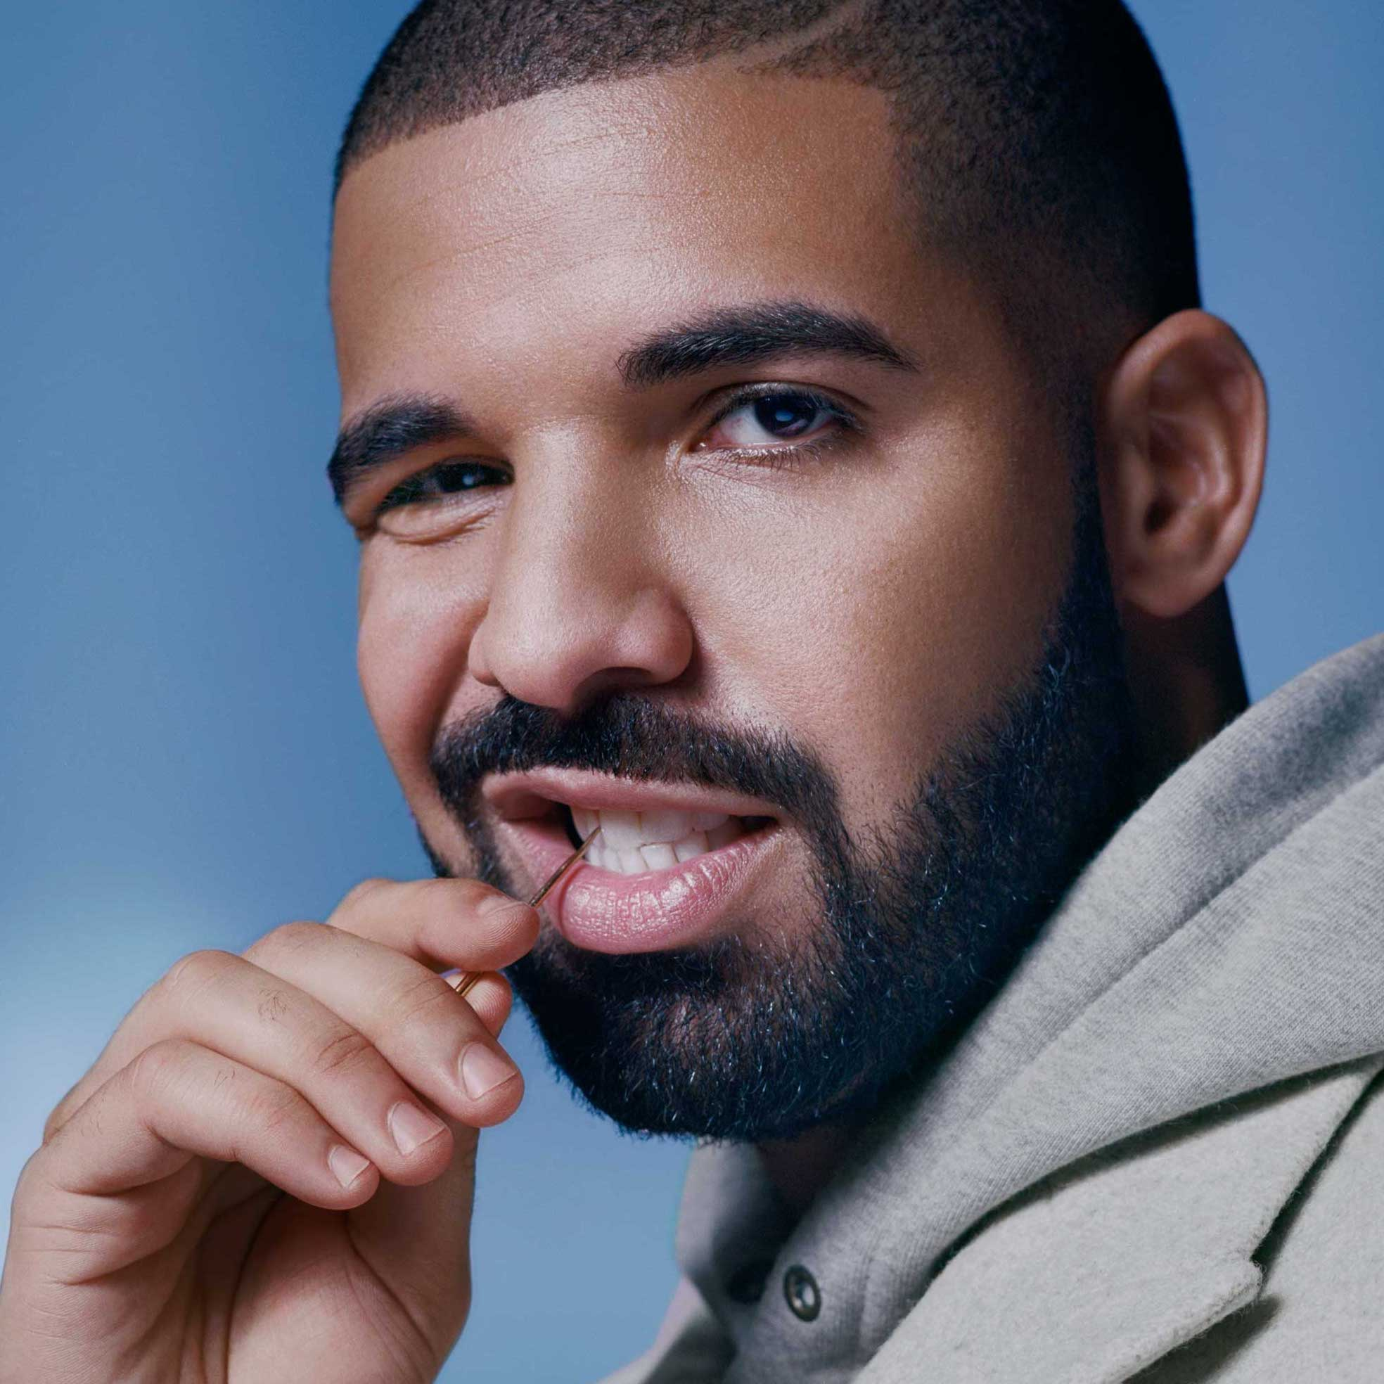
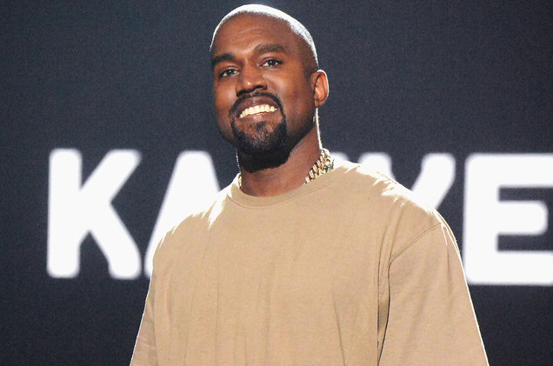
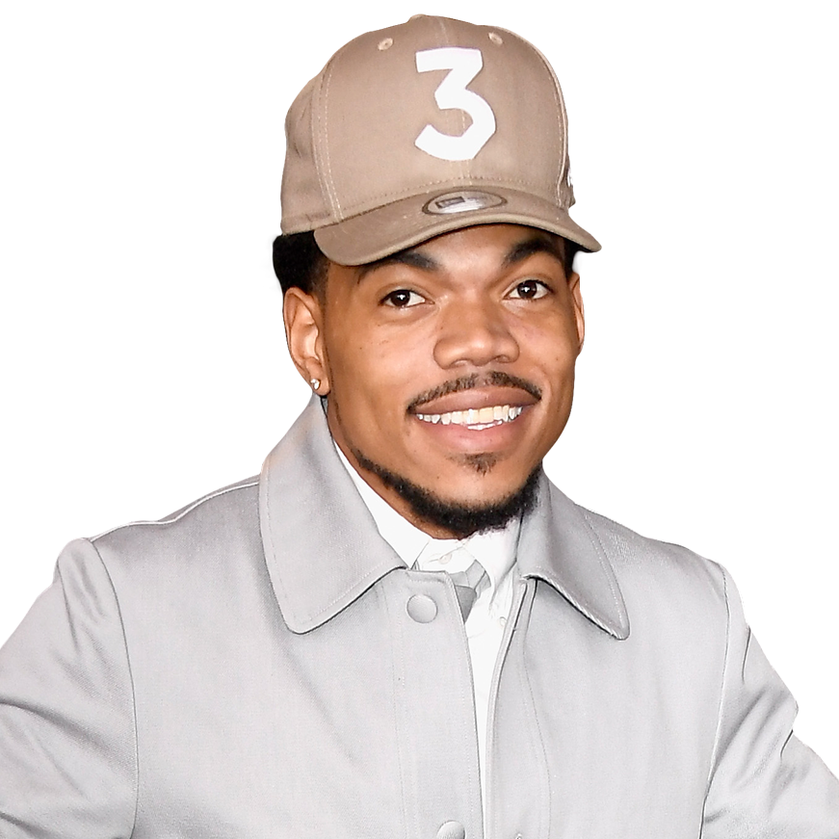
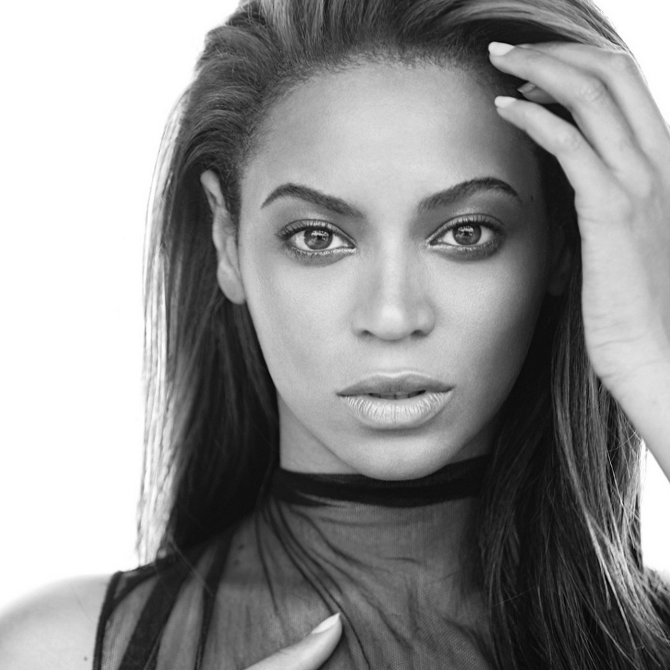
6
10
0
3
5

Slide 19
Mother
117
63
Father
Grandmother
63
Grandfather
31
77
74
Sister
Brother
Daughter
20
19
Son
Aunt
8
11
Uncle
Girlfriend
8
13
Boyfriend

Slide 20
Mother
117
63
Father
Grandmother
63
Grandfather
31
77
74
Sister
Brother
Daughter
20
19
Son
Aunt
8
11
Uncle
Girlfriend
8
13
Boyfriend*

Slide 21
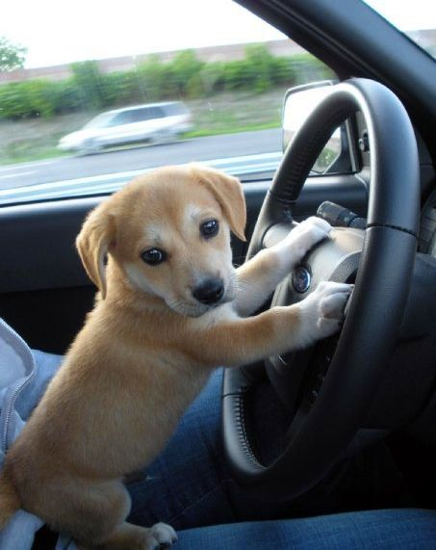
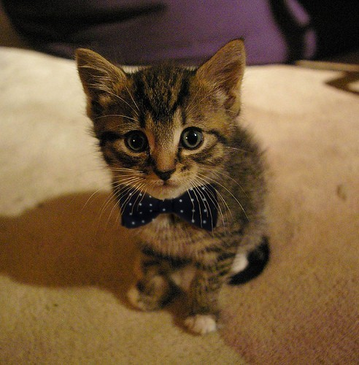
80
215

Slide 22
Professor
80
39

Slide 23
Mascot
Professor
33
39

Slide 24
Lab partner
Professor
99
39

Slide 25
Lab partner
Discoverer
99
153

Slide 26
Friend
Discoverer
222
153

Slide 27
Friend
Character
222
324

Slide 28
Characters > Moms >>> Professors
Dogs ≈ Friends
Cats ≠ Friends

Slide 29
Languages
Latin 157
Greek 112
Spanish 55
French 48
German 40
Japanese 33
English 24
Chinese 18
Italian 17
Arabic 11

Slide 30
Foods
Cheese 13
Lollipop 11
Vegetable 10
Fruit 9
Tomato 8
Cherry 7
Bread 6
Chocolate 5
Ice Cream 5
Pizza 4

Slide 31
Cardinal Directions
West 21
South 16
North 9
East 4

Slide 32
Numbers
One 44
Two 224
Three 62
Four 16
Five 13
Six 16
Seven 9
Eight 5
Nine 2
Ten 6

Slide 33
Pop culture
Harry Potter 38
Game of Thrones 19
Star Wars 17
Pokémon 17
Spongebob 14
Grey’s Anatomy 13
Star Trek 9
Lord of the Rings 9
The Hunger Games 7

Slide 34
Harry Potter
“Like most milestones, there is no ‘right age’…Harry Potter is categorized as a middle-grade read, which typically encompasses 9–to–12-year-olds.”
9-12 year olds in 2007 were born in 1995-1998
Those born in 1995-1998 were 18 in 2013-2016

Slide 35
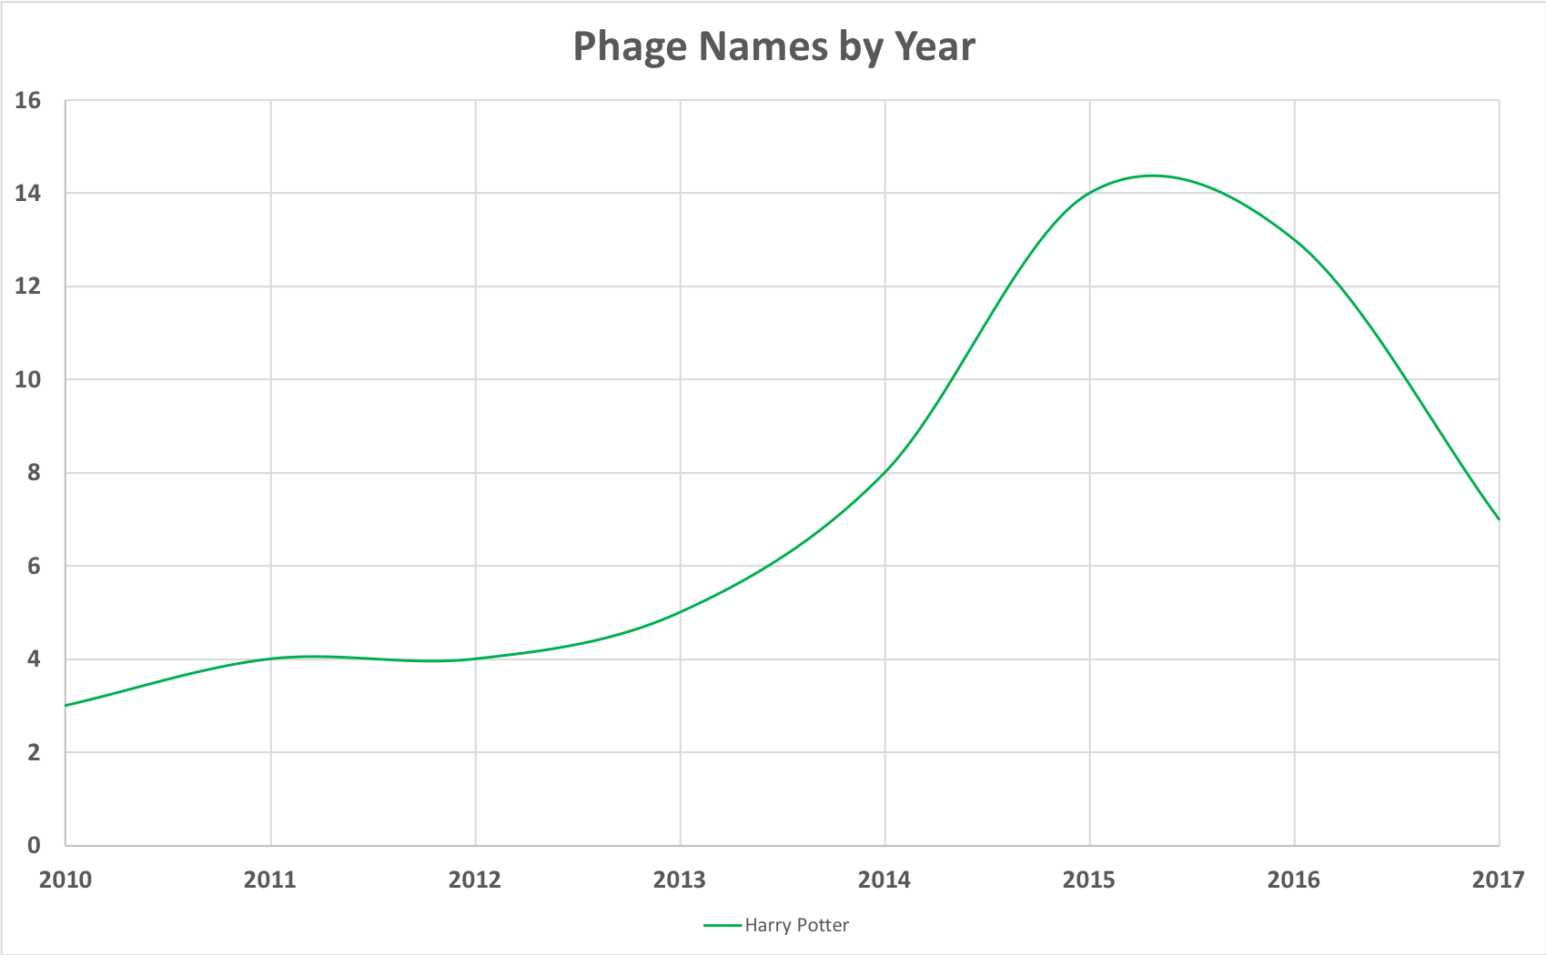
Potter Bump

Slide 36
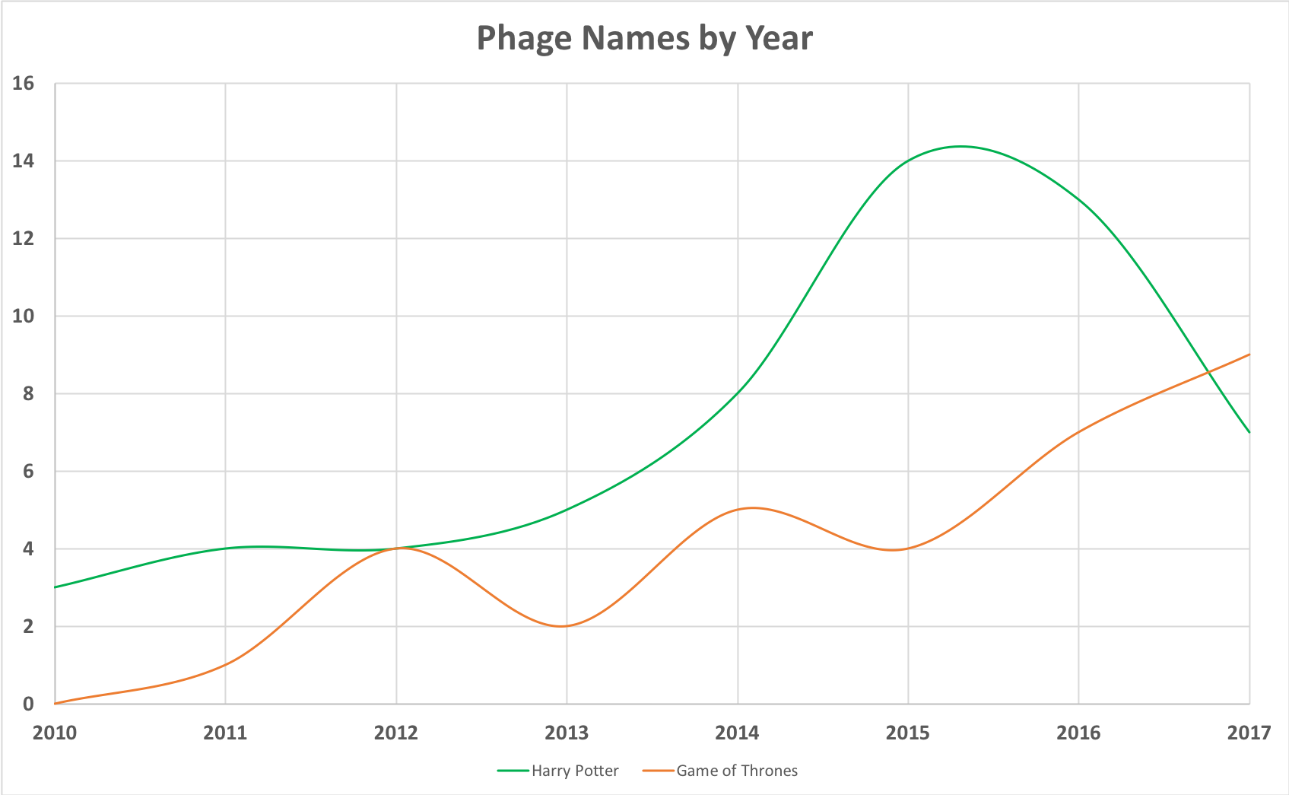

Slide 37
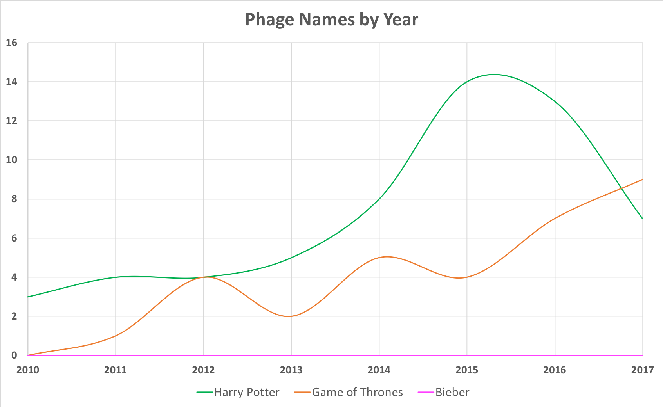

Slide 38
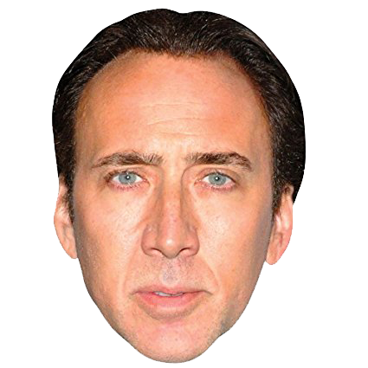
Nicolas Cage

Slide 39
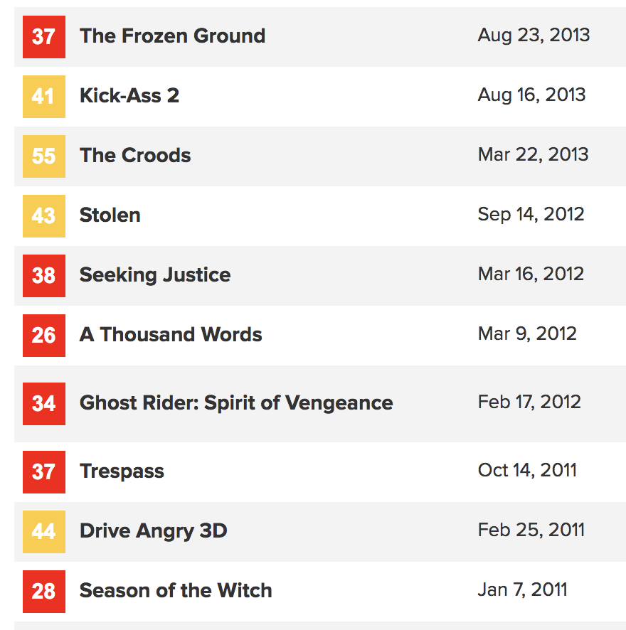
Nicolas Cage
Phage | Year | Notes
NicholasCagous | 2013 | The name is a play on the name Nicholas Cage, a famous actor.
Averages
38.3 metascore
$43M box office

Slide 40
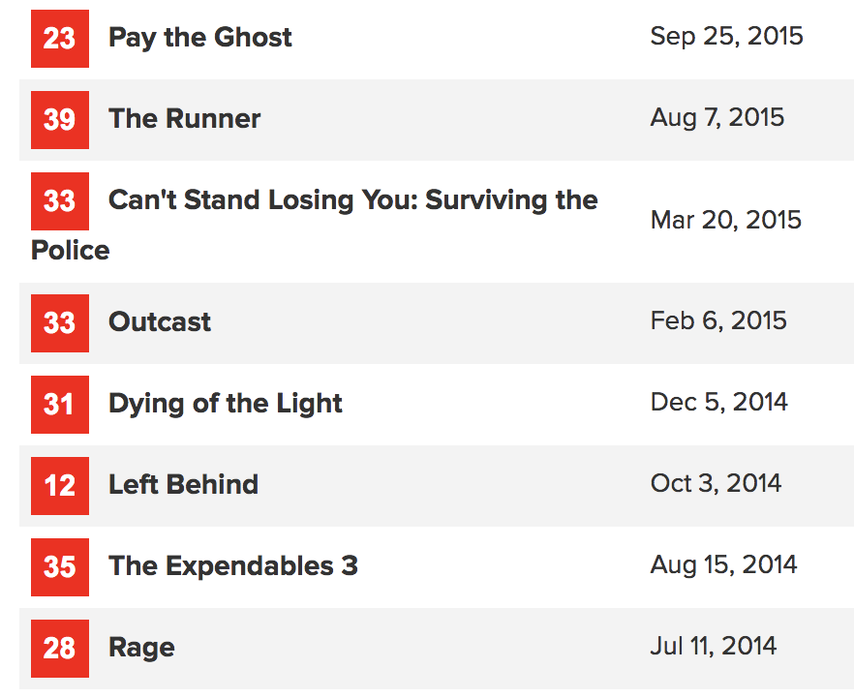
Nicolas Cage
Phage | Year | Notes
NicholasCagous | 2013 | The name is a play on the name Nicholas Cage, a famous actor.
Nicholasp | 2015 | Named after the extremely talented actor Nicholas Cage.
Averages
29.3 metascore
$5M box office

Slide 41
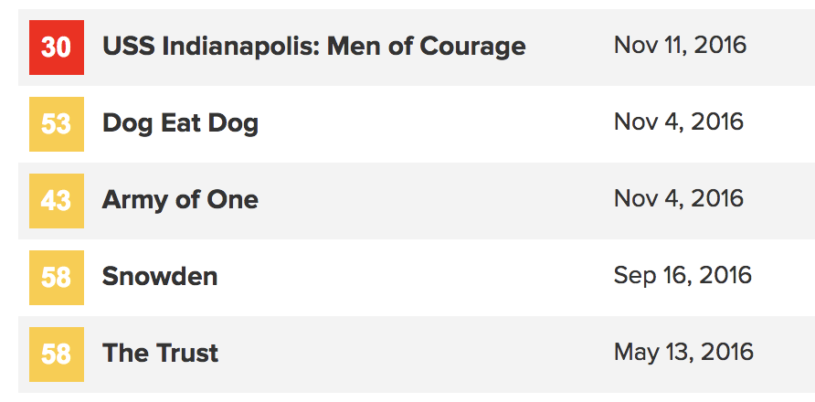
Nicolas Cage
Phage | Year | Notes
NicholasCagous | 2013 | The name is a play on the name Nicholas Cage, a famous actor.
Nicholasp | 2015 | Named after the extremely talented actor Nicholas Cage.
Nicholas | 2016 | We named our phage as a tribute to the great actor of our time, Nicolas Cage.
Averages
48.4 metascore
$7.6M box office

Slide 42
Nicolas Cage
Phage | Year | Notes
Cage | 2013 | The name reflects its ability to make a good gel better and a bad gel worse (referencing the common rule towards Nicolas Cage and movies).
Rage is the rare Nicolas Cage action thriller lacking enough energy to reach "so bad it's good" territory.
--Rotten Tomatoes

Slide 43
Nicolas Cage
Phage | Year | Notes
Cage | 2013 | The name reflects its ability to make a good gel better and a bad gel worse (referencing the common rule towards Nicolas Cage and movies).
Lotus | 2016 | Nicholas Cage starred in a movie titled "Frozen Ground" in 2013, which is what I had to dig through to collect soil samples this winter semester. It was a "National Treasure" when I finally found a phage.

Slide 44
Nicolas Cage
Phage | Year | Notes
Cage | 2013 | The name reflects its ability to make a good gel better and a bad gel worse (referencing the common rule towards Nicolas Cage and movies).
Lotus | 2016 | Nicholas Cage starred in a movie titled "Frozen Ground" in 2013, which is what I had to dig through to collect soil samples this winter semester. It was a "National Treasure" when I finally found a phage.
CicholasNage | 2017 | This phage is not named after Nicholas Cage, but inspired by him.

Slide 45
Nicolas Cage
Phage | Year | Notes
Inigo | 2013 | Favorite movie-The Princess Bride. (This phage was labeled Nicolas Phage when it was sent to Pitt.)
Nicolas 2009
Nicholasp3 2012
NicolasC 2014
Nicolasphaqe 2014
NicholasCage 2014

Slide 46
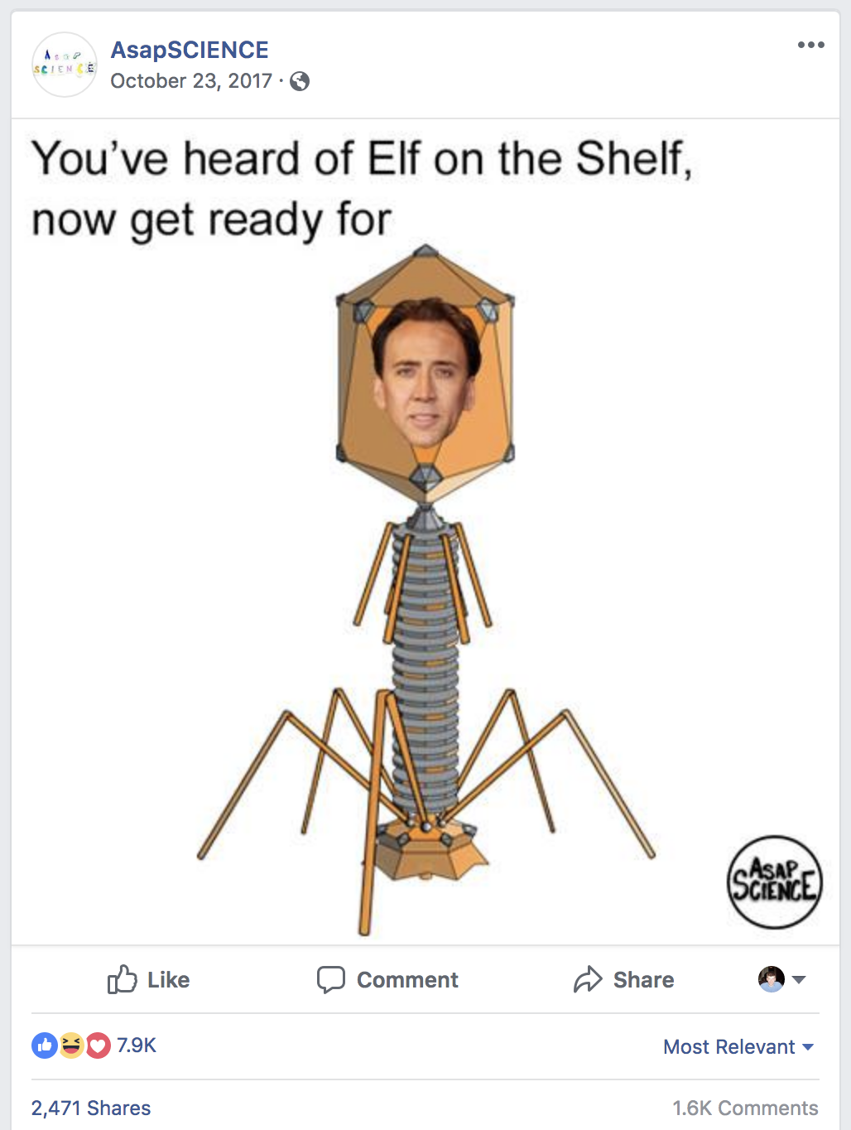
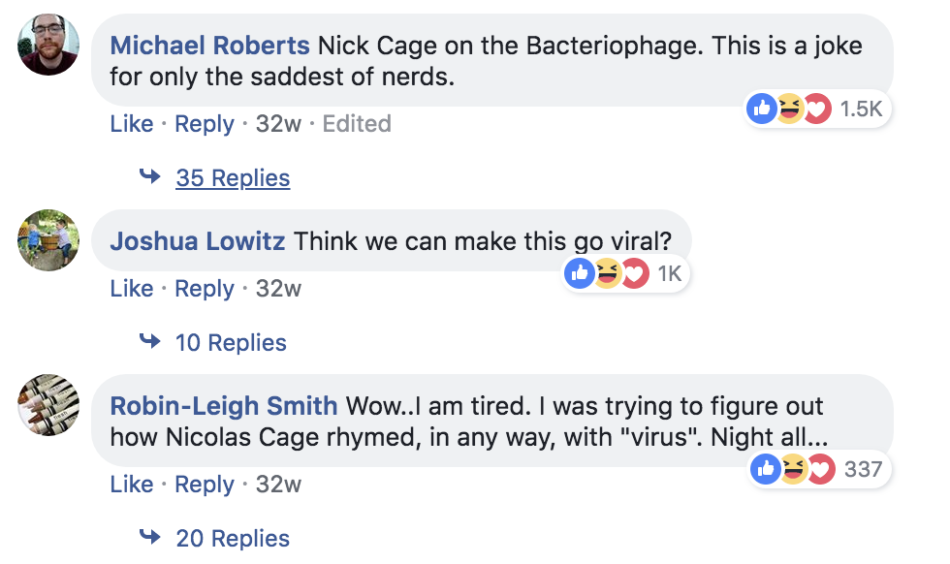
Nicolas Cage

Slide 47
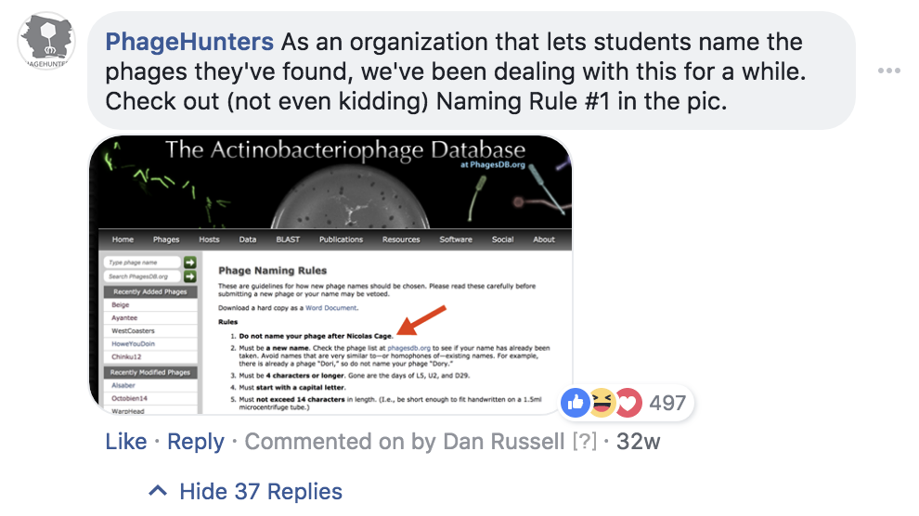
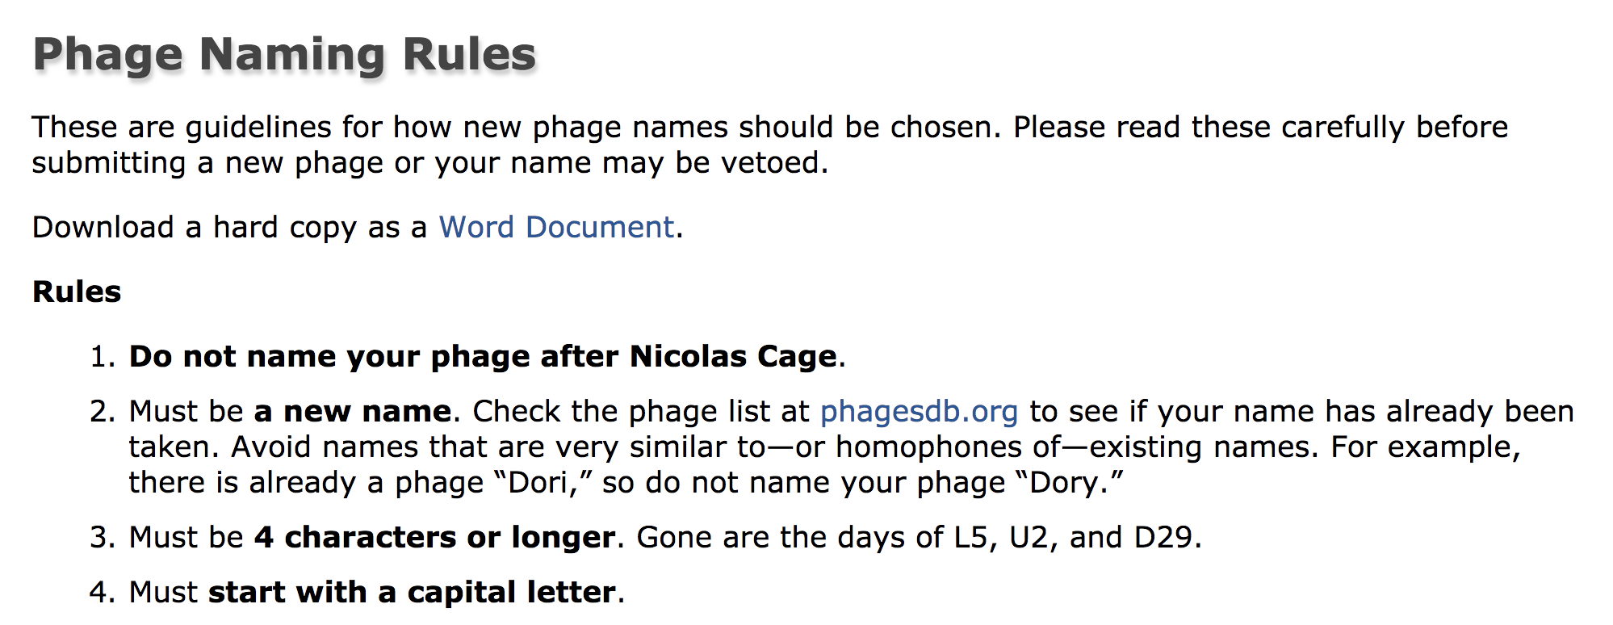
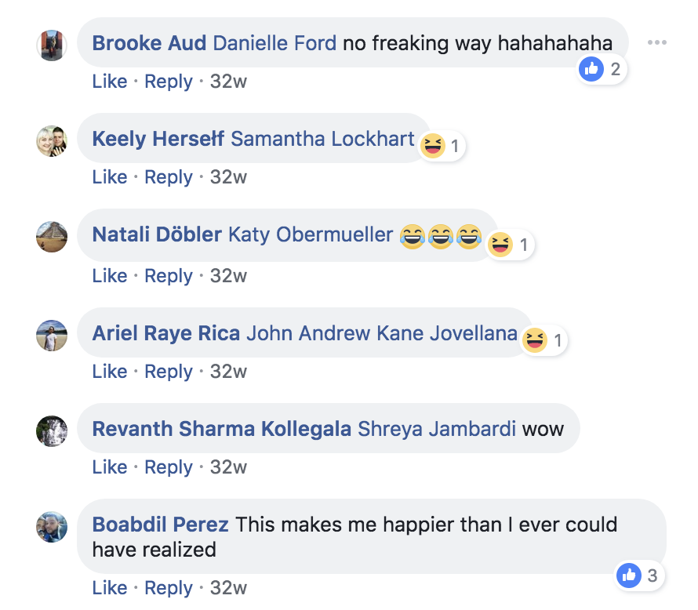
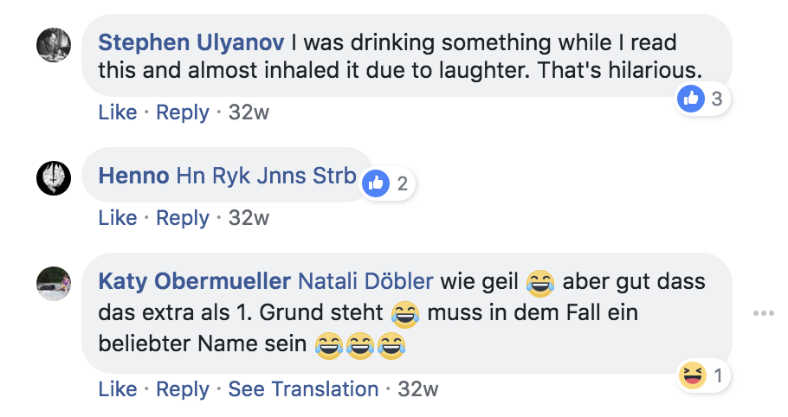
Nicolas Cage

Slide 48
The “Dark Side”: Rejected Names

Slide 49
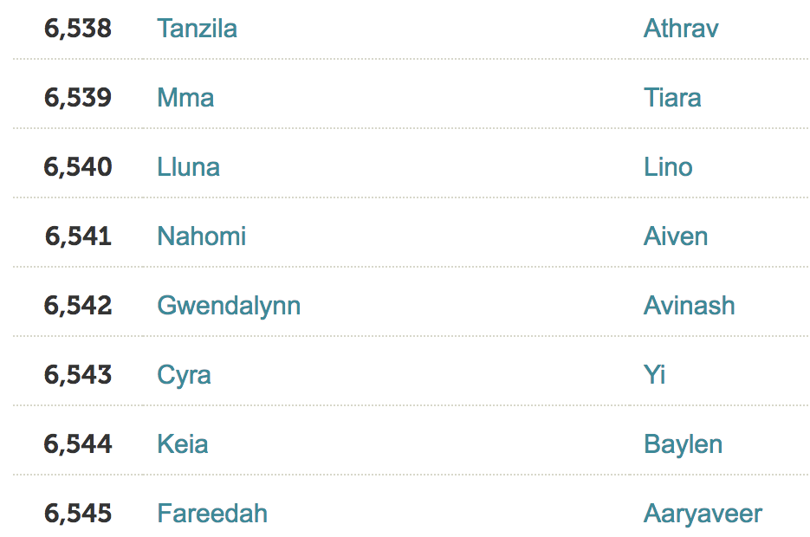
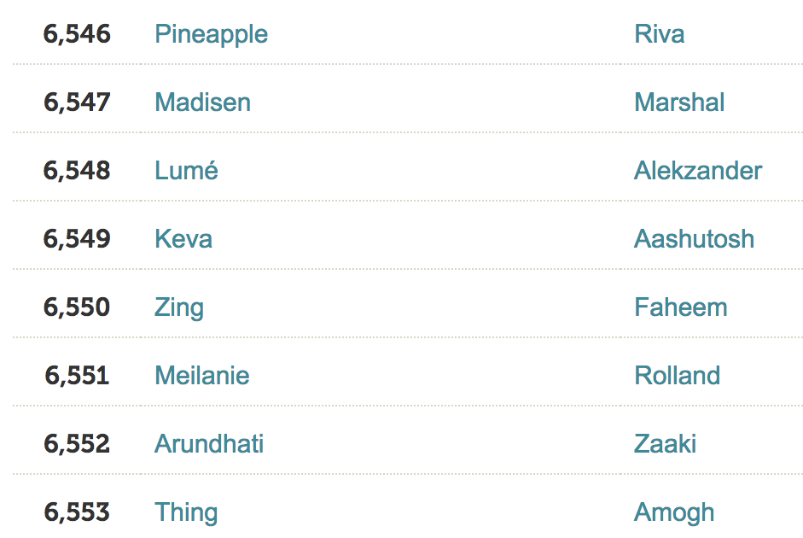
More than 13,000 names

Slide 50
Nonsense
JIBTJA825 2012
AMDG1886 2013
LT19Z44 2013
MM2A13 2013
AaCp3613 2013
TTx2 2013
JJTA120194 2014
J073097 2016
G4zz 2017
XxXx 2017
Pzzzz 2017

Slide 51
Homophones
Pear/pair
Would/wood
Led/Pb/lead

Slide 52
Cheating/Stretching
B00M3R 2018
Fr3d 2017
Sprinkkles 2017
Franklinnn 2017
Sushiiii 2017
Nooodle 2017
Lolaa 2017
Traviss 2015
Phill 2016
Philll 2017
Lucee 2016
LUCEE 2016

Slide 53
Unacceptable, but funny
MileyVyrus 2012
TheGreatPhagby 2014
RebaMcEnplaque 2015
JohntheBactist 2017
LyseLyseBaby 2014
Secretphgent 2018
Babygotplack 2016
CondoleezaLyze 2017
NotaphaageJK 2016

Slide 55
Most common…
NicholasPhg 2012
NicolasFayge 2012
NicolasPhagous 2013
NicolasPh8ge 2014
CagePhage 2014
NicolasCage 2015
NicolasCage 2016
NicolasCage 2017
NicolasCage 2017
NicolasCage 2017

Slide 56
Never had to reject
0

Slide 57
Conclusions
Do a good job naming your phages
Tell us why you chose the name
Mine the data!

