Slide 1
Functions
SEA-PHAGES Bioinformatics Workshop
December 2020
Adapted from presentation by Welkin Pope

Slide 2
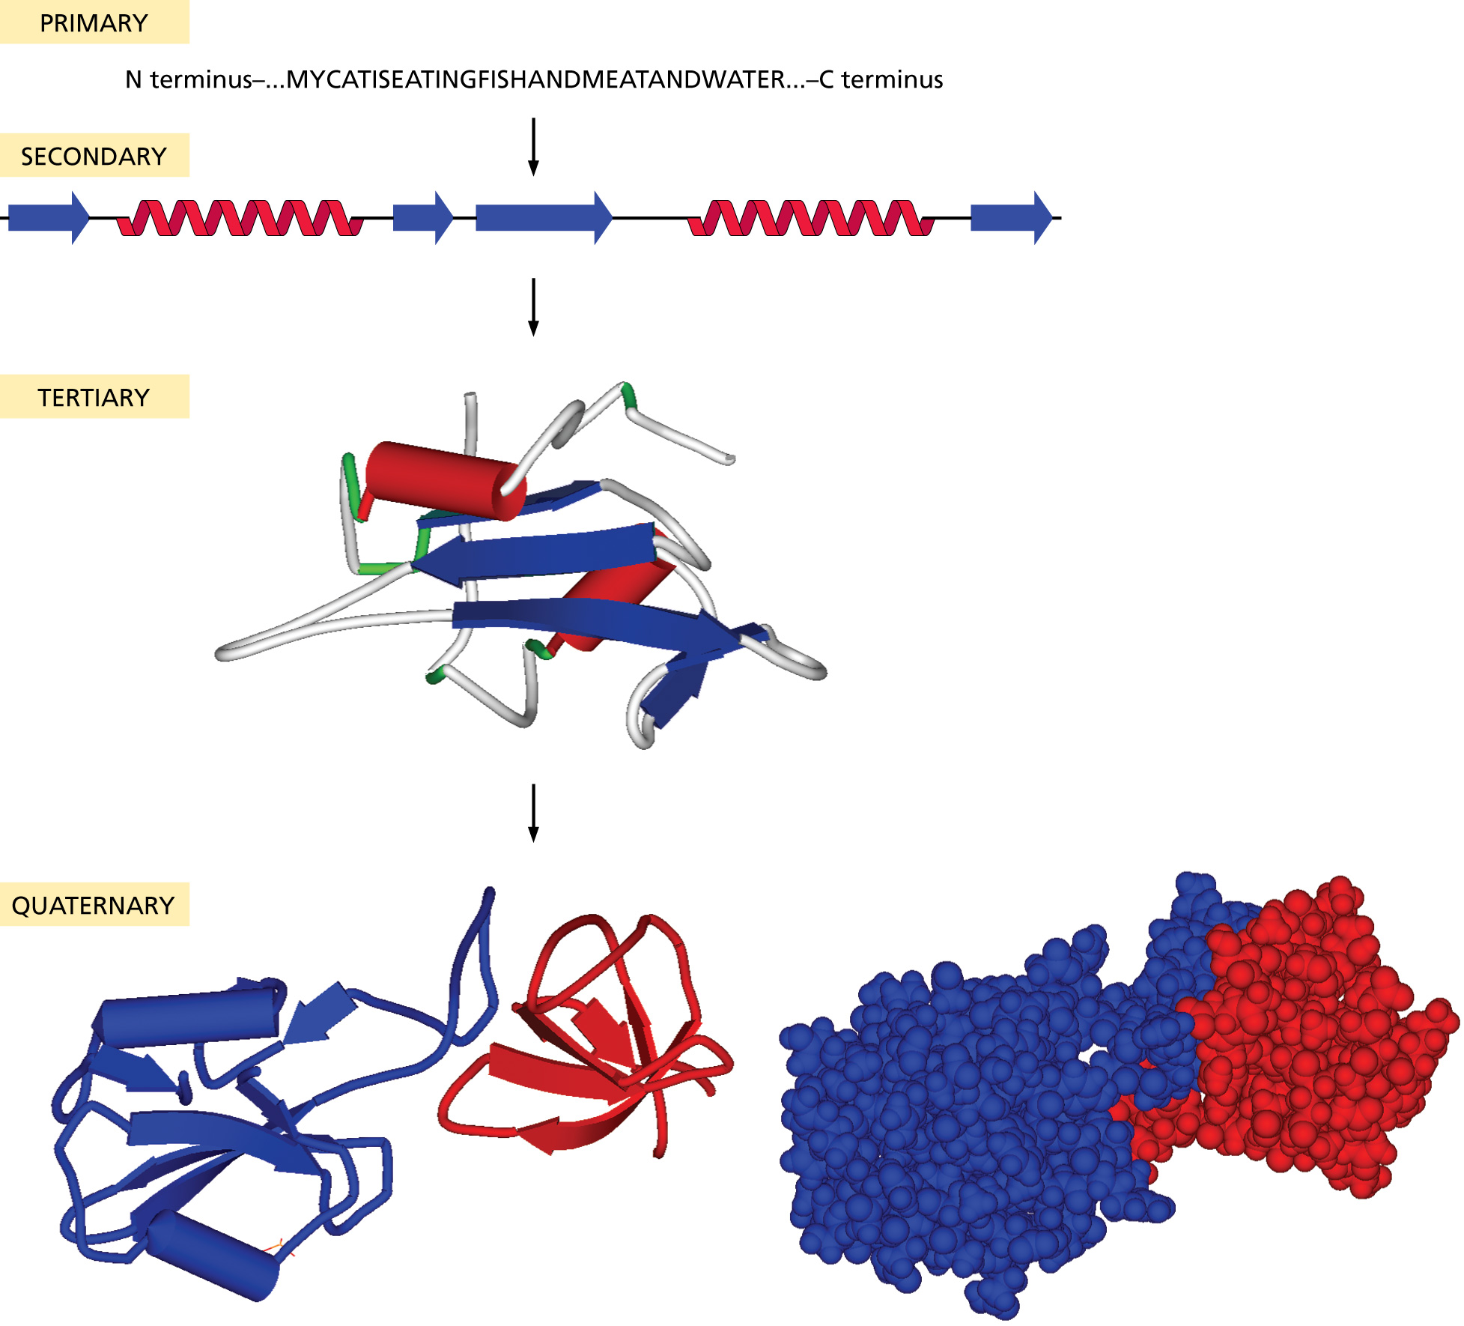
The shape of a protein and its function
are connected
Proteins may have domains, which may have
different functions
Specific residues may be critical for enzymatic
activities

Slide 3
Two ways of approaching functional assignments:
What functions *should* be in my genome?
What kinds of functions can I find using the tools available?
Remember, we are unable to assign functions to the majority (70%) of the genes in phage genomes.

Slide 4
Structural genes

Slide 6
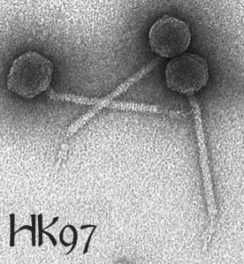
Bob Duda

Slide 7
Anaya
Virion structural and assembly genes, i.e. those encoding proteins that are either components of virion particles or assist in their formation. These include genes encoding the terminase, portal, capsid maturation protease, scaffolding protein, major capsid protein, head to tail connectors, major tail subunit, tail assembly chaperones, tape measure protein, and minor tail proteins.
Genes involved in phage DNA replication. These include DNA polymerase, DNA primase, DNA helicase, nucleotide metabolism genes, and ssDNA binding proteins.
Genes involved in life cycle regulation. These include various regulators such as repressors and activators, integrases, recombination directionality factors, etc.
Genes involved in lysis, including endolysins (referred to as Lysin A in the mycobacteriophages), Lysin B, and Holins.
Other genes, including transcription factors, toxin/anti-toxin systems, peptidases, phosphatases, host gene homologues, methylases, nucleases, and DNA binding proteins, among others.

Slide 8
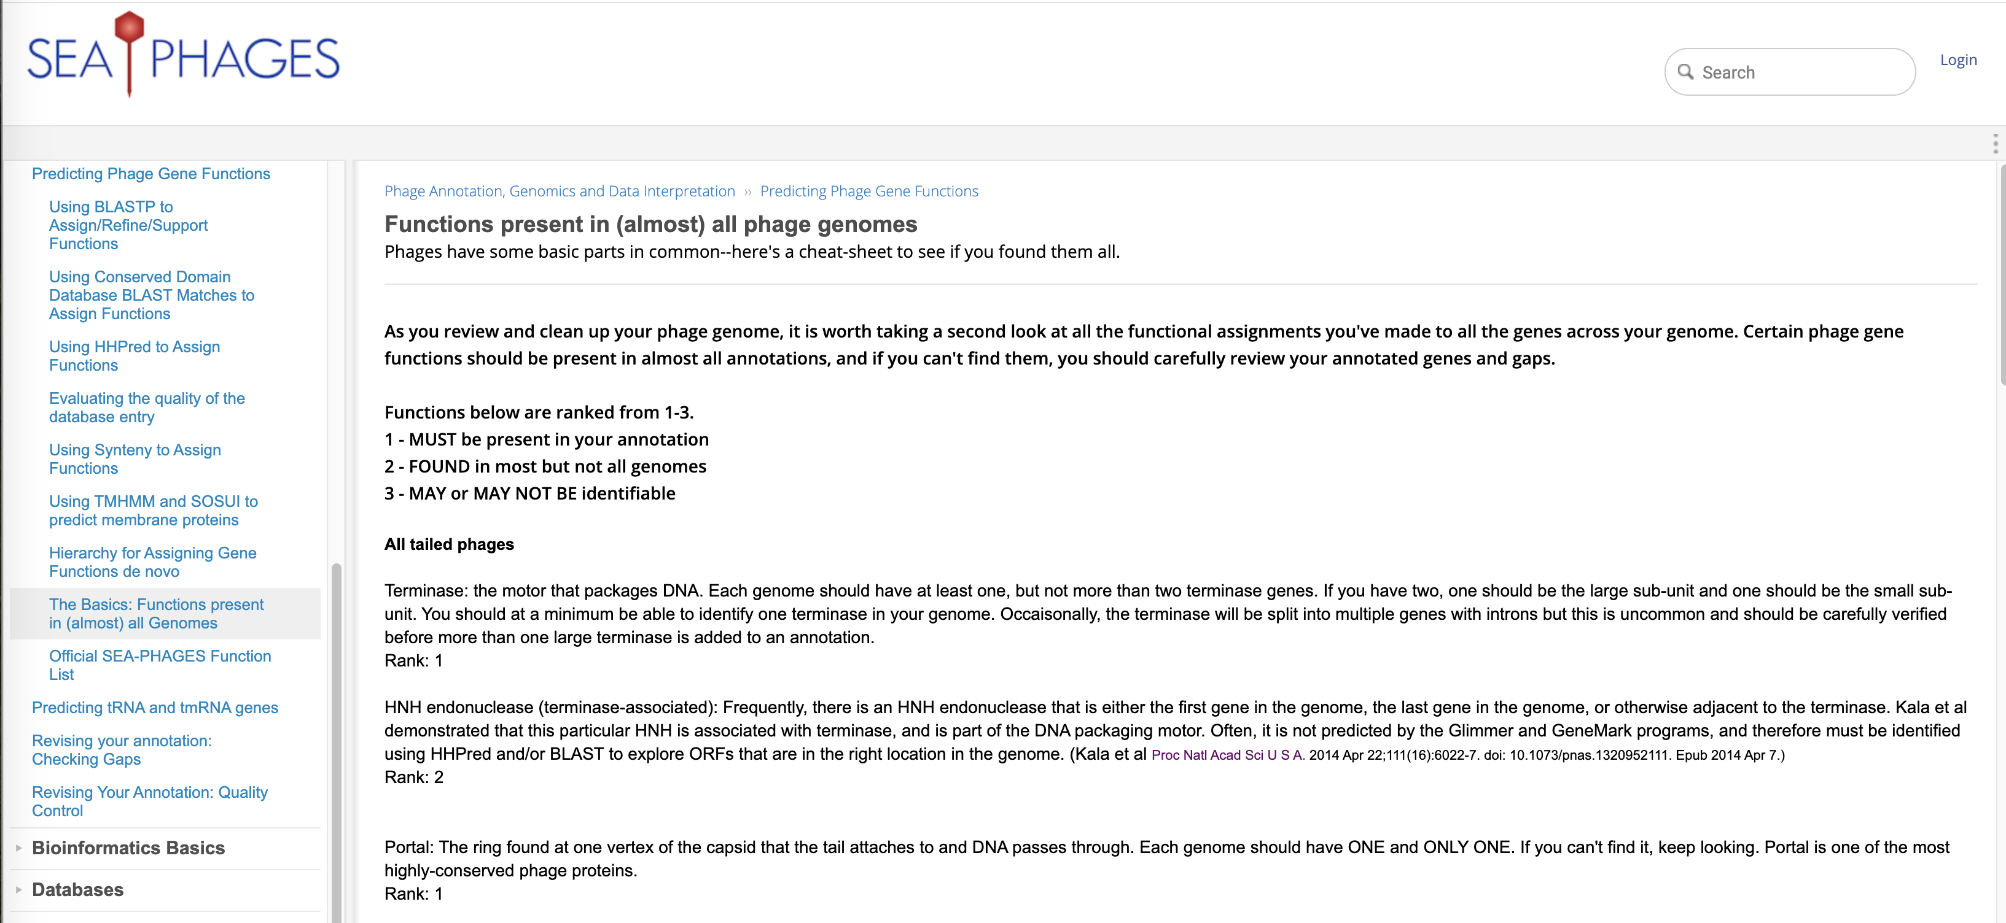

Slide 9
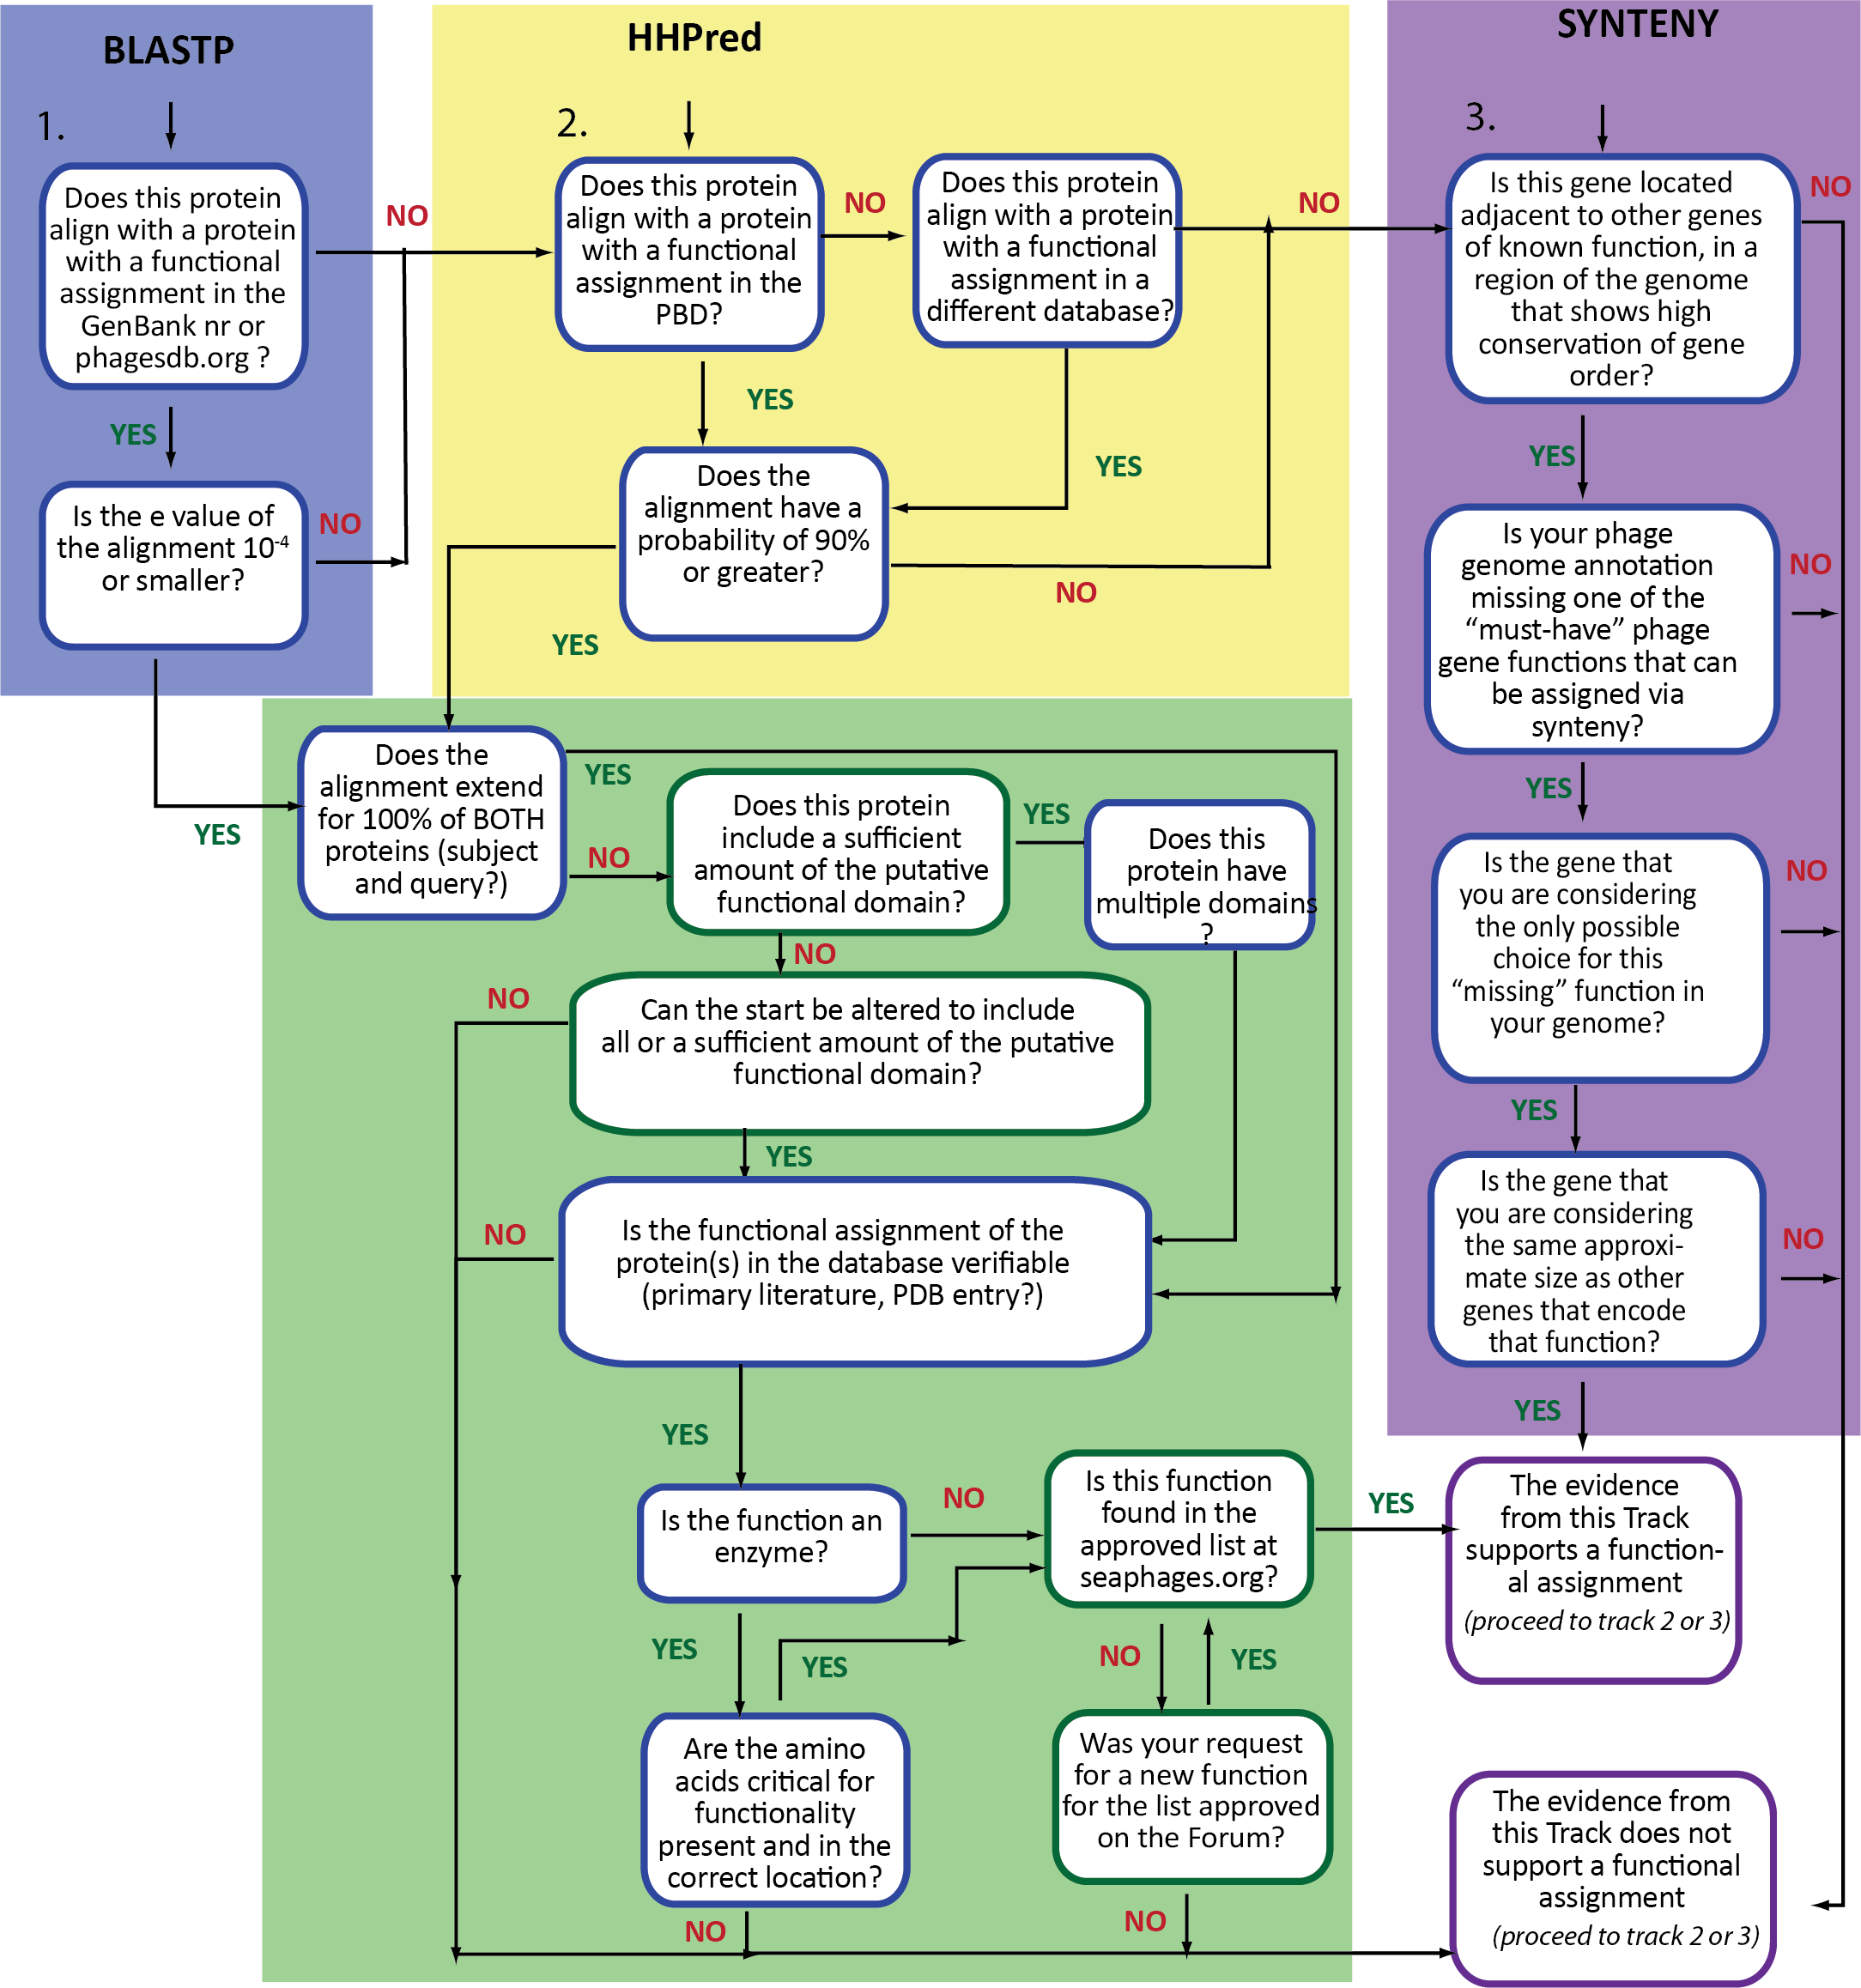
Three lines of investigation
should be performed for every
gene and every large ORF in
an annotation gap.

Slide 10
Using alignment tools and databases
The gold standard is to characterize a protein at the bench
(not really feasible)
Next best: have the same amino acid sequence as a protein characterized at the bench
Considerations:
Length of alignment
Quality of the alignment
Quality of the database entry (aka do you trust what someone else wrote about this entry?)

Slide 11
Functional Assignments with Alignment Tools
Databases:
Phagesdb
nr at GenBank
PDB
Conserved domain
pFam
Alignment Tools
BLASTp
HHpred
Browsers/Other programs
Website-phagesdb
Website-NCBI
Website-HHpred
Phamerator
DNA Master
PECAAN
Always try to find a database record with
wet bench evidence—the gold standard

Slide 12
Databases
Phagesdb.org:
Contains Actinobacteriophage genes and genomes
Maintained and curated by University of Pittsburgh
Phamerator
(same data as phagesdb.org, prettier maps)
Contains phage genomes and gene sequences, gene phamilies
Maintained and curated by JMU and Pitt
nr at GenBank
Contains all nucleotide and protein sequences
Additional db are RefSeq and Conserved Domain Database
Curated by GenBank staff (not phage experts)
Anyone can submit anything to nr

Slide 13
Databases, cont.
Conserved domain database (CDD)
Actually five databases of multiple sequence alignments (housed at NCBI): pFam, SMART, COGS, PRK, TIGRFAM
pFam (protein families)
Multiple sequence alignments of conserved protein sequences (housed at EBI)
Protein data bank (PDB)
Consists of crystal structure coordinates. Data is very high quality, however it is limited by what can be crystallized.

Slide 14
Alignment tools
BLASTp – pairwise local word-based alignments of protein sequences.
You can control your scoring matrix and word size (defaults are usually fine)
Sacrifices optimal alignment for speed
Scores are influenced by length of the alignment (longer alignments score more highly) and database size
E value and % alignment
You may need to manually check to see if critical residues are present for enzymatic activity

Slide 15
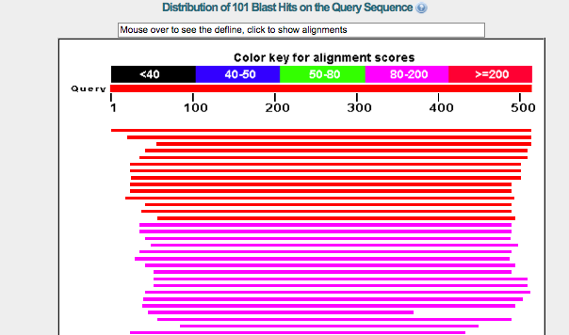
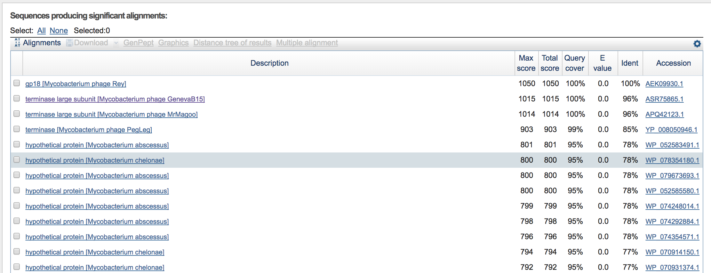

Slide 16
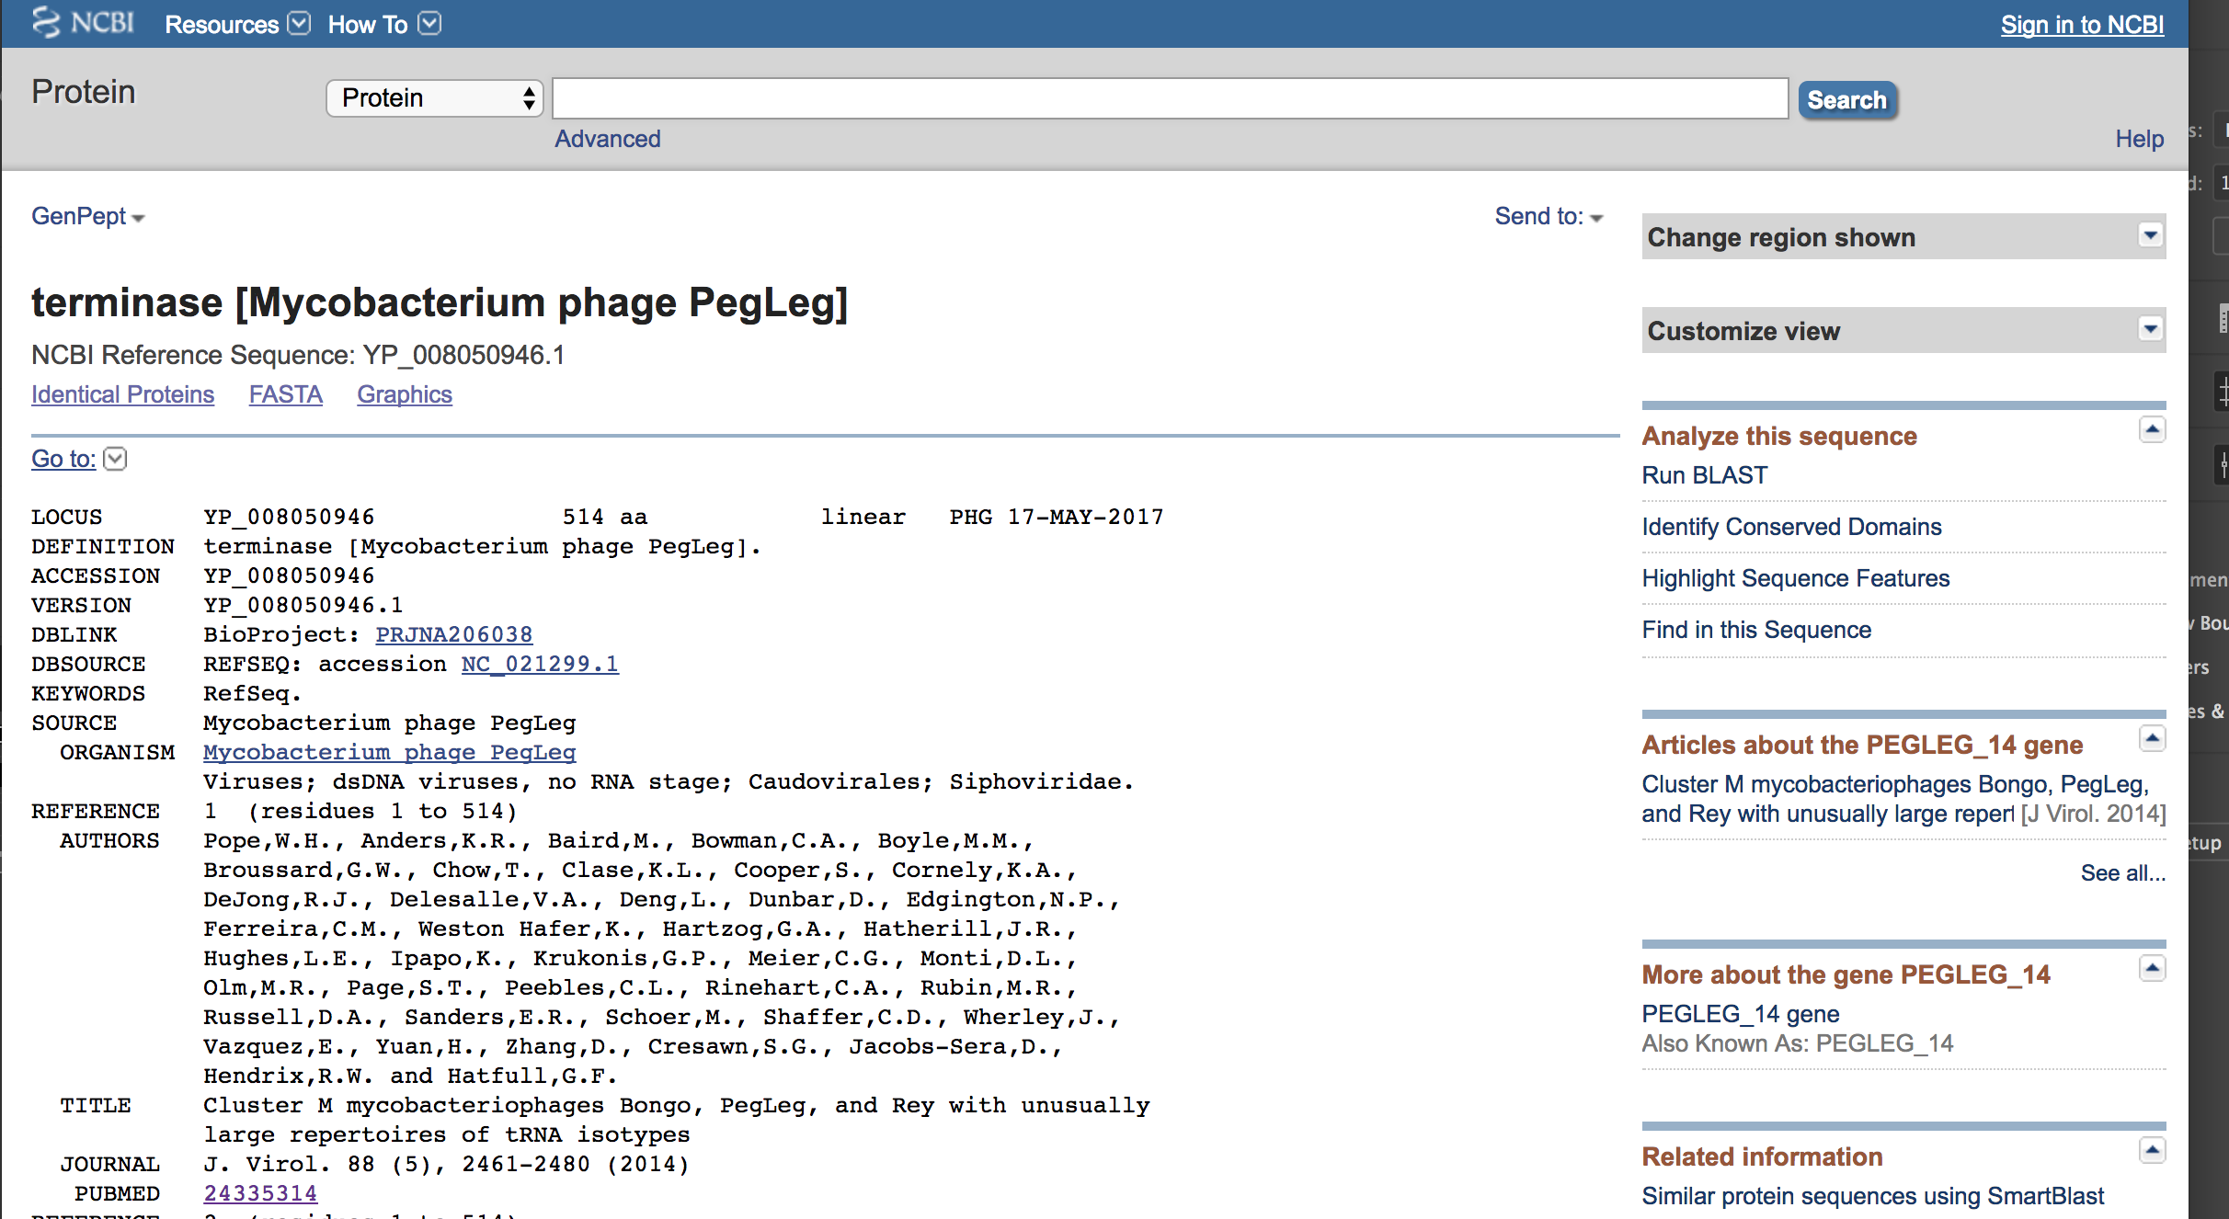

Slide 17
Conserved Domain Database

Slide 18
HHpred
HHPred
uses a combination of multiple sequence alignments and Profile Hidden Markov Models to find remote homologs: proteins that may be distantly related to your query sequence and share the same function.
Uses iterative alignments, somewhat like PSI-BLAST
Control number of iterations and databases you want to search
Probability and % alignment
You still need to manually check and see if critical conserved residues are present

Slide 19
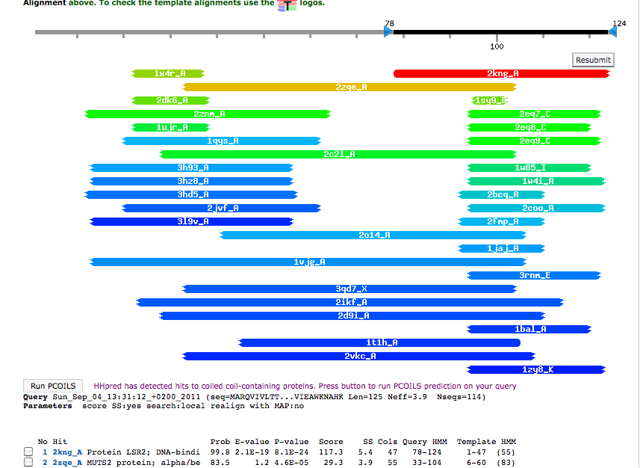
HHPred

Slide 20
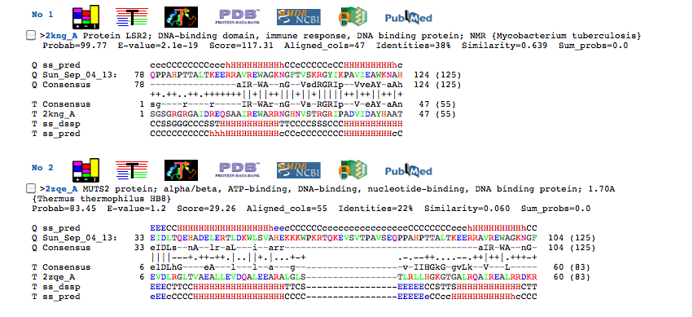

Slide 21
Synteny
Phage gene order is *somewhat* conserved, common phage genes with similar functions will likely be of similar sizes.
Use Phamerator or DNA Master Genome Comparison Tool
Terminase → Portal → Capsid Maturation Protease → Scaffolding → Major Capsid Subunit → Major Tail Subunit → Tail Assembly Chaperones → Tape measure → Minor Tail Proteins
Lysis (lysins, holins)
Integration cassette
DNA metabolism/Replication

Slide 23
The Official SEA-PHAGES function list
SEA-PHAGES functional assignments
USE | Do NOT use | Example
terminase, small subunit | TerS | Sisi_1
terminase, large subunit | TerL | Sisi_2
terminase | If there are not two obvious large and small terminase genes in the same genome, just assign the function "terminase". | TM4_4
portal protein | head to tail connector | TM4_5
scaffolding protein | Scaffold | Sisi_5
capsid maturation protease | Protease, prohead protease | Sisi_4
major capsid protein | capsid | Sisi_6
head-to-tail adaptor |  | Sisi_7
major tail protein | major tail subunit | Sisi_11
tail assembly chaperone | Tail scaffolding protein | TM4_15; 16
Note: case matters. GenBank wants functions written all lower-case (except when
using conventional protein labels derived from genes eg “LacZ”)

Slide 24
