Slide 1
Biological Information Flow
SEA-PHAGES Bioinformatics Workshop
December 2020
Adapted from presentation by Welkin Pope

Slide 2
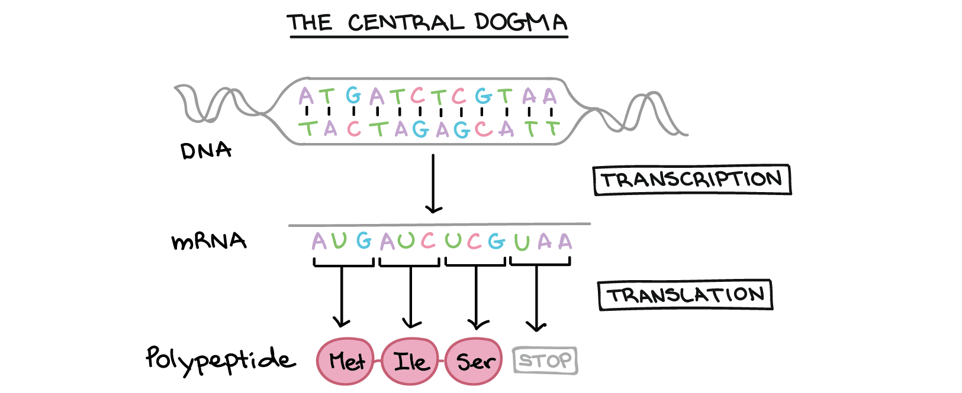
Khan Academy, www.khanacademy.org

Slide 3
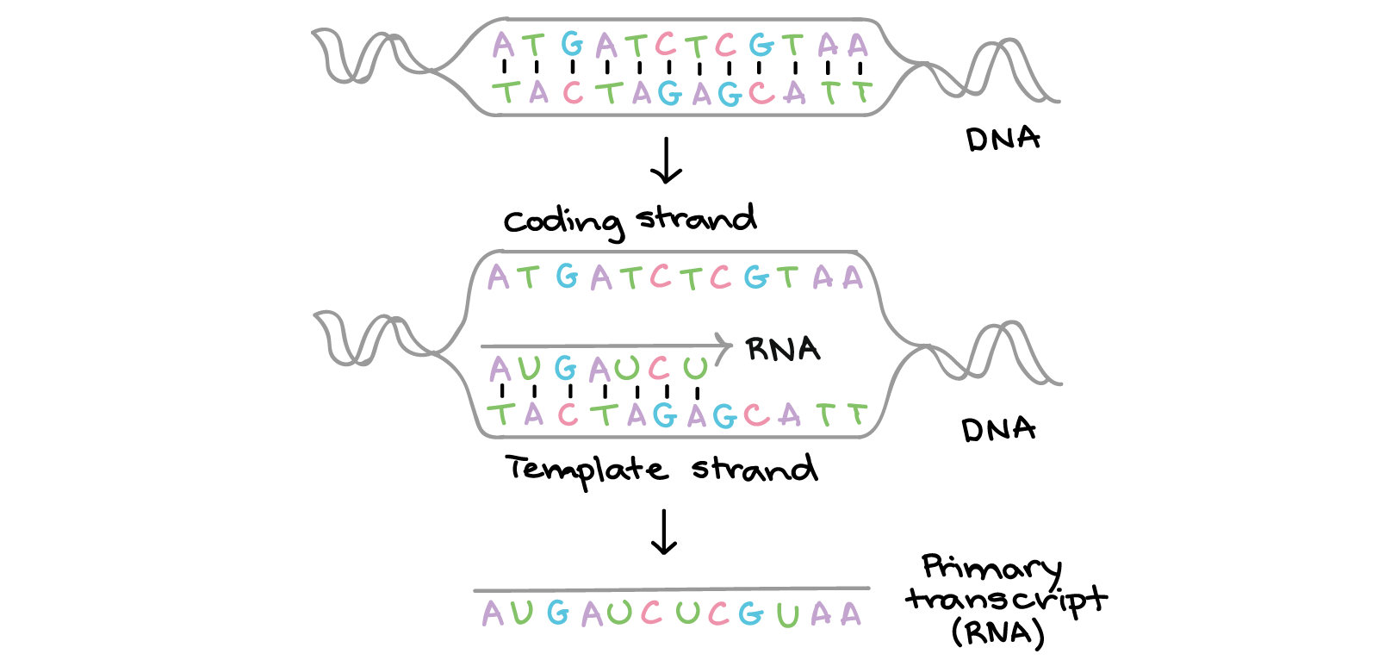
Transcription
Khan Academy, www.khanacademy.org

Slide 4
https://www.youtube.com/watch?v=xSQybiea2AA
Drew Berry

Slide 5
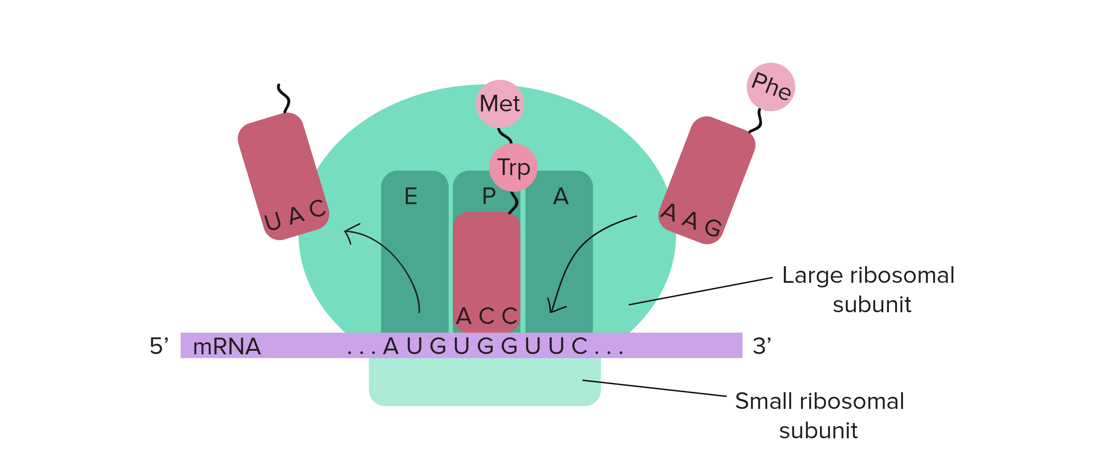
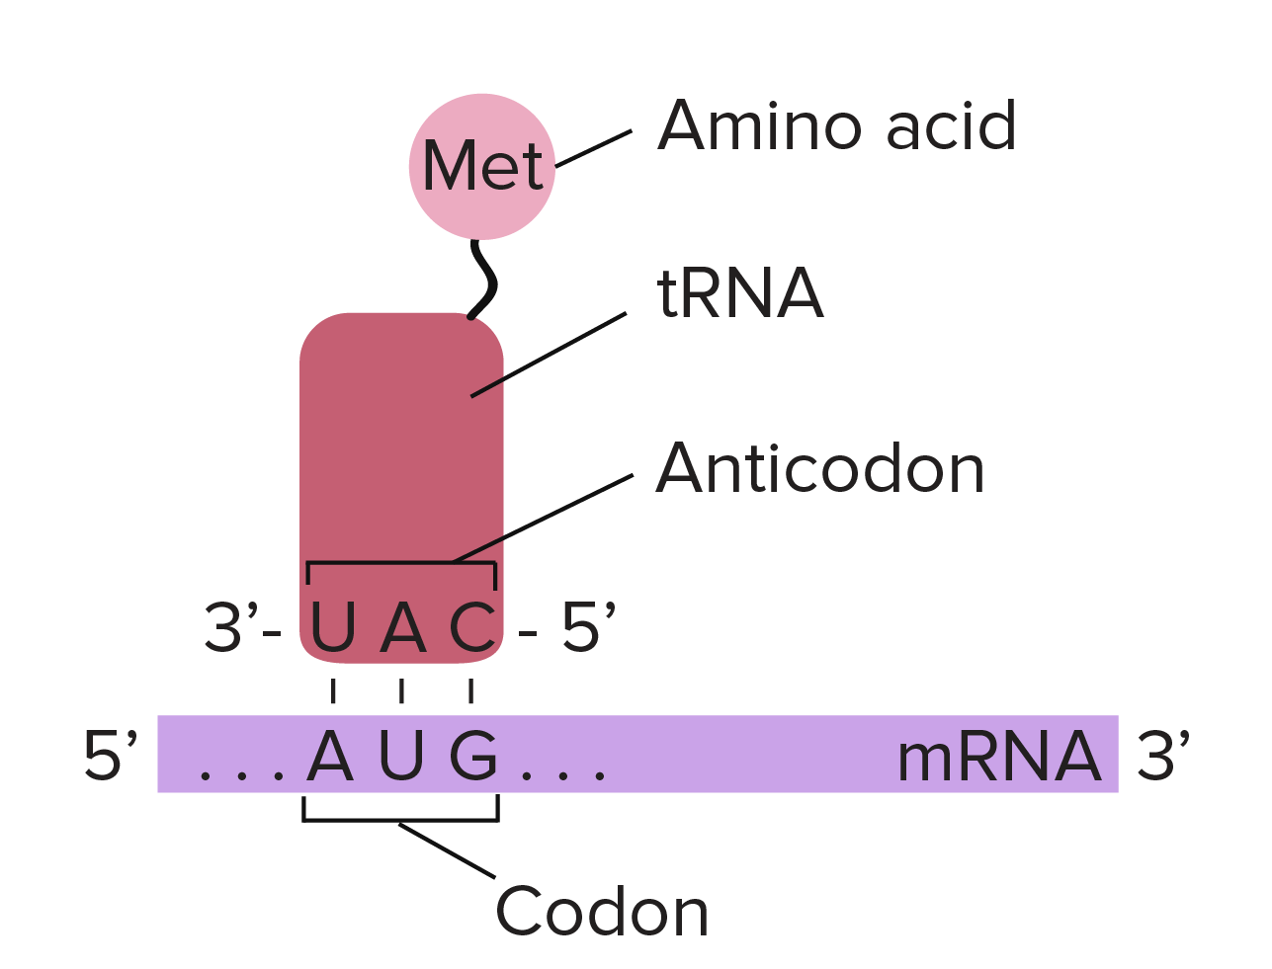
Translation

Slide 6
https://www.youtube.com/watch?v=WkI_Vbwn14g
Drew Berry

Slide 7
Prokarotic Gene Organization

Slide 8
Operon Organization

Slide 9
More realistic phage operon organization

