Slide 1
Predicting Genes in Actinobacteriophages
2020 Bioinformatics Summer Training
SEA-PHAGES Cohort 13
Deborah Jacobs-Sera

Slide 2
Context
What are they?
How did they get to be that way?
How can we use them to help others?

Slide 7
Major
capsid
protein
Tail assembly
chaperone
Terminase
Protease
Portal

Slide 8
It is all about finding the patterns…
Since the beginning of time, woman (being human) has tried to make order and sense out of her surroundings. Gene annotation and analysis is just a primal instinct to make order.
Young children, as they prepare to enter school, are tested to see if they are ready by recognizing patterns, a form of making order.
1. Where will the dot appear in the 4th box?
Remember, everything you need to know, you learned in kindergarten….

Slide 9
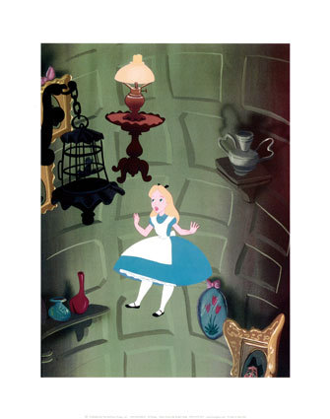
Make-Believe or Putative
Remember, you are working in the putative gene world. All gene predictions are made with the best evidence to date. Most of that evidence is computational (bioinformatic), not experimental. Tomorrow’s data may give us better evidence, but your prediction today is the best it can be … today! Make good predictions following a consistent approach. Let these predictions lead to experimentation that can provide the evidence to improve future predictions.

Slide 10
Not make-believe, but rather putative
Glimmer and GeneMark are algorithms that predict coding potential by looking at 4-nucleotide patterns using Hidden Markov models. They incorporate additional pieces to apprise start sites. They do it differently enough that we use both. Their literature claims >95% accuracy.
Our basic tenants:
Each gene prediction can be thought of as a single bench experiment:
make a claim, collect data, evaluate
The programs are fast, but not accurate enough
The programs won’t pick up a gene that is newly acquired from a source with a different coding pattern

Slide 11
Decision –making tress for Phage Genome annotations are found in the Bioinformatics Guide
https://seaphagesbioinformatics.helpdocsonline.com/article-25

Slide 13
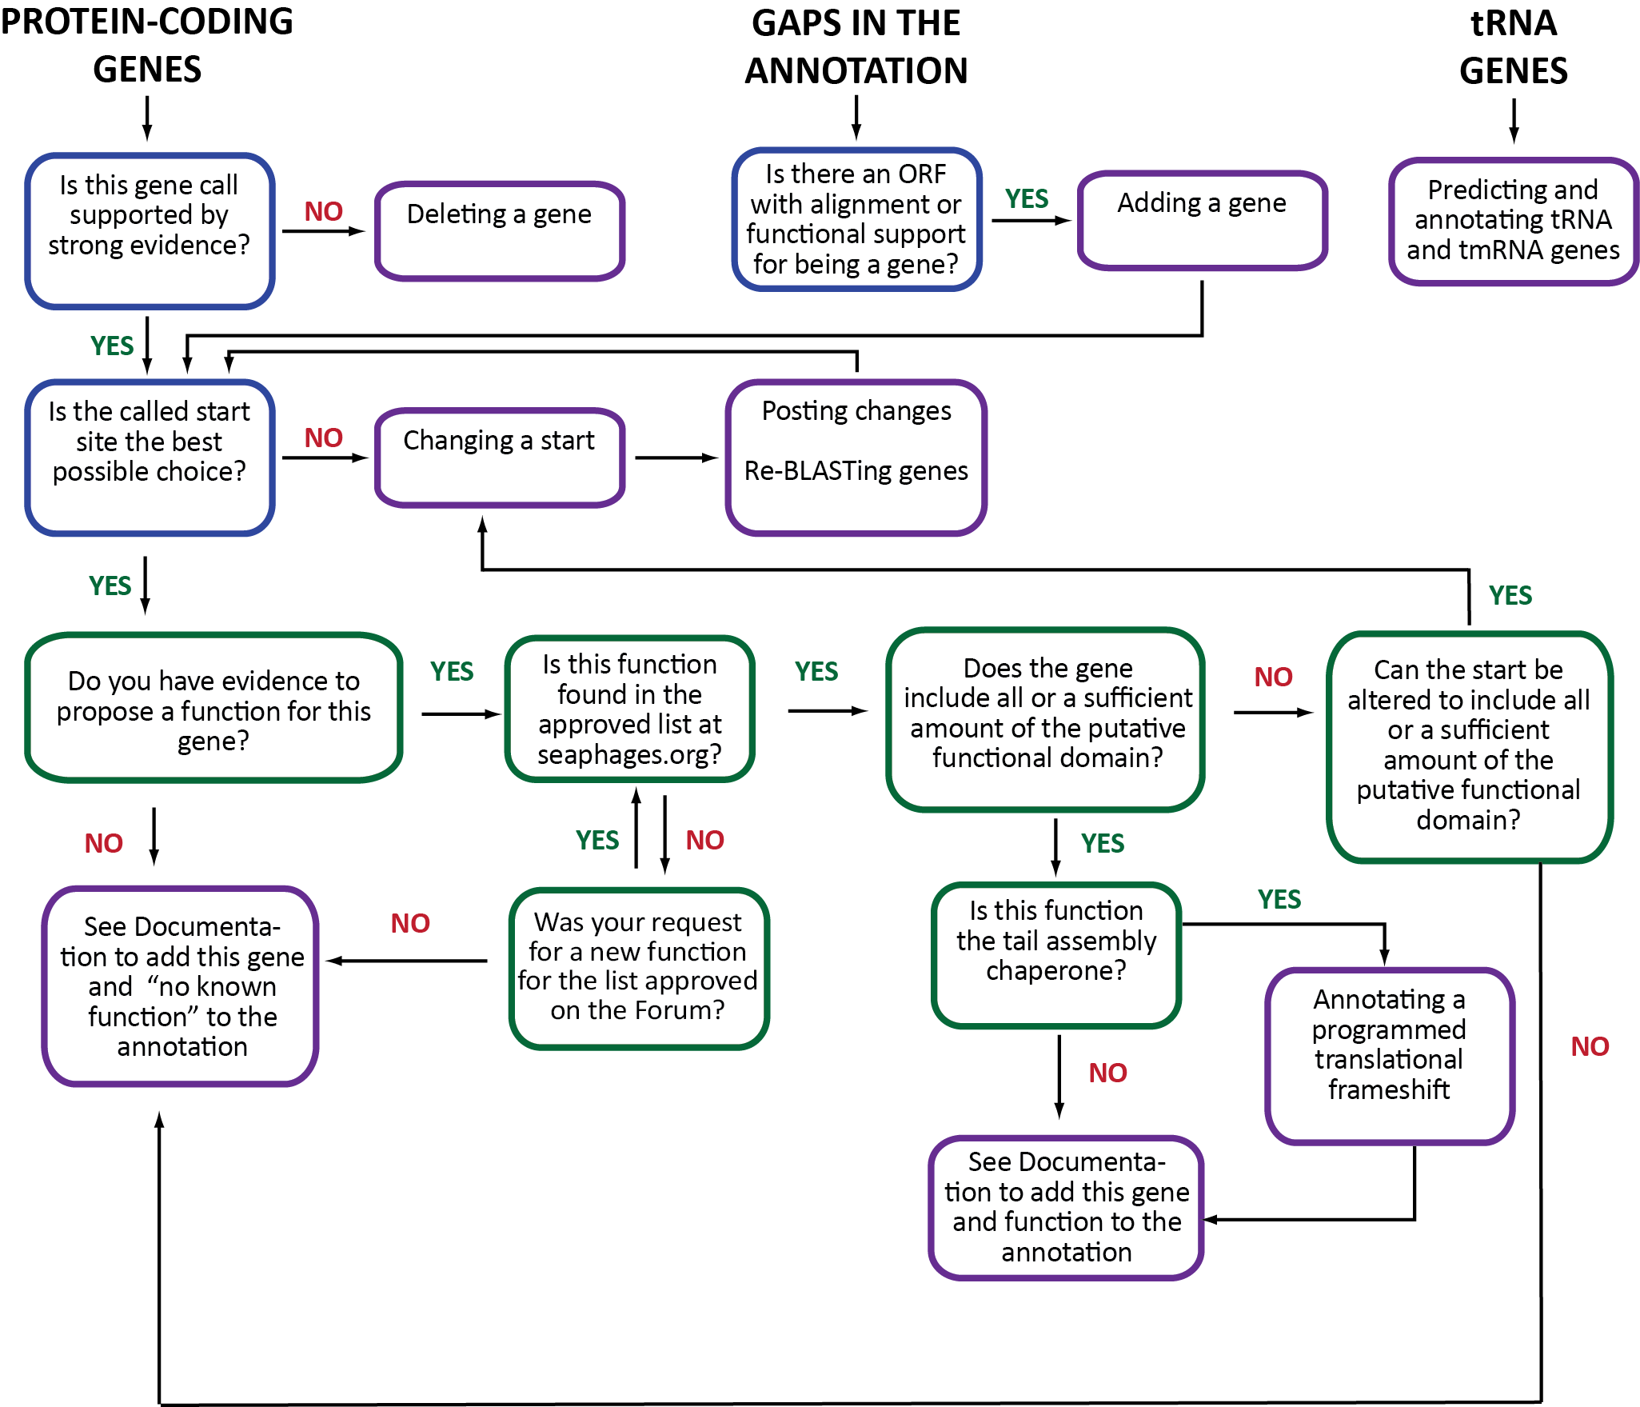

Slide 15
How many phage genome sequences are in GenBank?
thousands
How many actinobacteriophage genomes are sequenced?
3400
How many actinobacteriophage genomes are published?
3053
Notes:
684 last yeat

Slide 16
What is the universal format for a sequence?
How many As, Cs, Ts, and Gs are in a mycobacteriophage genome?
On average: ~70,000 base-pairs
Range: ~14,000 to ~192,000 bp
FASTA

Slide 17
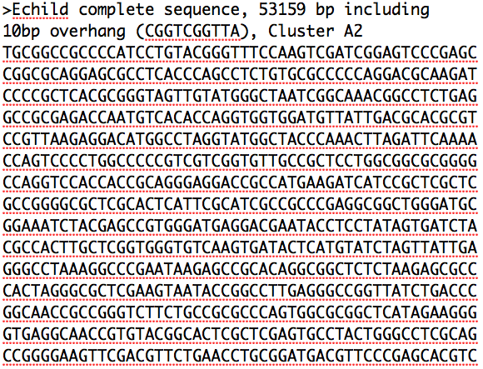

Slide 18
How do you make sense of the nucleotide sequence?
Convert to genes
How do you convert ATCGs to genes?
Codons
Code for Amino Acids, Starts, Stops

Slide 19
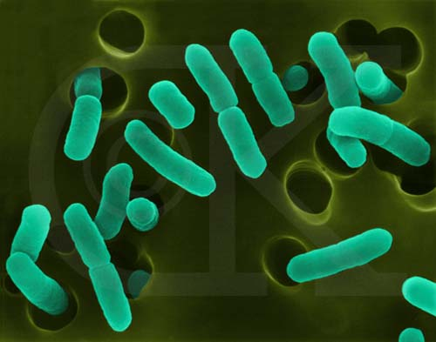
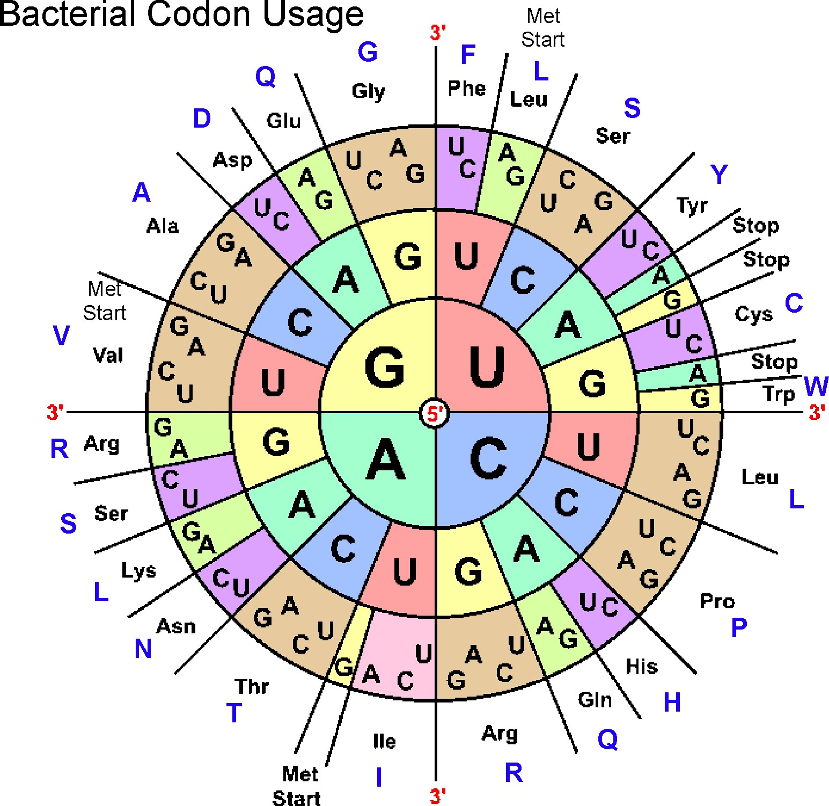
Phages use the Bacterial and Plant Plastid code (NCBI: Table 11)
3 starts
ATG (methionine)
GTG (valine)
TTG (leucine)
3 stops (TAA, TAG, TGA)
Space in-between: Open Reading Frame -- ORF
www.cen.ulaval.ca

Slide 20
ATGGACCTCTCGCCC
ATG GAC CTC TCG CCC
TGG ACC TCT CGC ….
GGA CCT CTC GCC ….
If there are 3 choices (frames) in the forward direction,
how many are in the reverse direction?

Slide 21
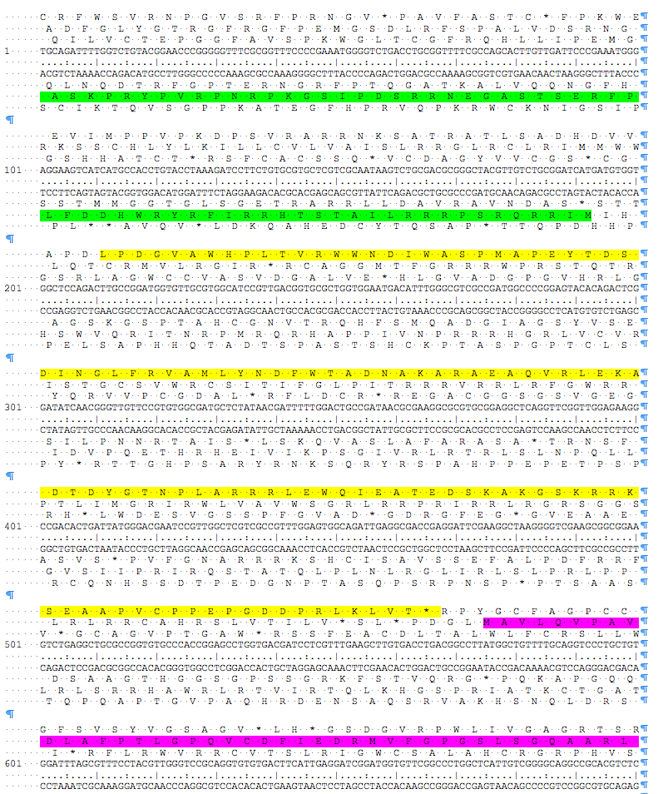
Six-Frame Translations

Slide 22
Features found in mycobacteriophage genomes
protein coding genes ✓
tRNAs ✓
tmRNAs
AttP sites
Terminators
Frame shifts ✓
…

Slide 23
Gene Evaluations
For each feature we have 3 questions
Is it a gene?
What is its start?
What is its function?

Slide 24
Gene Evaluations
We are always looking for the supporting data.
We ask 3 questions: Is it a gene?, what is its start? What is its function?
We use 2 programs, Glimmer and GeneMark, to identify coding potential.
We use Phamerator output for a visual representation of gene and nucleotide similarity.
We use the guiding principles to remind of us all of the parameters.
As we evaluate, we can:
Add a gene
Delete a gene
Change a gene start

Slide 25
Supporting Data #1: Coding Potential Glimmer and GeneMark
Uses Hidden Markov Models to identify coding potential
Uses a sample of the genome
Identifies longest ORFS in that sample
Calculates patterns in the nucleotides:
2 at a time, 4 at a time
Notes:
A hidden Markov model (HMM) is one in which you observe a sequence of emissions, but do not know the sequence of states the model went through to generate the emissions. Analyses of hidden Markov models seek to recover the sequence of states from the observed data. http://www.mathworks.com/help/stats/hidden-markov-models-hmm.html

Slide 26
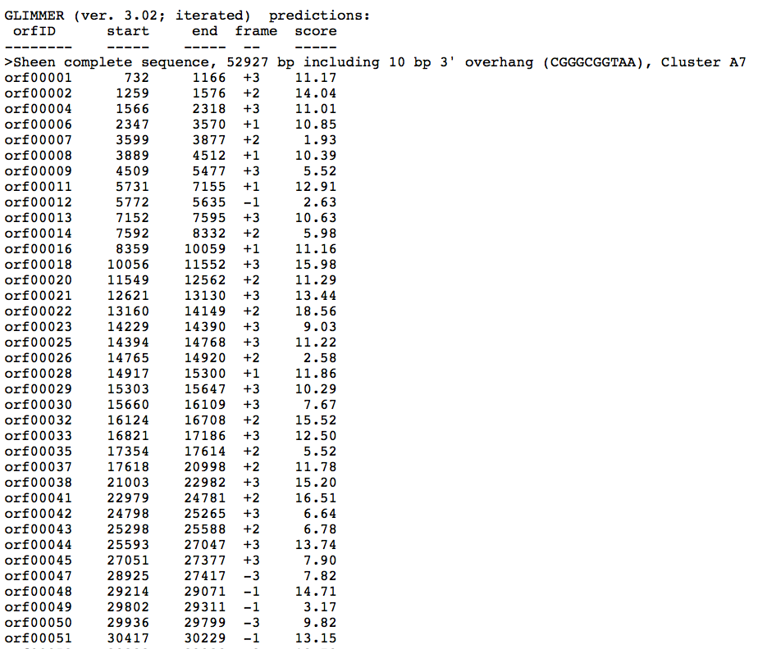
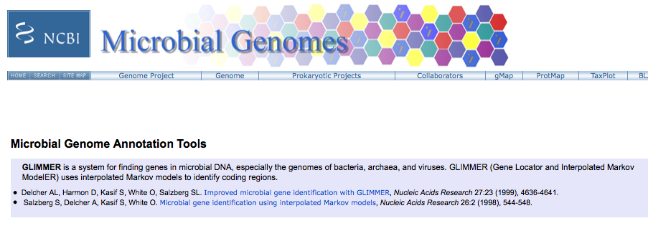
GLIMMER
http://www.ncbi.nlm.nih.gov/genomes/MICROBES/glimmer_3.cgi

Slide 27
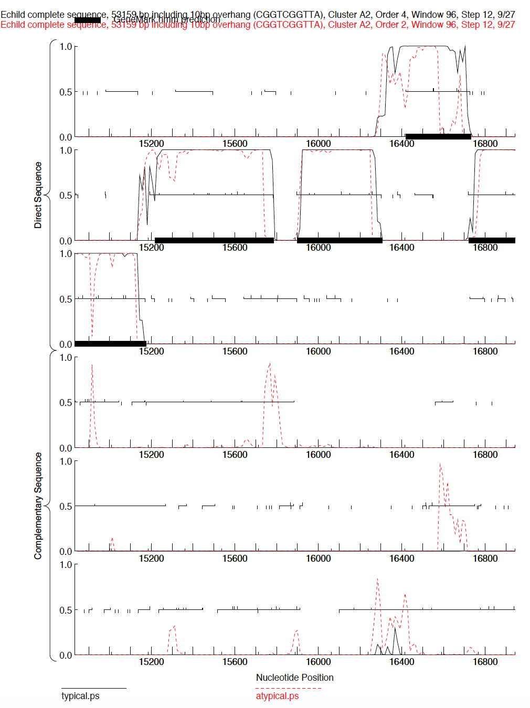
GeneMark Output
(trained on
M. tuberculosis)

Slide 28
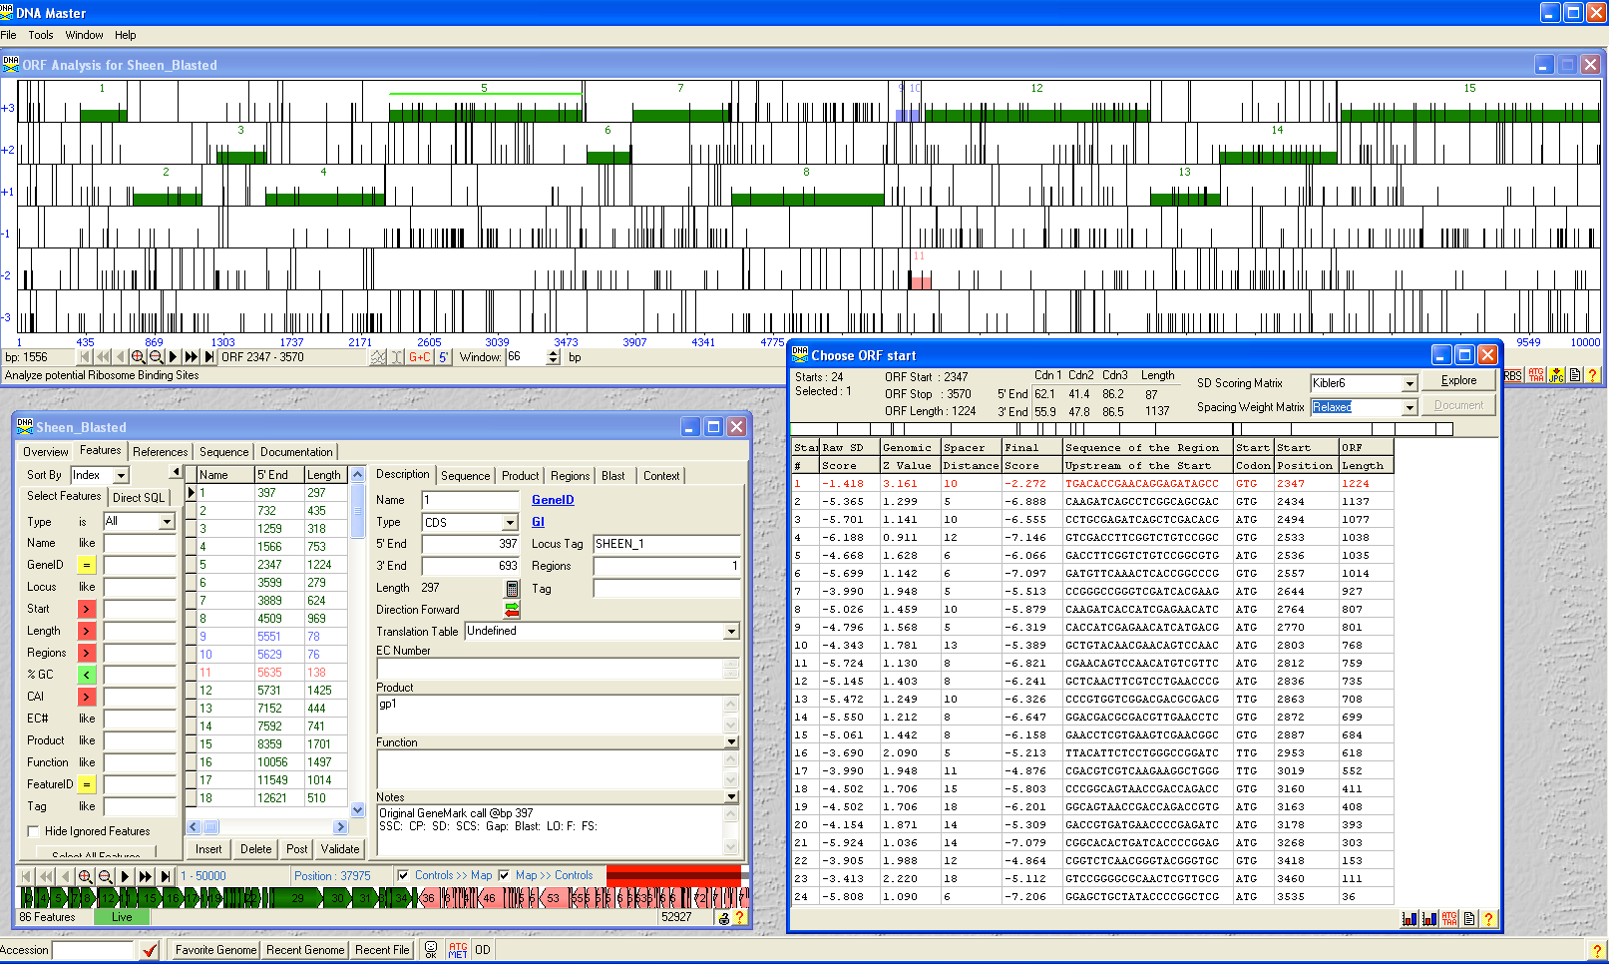

Slide 29
GUIDING PRINCIPLES
OF BACTERIOPHAGE GENOME ANNOTATION
Found in “Phage Annotation, Genomics and Data Interpretation” Section of the Bioinformatics Guide
15 Key Directives
Read for tomorrow

Slide 30
Comparisons with what we already know
Phamerator comparisons
BLAST comparisons
At NCBI
***At phagesDB***
Starterator data “New & Improved!!!”

Slide 31
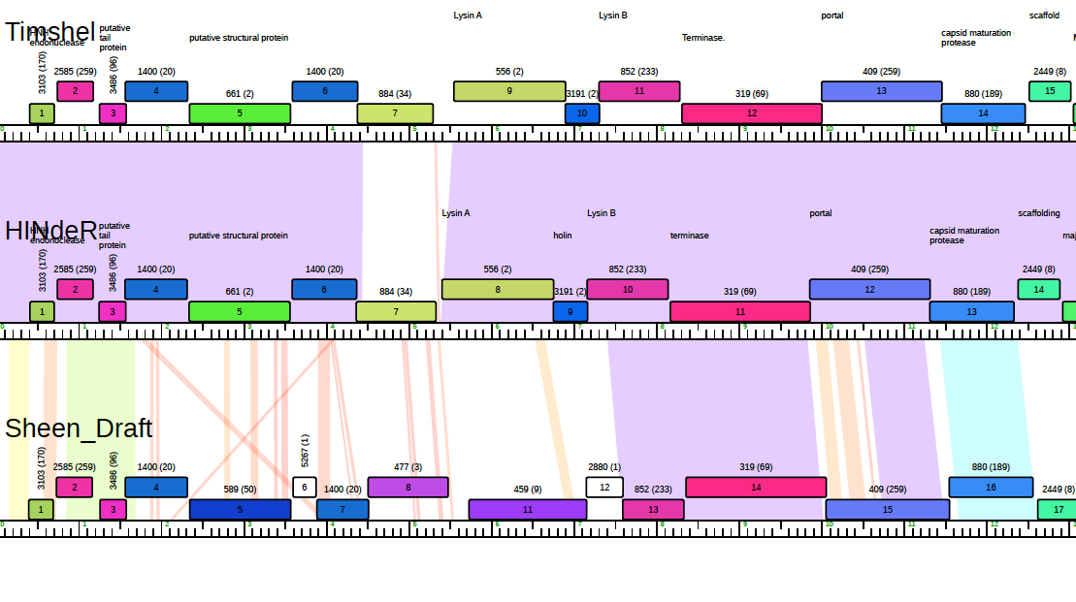
Phamerator map

Slide 32
Starterator data

Slide 33
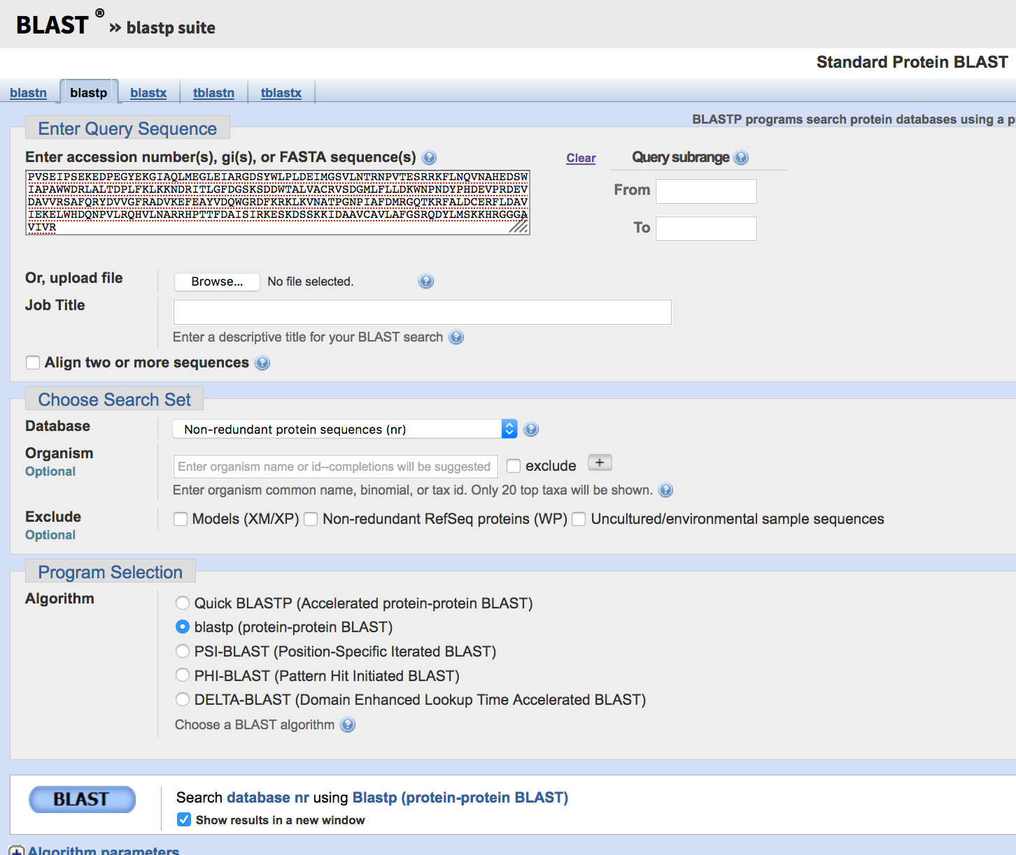
Blast Comparisons

Slide 34
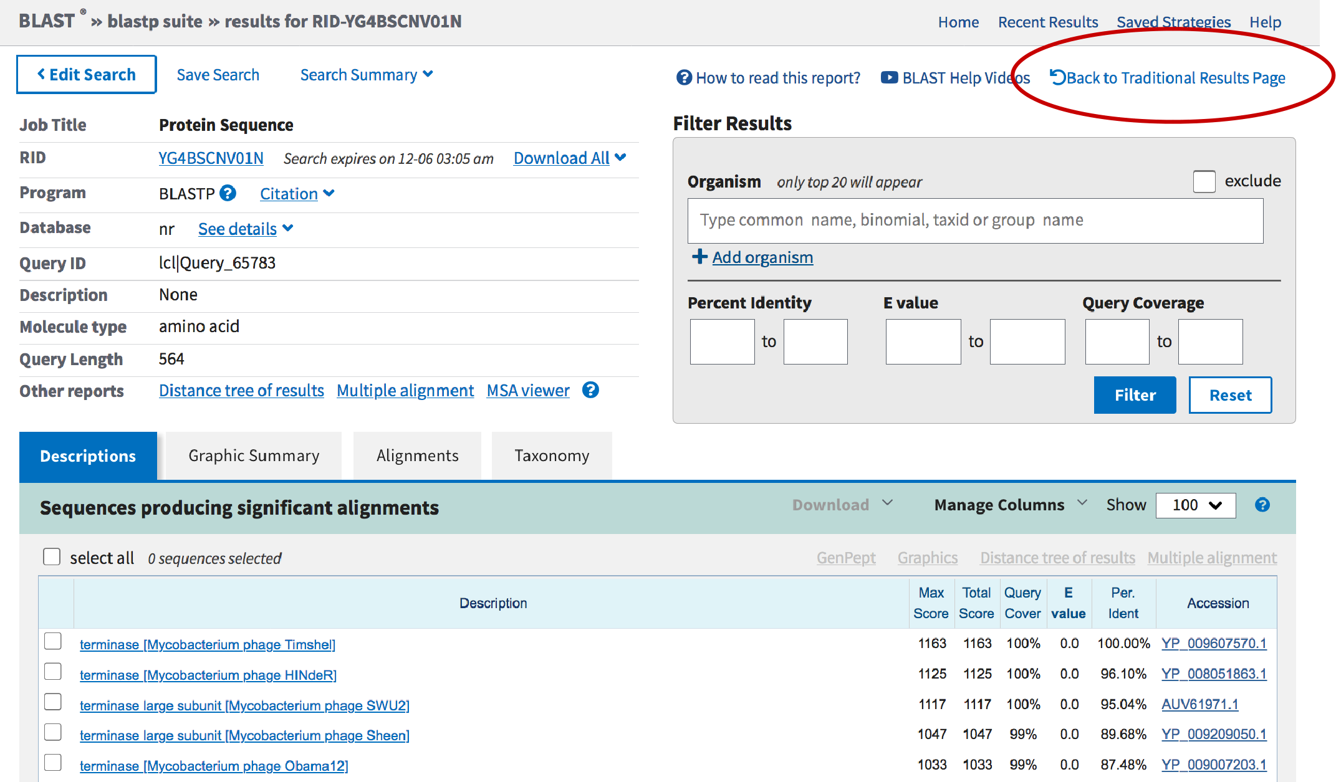

Slide 35
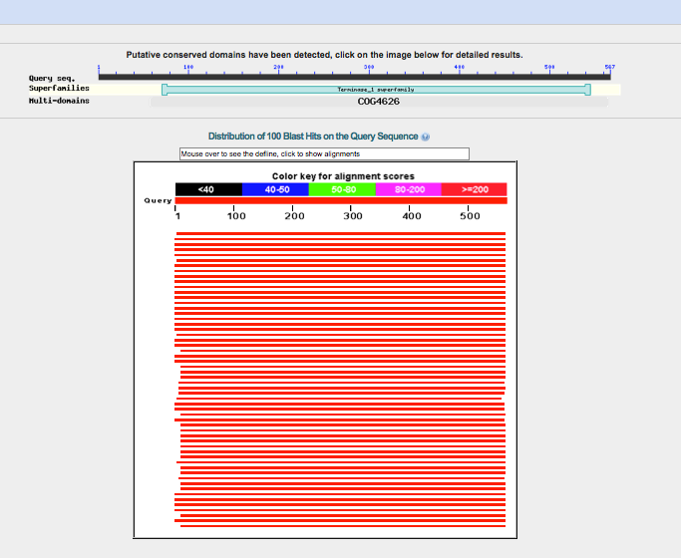

Slide 36
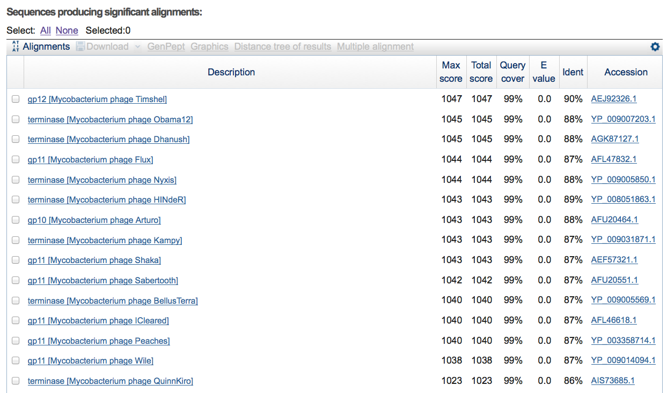

Slide 37
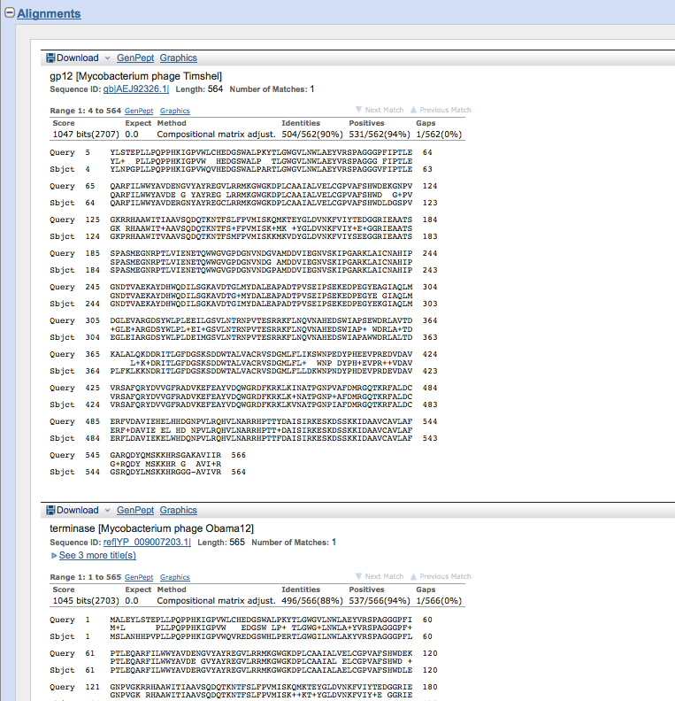

Slide 38
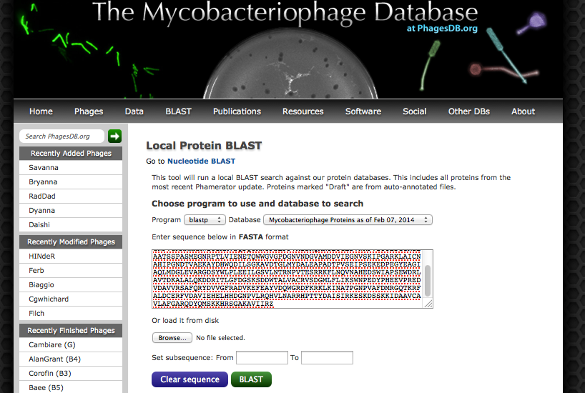

Slide 39
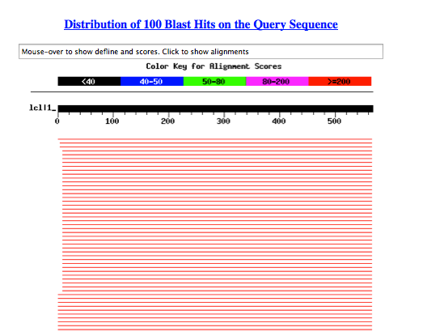

Slide 40
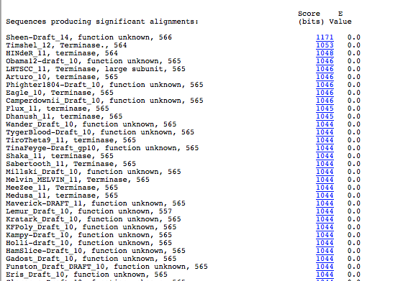

Slide 41
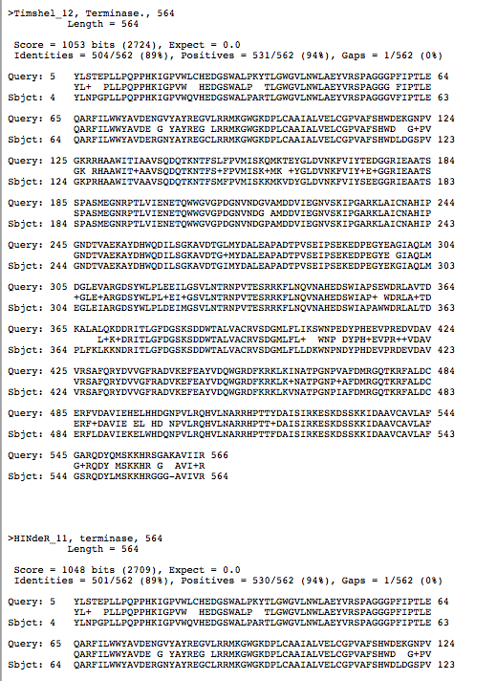

Slide 42
Tips for DNA Master Files
Save .dnam5 file often
Save .dnam5 file as a new name. (Then don’t save the old named one.)
If working in a virtual machine, be mindful about closing/shutting down
Did I mention to save your files often using a new name?

Slide 43
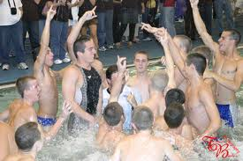

Slide 44
Let’s get started! For phage Ellie
Gather Data
Auto-annotate in DNA Master
Gene Calling
Functional Assignments

Slide 45
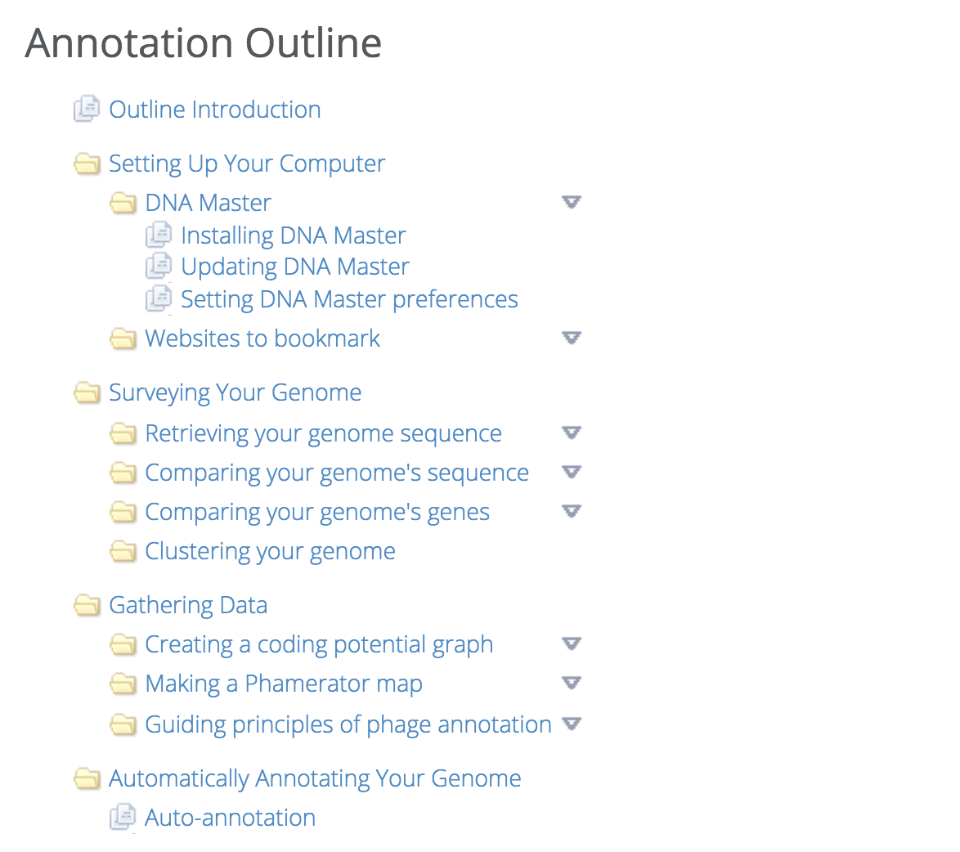
✓
DNA Master
Current Build
2649
✓
✓
✓

