Slide 1
Inside the Black Box: Phage Genome Sequencing, Assembly, and Finishing
AKA: What did my phage do over winter break?
Dan Russell

Slide 2
So I don’t forget…
This will not be on the “test”
These slides will be posted, please steal them
Lots of info, but feel free to ask questions anytime!

Slide 3
(Relevant) Trivia
How many base pairs (bp) are there in Feyre’s genome? A human genome?
When was the first human genome sequence complete?
How much did it cost to sequence the first human genome?
How long did it take to sequence the first human genome?
When was the first Mycobacteriophage sequenced, and which phage was it?

Slide 4
(Relevant) Trivia
How many base pairs (bp) are there in Feyre’s genome? A human genome?
When was the first human genome sequence complete?
How much did it cost to sequence the first human genome?
How long did it take to sequence the first human genome?
When was the first Mycobacteriophage sequenced, and which phage was it?
63,558 bp; ~3 billion bp (haploid)
2000 (2003)
~$2.7 billion
~13 years
1992, L5

Slide 5
Overview
The Winter Break Black Box
Sanger: Sequencing Begins
Next Gen: The Dark Light
Third Gen: The Read Length Rises
Assembly & Finishing
A Nano Note

Slide 6
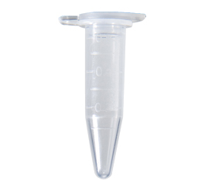
Jefe DNA
Fall semester lab work
Soil
Spring semester annotation
GenBank
MRA
Jefe.fasta

Slide 7
Jefe DNA
Fall semester lab work
Soil
What happens in here?
Spring semester annotation
GenBank
MRA
Jefe.fasta

Slide 8
Sequence*

Slide 9
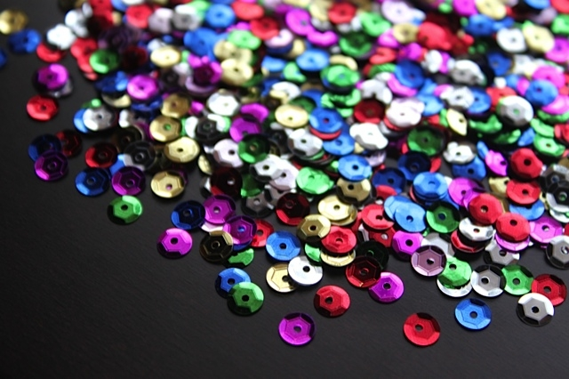
SEQUINS

Slide 10
A
B
C
SEQUINS

Slide 11
Sequence*
* Determining the number, order, and arrangement of As, Cs, Gs, and Ts that comprise a piece of DNA

Slide 12
Overview
The Winter Break Black Box
Sanger: Sequencing Begins
Next Gen: The Dark Light
Third Gen: The Read Length Rises
Assembly & Finishing
A Nano Note

Slide 13
Sanger Sequencing
LIBRARY
PREPARATION
Complete genome copies
Fragmented genome chunks

Slide 14
LIBRARY
PREPARATION
Fragments were cloned:

Slide 15
LIBRARY
PREPARATION
Notes:
One tube per 2 sequences with Sanger and cloning. Not so bad if you only want 100 sequences. What if you want 1 million?

Slide 16
LIBRARY
PREPARATION
x millions
Notes:
One tube per 2 sequences with Sanger and cloning. Not so bad if you only want 100 sequences. What if you want 1 million?

Slide 17
LIBRARY
PREPARATION
x millions
Notes:
One tube per 2 sequences with Sanger and cloning. Not so bad if you only want 100 sequences. What if you want 1 million?

Slide 18
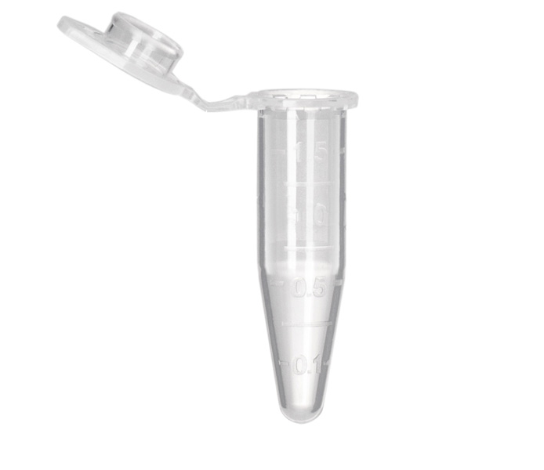
Sanger Sequencing
READING THE SEQUENCE
Template DNA
Known Primer (~20bp)
DNA Polymerase
Dideoxy Nucleotides
G
A
T
C
Regular Nucleotides
T
C
G
A
C
G
A
T
G
G
A
T
G
T
C
G
A
A
T
A
C
T
G
G
A
T
A
T
G
Labeled
Terminators
T
A
C
C
G
A
C
C
A
T
A
C
G

Slide 19
Sanger Sequencing
READING THE SEQUENCE
Primer
5’
T G C G C G G C C C A
A C G C G C C G G G T ? ? ? ? ? ? ? ? ? ? ? ? ? ? ?
3’
5’

Slide 20
Sanger Sequencing
READING THE SEQUENCE
Primer
5’
G T C T T G G G C T
T G C G C G G C C C A
A C G C G C C G G G T C A G A A C C C G A T C G C G
3’
5’

Slide 21
Sanger Sequencing
READING THE SEQUENCE
Primer
5’
G T C T T G G G C T A G C G C
T G C G C G G C C C A
A C G C G C C G G G T C A G A A C C C G A T C G C G
3’
5’
5’
21 bp
G T C T T G G G C T
T G C G C G G C C C A

Slide 22
Sanger Sequencing
READING THE SEQUENCE
Primer
5’
G T C T T G G G C T A
T G C G C G G C C C A
A C G C G C C G G G T C A G A A C C C G A T C G C G
3’
5’
5’
21 bp
G T C T T G G G C T
T G C G C G G C C C A
5’
26 bp
G T C T T G G G C T A G C G C
T G C G C G G C C C A

Slide 23
Sanger Sequencing
READING THE SEQUENCE
Primer
5’
G
T G C G C G G C C C A
A C G C G C C G G G T C A G A A C C C G A T C G C G
3’
5’
5’
21 bp
G T C T T G G G C T
T G C G C G G C C C A
5’
26 bp
G T C T T G G G C T A G C G C
T G C G C G G C C C A
5’
22 bp
G T C T T G G G C T A
T G C G C G G C C C A

Slide 24
Sanger Sequencing
READING THE SEQUENCE
Primer
5’
G T C T T G G G C
T G C G C G G C C C A
A C G C G C C G G G T C A G A A C C C G A T C G C G
3’
5’
5’
21 bp
G T C T T G G G C T
T G C G C G G C C C A
5’
26 bp
G T C T T G G G C T A G C G C
T G C G C G G C C C A
5’
22 bp
G T C T T G G G C T A
T G C G C G G C C C A
5’
12 bp
G
T G C G C G G C C C A

Slide 25
Sanger Sequencing
READING THE SEQUENCE
Primer
5’
G T C T T
T G C G C G G C C C A
A C G C G C C G G G T C A G A A C C C G A T C G C G
3’
5’
5’
21 bp
G T C T T G G G C T
T G C G C G G C C C A
5’
26 bp
G T C T T G G G C T A G C G C
T G C G C G G C C C A
5’
22 bp
G T C T T G G G C T A
T G C G C G G C C C A
5’
12 bp
G
T G C G C G G C C C A
5’
20 bp
G T C T T G G G C
T G C G C G G C C C A

Slide 26
Sanger Sequencing
READING THE SEQUENCE
A C G C G C C G G G T C A G A A C C C G A T C G C G
3’
5’
5’
21 bp
G T C T T G G G C T
T G C G C G G C C C A
5’
26 bp
G T C T T G G G C T A G C G C
T G C G C G G C C C A
5’
22 bp
G T C T T G G G C T A
T G C G C G G C C C A
5’
12 bp
G
T G C G C G G C C C A
5’
20 bp
G T C T T G G G C
T G C G C G G C C C A
5’
16 bp
G T C T T
T G C G C G G C C C A

Slide 27
Sanger Sequencing
READING THE SEQUENCE
A C G C G C C G G G T ? ? ? ? ? ? ? ? ? ? ? ? ? ? ?
3’
5’
5’
21 bp
? ? ? ? ? ? ? ? ? T
T G C G C G G C C C A
5’
26 bp
? ? ? ? ? ? ? ? ? ? ? ? ? ? C
T G C G C G G C C C A
5’
22 bp
? ? ? ? ? ? ? ? ? ? A
T G C G C G G C C C A
5’
12 bp
G
T G C G C G G C C C A
5’
20 bp
? ? ? ? ? ? ? ? C
T G C G C G G C C C A
5’
16 bp
? ? ? ? T
T G C G C G G C C C A
Notes:
Has to be done in a single tube per rxn.

Slide 28
Sanger Sequencing
Laser Reader
5’
5’
5’
5’
5’
5’
5’
5’
5’
5’
5’
20 bp
21 bp
19 bp
18 bp
13 bp
22 bp
15 bp
16 bp
14 bp
17 bp
G T C T T G G G C
12 bp
T G C G C G G C C C A
G T C T T G G G C T
T G C G C G G C C C A
G T C T T G G G
T G C G C G G C C C A
G T C T T G G
G T C T T G G G C T A
G T C T
T G C G C G G C C C A
T G C G C G G C C C A
G T
G T C T T
G T C T T G
G
T G C G C G G C C C A
T G C G C G G C C C A
T G C G C G G C C C A
T G C G C G G C C C A
T G C G C G G C C C A
T G C G C G G C C C A
G T C

Slide 29
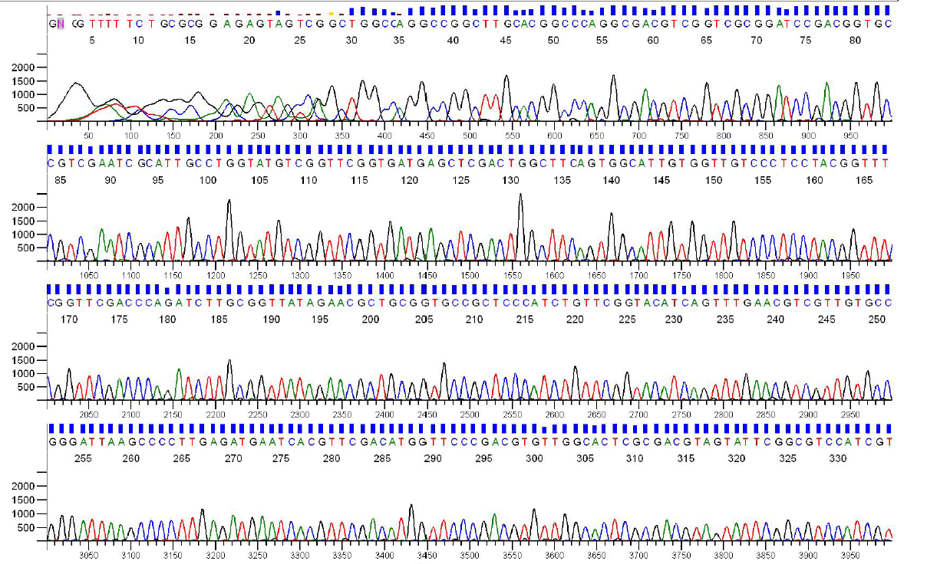
Sanger Sequencing Output
Each sequencing reaction gives us a chromatogram, usually ~600-1000 bp:

Slide 30
Sanger Throughput Limitations
Must have 1 colony picked for every 2 reactions
Must do 1 DNA prep for every 2 reactions
Must have 1 PCR tube for each reaction
Must have 1 gel lane for each reaction

Slide 31
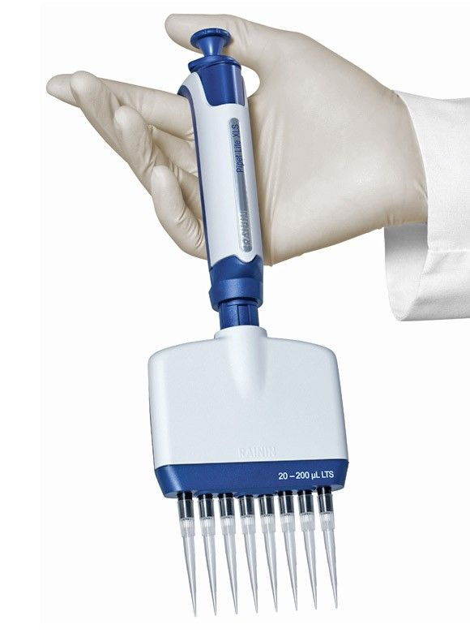
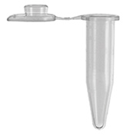
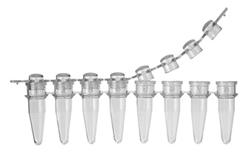

Slide 32
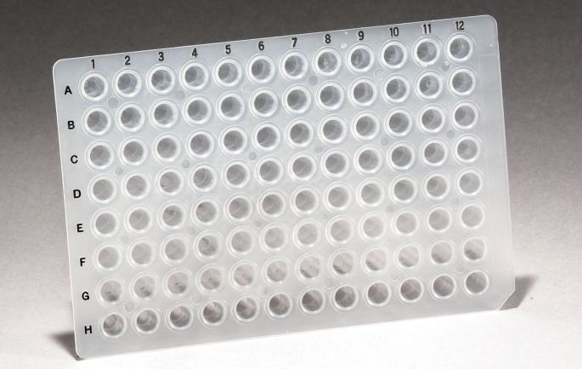
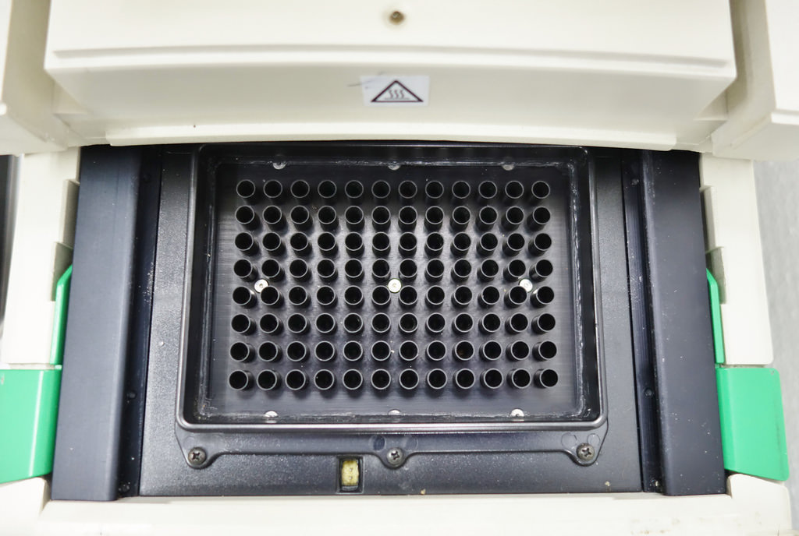
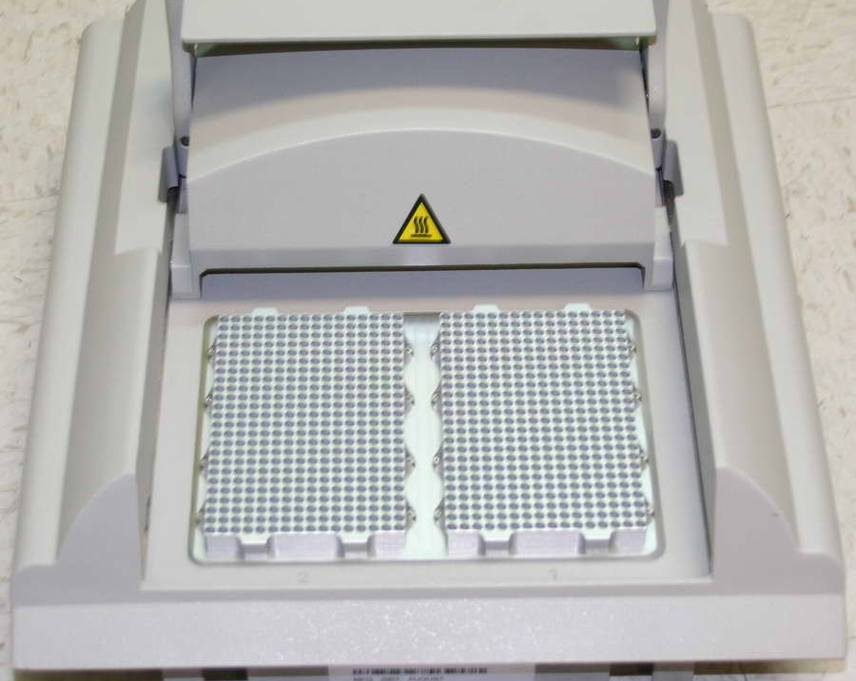
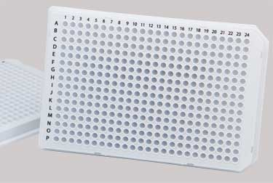

Slide 33
Colony Picking Robot

Slide 34
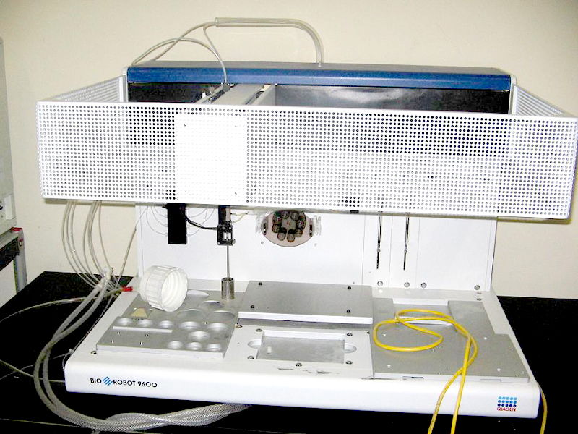

Slide 35
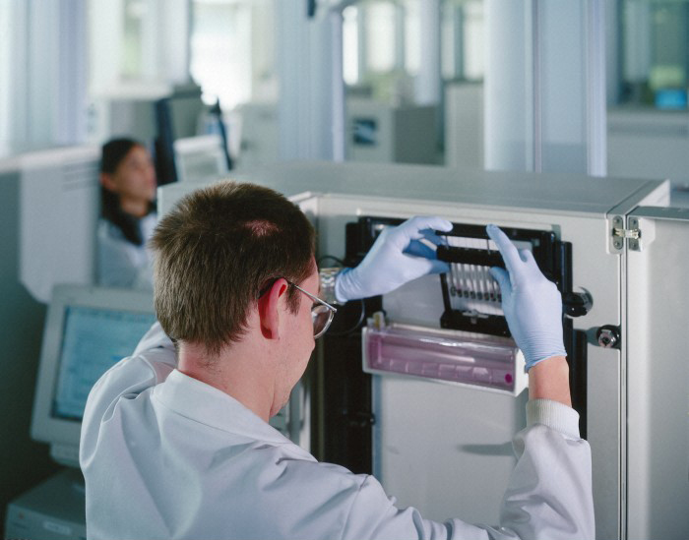

Slide 36
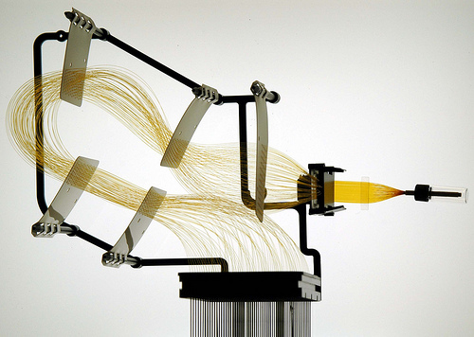
Capillary Arrays

Slide 37
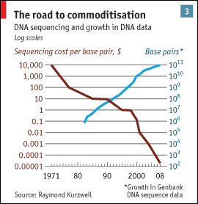
Sanger Throughput Limitations
Must have 1 colony picked for every 2 reactions
Must do 1 DNA prep for every 2 reactions
Must have 1 PCR tube for each reaction
Must have 1 gel lane for each reaction
from The Economist

Slide 38
Overview
The Winter Break Black Box
Sanger: Sequencing Begins
Next Gen: The Dark Light
Third Gen: The Read Length Rises
Assembly & Finishing
A Nano Note

Slide 39
Problem: How can we do way more reactions at once without having more tubes, thermocyclers, etc.?

Slide 40
Next generation sequencing

Slide 41
Next generation sequencing
LIBRARY
PREPARATION

Slide 42
Next generation sequencing
LIBRARY
PREPARATION
Genomic
Fragment
Adapters

Slide 43
Next generation sequencing
LIBRARY
PREPARATION

Slide 44
LIBRARY
PREPARATION
454/Ion Torrent Sequencing
Bead/ISP
Adapter
Complement
Sequences
Each bead should be amplified
all over with a SINGLE library fragment.

Slide 45
LIBRARY
PREPARATION
454/Ion Torrent Sequencing
Problem: How do I do PCR to amplify the fragments without having to use 1 tube for each reaction?

Slide 46
LIBRARY
PREPARATION
454/Ion Torrent Sequencing

Slide 47
LIBRARY
PREPARATION
454/Ion Torrent Sequencing

Slide 48
454/Ion Torrent Sequencing

Slide 49
454/Ion Torrent Sequencing
READING THE SEQUENCE
~3.5 µm for Ion Torrent, ~30 µm for 454

Slide 50
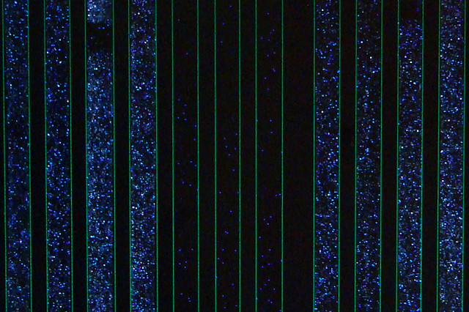
Raw 454 data
Only give polymerase one nucleotide at a time:
G
G
G
Primer
G
G
5’
G
T
T G C G C G G C C C A
C
T T
G G G
A C G C G C C G G G T C A G A A C C C G A T C G C G
3’
5’
If that nucleotide is incorporated, enzymes turn by-products into light:
1 2 3 4 5
The real power of this method is that it can take place in millions of tiny wells in a single plate at once.
T C A G T C A G T C A G

Slide 51
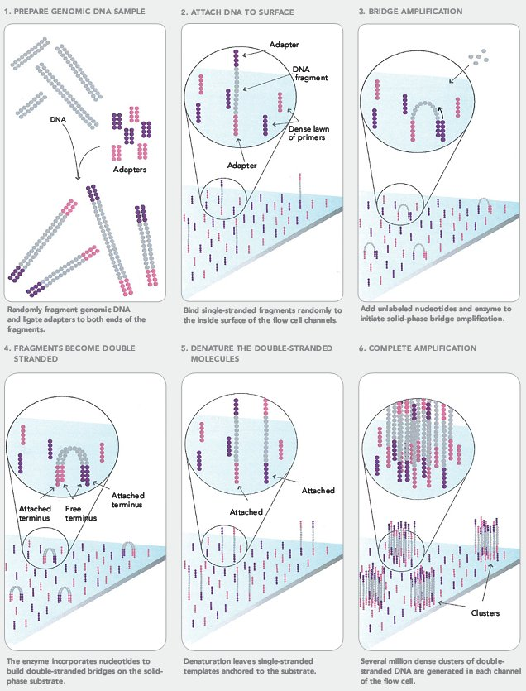
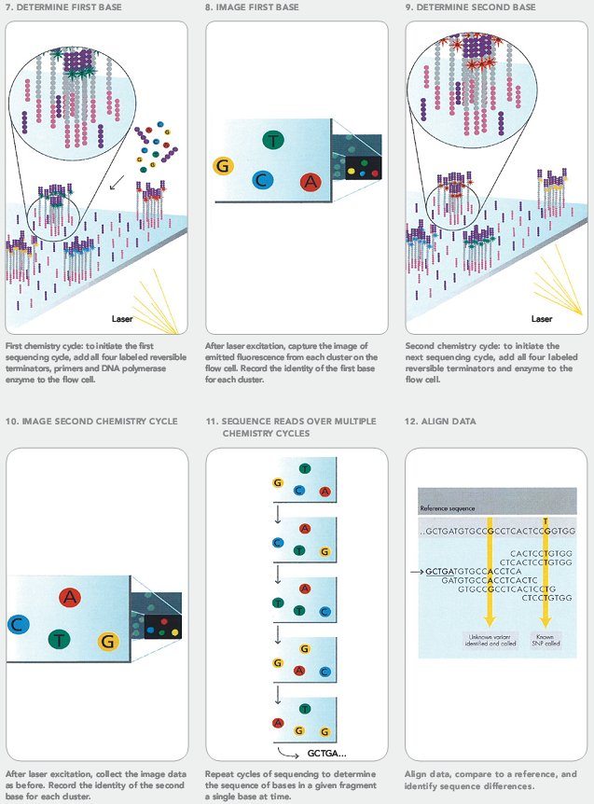
Illumina Sequencing
READING THE SEQUENCE
Illumina Sequencing

Slide 52
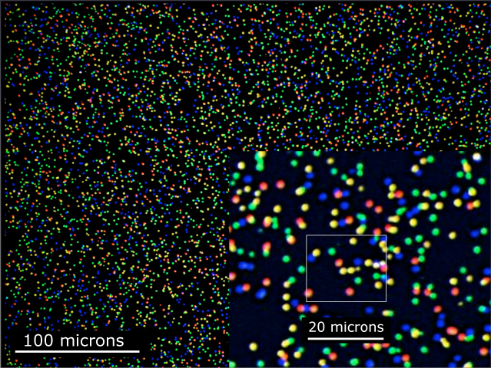
Illumina Sequencing

Slide 53
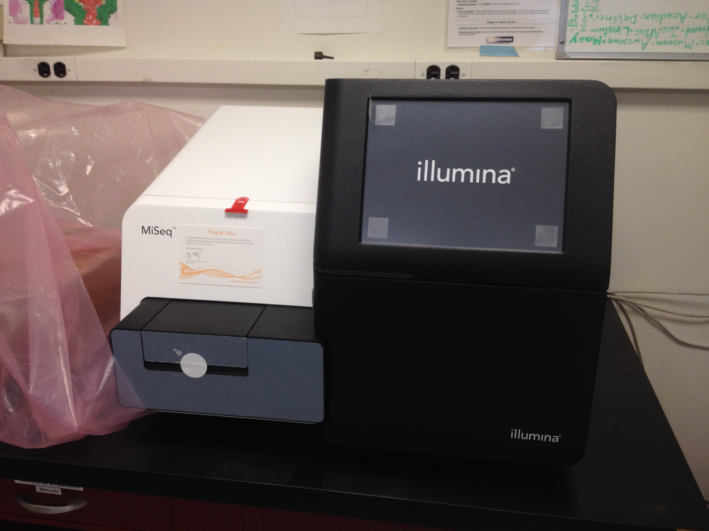
Illumina Sequencing
2013

Slide 54
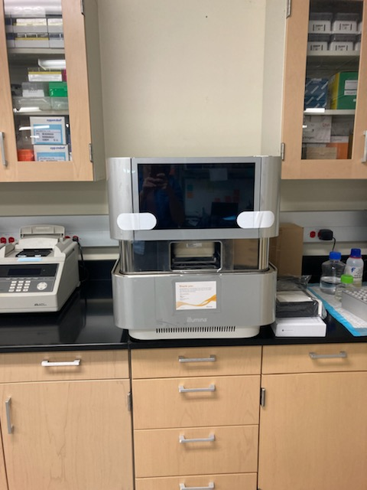
2023

Slide 55
Next-Gen Sequencing
Take home message: Massively Parallel
Millions (or billions) of concurrent reads

Slide 56
Sanger Throughput Limitations
Must have 1 colony picked for every 2 reactions
Must do 1 DNA prep for every 2 reactions
Must have 1 PCR tube for each reaction
Must have 1 gel lane for each reaction
from The Economist

Slide 57
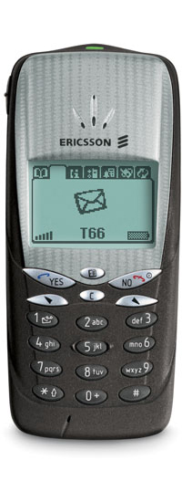
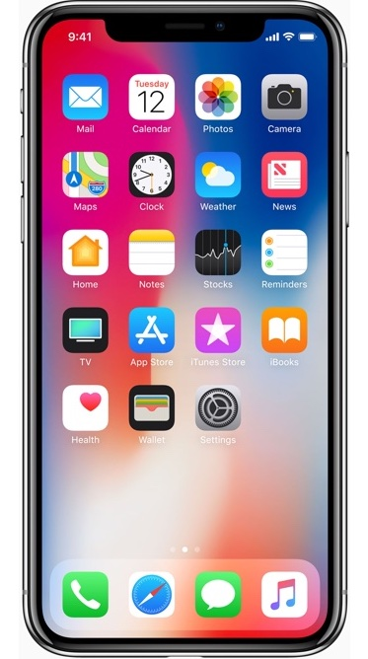

Slide 58
Overview
The Winter Break Black Box
Sanger: Sequencing Begins
Next Gen: The Dark Light
Third Gen: The Read Length Rises
Assembly & Finishing
A Nano Note

Slide 59
“Third” generation sequencing

Slide 60
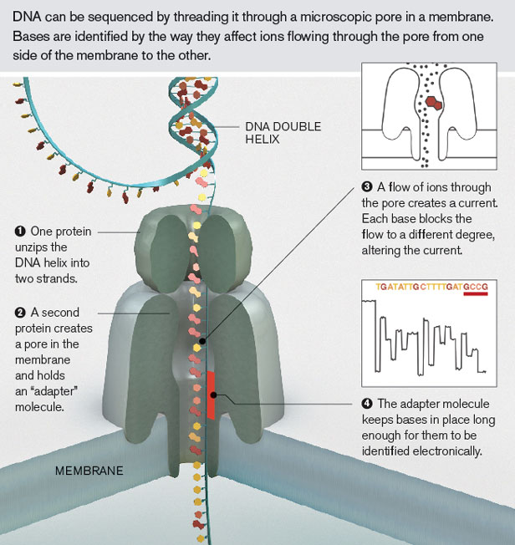
Oxford Nanopore
PacBio
Single Molecules
Long Reads
Lower per-Base Quality

Slide 61
 | Sanger | Ion Torrent | Illumina | PacBio | Oxford Nanopore
Cost per base | ⭐️ | ⭐️⭐️⭐️ | ⭐️⭐️⭐️⭐️⭐️ | ⭐️⭐️ | ⭐️⭐️
Read Quality | ⭐️⭐️⭐️⭐️⭐️ | ⭐️⭐️⭐️⭐️ | ⭐️⭐️⭐️⭐️⭐️ | ⭐️⭐️⭐️ | ⭐️⭐️
Read Length | ⭐️⭐️⭐️ | ⭐️⭐️ | ⭐️⭐️ | ⭐️⭐️⭐️⭐️⭐️ | ⭐️⭐️⭐️⭐️⭐️
Consensus Quality | ⭐️⭐️⭐️⭐️⭐️ | ⭐️⭐️⭐️⭐️ | ⭐️⭐️⭐️⭐️⭐️ | ⭐️⭐️⭐️⭐️⭐️ | ⭐️⭐️⭐️⭐️
Machine Affordability | ⭐️ | ⭐️⭐️⭐️ | ⭐️⭐️⭐️ | ⭐️ | ⭐️⭐️⭐️⭐️⭐️
Throughput | ⭐️ | ⭐️⭐️⭐️ | ⭐️⭐️⭐️⭐️⭐️ | ⭐️⭐️⭐️ | ⭐️⭐️⭐️
Modification Detection |  |  |  | ⭐️⭐️⭐️⭐️⭐️ | ⭐️⭐️⭐️⭐️

Slide 62
 | Sanger | Ion Torrent | Illumina | PacBio | Oxford Nanopore
Cost per base | ⭐️ | ⭐️⭐️⭐️ | ⭐️⭐️⭐️⭐️⭐️ | ⭐️⭐️ | ⭐️⭐️
Read Quality | ⭐️⭐️⭐️⭐️⭐️ | ⭐️⭐️⭐️⭐️ | ⭐️⭐️⭐️⭐️⭐️ | ⭐️⭐️⭐️ | ⭐️⭐️
Read Length | ⭐️⭐️⭐️ | ⭐️⭐️ | ⭐️⭐️ | ⭐️⭐️⭐️⭐️⭐️ | ⭐️⭐️⭐️⭐️⭐️
Consensus Quality | ⭐️⭐️⭐️⭐️⭐️ | ⭐️⭐️⭐️⭐️ | ⭐️⭐️⭐️⭐️⭐️ | ⭐️⭐️⭐️⭐️⭐️ | ⭐️⭐️⭐️⭐️
Machine Affordability | ⭐️ | ⭐️⭐️⭐️ | ⭐️⭐️⭐️ | ⭐️ | ⭐️⭐️⭐️⭐️⭐️
Throughput | ⭐️ | ⭐️⭐️⭐️ | ⭐️⭐️⭐️⭐️⭐️ | ⭐️⭐️⭐️ | ⭐️⭐️⭐️
Modification Detection |  |  |  | ⭐️⭐️⭐️⭐️⭐️ | ⭐️⭐️⭐️⭐️
RNA Seq

Slide 63
Verifying
Cloning
 | Sanger | Ion Torrent | Illumina | PacBio | Oxford Nanopore
Cost per base | ⭐️ | ⭐️⭐️⭐️ | ⭐️⭐️⭐️⭐️⭐️ | ⭐️⭐️ | ⭐️⭐️
Read Quality | ⭐️⭐️⭐️⭐️⭐️ | ⭐️⭐️⭐️⭐️ | ⭐️⭐️⭐️⭐️⭐️ | ⭐️⭐️⭐️ | ⭐️⭐️
Read Length | ⭐️⭐️⭐️ | ⭐️⭐️ | ⭐️⭐️ | ⭐️⭐️⭐️⭐️⭐️ | ⭐️⭐️⭐️⭐️⭐️
Consensus Quality | ⭐️⭐️⭐️⭐️⭐️ | ⭐️⭐️⭐️⭐️ | ⭐️⭐️⭐️⭐️⭐️ | ⭐️⭐️⭐️⭐️⭐️ | ⭐️⭐️⭐️⭐️
Machine Affordability | ⭐️ | ⭐️⭐️⭐️ | ⭐️⭐️⭐️ | ⭐️ | ⭐️⭐️⭐️⭐️⭐️
Throughput | ⭐️ | ⭐️⭐️⭐️ | ⭐️⭐️⭐️⭐️⭐️ | ⭐️⭐️⭐️ | ⭐️⭐️⭐️
Modification Detection |  |  |  | ⭐️⭐️⭐️⭐️⭐️ | ⭐️⭐️⭐️⭐️

Slide 64
 | Sanger | Ion Torrent | Illumina | PacBio | Oxford Nanopore
Cost per base | ⭐️ | ⭐️⭐️⭐️ | ⭐️⭐️⭐️⭐️⭐️ | ⭐️⭐️ | ⭐️⭐️
Read Quality | ⭐️⭐️⭐️⭐️⭐️ | ⭐️⭐️⭐️⭐️ | ⭐️⭐️⭐️⭐️⭐️ | ⭐️⭐️⭐️ | ⭐️⭐️
Read Length | ⭐️⭐️⭐️ | ⭐️⭐️ | ⭐️⭐️ | ⭐️⭐️⭐️⭐️⭐️ | ⭐️⭐️⭐️⭐️⭐️
Consensus Quality | ⭐️⭐️⭐️⭐️⭐️ | ⭐️⭐️⭐️⭐️ | ⭐️⭐️⭐️⭐️⭐️ | ⭐️⭐️⭐️⭐️⭐️ | ⭐️⭐️⭐️⭐️
Machine Affordability | ⭐️ | ⭐️⭐️⭐️ | ⭐️⭐️⭐️ | ⭐️ | ⭐️⭐️⭐️⭐️⭐️
Throughput | ⭐️ | ⭐️⭐️⭐️ | ⭐️⭐️⭐️⭐️⭐️ | ⭐️⭐️⭐️ | ⭐️⭐️⭐️
Modification Detection |  |  |  | ⭐️⭐️⭐️⭐️⭐️ | ⭐️⭐️⭐️⭐️
Epigenetics

Slide 65
Bacterial
Sequencing
 | Sanger | Ion Torrent | Illumina | PacBio | Oxford Nanopore
Cost per base | ⭐️ | ⭐️⭐️⭐️ | ⭐️⭐️⭐️⭐️⭐️ | ⭐️⭐️ | ⭐️⭐️
Read Quality | ⭐️⭐️⭐️⭐️⭐️ | ⭐️⭐️⭐️⭐️ | ⭐️⭐️⭐️⭐️⭐️ | ⭐️⭐️⭐️ | ⭐️⭐️
Read Length | ⭐️⭐️⭐️ | ⭐️⭐️ | ⭐️⭐️ | ⭐️⭐️⭐️⭐️⭐️ | ⭐️⭐️⭐️⭐️⭐️
Consensus Quality | ⭐️⭐️⭐️⭐️⭐️ | ⭐️⭐️⭐️⭐️ | ⭐️⭐️⭐️⭐️⭐️ | ⭐️⭐️⭐️⭐️⭐️ | ⭐️⭐️⭐️⭐️
Machine Affordability | ⭐️ | ⭐️⭐️⭐️ | ⭐️⭐️⭐️ | ⭐️ | ⭐️⭐️⭐️⭐️⭐️
Throughput | ⭐️ | ⭐️⭐️⭐️ | ⭐️⭐️⭐️⭐️⭐️ | ⭐️⭐️⭐️ | ⭐️⭐️⭐️
Modification Detection |  |  |  | ⭐️⭐️⭐️⭐️⭐️ | ⭐️⭐️⭐️⭐️

Slide 66
Phage Genome
Sequencing
 | Sanger | Ion Torrent | Illumina | PacBio | Oxford Nanopore
Cost per base | ⭐️ | ⭐️⭐️⭐️ | ⭐️⭐️⭐️⭐️⭐️ | ⭐️⭐️ | ⭐️⭐️
Read Quality | ⭐️⭐️⭐️⭐️⭐️ | ⭐️⭐️⭐️⭐️ | ⭐️⭐️⭐️⭐️⭐️ | ⭐️⭐️⭐️ | ⭐️⭐️
Read Length | ⭐️⭐️⭐️ | ⭐️⭐️ | ⭐️⭐️ | ⭐️⭐️⭐️⭐️⭐️ | ⭐️⭐️⭐️⭐️⭐️
Consensus Quality | ⭐️⭐️⭐️⭐️⭐️ | ⭐️⭐️⭐️⭐️ | ⭐️⭐️⭐️⭐️⭐️ | ⭐️⭐️⭐️⭐️⭐️ | ⭐️⭐️⭐️⭐️
Machine Affordability | ⭐️ | ⭐️⭐️⭐️ | ⭐️⭐️⭐️ | ⭐️ | ⭐️⭐️⭐️⭐️⭐️
Throughput | ⭐️ | ⭐️⭐️⭐️ | ⭐️⭐️⭐️⭐️⭐️ | ⭐️⭐️⭐️ | ⭐️⭐️⭐️
Modification Detection |  |  |  | ⭐️⭐️⭐️⭐️⭐️ | ⭐️⭐️⭐️⭐️

Slide 67
Overview
The Winter Break Black Box
Sanger: Sequencing Begins
Next Gen: The Dark Light
Third Gen: The Read Length Rises
Assembly & Finishing
A Nano Note

Slide 68
Method | Read Length
Sanger | 600-1000 bp
454 | 400-800 bp
Illumina | 75-300 bp
Ion Torrent | ~200 bp
PacBio/Nanopore | ~10,000 bp
But…
Phage Genome: ~5,000 to ~500,000 bp
Bacteria: Several million bp
Human: 3 billion bp

Slide 69
Assembly
17 bp
ATTGTTCCCACAGACCG
CGGCGAAGCATTGTTCC
ACCGTGTTTTCCGACCG
AGCTCGATGCCGGCGAAG
TTGTTCCCACAGACCGTG
TTTCCGACCGAAATGGC
ATGCCGGCGAAGCATTGT
ACAGACCGTGTTTCCCGA
TAATGCGACCTCGATGCC
AAGCATTGTTCCCACAG
TGTTTTCCGACCGAAAT
TGCCGGCGAAGCCTTGT
CCGACCGAAATGGCTCC
66 bp

Slide 70
Assembly
Consensus:
TAATGCGACCTCGATGCCGGCGAAGCATTGTTCCCACAGACCGTGTTTTCCGACCGAAATGGCTCC
ATTGTTCCCACAGACCG
CGGCGAAGCATTGTTCC
ACCGTGTTTTCCGACCG
AGCTCGATGCCGGCGAAG
TTGTTCCCACAGACCGTG
TTTCCGACCGAAATGGC
ATGCCGGCGAAGCATTGT
ACAGACCGTGTTTCCCGA
TAATGCGACCTCGATGCC
AAGCATTGTTCCCACAG
TGTTTTCCGACCGAAAT
TGCCGGCGAAGCCTTGT
CCGACCGAAATGGCTCC

Slide 71
Assembly
Consensus:
TAATGCGACCTCGATGCCGGCGAAGCATTGTTCCCACAGACCGTGTTTTCCGACCGAAATGGCTCC
ATTGTTCCCACAGACCG
CGGCGAAGCATTGTTCC
ACCGTGTTTTCCGACCG
AGCTCGATGCCGGCGAAG
TTGTTCCCACAGACCGTG
TTTCCGACCGAAATGGC
ATGCCGGCGAAGCATTGT
ACAGACCGTGTTTCCCGA
TAATGCGACCTCGATGCC
AAGCATTGTTCCCACAG
TGTTTTCCGACCGAAAT
TGCCGGCGAAGCCTTGT
CCGACCGAAATGGCTCC

Slide 72
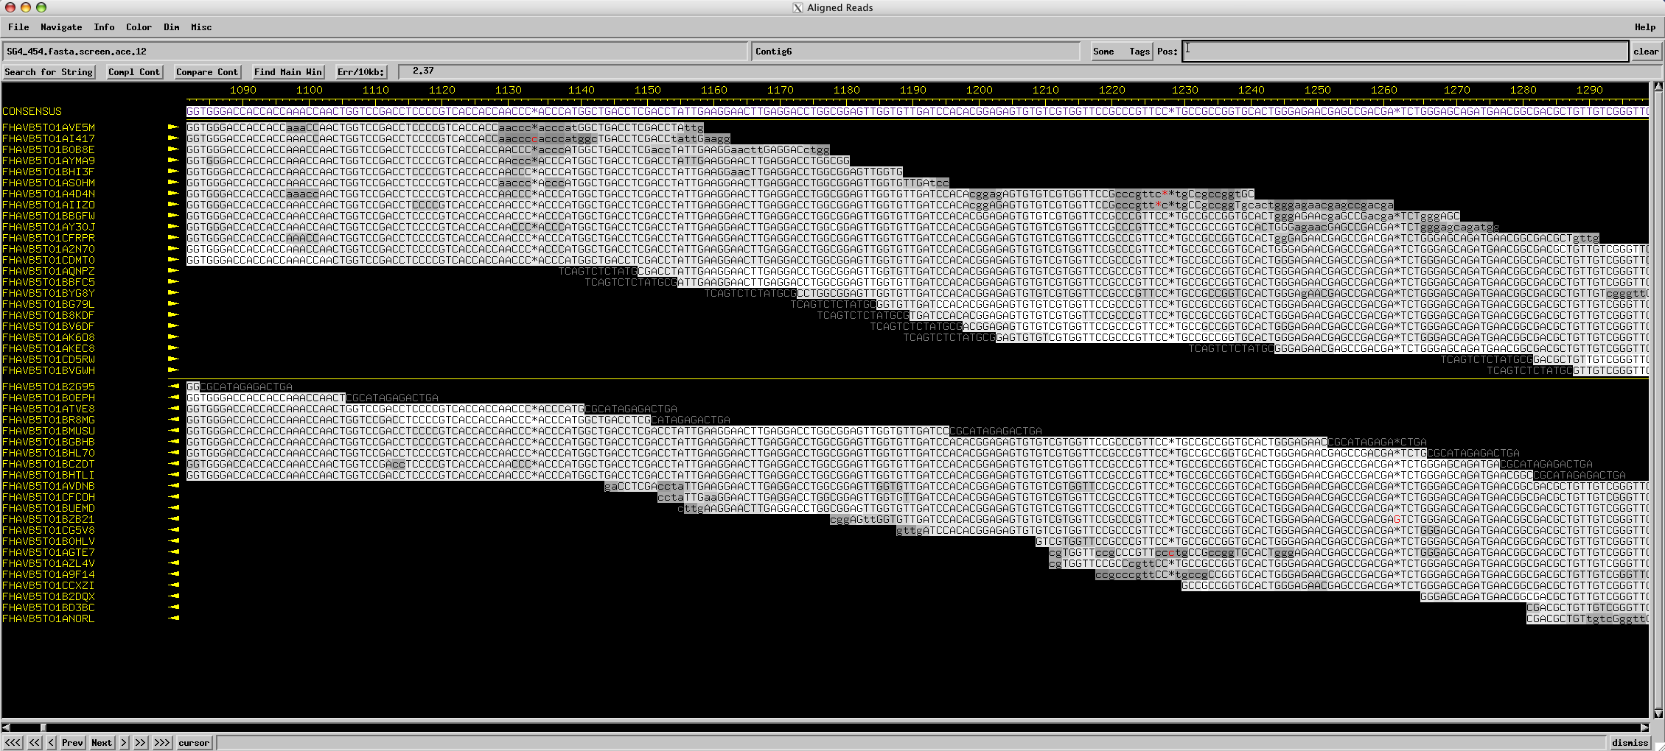
Assembly
Consed

Slide 73
Assembly
Using programs to find overlapping alignments in sequencing reads and build contigs.
The quality of an assembly depends on:
Number of reads
Length of reads
Genome complexity
Quality of reads
Assembly Program
Sequencing technology

Slide 74
Overview
The Winter Break Black Box
Sanger: Sequencing Begins
Next Gen: The Dark Light
Third Gen: The Read Length Rises
Assembly & Finishing
A Nano Note

Slide 75
Special use of the word “finish”
“On June 26, 2000, the International Human Genome Sequencing Consortium announced the production of a rough draft of the human genome sequence. In April, 2003, the International Human Genome Sequencing Consortium is announcing an essentially finished version of the human genome sequence.” —genome.gov
Finishing.
June 2000 → April 2003?

Slide 76
Special use of the word “finish”
“The difference between the draft and finished versions is defined by coverage, the number of gaps and the error rate. The draft [had] an error rate of 1 in 1,000 base pairs, [and] more than 150,000 gaps and only 28 percent of the genome had reached the finished standard. In the April 2003 version, there are less than 400 gaps and 99 percent of the genome is finished with an accuracy rate of less than 1 in 10,000 base pairs.”
1 in 1000 error rate times 3 billion bases equals 3 million errors!
Our goal for phages: 0 gaps, 0 errors

Slide 77
Areas Requiring Finishing Work
Multiple contigs (could indicate missing portions of the genome)
Low consensus quality
Discrepant positions
Low coverage
Genome ends
Multiple phages per sample
Draft Assembly → Final Sequence

Slide 78
Assembly
Consensus:
TAATGCGACCTCGATGCCGGCGAAGCATTGTTCCCACAGACCGTGTTTTCCGACCGAAATGGCTCC
ATTGTTCCCACAGACCG
CGGCGAAGCATTGTTCC
ACCGTGTTTTCCGACCG
AGCTCGATGCCGGCGAAG
TTGTTCCCACAGACCGTG
TTTCCGACCGAAATGGC
ATGCCGGCGAAGCATTGT
ACAGACCGTGTTTCCCGA
TAATGCGACCTCGATGCC
AAGCATTGTTCCCACAG
TGTTTTCCGACCGAAAT
TGCCGGCGAAGCCTTGT
CCGACCGAAATGGCTCC
Coverage: # of reads underlying the consensus
Coverage: # of reads underlying the consensus
Average coverage: Total bases / consensus length
13 reads * 17 bases per read = 221 bases
221 bases / 66 base consensus = 3.35-fold coverage

Slide 79
Assembly
Consensus:
TAATGCGACCTCGATGCCGGCGAAGCATTGTTCCCACAGACCGTGTTTTCCGACCGAAATGGCTCC
ATTGTTCCCACAGACCG
CGGCGAAGCATTGTTCC
ACCGTGTTTTCCGACCG
AGCTCGATGCCGGCGAAG
TTGTTCCCACAGACCGTG
TTTCCGACCGAAATGGC
ATGCCGGCGAAGCATTGT
ACAGACCGTGTTTCCCGA
TAATGCGACCTCGATGCC
AAGCATTGTTCCCACAG
TGTTTTCCGACCGAAAT
TGCCGGCGAAGCCTTGT
CCGACCGAAATGGCTCC
6x coverage
100% identity
Coverage: # of reads underlying the consensus

Slide 80
Assembly
Consensus:
TAATGCGACCTCGATGCCGGCGAAGCATTGTTCCCACAGACCGTGTTTTCCGACCGAAATGGCTCC
ATTGTTCCCACAGACCG
CGGCGAAGCATTGTTCC
ACCGTGTTTTCCGACCG
AGCTCGATGCCGGCGAAG
TTGTTCCCACAGACCGTG
TTTCCGACCGAAATGGC
ATGCCGGCGAAGCATTGT
ACAGACCGTGTTTCCCGA
TAATGCGACCTCGATGCC
AAGCATTGTTCCCACAG
TGTTTTCCGACCGAAAT
TGCCGGCGAAGCCTTGT
CCGACCGAAATGGCTCC
5x coverage
80% identity
Coverage: # of reads underlying the consensus

Slide 81
Assembly
Consensus:
TAATGCGACCTCGATGCCGGCGAAGCATTGTTCCCACAGACCGTGTTTTCCGACCGAAATGGCTCC
ATTGTTCCCACAGACCG
CGGCGAAGCATTGTTCC
ACCGTGTTTTCCGACCG
AGCTCGATGCCGGCGAAG
TTGTTCCCACAGACCGTG
TTTCCGACCGAAATGGC
ATGCCGGCGAAGCATTGT
ACAGACCGTGTTTCCCGA
TAATGCGACCTCGATGCC
AAGCATTGTTCCCACAG
TGTTTTCCGACCGAAAT
TGCCGGCGAAGCCTTGT
CCGACCGAAATGGCTCC
2x coverage
50% identity
Coverage: # of reads underlying the consensus

Slide 82
Assembly
Consensus:
TAATGCGACCTCGATGCCGGCGAAGCATTGTTCCCACAGACCGTGTTTTCCGACCGAAATGGCTCC
ATTGTTCCCACAGACCG
CGGCGAAGCATTGTTCC
ACCGTGTTTTCCGACCG
AGCTCGATGCCGGCGAAG
TTGTTCCCACAGACCGTG
TTTCCGACCGAAATGGC
ATGCCGGCGAAGCATTGT
ACAGACCGTGTTTCCCGA
TAATGCGACCTCGATGCC
AAGCATTGTTCCCACAG
TGTTTTCCGACCGAAAT
TGCCGGCGAAGCCTTGT
CCGACCGAAATGGCTCC
1x coverage
Coverage: # of reads underlying the consensus

Slide 83
Finishing
Draft Assembly → Final Sequence
Using a combination of programs and occasional wet-bench experiments to close gaps, resolve weak areas, and ensure a high-quality extremely-low-error final genome sequence that is properly cut, oriented, and ready to annotate.

Slide 84
Why we finish
Confidence during annotation
Quality sequence in GenBank
Relatively easy for phages
If Not…

Slide 85
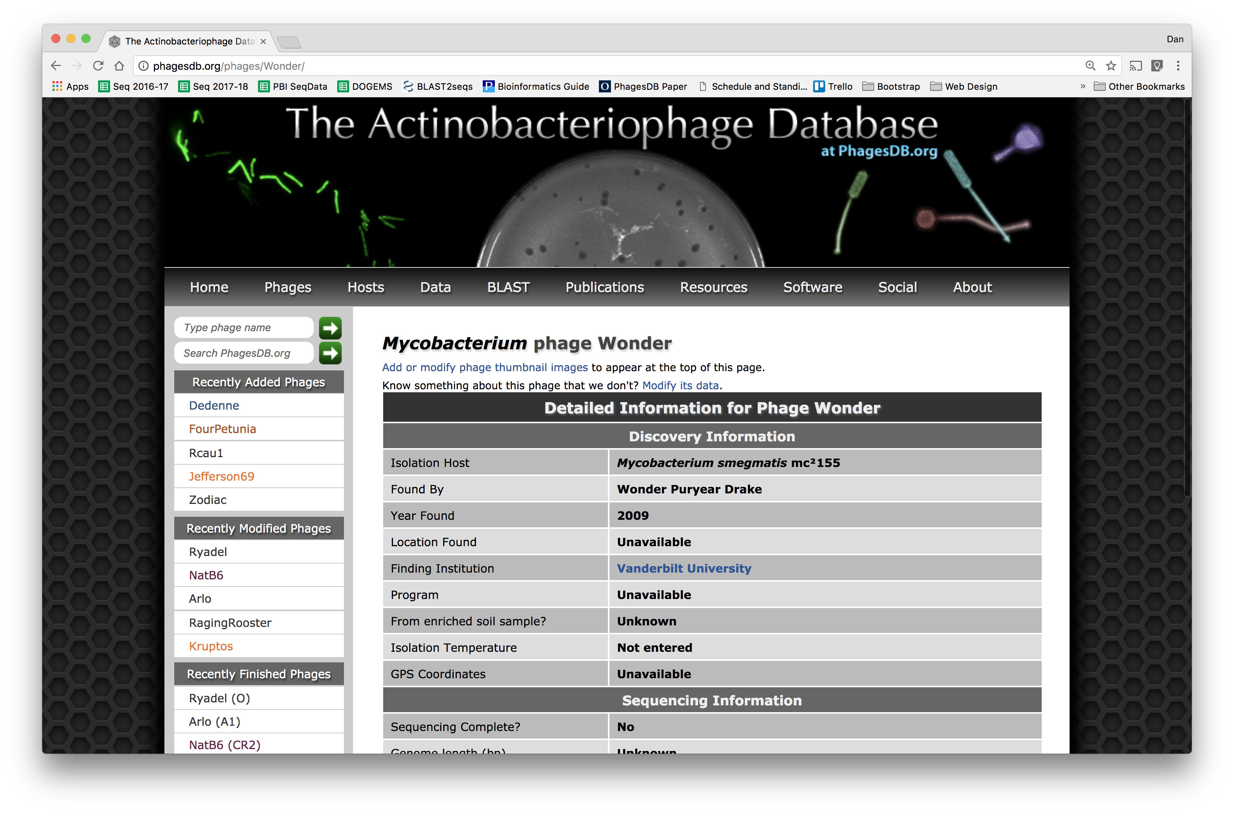

Slide 86
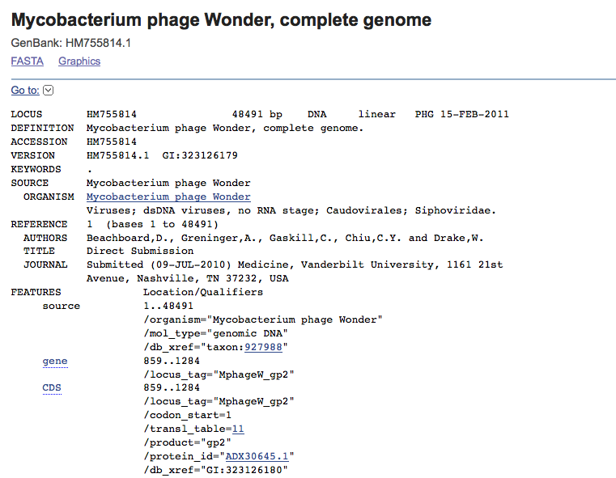
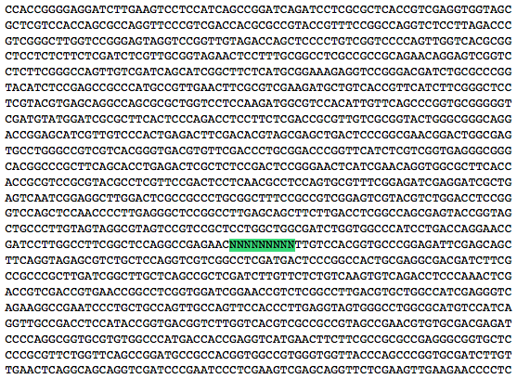
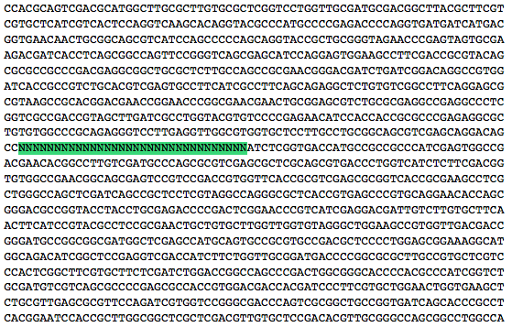

Slide 87
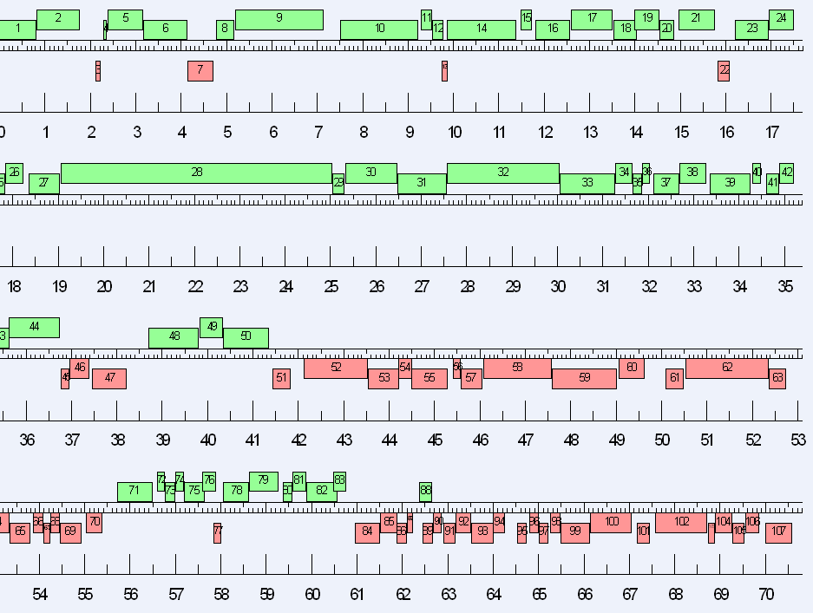
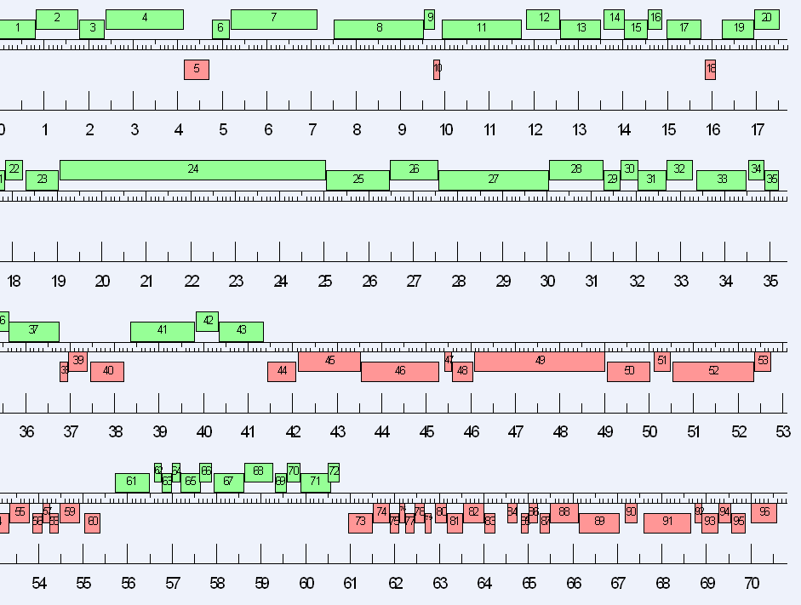

Slide 89
DNA QC (Qubit)
* The method may matter,
feel free to ask
Library Prep*
Sequencing
** We at Pitt are always
happy to help with this
Assembly**
*** Must be done or
checked by Pitt to
get into Phamerator
Finishing***

Slide 90
Overview
The Winter Break Black Box
Sanger: Sequencing Begins
Next Gen: The Dark Light
Third Gen: The Read Length Rises
Assembly & Finishing
A Nano Note

Slide 91
Phage Genome
Sequencing
 | Sanger | Ion Torrent | Illumina | PacBio | Oxford Nanopore
Cost per base | ⭐️ | ⭐️⭐️⭐️ | ⭐️⭐️⭐️⭐️⭐️ | ⭐️⭐️ | ⭐️⭐️
Read Quality | ⭐️⭐️⭐️⭐️⭐️ | ⭐️⭐️⭐️⭐️ | ⭐️⭐️⭐️⭐️⭐️ | ⭐️⭐️⭐️ | ⭐️⭐️
Read Length | ⭐️⭐️⭐️ | ⭐️⭐️ | ⭐️⭐️ | ⭐️⭐️⭐️⭐️⭐️ | ⭐️⭐️⭐️⭐️⭐️
Consensus Quality | ⭐️⭐️⭐️⭐️⭐️ | ⭐️⭐️⭐️⭐️ | ⭐️⭐️⭐️⭐️⭐️ | ⭐️⭐️⭐️⭐️⭐️ | ⭐️⭐️⭐️⭐️
Machine Affordability | ⭐️ | ⭐️⭐️⭐️ | ⭐️⭐️⭐️ | ⭐️ | ⭐️⭐️⭐️⭐️⭐️
Throughput | ⭐️ | ⭐️⭐️⭐️ | ⭐️⭐️⭐️⭐️⭐️ | ⭐️⭐️⭐️ | ⭐️⭐️⭐️
Modification Detection |  |  |  | ⭐️⭐️⭐️⭐️⭐️ | ⭐️⭐️⭐️⭐️

Slide 92
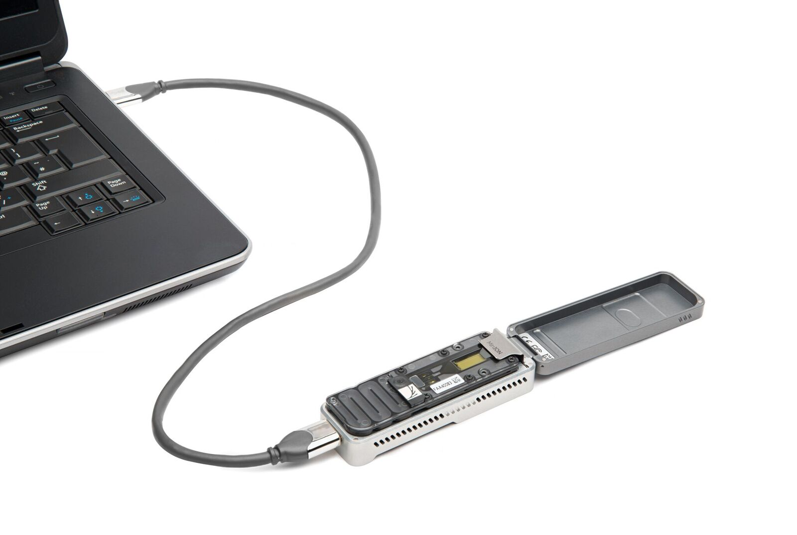

Slide 93
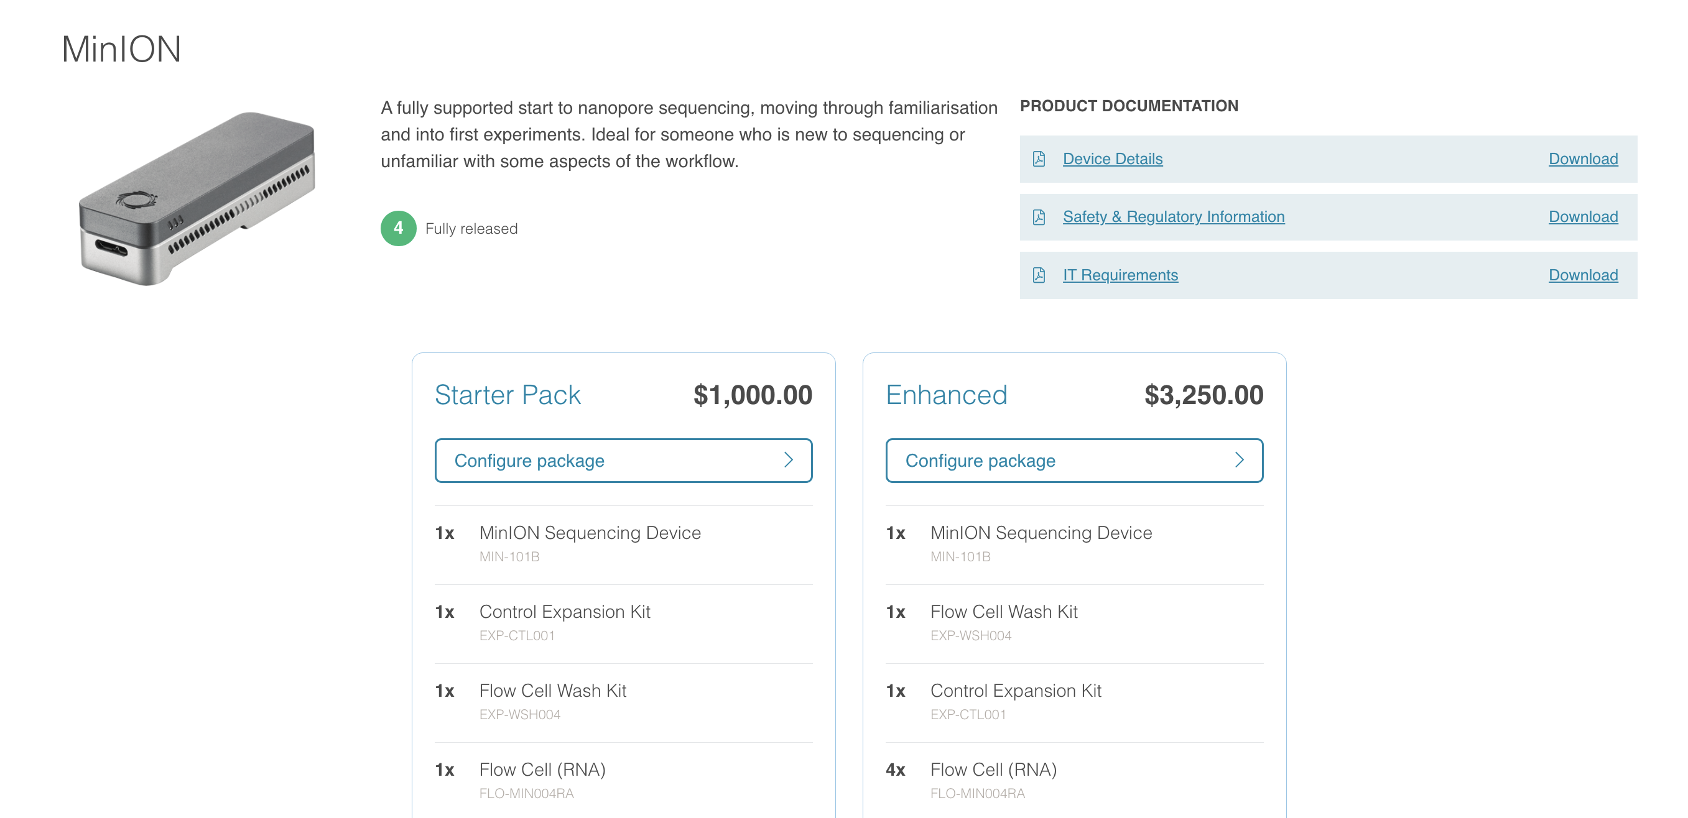

Slide 94
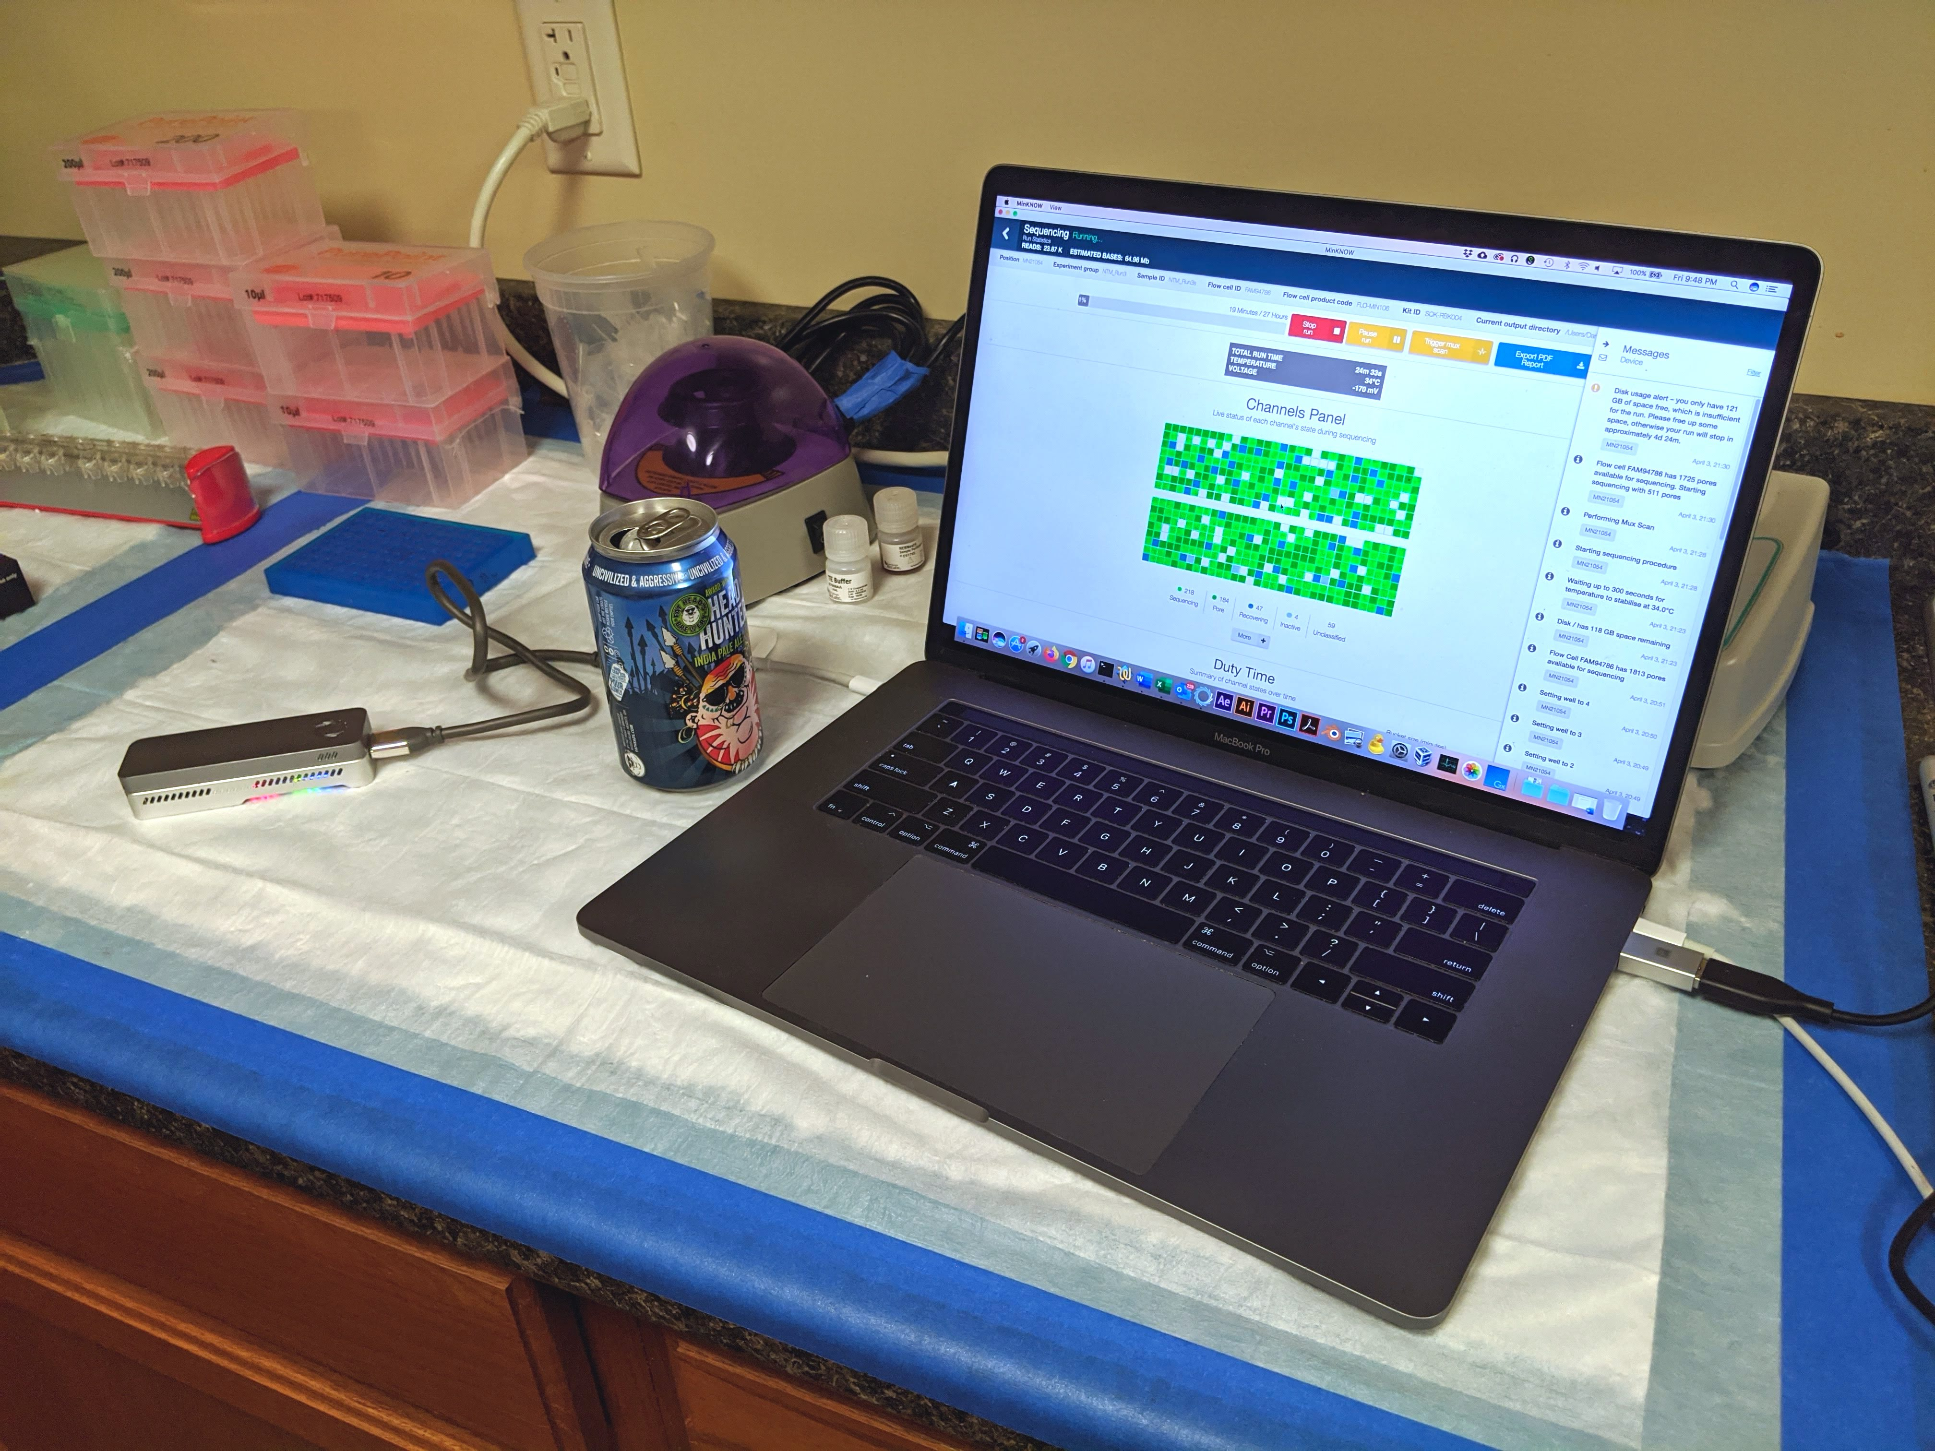
Oxford Nanopore Sequencing

Slide 96
Nanopore and Phage Notes
Ligation-based library preps may be necessary for phages (rather than transposase-based)
Can’t use R9 series flow cells alone to get finished phages
Possibly R10 series flow cells could, but need more data
Could be used in other ways however, e.g. to “cluster” all phages in a class

Slide 97
“The MinION has been used to successfully read … 100,000 base pairs during a single DNA capture, [which] has never been managed before using traditional sequencing techniques.
… but Oxford Nanopore has also introduced GridION [and] the company reckon that a 20-node GridION setup can sequence a complete human genome in just 15 minutes.”
—Wired

Slide 98
(Relevant) Trivia
How many base pairs (bp) are there in a human genome?
How much did it cost to sequence the first human genome?
How long did it take to sequence the first human genome?
When was the first human genome sequence complete?
~3 billion (haploid)
~$2.7 billion
~13 years
2000-2003

Slide 100
Take home
There are many powerful sequencing options out there, understanding a bit about them may help
Finishing is a prerequisite for annotation
Bioinformatics/analysis skills are important and marketable!
Notes:
Don’t understand why Jude Law’s genes are all better than ours, just the way it is!

Slide 101
Thanks!
Questions?

Slide 102
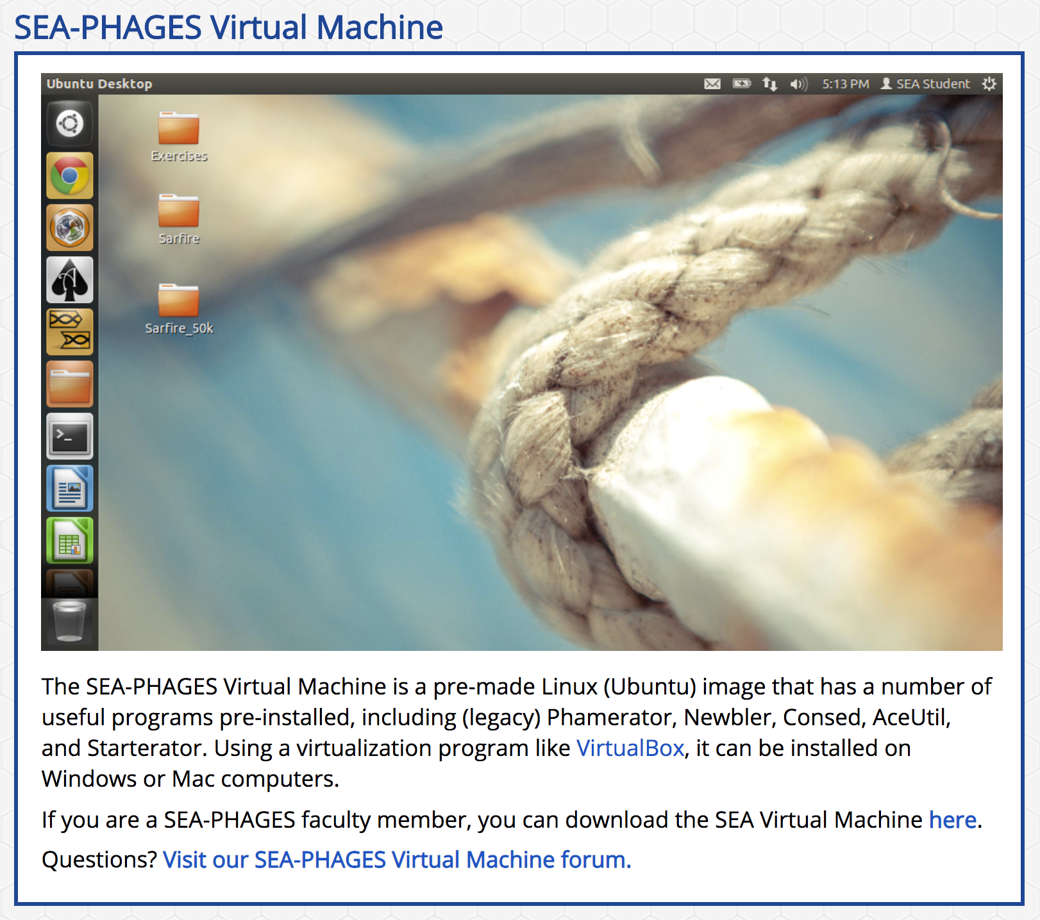

Slide 103
From 1998 Genome Project Report
“DNA sequencing technology has improved dramatically since the genome project began. The amount of sequence produced each year is increasing steadily; individual centers are now producing tens of millions of base pairs of sequence annually…”

Slide 104
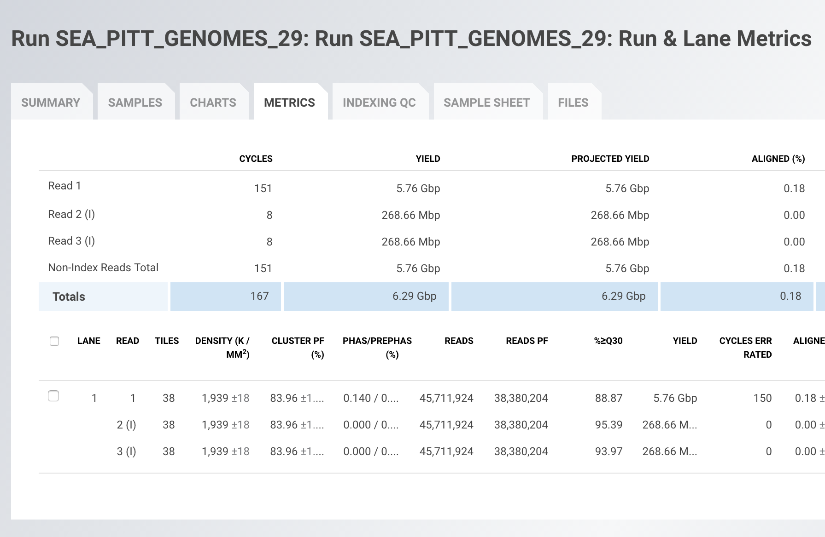
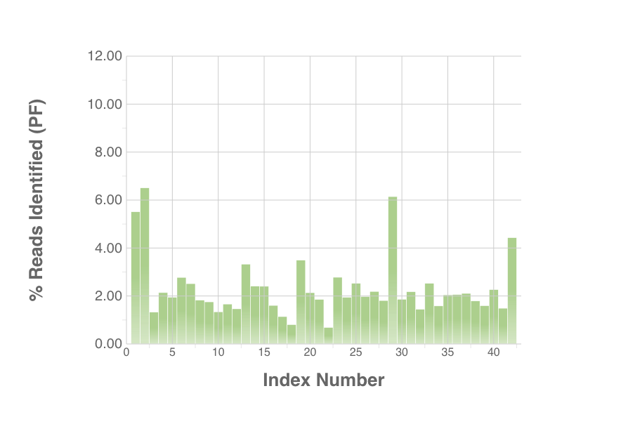
“Individual Dans are now producing billions of base pairs of sequence twice a week…”

Slide 105
From 1998 Genome Project Report
“DNA sequencing technology has improved dramatically since the genome project began. The amount of sequence produced each year is increasing steadily; individual centers are now producing tens of millions of base pairs of sequence annually…”

Slide 106
Sanger finishing reads

Slide 107
NC State Sequencing
https://research.ncsu.edu/gsl/pricing/

Slide 108
NextSeq Arrival

Slide 109
“Individual Dans are now producing billions of base pairs of sequence twice a week…”

