Slide 1
Inside the Black Box: Phage Genome Sequencing, Assembly, and Finishing
AKA: What will my phage do over winter break?
Dan Russell

Slide 2
So I don’t forget…
“This will not be on the test”
These slides will be posted, please steal them
Please post questions in the chat or unmute and ask

Slide 3
(Relevant) Trivia
How many base pairs (bp) are there in a human genome?
How much did it cost to sequence the first human genome?
How long did it take to sequence the first human genome?
When was the first human genome sequence complete?

Slide 4
(Relevant) Trivia
How many base pairs (bp) are there in a human genome?
How much did it cost to sequence the first human genome?
How long did it take to sequence the first human genome?
When was the first human genome sequence complete?
~3 billion (haploid)
~$2.7 billion
~13 years
2000-2003

Slide 5
Overview
The Winter Break Black Box
Sequencing
Assembly
Finishing
What’s new?

Slide 6
Overview
The Winter Break Black Box
Sequencing
Assembly
Finishing
What’s new?

Slide 7
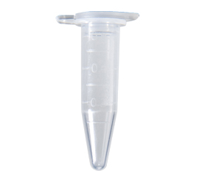
Jefe DNA
Fall semester lab work
Spring semester annotation
Jefe.fasta

Slide 8
Jefe DNA
Fall semester lab work
What happens in here?
Spring semester annotation
Jefe.fasta

Slide 9
Overview
The Winter Break Black Box
Sequencing*
Assembly
Finishing
What’s new?

Slide 10
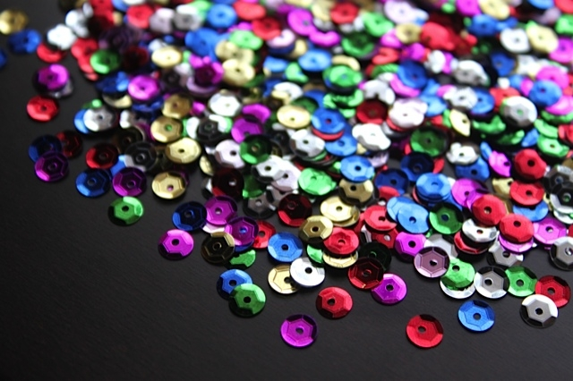
SEQUINS

Slide 11
Overview
The Winter Break Black Box
Sequencing*
Assembly
Finishing
What’s new?
* Determining the number, order, and arrangement of As, Cs, Gs, and Ts that comprise a piece of DNA

Slide 12
Shotgun Genome Sequencing
Complete genome copies
Fragmented genome chunks

Slide 13
Shotgun Genome Sequencing
Fragmented genome chunks
NOT REALLY DONE BY DUCK HUNTERS
Hydroshearing, sonication, enzymatic shearing
Notes:
Fragment sizes differ for different seq platforms.

Slide 14
Fragments were cloned:

Slide 15
Notes:
One tube per 2 sequences with Sanger and cloning. Not so bad if you only want 100 sequences. What if you want 1 million?

Slide 16
x millions
Notes:
One tube per 2 sequences with Sanger and cloning. Not so bad if you only want 100 sequences. What if you want 1 million?

Slide 17
x millions
Notes:
One tube per 2 sequences with Sanger and cloning. Not so bad if you only want 100 sequences. What if you want 1 million?

Slide 18
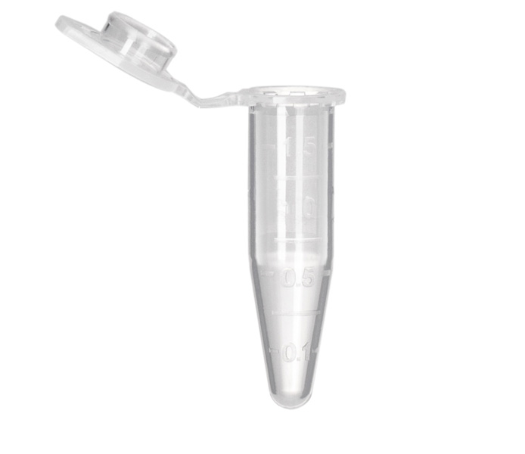
Sanger Sequencing Reactions
Template DNA
Known Primer (~20bp)
DNA Polymerase
Dideoxy Nucleotides
G
A
T
C
Regular Nucleotides
T
C
G
A
C
G
A
T
G
G
A
T
G
T
C
G
A
A
T
A
C
T
G
G
A
T
A
T
G
Labeled
Terminators
T
A
C
C
G
A
C
C
A
T
A
C
G

Slide 19
Sanger Sequencing
Primer
5’
T G C G C G G C C C A
A C G C G C C G G G T ? ? ? ? ? ? ? ? ? ? ? ? ? ? ?
3’
5’

Slide 20
Sanger Sequencing
Primer
5’
G T C T T G G G C T
T G C G C G G C C C A
A C G C G C C G G G T C A G A A C C C G A T C G C G
3’
5’

Slide 21
Sanger Sequencing
Primer
5’
G T C T T G G G C T A G C G C
T G C G C G G C C C A
A C G C G C C G G G T C A G A A C C C G A T C G C G
3’
5’
5’
21 bp
G T C T T G G G C T
T G C G C G G C C C A

Slide 22
Sanger Sequencing
Primer
5’
G T C T T G G G C T A
T G C G C G G C C C A
A C G C G C C G G G T C A G A A C C C G A T C G C G
3’
5’
5’
21 bp
G T C T T G G G C T
T G C G C G G C C C A
5’
26 bp
G T C T T G G G C T A G C G C
T G C G C G G C C C A

Slide 23
Sanger Sequencing
Primer
5’
G
T G C G C G G C C C A
A C G C G C C G G G T C A G A A C C C G A T C G C G
3’
5’
5’
21 bp
G T C T T G G G C T
T G C G C G G C C C A
5’
26 bp
G T C T T G G G C T A G C G C
T G C G C G G C C C A
5’
22 bp
G T C T T G G G C T A
T G C G C G G C C C A

Slide 24
Sanger Sequencing
Primer
5’
G T C T T G G G C
T G C G C G G C C C A
A C G C G C C G G G T C A G A A C C C G A T C G C G
3’
5’
5’
21 bp
G T C T T G G G C T
T G C G C G G C C C A
5’
26 bp
G T C T T G G G C T A G C G C
T G C G C G G C C C A
5’
22 bp
G T C T T G G G C T A
T G C G C G G C C C A
5’
12 bp
G
T G C G C G G C C C A

Slide 25
Sanger Sequencing
Primer
5’
G T C T T
T G C G C G G C C C A
A C G C G C C G G G T C A G A A C C C G A T C G C G
3’
5’
5’
21 bp
G T C T T G G G C T
T G C G C G G C C C A
5’
26 bp
G T C T T G G G C T A G C G C
T G C G C G G C C C A
5’
22 bp
G T C T T G G G C T A
T G C G C G G C C C A
5’
12 bp
G
T G C G C G G C C C A
5’
20 bp
G T C T T G G G C
T G C G C G G C C C A

Slide 26
Sanger Sequencing
A C G C G C C G G G T C A G A A C C C G A T C G C G
3’
5’
5’
21 bp
G T C T T G G G C T
T G C G C G G C C C A
5’
26 bp
G T C T T G G G C T A G C G C
T G C G C G G C C C A
5’
22 bp
G T C T T G G G C T A
T G C G C G G C C C A
5’
12 bp
G
T G C G C G G C C C A
5’
20 bp
G T C T T G G G C
T G C G C G G C C C A
5’
16 bp
G T C T T
T G C G C G G C C C A

Slide 27
Sanger Sequencing
A C G C G C C G G G T ? ? ? ? ? ? ? ? ? ? ? ? ? ? ?
3’
5’
5’
21 bp
? ? ? ? ? ? ? ? ? T
T G C G C G G C C C A
5’
26 bp
? ? ? ? ? ? ? ? ? ? ? ? ? ? C
T G C G C G G C C C A
5’
22 bp
? ? ? ? ? ? ? ? ? ? A
T G C G C G G C C C A
5’
12 bp
G
T G C G C G G C C C A
5’
20 bp
? ? ? ? ? ? ? ? C
T G C G C G G C C C A
5’
16 bp
? ? ? ? T
T G C G C G G C C C A
Notes:
Has to be done in a single tube per rxn.

Slide 28
Sanger Sequencing
Laser Reader
5’
5’
5’
5’
5’
5’
5’
5’
5’
5’
5’
20 bp
21 bp
19 bp
18 bp
13 bp
22 bp
15 bp
16 bp
14 bp
17 bp
G T C T T G G G C
12 bp
T G C G C G G C C C A
G T C T T G G G C T
T G C G C G G C C C A
G T C T T G G G
T G C G C G G C C C A
G T C T T G G
G T C T T G G G C T A
G T C T
T G C G C G G C C C A
T G C G C G G C C C A
G T
G T C T T
G T C T T G
G
T G C G C G G C C C A
T G C G C G G C C C A
T G C G C G G C C C A
T G C G C G G C C C A
T G C G C G G C C C A
T G C G C G G C C C A
G T C

Slide 29
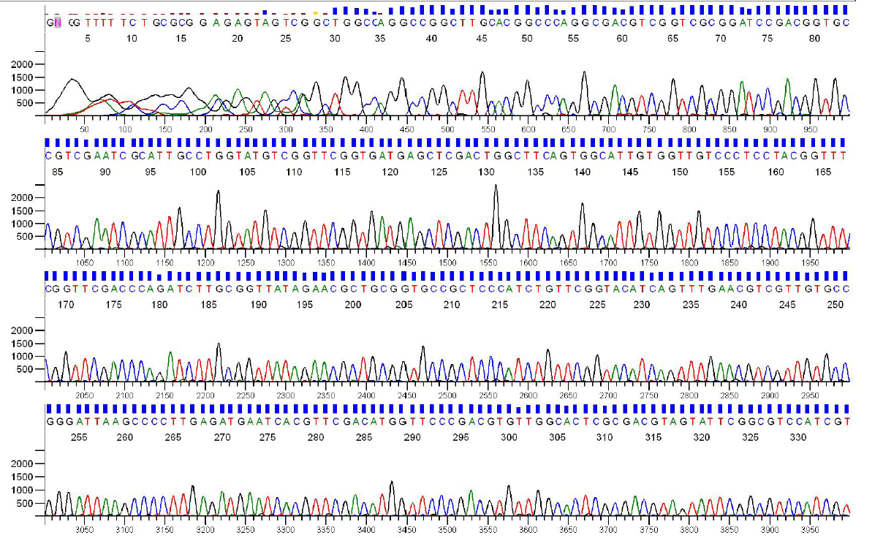
Sanger Sequencing Output
Each sequencing reaction gives us a chromatogram, usually ~600-1000 bp:

Slide 30
Sanger Throughput Limitations
Must have 1 colony picked for every 2 reactions
Must do 1 DNA prep for every 2 reactions
Must have 1 PCR tube for each reaction
Must have 1 gel lane for each reaction
Must have undergrad/entry-level labor!

Slide 31
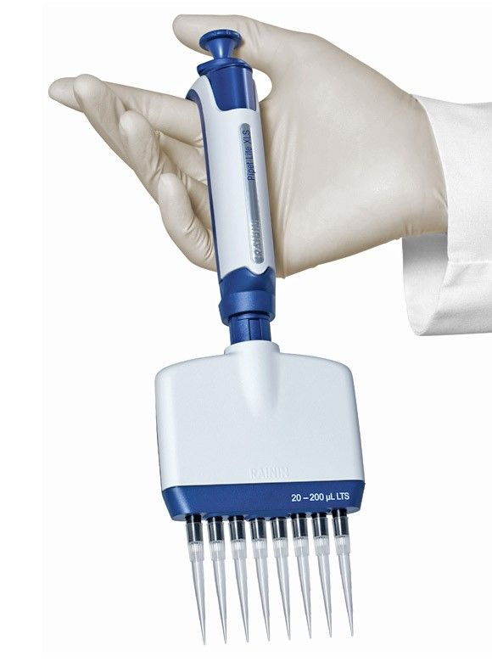
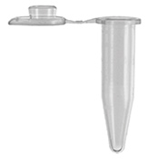
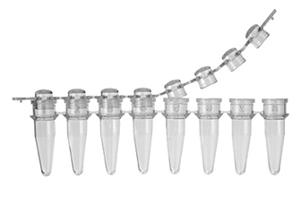

Slide 32
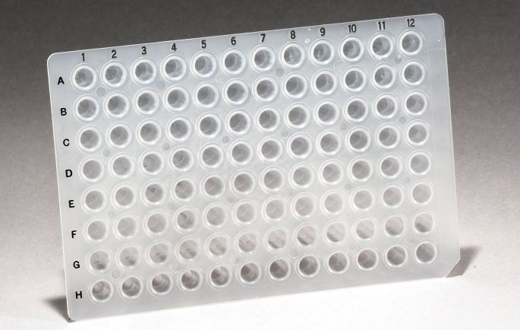
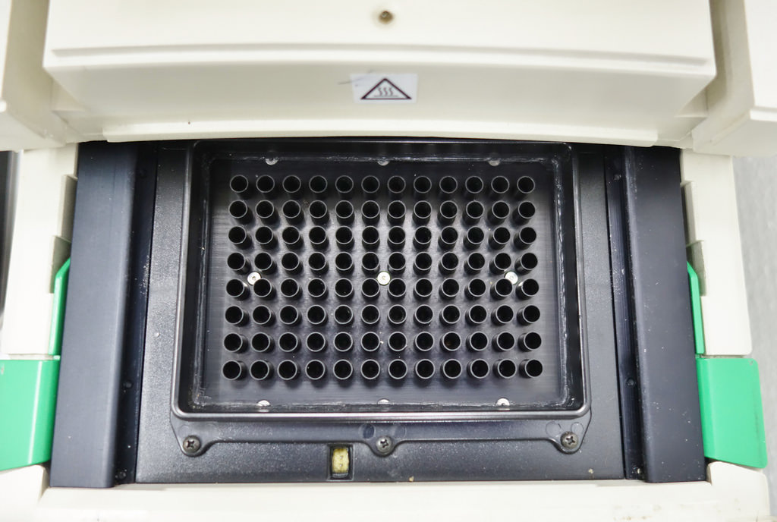
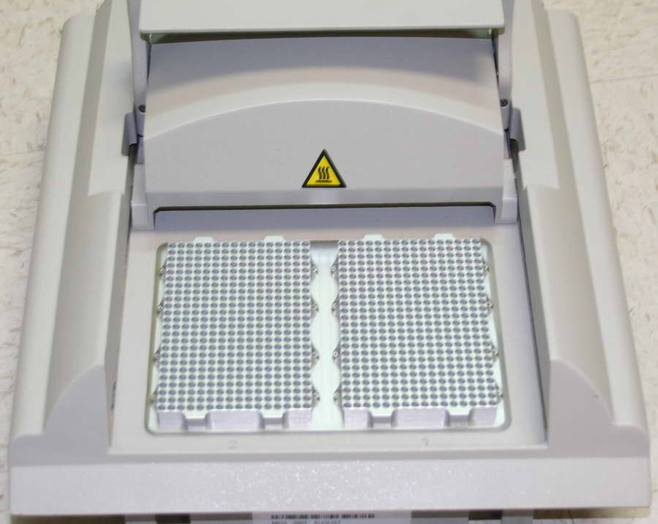
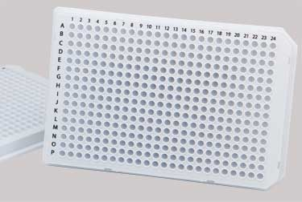

Slide 33
Colony Picking Robot

Slide 34
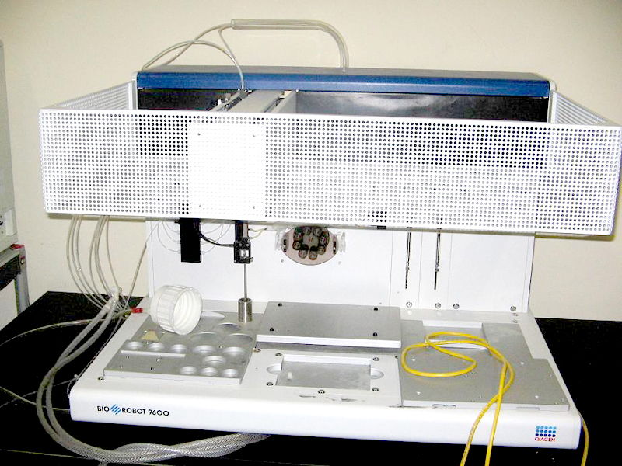
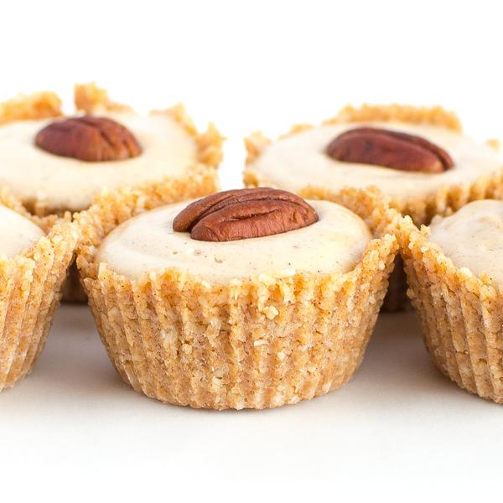

Slide 35
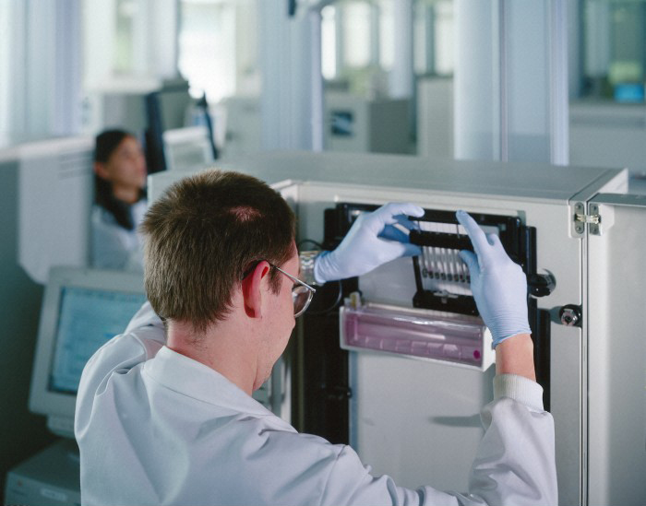

Slide 36
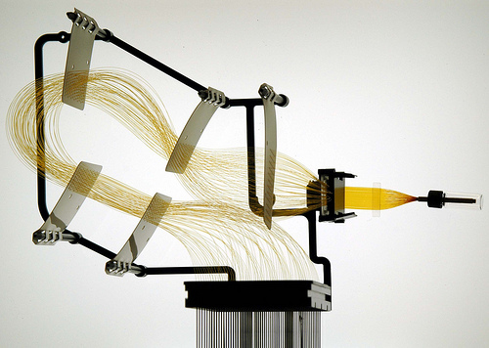
Capillary Arrays

Slide 37
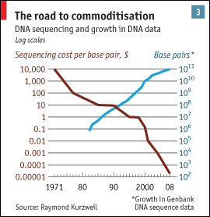
Sanger Throughput Limitations
Must have 1 colony picked for every 2 reactions
Must do 1 DNA prep for every 2 reactions
Must have 1 PCR tube for each reaction
Must have 1 gel lane for each reaction
from The Economist

Slide 38
Problem: How can we do way more reactions at once without having more tubes, thermocyclers, etc.?

Slide 39
Next generation sequencing

Slide 40
Shotgun sequencing by PGM/454
Genomic
Fragment
Adapters

Slide 41
Next generation sequencing

Slide 42
Shotgun sequencing by PGM/454
Bead/ISP
Adapter
Complement
Sequences
Each bead should be amplified
all over with a SINGLE library fragment.

Slide 43
Shotgun sequencing by PGM/454
Problem: How do I do PCR to amplify the fragments without having to use 1 tube for each reaction?

Slide 44
Shotgun sequencing by PGM/454

Slide 45
Shotgun sequencing by PGM/454

Slide 46
Shotgun sequencing by PGM/454

Slide 47
Shotgun sequencing by PGM/454
~3.5 µm for Ion Torrent, ~30 µm for 454

Slide 48
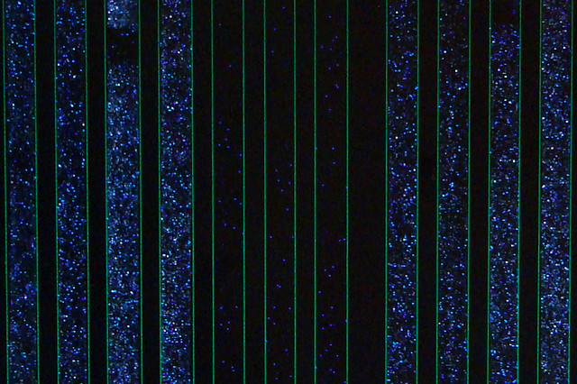
Raw 454 data
Only give polymerase one nucleotide at a time:
G
G
G
Primer
G
G
5’
G
T
T G C G C G G C C C A
C
T T
G G G
A C G C G C C G G G T C A G A A C C C G A T C G C G
3’
5’
If that nucleotide is incorporated, enzymes turn by-products into light:
1 2 3 4 5
The real power of this method is that it can take place in millions of tiny wells in a single plate at once.
T C A G T C A G T C A G

Slide 49
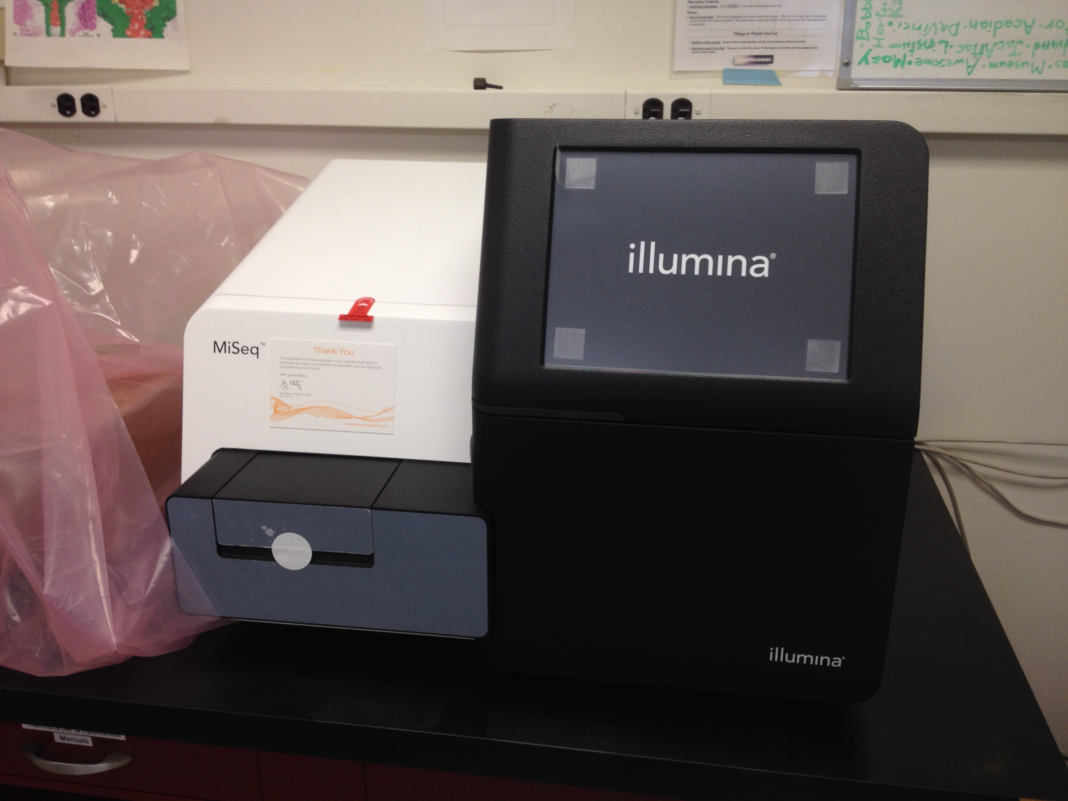
Illumina Sequencing

Slide 50
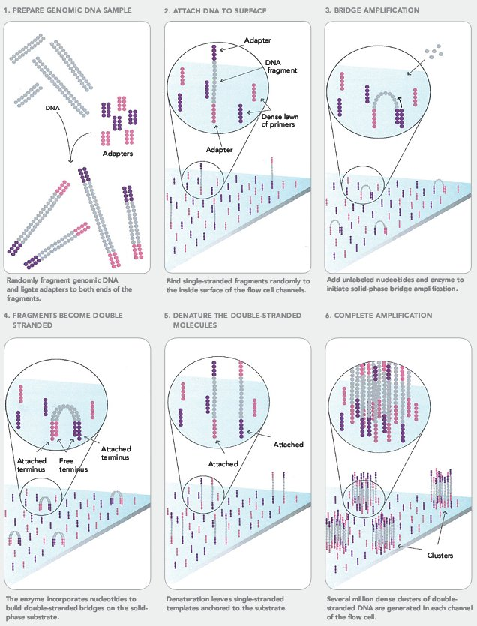
Illumina Sequencing

Slide 51
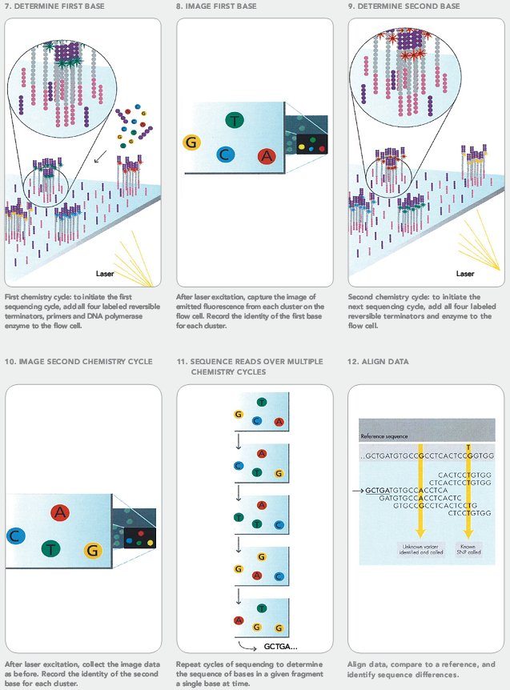
Illumina Sequencing

Slide 52
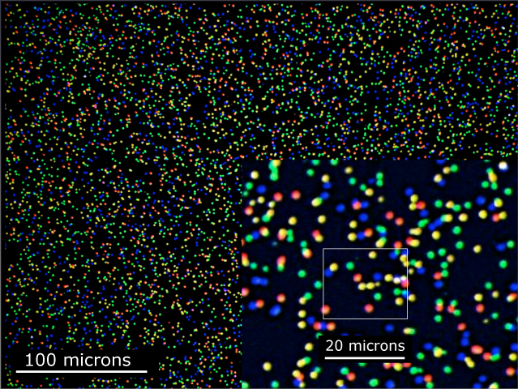
Illumina Sequencing

Slide 53
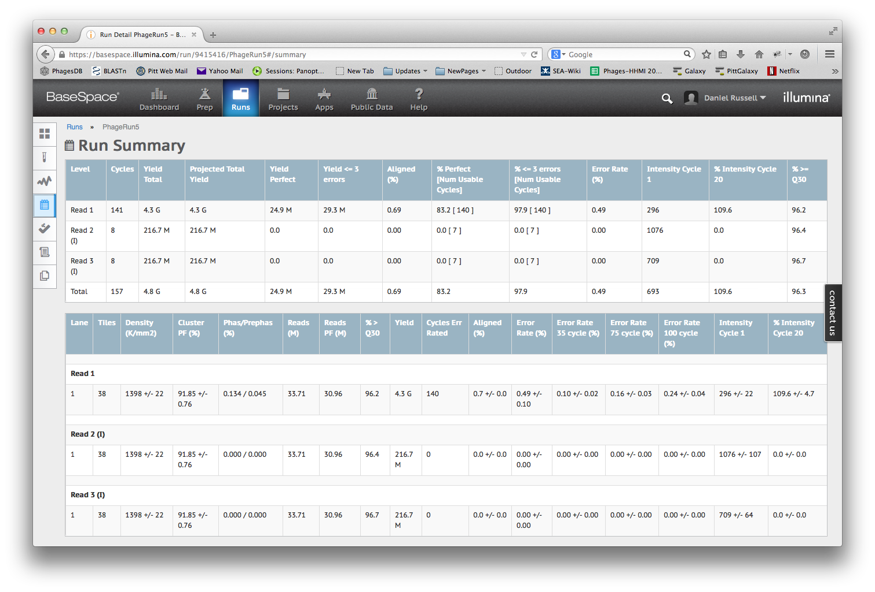

Slide 54
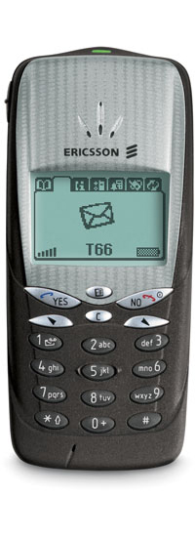
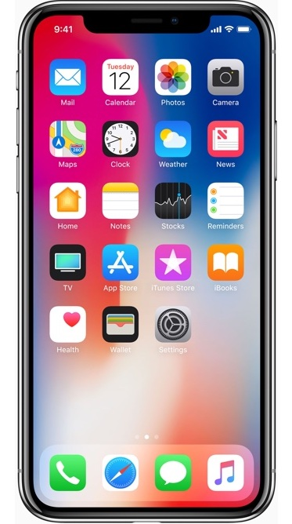

Slide 55
Next-Gen Sequencing
Take home message: Massively Parallel
Millions (or billions) of concurrent reads, but without separate tubes

Slide 56
Overview
The Winter Break Black Box
Sequencing
Assembly
Finishing
What’s new?

Slide 57
Method | Read Length
Sanger | 600-1000 bp
454 | 400-800 bp
Illumina | 75-300 bp
Ion Torrent | ~200 bp
PacBio/Nanopore | ~10,000 bp
But…
Phage Genome: ~5,000 to ~500,000 bp
Bacteria: Several million bp
Human: 3 billion bp

Slide 58
Assembly
17 bp
ATTGTTCCCACAGACCG
CGGCGAAGCATTGTTCC
ACCGTGTTTTCCGACCG
AGCTCGATGCCGGCGAAG
TTGTTCCCACAGACCGTG
TTTCCGACCGAAATGGC
ATGCCGGCGAAGCATTGT
ACAGACCGTGTTTCCCGA
TAATGCGACCTCGATGCC
AAGCATTGTTCCCACAG
TGTTTTCCGACCGAAAT
TGCCGGCGAAGCCTTGT
CCGACCGAAATGGCTCC
66 bp

Slide 59
Assembly
Consensus:
TAATGCGACCTCGATGCCGGCGAAGCATTGTTCCCACAGACCGTGTTTTCCGACCGAAATGGCTCC
ATTGTTCCCACAGACCG
CGGCGAAGCATTGTTCC
ACCGTGTTTTCCGACCG
AGCTCGATGCCGGCGAAG
TTGTTCCCACAGACCGTG
TTTCCGACCGAAATGGC
ATGCCGGCGAAGCATTGT
ACAGACCGTGTTTCCCGA
TAATGCGACCTCGATGCC
AAGCATTGTTCCCACAG
TGTTTTCCGACCGAAAT
TGCCGGCGAAGCCTTGT
CCGACCGAAATGGCTCC

Slide 60
Assembly
Consensus:
TAATGCGACCTCGATGCCGGCGAAGCATTGTTCCCACAGACCGTGTTTTCCGACCGAAATGGCTCC
ATTGTTCCCACAGACCG
CGGCGAAGCATTGTTCC
ACCGTGTTTTCCGACCG
AGCTCGATGCCGGCGAAG
TTGTTCCCACAGACCGTG
TTTCCGACCGAAATGGC
ATGCCGGCGAAGCATTGT
ACAGACCGTGTTTCCCGA
TAATGCGACCTCGATGCC
AAGCATTGTTCCCACAG
TGTTTTCCGACCGAAAT
TGCCGGCGAAGCCTTGT
CCGACCGAAATGGCTCC
Newbler

Slide 61
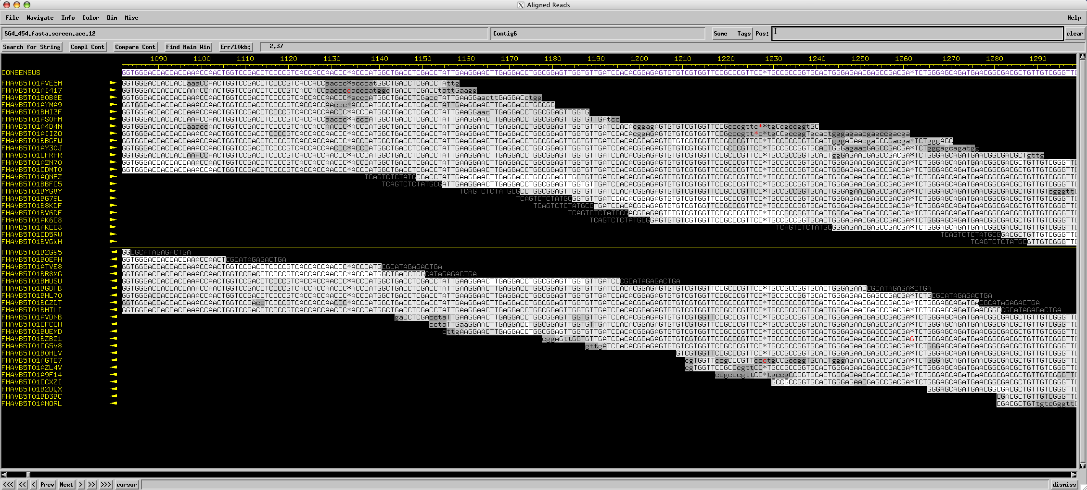
Assembly
Consed

Slide 62
Assembly
Using programs to find overlapping alignments in sequencing reads and build contigs.
The quality of an assembly depends on:
Number of reads
Length of reads
Genome complexity
Quality of reads
Assembly Program
Sequencing technology

Slide 63
Overview
The Winter Break Black Box
Sequencing
Assembly
Finishing
What’s new?

Slide 64
Special use of the word “finish”
“On June 26, 2000, the International Human Genome Sequencing Consortium announced the production of a rough draft of the human genome sequence. In April, 2003, the International Human Genome Sequencing Consortium is announcing an essentially finished version of the human genome sequence.” —genome.gov
Finishing.
June 2000 → April 2003?

Slide 65
Special use of the word “finish”
“The difference between the draft and finished versions is defined by coverage, the number of gaps and the error rate. The draft [had] an error rate of 1 in 1,000 base pairs, [and] more than 150,000 gaps and only 28 percent of the genome had reached the finished standard. In the April 2003 version, there are less than 400 gaps and 99 percent of the genome is finished with an accuracy rate of less than 1 in 10,000 base pairs.”
1 in 1000 error rate times 3 billion bases equals 3 million errors!
Our goal for phages: 0 gaps, 0 errors

Slide 66
Areas Requiring Finishing Work
Multiple contigs (could indicate missing portions of the genome)
Low consensus quality
Discrepant positions
Low coverage
Genome ends
Multiple phages per sample
Draft Assembly → Final Sequence

Slide 67
Assembly
Consensus:
TAATGCGACCTCGATGCCGGCGAAGCATTGTTCCCACAGACCGTGTTTTCCGACCGAAATGGCTCC
ATTGTTCCCACAGACCG
CGGCGAAGCATTGTTCC
ACCGTGTTTTCCGACCG
AGCTCGATGCCGGCGAAG
TTGTTCCCACAGACCGTG
TTTCCGACCGAAATGGC
ATGCCGGCGAAGCATTGT
ACAGACCGTGTTTCCCGA
TAATGCGACCTCGATGCC
AAGCATTGTTCCCACAG
TGTTTTCCGACCGAAAT
TGCCGGCGAAGCCTTGT
CCGACCGAAATGGCTCC
Coverage: # of reads underlying the consensus
Coverage: # of reads underlying the consensus
Average coverage: Total bases / consensus length
13 reads * 17 bases per read = 221 bases
221 bases / 66 base consensus = 3.35-fold coverage

Slide 68
Assembly
Consensus:
TAATGCGACCTCGATGCCGGCGAAGCATTGTTCCCACAGACCGTGTTTTCCGACCGAAATGGCTCC
ATTGTTCCCACAGACCG
CGGCGAAGCATTGTTCC
ACCGTGTTTTCCGACCG
AGCTCGATGCCGGCGAAG
TTGTTCCCACAGACCGTG
TTTCCGACCGAAATGGC
ATGCCGGCGAAGCATTGT
ACAGACCGTGTTTCCCGA
TAATGCGACCTCGATGCC
AAGCATTGTTCCCACAG
TGTTTTCCGACCGAAAT
TGCCGGCGAAGCCTTGT
CCGACCGAAATGGCTCC
6x coverage
100% identity
Coverage: # of reads underlying the consensus

Slide 69
Assembly
Consensus:
TAATGCGACCTCGATGCCGGCGAAGCATTGTTCCCACAGACCGTGTTTTCCGACCGAAATGGCTCC
ATTGTTCCCACAGACCG
CGGCGAAGCATTGTTCC
ACCGTGTTTTCCGACCG
AGCTCGATGCCGGCGAAG
TTGTTCCCACAGACCGTG
TTTCCGACCGAAATGGC
ATGCCGGCGAAGCATTGT
ACAGACCGTGTTTCCCGA
TAATGCGACCTCGATGCC
AAGCATTGTTCCCACAG
TGTTTTCCGACCGAAAT
TGCCGGCGAAGCCTTGT
CCGACCGAAATGGCTCC
5x coverage
80% identity
Coverage: # of reads underlying the consensus

Slide 70
Assembly
Consensus:
TAATGCGACCTCGATGCCGGCGAAGCATTGTTCCCACAGACCGTGTTTTCCGACCGAAATGGCTCC
ATTGTTCCCACAGACCG
CGGCGAAGCATTGTTCC
ACCGTGTTTTCCGACCG
AGCTCGATGCCGGCGAAG
TTGTTCCCACAGACCGTG
TTTCCGACCGAAATGGC
ATGCCGGCGAAGCATTGT
ACAGACCGTGTTTCCCGA
TAATGCGACCTCGATGCC
AAGCATTGTTCCCACAG
TGTTTTCCGACCGAAAT
TGCCGGCGAAGCCTTGT
CCGACCGAAATGGCTCC
2x coverage
50% identity
Coverage: # of reads underlying the consensus

Slide 71
Assembly
Consensus:
TAATGCGACCTCGATGCCGGCGAAGCATTGTTCCCACAGACCGTGTTTTCCGACCGAAATGGCTCC
ATTGTTCCCACAGACCG
CGGCGAAGCATTGTTCC
ACCGTGTTTTCCGACCG
AGCTCGATGCCGGCGAAG
TTGTTCCCACAGACCGTG
TTTCCGACCGAAATGGC
ATGCCGGCGAAGCATTGT
ACAGACCGTGTTTCCCGA
TAATGCGACCTCGATGCC
AAGCATTGTTCCCACAG
TGTTTTCCGACCGAAAT
TGCCGGCGAAGCCTTGT
CCGACCGAAATGGCTCC
1x coverage
Coverage: # of reads underlying the consensus

Slide 72
Sanger finishing reads

Slide 73
Finishing
Draft Assembly → Final Sequence
Using a combination of programs and wet-bench experiments to close gaps, resolve weak areas, and ensure a high-quality extremely-low-error final genome sequence that is properly cut, oriented, and ready to annotate.

Slide 74
Why we finish
Confidence during annotation
Quality sequence in GenBank
Relatively easy
If Not…

Slide 75
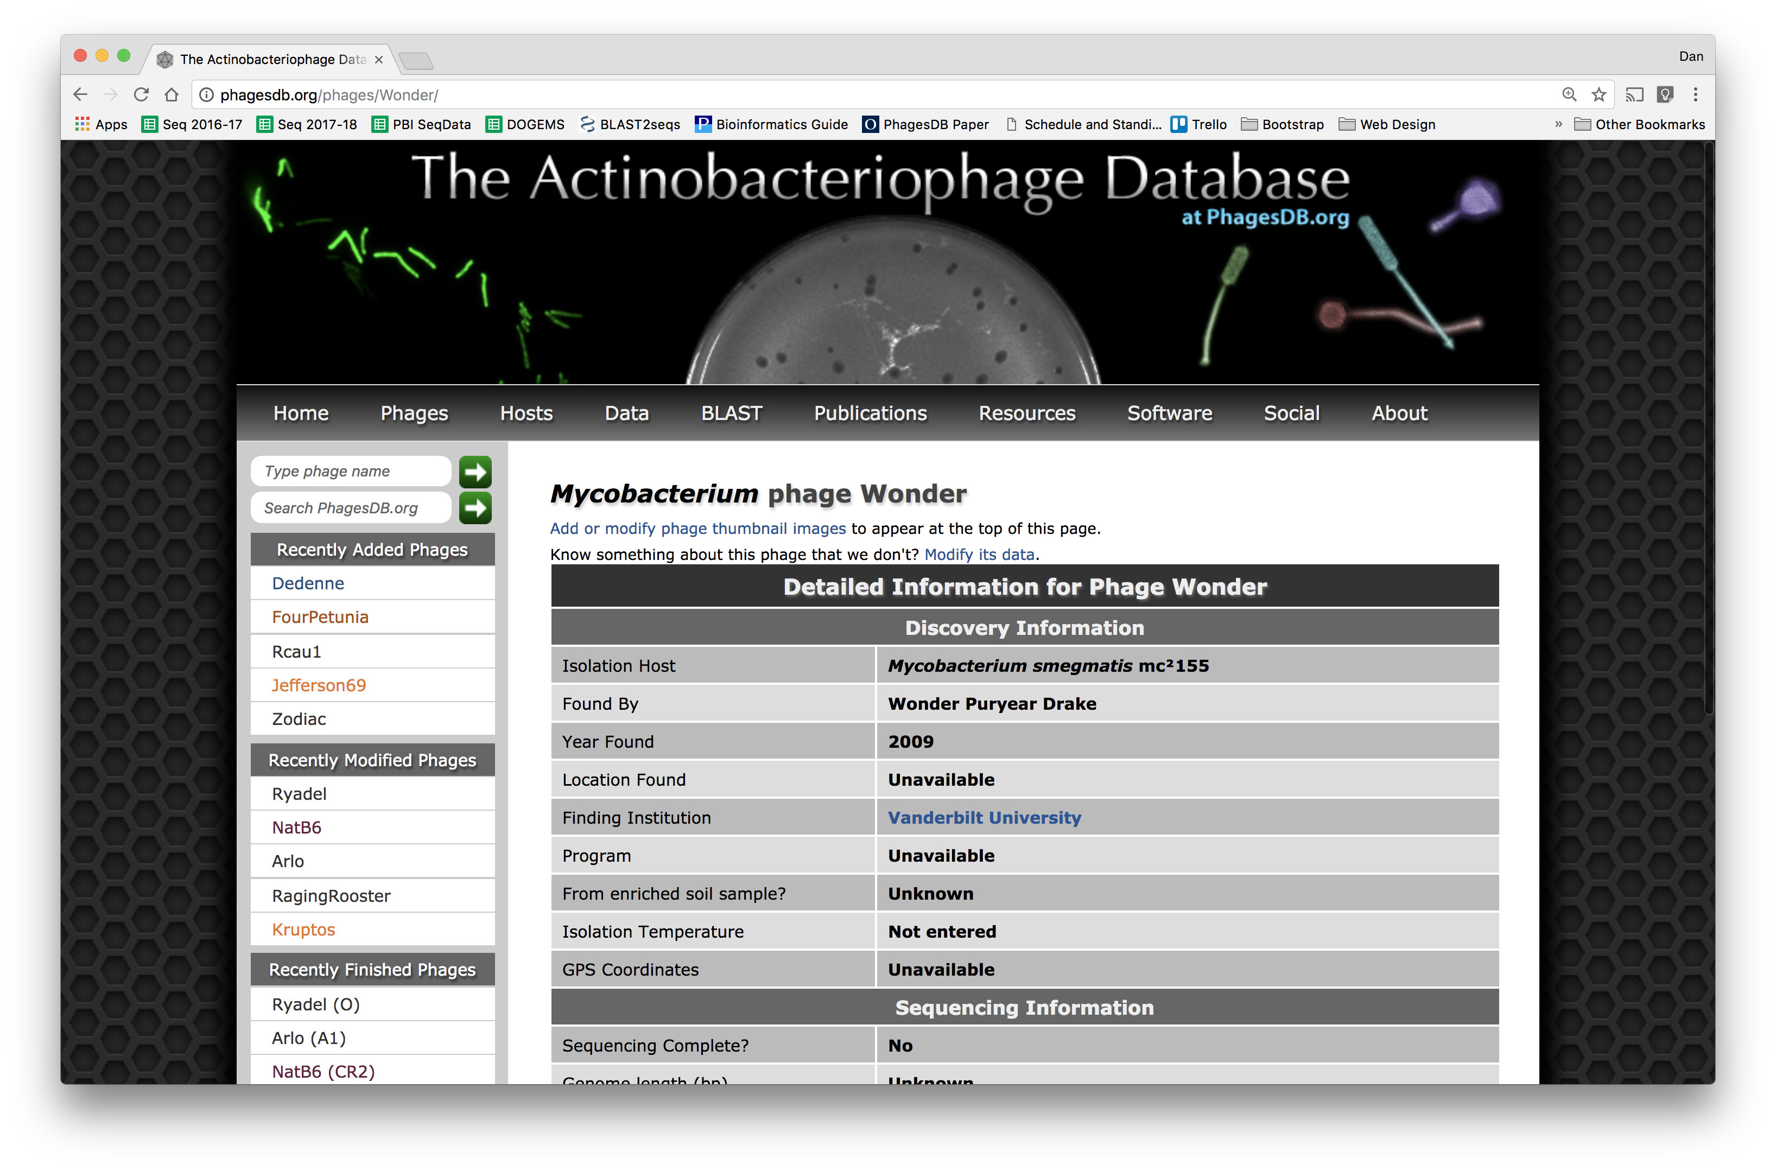

Slide 76
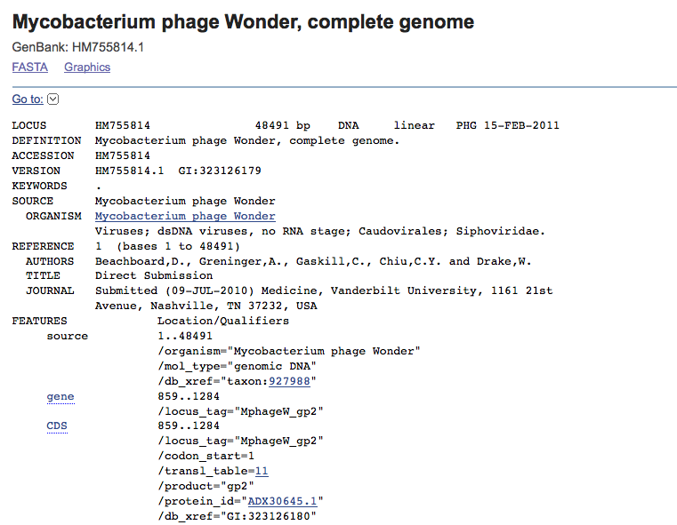
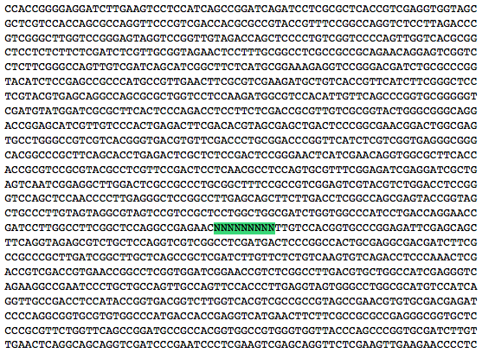
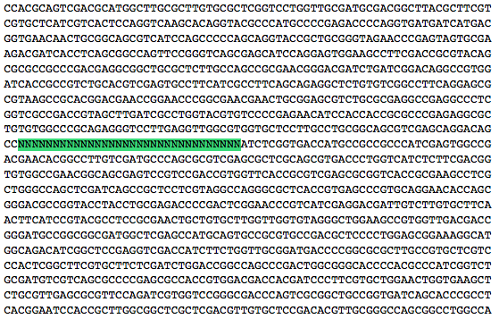

Slide 77
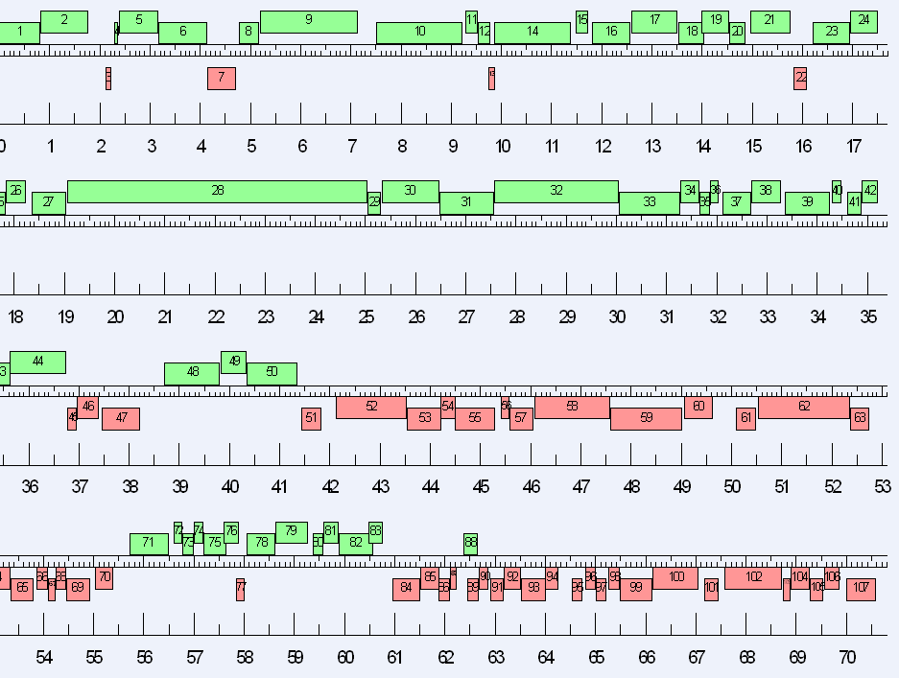
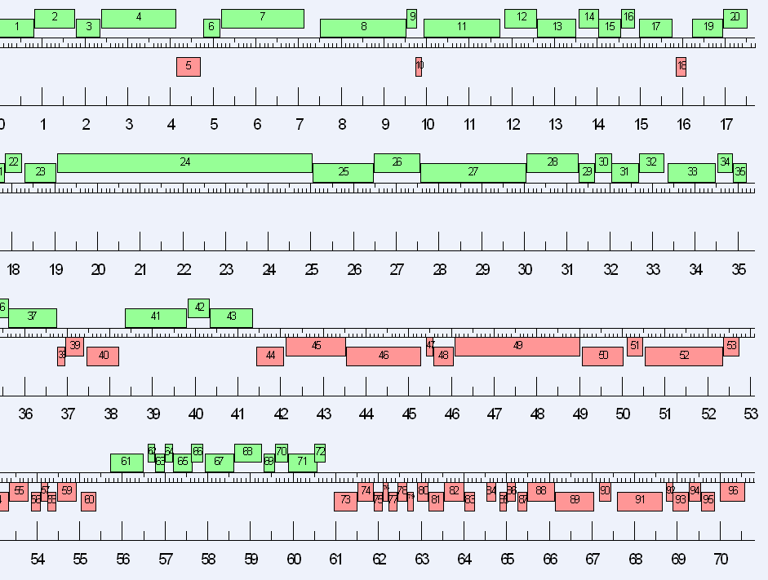

Slide 79
DNA QC (Qubit)
Library Prep
Sequencing
* We at Pitt are always
happy to help with this
Assembly*
** Must be done or
checked by Pitt to
get into Phamerator
Finishing**

Slide 80
Why we finish
Confidence during annotation
Quality sequence in GenBank
Relatively easy (now)
Average Number of Finishing Sanger Reactions
Technology | Sanger | 454 | Ion Torrent | Illumina
Reads | ~25-30 | 4.2 | 9.6 | 0.02
How we finish:
Consed
Bench work

Slide 81
Overview
The Winter Break Black Box
Sequencing
Assembly
Finishing
What’s new?

Slide 82
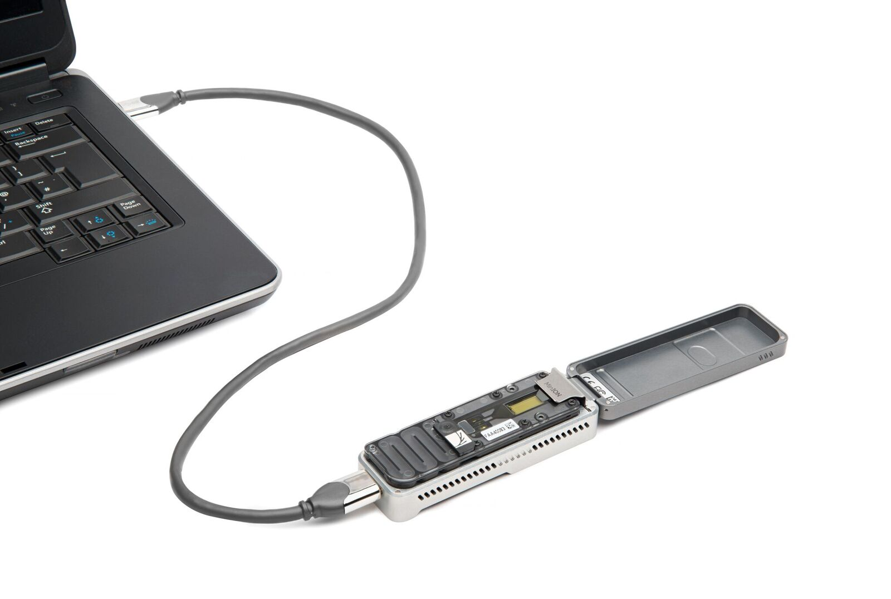

Slide 83
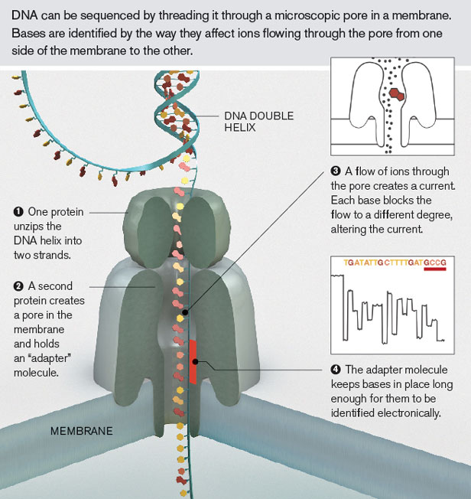
Oxford Nanopore

Slide 84
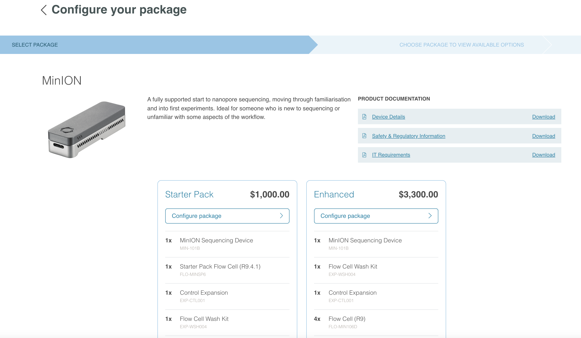
Oxford Nanopore Sequencing

Slide 85
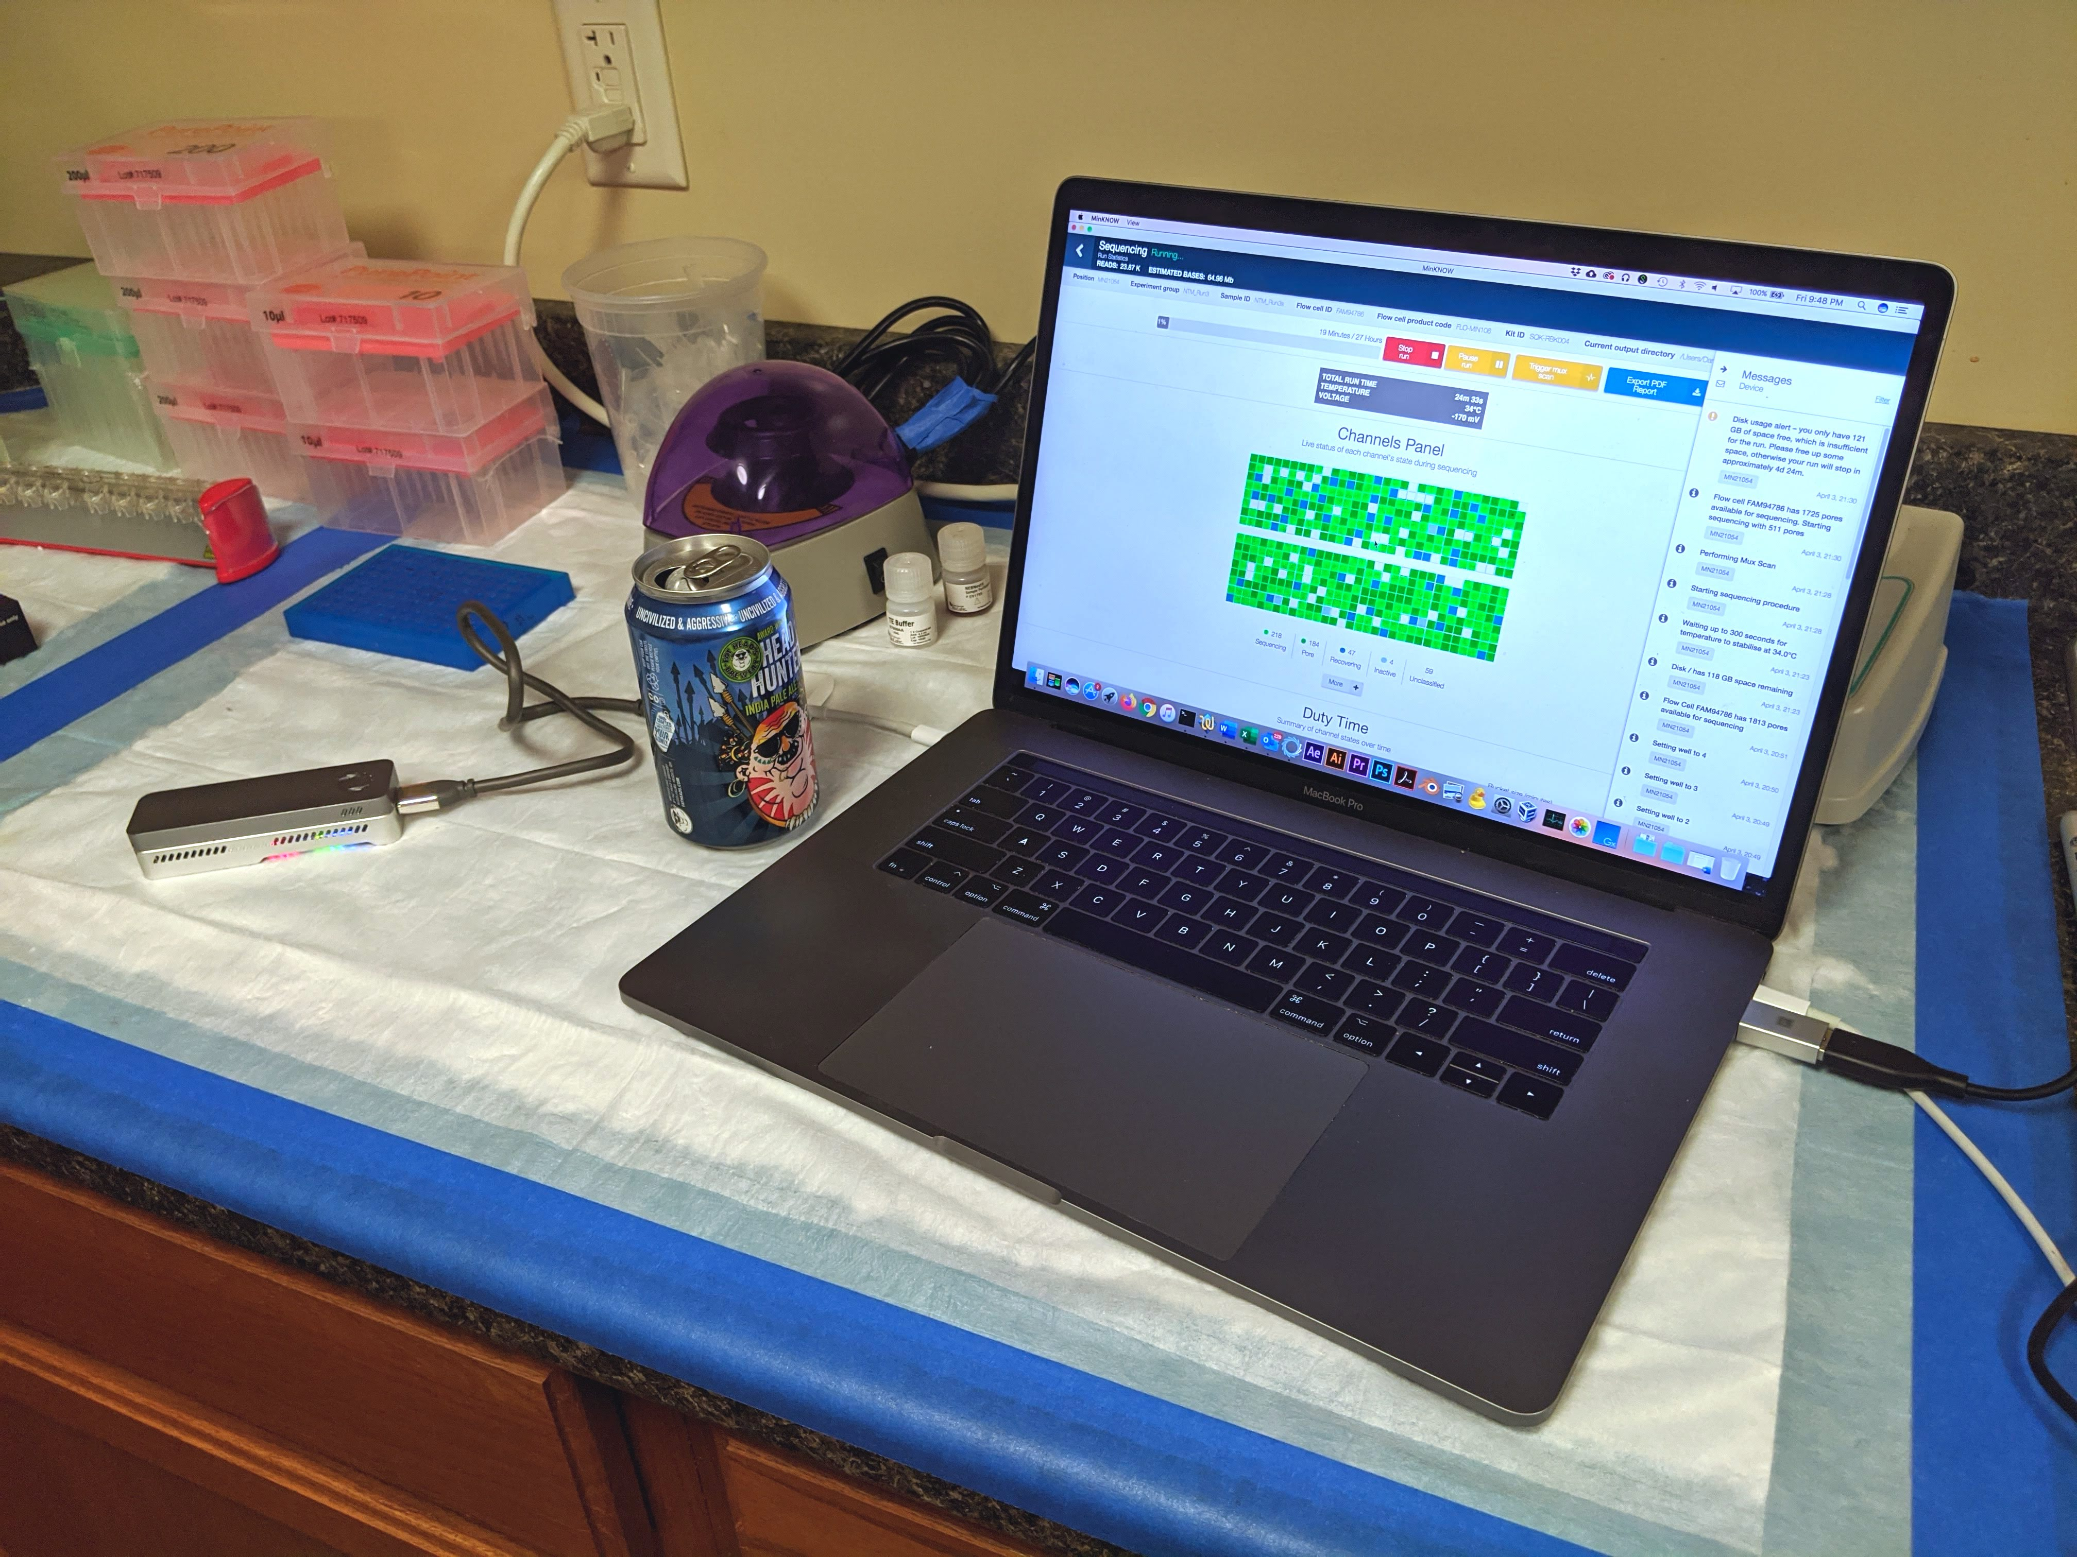
Oxford Nanopore Sequencing

Slide 87
“The MinION has been used to successfully read … 100,000 base pairs during a single DNA capture, [which] has never been managed before using traditional sequencing techniques.
… but Oxford Nanopore has also introduced GridION [and] the company reckon that a 20-node GridION setup can sequence a complete human genome in just 15 minutes.”
—Wired

Slide 88
(Relevant) Trivia
How many base pairs (bp) are there in a human genome?
How much did it cost to sequence the first human genome?
How long did it take to sequence the first human genome?
When was the first human genome sequence complete?
~3 billion (haploid)
~$2.7 billion
~13 years
2000-2003

Slide 89
GATTACA

Slide 90
Take home
Sequencing getting better faster than computers
Finishing is a prerequisite for annotation
Bioinformatics/analysis skills are important and marketable

Slide 91
Thanks!
Questions?

Slide 93
From 1998 Genome Project Report
“DNA sequencing technology has improved dramatically since the genome project began. The amount of sequence produced each year is increasing steadily; individual centers are now producing tens of millions of base pairs of sequence annually…”

Slide 94
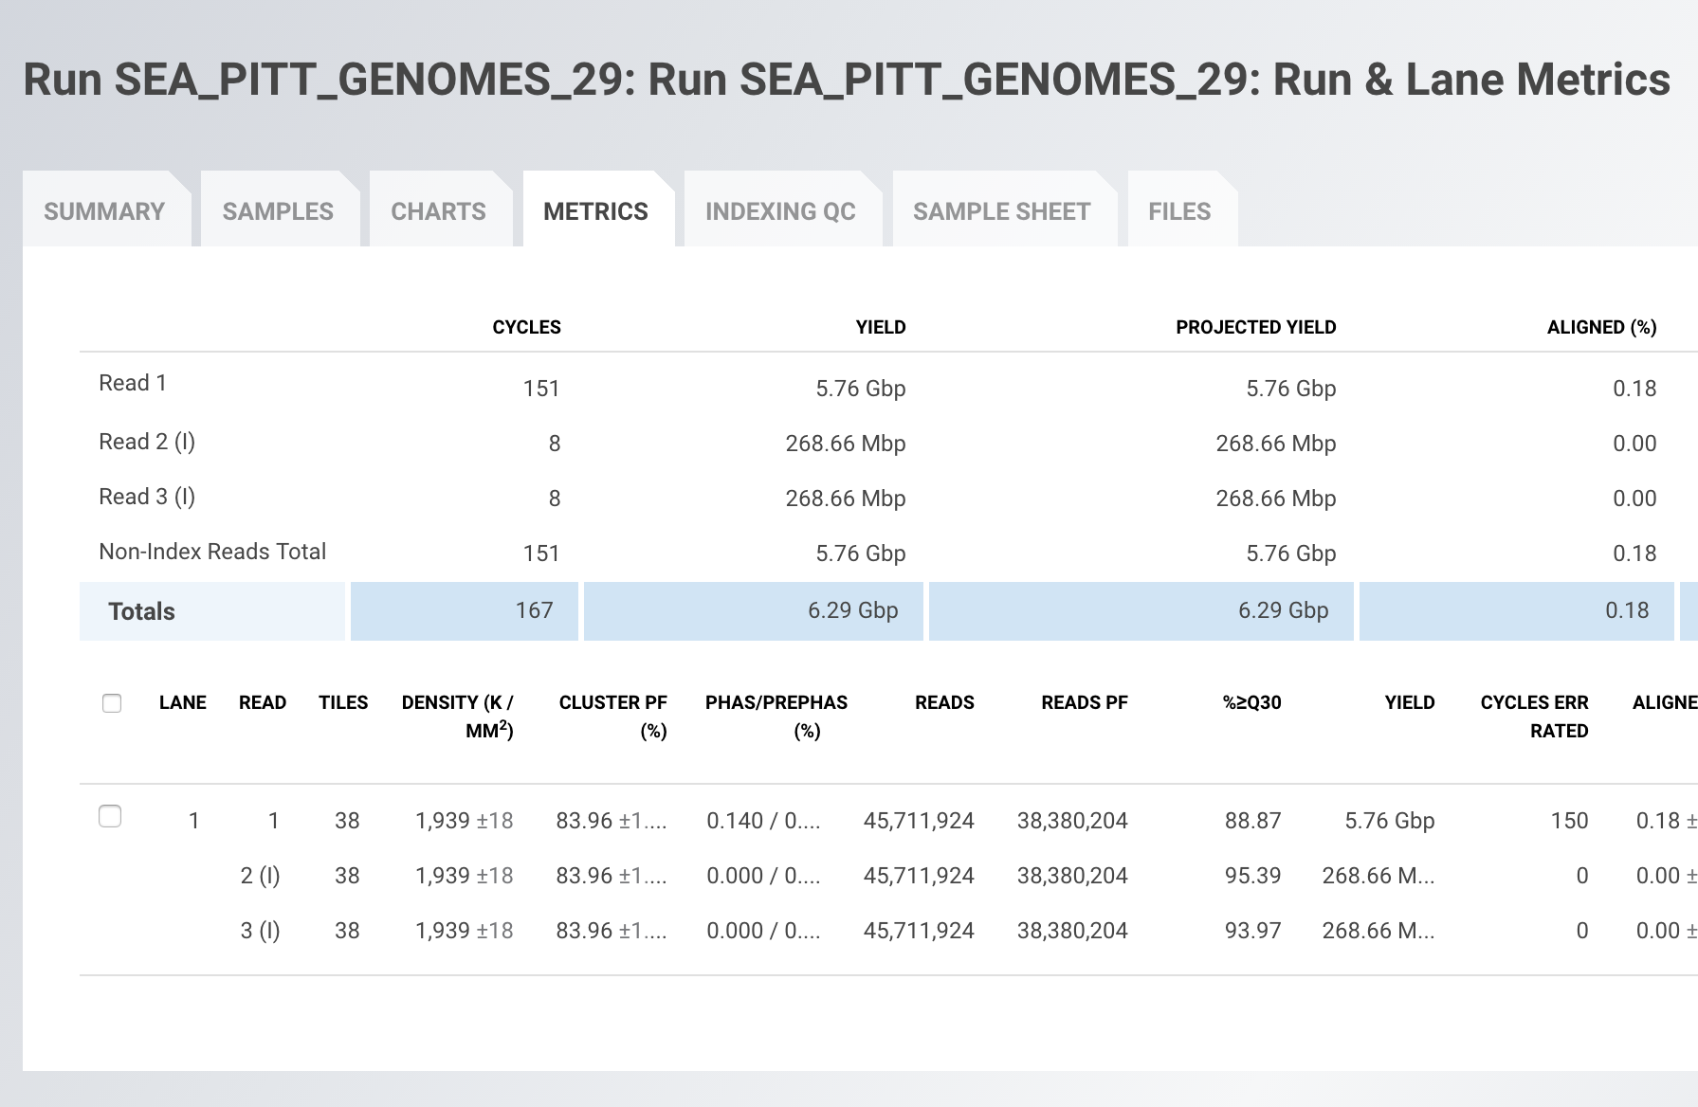
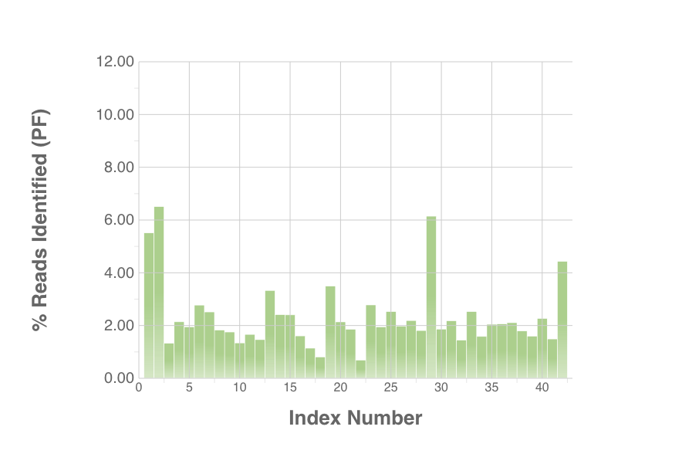
“Individual Dans are now producing billions of base pairs of sequence twice a week…”

Slide 95
From 1998 Genome Project Report
“DNA sequencing technology has improved dramatically since the genome project began. The amount of sequence produced each year is increasing steadily; individual centers are now producing tens of millions of base pairs of sequence annually…”

Slide 96
“Individual Dans are now producing billions of base pairs of sequence twice a week…”

