Slide 1
Biological Information Flow

Slide 2
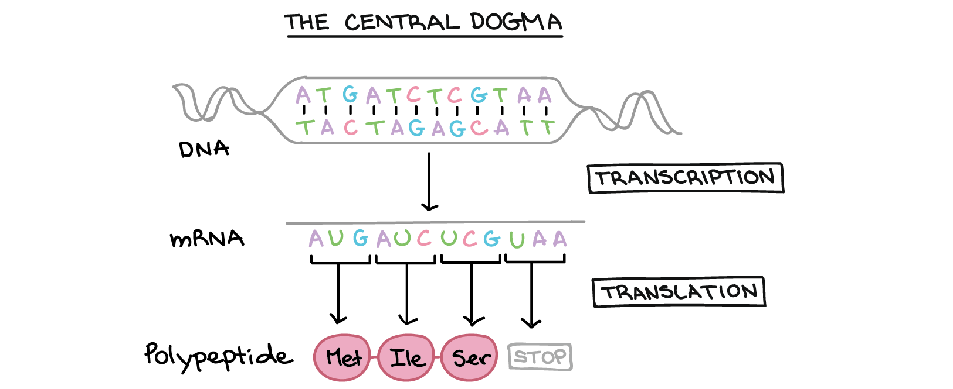
Khan Academy, www.khanacademy.org

Slide 3
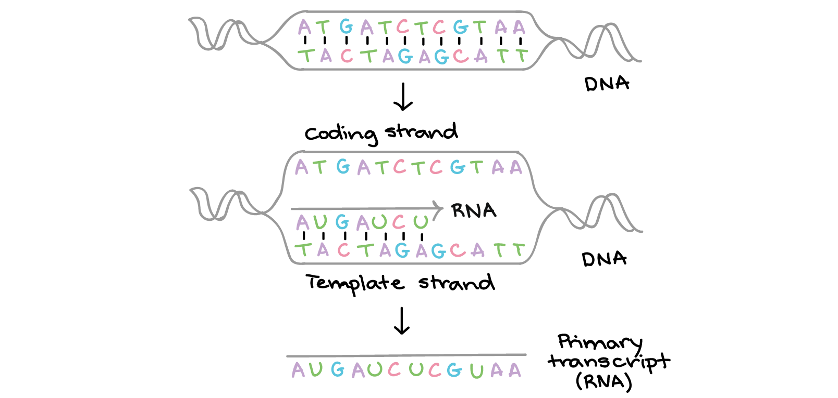
Transcription
Khan Academy, www.khanacademy.org

Slide 4
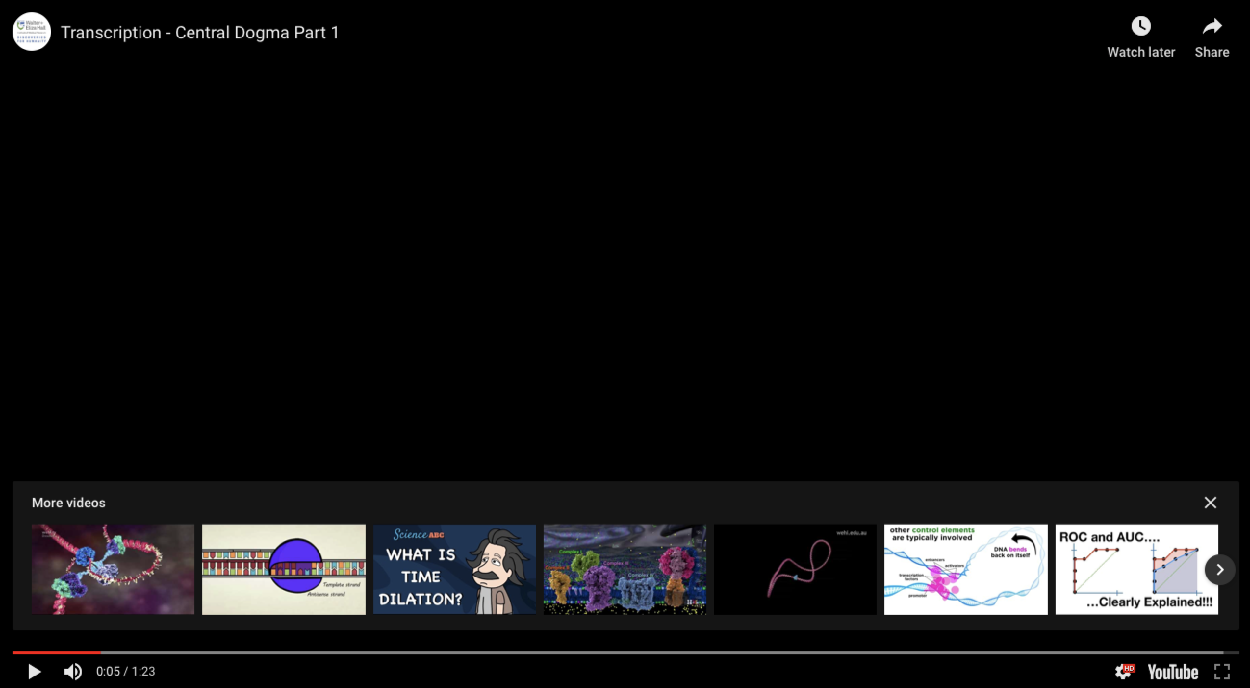
https://www.youtube.com/watch?v=xSQybiea2AA
Drew Berry

Slide 5
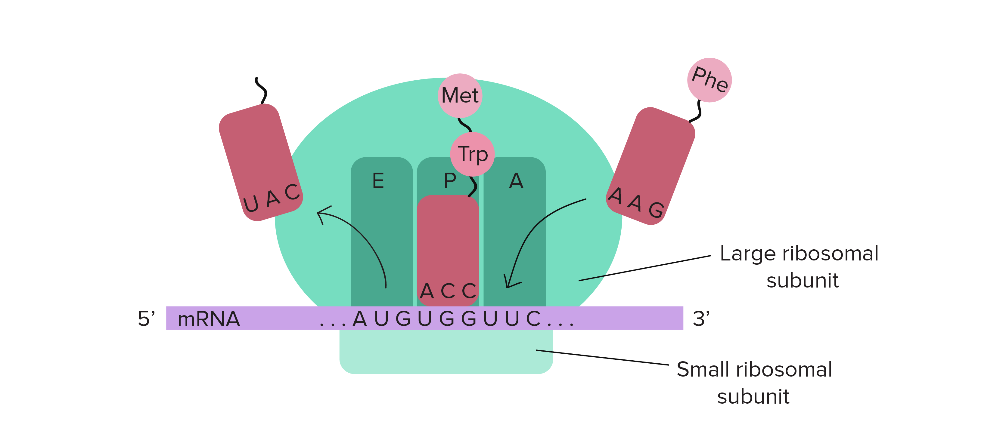
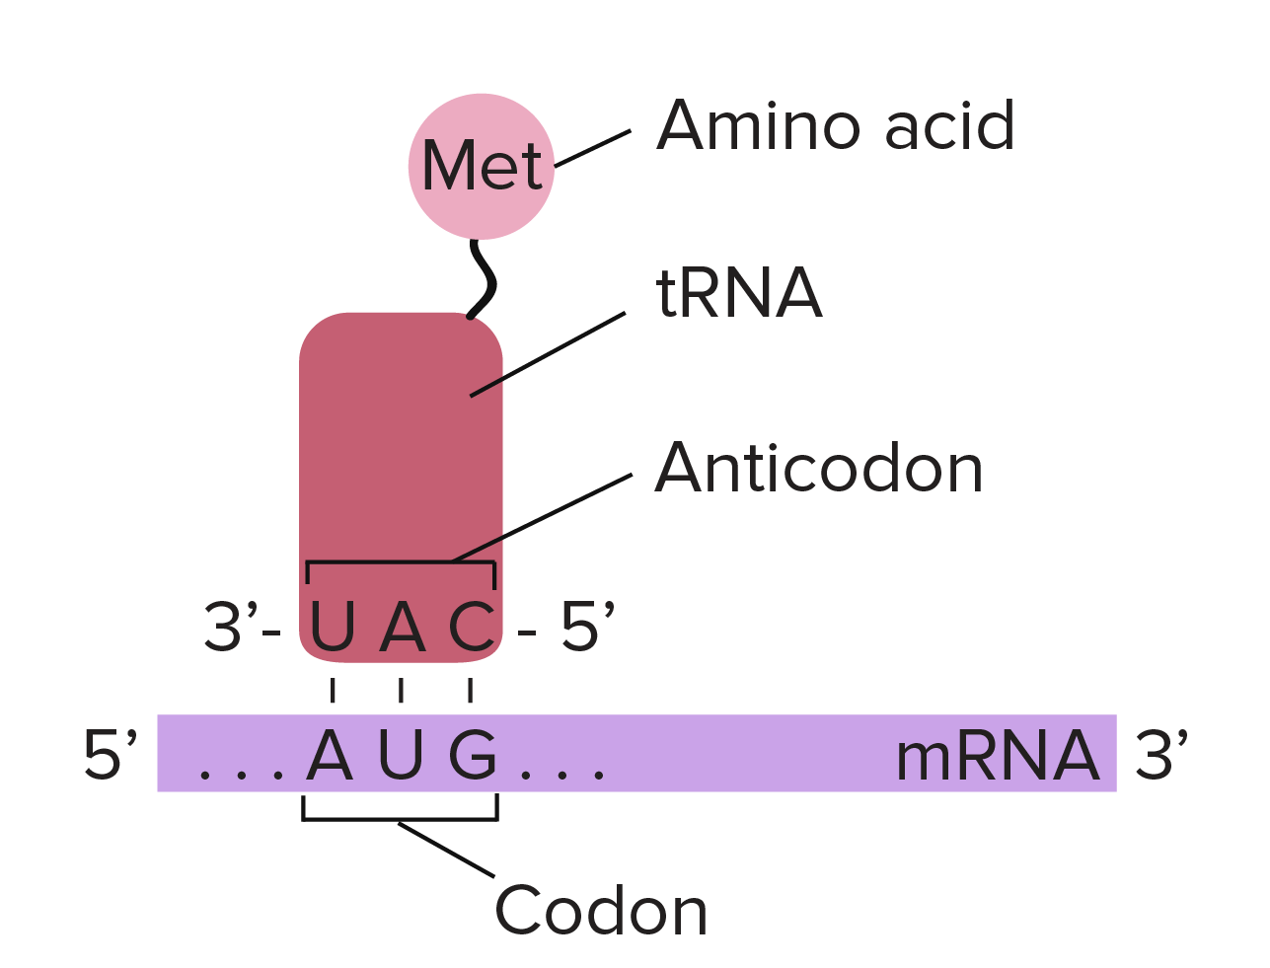
Translation

Slide 6
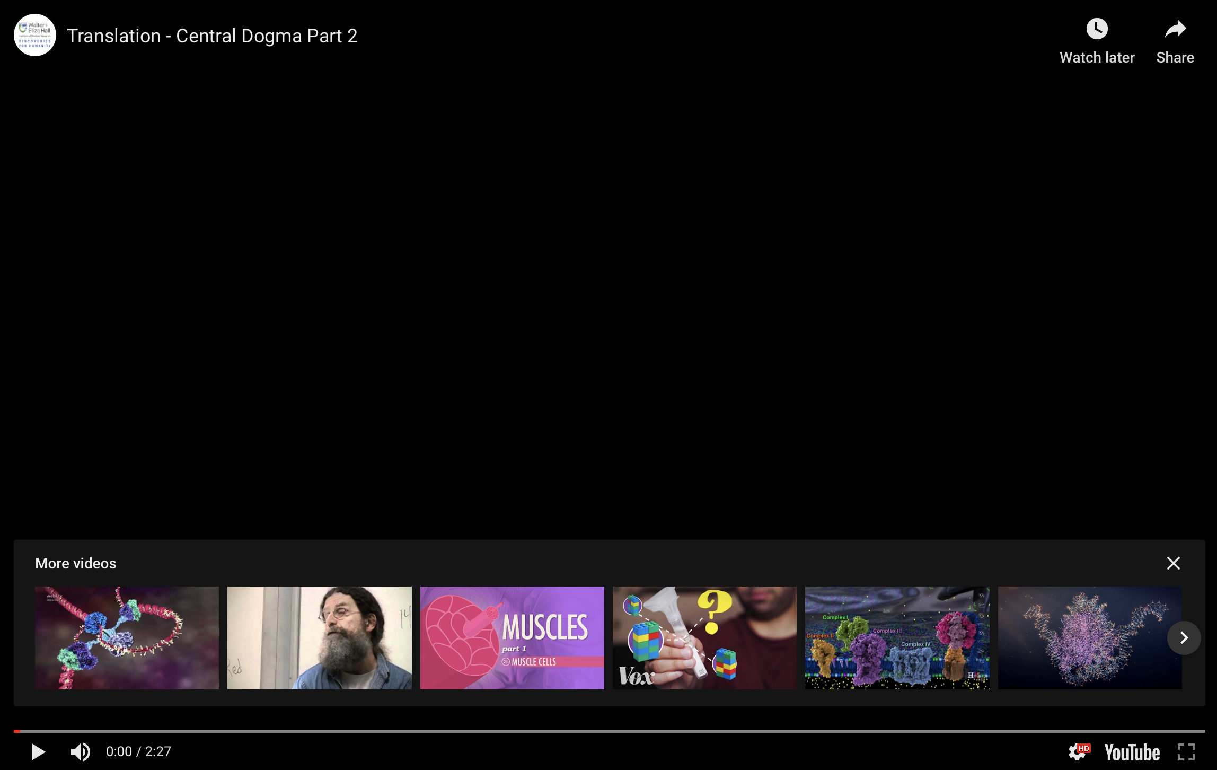
https://www.youtube.com/watch?v=WkI_Vbwn14g
Drew Berry

Slide 7
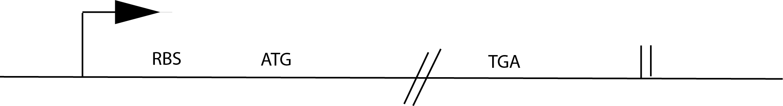
Prokarotic Gene Organization

Slide 8
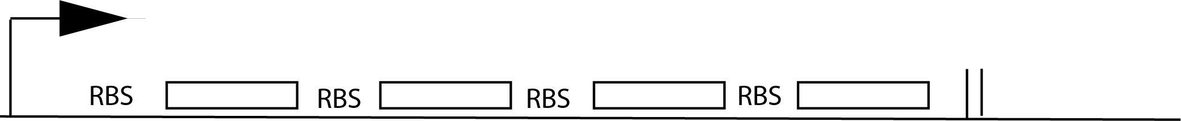
Operon Organization

Slide 9
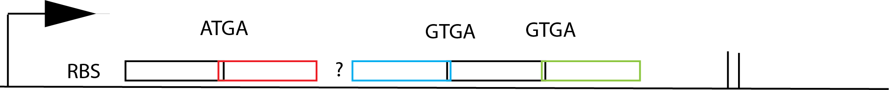
More realistic phage operon organization

Slide 10
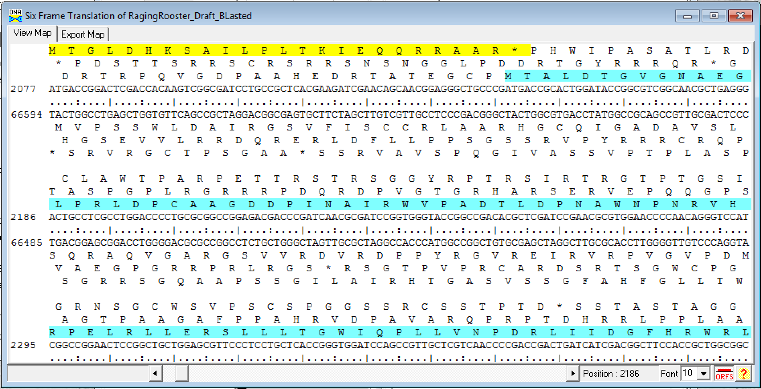

Slide 11
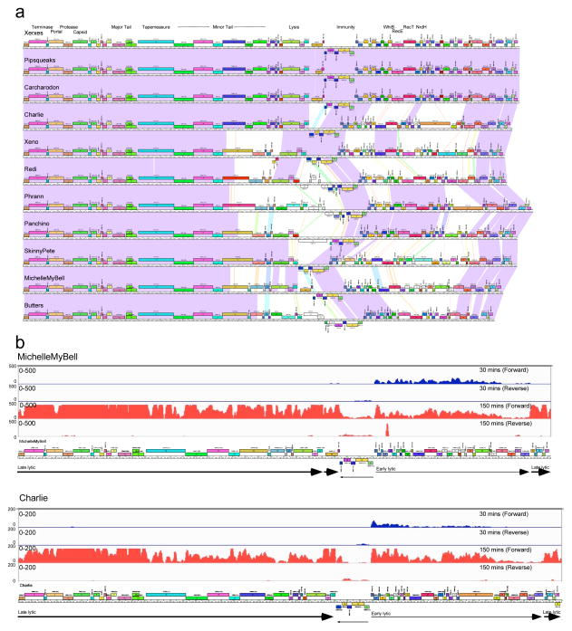
Dedrick et al 2017, Nature Micro

Slide 13
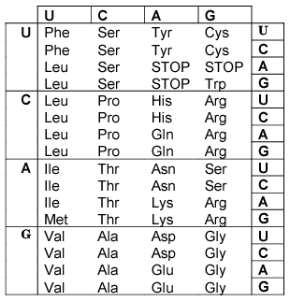
Gene Expression: Codon Usage

Slide 14
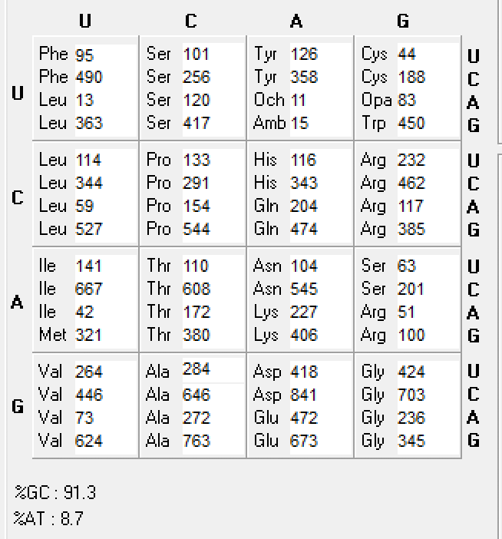
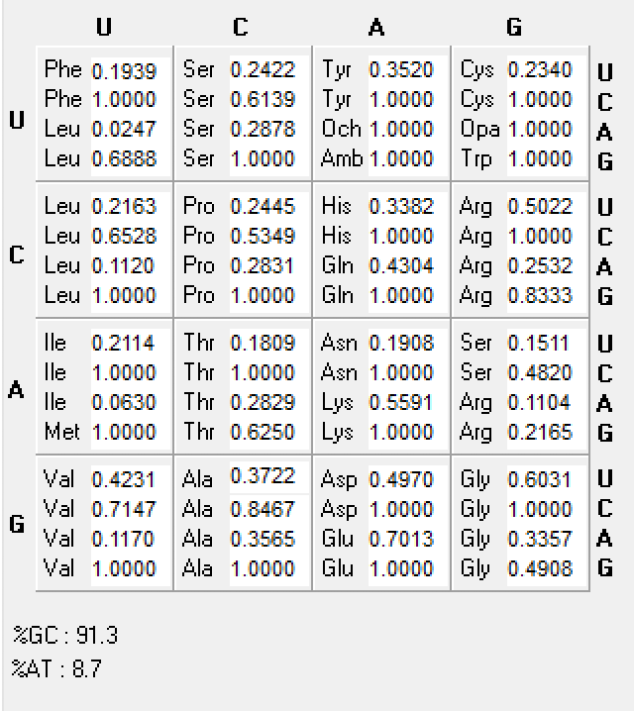
Codon Usage in BodE*
Total codon counts
Normalized Codon Usage
How does codon usage affect gene expression?
How does codon usage affect gene annotation?

Slide 15
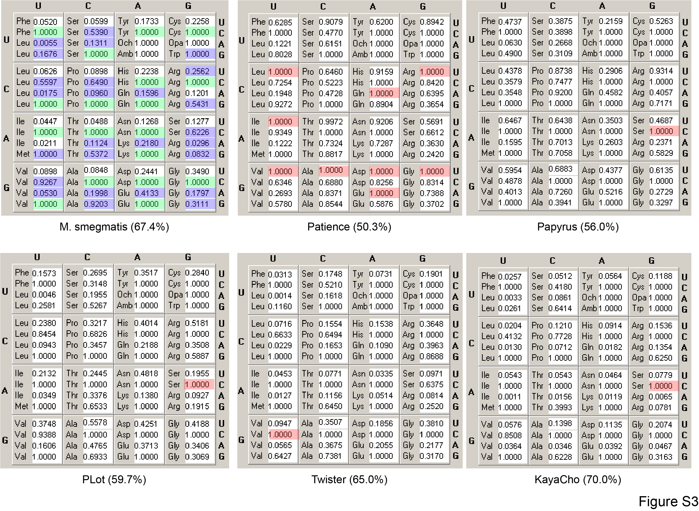
Pope et al mBio 2014

Slide 16
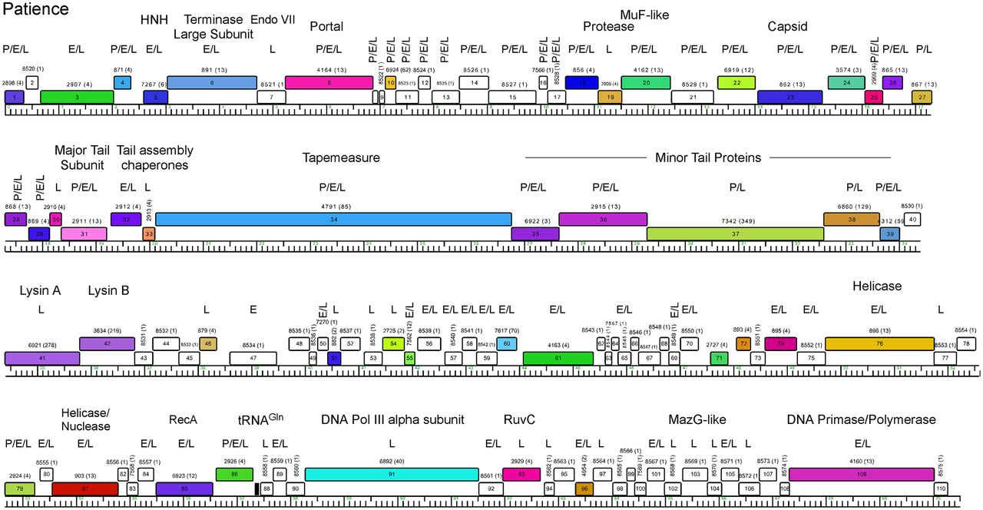
Patience
ID’d 82 of 111 predicted proteins
*Revised start site predictions to include larger overlaps
*included shorter ORFs (37aa protein)
*one out of frame protein
Pope et al mBio 2014
Notes:
Genome map of mycobacteriophage Patience. The map was generated using Phamerator (35) and displayed as described for Fig. 3. Putative functional assignments are shown. Identification of the gene product by mass spectrometry in particles (P) or early (E)- or late (L)-infected samples is shown above each gene.

Slide 17
R H L S L P S I F F Q A I S A F F H T R P A Q E Q P M D M T E S A P
G T F L S P A F F S K P F Q R F S T P D Q H R S N Q W T * P N P H
A P F S P Q H F F P S H F S V F P H P T S T G A T N G H D R I R T
1 AGGCACCTTTCTCTCCCCAGCATTTTTTTCCAAGCCATTTCAGCGTTTTTCCACACCCGACCAGCACAGGAGCAACCAATGGACATGACCGAATCCGCAC
....:....|....:....|....:....|....:....|....:....|....:....|....:....|....:....|....:....|....:....|
TCCGTGGAAAGAGAGGGGTCGTAAAAAAAGGTTCGGTAAAGTCGCAAAAAGGTGTGGGCTGGTCGTGTCCTCGTTGGTTACCTGTACTGGCTTAGGCGTG
Y A G K E G W C K K G L W K L T K G C G V L V P A V L P C S R I R V
L C R E R G L M K K W A M E A N K W V R G A C S C G I S M V S D A
P V K R E G A N K E L G N * R K E V G S W C L L L W H V H G F G C
T A R V W A F E D Q R D R A V R E Q S M H I A L R Q A D S V G I G
R L R A C G R S R I S A T A R C A S N Q C T S R C A R P T A W V S A
D C A R V G V R G S A R P R G A R A I N A H R A A P G R Q R G Y R
101 CGACTGCGCGCGTGTGGGCGTTCGAGGATCAGCGCGACCGCGCGGTGCGCGAGCAATCAATGCACATCGCGCTGCGCCAGGCCGACAGCGTGGGTATCGG
....:....|....:....|....:....|....:....|....:....|....:....|....:....|....:....|....:....|....:....|
GCTGACGCGCGCACACCCGCAAGCTCCTAGTCGCGCTGGCGCGCCACGCGCTCGTTAGTTACGTGTAGCGCGACGCGGTCCGGCTGTCGCACCCATAGCC
S Q A R T P T R P D A R G R P A R A I L A C R A A G P R C R P Y R
G V A R T H A N S S * R S R A T R S C D I C M A S R W A S L T P I P
R S R A H P R E L I L A V A R H A L L * H V D R Q A L G V A H T D
D L T V I E A A D K I A A F I L D G K V D R R P D A E R S P E * *
T * P * S R R P T R S P L S S S T A R S T G A P T L S G A P N D D
R L D R D R G G R Q D R R F H P R R Q G R P A P R R * A E P R M M T
201 CGACTTGACCGTGATCGAGGCGGCCGACAAGATCGCCGCTTTCATCCTCGACGGCAAGGTCGACCGGCGCCCCGACGCTGAGCGGAGCCCCGAATGATGA
....:....|....:....|....:....|....:....|....:....|....:....|....:....|....:....|....:....|....:....|
GCTGAACTGGCACTAGCTCCGCCGGCTGTTCTAGCGGCGAAAGTAGGAGCTGCCGTTCCAGCTGGCCGCGGGGCTGCGACTCGCCTCGGGGCTTACTACT
R S S R S R P P R C S R R K * G R R C P R G A G R R Q A S G R I I
S K V T I S A A S L I A A K M R S P L T S R R G S A S R L G S H H
A V Q G H D L R G V L D G S E D E V A L D V P A G V S L P A G F S S

Slide 18
GeneMark output of Anaya using M. tuberculosis model

