Slide 1
Inside the Black Box: Phage Genome Sequencing, Assembly, and Finishing
Dan Russell

Slide 2
I always forget to say…
“This will not be on the test”
Please interrupt with questions
These slides will be posted, and you can steal them

Slide 3
(Relevant) Trivia
How many base pairs (bp) are there in a human genome?
How much did it cost to sequence the first human genome?
How long did it take to sequence the first human genome?
When was the first human genome sequence complete?

Slide 4
(Relevant) Trivia
How many base pairs (bp) are there in a human genome?
How much did it cost to sequence the first human genome?
How long did it take to sequence the first human genome?
When was the first human genome sequence complete?
~3 billion (haploid)
~$2.7 billion
~13 years
2000-2003

Slide 5
Overview
The Winter Break Black Box
Sequencing
Assembly
Finishing
What’s new?

Slide 6
Overview
The Winter Break Black Box
Sequencing
Assembly
Finishing
What’s new?

Slide 7
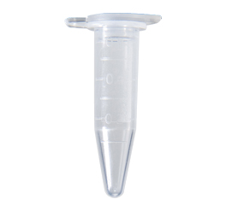
ArMaWen DNA
Fall semester lab work
Spring semester annotation
ArMaWen.fasta

Slide 8
ArMaWen DNA
Fall semester lab work
What happens in here?
Spring semester annotation
ArMaWen.fasta

Slide 9
Overview
The Winter Break Black Box
Sequencing*
Assembly
Finishing
What’s new?

Slide 10
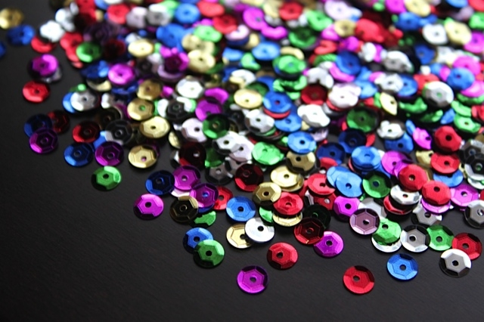
SEQUINS

Slide 11
SEE QUINNS

Slide 12
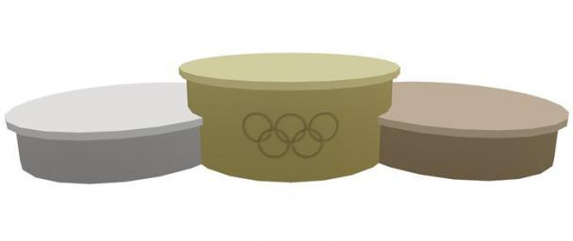
SIKH WINS!

Slide 13
Overview
The Winter Break Black Box
Sequencing*
Assembly
Finishing
What’s new?
* Determining the number, order, and arrangement of As, Cs, Gs, and Ts that comprise a piece of DNA

Slide 14
Shotgun Genome Sequencing
Complete genome copies
Fragmented genome chunks

Slide 15
Shotgun Genome Sequencing
Fragmented genome chunks
NOT REALLY DONE BY DUCK HUNTERS
Hydroshearing, sonication, enzymatic shearing
Notes:
Fragment sizes differ for different seq platforms.

Slide 16
Fragments were cloned:

Slide 17
Notes:
One tube per 2 sequences with Sanger and cloning. Not so bad if you only want 100 sequences. What if you want 1 million?

Slide 18
x millions
Notes:
One tube per 2 sequences with Sanger and cloning. Not so bad if you only want 100 sequences. What if you want 1 million?

Slide 19
x millions
Notes:
One tube per 2 sequences with Sanger and cloning. Not so bad if you only want 100 sequences. What if you want 1 million?

Slide 20
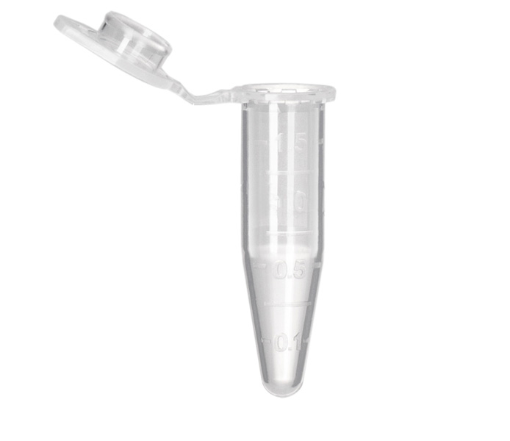
Sanger Sequencing Reactions
Template DNA
Known Primer (~20bp)
DNA Polymerase
Dideoxy Nucleotides
G
A
T
C
Regular Nucleotides
T
C
G
A
C
G
A
T
G
G
A
T
G
T
C
G
A
A
T
A
C
T
G
G
A
T
A
T
G
Labeled
Terminators
T
A
C
C
G
A
C
C
A
T
A
C
G

Slide 21
Sanger Sequencing
Primer
5’
T G C G C G G C C C A
A C G C G C C G G G T ? ? ? ? ? ? ? ? ? ? ? ? ? ? ?
3’
5’

Slide 22
Sanger Sequencing
Primer
5’
G T C T T G G G C T
T G C G C G G C C C A
A C G C G C C G G G T C A G A A C C C G A T C G C G
3’
5’

Slide 23
Sanger Sequencing
Primer
5’
G T C T T G G G C T A G C G C
T G C G C G G C C C A
A C G C G C C G G G T C A G A A C C C G A T C G C G
3’
5’
5’
21 bp
G T C T T G G G C T
T G C G C G G C C C A

Slide 24
Sanger Sequencing
Primer
5’
G T C T T G G G C T A
T G C G C G G C C C A
A C G C G C C G G G T C A G A A C C C G A T C G C G
3’
5’
5’
21 bp
G T C T T G G G C T
T G C G C G G C C C A
5’
26 bp
G T C T T G G G C T A G C G C
T G C G C G G C C C A

Slide 25
Sanger Sequencing
Primer
5’
G
T G C G C G G C C C A
A C G C G C C G G G T C A G A A C C C G A T C G C G
3’
5’
5’
21 bp
G T C T T G G G C T
T G C G C G G C C C A
5’
26 bp
G T C T T G G G C T A G C G C
T G C G C G G C C C A
5’
22 bp
G T C T T G G G C T A
T G C G C G G C C C A

Slide 26
Sanger Sequencing
Primer
5’
G T C T T G G G C
T G C G C G G C C C A
A C G C G C C G G G T C A G A A C C C G A T C G C G
3’
5’
5’
21 bp
G T C T T G G G C T
T G C G C G G C C C A
5’
26 bp
G T C T T G G G C T A G C G C
T G C G C G G C C C A
5’
22 bp
G T C T T G G G C T A
T G C G C G G C C C A
5’
12 bp
G
T G C G C G G C C C A

Slide 27
Sanger Sequencing
Primer
5’
G T C T T
T G C G C G G C C C A
A C G C G C C G G G T C A G A A C C C G A T C G C G
3’
5’
5’
21 bp
G T C T T G G G C T
T G C G C G G C C C A
5’
26 bp
G T C T T G G G C T A G C G C
T G C G C G G C C C A
5’
22 bp
G T C T T G G G C T A
T G C G C G G C C C A
5’
12 bp
G
T G C G C G G C C C A
5’
20 bp
G T C T T G G G C
T G C G C G G C C C A

Slide 28
Sanger Sequencing
A C G C G C C G G G T C A G A A C C C G A T C G C G
3’
5’
5’
21 bp
G T C T T G G G C T
T G C G C G G C C C A
5’
26 bp
G T C T T G G G C T A G C G C
T G C G C G G C C C A
5’
22 bp
G T C T T G G G C T A
T G C G C G G C C C A
5’
12 bp
G
T G C G C G G C C C A
5’
20 bp
G T C T T G G G C
T G C G C G G C C C A
5’
16 bp
G T C T T
T G C G C G G C C C A

Slide 29
Sanger Sequencing
A C G C G C C G G G T ? ? ? ? ? ? ? ? ? ? ? ? ? ? ?
3’
5’
5’
21 bp
? ? ? ? ? ? ? ? ? T
T G C G C G G C C C A
5’
26 bp
? ? ? ? ? ? ? ? ? ? ? ? ? ? C
T G C G C G G C C C A
5’
22 bp
? ? ? ? ? ? ? ? ? ? A
T G C G C G G C C C A
5’
12 bp
G
T G C G C G G C C C A
5’
20 bp
? ? ? ? ? ? ? ? C
T G C G C G G C C C A
5’
16 bp
? ? ? ? T
T G C G C G G C C C A
Notes:
Has to be done in a single tube per rxn.

Slide 30
Sanger Sequencing
Laser Reader
5’
5’
5’
5’
5’
5’
5’
5’
5’
5’
5’
20 bp
21 bp
19 bp
18 bp
13 bp
22 bp
15 bp
16 bp
14 bp
17 bp
G T C T T G G G C
12 bp
T G C G C G G C C C A
G T C T T G G G C T
T G C G C G G C C C A
G T C T T G G G
T G C G C G G C C C A
G T C T T G G
G T C T T G G G C T A
G T C T
T G C G C G G C C C A
T G C G C G G C C C A
G T
G T C T T
G T C T T G
G
T G C G C G G C C C A
T G C G C G G C C C A
T G C G C G G C C C A
T G C G C G G C C C A
T G C G C G G C C C A
T G C G C G G C C C A
G T C

Slide 31
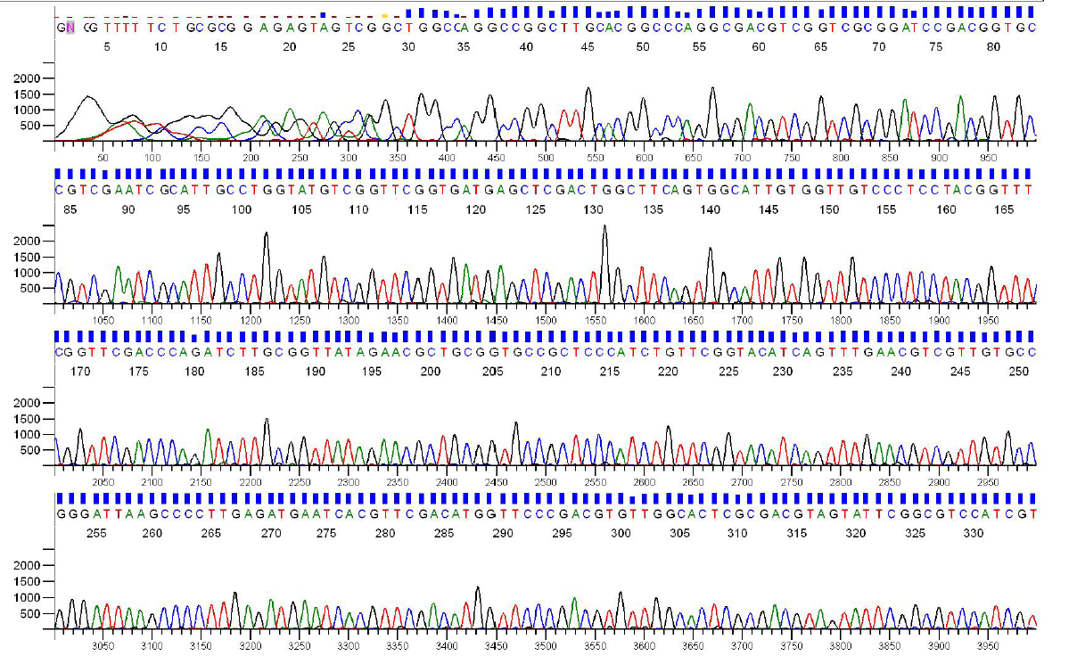
Sanger Sequencing Output
Each sequencing reaction gives us a chromatogram, usually ~600-1000 bp:

Slide 32
Sanger Throughput Limitations
Must have 1 colony picked for every 2 reactions
Must do 1 DNA prep for every 2 reactions
Must have 1 PCR tube for each reaction
Must have 1 gel lane for each reaction
AKA: Must have undergrad/entry-level labor!

Slide 33
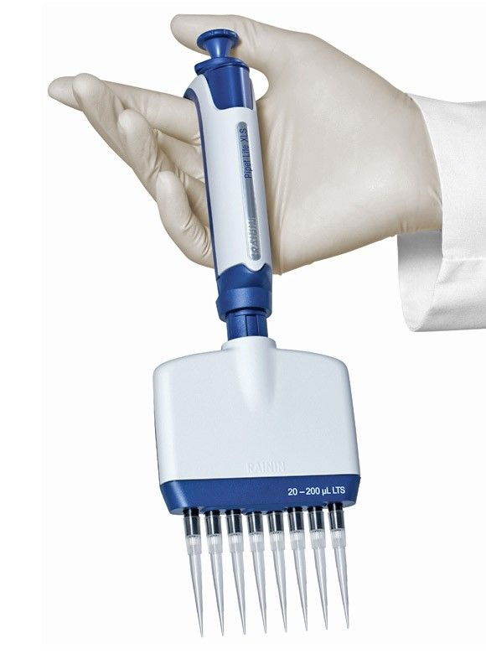
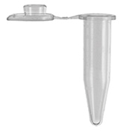
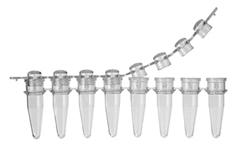

Slide 34
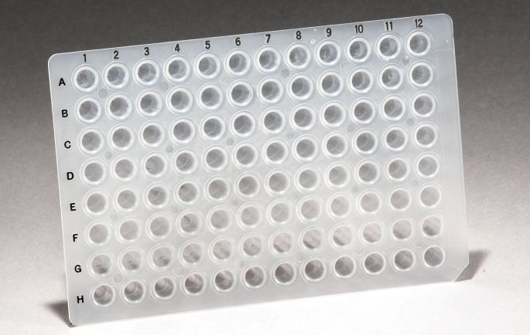
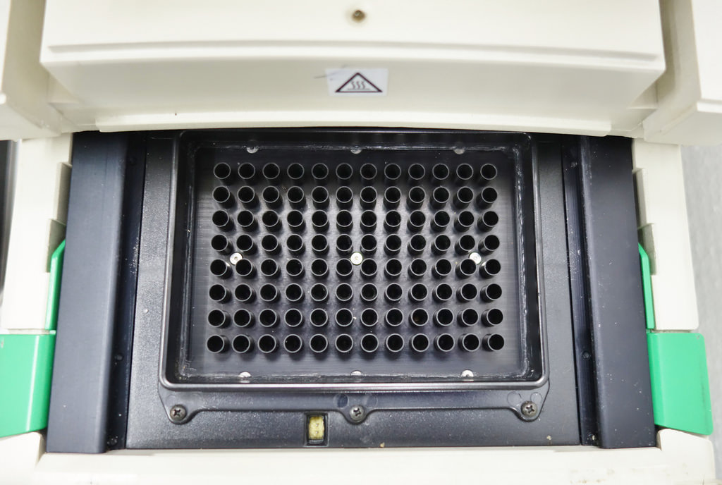
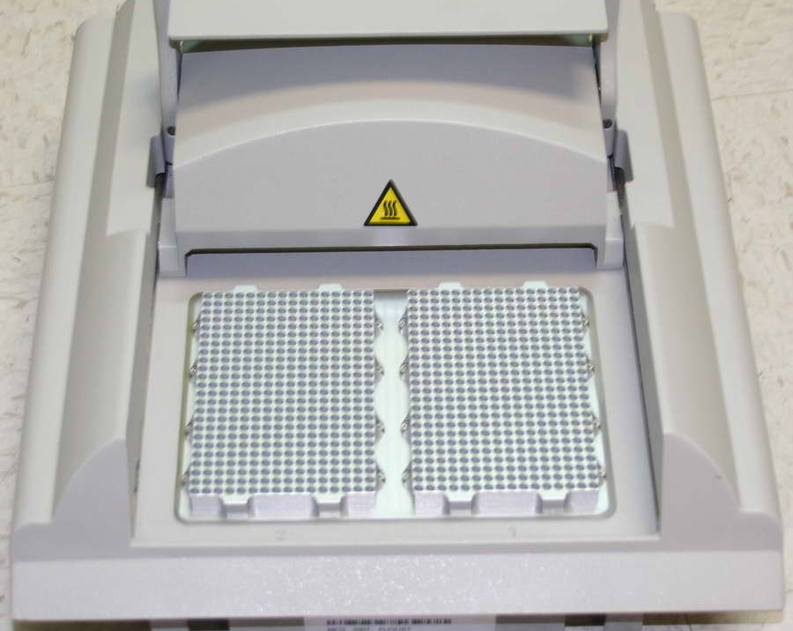
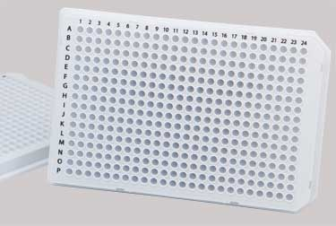

Slide 35
Colony Picking Robot

Slide 36
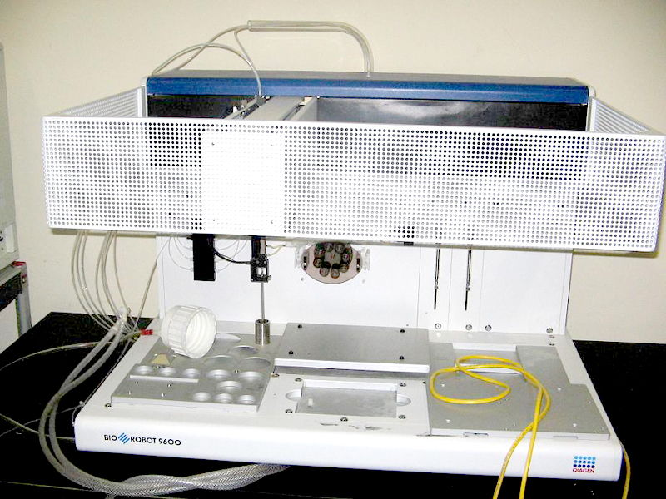

Slide 37
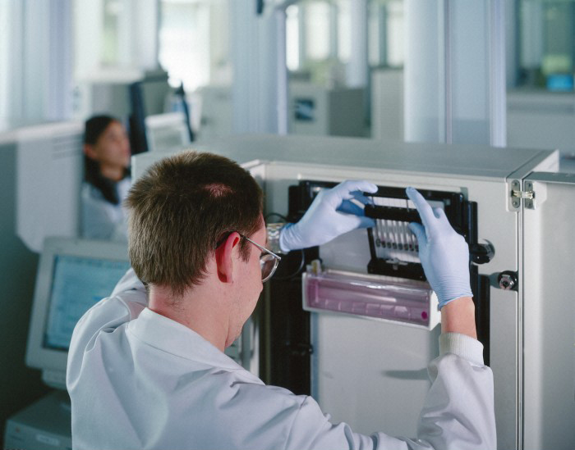

Slide 38
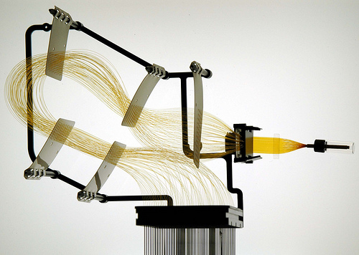
Capillary Arrays

Slide 39
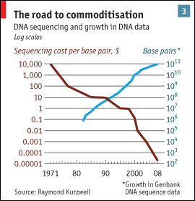
Sanger Throughput Limitations
Must have 1 colony picked for every 2 reactions
Must do 1 DNA prep for every 2 reactions
Must have 1 PCR tube for each reaction
Must have 1 gel lane for each reaction
from The Economist

Slide 40
Problem: How can we do way more reactions at once without having more tubes, thermocyclers, etc.?

Slide 41
Next generation sequencing
Massively parallel

Slide 42
Next generation sequencing

Slide 43
Shotgun sequencing by PGM/454
Genomic
Fragment
Adapters

Slide 44
Next generation sequencing

Slide 45
Shotgun sequencing by PGM/454
Bead/ISP
Adapter
Complement
Sequences
The idea is that each bead should be amplified
all over with a SINGLE library fragment.

Slide 46
Shotgun sequencing by PGM/454
Problem: How do I do PCR to amplify the fragments without having to use 1 tube for each reaction?

Slide 47
Shotgun sequencing by PGM/454

Slide 48
Shotgun sequencing by PGM/454

Slide 49
Shotgun sequencing by PGM/454

Slide 50
Shotgun sequencing by PGM/454
~3.5 µm for Ion Torrent, ~30 µm for 454

Slide 51
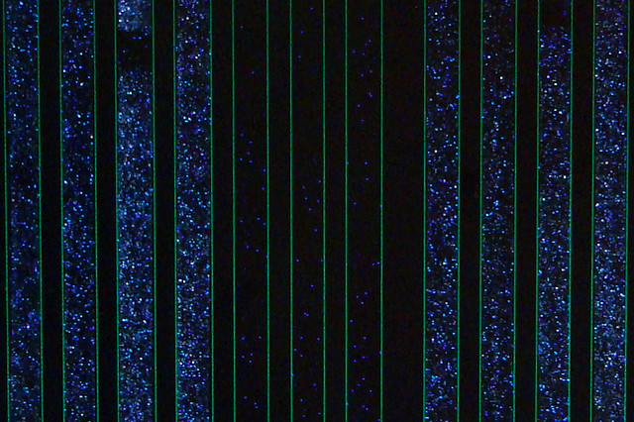
Raw 454 data
Only give polymerase one nucleotide at a time:
G
G
G
Primer
G
G
5’
G
T
T G C G C G G C C C A
C
T T
G G G
A C G C G C C G G G T C A G A A C C C G A T C G C G
3’
5’
If that nucleotide is incorporated, enzymes turn by-products into light:
1 2 3 4 5
The real power of this method is that it can take place in millions of tiny wells in a single plate at once.
T C A G T C A G T C A G

Slide 52
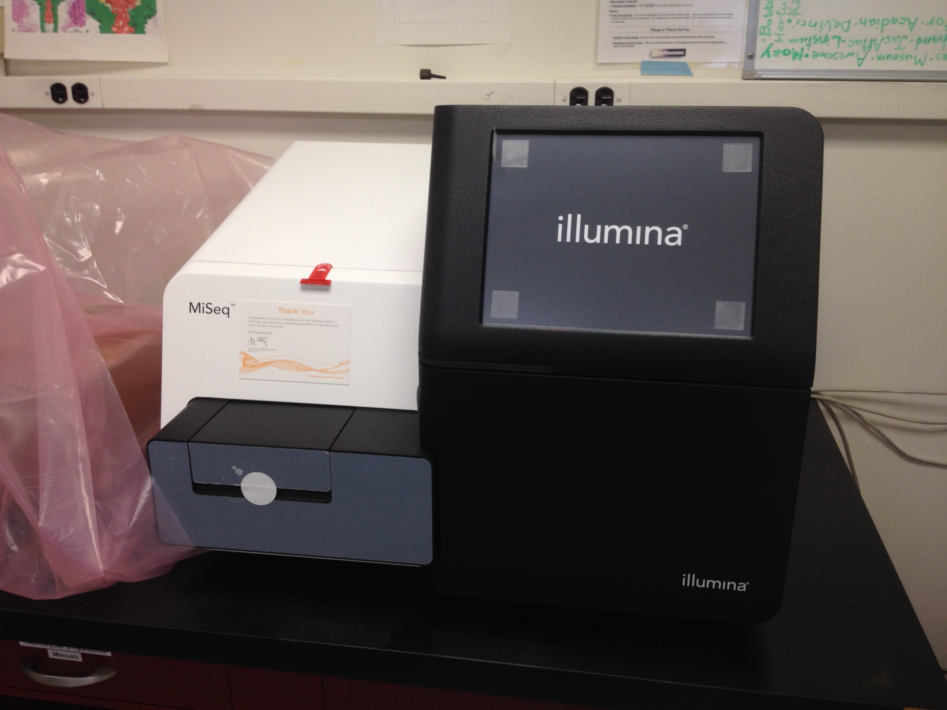
Illumina Sequencing

Slide 53
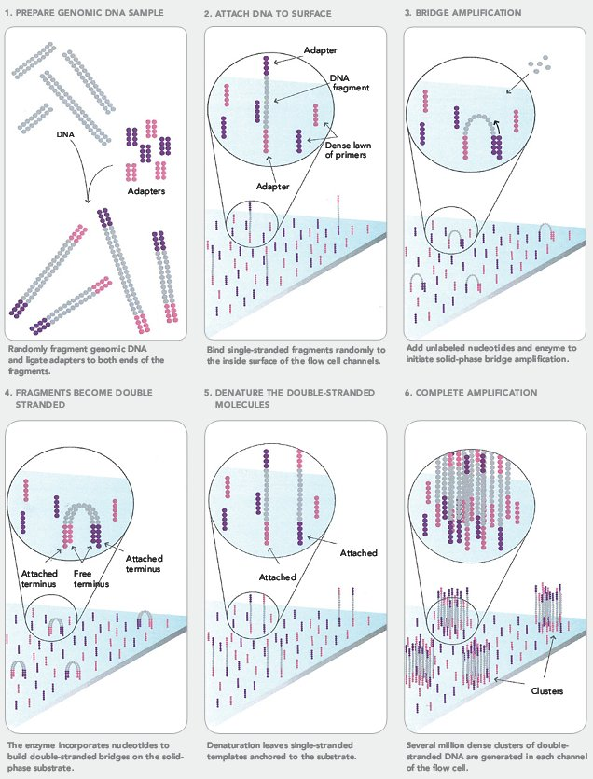
Illumina Sequencing

Slide 54
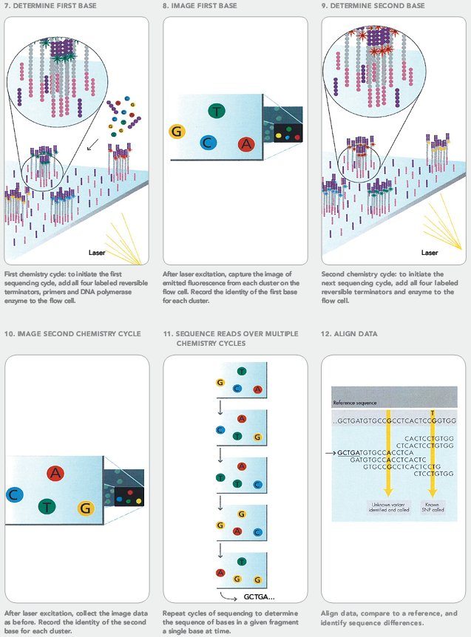
Illumina Sequencing

Slide 55
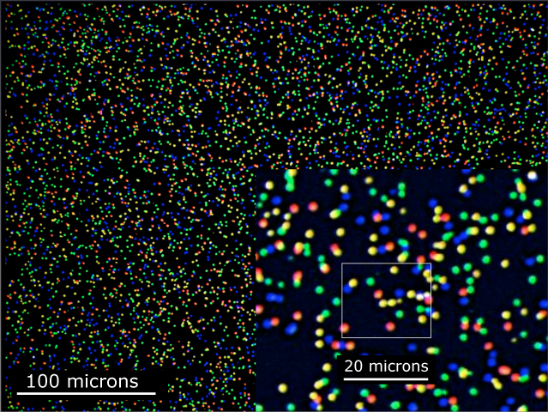
Illumina Sequencing

Slide 56
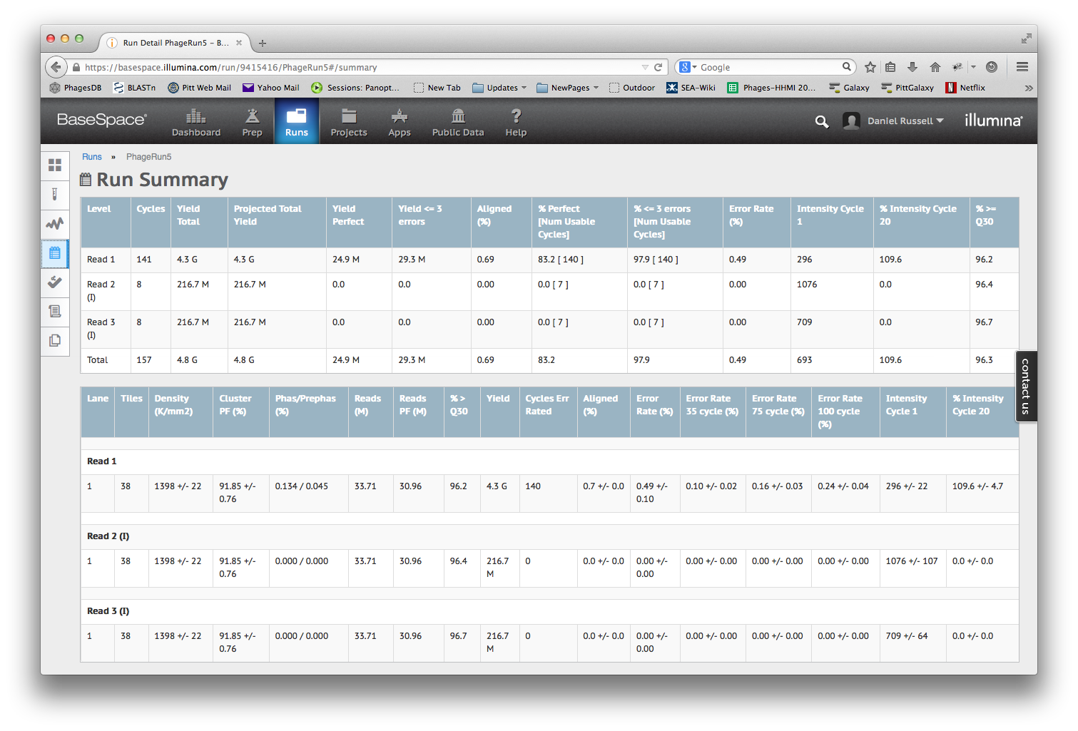

Slide 57
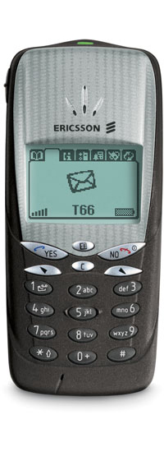
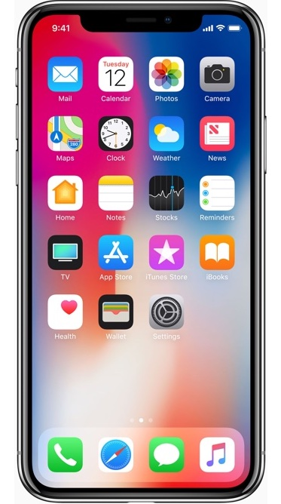

Slide 58
Next-Gen Sequencing
Take home message: Massively Parallel
We’re talking millions or billions of concurrent reads, but without separate tubes

Slide 59
Overview
The Winter Break Black Box
Sequencing
Assembly
Finishing
What’s new?

Slide 60
Method | Read Length
Sanger | 600-1000 bp
454 | 400-800 bp
Illumina | 75-300 bp
Ion Torrent | ~200 bp
PacBio/Nanopore | ~10,000 bp
But…
Phage Genome: ~5,000 to ~500,000 bp
Bacteria: Several million bp
Human: 3 billion bp

Slide 61
Assembly
17 bp
ATTGTTCCCACAGACCG
CGGCGAAGCATTGTTCC
ACCGTGTTTTCCGACCG
AGCTCGATGCCGGCGAAG
TTGTTCCCACAGACCGTG
TTTCCGACCGAAATGGC
ATGCCGGCGAAGCATTGT
ACAGACCGTGTTTCCCGA
TAATGCGACCTCGATGCC
AAGCATTGTTCCCACAG
TGTTTTCCGACCGAAAT
TGCCGGCGAAGCCTTGT
CCGACCGAAATGGCTCC
66 bp

Slide 62
Assembly
Consensus:
TAATGCGACCTCGATGCCGGCGAAGCATTGTTCCCACAGACCGTGTTTTCCGACCGAAATGGCTCC
ATTGTTCCCACAGACCG
CGGCGAAGCATTGTTCC
ACCGTGTTTTCCGACCG
AGCTCGATGCCGGCGAAG
TTGTTCCCACAGACCGTG
TTTCCGACCGAAATGGC
ATGCCGGCGAAGCATTGT
ACAGACCGTGTTTCCCGA
TAATGCGACCTCGATGCC
AAGCATTGTTCCCACAG
TGTTTTCCGACCGAAAT
TGCCGGCGAAGCCTTGT
CCGACCGAAATGGCTCC

Slide 63
Assembly
Consensus:
TAATGCGACCTCGATGCCGGCGAAGCATTGTTCCCACAGACCGTGTTTTCCGACCGAAATGGCTCC
ATTGTTCCCACAGACCG
CGGCGAAGCATTGTTCC
ACCGTGTTTTCCGACCG
AGCTCGATGCCGGCGAAG
TTGTTCCCACAGACCGTG
TTTCCGACCGAAATGGC
ATGCCGGCGAAGCATTGT
ACAGACCGTGTTTCCCGA
TAATGCGACCTCGATGCC
AAGCATTGTTCCCACAG
TGTTTTCCGACCGAAAT
TGCCGGCGAAGCCTTGT
CCGACCGAAATGGCTCC
Newbler

Slide 64
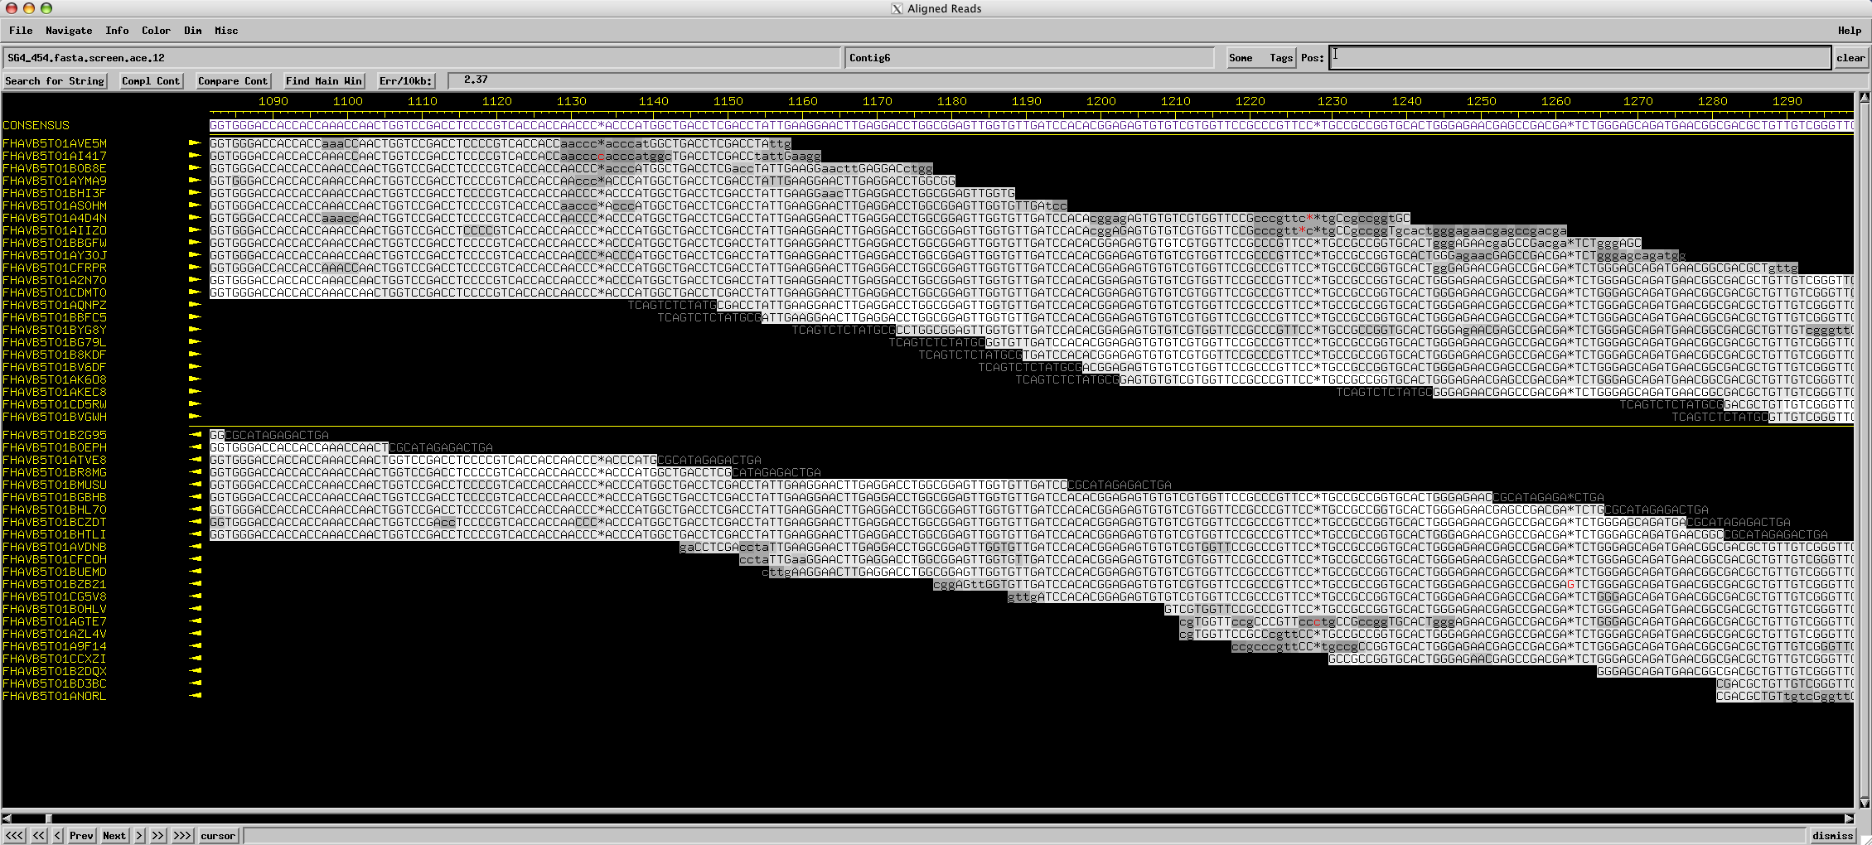
Assembly
Consed

Slide 65
Assembly
Using programs to find overlapping alignments in sequencing reads and build contigs.
The quality of an assembly depends on:
Program used
Type, quality, and length of individual reads
Number of reads used
Complexity of the genome

Slide 66
Overview
The Winter Break Black Box
Sequencing
Assembly
Finishing
What’s new?

Slide 67
Special use of the word “finish”
Some words have special meanings in scientific context
THEORY

Slide 68
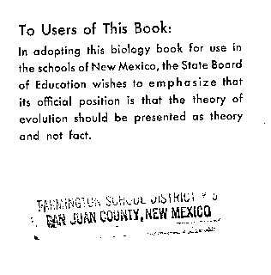
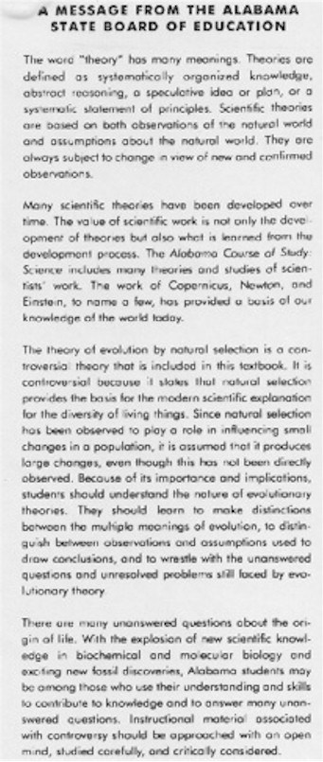
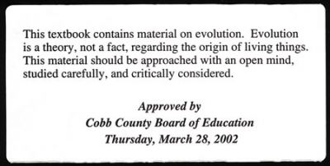

Slide 69
Special use of the word “finish”
Some words have special meanings in scientific context
THEORY
FINISH
Before annotation, phage genomes should be sequenced AND finished.

Slide 70
Special use of the word “finish”
“On June 26, 2000, the International Human Genome Sequencing Consortium announced the production of a rough draft of the human genome sequence. In April, 2003, the International Human Genome Sequencing Consortium is announcing an essentially finished version of the human genome sequence.” —genome.gov
Finishing.
June 2000 → April 2003?

Slide 71
Special use of the word “finish”
“The difference between the draft and finished versions is defined by coverage, the number of gaps and the error rate. The draft [had] an error rate of 1 in 1,000 base pairs, [and] more than 150,000 gaps and only 28 percent of the genome had reached the finished standard. In the April 2003 version, there are less than 400 gaps and 99 percent of the genome is finished with an accuracy rate of less than 1 in 10,000 base pairs.”
1 in 1000 error rate times 3 billion bases equals 3 million errors!
Our goal for phages: 0 gaps, 0 errors

Slide 72
Weak Areas
Multiple contigs (could indicate missing portions of the genome)
Low consensus quality
Discrepant positions
Low coverage
Genome ends

Slide 73
Assembly
Consensus:
TAATGCGACCTCGATGCCGGCGAAGCATTGTTCCCACAGACCGTGTTTTCCGACCGAAATGGCTCC
ATTGTTCCCACAGACCG
CGGCGAAGCATTGTTCC
ACCGTGTTTTCCGACCG
AGCTCGATGCCGGCGAAG
TTGTTCCCACAGACCGTG
TTTCCGACCGAAATGGC
ATGCCGGCGAAGCATTGT
ACAGACCGTGTTTCCCGA
TAATGCGACCTCGATGCC
AAGCATTGTTCCCACAG
TGTTTTCCGACCGAAAT
TGCCGGCGAAGCCTTGT
CCGACCGAAATGGCTCC
Coverage: # of reads underlying the consensus
Coverage: # of reads underlying the consensus
Average coverage: Total bases / consensus length
13 reads * 17 bases per read = 221 bases
221 bases / 66 base consensus = 3.35-fold coverage

Slide 74
Assembly
Consensus:
TAATGCGACCTCGATGCCGGCGAAGCATTGTTCCCACAGACCGTGTTTTCCGACCGAAATGGCTCC
ATTGTTCCCACAGACCG
CGGCGAAGCATTGTTCC
ACCGTGTTTTCCGACCG
AGCTCGATGCCGGCGAAG
TTGTTCCCACAGACCGTG
TTTCCGACCGAAATGGC
ATGCCGGCGAAGCATTGT
ACAGACCGTGTTTCCCGA
TAATGCGACCTCGATGCC
AAGCATTGTTCCCACAG
TGTTTTCCGACCGAAAT
TGCCGGCGAAGCCTTGT
CCGACCGAAATGGCTCC
6x coverage
100% identity
Coverage: # of reads underlying the consensus

Slide 75
Assembly
Consensus:
TAATGCGACCTCGATGCCGGCGAAGCATTGTTCCCACAGACCGTGTTTTCCGACCGAAATGGCTCC
ATTGTTCCCACAGACCG
CGGCGAAGCATTGTTCC
ACCGTGTTTTCCGACCG
AGCTCGATGCCGGCGAAG
TTGTTCCCACAGACCGTG
TTTCCGACCGAAATGGC
ATGCCGGCGAAGCATTGT
ACAGACCGTGTTTCCCGA
TAATGCGACCTCGATGCC
AAGCATTGTTCCCACAG
TGTTTTCCGACCGAAAT
TGCCGGCGAAGCCTTGT
CCGACCGAAATGGCTCC
5x coverage
80% identity
Coverage: # of reads underlying the consensus

Slide 76
Assembly
Consensus:
TAATGCGACCTCGATGCCGGCGAAGCATTGTTCCCACAGACCGTGTTTTCCGACCGAAATGGCTCC
ATTGTTCCCACAGACCG
CGGCGAAGCATTGTTCC
ACCGTGTTTTCCGACCG
AGCTCGATGCCGGCGAAG
TTGTTCCCACAGACCGTG
TTTCCGACCGAAATGGC
ATGCCGGCGAAGCATTGT
ACAGACCGTGTTTCCCGA
TAATGCGACCTCGATGCC
AAGCATTGTTCCCACAG
TGTTTTCCGACCGAAAT
TGCCGGCGAAGCCTTGT
CCGACCGAAATGGCTCC
2x coverage
50% identity
Coverage: # of reads underlying the consensus

Slide 77
Assembly
Consensus:
TAATGCGACCTCGATGCCGGCGAAGCATTGTTCCCACAGACCGTGTTTTCCGACCGAAATGGCTCC
ATTGTTCCCACAGACCG
CGGCGAAGCATTGTTCC
ACCGTGTTTTCCGACCG
AGCTCGATGCCGGCGAAG
TTGTTCCCACAGACCGTG
TTTCCGACCGAAATGGC
ATGCCGGCGAAGCATTGT
ACAGACCGTGTTTCCCGA
TAATGCGACCTCGATGCC
AAGCATTGTTCCCACAG
TGTTTTCCGACCGAAAT
TGCCGGCGAAGCCTTGT
CCGACCGAAATGGCTCC
1x coverage
Coverage: # of reads underlying the consensus

Slide 78
Sanger finishing reads

Slide 79
Finishing
Using a combination of programs and wet-bench experiments to close gaps, resolve weak areas, and ensure a high-quality extremely-low-error final genome sequence that is properly cut, oriented, and ready to annotate.

Slide 80
Why we finish
Confidence during annotation
Quality sequence in GenBank
Relatively easy

Slide 81
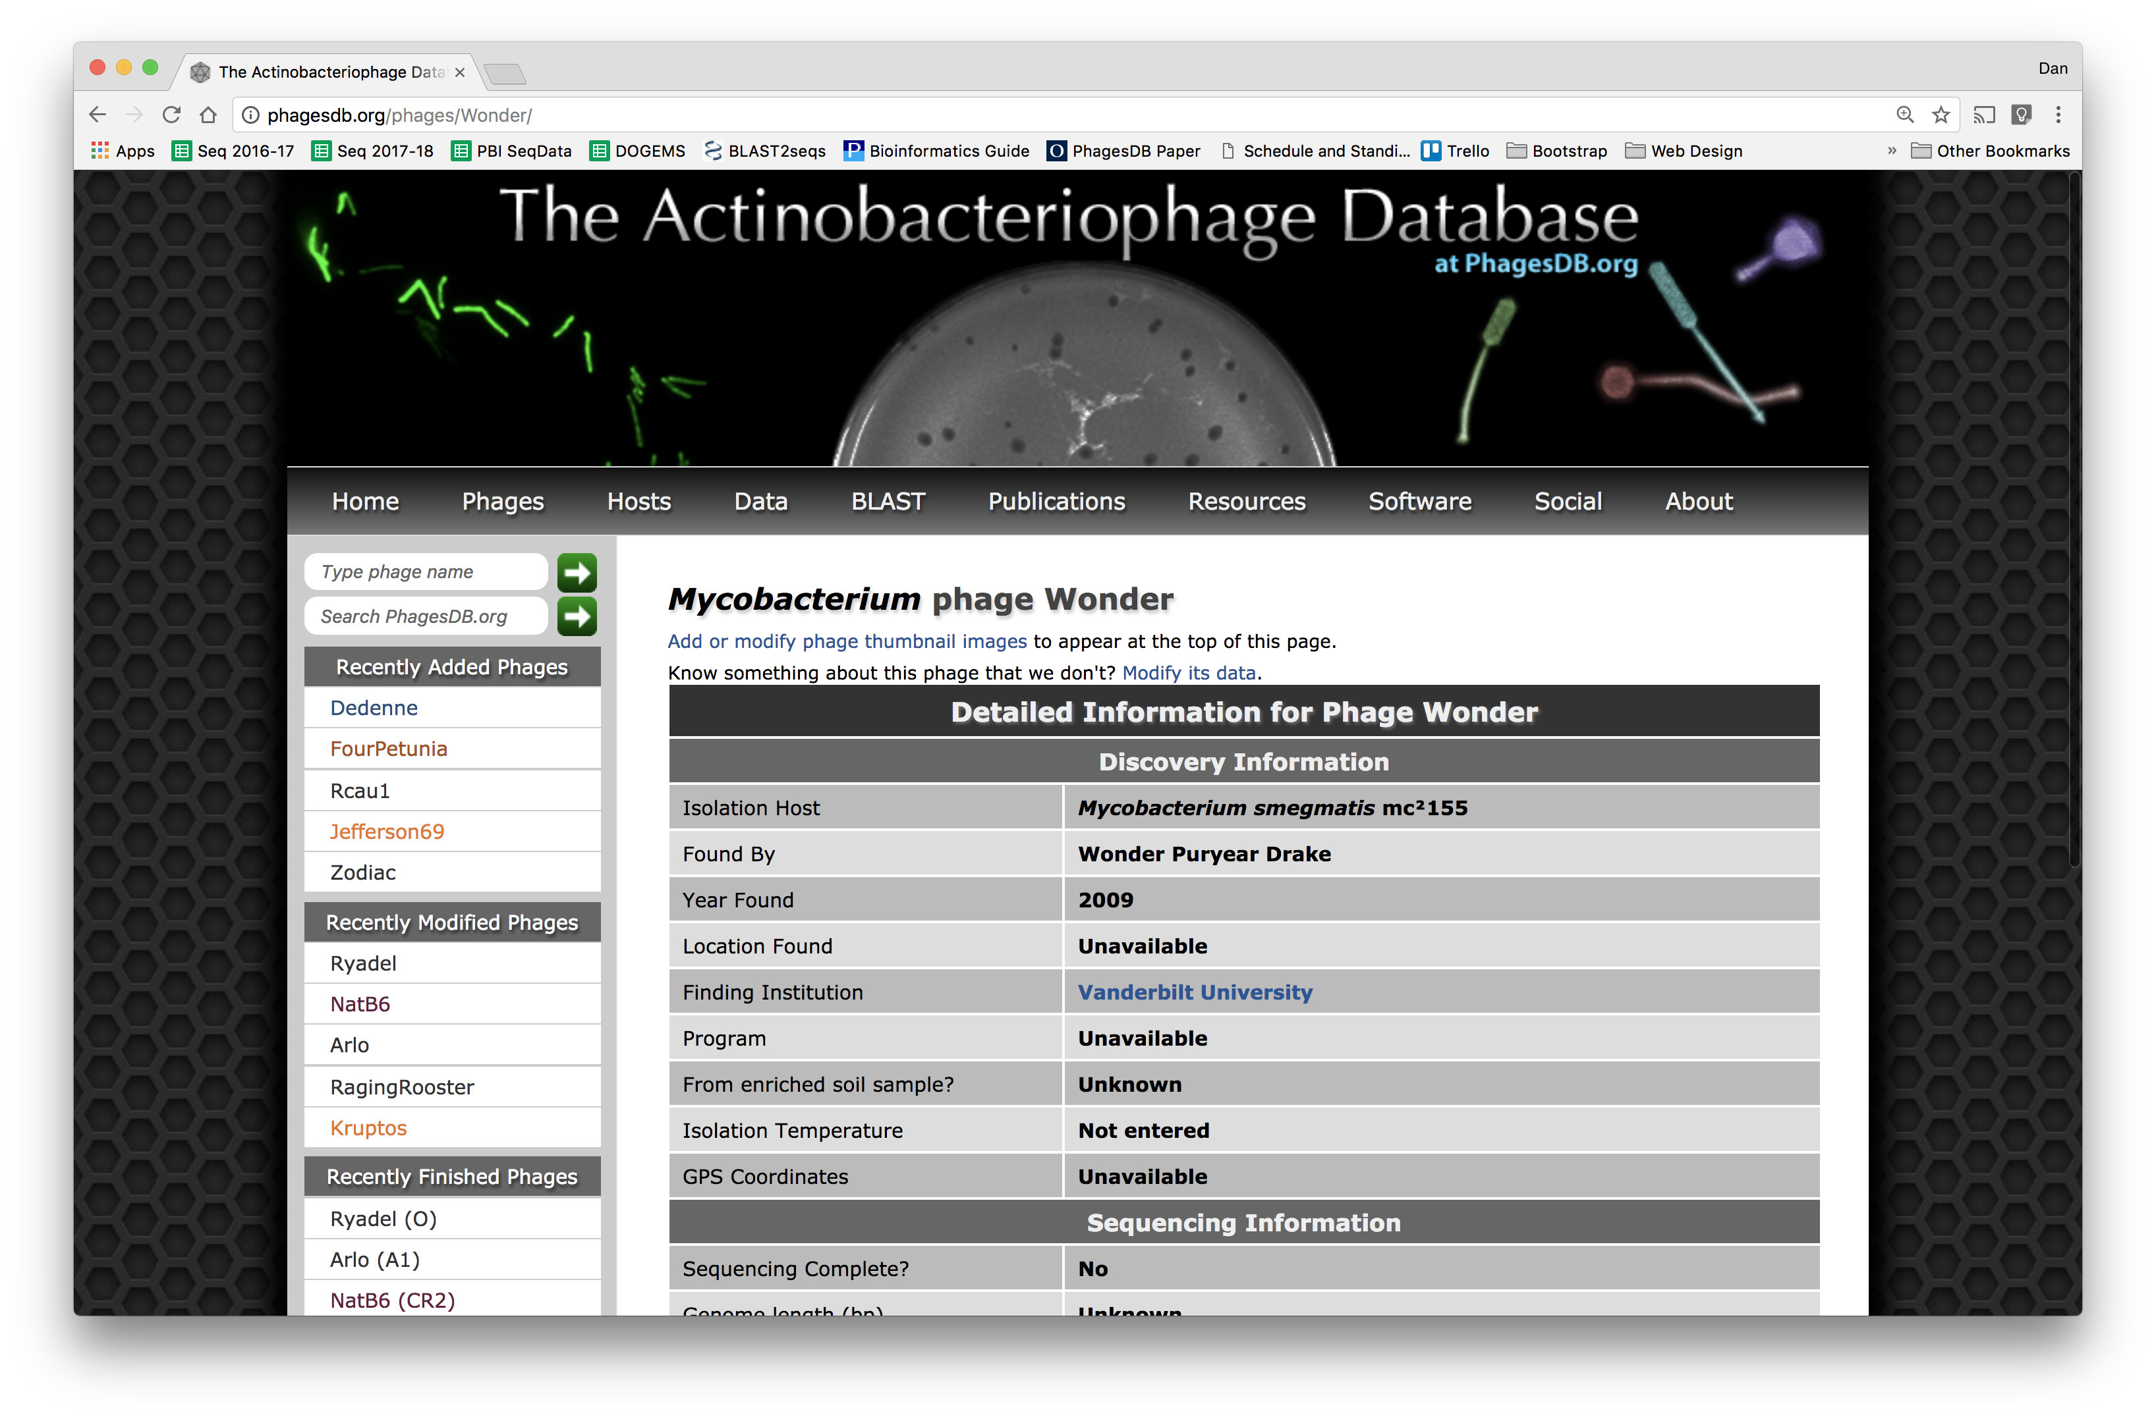

Slide 82
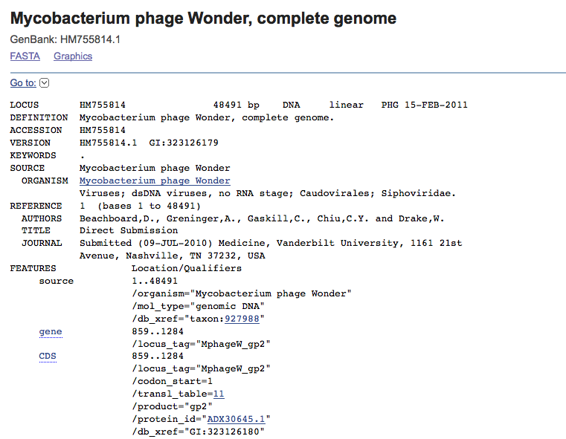
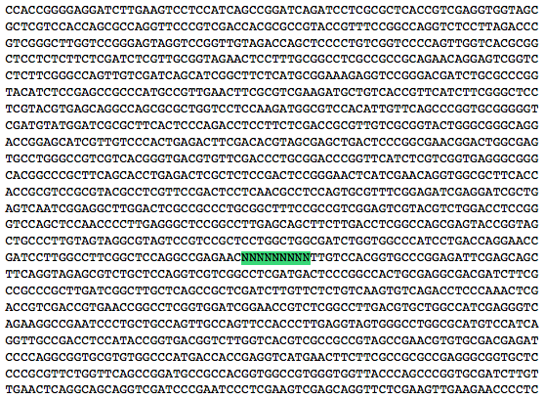
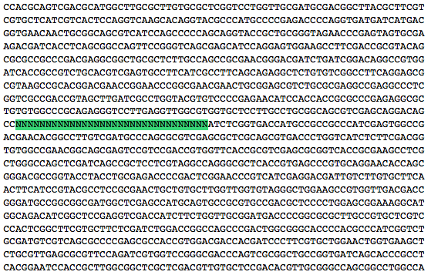

Slide 83
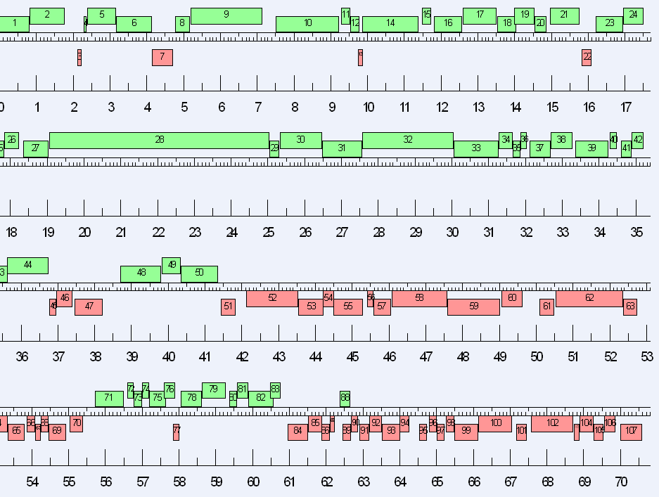

Slide 84
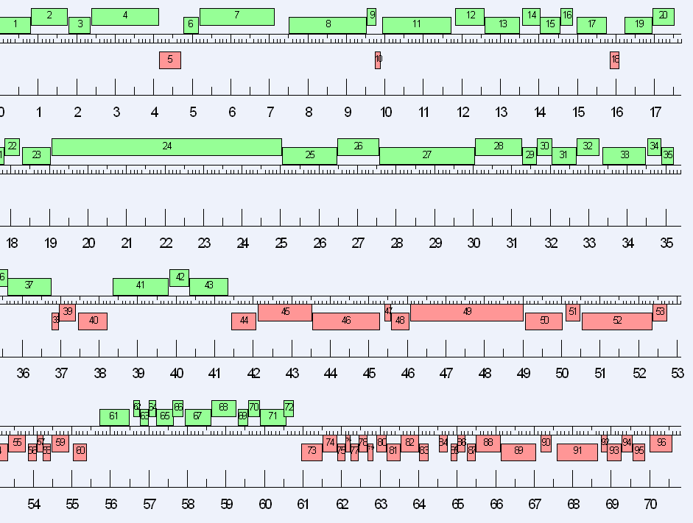

Slide 87
Why we finish
Confidence during annotation
Quality sequence in GenBank
Relatively easy
How we finish:
Consed
Bench work

Slide 88
Overview
The Winter Break Black Box
Sequencing
Assembly
Finishing
What’s new?

Slide 89
Improved Sequencing and SEA-PHAGES
 | 2008- 2009 | 2009- 2010 | 2010- 2011 | 2011- 2012 | 2012- 2013 | 2013- 2014 | 2014- 2015
# Sequenced (Paid by SEA) | 13 | 24 | 40 | 56 (+20) | 72 | 72 | ~150
Median Finished Date | March | Mar 15 | Feb 24 | Jan 31 | Jan 28 | Jan 10 | Jan 16
Latest Genome | Late April | May 11 | Apr 29 | Apr 13 | Feb 19 | Feb 27 | Feb 12
Methods | Sanger | Sanger | 454 | 454 Ion Torrent | 454 Ion Torrent | Illumina | Illumina

Slide 90
Improved Sequencing and SEA-PHAGES
2015-16
348 sequenced
2016-17
392 sequenced
2017-18
426 sequenced
2018-19
~150 sequenced, ~500 expected

Slide 91
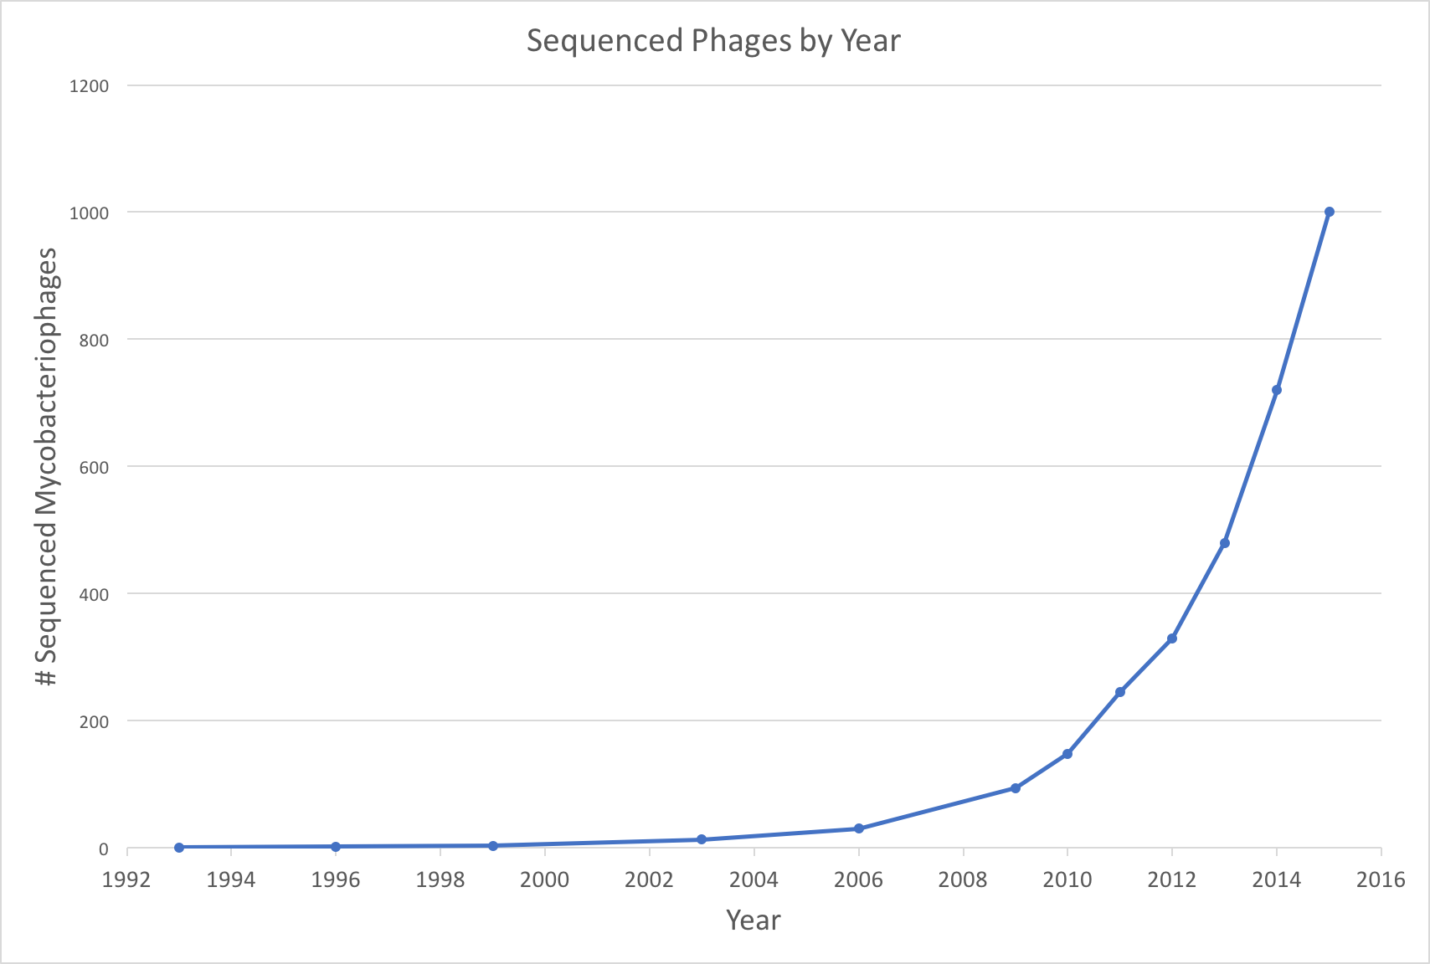
Largely because of PHIRE and SEA-PHAGES…

Slide 92
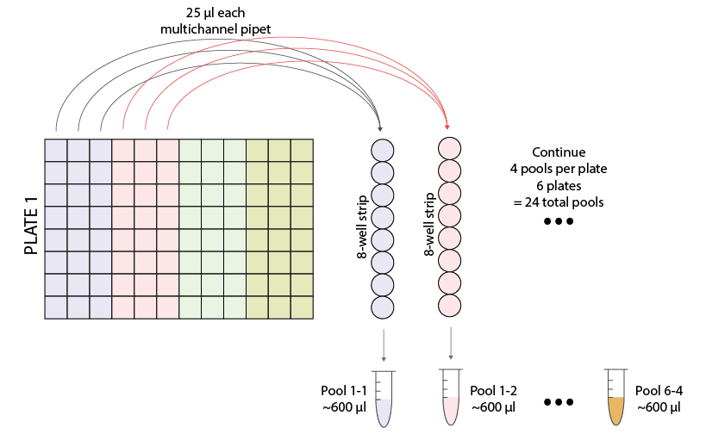
Make and sequence pools from lysate archives
Pool 24 pools of 24
= 576 phages
Extract DNA
Sequence & Assemble
Archive lysate box

Slide 93
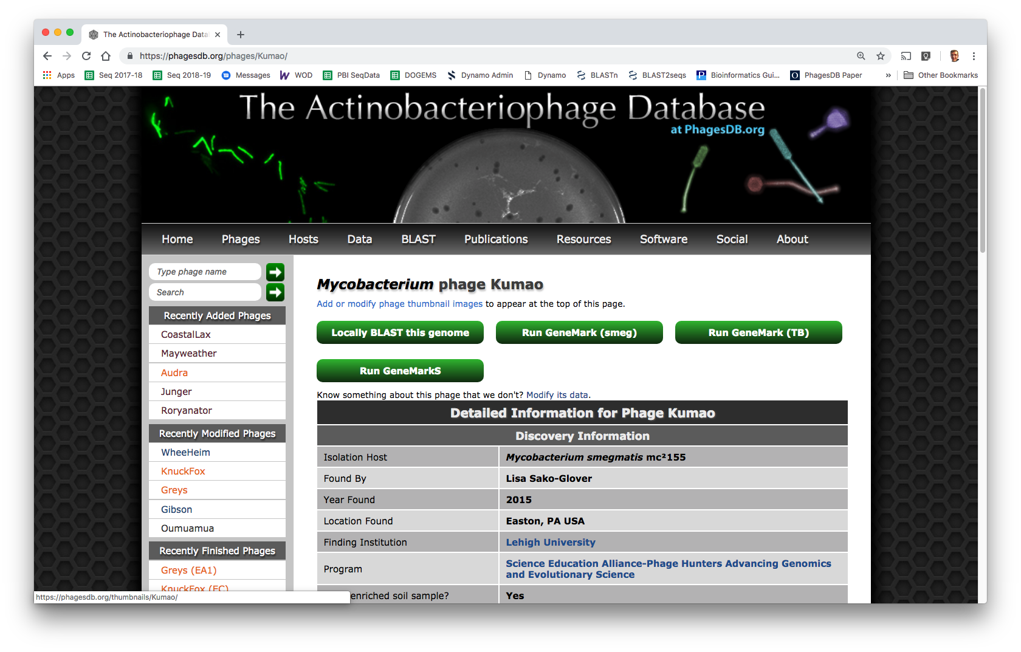

Slide 94
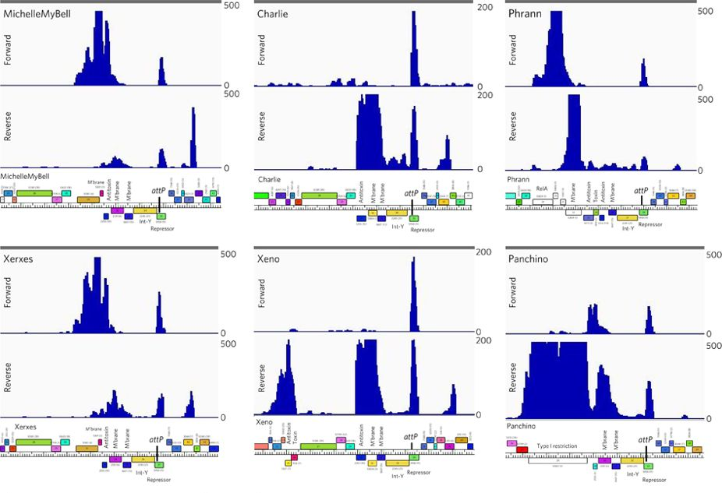

Slide 95
From 1998 Genome Project Report
“DNA sequencing technology has improved dramatically since the genome project began. The amount of sequence produced each year is increasing steadily; individual centers are now producing tens of millions of base pairs of sequence annually…”

Slide 96
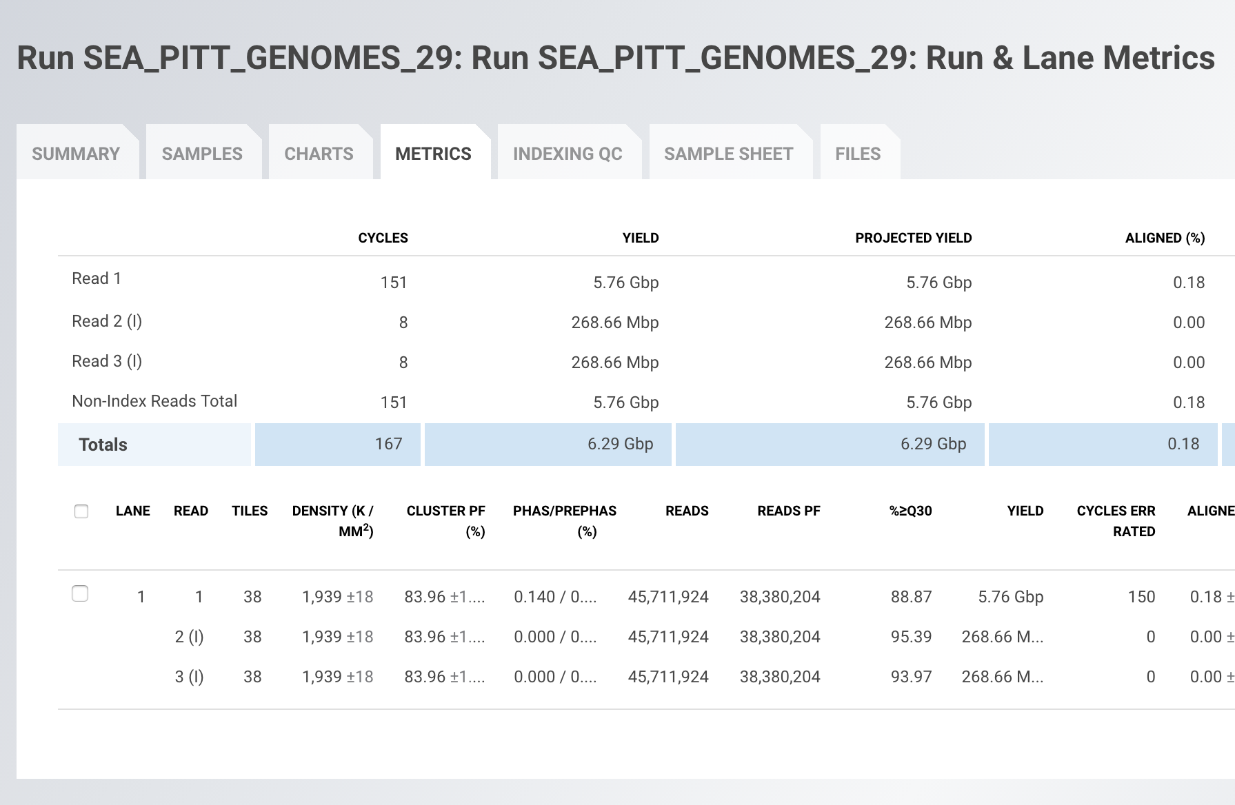
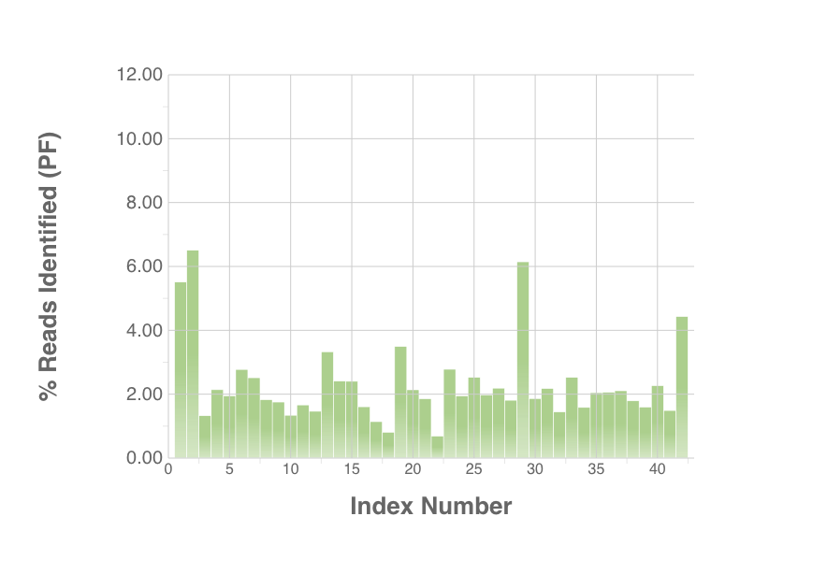
Becky Garlena

Slide 97
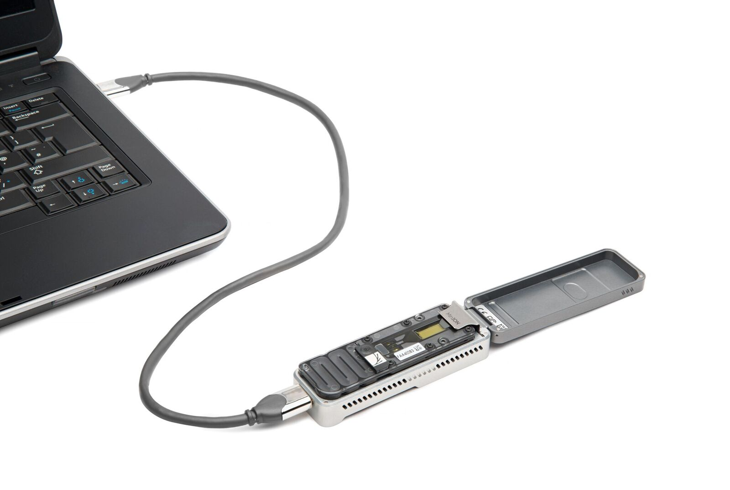

Slide 98
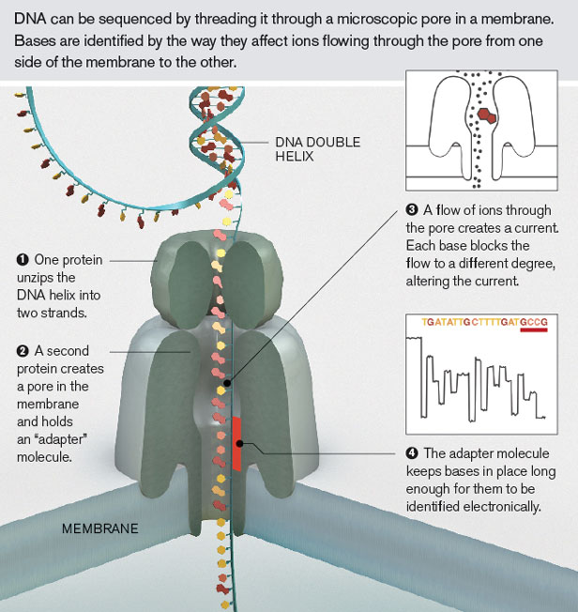
Oxford Nanopore

Slide 99
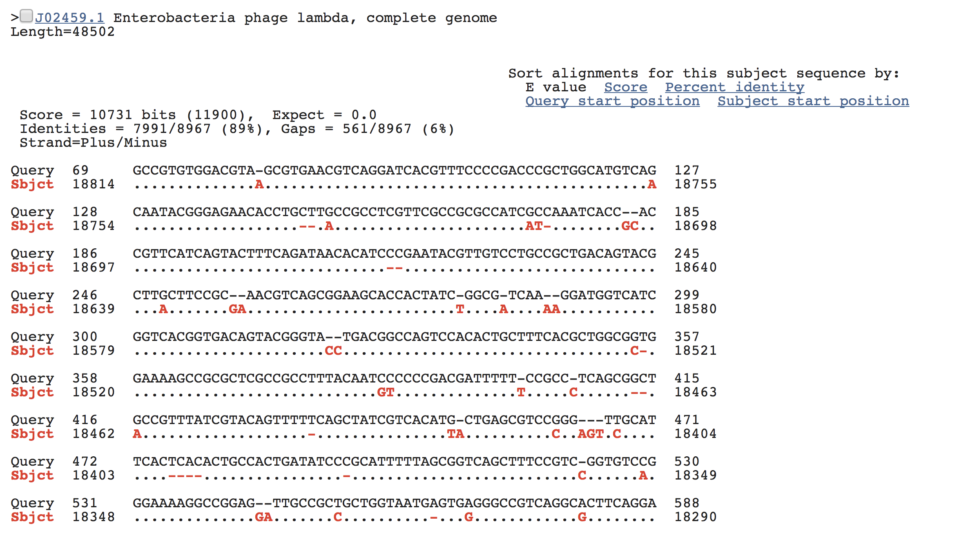

Slide 100
“The MinION has been used to successfully read … 100,000 base pairs during a single DNA capture, [which] has never been managed before using traditional sequencing techniques.
… but Oxford Nanopore has also introduced GridION [and] the company reckon that a 20-node GridION setup can sequence a complete human genome in just 15 minutes.”
—Wired

Slide 101
GATTACA

Slide 102
(Relevant) Trivia
How many base pairs (bp) are there in a human genome?
How much did it cost to sequence the first human genome?
How long did it take to sequence the first human genome?
When was the first human genome sequence complete?
~3 billion (haploid)
~$2.7 billion
~13 years
2000-2003

Slide 103
Take home
Sequencing getting better faster than computers
Finishing is a prerequisite for annotation
Bioinformatics skills are very marketable

Slide 104
Thanks!
Questions?

