Slide 1
Biological Information Flow

Slide 2
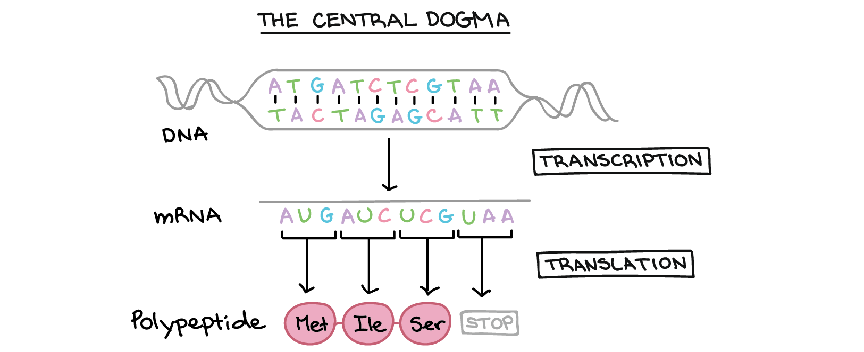
Khan Academy, www.khanacademy.org

Slide 3
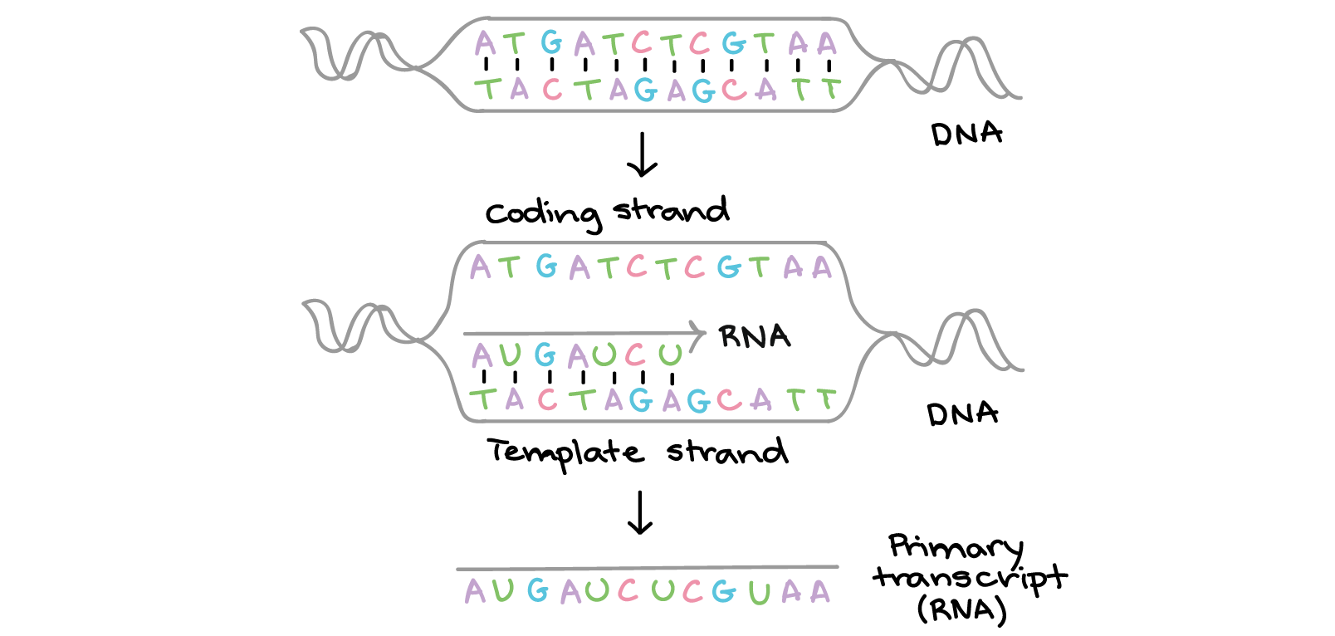
Transcription
Khan Academy, www.khanacademy.org

Slide 4
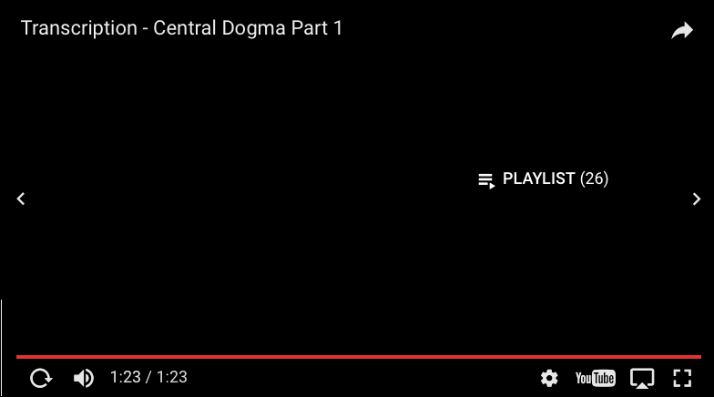
https://www.youtube.com/watch?v=xSQybiea2AA
Drew Berry

Slide 5
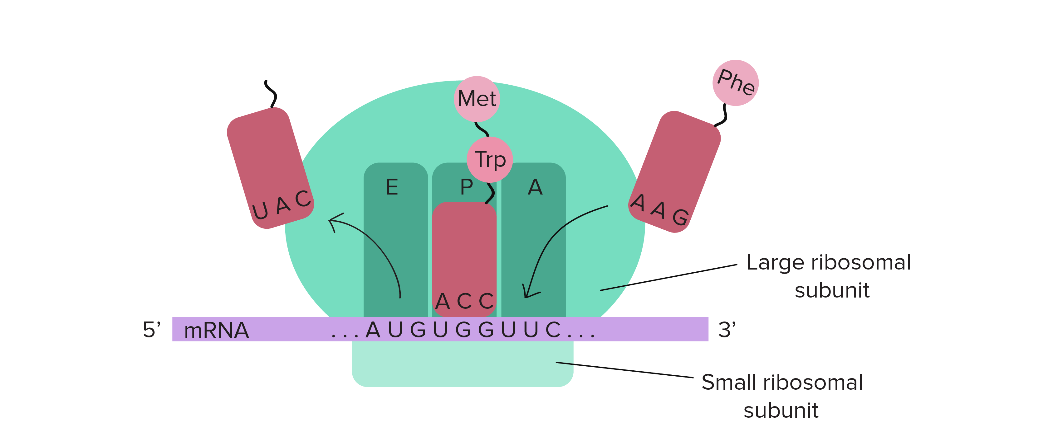
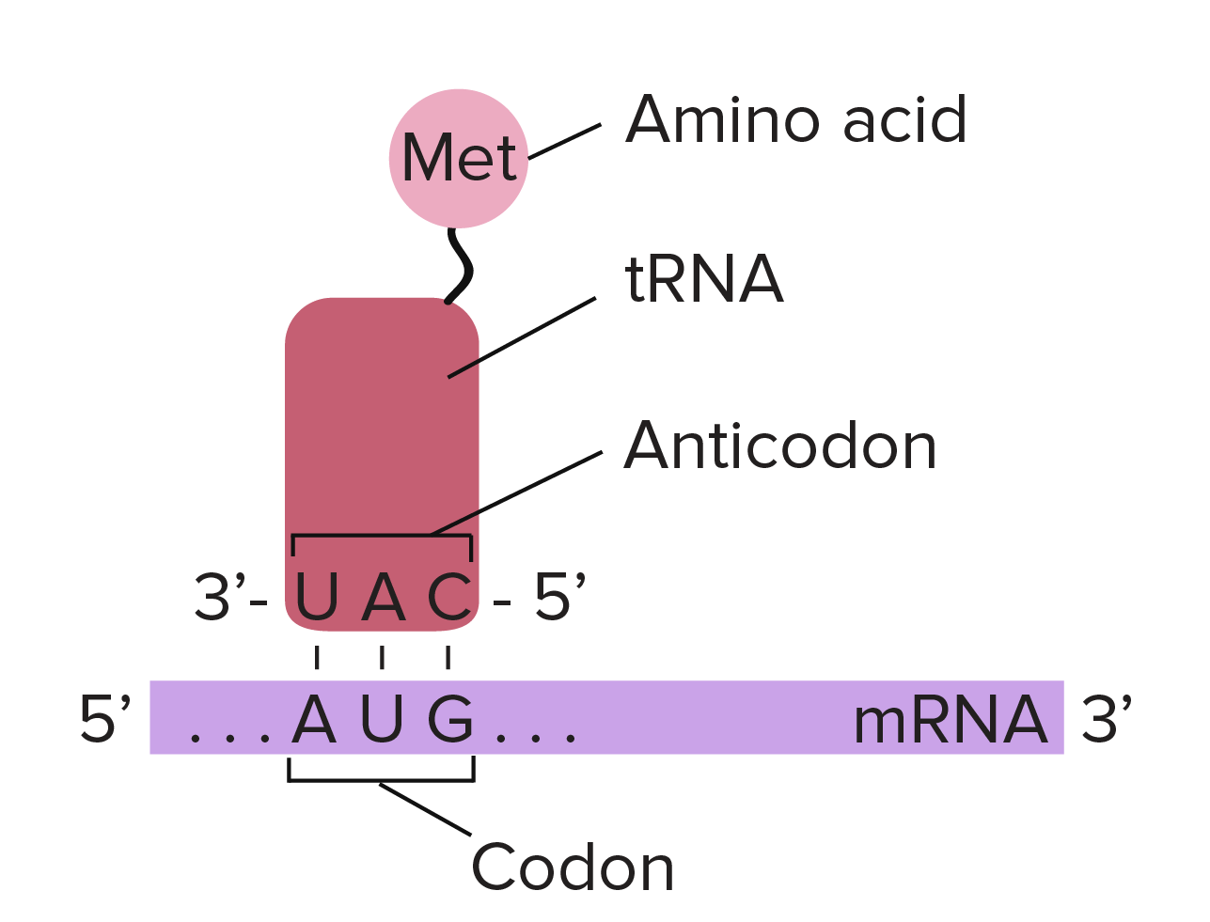
Translation

Slide 6
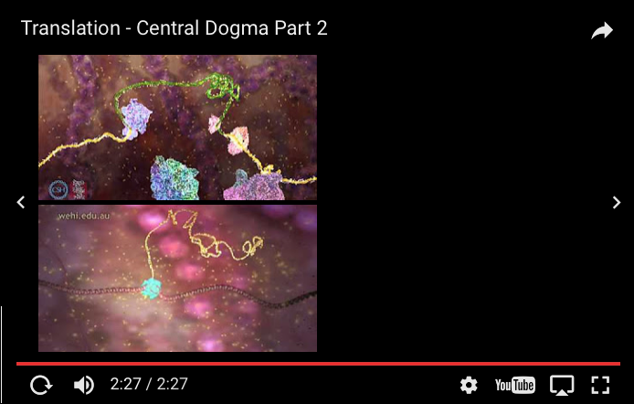
https://www.youtube.com/watch?v=WkI_Vbwn14g
Drew Berry

Slide 7
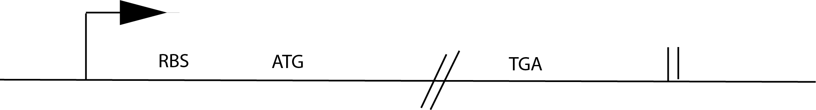
Prokarotic Gene Organization

Slide 8
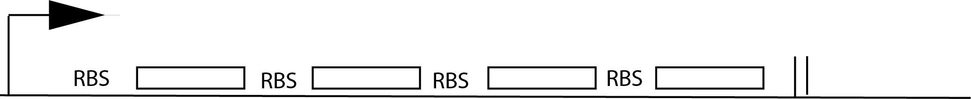
Operon Organization

Slide 9
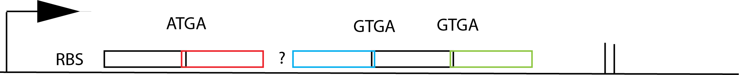
More realistic phage operon organization

Slide 10
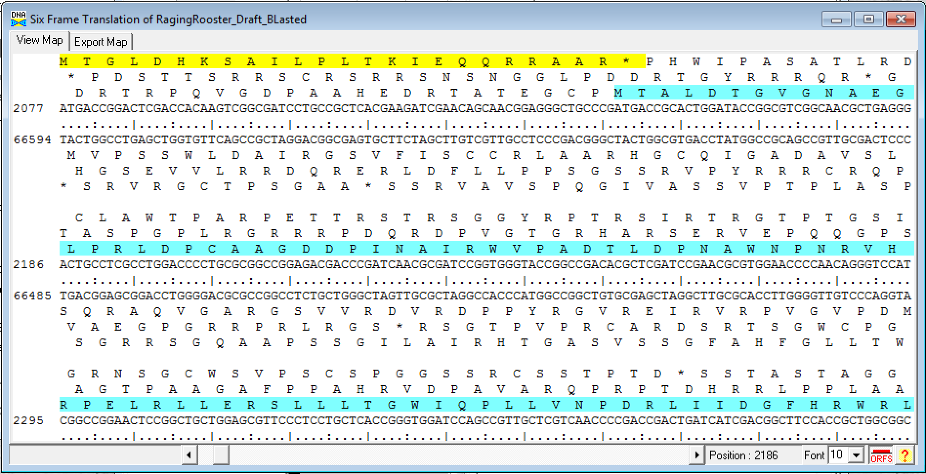

Slide 11
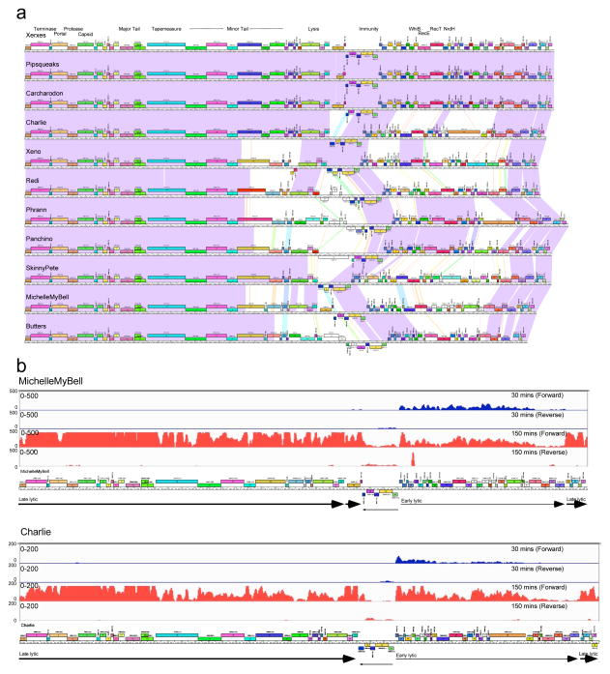
Dedrick et al 2017, Nature Micro

Slide 13
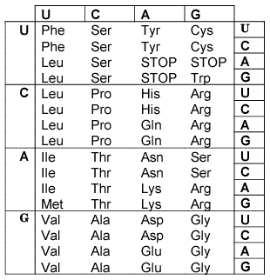
Gene Expression: Codon Usage

Slide 14
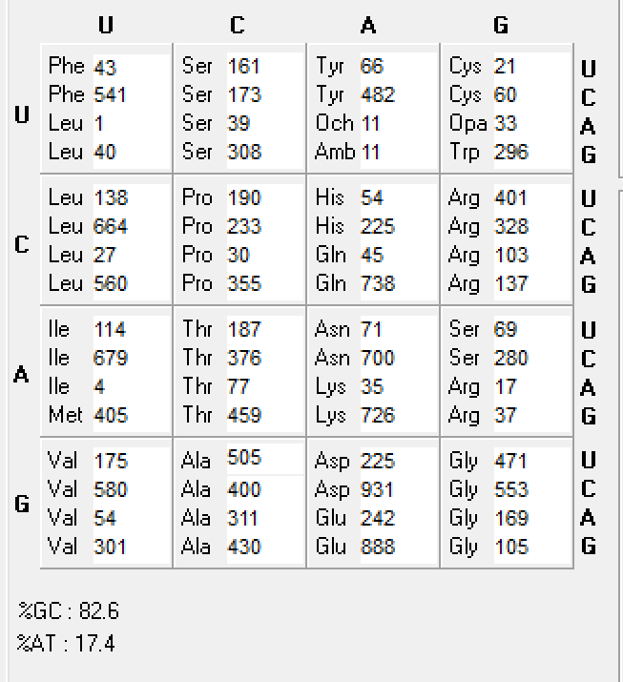
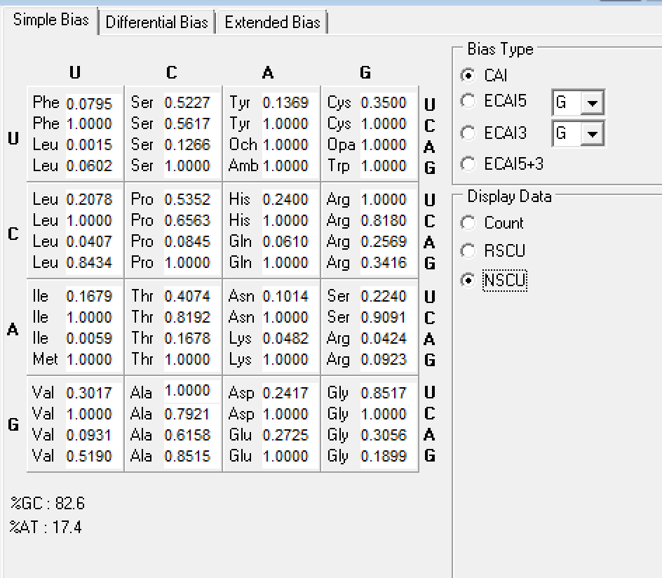
Codon Usage in ArMaWen
Total codon counts
Normalized Codon Usage
How does codon usage affect gene expression?
How does codon usage affect gene annotation?

Slide 15
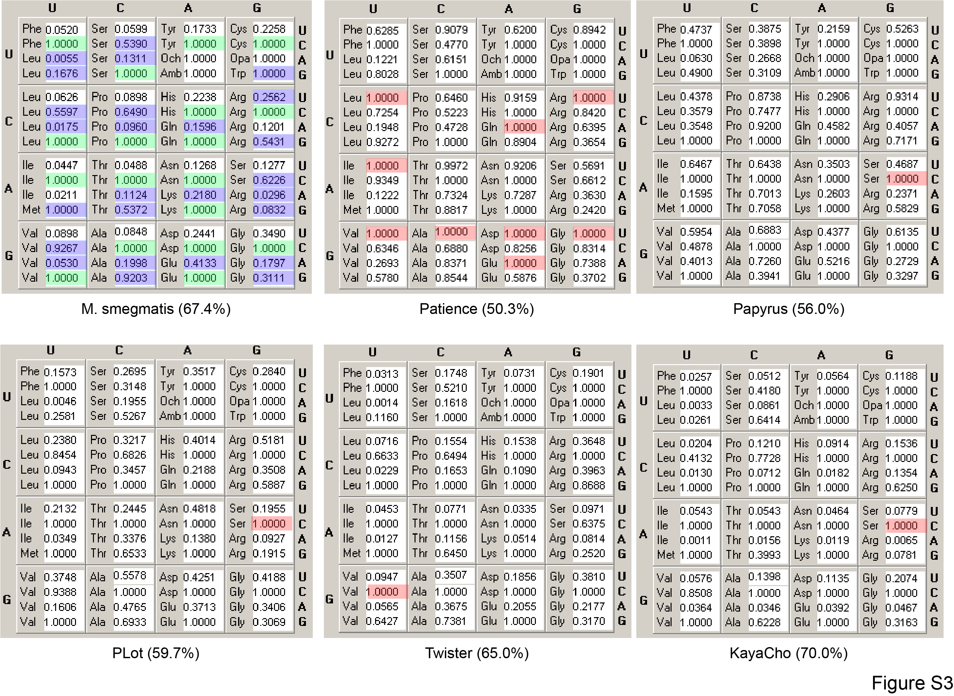
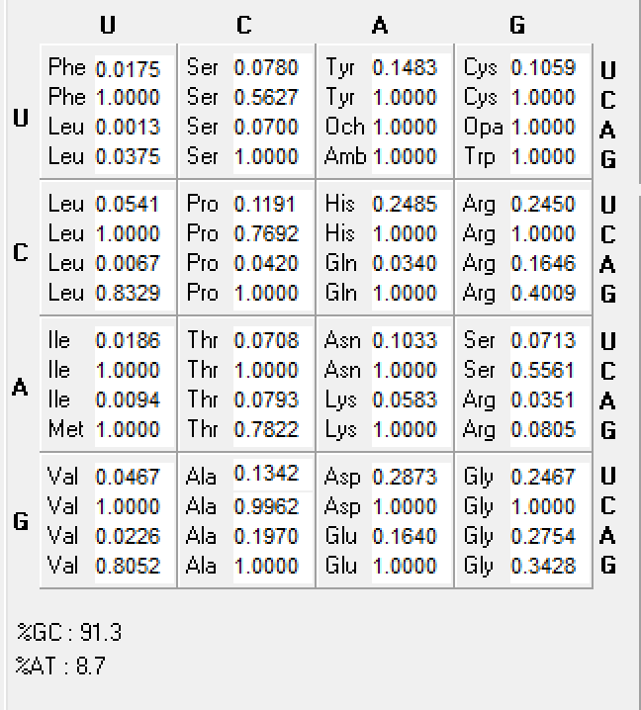
M. foliorum
ArMaWen

Slide 16
R H L S L P S I F F Q A I S A F F H T R P A Q E Q P M D M T E S A P
G T F L S P A F F S K P F Q R F S T P D Q H R S N Q W T * P N P H
A P F S P Q H F F P S H F S V F P H P T S T G A T N G H D R I R T
1 AGGCACCTTTCTCTCCCCAGCATTTTTTTCCAAGCCATTTCAGCGTTTTTCCACACCCGACCAGCACAGGAGCAACCAATGGACATGACCGAATCCGCAC
....:....|....:....|....:....|....:....|....:....|....:....|....:....|....:....|....:....|....:....|
TCCGTGGAAAGAGAGGGGTCGTAAAAAAAGGTTCGGTAAAGTCGCAAAAAGGTGTGGGCTGGTCGTGTCCTCGTTGGTTACCTGTACTGGCTTAGGCGTG
Y A G K E G W C K K G L W K L T K G C G V L V P A V L P C S R I R V
L C R E R G L M K K W A M E A N K W V R G A C S C G I S M V S D A
P V K R E G A N K E L G N * R K E V G S W C L L L W H V H G F G C
T A R V W A F E D Q R D R A V R E Q S M H I A L R Q A D S V G I G
R L R A C G R S R I S A T A R C A S N Q C T S R C A R P T A W V S A
D C A R V G V R G S A R P R G A R A I N A H R A A P G R Q R G Y R
101 CGACTGCGCGCGTGTGGGCGTTCGAGGATCAGCGCGACCGCGCGGTGCGCGAGCAATCAATGCACATCGCGCTGCGCCAGGCCGACAGCGTGGGTATCGG
....:....|....:....|....:....|....:....|....:....|....:....|....:....|....:....|....:....|....:....|
GCTGACGCGCGCACACCCGCAAGCTCCTAGTCGCGCTGGCGCGCCACGCGCTCGTTAGTTACGTGTAGCGCGACGCGGTCCGGCTGTCGCACCCATAGCC
S Q A R T P T R P D A R G R P A R A I L A C R A A G P R C R P Y R
G V A R T H A N S S * R S R A T R S C D I C M A S R W A S L T P I P
R S R A H P R E L I L A V A R H A L L * H V D R Q A L G V A H T D
D L T V I E A A D K I A A F I L D G K V D R R P D A E R S P E * *
T * P * S R R P T R S P L S S S T A R S T G A P T L S G A P N D D
R L D R D R G G R Q D R R F H P R R Q G R P A P R R * A E P R M M T
201 CGACTTGACCGTGATCGAGGCGGCCGACAAGATCGCCGCTTTCATCCTCGACGGCAAGGTCGACCGGCGCCCCGACGCTGAGCGGAGCCCCGAATGATGA
....:....|....:....|....:....|....:....|....:....|....:....|....:....|....:....|....:....|....:....|
GCTGAACTGGCACTAGCTCCGCCGGCTGTTCTAGCGGCGAAAGTAGGAGCTGCCGTTCCAGCTGGCCGCGGGGCTGCGACTCGCCTCGGGGCTTACTACT
R S S R S R P P R C S R R K * G R R C P R G A G R R Q A S G R I I
S K V T I S A A S L I A A K M R S P L T S R R G S A S R L G S H H
A V Q G H D L R G V L D G S E D E V A L D V P A G V S L P A G F S S

Slide 17
GeneMark output of Anaya using M. tuberculosis model

