Slide 1
Inside the Black Box: Phage Genome Sequencing, Assembly, and Finishing
Dan Russell

Slide 2
(Relevant) Trivia
How many base pairs (bp) are there in a human genome?
How much did it cost to sequence the first human genome?
How long did it take to sequence the first human genome?
When was the first human genome sequence complete?
Whose genome was it?

Slide 3
(Relevant) Trivia
How many base pairs (bp) are there in a human genome?
How much did it cost to sequence the first human genome?
How long did it take to sequence the first human genome?
When was the first human genome sequence complete?
Whose genome was it?
~3 billion (haploid)
~$2.7 billion
~13 years
2000-2003
Several people’s, but actually mostly a dude from Buffalo

Slide 4
Overview
The Winter Break Black Box
Assembly
Sequencing
Finishing
What’s new?

Slide 5
Overview
The Winter Break Black Box
Assembly
Sequencing
Finishing
What’s new?

Slide 6
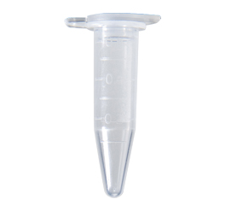
NaSiaTalie DNA
Fall semester lab work
Spring semester annotation
NaSiaTalie.fasta

Slide 7
NaSiaTalie DNA
Fall semester lab work
What happens in here?
Spring semester annotation
NaSiaTalie.fasta

Slide 8
Overview
The Winter Break Black Box
Assembly
Sequencing
Finishing
What’s new?

Slide 9
Method | Read Length
Sanger | 600-1000 bp
454 | 400-800 bp
Illumina | 75-300 bp
Ion Torrent | ~200 bp
PacBio | ~10,000 bp
But…
Phage Genome: 5,000 to 500,000 bp
Bacteria: Several million bp
Human: 3 billion bp

Slide 10
All the King’s horses and all the King’s men…
Assembly, aka
17 bp
ATTGTTCCCACAGACCG
CGGCGAAGCATTGTTCC
ACCGTGTTTTCCGACCG
AGCTCGATGCCGGCGAAG
TTGTTCCCACAGACCGTG
TTTCCGACCGAAATGGC
ATGCCGGCGAAGCATTGT
ACAGACCGTGTTTCCCGA
TAATGCGACCTCGATGCC
AAGCATTGTTCCCACAG
TGTTTTCCGACCGAAAT
TGCCGGCGAAGCCTTGT
CCGACCGAAATGGCTCC
66 bp

Slide 11
Assembly
Consensus:
TAATGCGACCTCGATGCCGGCGAAGCATTGTTCCCACAGACCGTGTTTTCCGACCGAAATGGCTCC
ATTGTTCCCACAGACCG
CGGCGAAGCATTGTTCC
ACCGTGTTTTCCGACCG
AGCTCGATGCCGGCGAAG
TTGTTCCCACAGACCGTG
TTTCCGACCGAAATGGC
ATGCCGGCGAAGCATTGT
ACAGACCGTGTTTCCCGA
TAATGCGACCTCGATGCC
AAGCATTGTTCCCACAG
TGTTTTCCGACCGAAAT
TGCCGGCGAAGCCTTGT
CCGACCGAAATGGCTCC

Slide 12
Assembly
Consensus:
TAATGCGACCTCGATGCCGGCGAAGCATTGTTCCCACAGACCGTGTTTTCCGACCGAAATGGCTCC
ATTGTTCCCACAGACCG
CGGCGAAGCATTGTTCC
ACCGTGTTTTCCGACCG
AGCTCGATGCCGGCGAAG
TTGTTCCCACAGACCGTG
TTTCCGACCGAAATGGC
ATGCCGGCGAAGCATTGT
ACAGACCGTGTTTCCCGA
TAATGCGACCTCGATGCC
AAGCATTGTTCCCACAG
TGTTTTCCGACCGAAAT
TGCCGGCGAAGCCTTGT
CCGACCGAAATGGCTCC
Newbler (on VM!)

Slide 13
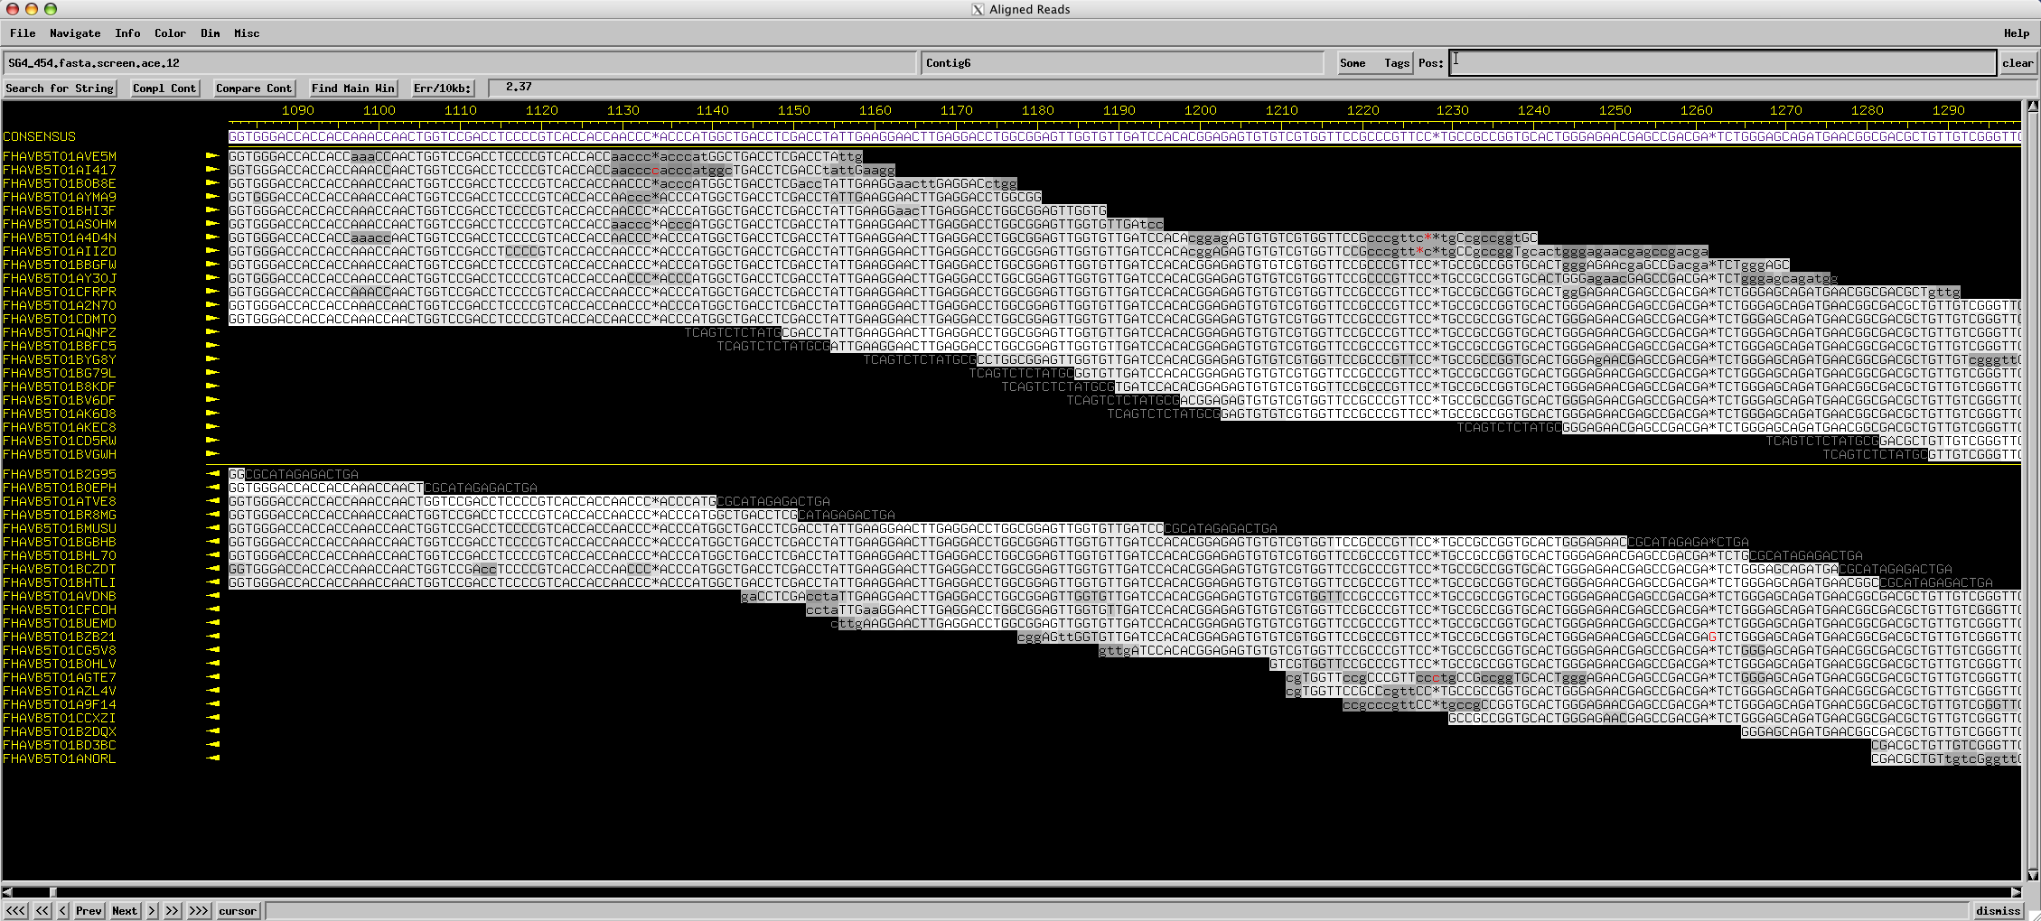
Assembly
Consed (on VM!)

Slide 14
Assembly
Using programs to find overlapping alignments in sequencing reads and to build contigs with consensus sequences.
The quality of an assembly depends on:
Program used
Type, quality, and length of individual reads
Number of reads used

Slide 15
Overview
The Winter Break Black Box
Assembly
Sequencing*
Finishing
What’s new?

Slide 16
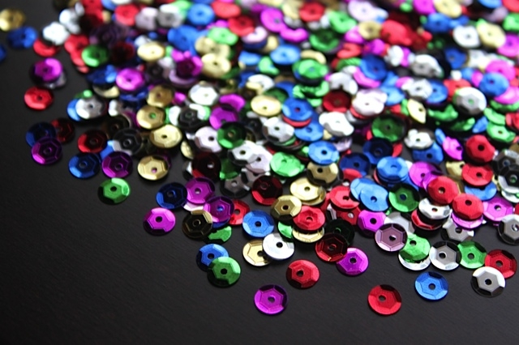
SEQUINS

Slide 17
Overview
The Winter Break Black Box
Assembly
Sequencing*
Finishing
What’s new?
* Determining the number and order of As, Cs, Gs, and Ts that comprise a piece of DNA

Slide 18
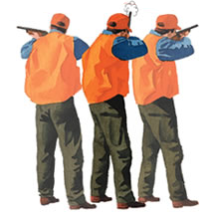
Shotgun Genome Sequencing
Complete genome copies
Fragmented genome chunks

Slide 19
Shotgun Genome Sequencing
Fragmented genome chunks
NOT REALLY DONE BY DUCK HUNTERS
Hydroshearing, sonication, enzymatic shearing
Notes:
Fragment sizes differ for different seq platforms.

Slide 20
Fragments were cloned:

Slide 21
x millions
x millions
Notes:
One tube per 2 sequences with Sanger and cloning. Not so bad if you only want 100 sequences. What if you want 1 million?

Slide 22
x millions
x millions
Notes:
One tube per 2 sequences with Sanger and cloning. Not so bad if you only want 100 sequences. What if you want 1 million?

Slide 23
Sanger Sequencing Reactions
Like PCR, except:
One primer
Make ssDNA pieces
Not exponential
Two kinds of nucleotides
Dideoxy Nucleotides
G
A
T
C
Regular Nucleotides
T
C
G
A
C
G
A
T
G
G
A
T
G
T
C
G
A
A
T
A
C
T
G
G
A
T
A
T
G
Labeled
Terminators
T
A
C
C
G
A
C
C
A
T
A
C
G

Slide 24
Sanger Sequencing
Primer
5’
T G C G C G G C C C A
A C G C G C C G G G T ? ? ? ? ? ? ? ? ? ? ? ? ? ? ?
3’
5’

Slide 25
Sanger Sequencing
Primer
5’
G T C T T G G G C T
T G C G C G G C C C A
A C G C G C C G G G T C A G A A C C C G A T C G C G
3’
5’

Slide 26
Sanger Sequencing
Primer
5’
G T C T T G G G C T A G C G C
T G C G C G G C C C A
A C G C G C C G G G T C A G A A C C C G A T C G C G
3’
5’
5’
21 bp
G T C T T G G G C T
T G C G C G G C C C A

Slide 27
Sanger Sequencing
Primer
5’
G T C T T G G G C T A
T G C G C G G C C C A
A C G C G C C G G G T C A G A A C C C G A T C G C G
3’
5’
5’
21 bp
G T C T T G G G C T
T G C G C G G C C C A
5’
26 bp
G T C T T G G G C T A G C G C
T G C G C G G C C C A

Slide 28
Sanger Sequencing
Primer
5’
G
T G C G C G G C C C A
A C G C G C C G G G T C A G A A C C C G A T C G C G
3’
5’
5’
21 bp
G T C T T G G G C T
T G C G C G G C C C A
5’
26 bp
G T C T T G G G C T A G C G C
T G C G C G G C C C A
5’
22 bp
G T C T T G G G C T A
T G C G C G G C C C A

Slide 29
Sanger Sequencing
Primer
5’
G T C T T G G G C
T G C G C G G C C C A
A C G C G C C G G G T C A G A A C C C G A T C G C G
3’
5’
5’
21 bp
G T C T T G G G C T
T G C G C G G C C C A
5’
26 bp
G T C T T G G G C T A G C G C
T G C G C G G C C C A
5’
22 bp
G T C T T G G G C T A
T G C G C G G C C C A
5’
12 bp
G
T G C G C G G C C C A

Slide 30
Sanger Sequencing
Primer
5’
G T C T T
T G C G C G G C C C A
A C G C G C C G G G T C A G A A C C C G A T C G C G
3’
5’
5’
21 bp
G T C T T G G G C T
T G C G C G G C C C A
5’
26 bp
G T C T T G G G C T A G C G C
T G C G C G G C C C A
5’
22 bp
G T C T T G G G C T A
T G C G C G G C C C A
5’
12 bp
G
T G C G C G G C C C A
5’
20 bp
G T C T T G G G C
T G C G C G G C C C A

Slide 31
Sanger Sequencing
A C G C G C C G G G T C A G A A C C C G A T C G C G
3’
5’
5’
21 bp
G T C T T G G G C T
T G C G C G G C C C A
5’
26 bp
G T C T T G G G C T A G C G C
T G C G C G G C C C A
5’
22 bp
G T C T T G G G C T A
T G C G C G G C C C A
5’
12 bp
G
T G C G C G G C C C A
5’
20 bp
G T C T T G G G C
T G C G C G G C C C A
5’
16 bp
G T C T T
T G C G C G G C C C A

Slide 32
Sanger Sequencing
A C G C G C C G G G T ? ? ? ? ? ? ? ? ? ? ? ? ? ? ?
3’
5’
5’
21 bp
? ? ? ? ? ? ? ? ? T
T G C G C G G C C C A
5’
26 bp
? ? ? ? ? ? ? ? ? ? ? ? ? ? C
T G C G C G G C C C A
5’
22 bp
? ? ? ? ? ? ? ? ? ? A
T G C G C G G C C C A
5’
12 bp
G
T G C G C G G C C C A
5’
20 bp
? ? ? ? ? ? ? ? C
T G C G C G G C C C A
5’
16 bp
? ? ? ? T
T G C G C G G C C C A
Notes:
Has to be done in a single tube per rxn.

Slide 33
Sanger Sequencing
Laser Reader
5’
5’
5’
5’
5’
5’
5’
5’
5’
5’
5’
20 bp
21 bp
19 bp
18 bp
13 bp
22 bp
15 bp
16 bp
14 bp
17 bp
G T C T T G G G C
12 bp
T G C G C G G C C C A
G T C T T G G G C T
T G C G C G G C C C A
G T C T T G G G
T G C G C G G C C C A
G T C T T G G
G T C T T G G G C T A
G T C T
T G C G C G G C C C A
T G C G C G G C C C A
G T
G T C T T
G T C T T G
G
T G C G C G G C C C A
T G C G C G G C C C A
T G C G C G G C C C A
T G C G C G G C C C A
T G C G C G G C C C A
T G C G C G G C C C A
G T C

Slide 34
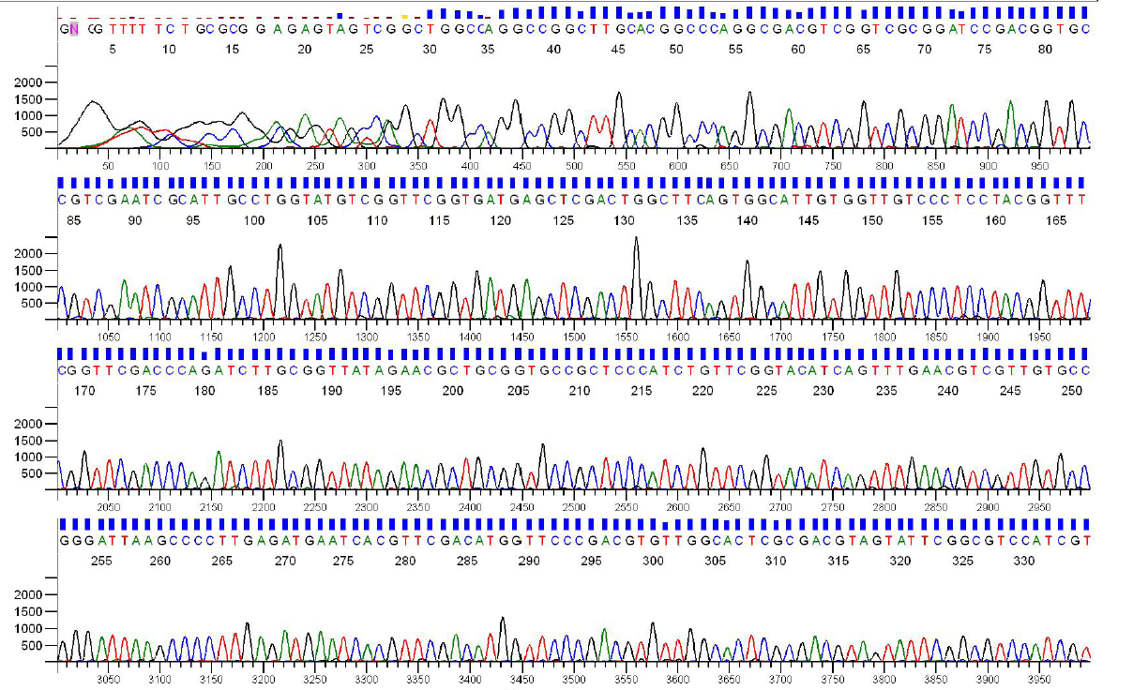
Sanger Sequencing Output
Each sequencing reaction gives us a chromatogram, usually ~600-1000 bp:

Slide 35
Diversion: Why clone?
Signal vs. Noise

Slide 39
Diversion: Why clone?
Signal vs. Noise
It’s difficult to measure a single base being added to a single strand of DNA
Sequencing technologies either boost signal or reduce noise

Slide 40
Sanger Throughput Limitations
Must have 1 colony picked for every 2 reactions
Must do 1 DNA prep for every 2 reactions
Must have 1 PCR tube for each reaction
Must have 1 gel lane for each reaction

Slide 41
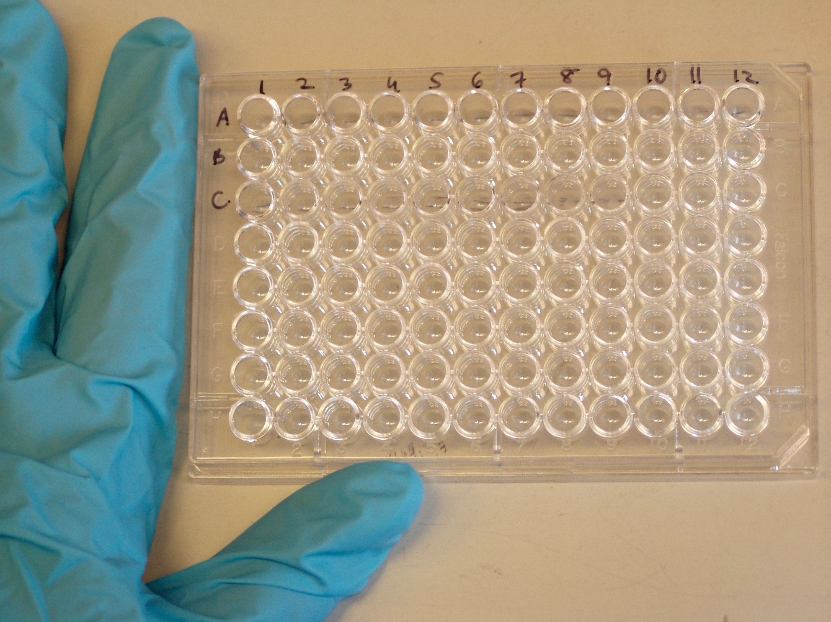
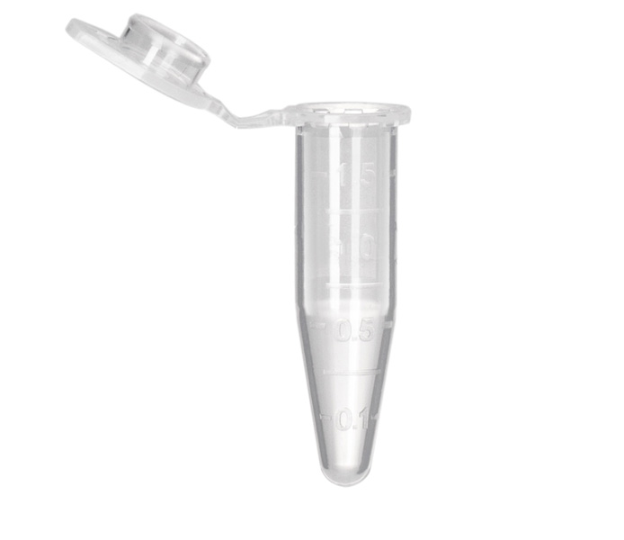
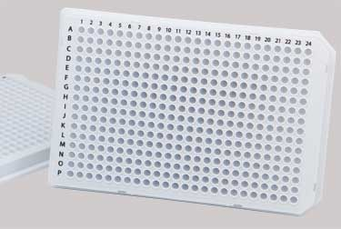
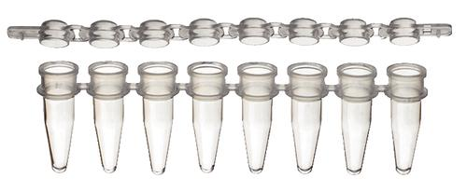

Slide 42
Colony Picking Robot

Slide 43
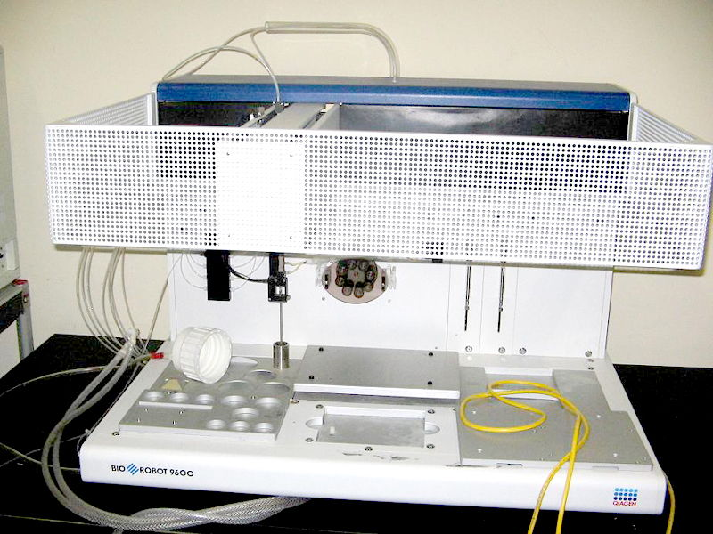

Slide 44
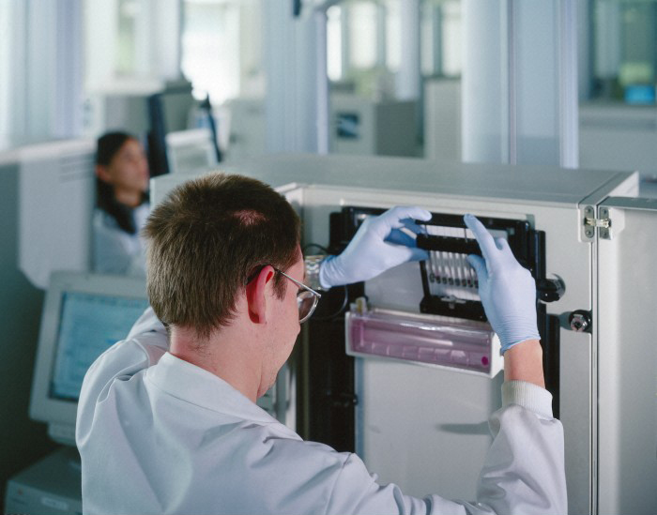

Slide 45
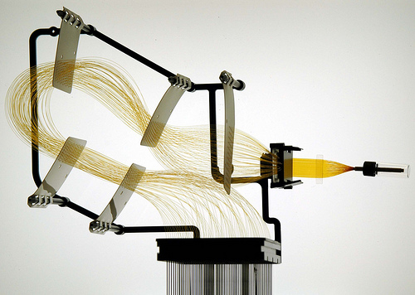
Arrays

Slide 46
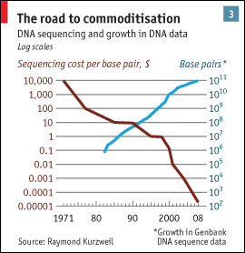
Sanger Throughput Limitations
Must have 1 colony picked for every 2 reactions
Must do 1 DNA prep for every 2 reactions
Must have 1 PCR tube for each reaction
Must have 1 gel lane for each reaction
from The Economist

Slide 47
Problem: How can we do way more reactions at once without having more tubes, thermocyclers, etc.?

Slide 48
Next generation sequencing
Massively parallel

Slide 49
Next generation sequencing

Slide 50
Shotgun sequencing by PGM/454
Genomic
Fragment
Adapters

Slide 51
Next generation sequencing

Slide 52
Shotgun sequencing by PGM/454
Bead/ISP
Adapter
Complement
Sequences
The idea is that each bead should be amplified
all over with a SINGLE library fragment.

Slide 53
Shotgun sequencing by PGM/454
Problem: How do I do PCR to amplify the fragments without having to use 1 tube for each reaction?

Slide 54
Shotgun sequencing by PGM/454

Slide 55
Shotgun sequencing by PGM/454

Slide 56
Shotgun sequencing by PGM/454

Slide 57
Shotgun sequencing by PGM/454
~3.5 µm for Ion Torrent, ~30 µm for 454

Slide 58
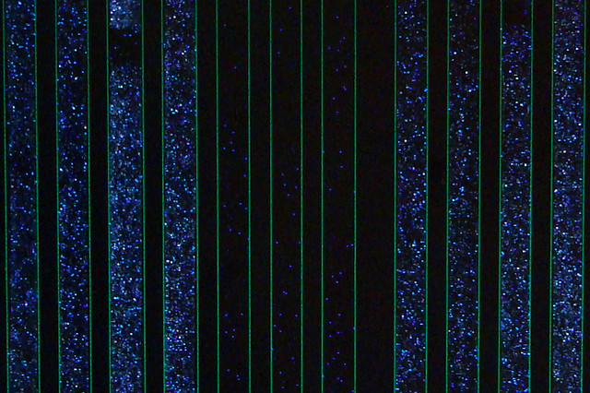
Raw 454 data
Only give polymerase one nucleotide at a time:
G
G
G
Primer
G
G
5’
G
T
T G C G C G G C C C A
C
T T
G G G
A C G C G C C G G G T C A G A A C C C G A T C G C G
3’
5’
If that nucleotide is incorporated, enzymes turn by-products into light:
1 2 3 4 5
The real power of this method is that it can take place in millions of tiny wells in a single plate at once.
T C A G T C A G T C A G

Slide 59
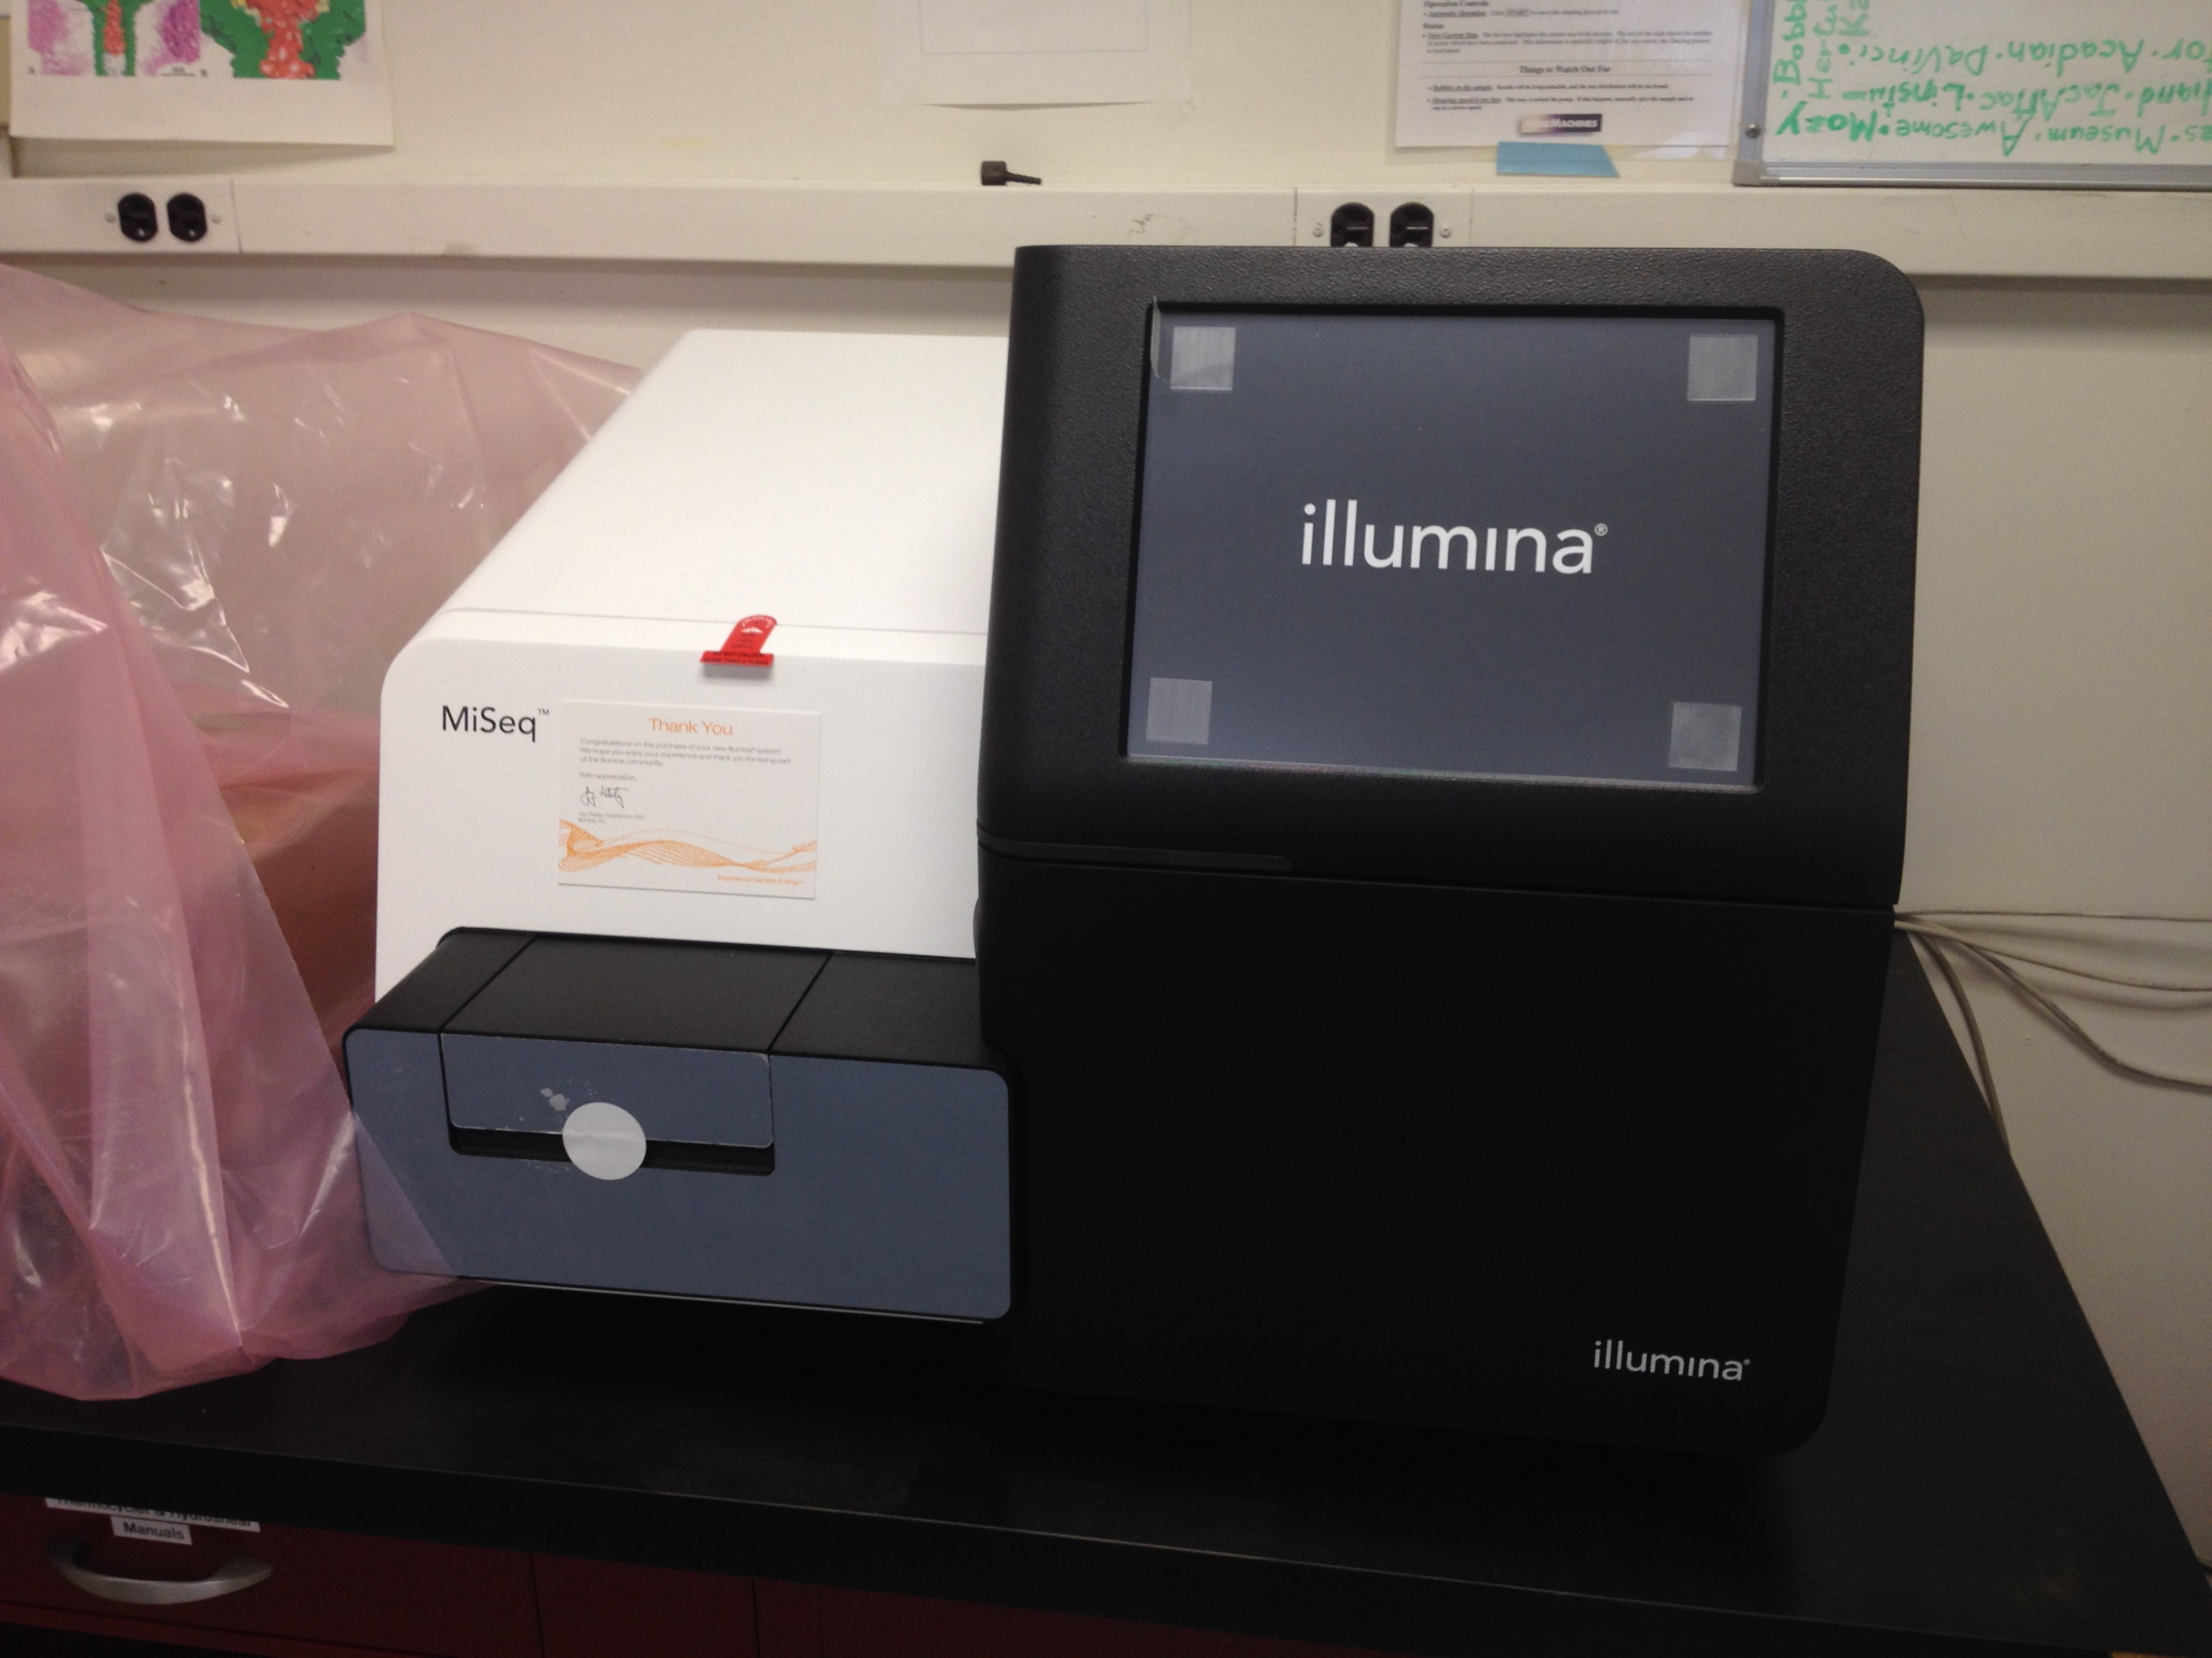
Illumina Sequencing

Slide 60
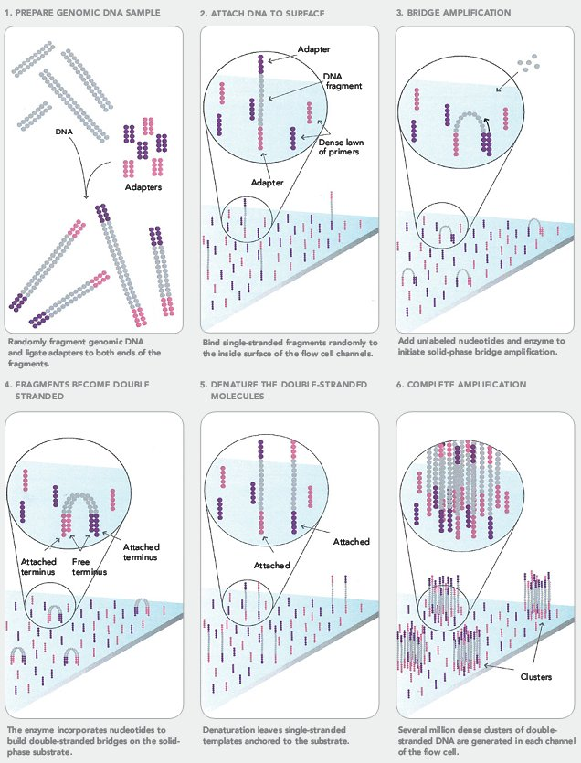
Illumina Sequencing

Slide 61
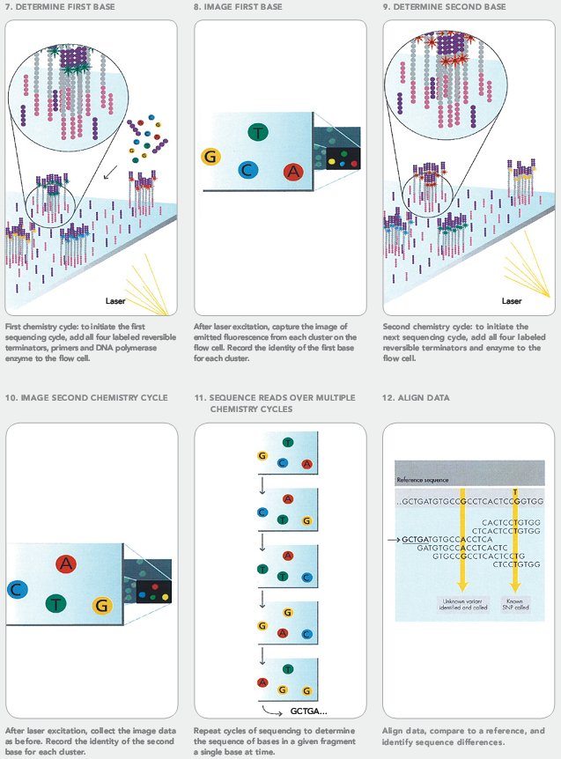
Illumina Sequencing

Slide 62
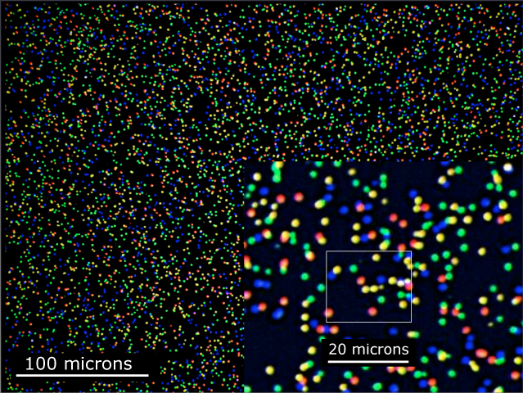
Illumina Sequencing

Slide 63
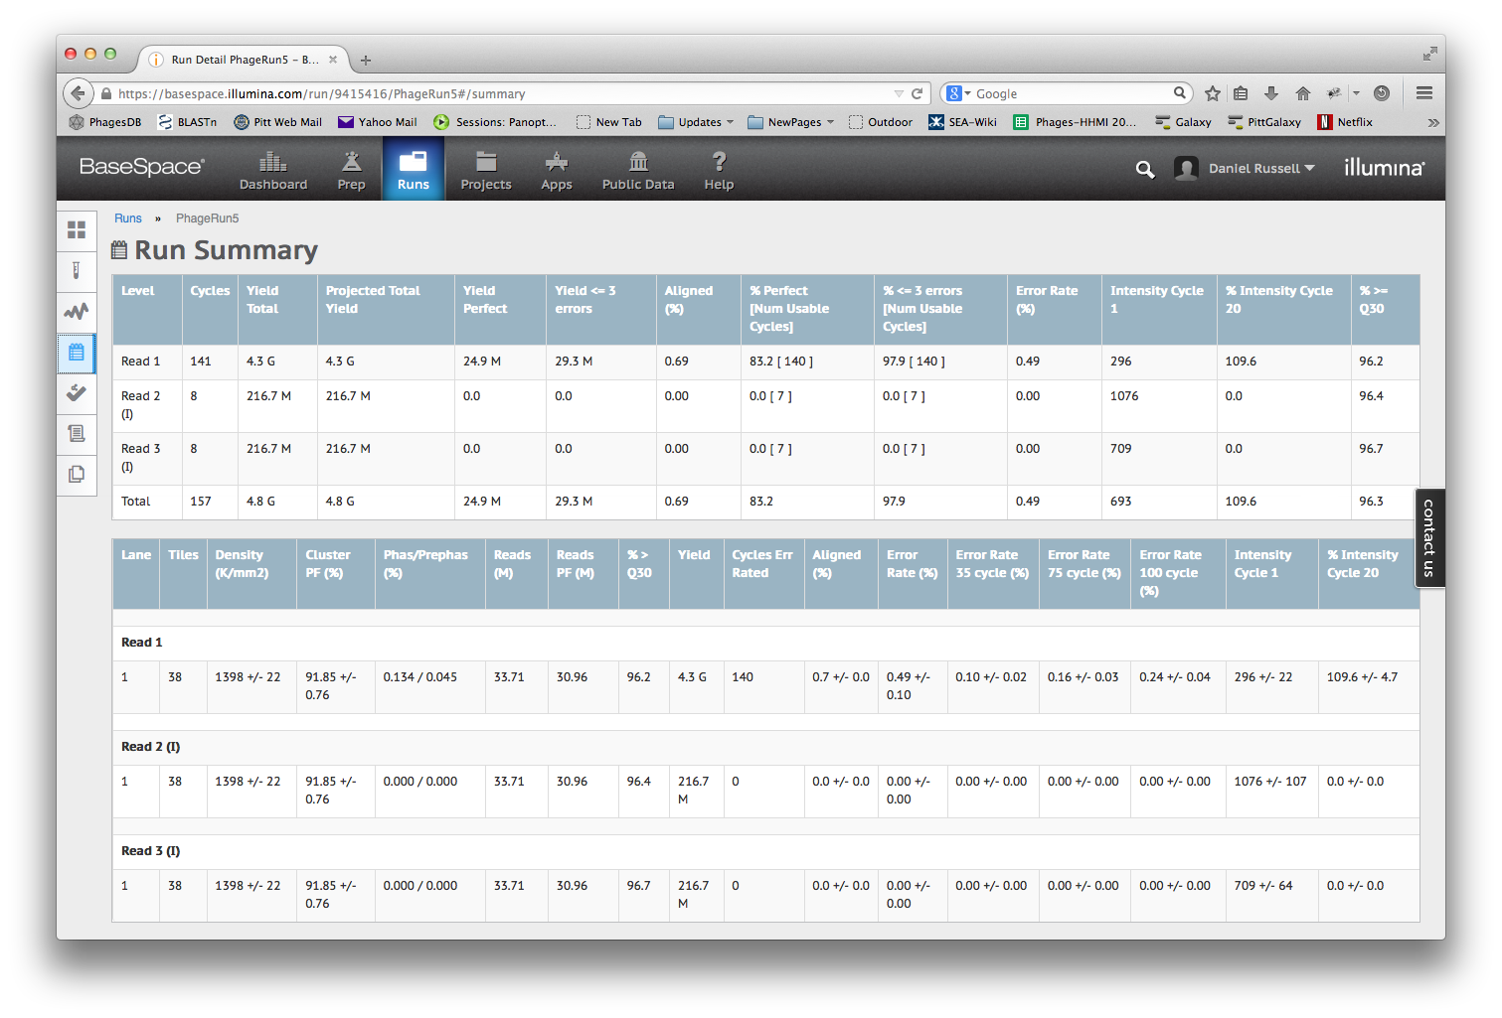

Slide 64
Overview
The Winter Break Black Box
Assembly
Sequencing
Finishing
What’s new?

Slide 65
Special use of the word “finish”
Some words have special meanings in scientific context
THEORY

Slide 66
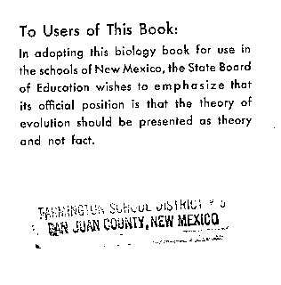
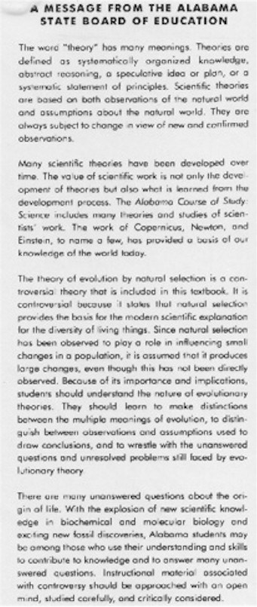
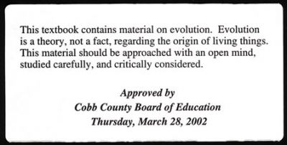

Slide 67
Special use of the word “finish”
Some words have special meanings in scientific context
THEORY
FINISH
Before annotation, phage genomes should be sequenced AND finished.

Slide 68
Special use of the word “finish”
“On June 26, 2000, the International Human Genome Sequencing Consortium announced the production of a rough draft of the human genome sequence. In April, 2003, the International Human Genome Sequencing Consortium is announcing an essentially finished version of the human genome sequence.” —genome.gov
Finishing.
June 2000 → April 2003?

Slide 69
Special use of the word “finish”
“The difference between the draft and finished versions is defined by coverage, the number of gaps and the error rate. The draft sequence covered 90 percent of the genome at an error rate of 1 in 1,000 base pairs, but there were more than 150,000 gaps and only 28 percent of the genome had reached the finished standard. In the April 2003 version, there are less than 400 gaps and 99 percent of the genome is finished with an accuracy rate of less than 1 in 10,000 base pairs.”
1 in 1000 error rate times 3 billion bases equals 3 million errors!
Our goal for phages: 0 gaps, 0 errors

Slide 70
Weak Areas
Multiple contigs (could indicate missing portions of the genome)
Low consensus quality
Discrepant positions
Low coverage
Genome ends

Slide 71
Assembly
Consensus:
TAATGCGACCTCGATGCCGGCGAAGCATTGTTCCCACAGACCGTGTTTTCCGACCGAAATGGCTCC
ATTGTTCCCACAGACCG
CGGCGAAGCATTGTTCC
ACCGTGTTTTCCGACCG
AGCTCGATGCCGGCGAAG
TTGTTCCCACAGACCGTG
TTTCCGACCGAAATGGC
ATGCCGGCGAAGCATTGT
ACAGACCGTGTTTCCCGA
TAATGCGACCTCGATGCC
AAGCATTGTTCCCACAG
TGTTTTCCGACCGAAAT
TGCCGGCGAAGCCTTGT
CCGACCGAAATGGCTCC
Coverage: # of reads underlying the consensus
Coverage: # of reads underlying the consensus
Average coverage: Total bases / consensus length
13 reads * 17 bases per read = 221 bases
221 bases / 66 base consensus = 3.35-fold coverage

Slide 72
Assembly
Consensus:
TAATGCGACCTCGATGCCGGCGAAGCATTGTTCCCACAGACCGTGTTTTCCGACCGAAATGGCTCC
ATTGTTCCCACAGACCG
CGGCGAAGCATTGTTCC
ACCGTGTTTTCCGACCG
AGCTCGATGCCGGCGAAG
TTGTTCCCACAGACCGTG
TTTCCGACCGAAATGGC
ATGCCGGCGAAGCATTGT
ACAGACCGTGTTTCCCGA
TAATGCGACCTCGATGCC
AAGCATTGTTCCCACAG
TGTTTTCCGACCGAAAT
TGCCGGCGAAGCCTTGT
CCGACCGAAATGGCTCC
6x coverage
100% identity
Coverage: # of reads underlying the consensus

Slide 73
Assembly
Consensus:
TAATGCGACCTCGATGCCGGCGAAGCATTGTTCCCACAGACCGTGTTTTCCGACCGAAATGGCTCC
ATTGTTCCCACAGACCG
CGGCGAAGCATTGTTCC
ACCGTGTTTTCCGACCG
AGCTCGATGCCGGCGAAG
TTGTTCCCACAGACCGTG
TTTCCGACCGAAATGGC
ATGCCGGCGAAGCATTGT
ACAGACCGTGTTTCCCGA
TAATGCGACCTCGATGCC
AAGCATTGTTCCCACAG
TGTTTTCCGACCGAAAT
TGCCGGCGAAGCCTTGT
CCGACCGAAATGGCTCC
5x coverage
80% identity
Coverage: # of reads underlying the consensus

Slide 74
Assembly
Consensus:
TAATGCGACCTCGATGCCGGCGAAGCATTGTTCCCACAGACCGTGTTTTCCGACCGAAATGGCTCC
ATTGTTCCCACAGACCG
CGGCGAAGCATTGTTCC
ACCGTGTTTTCCGACCG
AGCTCGATGCCGGCGAAG
TTGTTCCCACAGACCGTG
TTTCCGACCGAAATGGC
ATGCCGGCGAAGCATTGT
ACAGACCGTGTTTCCCGA
TAATGCGACCTCGATGCC
AAGCATTGTTCCCACAG
TGTTTTCCGACCGAAAT
TGCCGGCGAAGCCTTGT
CCGACCGAAATGGCTCC
2x coverage
50% identity
Coverage: # of reads underlying the consensus

Slide 75
Assembly
Consensus:
TAATGCGACCTCGATGCCGGCGAAGCATTGTTCCCACAGACCGTGTTTTCCGACCGAAATGGCTCC
ATTGTTCCCACAGACCG
CGGCGAAGCATTGTTCC
ACCGTGTTTTCCGACCG
AGCTCGATGCCGGCGAAG
TTGTTCCCACAGACCGTG
TTTCCGACCGAAATGGC
ATGCCGGCGAAGCATTGT
ACAGACCGTGTTTCCCGA
TAATGCGACCTCGATGCC
AAGCATTGTTCCCACAG
TGTTTTCCGACCGAAAT
TGCCGGCGAAGCCTTGT
CCGACCGAAATGGCTCC
1x coverage
Coverage: # of reads underlying the consensus

Slide 76
Sanger finishing reads

Slide 77
Finishing
Using a combination of programs and wet-bench experiments to close gaps, resolve weak areas, and ensure a high-quality extremely-low-error final genome sequence that is properly cut, oriented, and ready to annotate.

Slide 78
Why we finish
Confidence during annotation
Quality sequence in GenBank
Relatively easy

Slide 79
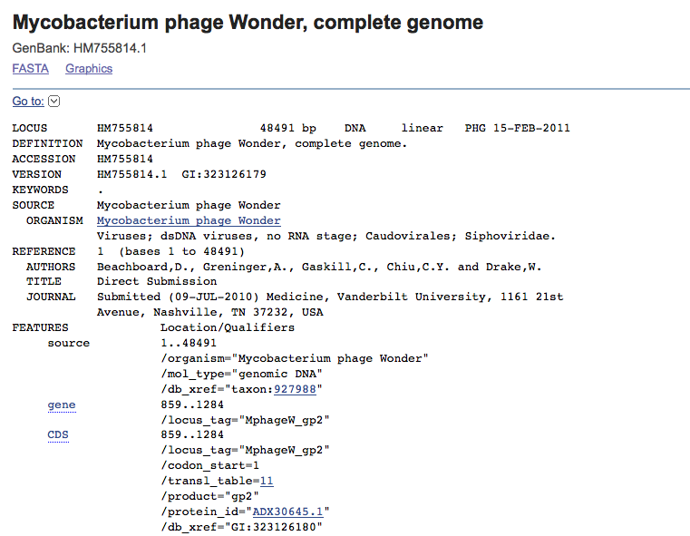
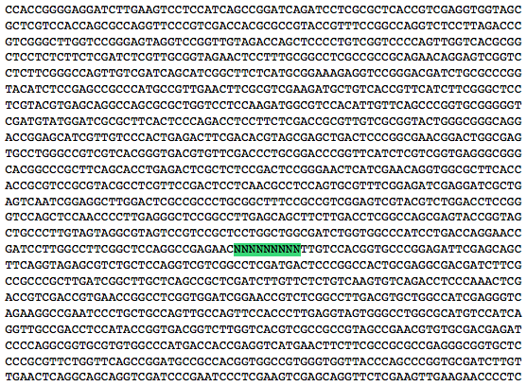
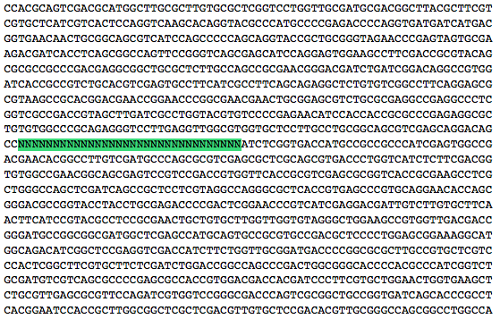

Slide 80
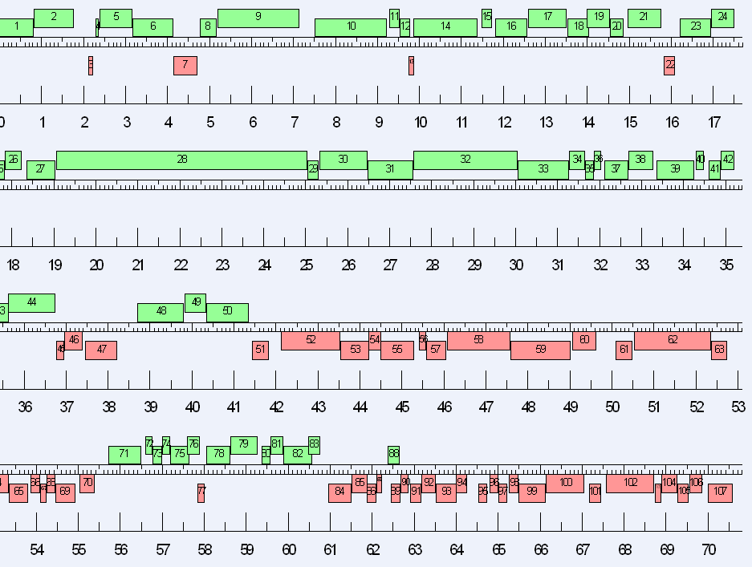

Slide 81
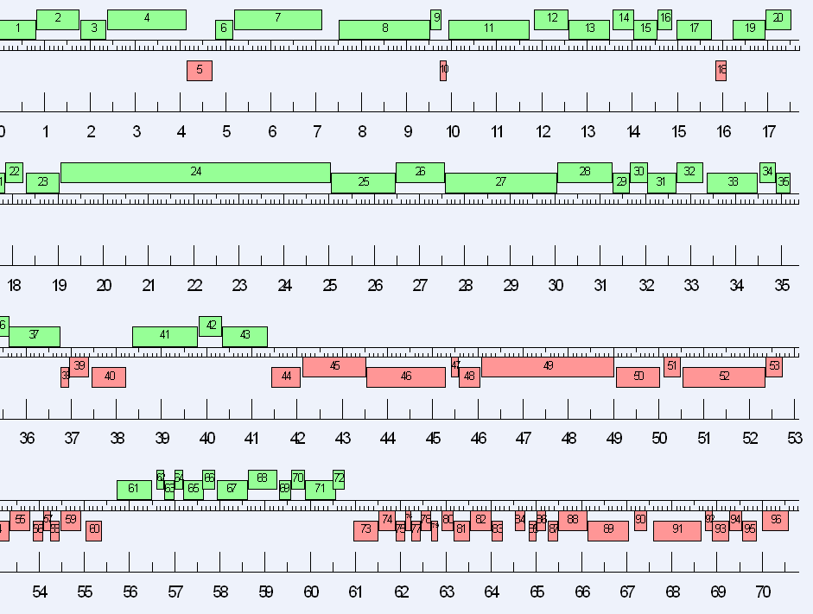

Slide 84
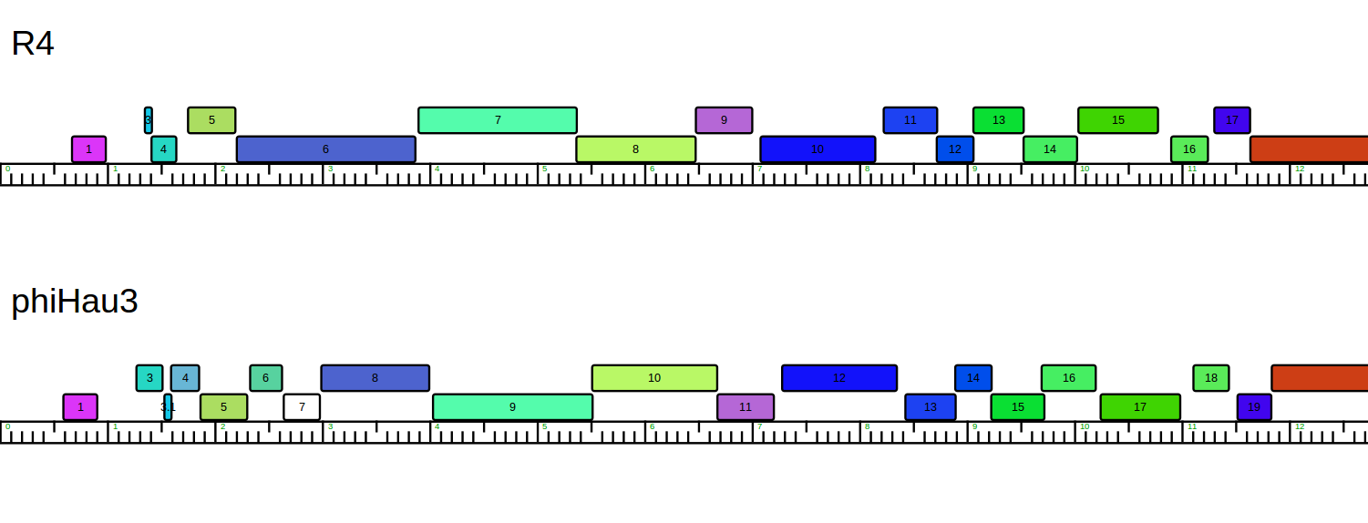
Small
Terminase
Large
Terminase
Portal
Small
Terminase
Portal
Large
Terminase?

Slide 85
Why we finish
Confidence during annotation
Quality sequence in GenBank
Relatively easy
How we finish:
Consed
Bench work

Slide 86
So what’s the easiest technology to do finishing for phages?
Laroye (Ion Torrent)
discFind analysis finished - 743 discrepancies at 18% cutoff.
discStrand
discFind analysis finished - 127 FORWARD discrepancies at 70% cutoff.
discFind analysis finished - 122 REVERSE discrepancies at 70% cutoff.
lowCov writeOut
lowCov analysis finished - 882 low coverage bases and 11 regions of low coverage at 30x cutoff.
Cyclops (Ion Torrent)
discFind analysis finished - 2595 discrepancies at 18% cutoff.
discStrand
discFind analysis finished - 29 FORWARD discrepancies at 70% cutoff.
discFind analysis finished - 40 REVERSE discrepancies at 70% cutoff.
lowCov writeOut
lowCov analysis finished - 107 low coverage bases and 2 regions of low coverage at 30x cutoff.

Slide 87
So what’s the easiest technology to do finishing for phages?
DUDM (454)
discFind analysis finished - 106 discrepancies at 18% cutoff.
discStrand
discFind analysis finished - 3 FORWARD discrepancies at 70% cutoff.
discFind analysis finished - 0 REVERSE discrepancies at 70% cutoff.
lowCov writeOut
lowCov analysis finished - 0 low coverage bases and 0 regions of low coverage at 30x cutoff.
Amelie (454)
discFind analysis finished - 69 discrepancies at 18% cutoff.
discStrand
discFind analysis finished - 0 FORWARD discrepancies at 70% cutoff.
discFind analysis finished - 34 REVERSE discrepancies at 70% cutoff.
lowCov writeOut
lowCov analysis finished - 138 low coverage bases and 2 regions of low coverage at 30x cutoff.

Slide 88
So what’s the easiest technology to do finishing for phages?
Fibonacci (Illumina)
discFind analysis finished - 4 discrepancies at 18% cutoff.
discStrand
discFind analysis finished - 0 FORWARD discrepancies at 70% cutoff.
discFind analysis finished - 0 REVERSE discrepancies at 70% cutoff.
lowCov writeOut
lowCov analysis finished - 227 low coverage bases and 1 regions of low coverage at 30x cutoff.
Petp2012 (Illumina)
discFind analysis finished - 6 discrepancies at 18% cutoff.
discStrand
discFind analysis finished - 0 FORWARD discrepancies at 70% cutoff.
discFind analysis finished - 2 REVERSE discrepancies at 70% cutoff.
lowCov writeOut
lowCov analysis finished - 2 low coverage bases and 1 regions of low coverage at 30x cutoff.

Slide 89
What’s new?
 | 2008- 2009 | 2009- 2010 | 2010- 2011 | 2011- 2012 | 2012- 2013
# Sequenced (Paid by SEA) | 13 | 24 | 40 | 56 (+20) | 72
Median Finished Date | March | Mar 15 | Feb 24 | Jan 31 | Jan 28
Latest Genome | Late April | May 11 | Apr 29 | Apr 13 | Feb 19
Methods | Sanger | Sanger | 454 | 454 Ion Torrent | 454 Ion Torrent

Slide 90
What’s new?
 | 2008- 2009 | 2009- 2010 | 2010- 2011 | 2011- 2012 | 2012- 2013 | 2013- 2014 | 2014- 2015
# Sequenced (Paid by SEA) | 13 | 24 | 40 | 56 (+20) | 72 | 72 | ~150
Median Finished Date | March | Mar 15 | Feb 24 | Jan 31 | Jan 28 | Jan 10 | Jan 16
Latest Genome | Late April | May 11 | Apr 29 | Apr 13 | Feb 19 | Feb 27 | Feb 12
Methods | Sanger | Sanger | 454 | 454 Ion Torrent | 454 Ion Torrent | Illumina | Illumina

Slide 91
What’s new?
2015-16
DNA received from ~52 schools (~60%)
~70 sections
~140 already sequenced, ~300 expected

Slide 92
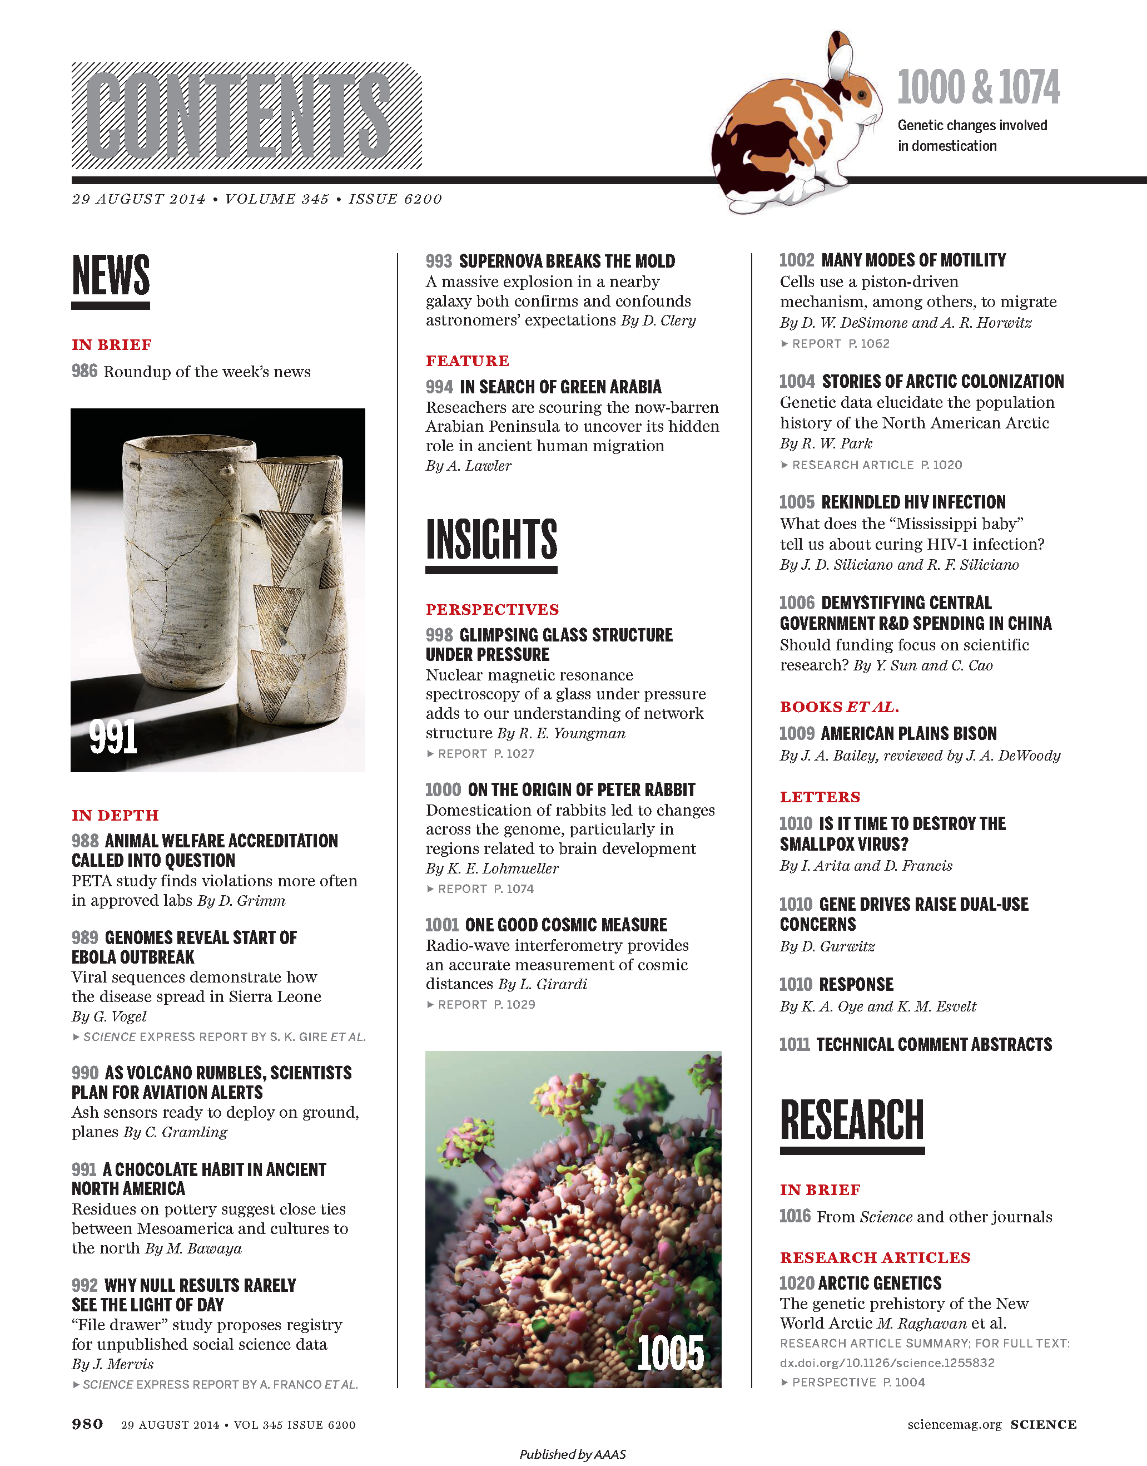
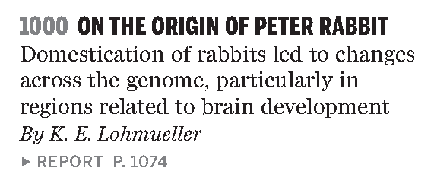
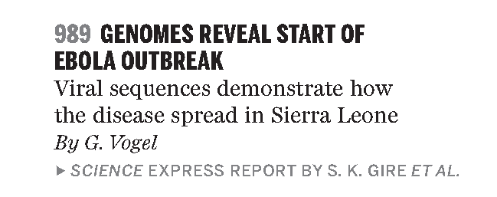
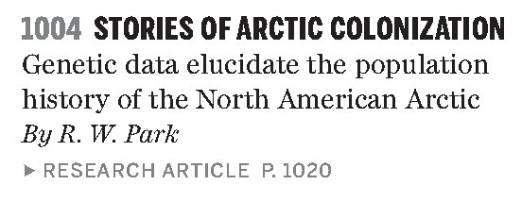

Slide 93
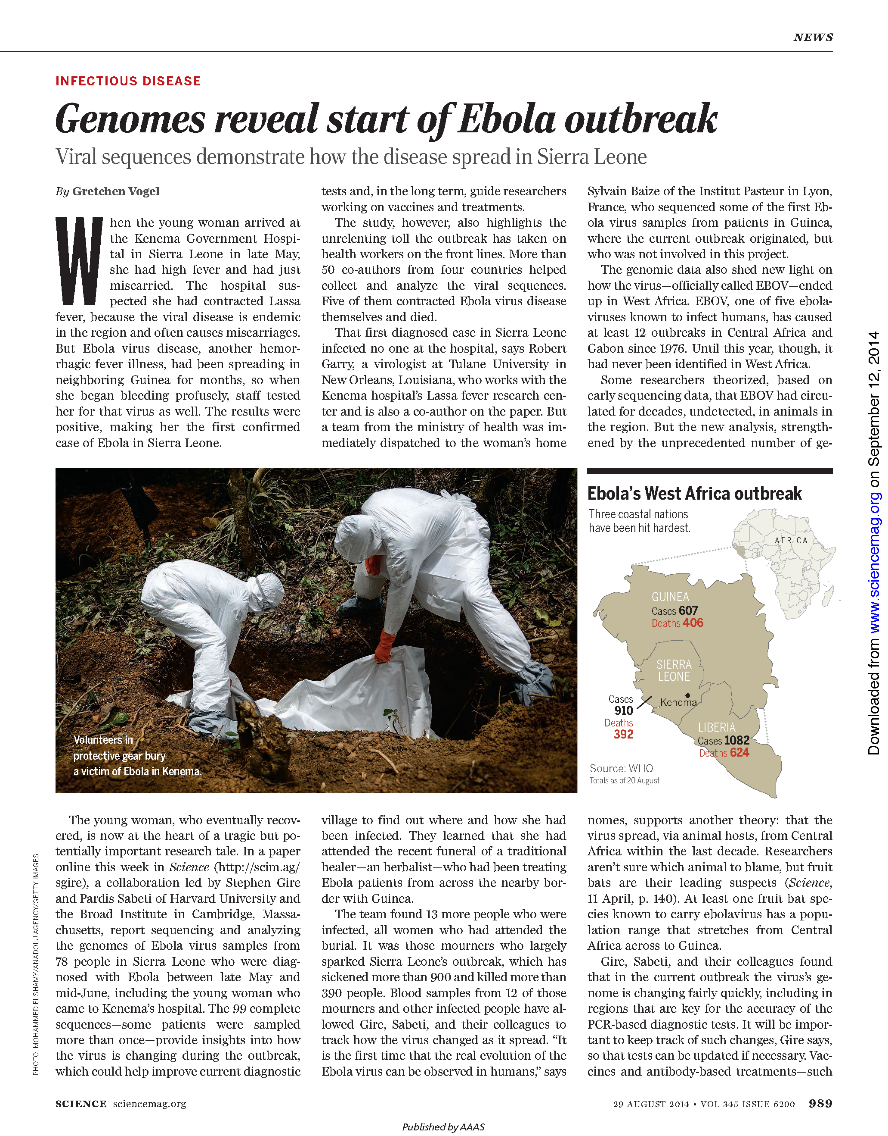
“…report sequencing and analyzing the genomes of Ebola virus samples from 78 people in Sierra Leone who were diagnosed with Ebola between late May and mid-June…The 99 complete sequences provide insights into how the virus is changing during the outbreak.”

Slide 94
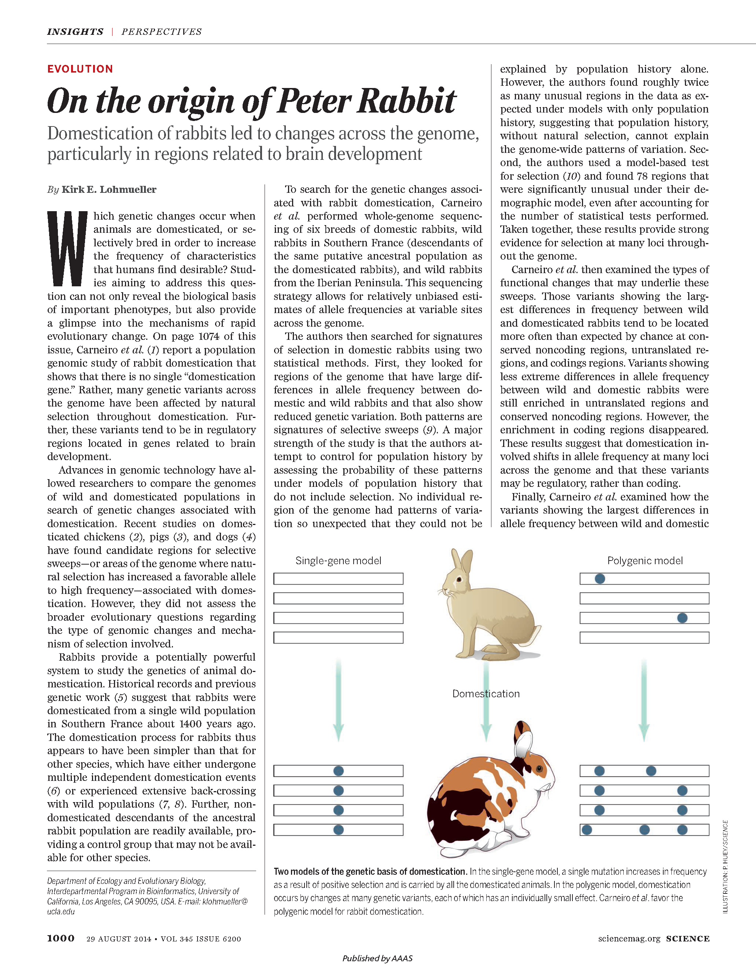
“Carneiro et al. performed whole-genome sequencing of six breeds of domestic rabbits, wild rabbits in Southern France, and wild rabbits from the Iberian Peninsula.”

Slide 95
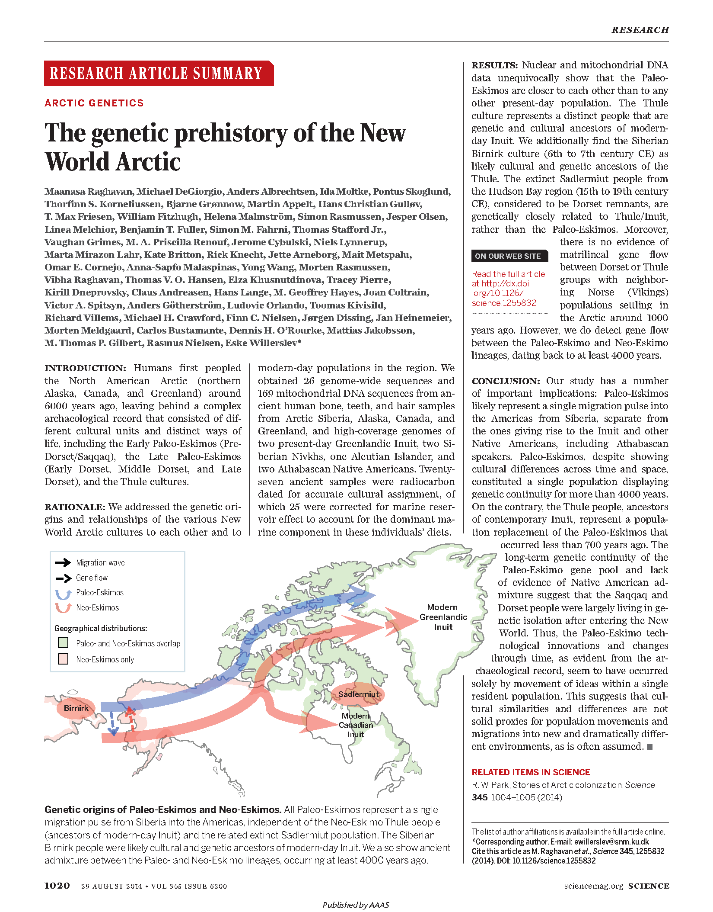
“We obtained 26 genome-wide sequences and 169 mitochondrial DNA sequences from ancient human bone, teeth, and hair samples from Arctic Siberia, Alaska, Canada, and Greenland, and high-coverage genomes of two present-day Greenlandic Inuit, two Siberian Nivkhs, one Aleutian Islander, and two Athabascan Native Americans.”

Slide 96
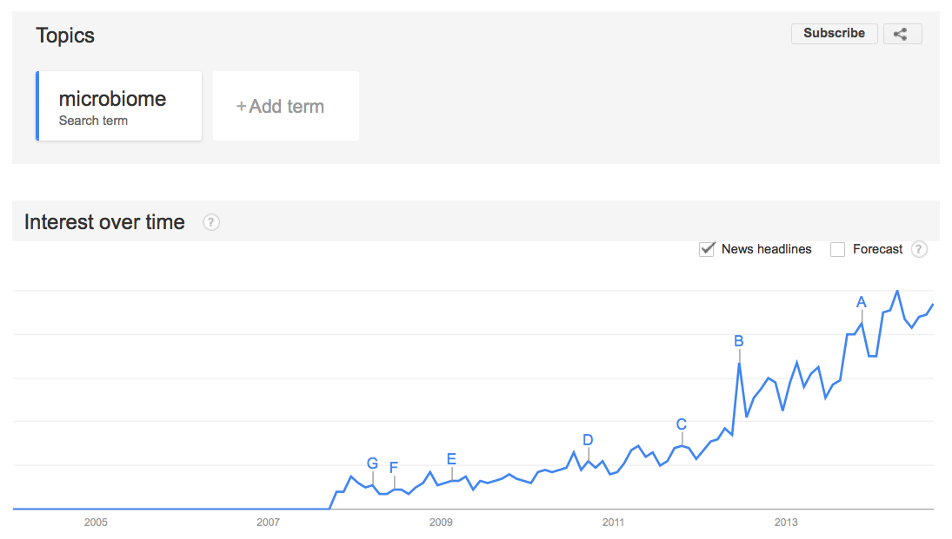

Slide 97
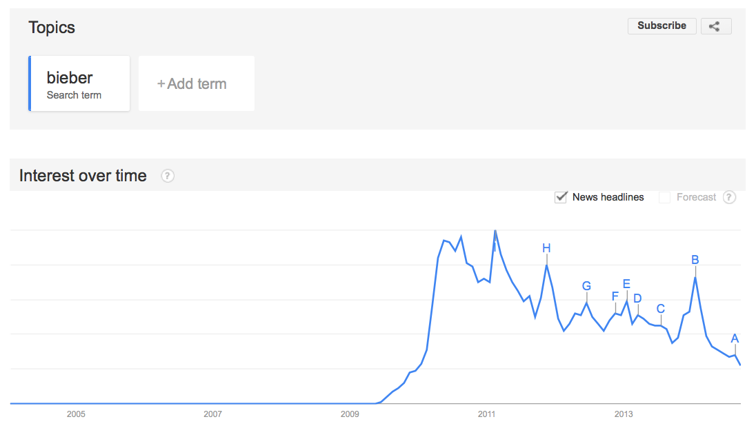

Slide 98
(Relevant) Trivia
How many base pairs (bp) are there in a human genome?
How much did it cost to sequence the first human genome?
How long did it take to sequence the first human genome?
When was the first human genome sequence complete?
Whose genome was it?
~3 billion (haploid)
~$2.7 billion
~13 years
2000-2003
Several people’s, but actually mostly a dude from Buffalo

Slide 99
Questions?

