Slide 1
SEA-PHAGES Bioinformatics Workshop Overview

Slide 2
Objectives: Overall
Characterize and investigate phage genomes including the details of gene calling, functional assignments, and preparing final submission files that meet QC requirements.
This year’s genome is Mycobacterium phage Ellie.
Install and use the software for annotation and analysis of phages. The software includes DNA Master, Phamerator, and other web-based tools.
Identify basic phage biology concepts that underlie bioinformatic investigations.
Explore classroom implementation strategies.
Objectives: Daily: See each day’s list

Slide 3
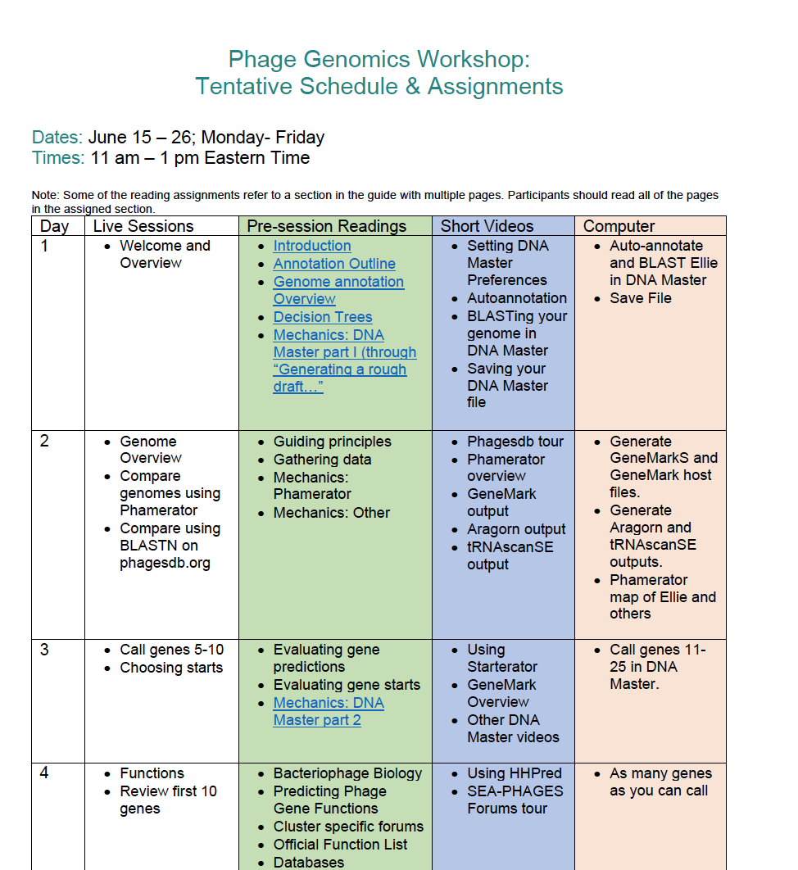
Found on the seaphages.org meeting page

Slide 4
Primary Learning Method
Learn by doing
  Gather data
  Do the work: annotate & analyze the genome
  Do science like scientists do it. [Translation: new technology changes at a moment’s notice]

Slide 5
Workshop Logistics
Workshop page at seaphages.org
Try to not work in isolation
Use the SEA-PHAGES Bioinformatics Guide
Lab notebook. Take notes while annotating!
seaphages.org forums: Let’s model that at the workshop so it will be easy later!
Daily objectives and assessments

Slide 6
We Will…
Use mycobacteriophage Ellie genome to
  Learn to manipulate the tools we use
    DNA Master
    GeneMark, Glimmer
    BLAST
    Phamerator
    HHpred
    Starterator
  Practice calling genes and functions
Investigate other types of genes you will come across
Produce a quality genome annotation
  Sequence quality control: ✓
  Annotation quality control: Checklist and files

Slide 7
Your learning starts here, but continues.....
Final file preparations on-line training
  Time to be announced, late March – April
  Content will include formatting requirements
  How to pass preliminary QC
  Do not hold annotation questions until then, use the forums
Review to Improve reporting
  Once your genome is checked, you must submit a comparison report of your annotation with the submitted version
    How did you do?
  After you have 3 genomes compared, are you ready to be a trusted submitter?

Slide 8
Important Context
Biological Information Flow
Sequencing and Finishing Genomes
Bioinformatic Information Flow

Slide 9
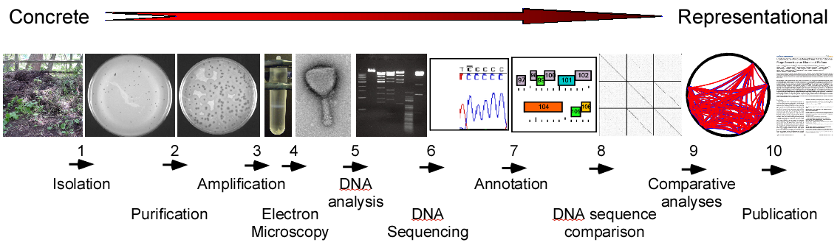
Fall (microbiology)
Spring (bioinformatics)
Concrete beginnings offer equal opportunity of engagement
Complex abstract processes contextualized for constructed learning
Parallel projects facilitate peer-mentoring and development of flourishing scientist/educators
Notes:
An overview of the phage discovery and genomics platform. Delivered in multiple formats, but the biggest is the SEA-PHAGES program, which is a two-term course for first-year undergrads, and involves many schools and students (5,500/year). The central figure shows the technical progression from phage isolation, through purification, amplification, genome sequencing, and bioinformatics etc.

Slide 10
First semester start: Sept. 1
Phage discovery and isolation
Phage DNA and lysates
DNA due: Nov. 15
Nov. 15 – Feb. 29
DNA sequencing/assembly/QC
2nd semester start: Jan. 1
In-class annotation
Final annotation files
Annotation QC (SMART)
Files are due: May 1
GenBank submission
Files to GenBank: Sept. 1
First semester start: Sept. 1

Slide 11
Phage discovery and isolation
Phage DNA and lysates
Preliminary genome investigation
DNA sequencing/assembly/QC
Auto annotate in DNA Master
In-class annotation
Manually improve annotation
Final annotation files
Call functions
Annotation QC (SMART)
Prepare final files
GenBank submission

Slide 12
Phage discovery and isolation
BLASTn genome
Phage DNA and lysates
Preliminary genome investigation
Generate GeneMark output
Auto annotate in DNA Master
Make Phamerator map
DNA sequencing/assembly/QC
Manually improve annotation
Add/delete genes
In-class annotation
Improve start sites
Final annotation files
Call functions
Calls tRNAs, frameshifts, …
Annotation QC (SMART)
Prepare final files
Merge annotations
GenBank submission
Finalize and perfect notes

